Slide 1


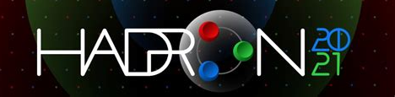
Meson and Baryon Masses: A Unified Treatment
Gustavo Paredes Torres
Dra. Laura Xiomara Gutiérrez Guerrero ​
Dr. Adnan Bashir

Slide 2
contents
Introduction
Contact Interaction Model
Schwinger–Dyson and Bethe–Salpeter equations
Mesons and Diquarks
Faddeev equation
Baryons
Results
Conclusions

Slide 3

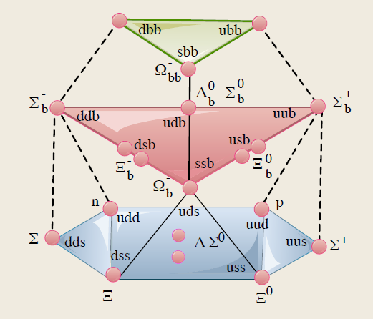
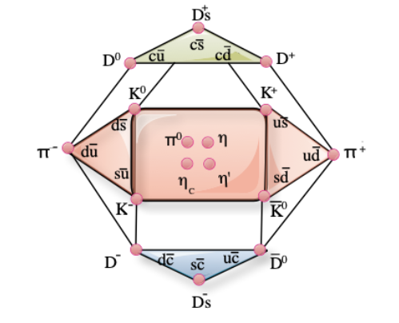
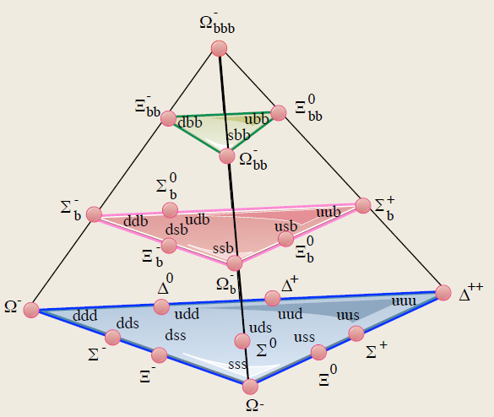
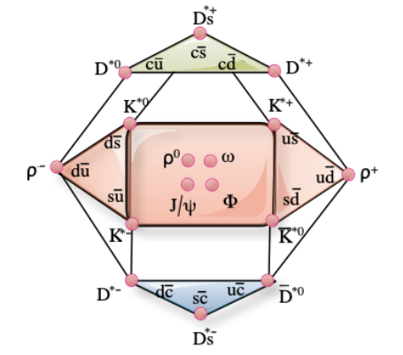
Introducción
Multipletes de mesones y bariones:
Mesones vectoriales:
Bariones 1/2:
Mesones pseudoescalares:
Bariones 3/2:
Notes:
Multipletes de hadrones se acomodan según sun números cuánticos en planos de Y hipercarga, I isospín , Carga Q etc
Bases de barione calculadas y/o obsrvadas, los mas pesados no todos calculados.
2X \overline{2}=3+1
3X \overline{3}=8+1
3X3X3=10+8+8+1
4X4X4=20+20+20+4

Slide 4
Introducción
[1] L. X. Gutiérrez-Guerrero, A. Bashir, I. C. Cloët, and C. D. Roberts, Phys. Rev. C, 81, 065202 (2010).
[2] H. L. L. Roberts, A. Bashir, L. X. Gutierrez-Guerrero, C. D. Roberts, and D. J. Wilson, Phys. Rev. C, 83, 065206 (2011).
[3] Hannes L. L. Roberts, Lei Chang, Ian C. Cloët, and Craig D. Roberts, Few Body Syst., 51,1–25 (2011).
[4] Hua-Xing Chen, Wei Chen, Xiang Liu, Yan-Rui Liu, and Shi-Lin Zhu, Rept. Prog. Phys., 076201 (2017).
[5] Ya Lu, Chen Chen, Craig D. Roberts, Jorge Segovia, Shu-Sheng Xu, and Hong-Shi Zong, Phys. Rev. C, 96, 015208 (2017).
[6] L. X. Gutiérrez-Guerrero, Adnan Bashir, Marco A. Bedolla, E. Santopinto, Phys. Rev. D, 100, 114032 (2019).
Notes:
Literatura referente al modelo de CI

Slide 5
Introducción
[7] P. L. Yin, C. Chen, G. Krein, C. D. Roberts, J. Segovia and S. S. Xu, Phys. Rev. D, 100, 034008 (2019).​
​
[8] Marco A. Bedolla, J. J. Cobos-Martínez, Adnan Bashir, Phys.Rev.D, 92, 054031 (2015).​
​
[9] Khepani Raya, Marco A. Bedolla, J. J. Cobos-Martínez, and Adnan Bashir, Few Body Syst., 59, 133 (2018).​
​
[10] Shu-Sheng Xu, Chen Chen, Ian C. Cloet, Craig D. Roberts, Jorge Segovia, and Hong-Shi Zong,Phys. Rev. D,92, 114034 (2015).​
​
[11] Marco Antonio Bedolla, Jacopo Ferretti, Craig D Roberts, and Elena Santopinto,Eur. Phys. J. C, 80,1004 (2020)​.
​
​
​
​

Slide 6
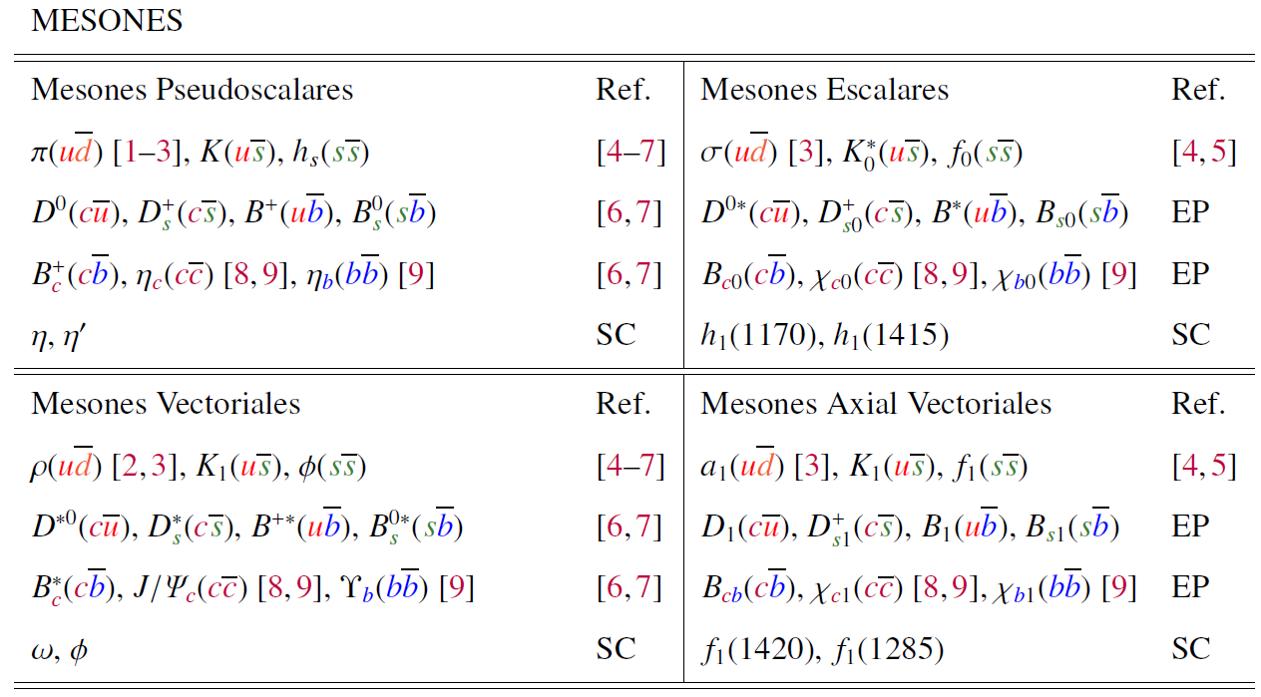
Introduction
Notes:
Resumen de las partículas utilizando CI

Slide 7
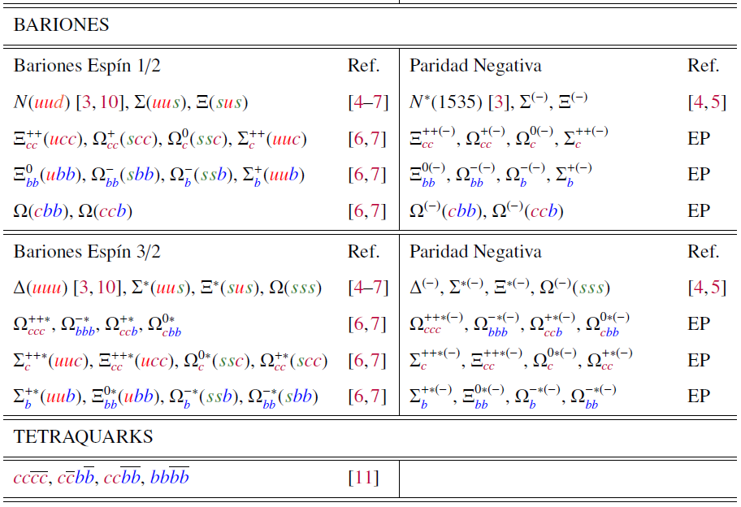
Introduction

Slide 8
Introduction
Several labs are trying to measure heavy particles:
BELLE searches resonances of Ξ_{c} and Ω_{c}
A.J. Schwartz, Proc. Sci., CHARM2016, 042 [arXiv:1701.07159], (2017).
Jefferson Lab studies hadrons in terms of their form factors. G. Aznauryan et al., Int. J. Mod. Phys. E 22, 1330015 (2013).
PANDA searches for baryons with s and c quarks.
Q.-Y. Lin, X. Liu, and H.-S. Xu, Phys. Rev. D 90, 014014 (2014).
LHCb searches for baryons with quarks c and b.
R. Aaij et al. (LHCb Collaboration), Phys. Rev. Lett. 122 (2019).

Slide 9
Introduction
On the theoretical side there are several approaches to calculate hadrons:
Poincaré Covariant Analysis for Continuous QCD.
R. Aaij et al. (LHCb Collaboration), Phys. Rev. Lett. 122, (2018).
Lattice.
Z. S. Brown, W. Detmold, S. Meinel, and K. Orginos,Z. S. Brown, W. Detmold,
S. Meinel, and K. Orginos, Phys. Rev. D 90, 094507 (2014).
Formalism of the Faddeev Equation (Fadv).
B. Silvestre-Brac, Few-Body Syst. 20, 1 (1996).
Bag model.
P. Hasenfratz, R. R. Horgan, J. Kuti, and J. M. Richard, Phys. Lett. 94B, 401 (1980).
Quark counting rules (QCR).
J. D. Bjorken, AIP Conf. Proc. 132, 390 (1985).

Slide 10
Introduction
The constituent model of the quark (CQM1, CQM2).
J. Vijande, H. Garcilazo, A. Valcarce, and F. Fernandez, PhyS. Rev. D70, 054022 (2014)
Relativistic quark model (RQM).
A. P. Martynenko, Phys. Lett. B 663, 317 (2008).
Instanton quark model (IQM).
S. Migura, D. Merten, B. Metsch, and H.-R. Petry, Eur. Phys. J. A 28, 41 (2006).
Hypercentral model (HCM).
B. Patel, A. Majethiya, and P. C. Vinodkumar, Pramana 72, 679 (2009).
QCD sum rules (SR).
J.-R. Zhang and M.-Q. Huang, Phys. Lett. B 674, 28 (2009).
Non-Relativistic QCD (NRQCD).
F. J. Llanes-Estrada, O. I. Pavlova, and R. Williams, Eur. Phys. J. C 72, 2019 (2012).

Slide 11
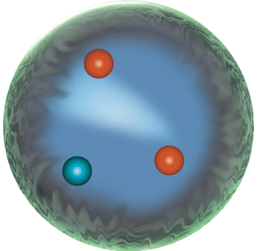
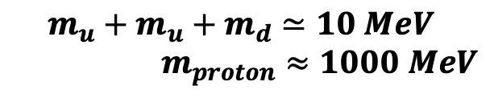
QUARK’s MASS
We can distinguish among two different types of quark masses.
The current mass that appears in the renormalized Lagrangian of QCD.
Due to interactions, quarks and gluons acquire constituent/dressed mass dynamically within hadrons.
$$m_{u}+m_{u}+m_{d}≃10 MeV$$
$m_{proton}≈1000 MeV$
Notes:
Una tercera masa es la masa Desnuda es la que aparece en el Lagrangiano desnudo.

Slide 12
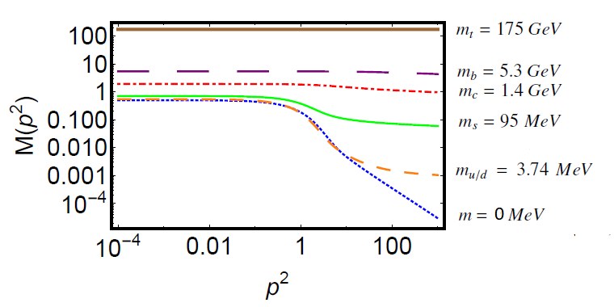
Current vs constituent mass
The breaking of chiral symmetry causes the difference between the current and constituent masses.
About the same mass is generated for each quark (300 MeV); for the heavier quarks it is less noticeable because of the large value of their explicit mass.
DCSB is the mechanism that generates 98% of the mass of visible matter.
Notes:
Realce en el infrarrojo con respecto a la masa corriente.
A medida que aumenta la masa corriente de los quarks los efectos de la DCSB son menores.
Incluso en una masa corriente cero “limite quiral” hay generación dinámica de masas
dynamic breaking of chiral symmetry

Slide 13
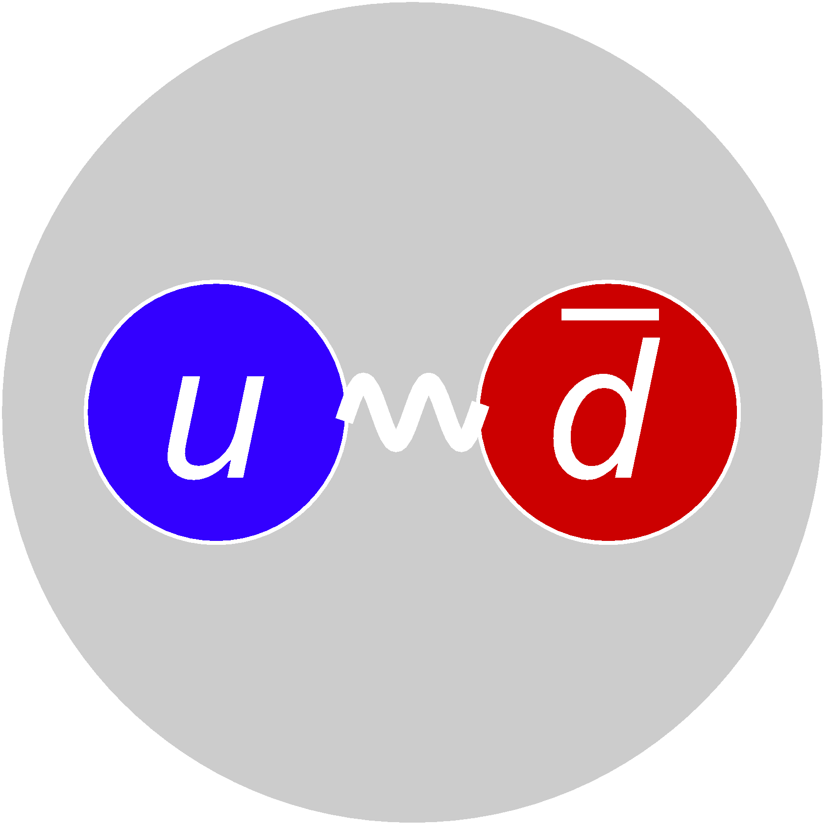
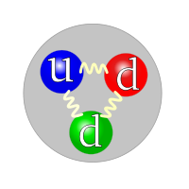
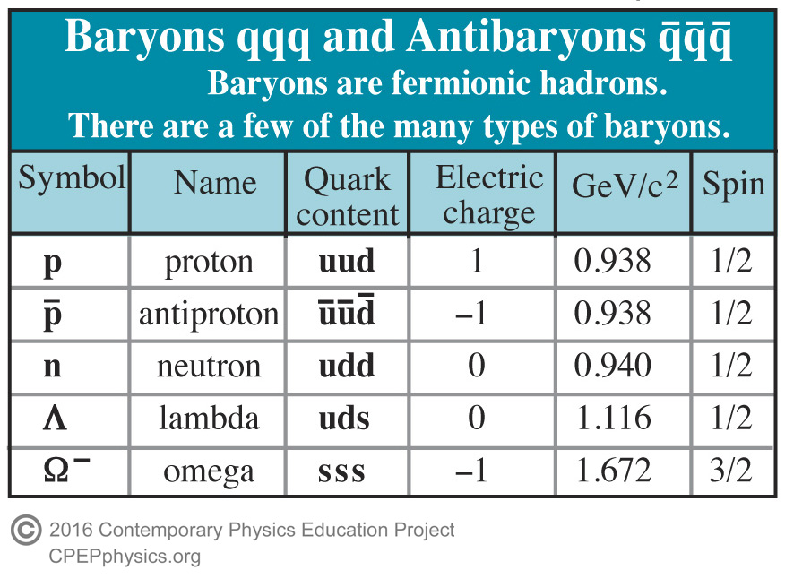
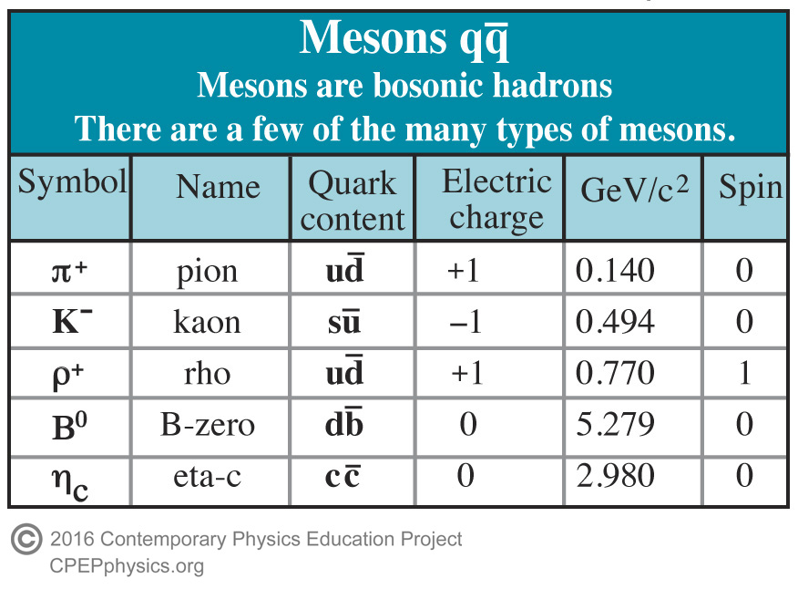
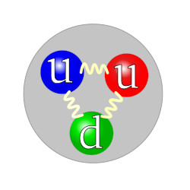

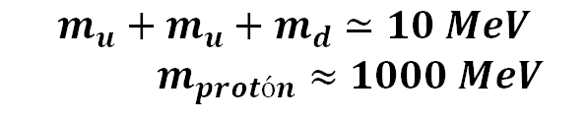

Hadrones: Mesones y bariones
La materia visible esta constituida por protones y neutrones ($e^{−},u y d$) llamados Bariones.
Los Bariones ($qqq$). Son fermiones $s=\frac{1}{2},\frac{3}{2}$
Mesones ($q\overline{q}$). Son Bosones $s=1$
$$π^{+}$$
$$m_{u}+m_{u}+m_{d}≃10 MeV$$
$m_{protón}≈1000 MeV$
Neutrón
Protón

Slide 14
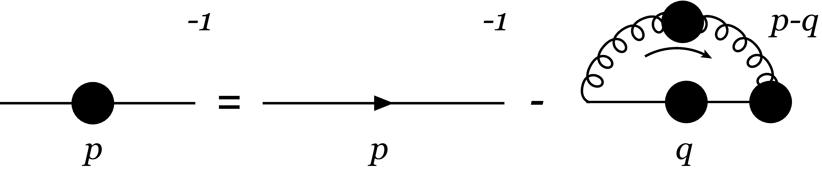


SDE FOR THE QUARK PROPAGATOR
Ideal for studying non-perturbative phenomena as no assumptions are made about the value of the coupling.
Complete Propagator, dressed
Bare propagator, tree level
Dressed quark-gluon vertex
Dressed gluon propagator
Gap equation
$Σ\left(p\right)$ Self-energy
Notes:
.Exactas, invariantes de poincare (Lorentz + translaciones esp. minkoski), infinitas en número,
Consistentes con confinamiento, DCSB y QCD perturbativa.
En el espacio Euclideano. Vértice completo = vértice a nivel árbol – corrección al vértice al gluon y al propagador de quark,
DEBEMOS TRUNCARLAS.

Slide 15
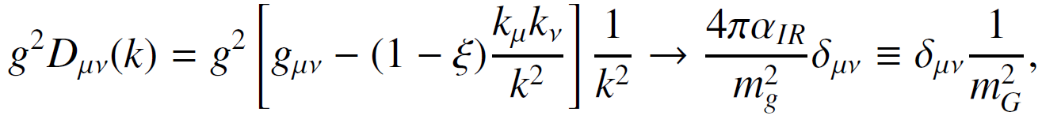

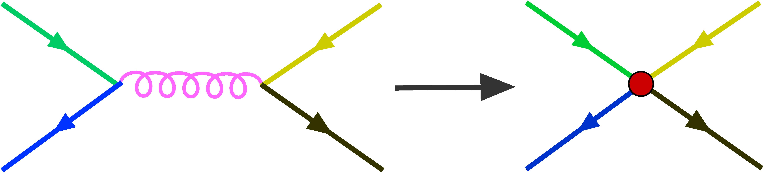
CONTACT INTERACTION MODEL
Simplified QCD model, where UV divergences are regularized to preserve QCD symmetries, compatible with confinement and DCSB.
Interaction strength in infrared
The gluon propagator is considered as a constant:
The vertex is assumed to be tree level, that is (bare vertex):
Gluon mass scale
Feynman diagram for $q\overline{q}$ scattering:
Notes:
El propagador no depende del momento
mg=escala de masa del gluon generada dinámicamente.
air = fuerza de interacción en el infrarrojo. Matrices de GellMann
IC reproduce muy bien las masas y las constantes de decaimiento.
Simple de usar
Buenas aproximaciones para Q^2 pequeñas. (momentos pequeños)
Sustituto útil, en dominios donde QCD es incapaz de entrar.

Slide 16
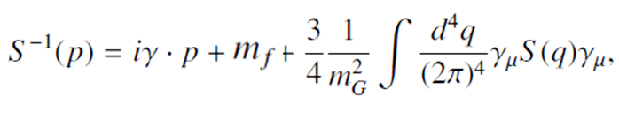
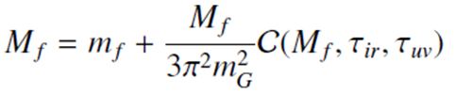
CONTACT INTERACTION MODEL
With CI the equation of the quark propagator takes the form:
It has quadratic and logarithmic divergences, that is why it must be regularized, for this, a proper time regularization scheme is used:
Notes:
4 fermiones a un punto no es renormalizable, Z’s =1.
M es una constante.
Función gamma-incompleta.
f es el sabor del quark

Slide 17
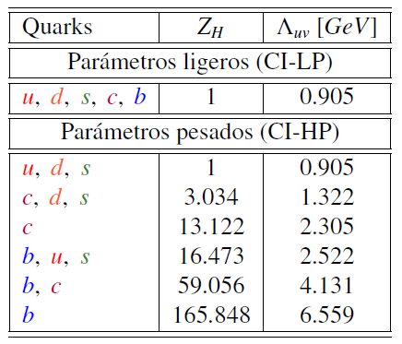
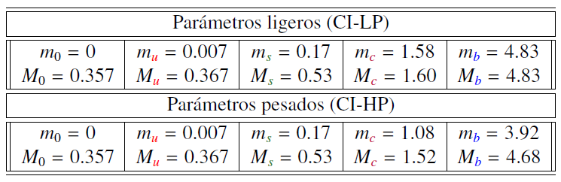
QUAKR DRESSED MASS RESULTS.
Using the following parameters:
Light parameters
Light parameters
Heavy parameters
Heavy parameters
L. X. Gutiérrez-Guerrero, A. Bashir, I. C. Cloët, and C. D. Roberts, Phys. Rev. C, 81, 065202 (2010).
With these parameters we calculate the masses of bound states of quarks, i.e. mesons and diquarks.
Notes:
Consideramos mu=md por la simetría de isospín.

Slide 18
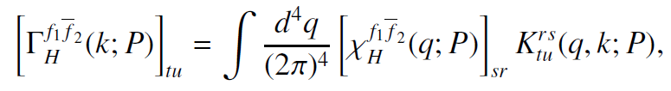

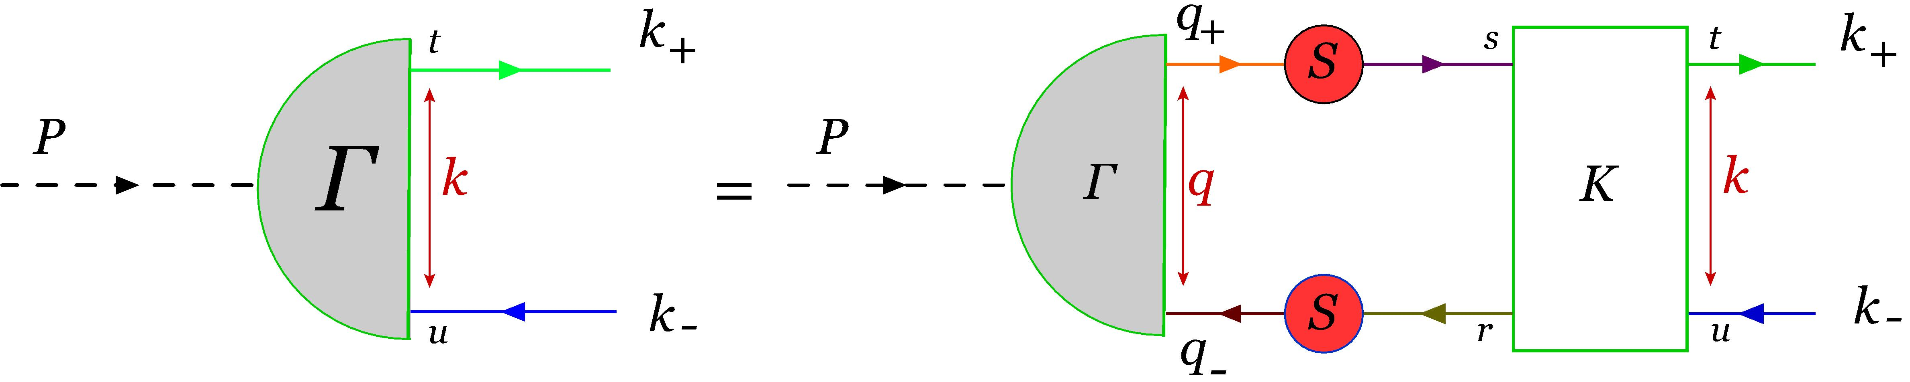
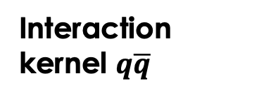
BETHE-SALPETER EQUATION
Describes bound states of two particles such as mesons (flavored quarks $f_{1}$ and $f_{2}$).
The mesons appear as poles of the Green function.
BS equation:
BS wave function:
Interaction kernel $q\overline{q}$
BS amplitude
Quark propagator
E. E. Salpeter and H. A. Bethe, Phys. Rev. 84, 1232 (1951).
Notes:
Índices de color r, s, t, u
F1 y f2 son los sabores del quark y antiquark
H es el meson como pi, rho etc

Slide 19
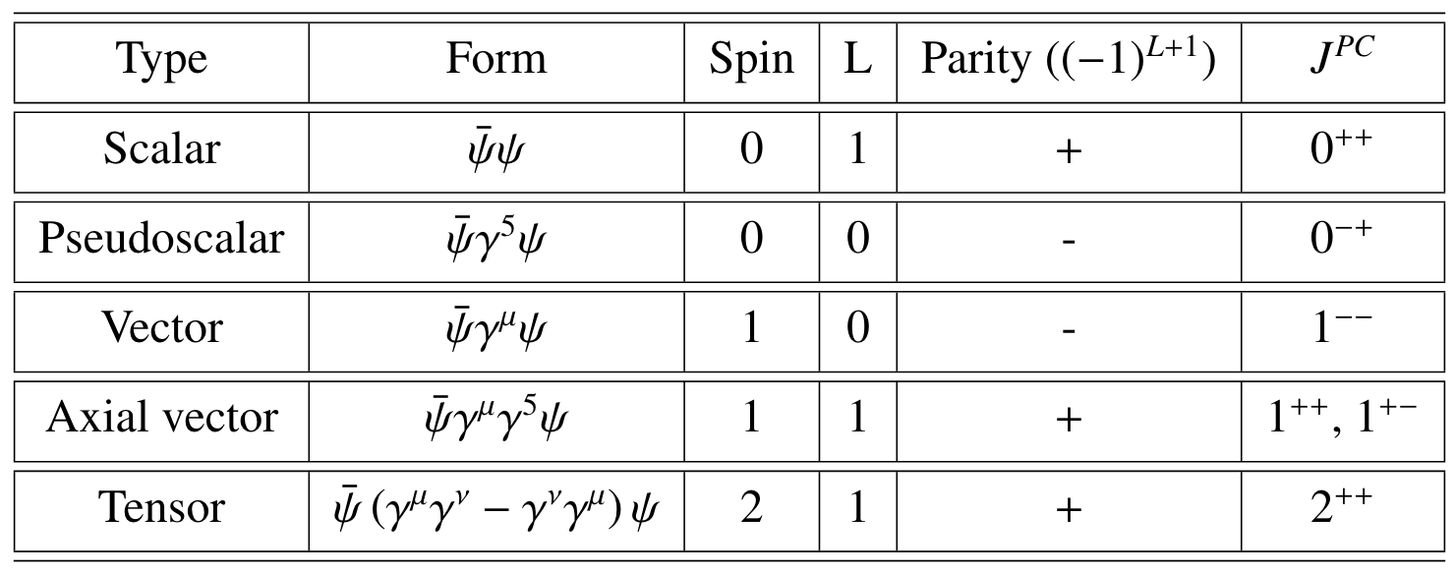
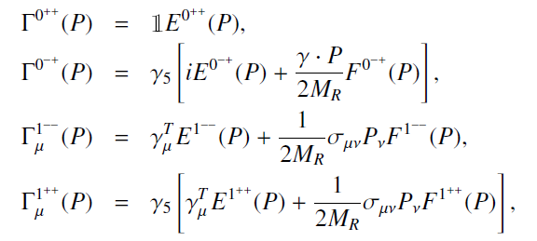

BS AMPLITUDES IN CI
Mesons types:
BS amplitude:
In the CI Model the BSA does not depend on k, the relative momentum:
$M_{R}$ is the reduced mass.
Notes:
T matrices de Paulli
C= (-1)^{L+S}
k, P momento relativo y total del par quark-antiquark
E, F, G y H funciones escalares de Lorentz de k^2 y k.P

Slide 20


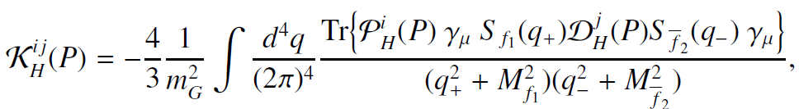
MASSES OF MESONS
We solve the BS equation in the form of eigenequation:
We look for the solution with:
Matrix elements are generally written as follows :
Dirac covariant projectors
Marco A. Bedolla, J. J. Cobos-Martínez, Adnan Bashir, Phys.Rev.D, 92, 054031 (2015).

Slide 21
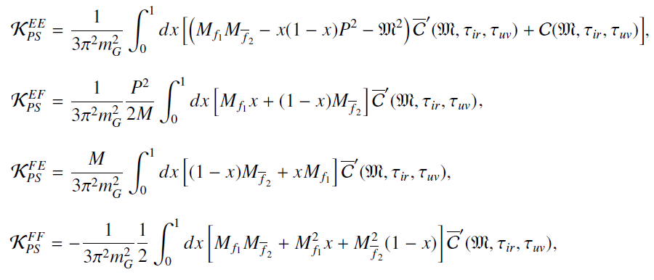
KERNEL FOR PSEUDOSCALAR MESONS
The matrix elements are:
Notes:
BSA se normalizan a 1 para Q^2 yendo a cero.
Ahora se habla sobre diquarks.
Parejas de paridad de los mesones.

Slide 22
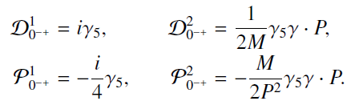

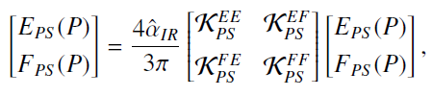
KERNEL FOR PSEUDOSCALAR MESONS
The projectors used are:
Using the Feynman parametrization we obtain:
Matrix equation:
Notes:
BSA se normalizan a 1 para Q^2 yendo a cero.
Ahora se habla sobre diquarks.
Parejas de paridad de los mesones.
Usamos M= M_R
air = fuerza de interacción en el infrarrojo/mg

Slide 23

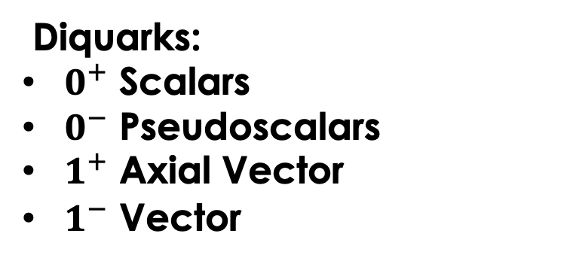
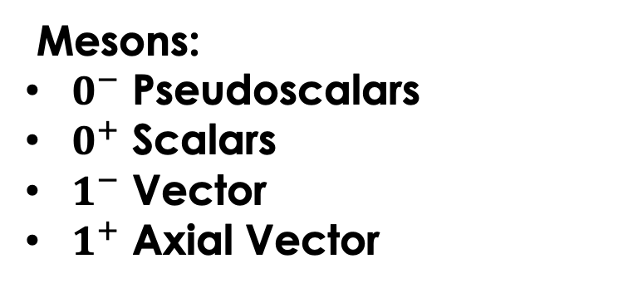
DIQUARKS
They are correlations of two quarks within a baryon.
Trivial changes in the BS equations of the mesons will give us those of the diquarks.
Mesons:
$0^{−}$ Pseudoscalars
$0^{+}$ Scalars
$1^{−}$ Vector
$1^{+}$ Axial Vector
Diquarks:
$0^{+}$ Scalars
$0^{−}$ Pseudoscalars
$1^{+}$ Axial Vector
$1^{−}$ Vector
Notes:
Fue una idea introducida para describir al barión como compuesto de dos partículas un quark y un diquark .
Reduce en problema de 3 cuerpos a dos.
Los diquarks 0⁺ y 1⁺ son pareja de paridad de los mesones π y ρ. Por lo tanto la ecuación de BS que describe estos mesones es la misma que describe la dinámica de los diquarks correspondientes.

Slide 24
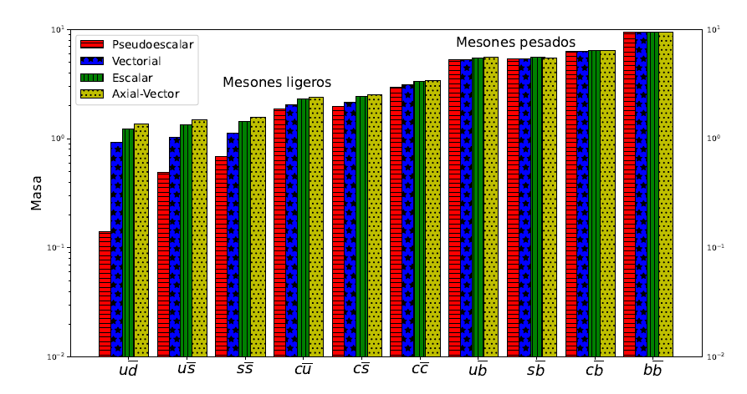
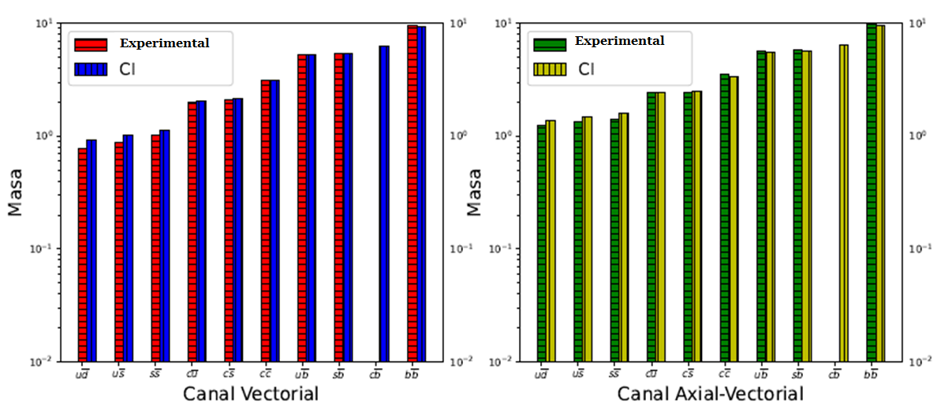
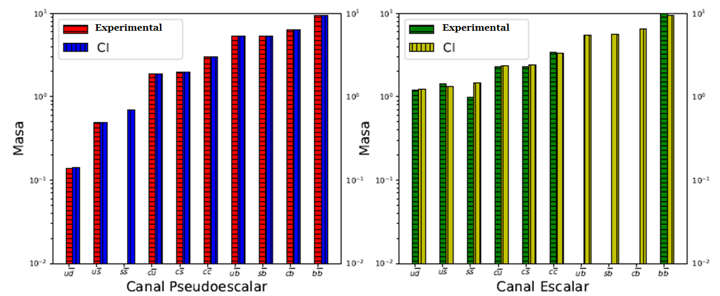
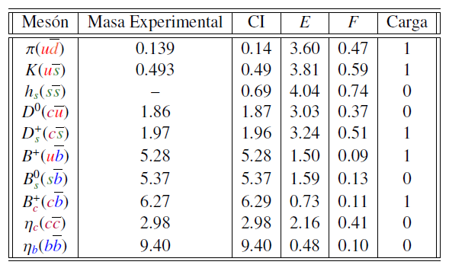
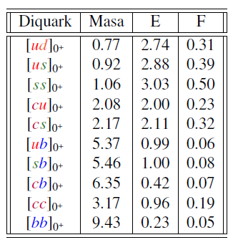
RESULTS
      Using the advocated parameters we obtain:
Heavy mesons
Mesons
Expermental mass
Light mesons
Charge
Mass
Mass
Mass
Mass
Mass
Pseudoscalar
Scalar
Vector
Axial - Vector
L. X. Gutiérrez-Guerrero, Adnan Bashir, Marco A. Bedolla, E. Santopinto, Phys. Rev. D, 100, 114032 (2019).
Notes:
Canal av mas pesado y el pseudoescalar mas ligero.
Pion teorema de Goldstone que predice una partícula no masiva. Cuando se rompe una simetría continua.
Los resultados de los diquarks son novedosos, comparamos calculando los bariones

Slide 25
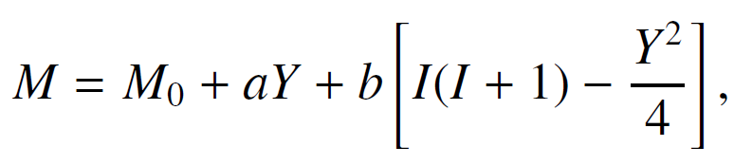
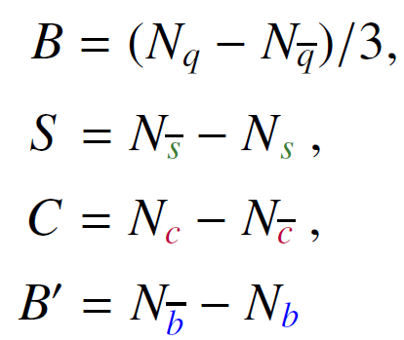


RELATIONS
      The Gell-Mann-Okubo formula provides a sum rule for the masses of the hadrons in a specific multiplet :
      Mass relation for pseudoscalar mesons is :
M. Gell-Mann, Phys. Rev. 125, 1067 (1962).
      Mass relation for vector mesons is :
S. Okubo, Prog. Theor. Phys. 27, 949 (1962).
Notes:
Y, hipercarga
I isospín
Hay mas reglas por ejemplo relacionan el canal ps con el V.
Los cálculos de los diquark’s se revisan al calcular los bariones.
0
0.02

Slide 26
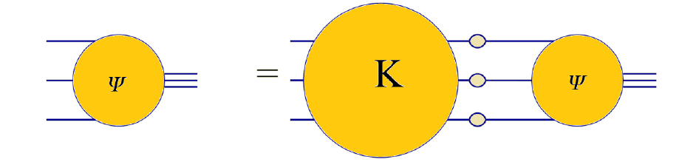
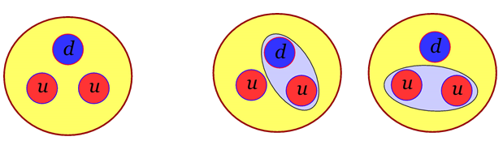
Baryons
The Faddeev equation has 64 Dirac structures: G. Eichmann, Phys. Rev. D84, 014014 (2011).
In the quark-diquark model that describes the baryons, there is a quark and a diquark that are constantly exchanged, so we have 8 Dirac structures. Such approach reproduces the nucleon mass with a 5% error :

Slide 27
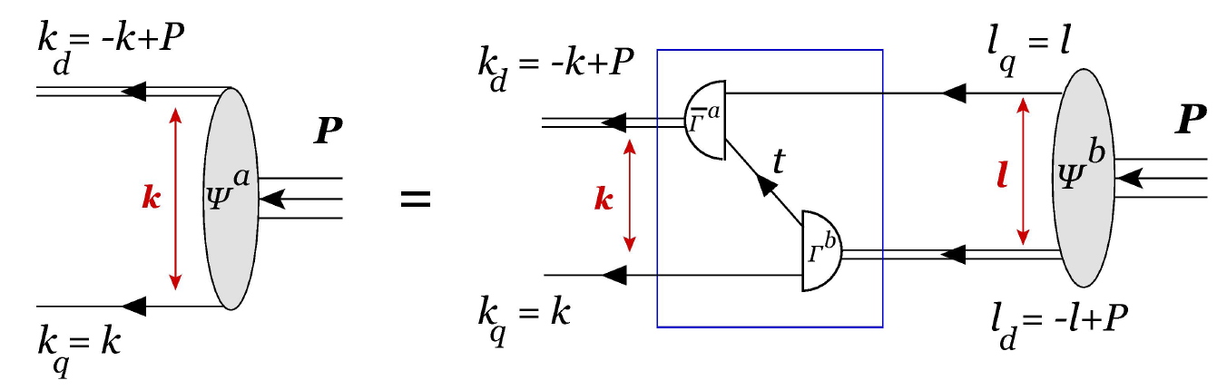
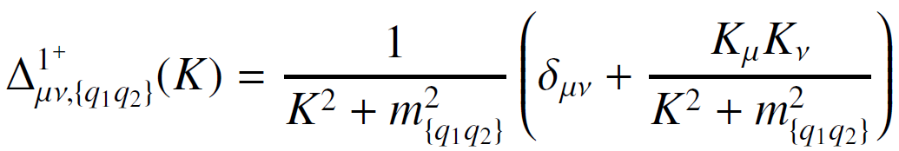
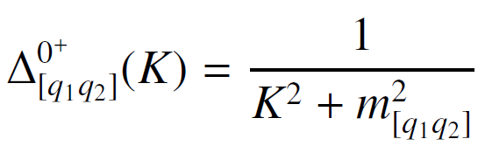

Baryons
      We consider a Faddeev amplitude 𝚿 that is composed of scalar and axial-vector diquark correlations :
$$P^{2}=−M_{B}^{2}$$

Slide 28
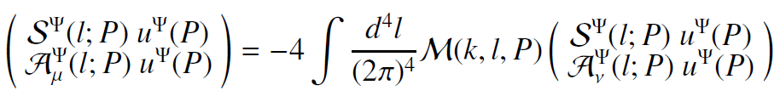


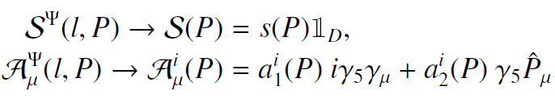
Baryons
The mass of the baryons is determined by a 𝟓×𝟓 matrix equation:
The Dirac matrices and in CI do not depend on the relative quark-diquark momentum:
s and a are scalars independent of relative momentum.

Slide 29
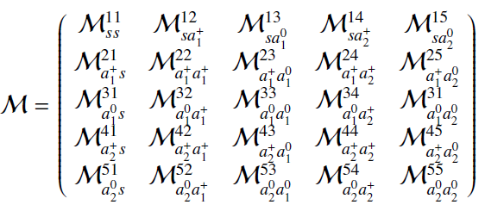
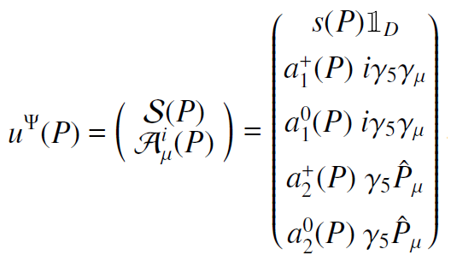
Baryons
The 5x5 matrix has the following form:
where each element is of the form:
Describes the breakdown of a diquark through the emission of a quark and the formation of another diquark.
Notes:
Ver t^f para describir se emite q1
U amplitud de Faddeev y Psi
M = kernel de interaciones

Slide 30



Baryons
Basis vectors in SU(5):
The flavor matrices are:
We use the static approximation for the exchanged quark propagator:
A. Buck, R. Alkofer and H. Reinhardt, Phys. Lett. B286, 29 (1992).

Slide 31



Baryons
Since the diquarks $0^{+}$ and $1^{+}$ have the same parity as the nucleons they are expected to be a dominant component in the nucleon:
So we can ignore the contributions of other diquarks.
Furthermore, the diquarks $0^{−}$ and $1^{−}$ are heavier and cannot be part of the ground state nucleon.
For the nucleon we have:

Slide 32


Nucleon
The eigenvalue equation for the nucleon is:
The first element is of the form:

Slide 33


Nucleon
After using Feynman parametrization and regularization, we get:
Notes:
Se hizo un cambio de variable con F para incluir la integral y la traza

Slide 34


BARyoNS
The equation to be solved is:
We look for the solution with:
Notes:
Se hizo un cambio de variable con F para incluir la integral y la traza

Slide 35

Baryons with spin 1/2
For different baryons with spin1/2 we have the vectors:

Slide 36



Baryons with spin 1/2
The results for the spin 1/2 baryons are:
L. X. Gutiérrez, Adnan Bashir, Marco A. Bedolla, E. Santopinto, Phys. Rev. D, 100, 114032 (2019).
The contribution of each diquark within the baryon is shown:

Slide 37



Baryons with SPIN 3/2
Two structures (𝒒𝒒𝒒) and ($q_{1}q_{2}q_{2}$) can be considered:
For the baryons (𝒒𝒒𝒒) the Faddeev amplitude is:
Faddeev equation is:
With the kernel described as:
After performing the Feynman parametrization and regularization, we obtain:
Notes:
Para calcular las masas se observa que no es posible combinar
un diquark de espín cero con un quark de espín 1/2 para obtener bariones con espín 3/2. Por tanto,
dicho barión se compone ´únicamente de correlaciones vectoriales.

Slide 38



Baryons with SPIN 3/2
For baryons ($q_{1}q_{2}q_{2}$) the Faddeev amplitude is:
Faddeev equation is:
The kernel has the same form.
After performing the Feynman parametrization and regularizing, we get:

Slide 39



Baryons with SPIN 3/2
The equation to be solved is:
For baryons (𝒒𝒒𝒒) of negative parity the Faddeev amplitude is:
The kernel is:
After performing the Feynman parametrization and regularizing, we get:
Notes:
De la misma manera se agrega un gamma 5 en el otro tipo de bariones.

Slide 40


Baryons with SPIN 3/2
The color singlet bound states of negative and positive parity constructed from three quarks are:

Slide 41



Baryons with SPIN 3/2
Comparison of heavy baryons masses with other approaches:
Mass
Mass
Notes:
Error del 2% en las graficas

Slide 42

Baryons with SPIN 3/2
Masses of the baryons:
Notes:
Error del 2% en las graficas

Slide 43

Baryons with SPIN 3/2
Contribution of the diquarks within the baryon:
Notes:
Error del 2% en las graficas

Slide 44





Baryons
Gell-Mann-Okubo relation:
Let us define the passive mass of the constituent quark:
Approach
Approach
Baryons.
Vector mesons.
Notes:
Error del 2% en las graficas

Slide 45
CONCLUSIONS
The CI model is easy to implement and teaches us a lot about hadrons.
CI shows good results for the masses of mesons and diquarks.
The quark-diquarks picture was used to calculate the masses of the baryons, viewed as all possible interactions between the quarks and the diquarks. We did this analysis using the Faddeev equation.
We use gB = 1 for all baryons, obtaining excellent precision.
Parity partners of the baryons with spin 3/2 are calculated.
The results obtained are in agreement with other theoretical approaches as well as with the experimental results that already exist.
Thank you !!!

