Slide 1
Coherent neutral pion and eta meson photoproduction on the deuteron
The 19th International Conference on Hadron Spectroscopy and Structure in memoriam Simon Eidelman (HADRON2021), Mexico City, Mexico, July 26~31, 2021
Contents
Introduction coherent double neutral-meson photoproduction on the deuteron
Experiment
Event Selection
Total and differential cross sections, and observed states,
Summary
Takatsugu Ishikawa (ishikawa@lns.tohoku.ac.jp)
Research Center for Electron Photon Science (ELPH), Tohoku University, Japan

Slide 2
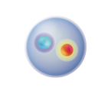
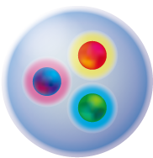
Introduction
meson photoproduction
a GeV photon beam has a function to produce baryon resonances from the nucleon
their excitation spectra are important testing ground for understanding the non-perturbative domain of QCD
meson
nucleon
baryon resonance
(excited baryon)
baryon
photon

Slide 3
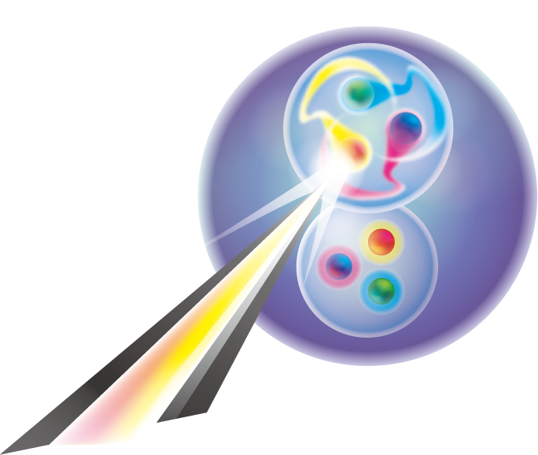
Introduction
meson photoproduction from a nucleus
baryon resonances are produced from the quasi-free (QF) nucleon even when a nuclear target is irradiated with a GeV photon beam. the QF nucleon is a participant, and the residual nucleus is a spectator coherent meson photoproduction
the same nucleus appears in the final state expected mechanism coherent sum of the elementary amplitudes coalescence of the final-state nucleus final-state interactions
$$γN→mN$$

Slide 4
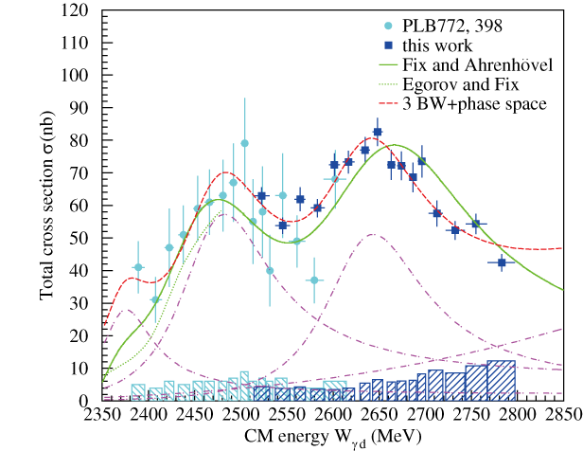
Introduction
$$γd→π^{0}π^{0}d$$
total cross section as a function of the $γd$CM frame (excitation function)
resonance-like behavior peaked at around 2.47 and 2.63 GeV
similar to the excitation function of $γN′→π^{0}π^{0}N$
naïve interpretation is QF excitation of the nucleon in the deuteron
at $E_{γ}<1.2 GeV$
PLB789, 413 (2019).

Slide 5
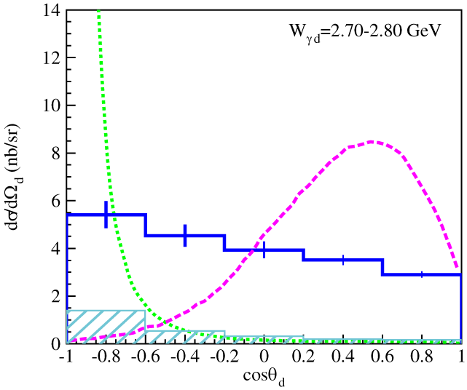
Introduction
$$γd→π^{0}π^{0}d$$
the kinematic condition completely differs from QF process
angular distribution of deuteron emission
QF $ππ$ production
QF $π$ production

Slide 6
Introduction
$$γd→π^{0}π^{0}d$$
sequential process: $γd→𝓓_{IS}→π^{0}𝓓_{IV}→π^{0}π^{0}d$ with an $I=0$ dibaryon $𝓓_{IS}$ and an $I=1$ dibaryon $𝓓_{IV}$
dibaryon: $B=2$ resonance
two $𝓓_{IS}$s are observed in the excitation function
How is $γd→π^{0}ηd \text{?}$
$$I=1, J^{π}=2^{+}, \\ M=2.14 GeV, Γ=0.09 GeV$$
PLB789, 413 (2019).

Slide 7
Accelerator

Slide 8
EM calorimeter

Slide 9
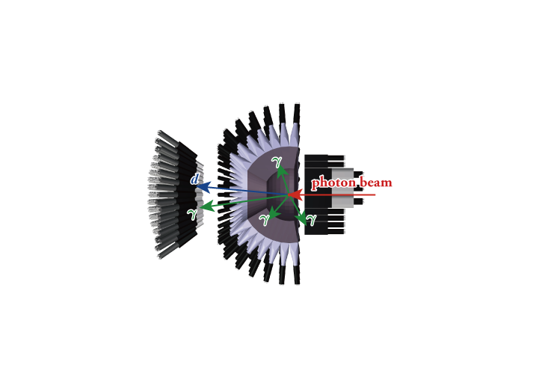
Event selection ($γd→π^{0}ηd$)
4 neutral particles and 1 charged particle
$π^{0}$ and $η$: $γγ$decay time difference is less than $3σ_{t}$ between every 2 neutral clusters out of 4
$d$ is detected with SPIDER (response of SCISSORS III is not required) time delay is larger than 1 ns wrt average $γγγγ$ time energy deposit is higher than $2E_{mip}$
sideband background subtraction to remove accidental coincidence between STB-Tagger II and FOREST

Slide 10
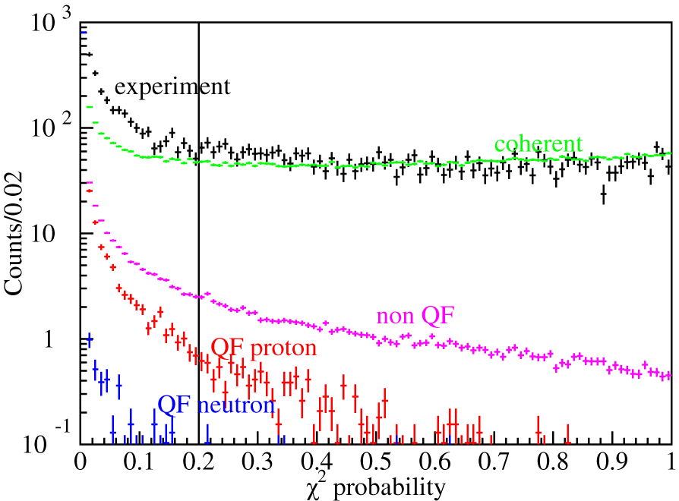
Event selection ($γd→π^{0}ηd$)
Further event selection a kinematic fit (KF) with 6 constraints is applied energy and momentum conservation (4) $γγ$ invariant masses are $m_{π^{0}}$ and $m_{η}$ (2) $χ^{2}$ probability is higher than 0.2 QF $γp^{′}→π^{0}ηp$is rejected using another KF

Slide 11
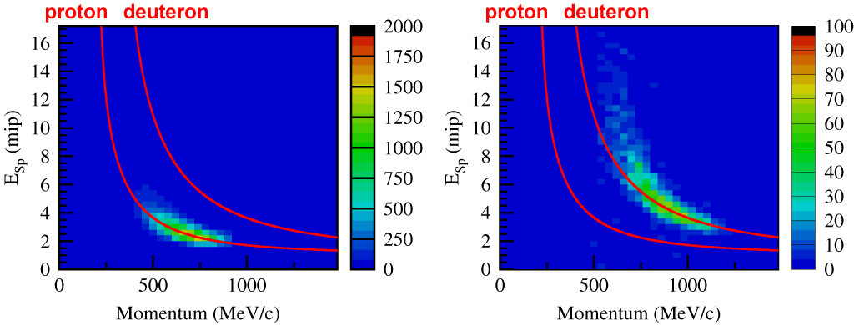
Event selection ($γd→π^{0}ηd$)
Further event selection a kinematic fit (KF) with 6 constraints is applied energy and momentum conservation (4) $γγ$ invariant masses are $m_{π^{0}}$ and $m_{η}$ (2) $χ^{2}$ probability is higher than 0.2 QF $γp^{′}→π^{0}ηp$is rejected using another KF
missing momentum is given for the deuteron in these plots
QF $γp^{′}→π^{0}ηp$
$$γd→π^{0}ηd$$

Slide 12
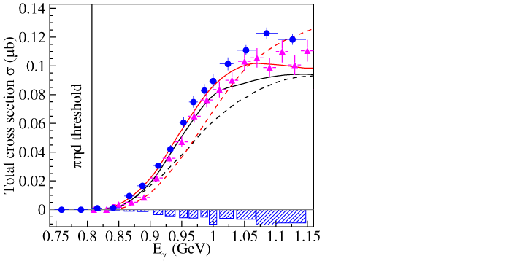
Total cross section
excitation function
dashed curves impulse solid curves including $ηd$ final- state interaction
two models M. Egorov, A. Fix, PRC88, 054611 (2013). M. Egorov, PRC101, 065205 (2020). unified microscopic approach
A. Käser et al., PLB748, 244(2015).
Mainz
ELPH
Both models are based on QF$π^{0}η$ production with deuteron coalescence but different approaches are adopted to incorporate the meson-deuteron final-state interaction

Slide 13
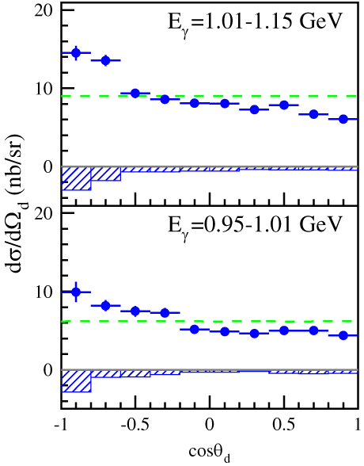
Differential cross sections
angular distributions $dσ/dΩ_{d}$
for the first time
angular distribution of deuteron emission in the $γd$ CM frame
does not show a strongly backward-peaking behavior but shows a rather flat distribution, suggesting a sequential process
phase space

Slide 14
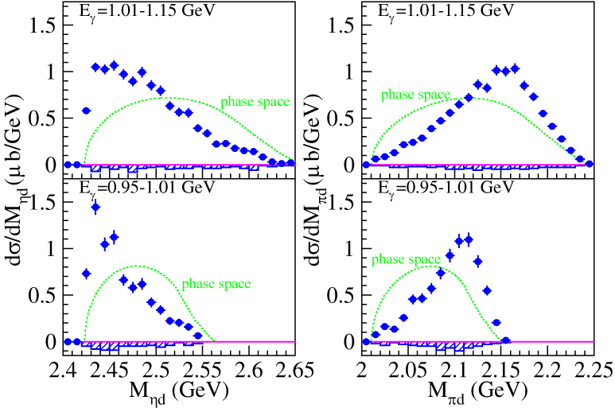
Differential cross sections
mass distributions $dσ/dM_{ηd}$ and $dσ/dM_{πd}$
for the first time

Slide 15
Observes states
$$γd→π^{0}ηd$$
two sequential processes: $γd→𝓓_{IV}→π^{0}𝓓_{ηd}→π^{0}ηd$ $γd→𝓓_{IV}→η𝓓_{12}→π^{0}ηd$
$𝓓_{ηd}$: S-wave $ηd$ system with $I=0, J^{π}=1^{−}$
$𝓓_{12}$: well-known $πd$ resonance with $I=1, J^{π}=2^{+}$ mass ~2.14 GeV width ~0.09 GeV

Slide 16
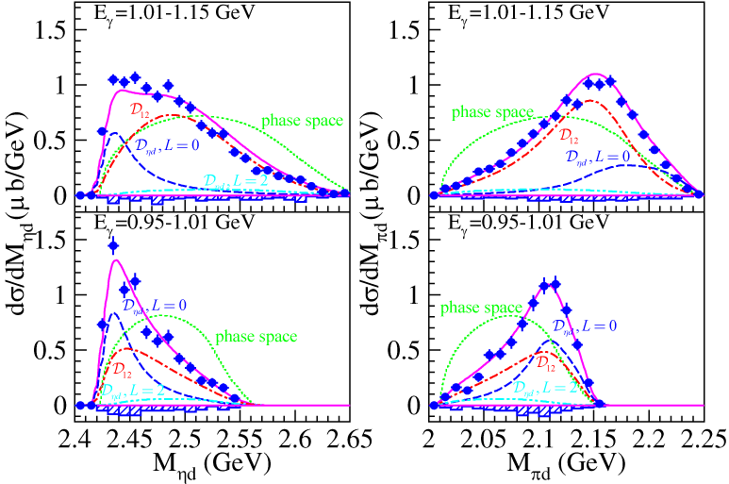
Observes states
mass distributions $dσ/dM_{ηd}$ and $dσ/dM_{πd}$
$𝓓_{ηd}$ ($M∼2.42 GeV, Γ∼0.03 GeV$) & $𝓓_{12}\text{(}M∼2.15 GeV, Γ∼0.11 GeV\text{)}$

Slide 17
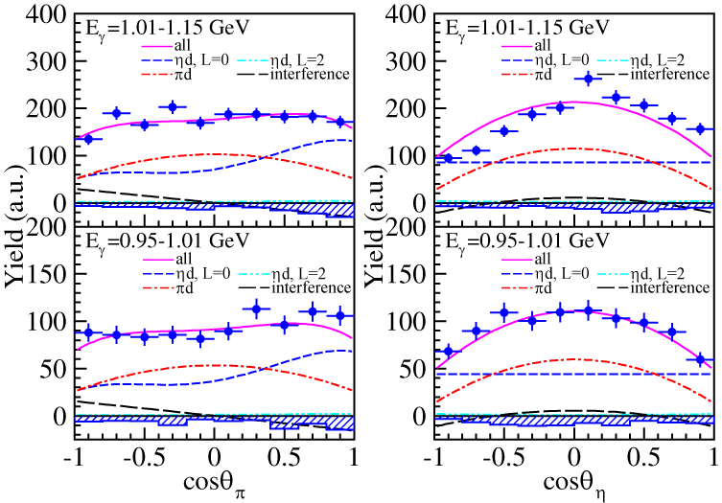
Observes states
angular distribution & correlation
$$M_{ηd}<2.47 GeV$$
inconsistent with the fact that the$Δ(1700)3/2^{−}$ is the main
contributor for the elementary
$πη$ photoproduction
M. Döring et al., PRC73, 045209 (2006).
J. Ajaka et al., PRL100, 052003 (2008).
Fix et al., PRC82, 035207 (2010).
E. Gutz et al., EPJA50, 74 (2014).
V. Sokhoyan et al., PRC97, 055212 (2018).
$γ\text{−}π$ in the $γd$-CM frame
$π\text{−}η$ in the $ηd$ rest frame
(opposite sign)
$$L=1, 2$$
57%
$$L=0,1, 2$$
$$L=0,2$$
$d\left(1^{+}\right)→𝓓_{IV}\left(0^{−}, 1^{±}, 2^{±}\right)→𝓓_{ηd}\left(1^{−}\right)→d\left(1^{+}\right)$
$d(1^{+})→𝓓_{IV}(2^{+})→𝓓_{12}(2^{+})→d(1^{+})$
$$L=1,2$$
$$L=1$$
$$L=1$$

Slide 18
Summary
neither $γd→π^{0}π^{0}d$ nor $γd→π^{0}ηd$ is described by a coherent sum of the elementary amplitudes with deuteron coalescence
a sequential process in $γd→π^{0}π^{0}d$ $γd→𝓓_{IS}→π^{0}𝓓_{12}→π^{0}π^{0}d$ $𝓓_{12}$: $I=1, J^{π}=2^{+}, M=2.14 GeV, Γ=0.09 GeV$
two sequential processes in $γd→π^{0}ηd$ $γd→𝓓_{IV}→π^{0}𝓓_{ηd}→π^{0}ηd$ $γd→𝓓_{IV}→η𝓓_{12}→π^{0}ηd$ $𝓓_{ηd}$: $I=0, J^{π}=1^{−}, M\sim 2.42 GeV, Γ\sim 0.03 GeV$ consistent with a theoretical prediction: three-body calculation for the $ηNN\text{−}πNN$ coupled channels $M≃M_{η}+M_{d}, Γ=0.01∼0.02 GeV$ also interpreted as an $ηd$ virtual state Detailed discussion can be found in arXiv: 2105.10887
T. Ueda, PRL66, 297 (1991).

Slide 19
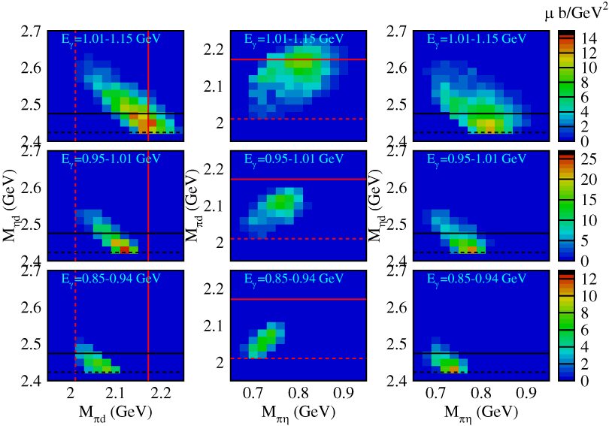
Backup slides

