Slide 1



Open Heavy-Flavor Production in Heavy-Ion Collisions
Ralf Rapp
Cyclotron Institute +
Dept of Phys & Astro
Texas A&M University
College Station, TX, USA
19th Int. Conference on Hadron Spectroscopy + Structure
“Hadron 2021”
Online (UNAM, Mexico City), July 26-31, 2021

Slide 2
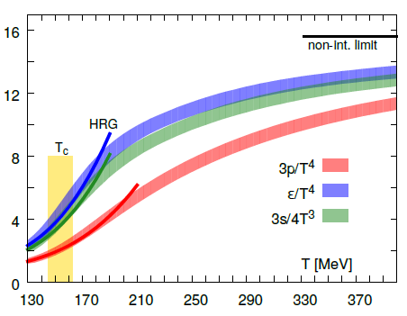
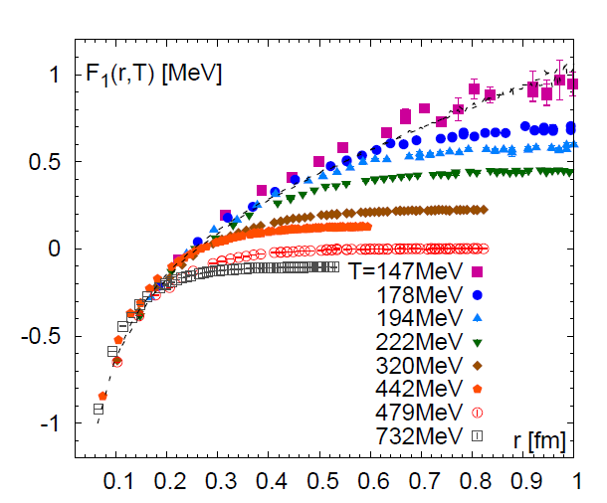
1.) QCD Matter and In-Medium Force
Equation of State Heavy-Quark Free Energy
μ_{Β} = 0
[GeV]
[Bazavov
et al ’13,’14]
F_{QQ} = U_{QQ} – T S_{QQ}
Non-perturbative above T_{c}
Change in dofs above T~160MeV
- - -
Heavy-quark diffusion sensitive to long-range forces in medium,
probing the non-perturbative structure of the QGP

Slide 3
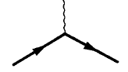
1.2 Heavy-Flavor Diffusion
Q
Brownian motion via elastic interactions
(radiation suppressed: q₀ ~ q²/2m_{Q} << q ~ T << m_{Q})
Thermalization delayed by m_{Q}/T → memory
Transport coefficient: <x²> - <x>² = 6 D_{s} t
(relation D_{s} (2πT) ~ η/s ?)
Scattering rates
- widths ↔ quasiparticles?
⇒ Implications for QGP structure
Non-perturbative effects (potential interactions)
Mechanisms of hadronization: c → D, D_{s}, L_{c}, … (m_{Q} >> T_{c})
QGP
Q

Slide 4
Outline
1.) Introduction
2.) Open Heavy-Flavor Transport
● Boltzmann vs. Fokker-Planck
● Transport Coefficients
3.) Heavy-Quark Interactions in QGP
● Perturbative vs. Non-perturbative
● Hadronization
4.) Heavy-Ion Phenomenology
● Constraints on Transport Coefficients
5.) Conclusions

Slide 5
2.1 Heavy-Flavor Transport in Heavy-Ion Collisions
0 0.5 5 10
| | | |
τ [fm/c]
D
c
initial cond.
(nPDFs, …),
pre-equil. fields
c-quark diffusion
in QGP liquid
c-quark
hadronization
D-meson
diffusion in
hadron liquid
no “discontinuities” in interaction
⇒ diffusion near T_{pc} ↔ hadronization
[Moore+Teaney ‘05, van Hees et al ‘05, Gossiaux et al ‘08, Vitev et al ‘08, Das et al ‘09, Uphoff et al ’10,
M.He et al ‘11, Beraudo et al ‘11, Cao et al ’13, Bratkovskaya et al ‘14, Liao et al ‘17, Katz et al ‘19,…]

Slide 6

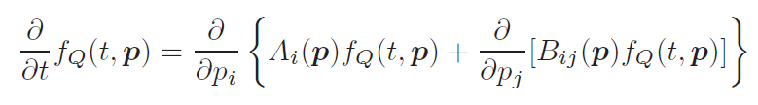
2.2 Transport Approaches
Boltzmann equation for HQ phase-space distribution f_{Q}
Collision term: semiclassical simulation of medium + HQ quasi-particles
Fokker-Planck equation
follows from Boltzmann with p² ~ m_{Q} T >> q² ~ T²
does not require quasi-particle medium
well suited for strongly coupled medium where E_{th} ~ Γ_{q,Q} < m_{Q}

Slide 7

2.3 Transport Coefficients
Fokker-
Planck
Q
thermalization rate momentum diffusion coefficient
g p = ∫ d³q w_{Q}(q,p) q
~ ∫ |T_{Qj}|² (1-cosq) f ^{j}
D_{p} = ∫ d³q w_{Q}(q,p) q²
thermal relaxation time: τ_{Q} = 1/γ
Einstein relation: T = D_{p} / γ m_{Q}
spatial diffusion constant: D_{s} = T / γ m_{Q}
Key ingredients: - heavy-light scattering amplitude T_{Qj}
- thermal-medium partons in f ^{j}

Slide 8
Outline
1.) Introduction
2.) Open Heavy-Flavor Transport
● Boltzmann vs. Fokker-Planck
● Transport Coefficients
3.) Heavy-Quark Interactions in QGP
● Perturbative vs. Nonperturbative
● Hadronization
4.) Heavy-Ion Phenomenology
● Constraints on Transport Coefficients
5.) Conclusions

Slide 9
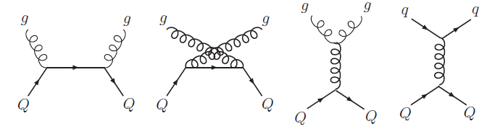

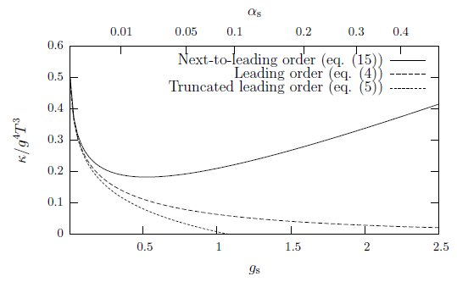
3.1 Perturbative QCD Approaches
Leading Order
screened 1-gluon exchange
2
dominated by forward scattering
long thermalization time: τ_{c} ≥ 20 fm/c (T≤ 300MeV, α_{s}=0.4)
[Svetitsky ’88, Mustafa et al ’98, Molnar et al ’04, Zhang et al ’04,
Teaney+Moore’04, Gossiaux et al ‘08, Greco et al, PHSD, …]
Next-to-Leading Order
bad convergence behavior
(even for α_{s} ~ 0.1)
genuine non-perturbative effects?
g m_{Q}/T²
[Caron-Huot+Moore ‘08]

Slide 10
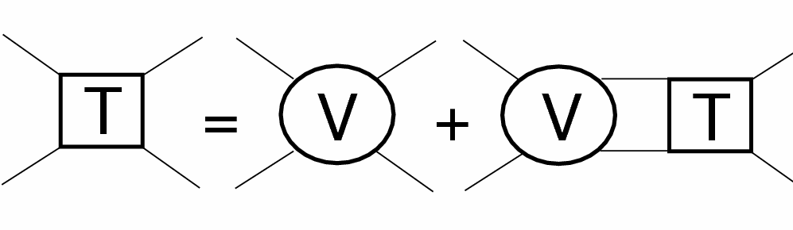
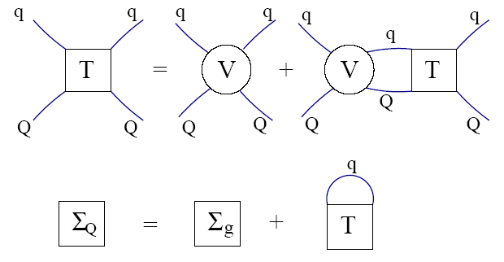
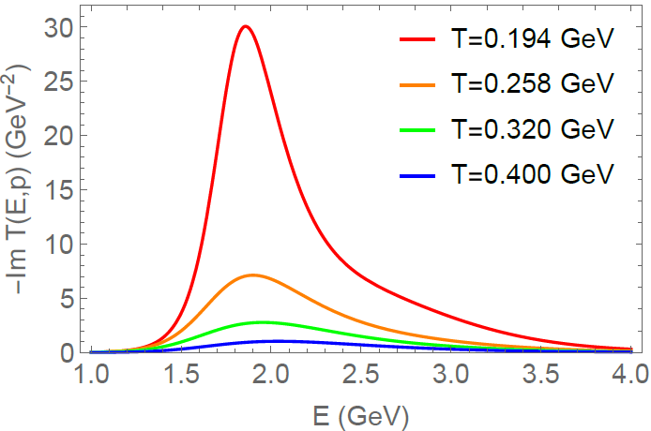
3.2 Nonperturbative Approaches: T-Matrix
Scattering
equation
Q
j=q,g
Strong coupling → resummation: T_{Qj} = V_{Qj} + ∫ V_{Qj} D_{Q} D_{j} T_{Qj}
parton propagators + selfenergies: D = 1 / [ω – ω_{k} –Σ(ω,k)]
Nonperturbative potential V_{Qj}
Σ
=
D-meson states emerge neat T_{c}
Thermalization time: τ_{c} ≈ 3-4 fm/c
Seamless onset of recombination
[TAMU ’05-’18]

Slide 11
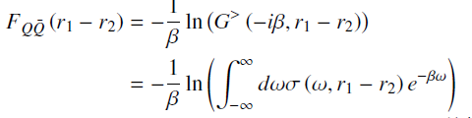

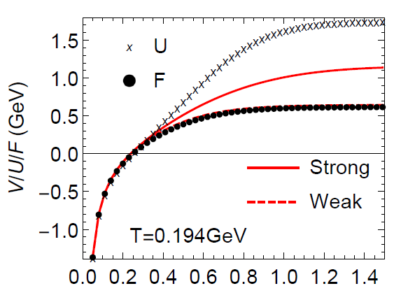
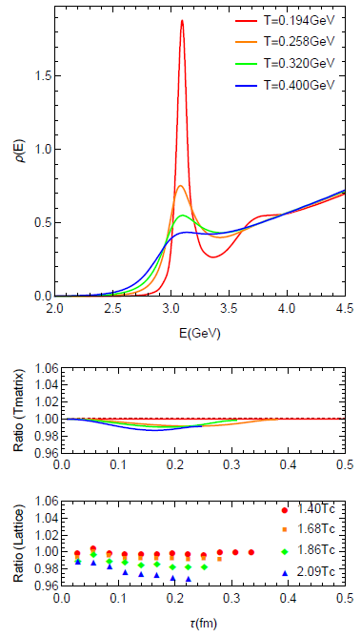
3.2.2 Potential Extraction from Lattice QCD
Free Energy
-
QQ Spectral Function
Euclidean Correlation Functions
V
T-matrix
Lattice-QCD
r [fm]
[Aarts et al ’11]
Large widths Γ_{Q} ~ 0.5 GeV ⇒ V > F
Remnants of confining force above T_{c}!
further constraints from
lattice QCD
[Liu+RR ’18]

Slide 12
Outline
1.) Introduction
2.) Open Heavy-Flavor Transport
● Boltzmann vs. Fokker-Planck
● Transport Coefficients
3.) Heavy-Quark Interactions in QGP
● Perturbative vs. Non-perturbative
● Hadronization
4.) Heavy-Ion Phenomenology
● Constraints on Transport Coefficients
5.) Conclusions

Slide 13
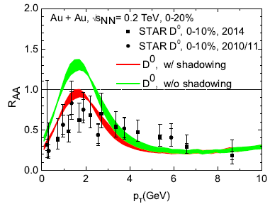
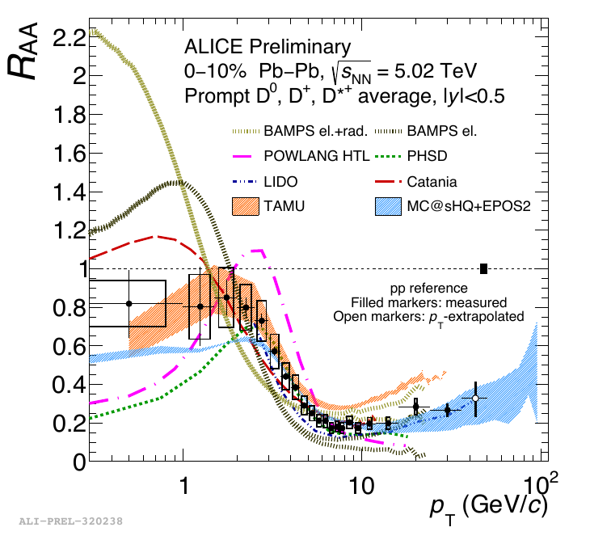
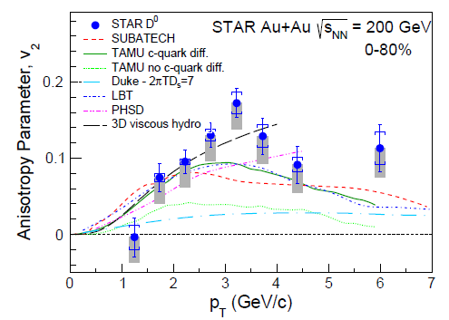
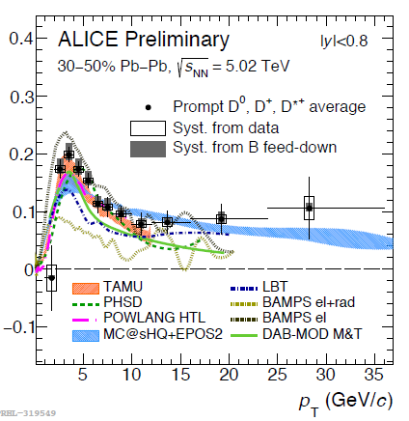
4.1 Heavy-Flavor Phenomenology at RHIC + LHC
v₂
“Flow bump” in R_{AA} + large v₂ ↔ strong coupling near T_{pc}
High-precision v₂: gauge of interaction strength

Slide 14
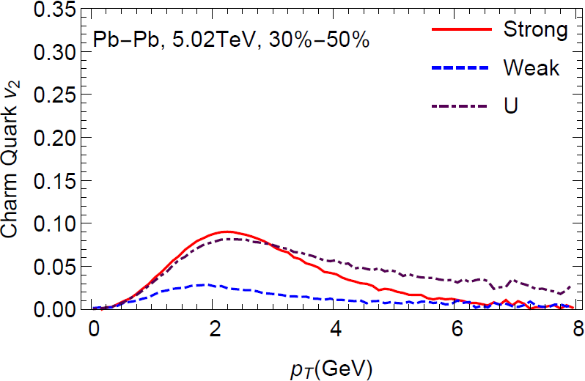
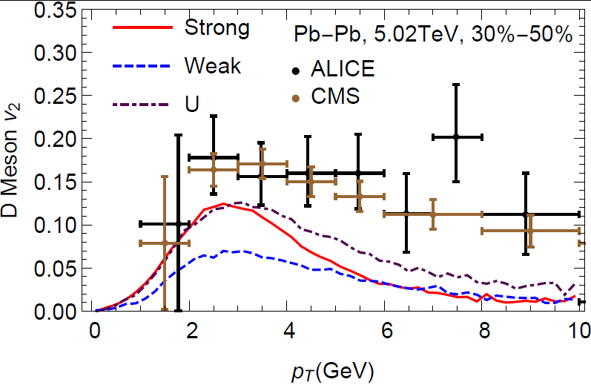
4.2.1 Sensitivity to Heavy-Quark Potential
Charm Quark D Meson
Strongly-coupled potential gives max. low-p_{T} c-quark v₂
Weakly-coupled potential (~ free energy) insufficient
[Liu,He+RR ‘19]

Slide 15
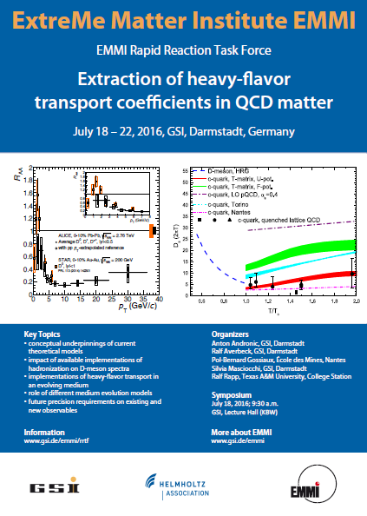
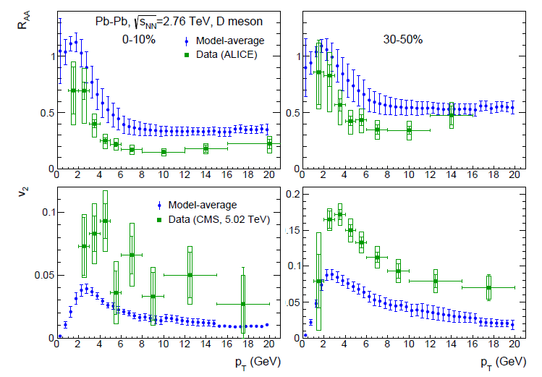
4.2.2 EMMI Rapid Reaction Task Force
[RR,Gossiaux,Andronic,Averbeck,Masciocchi et al. ’18 ]
Scrutinize different components in HF transport:
- initial spectra
- bulk medium evolution
- hadronization
Exercise:
use common transport coefficient
(5 x pQCD) in different medium
evolution + hadronization models
⇒ D_{s} (2pT) < 6

Slide 16
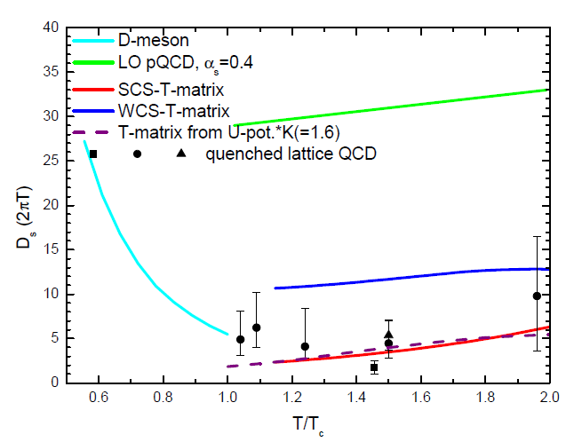
4.2.3 Spatial Charm-Quark Diffusion Coefficient
D_{s} =T / [m_{Q} Α(p=0)]
EMMI RRTF ‘18
Τ/Τ_{c}
suggests D_{s}(2πT) ~ 2-4 near T_{pc}
width: Γ_{c} ~ 3 / D_{s} ~ 1 GeV − no light quasi-particles!

Slide 17
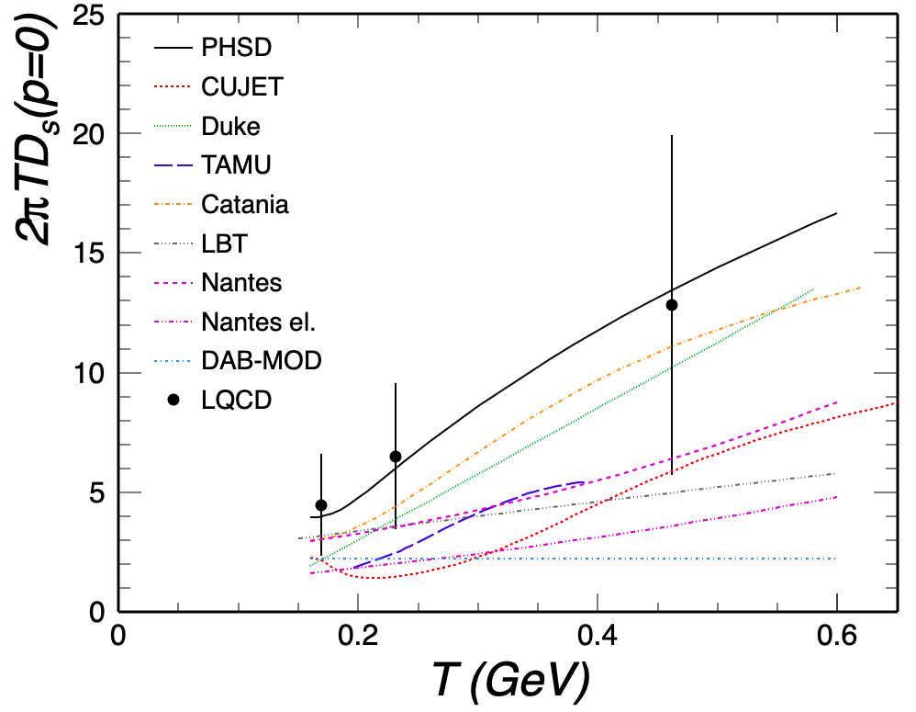
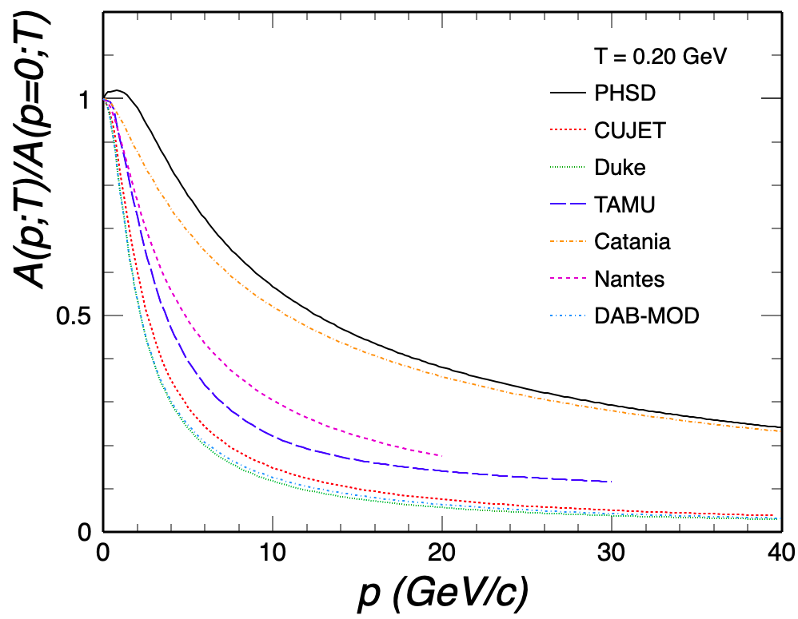
4.3 Momentum Dependence of Relaxation Rate
[ECT* HF workshop ’21 ]
correlation: large D_{s} ↔ weak p-dependence
need handle on momentum dependence

Slide 18
4.4 D-Meson Diffusion in Hadronic Matter
[He et al ‘12]
Up to ~30 % increase in v₂
smaller effect in R_{AA}
recent work by
[Montana et al ‘21]
[Song et al ‘15]

Slide 19
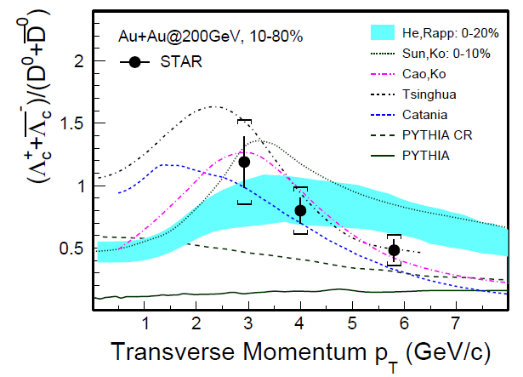
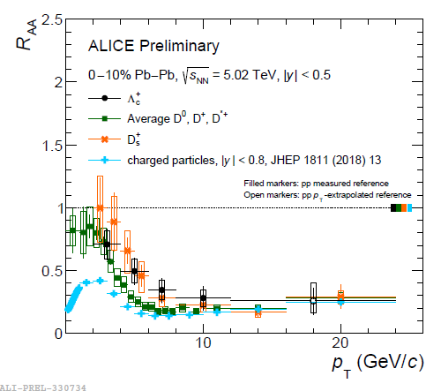
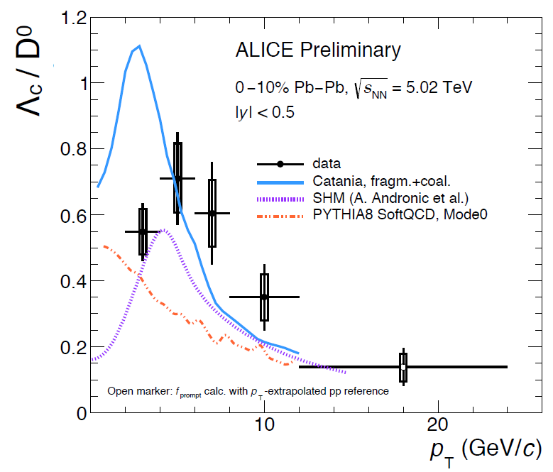
4.5 Heavy-Flavor Hadro-Chemistry
D, D_{s} and L_{c}
Distinct pattern up to p_{T} ~ 10 GeV
D_{s} strangeness-enhanced!?
Λ_{c} coalescence enhanced!?
Importance of low-p_{T} limit

Slide 20
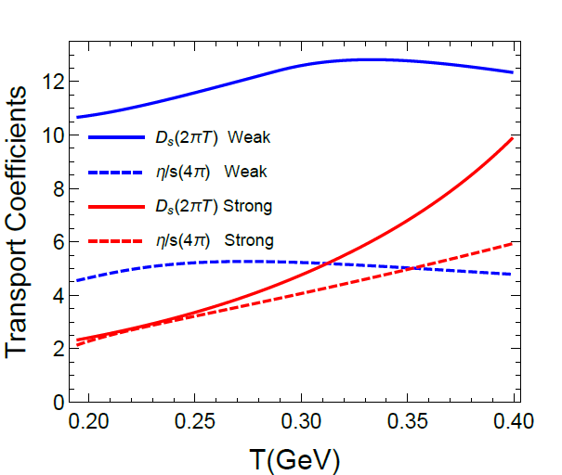
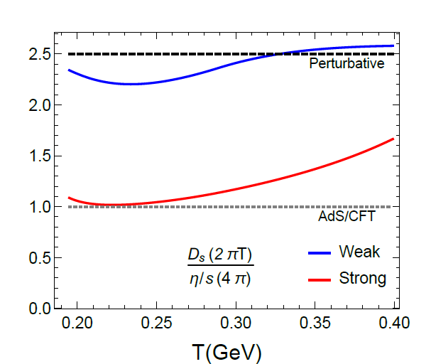
4.6 Heavy-Flavor vs. Bulk Transport
Heavy-Quark Diffusion vs. Shear Viscosity
Strongly coupled: (2πT) D_{s} ~ (4π) η/s
Perturbative: (2πT) D_{s} ~ 5/2 (4π) η/s
Transition as T increases
[Liu+RR ‘19]

Slide 21
5.) Summary
QCD-based understanding of HF transport coefficient
Lattice-QCD constraints vital (correlation fcts., free energy, susceptibilities,…)
3-momentum dependence of transport coefficient
Medium partons to evaluate HQ scattering
Off-shell (quantum) effects ubiquitous: large scattering rates, near-threshold resonances, transport coefficients near quantum bound, …

Slide 22
Outlook
Recommendations of ECT* HF workshop ‘21:
- common bulk evolution model + initial c-quark spectra
- temperature profiles of propagating c-quark
- lattice-QCD constraints on heavy-light scattering amplitudes
- parameter dependence of hadronization models
- gluon mass in radiation

Slide 23
4.4.2 Progress on Hadronic D-Meson Diffusion
[Montana et al ‘21]
small values in the hadronic medium: D_{s}(2πT) ~ 4 at T=150 MeV

Slide 24
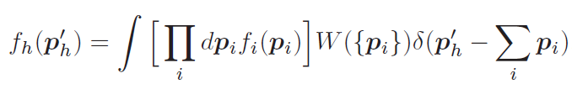

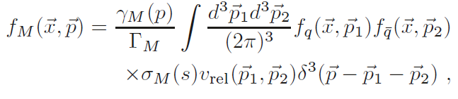
3.4 Heavy-Quark Recombination
Instantaneous Coalescence Models (ICMs)
projection on hadron WF, σ ~ radius parameter
- energy not conserved → challenge for chemical + thermal equilibrium
Resonance Recombination Model (RRM)
- derived from Boltzmann equation
σ_{Μ} (s) v_{rel} ~ |T_{Qj} |² : resonant heavy-light scattering amplitude
→ connects to T-matrix interactions in QGP near T_{c}
→ satisfies equilibrium limits (resonance masses)
[Hwa ‘80, Likhoded et al ‘83, …
Greco et al + Fries et al ‘03,…]
[Ravagli et al ‘07, He et al ‘12]

Slide 25
3.3 QGP Medium Models: Light Partons
→ essential for quantitative evaluation of transport coefficients, e.g.:
Massless quarks and gluons (over-estimates equation of state)
Perturbative quasiparticles (m_{q,g} ~ gT, over-estimates EoS for T < 1.5T_{c})
Effective quasiparticles (m_{q,g} ~ gT with g large near T_{c})
Dynamical quasiparticles (moderate widths Γ_{g,q} ~ 100-200 MeV)
T-matrix approach (large widths, no quasiparticles near T_{c})

Slide 26
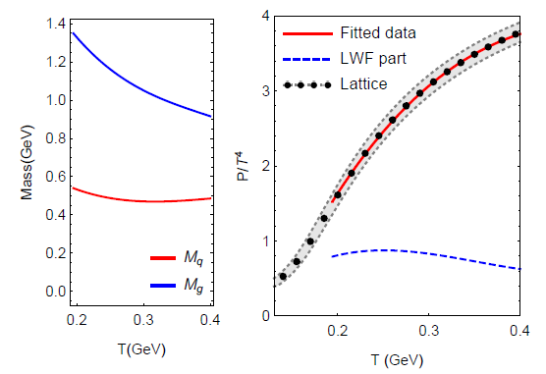
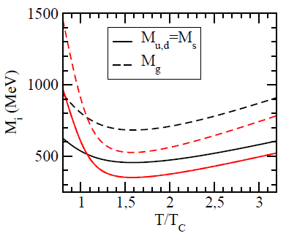
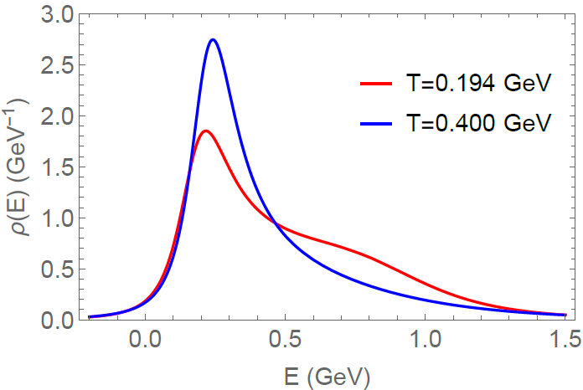
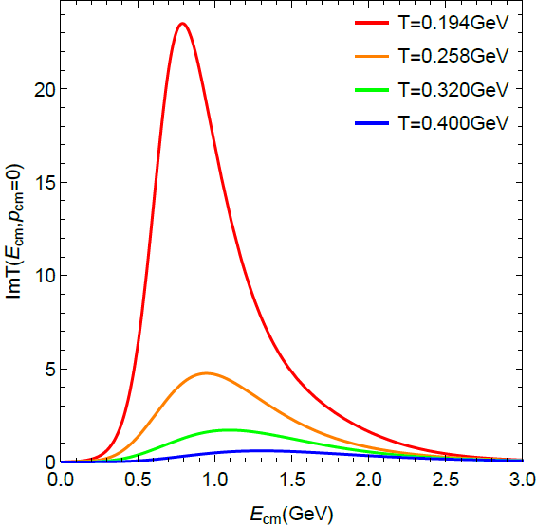
3.3.2 QGP Medium Properties: Light Partons
Effective Quasiparticle Model T-Matrix Approach
g(T)
[MeV]
Quark SF
Im T_{qq}
[Plumari
et al ‘11]
Large coupling / masses near T_{c}
Near T_{c}, partons “melt”,
hadronic bound states emerge

Slide 27


4.) Hadronization of Heavy Quarks
Fragmentation
c → D, D*, D_{s}, Λ_{c}, …
determined by empirical fragmentation functions D_{c→Hc}(z) ;
universal in “vacuum”: e⁺e⁻ collisions or high p_{T}
Coalescence / Recombination
c + q (s) → D (D_{s}), D*,… ; c + q + q (s) → Λ_{c} (Ξ_{c}), …
depends on environment (phase space of surrounding anti-/quarks)
-- instantaneous coalescence (based on spatial wave functions)
-- resonance recombination (momentum space)

Slide 28


1.4 Quarkonia in Medium
potential V(r,T) → binding energy E_{B}(p,T)
Dissociation rate → width G(p,T,E_{B})
How do heavy quarks
within quarkonia interact
with the medium?
Quarkonium spectral functions
Constraints from lattice-QCD:
Euclidean-time correlators
QGP
Q
−
Q
→ Simpler problem: one heavy quark!

Slide 29
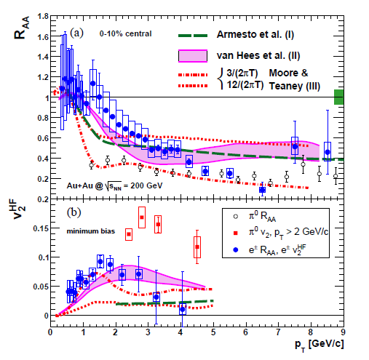
5.2 The v₂ – R_{AA} Correlation Story
Heavy-Flavor Electrons [PHENIX ’07]
Challenge: Large elliptic flow but not too large suppression in R_{AA}
→ better met by non-perturbative than perturbative interactions
[van Hees et al ’05] [Moore+Teaney ’05, Armesto et al ‘05]

Slide 30
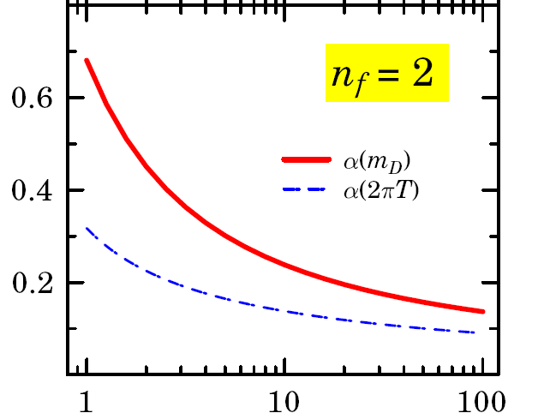

3.1.3 “Effective” pQCD with Running Coupling
M_{Qj} ~
run α_{s} to m_{D} ~ gT, rather than 2πT
reduced Debye mass μ² ~ 1/5 m_{D}²
factor ~10 faster thermalization: τ_{c} ≈ 2-3 fm/c
perturbative regime? Need to resum large diagrams…
[Peshier ’07,
Gossiaux et al ’08,
BAMPS ‘14]

