Slide 1



Amplitude analysis for/from charmonia
Alessandro Pilloni
CHARM2021, Mexico City, May 31st, 2021
H2020 MSCA COFUND G.A. 754496

Slide 2
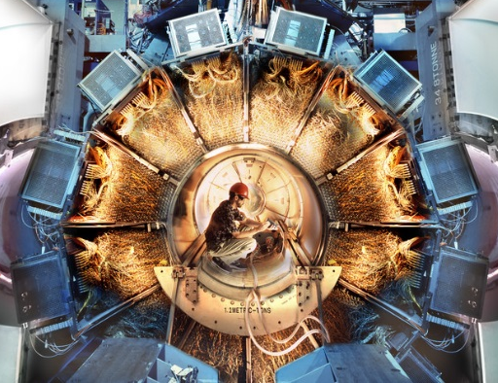





Hadron Spectroscopy
Hybrids
Tetraquark
Meson
Baryon
Glueball
$$π$$
$$π$$
$$J/ψ$$
$$π$$
Hadroquarkonium
Molecule
Experiment
Data
Amplitude analysis
Properties,
Model building
Lattice QCD
Interpretations on the spectrum leads to
understanding fundamental laws of nature

Slide 3

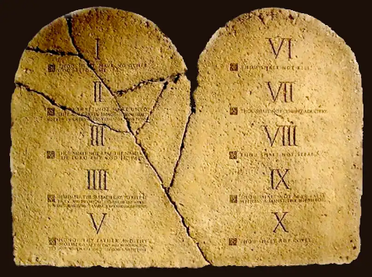
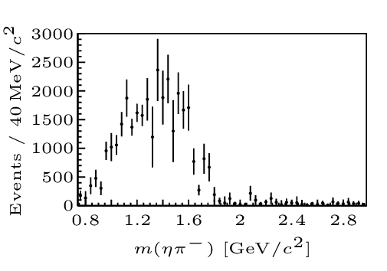

The flowchart(s)
You are given a model/theory
$$f(s)$$
You calculate the amplitude
You compare with data.
Or you don’t.
Predictive power ✓
Physical interpretation ✓
(within the model! ✗)
Biased by the input ✗
A. Pilloni – Amplitude analysis for/from charmonia

Slide 4
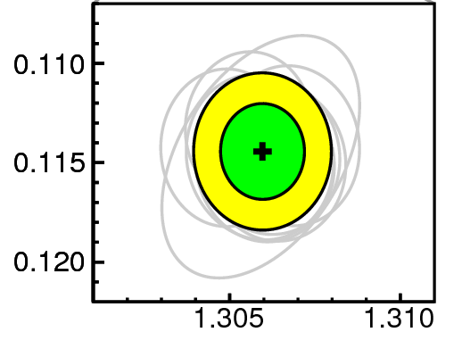
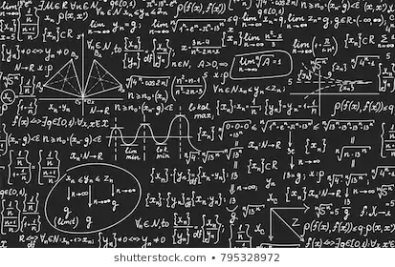
The flowchart(s)
Less predictive power ✗
Some physical interpretation ✗
Minimally biased ✓
You extract physics
You choose a set of generic amplitudes
You start with data
A. Pilloni – Amplitude analysis for/from charmonia

Slide 5
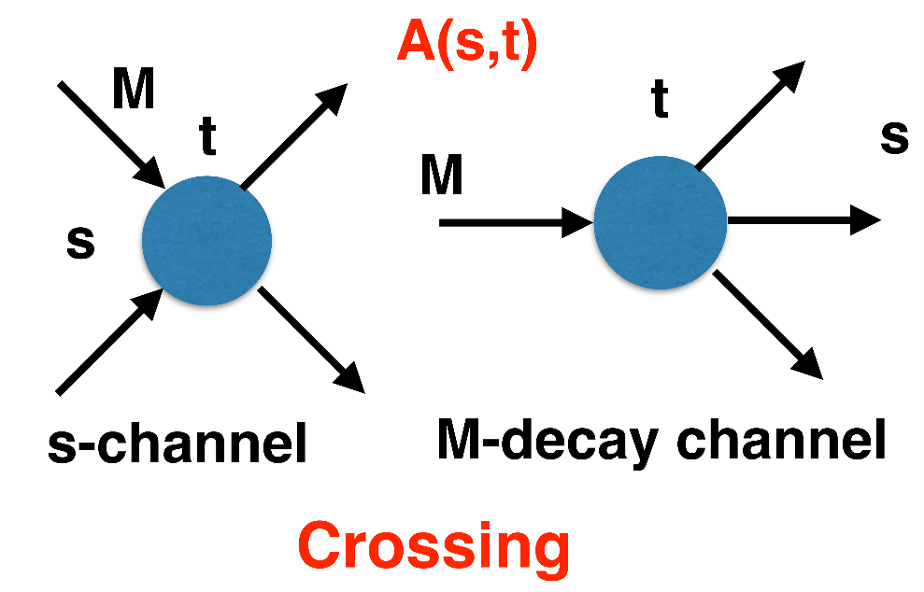
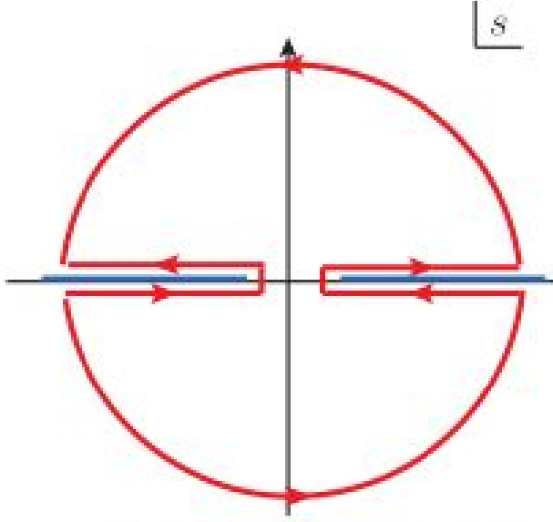
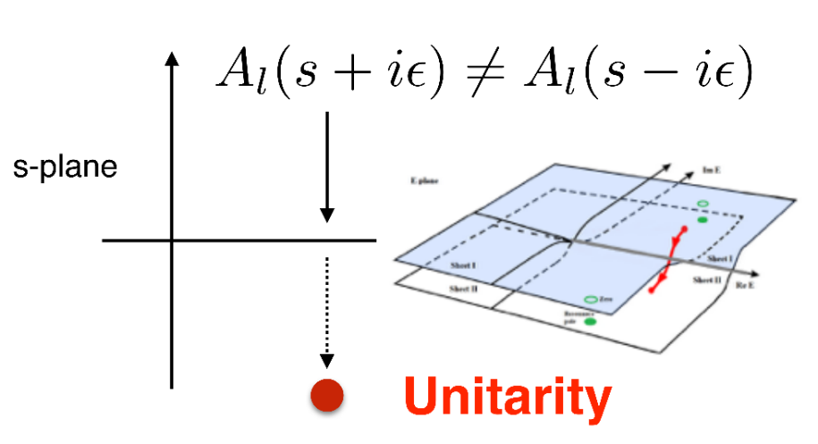



$S$-Matrix principles
$$t_{l}\left(s\right)=\lim_{ε→0}t_{l}(s+iε)⁡$$
Analyticity
$$\text{Im} t_{l}=ρ_{l}{\left|t_{l}\right|}^{2} ⁡$$
These are constraints the amplitudes have to satisfy, but do not fix the dynamics
They can be imposed with an increasing amount of rigor, to extract robust physics information
The «background» phenomena can be effectively parameterized in a controlled way
+ Lorentz, discrete & global symmetries
A. Pilloni – Amplitude analysis for/from charmonia
Notes:
Controlla la parte su Regge

Slide 6

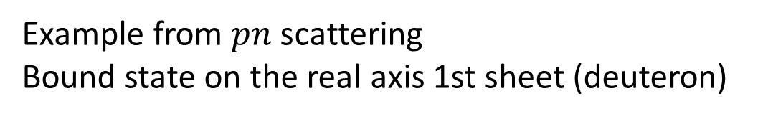






Bound and virtual states
Decreasing the potential strength,
the pole reaches threshold
The pole jumps on the 2nd sheet (dineutron),
it becomes a virtual state
Example from $pn$ scattering
Bound state on the real axis 1st sheet (deuteron)
$$V(r)$$
$$\text{Im} E$$
$$r$$
$$V$$
Deuteron
$$\text{Re} E$$
$${}_{}^{1}S$$
Deuteron
pole
Dineutron
pole
$${}_{}^{3}S$$
A. Pilloni – Amplitude analysis for/from charmonia
Notes:
Controlla la parte su Regge

Slide 7
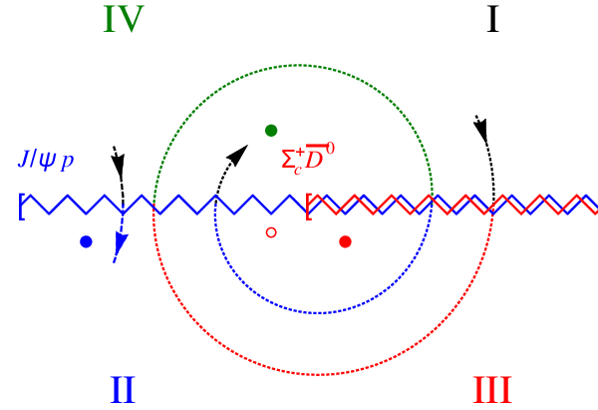
Bound and virtual states
The situation is more complicated when more channels are open
Virtual state
Bound state
Resonance
A. Pilloni – Amplitude analysis for/from charmonia
Notes:
Controlla la parte su Regge

Slide 8
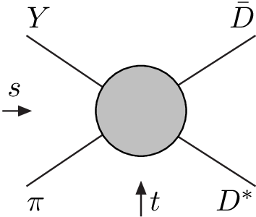
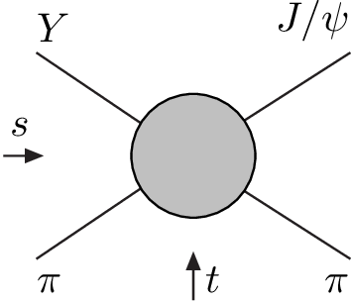
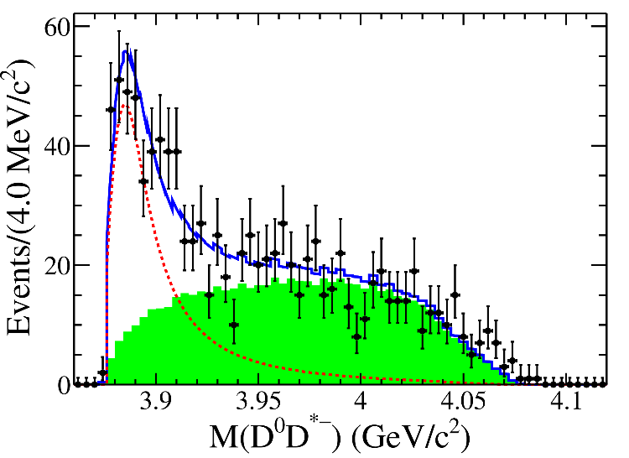
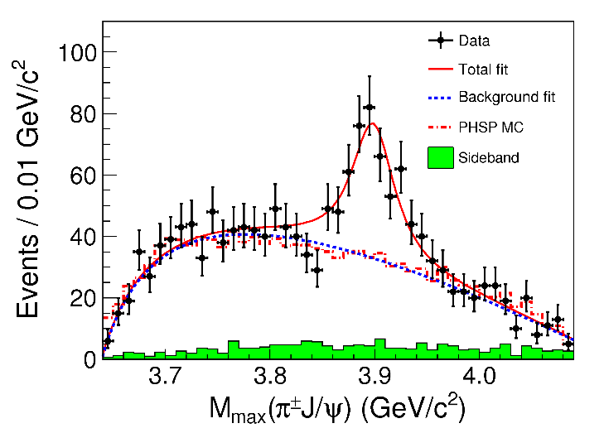


Amplitude analysis for $Z_{c}(3900)$
One can test different parametrizations of the amplitude,
different singularities → different natures
AP et al. (JPAC), PLB772, 200
A. Pilloni – Amplitude analysis for/from charmonia
Notes:
Controlla la parte su Regge

Slide 9
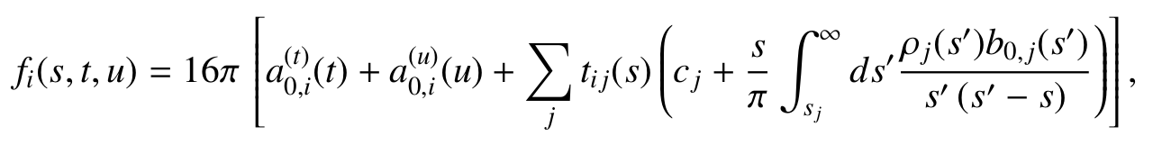












Amplitude model
$$Z_{c}\left(3900\right)?$$
$${u: D}_{0}(2400)$$
$${u:Z}_{c}\left(3900\right)?$$
$$"σ, f_{0}(980)"$$
$$D_{1}(2420)$$
Logarithmic branch points simulate
resonant behavior, only in special kinematics
Coleman and Norton, Nuovo Cim. 38, 438
Schmid, Phys.Rev. 154, 1363
Szczepaniak, PLB747, 410-416
Szczepaniak, PLB757, 61-64
Guo, Nucl.Phys.Rev.37, 406
$$π$$
Isobars
Rescattering
$$D_{1}$$
$$Y(4260)$$
$$D^{∗}$$
$$π$$
$$\overline{D}$$
$$J/ψ$$
Triangle singularity?
A. Pilloni – Amplitude analysis for/from charmonia

Slide 10
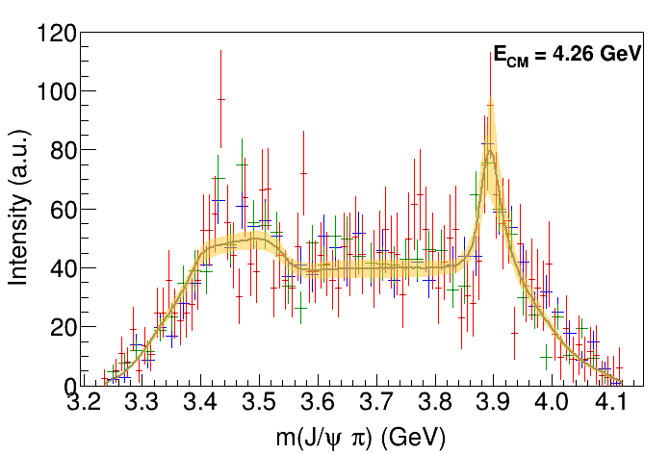
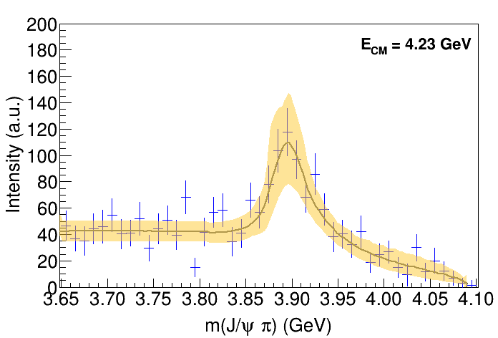
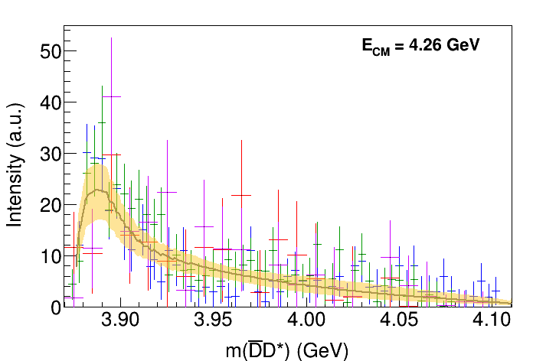
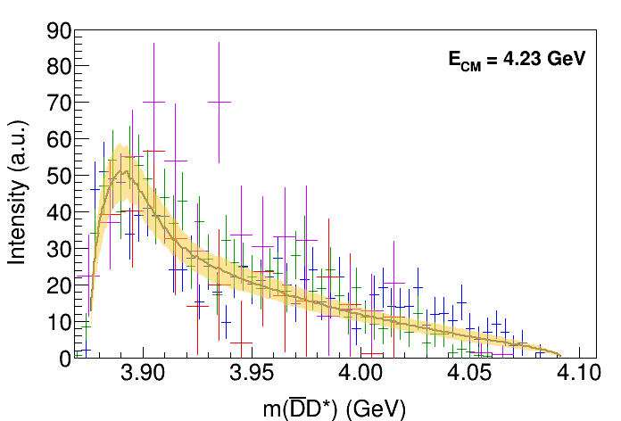
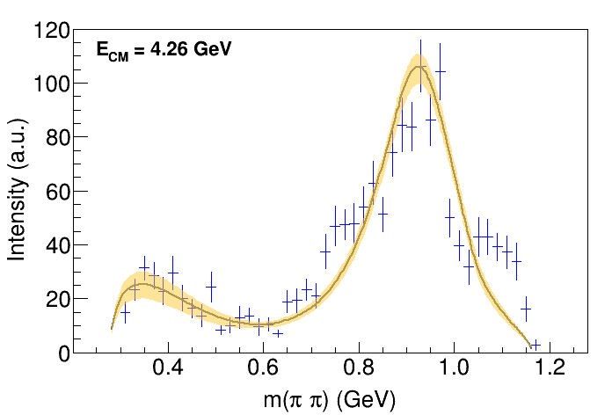
Fit: III
( data)
A. Pilloni – Amplitude analysis for/from charmonia
Notes:
Controlla la parte su Regge

Slide 11

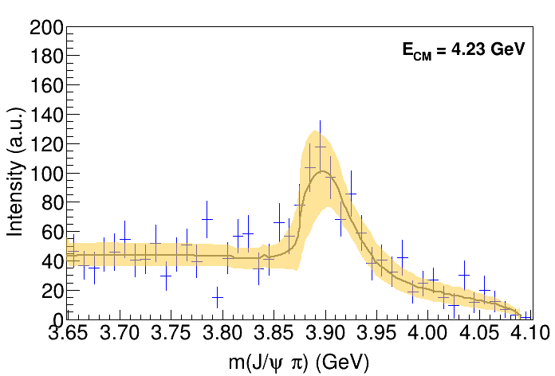

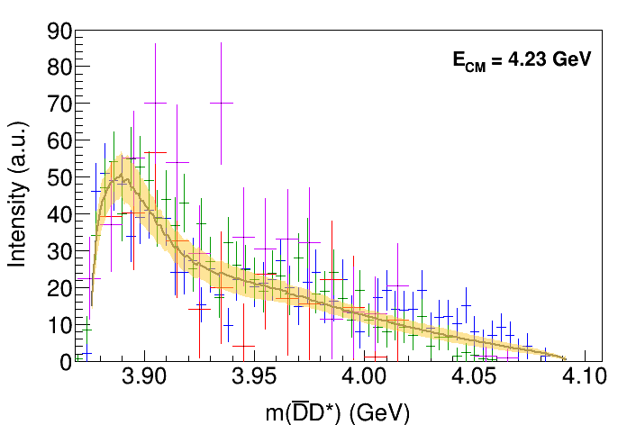

Fit: III+tr.
( data)
A. Pilloni – Amplitude analysis for/from charmonia
Notes:
Controlla la parte su Regge

Slide 12
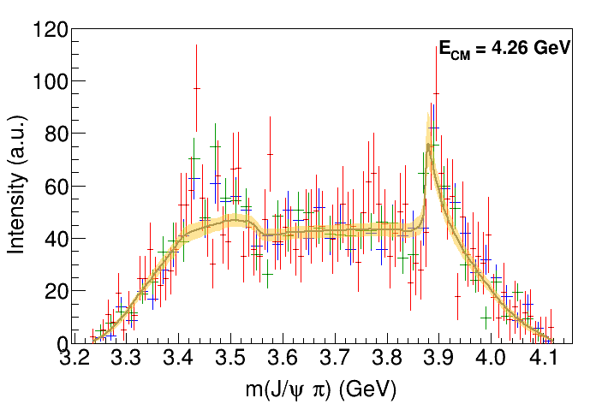
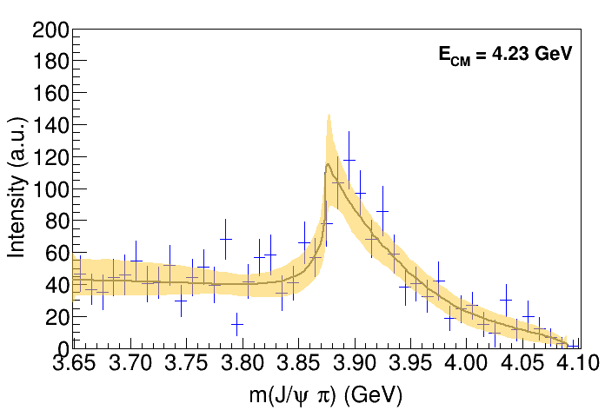

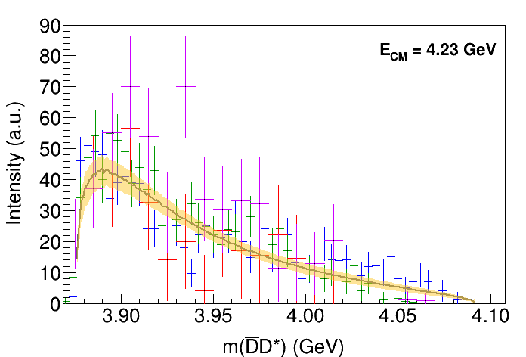
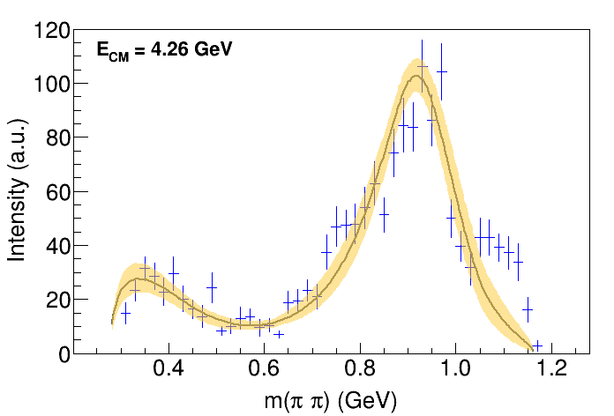
Fit: IV+tr.
( data)
A. Pilloni – Amplitude analysis for/from charmonia
Notes:
Controlla la parte su Regge

Slide 13
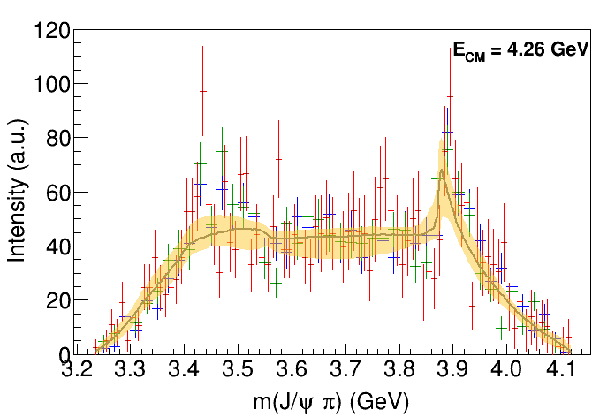
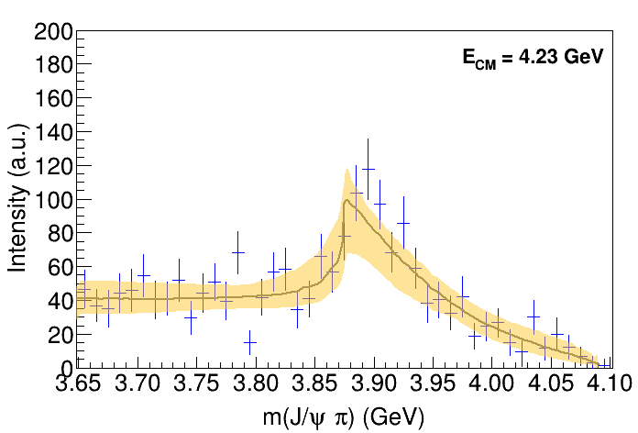
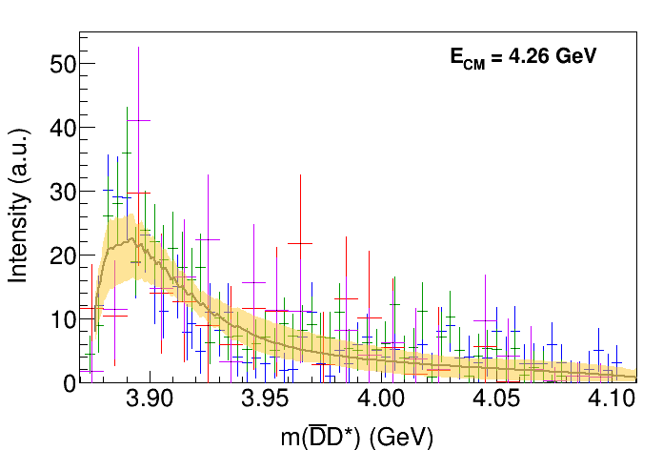

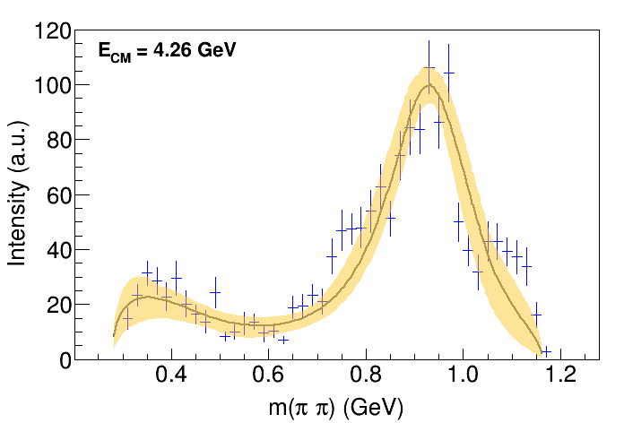
Fit: tr.
( data)
A. Pilloni – Amplitude analysis for/from charmonia
Notes:
Controlla la parte su Regge

Slide 14

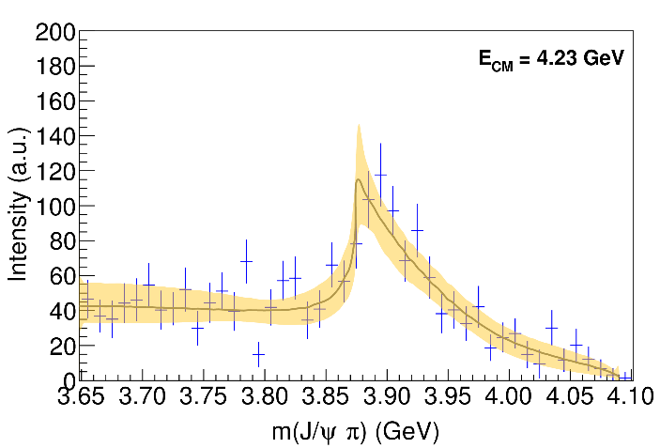
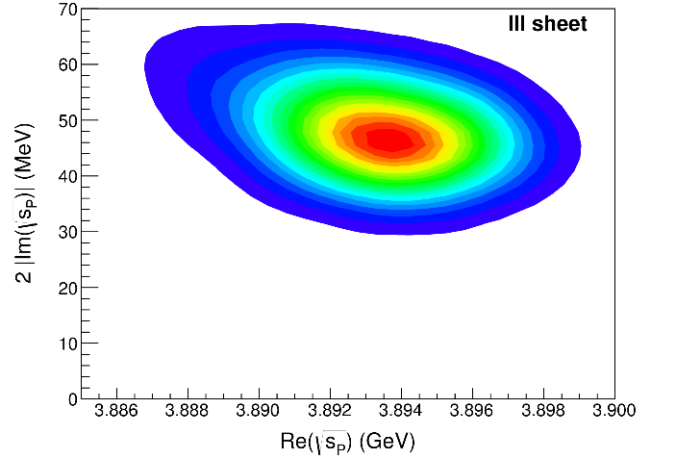
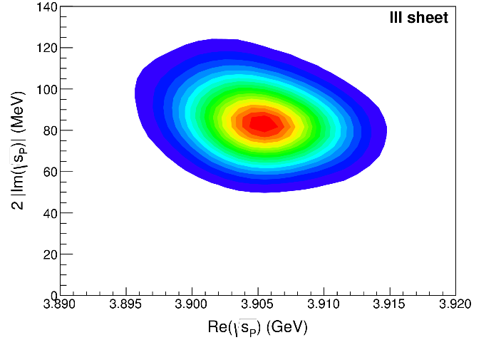
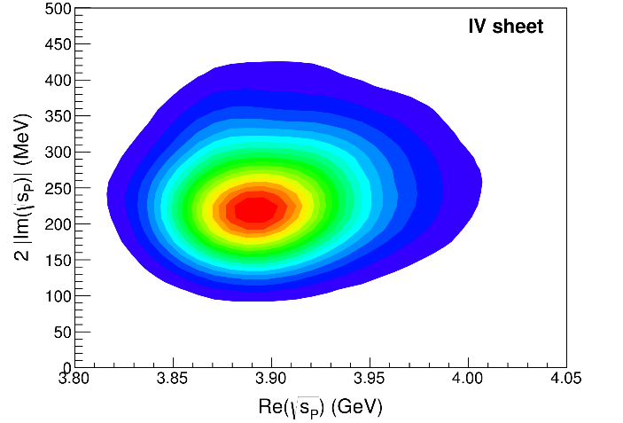
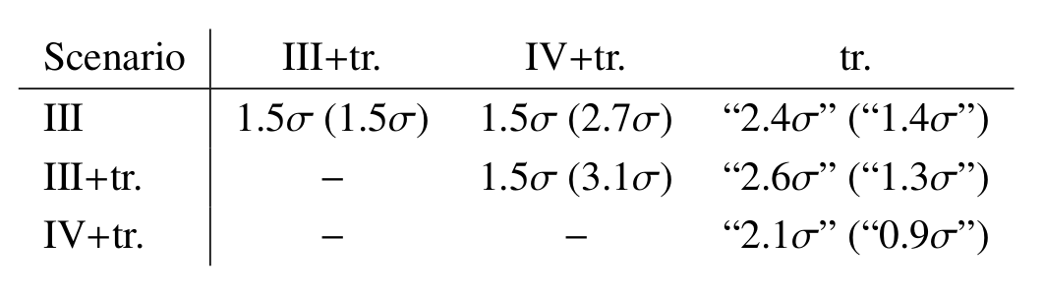
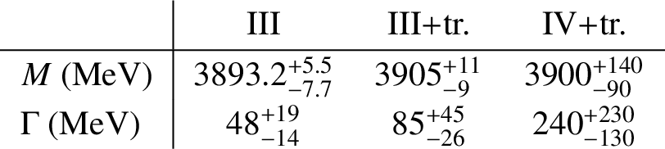
Pole extraction
III
III+tr.
IV+tr.
A. Pilloni – Amplitude analysis for/from charmonia
Not conclusive at this stage
Notes:
Controlla la parte su Regge

Slide 15
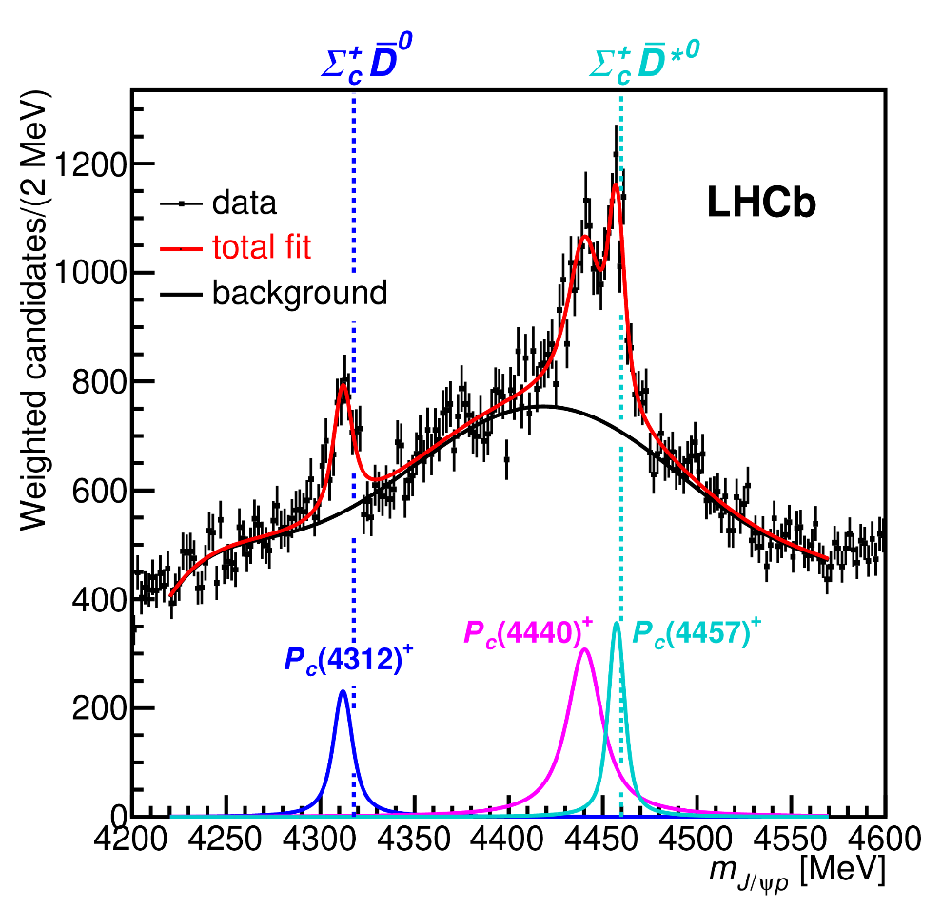

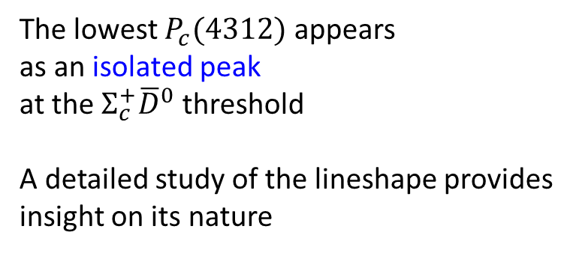
New pentaquarks discovered
The lowest $P_{c}(4312)$ appears
as an isolated peak
at the $Σ_{c}^{+}{\overline{D}}^{0}$ threshold
A detailed study of the lineshape provides insight on its nature
Bottom-up:
DON’T YOU DARE describing everything!!!
Focus on the peak region
See J. Silva-Castro’s talk, tomorrow 12:40pm
A. Pilloni – Amplitude analysis for/from charmonia
Notes:
Controlla la parte su Regge

Slide 16
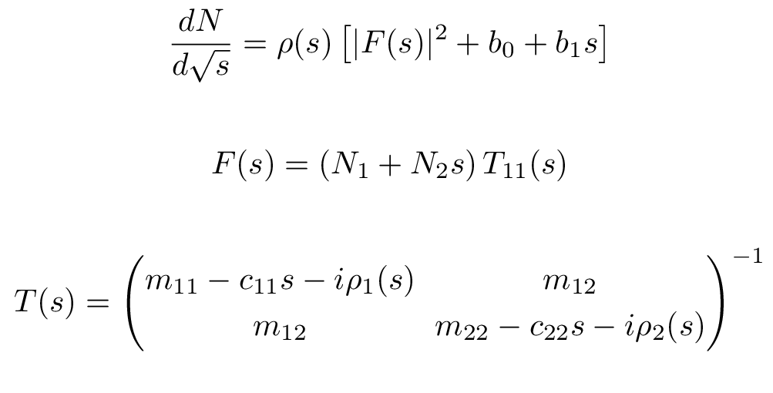
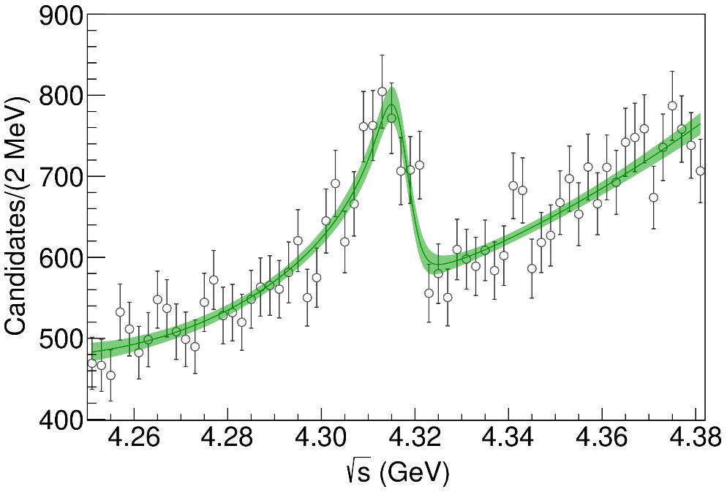
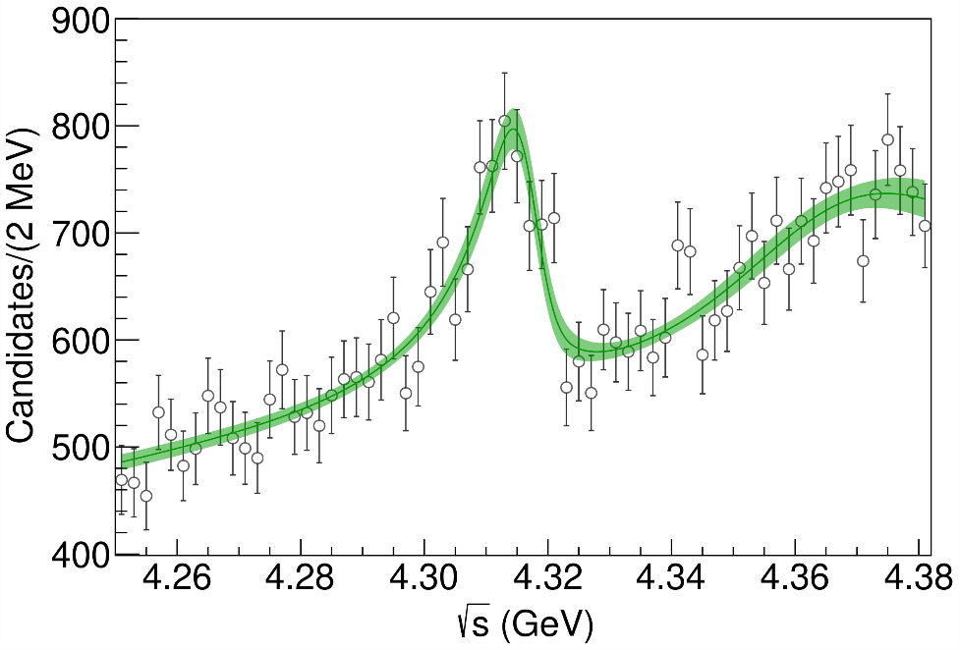


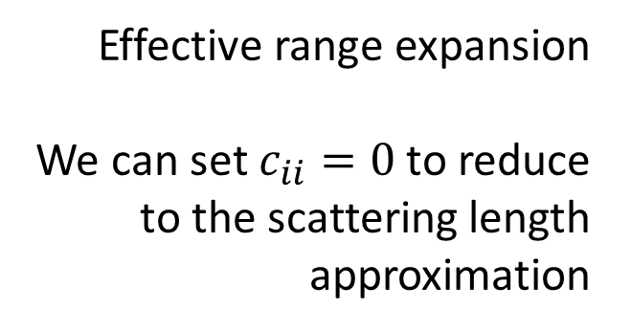
Minimal(istic) model
Fernandez-Ramirez, AP et al. (JPAC), PRL 123, 092001
Effective range expansion
We can set $c_{ii}=0$ to reduce
to the scattering length approximation
$$c_{ii}=0$$
( data)
Finite $c_{ii}$
A. Pilloni – Amplitude analysis for/from charmonia
Notes:
2 slides su Zc, a Bes e a Belle
2 slide su tetraquark model: dall’hamiltoniana di Jaffe al calcolo delle masse
1 slide su molecular models, dove sono i carichi? (non in Tornqvist, si in Hanhart, vedere Braaten, citare Nefediev)
2 slides su decay channels, dove si dovrebbe vedere, e a seconda del modello, vedere qualche plot
1 slide su Y(4260), tetraquark? C’è lo strano (si vede la f0)
1 slide su Zc a cleo (anche il neutro)

Slide 17
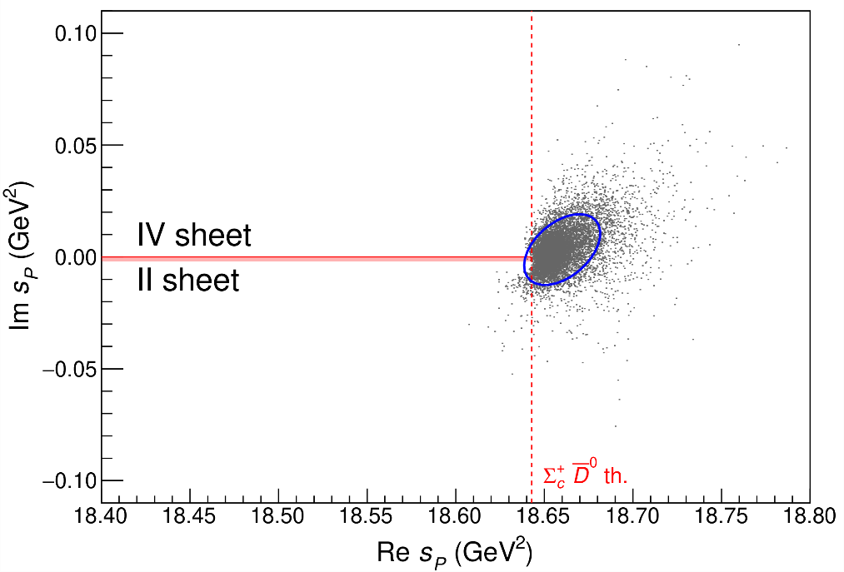
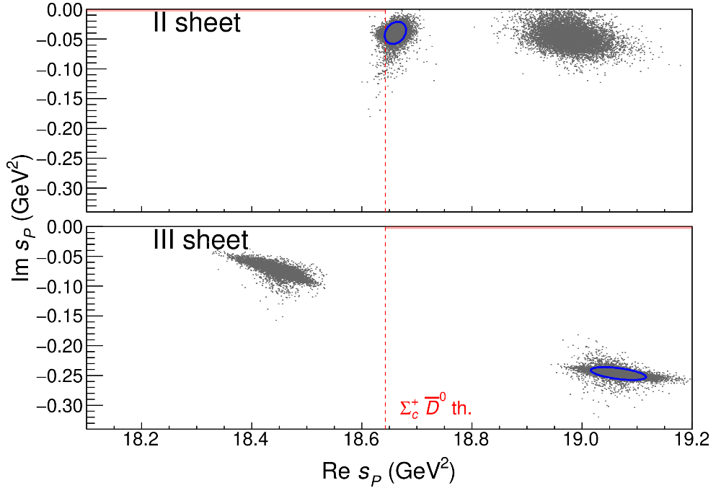


Minimal(istic) model
See J. Silva-Castro’s talk, tomorrow 12:40pm
Effective range expansion
We can set $c_{ii}=0$ to reduce
to the scattering length approximation
Points to a virtual state
Points to a virtual state
$$c_{ii}=0$$
Finite $c_{ii}$
A. Pilloni – Amplitude analysis for/from charmonia
Notes:
2 slides su Zc, a Bes e a Belle
2 slide su tetraquark model: dall’hamiltoniana di Jaffe al calcolo delle masse
1 slide su molecular models, dove sono i carichi? (non in Tornqvist, si in Hanhart, vedere Braaten, citare Nefediev)
2 slides su decay channels, dove si dovrebbe vedere, e a seconda del modello, vedere qualche plot
1 slide su Y(4260), tetraquark? C’è lo strano (si vede la f0)
1 slide su Zc a cleo (anche il neutro)

Slide 18
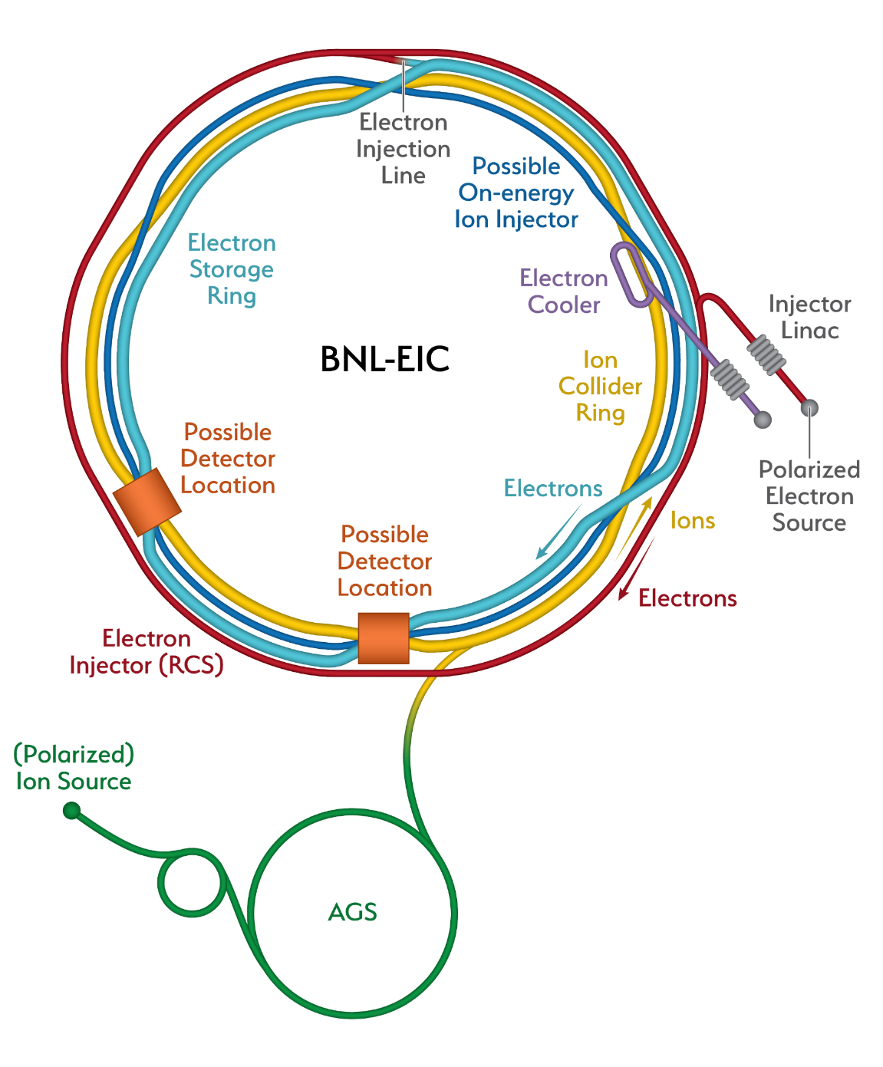
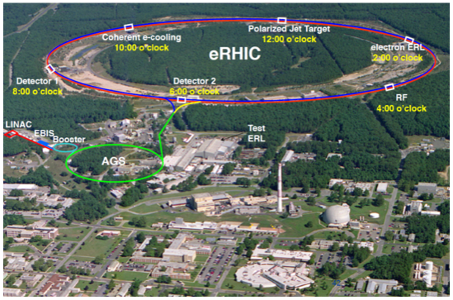
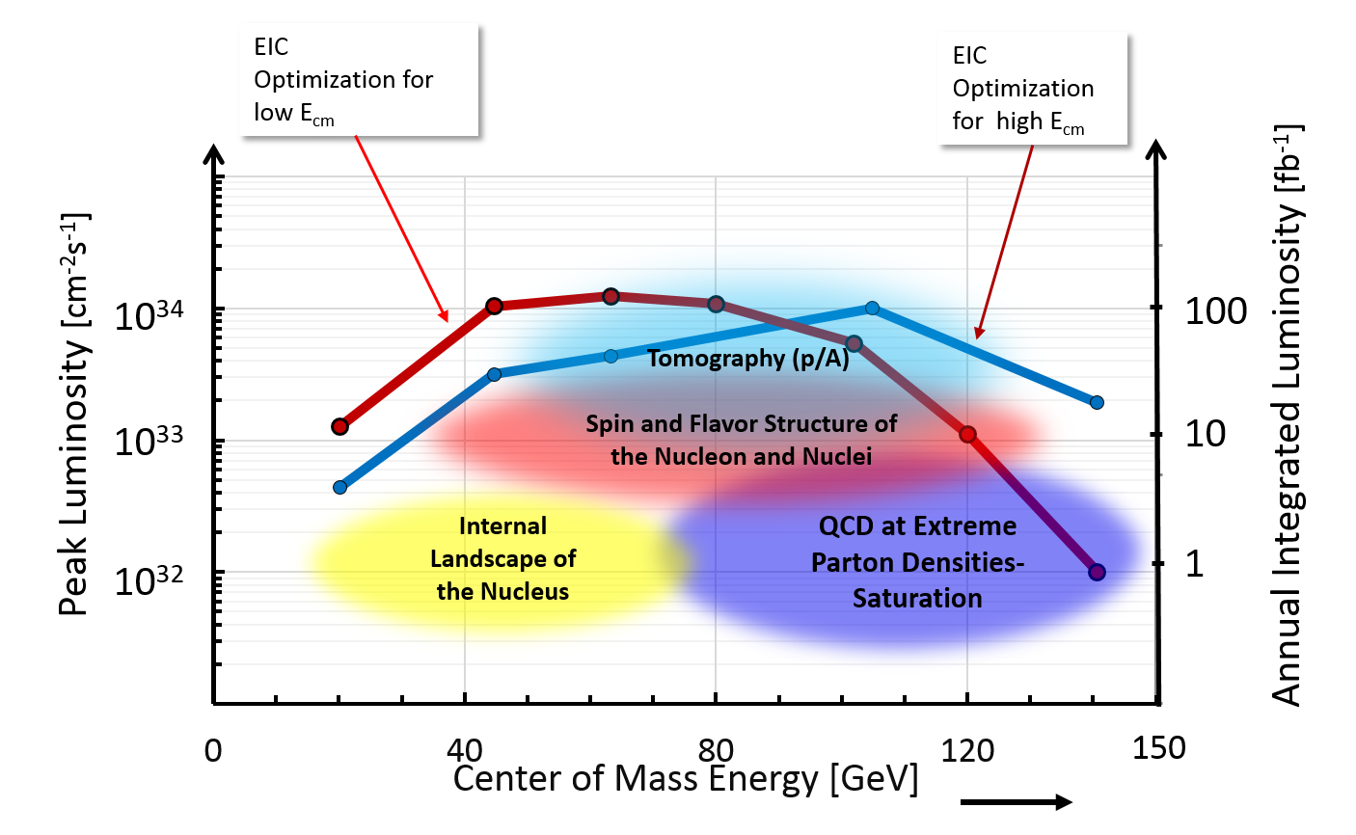
An Electron Ion Collider @BNL
A. Pilloni – Amplitude analysis for/from charmonia

Slide 19
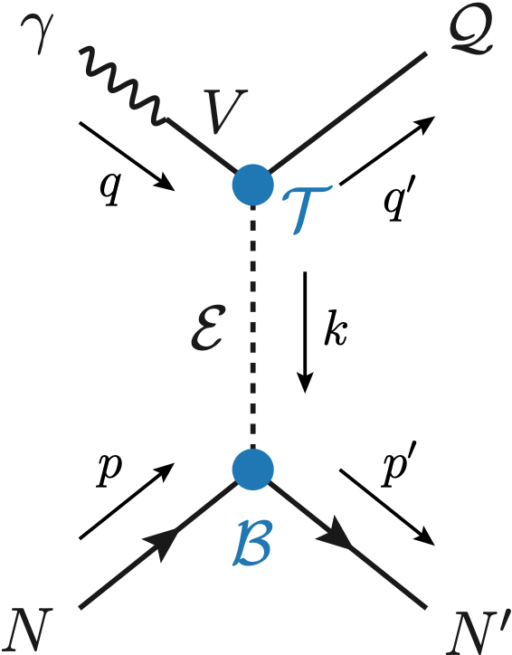


Exclusive (quasi-real) photoproduction
XYZ have so far not been seen in photoproduction: independent confirmation
Not affected by 3-body dynamics: determination of resonant nature
Experiments with high luminosity in the appropriate energy range are promising
We study near-threshold (LE) and high energies (HE)
Couplings extracted from data as much as possible, not relying on the nature of XYZ
M. Albaladejo et al. [JPAC], PRD
$$<λ_{𝒬}λ_{N}^{′}|T|λ_{γ}λ_{N}>=\underset{V,ℰ}{∑}\frac{ef_{V}}{m_{V}}𝒯_{λ_{V}=λ_{γ},λ_{𝒬}}^{α_{1}⋯α_{j}}𝒫_{α_{1}⋯α_{j};β_{1}⋯β_{j}}ℬ_{λ_{N}λ_{N}^{′}}^{β_{1}⋯β_{j}}$$
Bottom vertex from standard photoproduction pheno,
exponential form factors to further suppress large t
VMD is used to couple the incoming photon
to a vector quarkonium V
Top vertex from measured $𝒬→Vℰ$ decay width
A. Pilloni – Amplitude analysis for/from charmonia

Slide 20




$Z$ photoproduction
The $Zs$ are charged charmoniumlike $1^{+−}$ states close to open flavor thresholds
Focus on $Z_{c}{\left(3900\right)}^{+}→J/ψ π^{+}$, $Z_{b}{\left(10610\right)}^{+},Z_{b}^{′}{\left(10650\right)}^{+}→Υ(nS) π^{+}$
The pion is exchanged in the $t$-channel
Sizeable cross sections especially at LE
A. Pilloni – Amplitude analysis for/from charmonia

Slide 21





$X$ photoproduction
Focus on the famous $1^{++} X\left(3872\right)→J/ψ ρ,ω$
Studying also $X\left(6900\right)→J/ψ J/ψ$ (assumed $0^{++}$)
𝛚 and 𝛒 exchanges give main contributions:
need to assume the existence of a OZI-suppressed $X\left(6900\right)→J/ψ ω$
Extremely suppressed cross sections at HE: LE most promising
A. Pilloni – Amplitude analysis for/from charmonia

Slide 22





$Y$ (vector) photoproduction
Diffractive production, dominated by Pomeron (2-gluon) exchange
Existing data allow to put a 95% upper limit
on the ratio of $ψ′/Y(4260)$ yields
Assuming previous formula, one gets:
$Γ_{ee}^{Y}=930 eV$
(cfr. hep-ex/0603024, 2002.05641)
$BR\left(Y→J/ψππ\right)=0.96\%$
$R_{Y}=0.84$
$$R_{Y}=\frac{ef_{ψ}}{m_{ψ}}\sqrt{\frac{g^{2}(Y→ψππ)}{g^{2}(ψ→γgg)}\frac{g^{2}(ψ^{′}→ψgg)}{g^{2}(ψ^{′}→ψππ)}}$$
A. Pilloni – Amplitude analysis for/from charmonia

Slide 23








$J/ψ→γ π^{0}π^{0} and→γ K_{S}^{0}K_{S}^{0}$
$$c$$
This is a gluon-rich process, expected to be one of the
golden channels for the search of the scalar glueball
J/ψ
$$\overline{c}$$
G
A. Pilloni – Amplitude analysis of $J/ψ→γ π^{0}π^{0}$

Slide 24


$J/ψ→γ π^{0}π^{0} and→γ K_{S}^{0}K_{S}^{0}$ : in progress
Rodas, AP, in preparation
A. Pilloni – Amplitude analysis for/from charmonia

Slide 25


Poles: in progress
Large systematic uncertainty
for the heavier poles
Study of residues ongoing
A. Pilloni – Amplitude analysis for/from charmonia

Slide 26


Joint Physics Analysis Center
Bottom-up approaches are important!
Joint effort between theorists and experimentalists in support of experimental data from JLab12 and other accelerator laboratories
Cooperation between JPAC and experiments: co-authoring papers
http://www.indiana.edu/~jpac
Thank you!
A. Pilloni – Amplitude analysis for/from charmonia

Slide 27
Backup

Slide 28






$Y$ (vector) photoproduction
Focus on the $1^{−−} Y\left(4260\right)→J/ψ π^{+}π^{−}$, check with $ψ′→J/ψ π^{+}π^{−}$
Diffractive production, dominated by Pomeron (2-gluon) exchange
Good candidates for EIC: diffractive production increases with energy!
We have $γψ$-pomeron coupling from our analyses 1606.08912, 1907.09393
How to rescale from $J/ψ$ to $ψ′$ ?
How to rescale from $J/ψ$ to $Y(4260)$ ?
We assume VMD and $g^{2}\left(Y→ψππ\right)=g^{2}\left(Y→ψgg\right)×g^{2}(gg→ππ)$ (Novikov & Shifman)
$$R_{ψ^{′}}=\sqrt{\frac{g^{2}(ψ^{′}→γgg)}{g^{2}(ψ→γgg)}}∼0.55$$
$$g^{2}(ψ→γgg)=\frac{6m_{ψ}ℬ(ψ→γgg)Γ_{ψ}}{PS(ψ→γgg)}$$
$$R_{Y}=\frac{ef_{ψ}}{m_{ψ}}\sqrt{\frac{g^{2}(Y→ψππ)}{g^{2}(ψ→γgg)}\frac{g^{2}(ψ^{′}→ψgg)}{g^{2}(ψ^{′}→ψππ)}}$$
Caveat : $BR(Y→ψππ)$ only known times the leptonic width $Γ_{ee}^{Y}$
A. Pilloni – Amplitude analysis for/from charmonia

Slide 29


From threshold to high energy
Fixed-spin exchanges expected to hold from threshold to moderate energies (LE):
Contain full $s$ dependence
$t$ channel grows as $s j$, exceeding unitarity bound:
Reggeized tower of particles with arbitrary spin at HE
$${\left(\frac{4p(t)q(t)}{s_{0}}\right)}^{j−M}𝒩_{μμ^{′}}^{j}\frac{d_{μμ^{′}}^{j}(θ_{t})}{ξ_{μμ}^{(t)}(s,t)}\frac{1}{t−m_{ℰ}^{2}}⟶−α^{′}Γ(j−α(t))[\frac{1+τe^{−iπα(t)}}{2}]{\left(\frac{s}{s_{0}}\right)}^{α(t)−M}$$
Holds at LE, fixed spin
Holds at HE, resummation
of leading $s$ power
A. Pilloni – Amplitude analysis for/from charmonia

Slide 30


Same model as before
Two/three channels, $i,k=ππ, KK,(ρρ)$ Two waves, $J=S,D$
3 K-matrix pole for the S-wave
3 K-matrix poles for the D-wave
A. Pilloni – Amplitude analysis for/from charmonia
Notes:
Controlla la parte su Regge

Slide 31
Conclusions
Bottom-up approaches are important!
They allow us to get the most out of high statistics data!
The study of analytic stuctrures offer insights ino the nature of resonances
Dispersive methods can improve the rigour and robustness in the extraction of the spectrum
Thank you!
A. Pilloni – Amplitude analysis for/from charmonia
Notes:
2 slides su Zc, a Bes e a Belle
2 slide su tetraquark model: dall’hamiltoniana di Jaffe al calcolo delle masse
1 slide su molecular models, dove sono i carichi? (non in Tornqvist, si in Hanhart, vedere Braaten, citare Nefediev)
2 slides su decay channels, dove si dovrebbe vedere, e a seconda del modello, vedere qualche plot
1 slide su Y(4260), tetraquark? C’è lo strano (si vede la f0)
1 slide su Zc a cleo (anche il neutro)

Slide 32
JPAC 2021
Jefferson Lab
Victor Mokeev
Miguel Albaladejo
Astrid Hiller Blin
Pedagogical U. Kraków
Lukasz Bibrzycki
INP Kraków
Robert Kaminski
Chiao-Tung University
Robert Perry
INFN Roma
Alessandro Pilloni
Indiana U.
Emilie Passemar
Adam Szczepaniak (also JLab)
Sergi Gonzàles-Solís
Nathan Sherrill
Daniel Winney
Sebastian Dawid
TUM
Misha Mikhasenko
W&M
Arkaitz Rodas
Barcelona U.
Vincent Mathieu
ODU
Andrew Jackura
UNAM
César Fernández-Ramírez
Jorge Silva-Castro
INFN Genova
Andrea Celentano
JGU-Mainz U.
Igor Danilkin
Faculty/Staff
Postdoc
Student
Members affiliated with CLAS, GlueX, LHCb, BESIII, BaBar, COMPASS
A. Pilloni – Amplitude analysis for/from charmonia

Slide 33








Triangle singularity
$$π$$
$$D_{1}$$
Logarithmic branch points can simulate a resonant behavior, only in very special kinematical conditions
Coleman and Norton, Nuovo Cim. 38, 438
$$Y(4260)$$
$$D^{∗}$$
$$π$$
$$\overline{D}$$
$$J/ψ$$
However, this effects cancels in Dalitz projections, no peaks Schmid, Phys.Rev. 154, 1363
Szczepaniak, PLB747, 410-416
Szczepaniak, PLB757, 61-64
Guo, Meissner, Wang, Yang PRD92, 071502
...but the cancellation can be spread in different channels, you might still see peaks in other channels only!
A. Pilloni – Amplitude analysis for/from charmonia

Slide 34

Fit summary
III
IV+tr.
III+tr.
tr.
Naive loglikelihood ratio test give a $∼4σ$ significance of the scenario III+tr. over IV+tr.,
looking at plots it looks too much – better using some more solid test
A. Pilloni – Amplitude analysis for/from charmonia
Notes:
Controlla la parte su Regge

Slide 35

Testing scenarios
We approximate all the particles to be scalar – this affects the value of couplings, which are not normalized anyway – but not the position of singularities.
This also limits the number of free parameters
The scattering matrix is parametrized as ${\left(t^{−1}\right)}_{ij}=K_{ij}−i ρ_{i} δ_{ij}$
Four different scenarios considered:
«III»: the K matrix is $\frac{g_{i} g_{j}}{M^{2}−s}$, this generates a pole in the closest unphysical sheet
the rescattering integral is set to zero
«III+tr.»: same, but with the correct value of the rescattering integral
«IV+tr.»: the K matrix is constant, this generates a virtual state pole in the IV sheet
«tr.»: same, but the pole is pushed far away by adding a penalty in the $χ^{2}$
A. Pilloni – Amplitude analysis for/from charmonia

Slide 36

Minimal(istic) model
Effective range expansion
We can set $c_{ii}=0$ to reduce
to the scattering length approximation
Points to a virtual state
$$c_{ii}=0$$
Finite $c_{ii}$
A. Pilloni – Amplitude analysis for/from charmonia
Notes:
2 slides su Zc, a Bes e a Belle
2 slide su tetraquark model: dall’hamiltoniana di Jaffe al calcolo delle masse
1 slide su molecular models, dove sono i carichi? (non in Tornqvist, si in Hanhart, vedere Braaten, citare Nefediev)
2 slides su decay channels, dove si dovrebbe vedere, e a seconda del modello, vedere qualche plot
1 slide su Y(4260), tetraquark? C’è lo strano (si vede la f0)
1 slide su Zc a cleo (anche il neutro)

Slide 37

Minimal(istic) model
Effective range expansion
We can set $c_{ii}=0$ to reduce
to the scattering length approximation
Points to a virtual state
Doesn’t point to a resonance
$$c_{ii}=0$$
Finite $c_{ii}$
A. Pilloni – Amplitude analysis for/from charmonia
Notes:
2 slides su Zc, a Bes e a Belle
2 slide su tetraquark model: dall’hamiltoniana di Jaffe al calcolo delle masse
1 slide su molecular models, dove sono i carichi? (non in Tornqvist, si in Hanhart, vedere Braaten, citare Nefediev)
2 slides su decay channels, dove si dovrebbe vedere, e a seconda del modello, vedere qualche plot
1 slide su Y(4260), tetraquark? C’è lo strano (si vede la f0)
1 slide su Zc a cleo (anche il neutro)

Slide 38

Minimal(istic) model
Effective range expansion
We can set $c_{ii}=0$ to reduce
to the scattering length approximation
Points to a virtual state
Doesn’t point to a resonance
$$c_{ii}=0$$
Finite $c_{ii}$
A. Pilloni – Amplitude analysis for/from charmonia
Notes:
2 slides su Zc, a Bes e a Belle
2 slide su tetraquark model: dall’hamiltoniana di Jaffe al calcolo delle masse
1 slide su molecular models, dove sono i carichi? (non in Tornqvist, si in Hanhart, vedere Braaten, citare Nefediev)
2 slides su decay channels, dove si dovrebbe vedere, e a seconda del modello, vedere qualche plot
1 slide su Y(4260), tetraquark? C’è lo strano (si vede la f0)
1 slide su Zc a cleo (anche il neutro)

