Slide 1
Charming bound states in a symmetry preserving contact interaction
Marco Antonio Bedolla Hernández
10th International Workshop on Charm Physics
CHARM 2020

Slide 2
QCD and Hadron Physics
Schwinger-Dyson Equations
Quantum chromodynamics (QCD) it the theory of quarks, gluons and their interactions.
In particular, the way particles interact through strong interactions hides fascinating secrets, to be still found out in the next years.
Due to the theory running coupling constant particular behavior, studies on QCD are done in three regimes:
A light sector, where the interactions are mainly dominated by chiral symmetry breaking and a strong coupling.
A heavy sector, where the coupling tends to approach asymptotic freedom and the systems can be treated in a non relativistic way.
Notes:
Lamentablemente, estos fenómenos no son obvios de lagrangiano de QCD. Sin estos QCD sería igual que QED, pero las interacciones entre tres y cuatro gluones estos fenómenos bastante interesantes

Slide 3
QCD and Hadron Physics
Schwinger-Dyson Equations
A transition region, where the dynamics goes from the regime of chiral dynamics to the heavy sector symmetries.
In order to study this bridge, we study the QCD simplest bound states: mesons.
We use the Schwinger-Dyson equations (SDEs) of quantum chromodynamics. They provide a natural means to study the different QCD regions.
Earlier studies of QCD through SDEs with refined truncations are a brute force numerical evaluation, which stops short of exploring the large momentum transfer region.
We present a simple momentum independent contact interaction (CI) model, which provides a simple scheme to exploratory studies on QCD.
Notes:
Lamentablemente, estos fenómenos no son obvios de lagrangiano de QCD. Sin estos QCD sería igual que QED, pero las interacciones entre tres y cuatro gluones estos fenómenos bastante interesantes

Slide 4
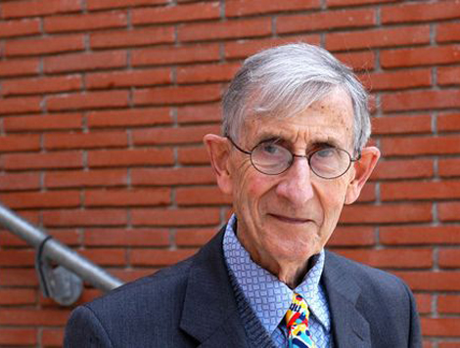
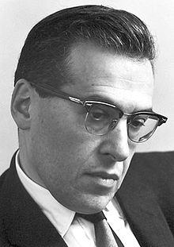
QCD and Hadron Physics
Schwinger-Dyson Equations
F. J. Dyson Phys. Rev. 75, 1736(1949)
J. Schwinger, PNAS 37 452–459 (1951)
Quark SDE:
Mathematical expression:
Notes:
El propagador vestido del quark se escribe como el propagador desnudo más los términos de autointeracción. Aquí tenemos las correcciones al propagador del quark, las correcciones al vértice y las correccones al propagador del gluón

Slide 5
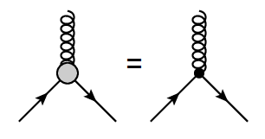
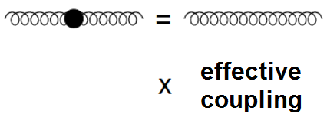
QCD and Hadron Physics
Schwinger-Dyson Equations
In order to solve the SDE, we employ a truncation scheme:
Rainbow truncation:
Notes:
La ecuación de Schwinger-Dyson no se puede resolver hasta que se define un problema manejable. Para ello se hace un modelo para el gluón, donde por lo general se considera el gluón libre multiplicado por un acoplamiento efectivo que reuna las propiedades de QCD. Al mismo tiempo para el vértice, donde usualmente se toma el vértice desnudo. Nosotros las truncamos a primer orden. Y los efectos de QCD se incluyen en el acoplamiento efectivo.

Slide 6
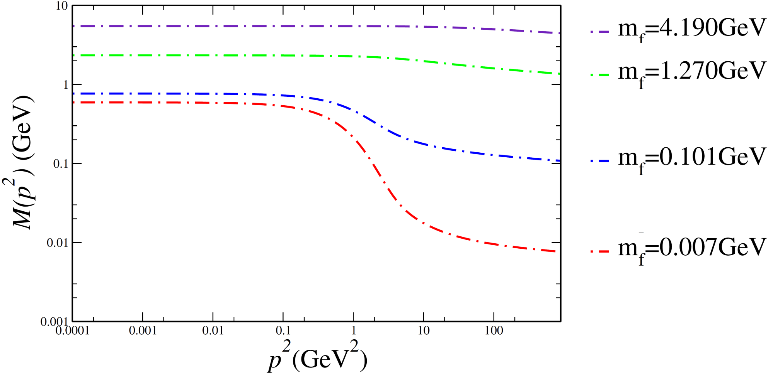
QCD and Hadron Physics
Schwinger-Dyson Equations
Mass function for different quark masses.
P. Maris and P. C. Tandy Phys. Rev. C60, 055214 (1999)
Notes:
Mientras más pequeña es la masa, los efectos de las autointeracciones influyen más en la adquisición de masa dinámica del quark, los quarks pesados no sienten tanta influencia. Dicho de otra manera, los quarks pesados no se ven afectados por la masa del gluón

Slide 7
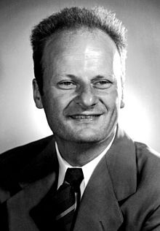
Bethe-Salpeter Equation
A meson appears as a pole in the quark-antiquark (quark-quark) Green function → Bethe-Salpeter Equation. In order to compute diquark mass, there is a factor a ½ due to the color factors.
E. E. Salpeter Phys. Rev. 84, 1226 (1951)
E. E. Salpeter and H. A. Bethe Phys. Rev. 84, 1232 (1951)
Notes:
Quarks and gluons are not free– This makes QCD unique: the elementary constituents are not the asymptotic states of the theory.

Slide 8
Contact Interaction
We use a contact interaction model mediated by a vector-vector interaction employed in:
L. Xiomara Gutiérrez, et. al., Phys. Rev. C81, 065202 (2010);
H.L.L Roberts, et. al. Phys. Rev. C82, 065202 (2010);
Phys. Rev. C83, 065206 (2011).
This model provides a simple scheme to exploratory studies of the spontaneous chiral symmetry breaking and its consequences like:
Dynamical mass generation.
Quark condensate.
Goldstone bosons in chiral limit.
Confinement.
Notes:
It a model which is independent of relative momentum
En el segundo se calcula para el meson rho

Slide 9
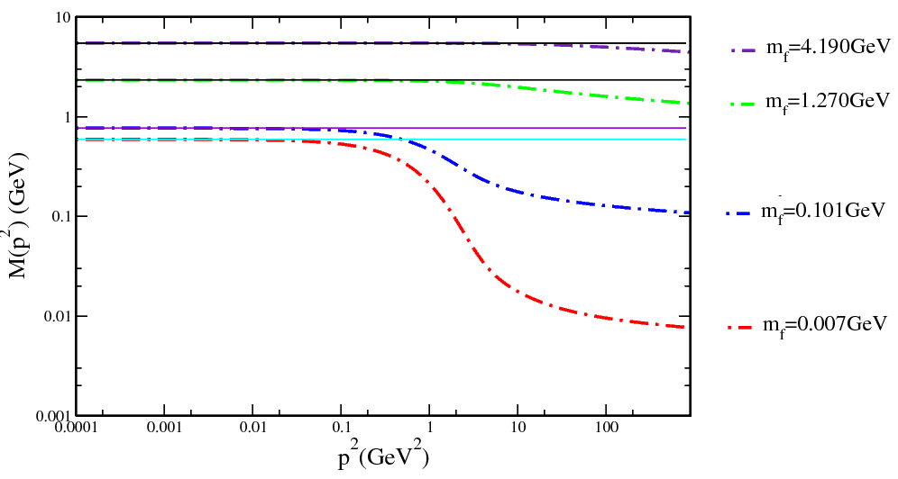
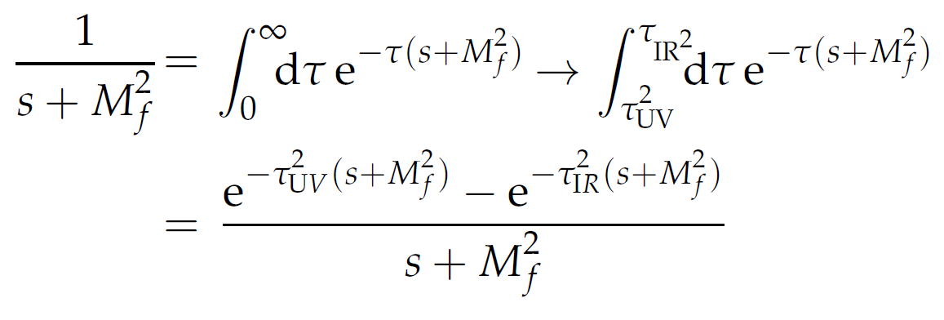
Contact Interaction
Mass function:
Proper time
regularization:
The constant τ_{UV} is the regulator since the model is not renormalizable and cannot been removed. This regulator plays a dynamical role and sets the scale of dimensioned quantities.
A non zero value of τ_{IR} implements confinement by ensuring the absence of quark production threshold at s=-M²_{f} .
Notes:
Tau ir diferente de cero implementa confinamiento al eliminar el polo, tau uv es el regulador, no puede ser eliminado pero juega un rol dinámico y ajusta la escala para nuestras dimensiones

Slide 10
Light mesons: masses and decay constants
C. Chen, et. al. Few Body Syst. 53, 293 (2012).
Few Body Syst. 51, 1 (2011).
M_{u}=367 | Λ_{UV}=905 | Λ_{IR}=240 | m_{u,d}=7 | α_{IR}=0.93π
Masses in MeV | m_{π}(1S) | m_{ρ}(1S) | m_{σ}(1P) | m_{a1}(1P)
PDG(2016) | 140 | 780 | 1000-1200 | 1230
Contact Interaction | 140 | 930 | 1290 | 1380
Decay Constants (GeV) (g_{so}=0.24)
PDG(2016) | 130 | 152
Contact Interaction | 101 | 129
Bethe-Salpeter Amplitudes
E_{H} | 3.593 | 1.530 | 0.472 | 0.309
F_{H} | 0.474
Charge-Radii (fm)
PDG(2016) | 0.672
Contact Interaction | 0.450
Notes:
El resto se ajustó para tener en el límite chiral Mpi=0.4GeV, Mrho=0.78 fpi=0.088, frho=0.15, kpi=0.22 con error del 13%

Slide 11
Charm mesons: masses and decay constants
M.A. Bedolla, et. al Phys. Rev. D 92, 054031 (2015).
M.A Bedolla, et. al. Phys. Rev. D 93, 094025 (2016).
M_{u}=1600 | Λ_{UV}=905 | Λ_{IR}=240 | m_{u,d}=1578 | α_{IR}=0.93π
Masses in MeV | m_{ηc}(1S) | m_{J/Ψ} (1S) | m_{χc0}(1P) | m_{χc1}(1P)
PDG(2016) | 2983 | 3096 | 3414 | 3510
Contact Interaction | 298 | 2994 | 3419 | 3442
Decay Constants (MeV) (g_{so}=0.24)
PDG(2016) | 361 | 416
Contact Interaction | 8.38 | 7.96
Bethe-Salpeter Amplitudes
E_{H} | 6.026 | 3.023 | 0.437 | 0.297
F_{H} | 1.711
Charge-Radii (fm)
SDE(2017) | 0.219
Contact Interaction | 0.186
Notes:
El resto se ajustó para tener en el límite chiral Mpi=0.4GeV, Mrho=0.78 fpi=0.088, frho=0.15, kpi=0.22 con error del 13%

Slide 12
Contact Interaction
M.A. Bedolla, et. al Phys. Rev. D 92, 054031 (2015).
M.A Bedolla, et. al. Phys. Rev. D 93, 094025 (2016).
The leptonic decay constant is highly influenced by the high momentum tail of the quark mass function.
This high momentum region probes the wave function at the origin.
The CI yields constant dressing functions with no perturbative tail.
By increasing the mass of heavy quarks, quarkonuim becomes increasingly point like—and the closer the quarks, the smaller the interaction between them.
We need to reduce the effective interaction strength for the ci to extend to the heavy quarks sector.
A reduction in the strength of the kernel has to be compensated by an increased ultraviolet cutoff.

Slide 13
Charm mesons: masses and decay constants
M.A. Bedolla, et. al Phys. Rev. D 92, 054031 (2015).
M.A Bedolla, et. al. Phys. Rev. D 93, 094025 (2016).
M_{c}=1482 | Λ_{UV}=2400 | Λ_{IR}=240 | m_{c}=1090 | α_{IR}=0.172
Masses in MeV | m_{ηc}(1S) | m_{J/Ψ} (1S) | m_{χc0}(1P) | m_{χc1}(1P)
PDG(2016) | 2983 | 3096 | 3414 | 3510
Contact Interaction | 2976 | 3090 | 3374 | 3400
Decay Constants (MeV) (g_{so}=0.24)
PDG(2016) | 238 | 294
Contact Interaction | 255 | 206
Bethe-Salpeter Amplitudes
E_{H} | 2.156 | 0.612 | 0.051 | 0.028
F_{H} | 0.406
Charge-Radii (fm)
SDE(2017) | 0.219
Contact Interaction | 0.250
Notes:
El resto se ajustó para tener en el límite chiral Mpi=0.4GeV, Mrho=0.78 fpi=0.088, frho=0.15, kpi=0.22 con error del 13%

Slide 14
There is Charm on the Beauty: masses and decay constants
K. Raya, et. al Few Body Syst. 59 (2018) no.6, 133
M_{b}=4710 | Λ_{UV}=6400 | Λ_{IR}=240 | m_{b}=3800 | α_{IR}=0.023
Masses in MeV | m_{ηb}(1S) | m_{Υ}(1S) | m_{χb0}(1P) | m_{χb1}(1P)
PDG(2016) | 9400 | 9460 | 9860 | 9892
Contact Interaction | 9407 | 9547 | 9671 | 9680
Decay Constants (MeV) (g_{so}=0.24)
PDG(2016) | ---- | 506
Contact Interaction | 553 | 219
Bethe-Salpeter Amplitudes
E_{H} | 0.851 | 0.184 | 0.001 | 0.0008
F_{H} | 0.173
Charge-Radii (fm)
SDE(2017) | 0.086
Contact Interaction | 0.109
Notes:
El resto se ajustó para tener en el límite chiral Mpi=0.4GeV, Mrho=0.78 fpi=0.088, frho=0.15, kpi=0.22 con error del 13%

Slide 15
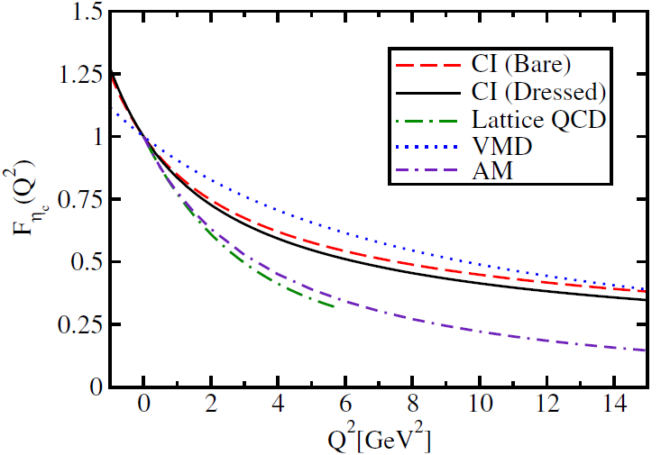
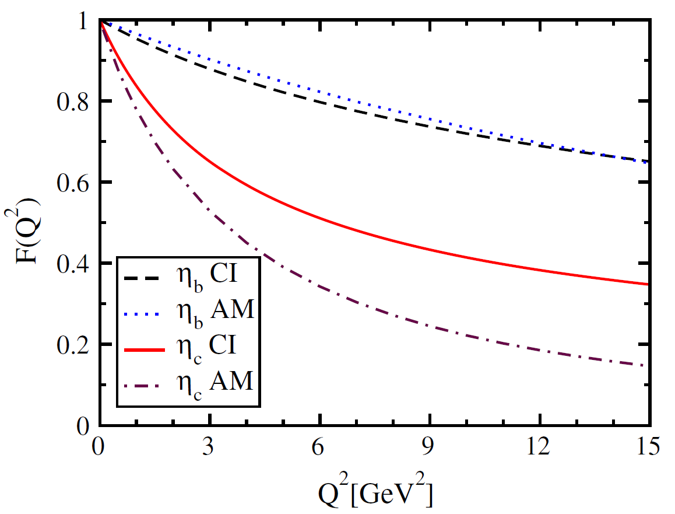
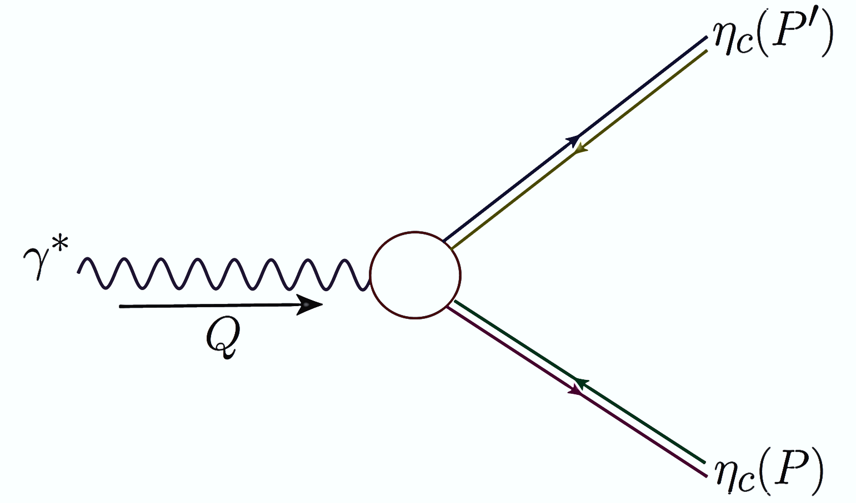
Elastic Form Factor
M.A Bedolla, et. al Phys. Rev. D 93, 094025 (2016).
K. Raya, et. al Few Body Syst. 59 (2018) no.6, 133
Charge Radii
Dyson-Schwinger Equations | 0.219fm
Lattice | 0.25fm
Contact Interaction | 0.21fm
VMD | 0.156fm
Algebraic Model | 0.256fm
Charge Radii
η_{b} | 0.107fm
η_{c} | 0.210fm

Slide 16
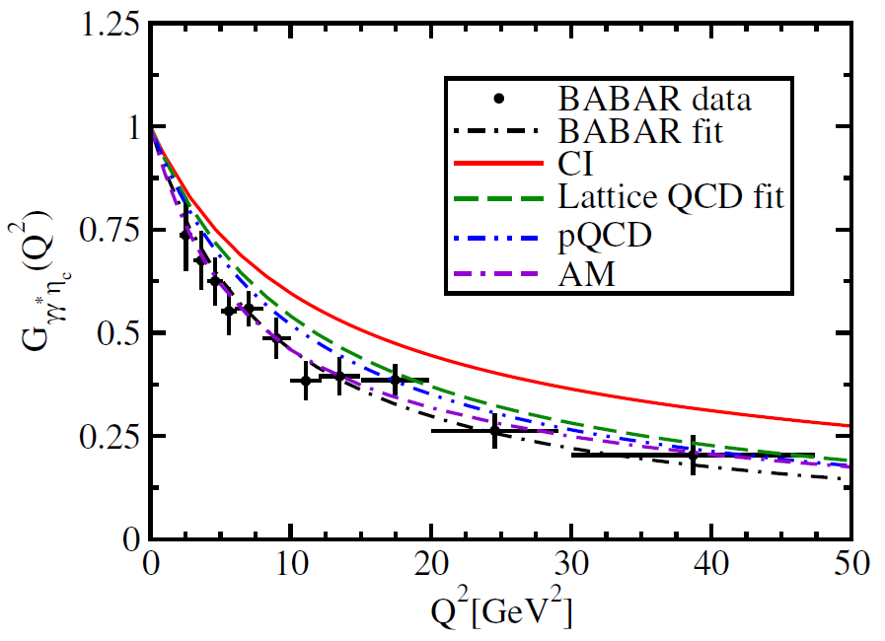
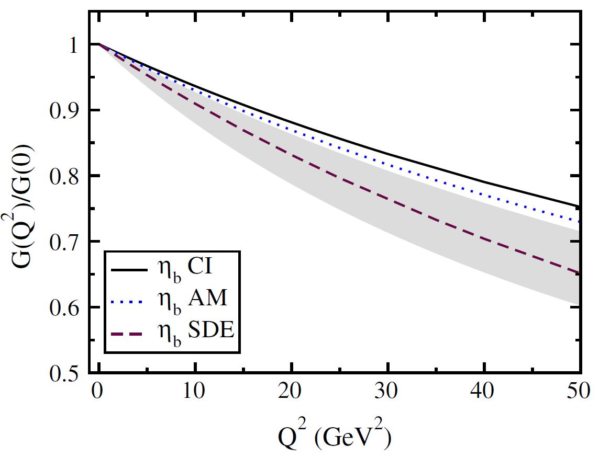
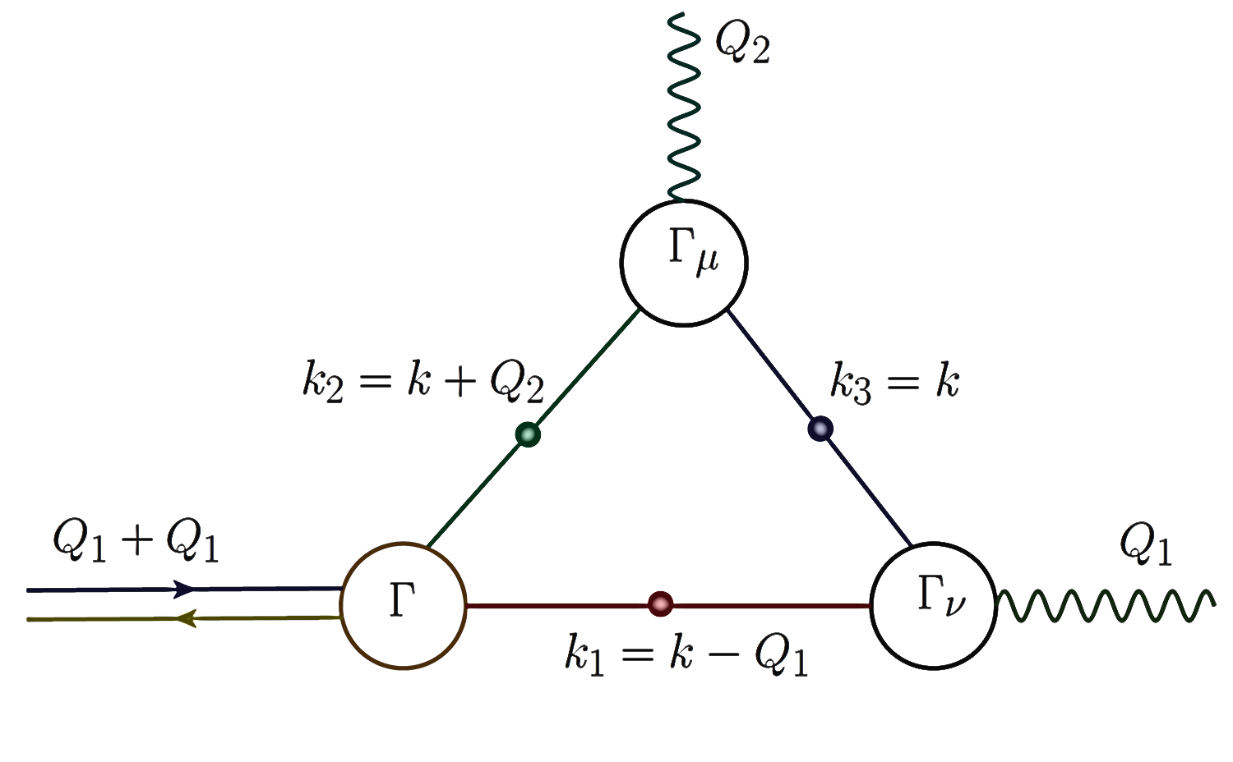
Transition Form Factor
M.A Bedolla, et. al. Phys. Rev. D 93, 094025 (2016).
K. Raya, et. al Few Body Syst. 59 (2018) no.6, 133
K. Raya, M. Ding et. al. Phys. Rev. D 95, 074014.
Interaction Radii
BABAR | 0.166fm
Lattice | 0.141fm
CI model | 0.133fm
Algebraic Model | 0.170fm
Interaction Radii
Dyson-Schwinger Equations | 0.041fm
Contact Interaction | 0.043fm

Slide 17
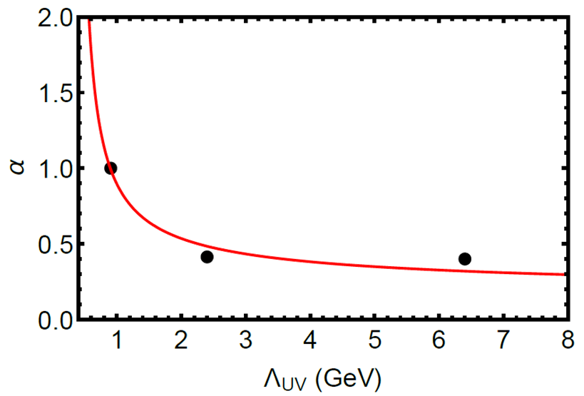
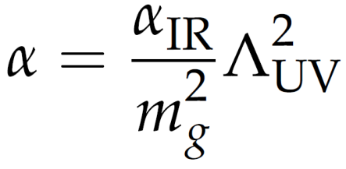
Contact Interaction
K. Raya, et. al Few Body Syst. 59 (2018) no.6, 133
Let’s define a dimensionless coupling constant.
Notes:
Para hacerlo momentum dependance, dividimos por mg^2 para así poder tener una dependencia con Lambda ^2

Slide 18
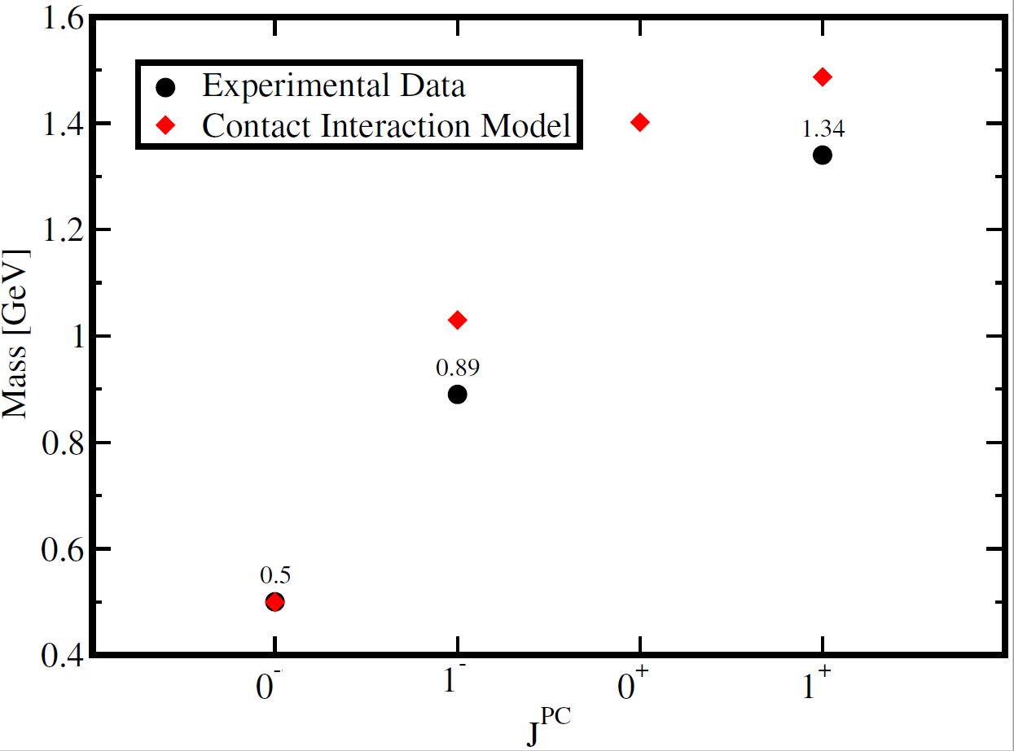
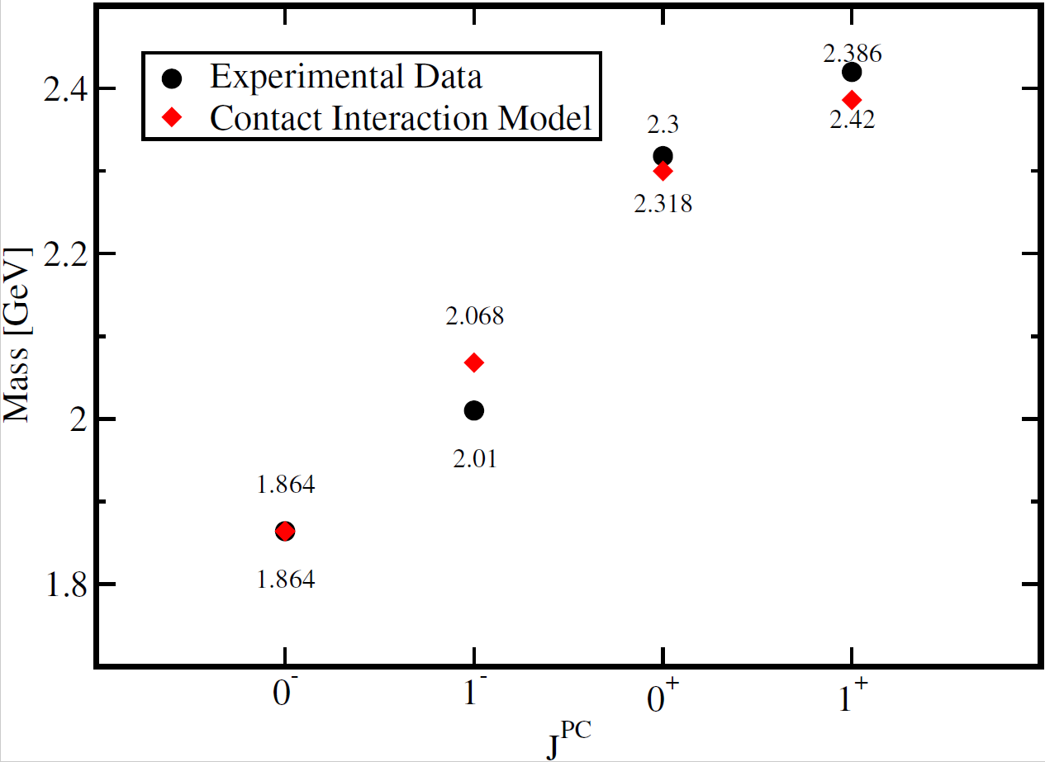
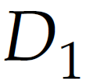
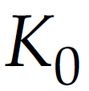
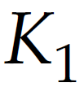
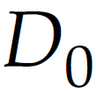
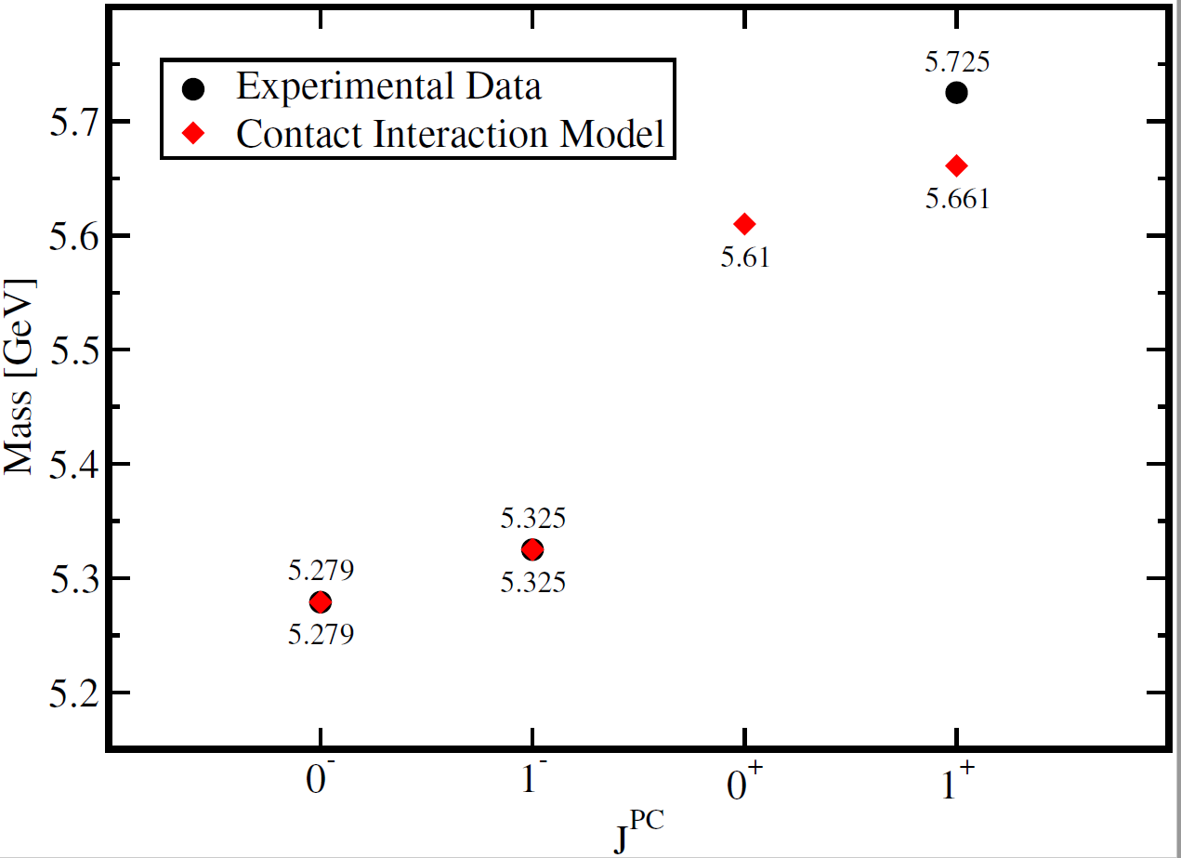
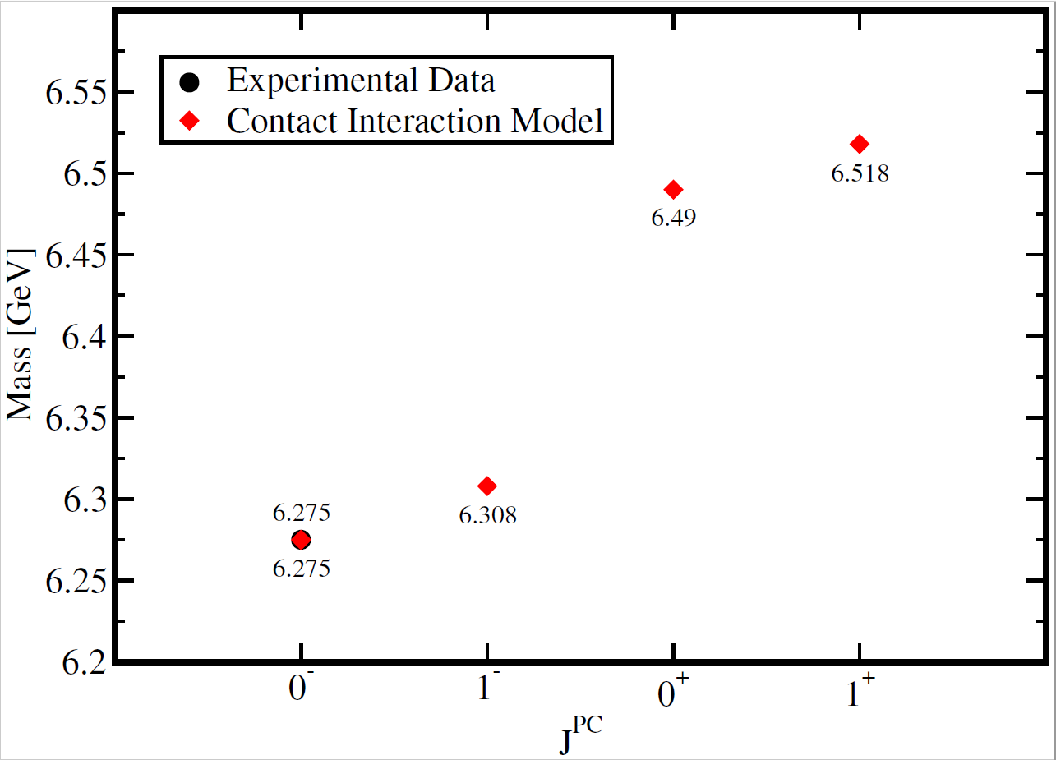
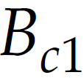
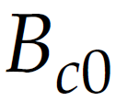
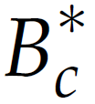
Charming Spectra
$$u\overline{s}$$
$$c\overline{u}$$
$$b\overline{u}$$
$$b\overline{c}$$
M. A. Bedolla, and E. Santopinto EPJ Web Conf. 192 (2018) 00039
M. A. Bedolla, and E. Santopinto Springer Proc.Phys. 238 (2020) 737-743

Slide 19
How to study baryons in the
Schwinger-Dyson Equations approach
The single heavy baryons are not all discovered.
In 2002, the observation of the double charm $Ξ_{cc}^{++}$baryon with a mass of 3460. However, recent observations by LHCb put it in the range of 3621. This produced a new interest in restudy baryons with heavy-quarks.
The Schwinger-Dyson equations and the contact interaction have a baryon description in a quark-diquark interaction kernel with a quark exchange interaction.
These studies have been performed in both light-sector and heavy-sector. Studies on tetraquarks using this scheme produces mainly meson-molecules
Chen Chen, et. al Few Body Syst. 53 (2012) 293-326
Pei-Li Yin, et. al Phys. Rev. D100 (2019) no.3, 034008
P.C. Wallbott, et. al J. Phys. Conf. Ser. 1024 (2018) no.1, 01205

Slide 20
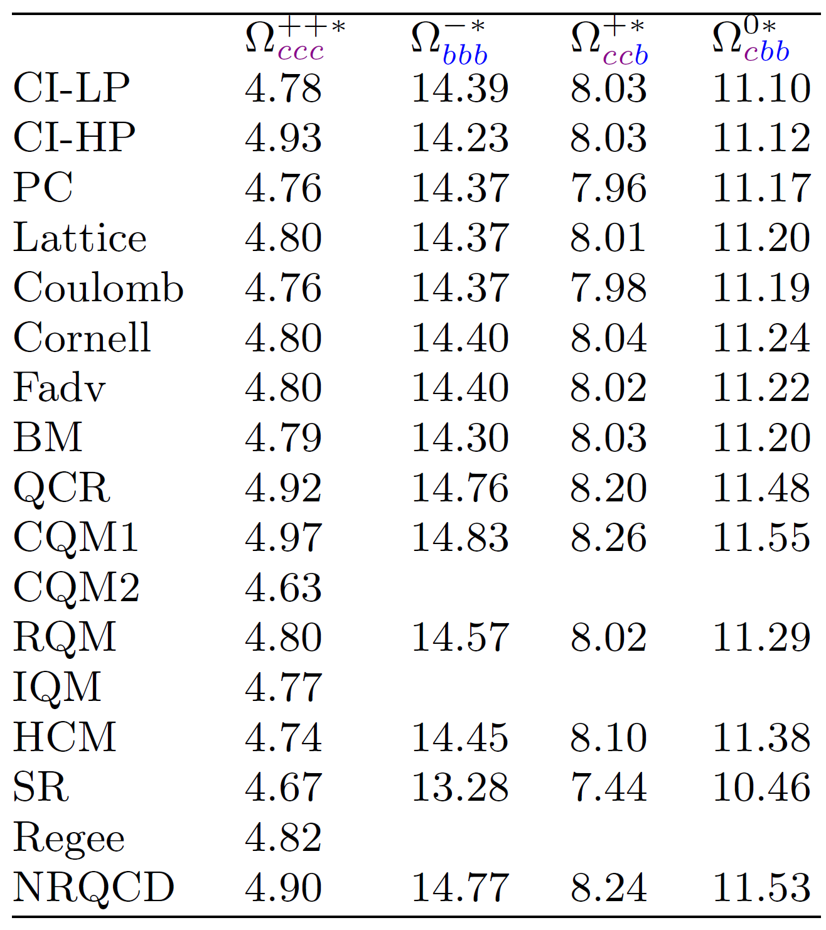
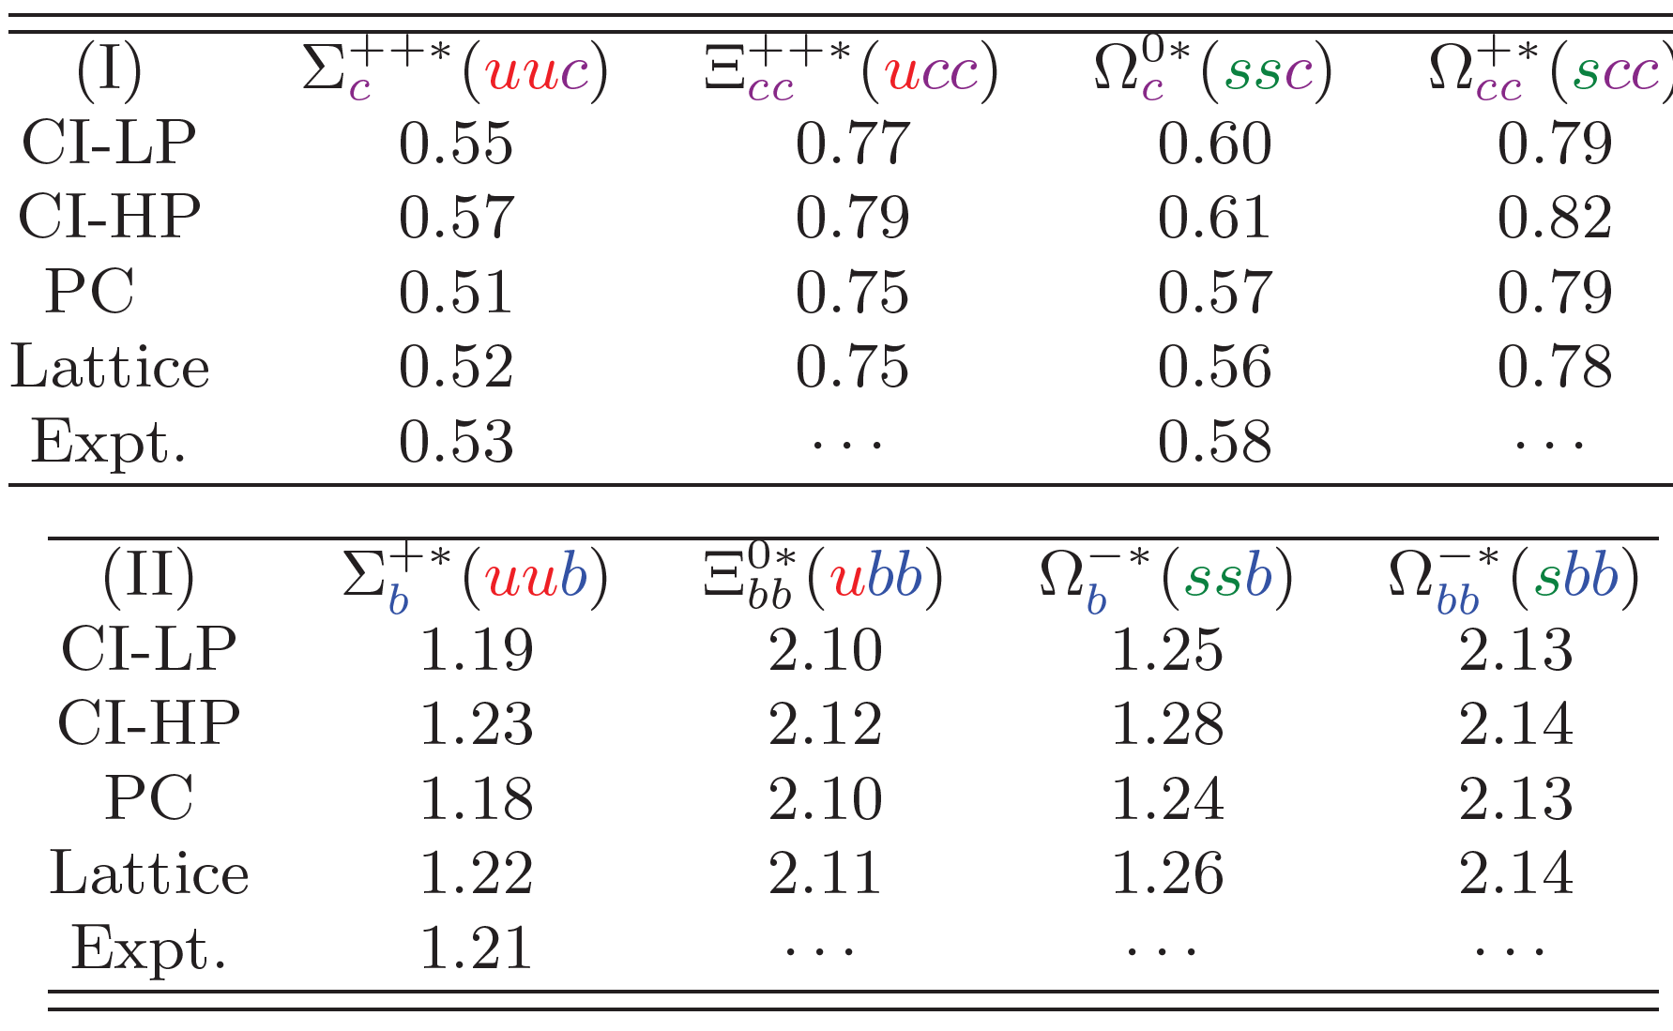
Baryons with heavy-quarks
L.X Gutiérrez-Guerrero, A. Bashir. M.A. Bedolla, E. Santopinto
Phys.Rev.D 100 (2019) 11, 114032

Slide 21
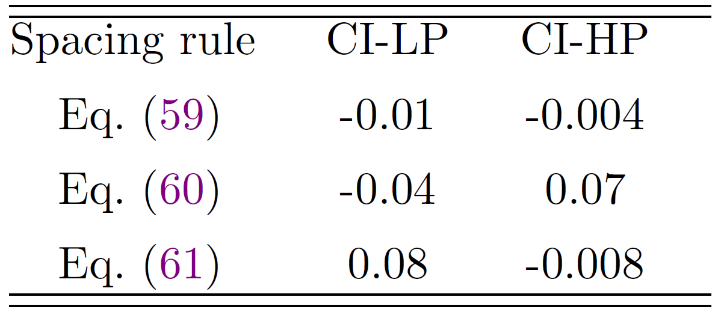
Baryons with heavy-quarks
L.X Gutiérrez-Guerrero, A. Bashir. M.A. Bedolla, E. Santopinto
Phys.Rev.D 100 (2019) 11, 114032
The masses of baryons with spin-3/2 with a single heavy quark obey an equal-spacing rule.
For light parameters, we obtain a mass of $m_{Ξ_{usc(b)}}=2.76\left(5.86\right)GeV$, for CI’s $m_{Ξ_{usc(b)}}=2.83\left(6.024\right)GeV.$The experimental values are 2.467 (5.948)GeV
The spacing rules combining baryons with different spins.

Slide 22
Tetraquarks in the Diquark Model
M.A. Bedolla, Few Body Syst. 60 (2019) no.2, 24.
In the diquark model, a tetraquark is seen as a pointlike diquark embedded with a pointlike antidiquark:
Diquarks are colored, so they should be confined.
Two quarks can couple in an antisymmetric color anti triplet or a symmetric color sextet:
The color sextet leads to repulsive interactions, so diquarks in the anti triplet are the only ones that can couple to form bound-states.
The ground-state diquark is in S-wave, so its spin is 0 or 1 .
To study scalar tetraquarks, Fermi-Dirac statistics only allows spin 1 diquarks for tetraquarks with the same flavor.
We compute the scalar bbbb tetraquark mass an get m=18.800
Notes:
It a model which is independent of relative momentum
En el segundo se calcula para el meson rho

Slide 23
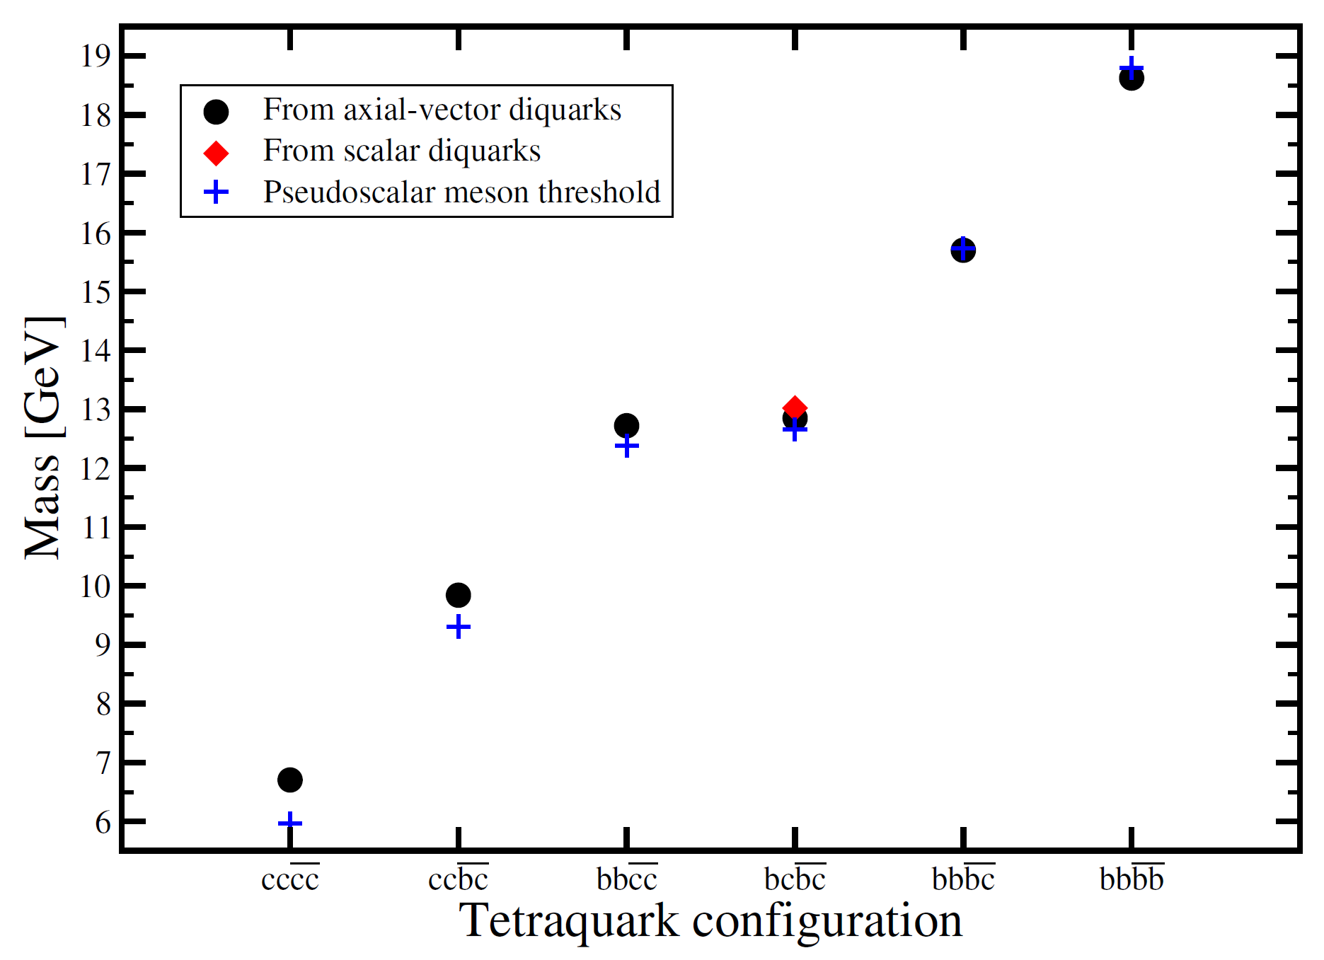
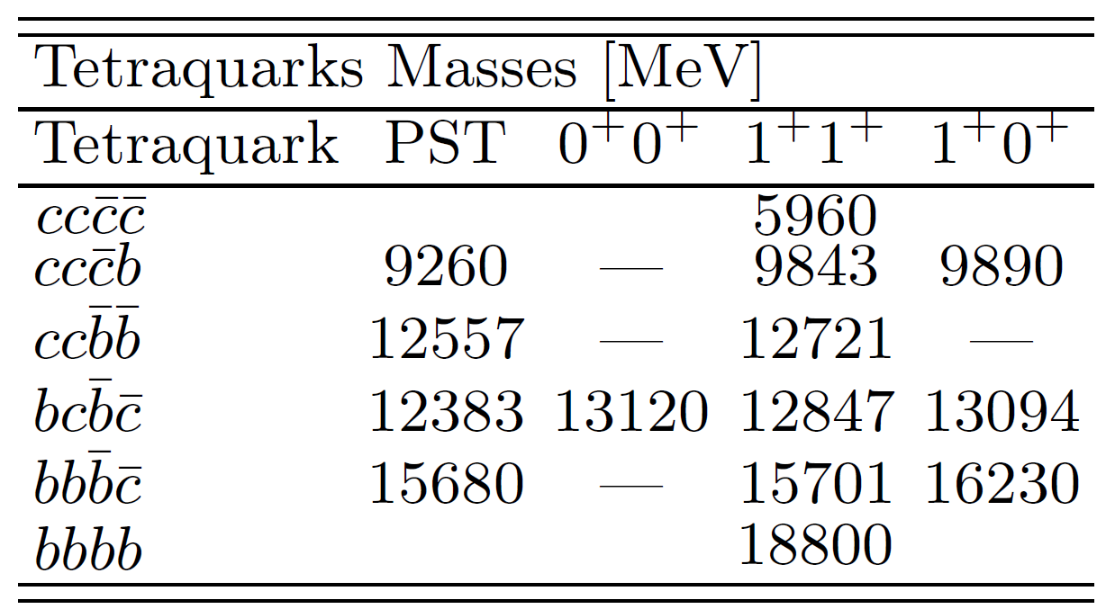
Tetraquarks in the Diquark Model
M.A. Bedolla, E. Santopinto and J. Ferretti In preparation
M.A. Bedolla, Few-Body Syst (2019) 60: 24.
Notes:
It a model which is independent of relative momentum
En el segundo se calcula para el meson rho

Slide 24
Final Remarks
We used the contact interaction in order to describe the spectra of light , charm, bottom and heavy-light mesons/diquarks and baryons successfully.
Generally, the coupling is a function of the larger mass scale (which is related to the quarks masses involved). Therefore, we can utilize the contact interaction to study mesons composed of light and heavy quarks.
When it is possible to make a comparison, our results are in a good of agreement with experimental data and with other models employing more sophisticated interaction kernels.
We computed the mass of some scalar tetraquarks in a contact interaction under diquark-antidiquark picture.
Future projects involve to study the electromagnetic form factor of pseudoscalar and vector mesons, and the behavior of heavy-quarkonia at finite temperature.

