Slide 1



Heavy Quarkonia in Medium (Theory)
Ralf Rapp
Cyclotron Institute +
Dept of Phys & Astro
Texas A&M University
College Station, TX, USA
rapp@comp.tamu.edu
Charm 2020 Conference
Online
May 31 - June 04, 2021

Slide 2
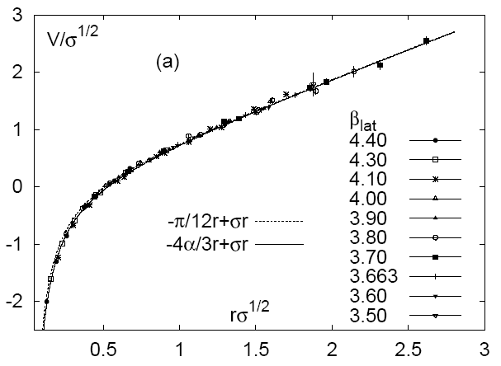
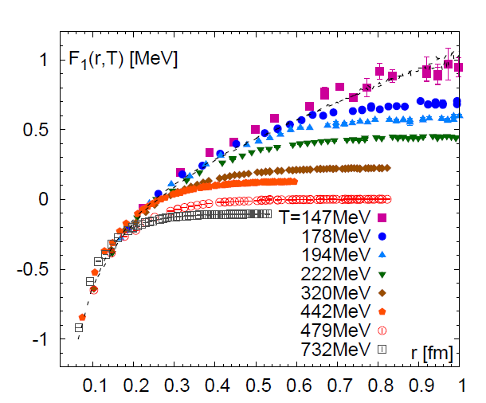
1.) Heavy Quarks: A “Calibrated” QCD Force
V [½ GeV]
[GeV]
r [½ fm]
[Bazavov et al ‘13]
Vacuum quarkonium spectroscopy well described
Confinement ↔ linear part of potential
Goal: find medium-modifications of QCD force
⇔ transport properties + spectral functions of
heavy flavor, probing QGP at varying resolution
Exploit m_{Q} >> Λ_{QCD} , T_{c} , T_{RHIC,LHC}

Slide 3

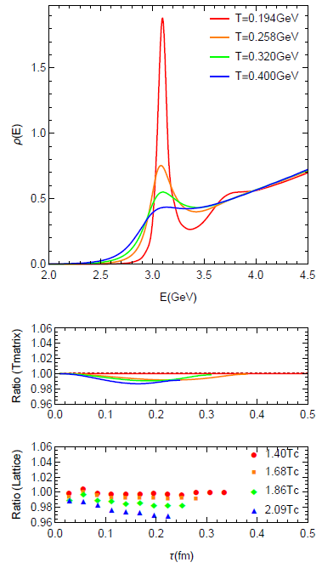
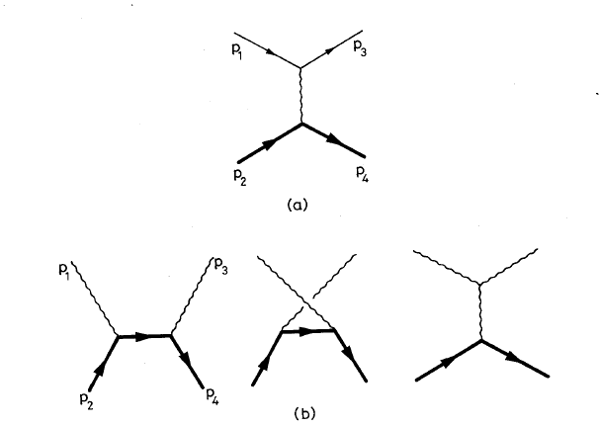
1.2 Quarkonia in Medium
In-medium spectral functions:
- Mass / binding energy E_{B}(p,T)
- Inelastic reaction rate G(p,T;E_{B})
ϒ(1S): color-Coulomb force
J/y, ϒ(2S), …: confining force
Screening lowers binding energies E_{B}(T)
⇒ opens phase space for dissociation
Dissociation rate G(p;T) is key transport
parameter for phenomenology
Connection to open heavy-flavor transport
Spectral Function
1⁻
J/y
vacuum
QGP
Q
−
Q

Slide 4
Outline
1.) Introduction
2.) Quarkonia at Finite Temperature
● In-Medium HQ Potential
● Spectral Properties
3.) Quarkonia in Heavy-Ion Collisions
● Transport Approaches + Coefficients
● Charmonium + Bottomonium
● X(3872) + B_{c}
4.) Conclusions

Slide 5
2.1 Many-Body Theory of Heavy Flavor in Matter
Microscopic Transport in Test in
Theory HI collisions Experiment
Lat-QCD HQ
free energy
HQ interactions
in QGP (D_{s})
Open HF
observables
Heavy-quark
potential
Quarkonium
reaction rate Γ_{Ψ},
equil. limit N_{Ψ}^{eq}
Quarkonium
observables
Quarkonium
binding E_{B}

Slide 6
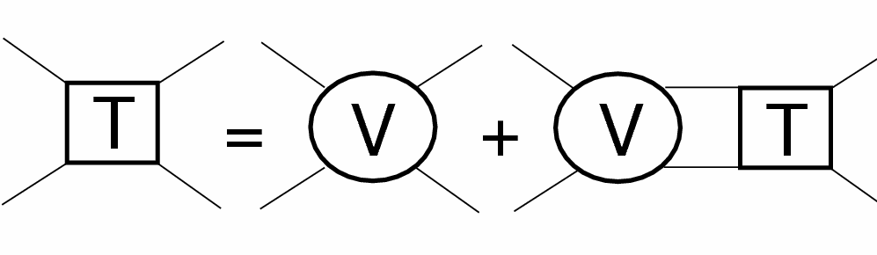
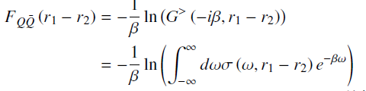

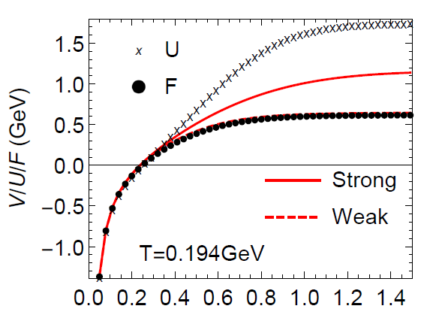
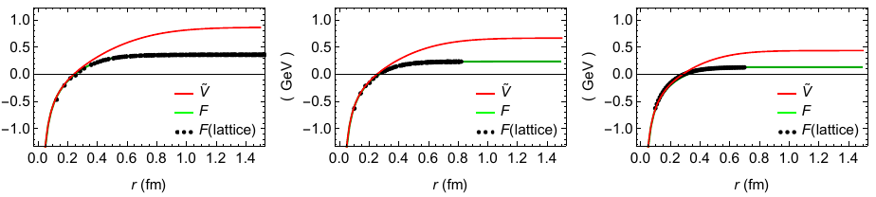
2.2 In-Medium Potential Approach
T-matrix
equation
Q
Q
In-medium potential?
Free energy:
Spectral function:
⇒ infer in-medium potential
Large imaginary parts Σ_{I} ⇒ V > F
Remnants of confining force above T_{c}!
V
T=258 T=320 T=400
r [fm]
[TAMU ’05-’18]

Slide 7


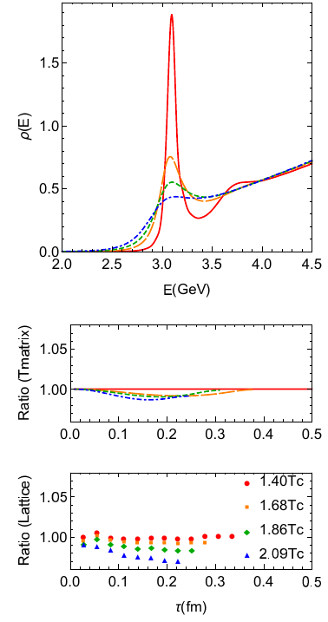
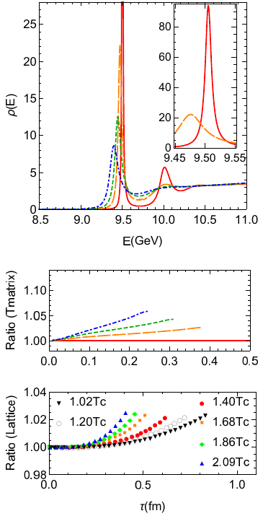
2.3 More lQCD Constraints: Euclidean Correlators
Charmonium Bottomonium
J/y melts near T~ 300 MeV
ϒ(1S) survives until T > 400 MeV

Slide 8
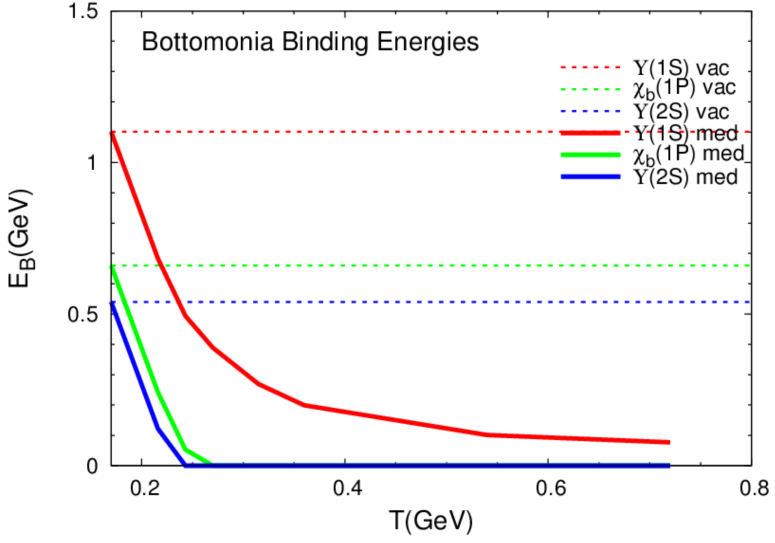
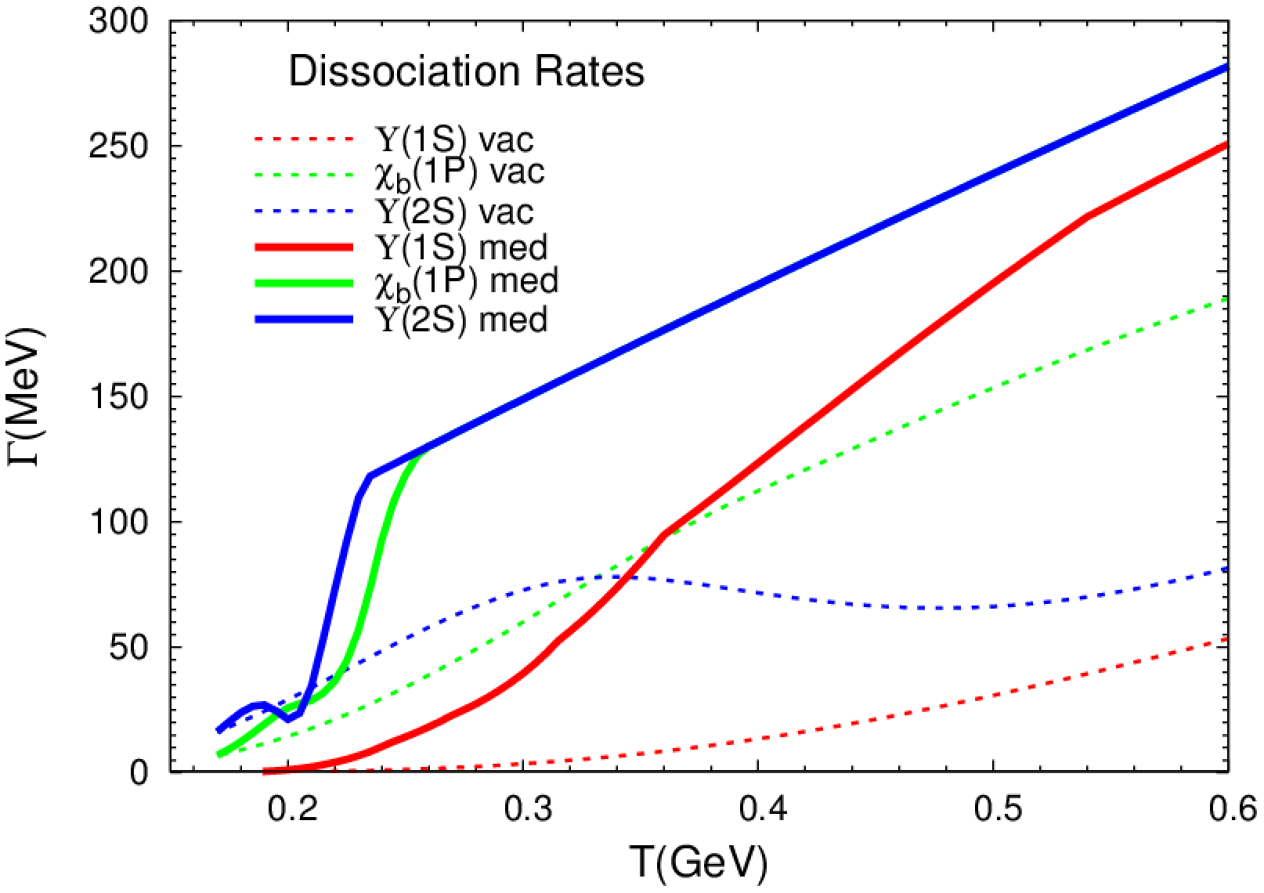
2.4 Binding Energies + Reaction Rates: Y States
1S
1P
2S
2S
1S
1P
1P
1S
2S
Reduced binding “accelerates” dissociation
Same rate for dissociation + regeneration (for T < T_{diss})

Slide 9
Outline
1.) Introduction
2.) Quarkonia at Finite Temperature
● In-Medium HQ Potential
● Spectral Properties
3.) Quarkonia in Heavy-Ion Collisions
● Transport Approaches + Coefficients
● Charmonium + Bottomonium
● X(3872) + B_{c}
4.) Conclusions

Slide 10
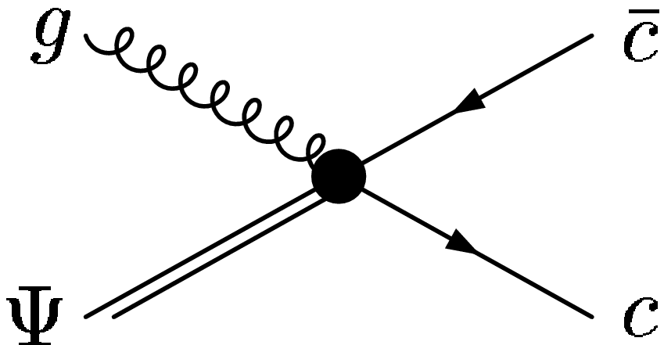
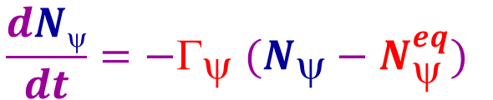
3.1 Quarkonium Transport in Heavy-Ion Collisions
[PBM+Stachel ’00, Thews et al ’01, Grandchamp+RR ‘01,
Gorenstein et al ’02, Ko et al ’02, Andronic et al ‘03,
Zhuang et al ’05, Ferreiro et al ‘11, Strickland et al ‘11 …]
Semiclassical Transport
Boltzmann eq. p^{μ} ∂_{μ}f^{ψ} = −E_{p} Γ_{ψ} f^{ψ} + E_{p} β
→ Rate eq.
D
-
J/ψ
D
$$\frac{dNψ}{dt}=−Γ_{ψ} (N_{ψ}−N_{ψ}^{eq})$$
-
c
c
Transport coefficients
- Equilibrium limit: N_{y}^{eq}(m_{y},T; N_{cc}) = g_{c}² n_{y}(T) V_{FB}
depends quadratically on charm cross section s_{cc} ~ N_{cc} ~ g_{c} n_{c} V_{FB}
J/ψ
→
-
ψ + g,q c + c + X
- Reaction rate G_{y} (E_{B}(T)):
←
“Large” binding E_{B} ≥ T
“Small” binding E_{B} < m_{D}
q q
gluo-dissociation (“singlet-to-octet”)
• “quasi-free”/ Landau damping

Slide 11
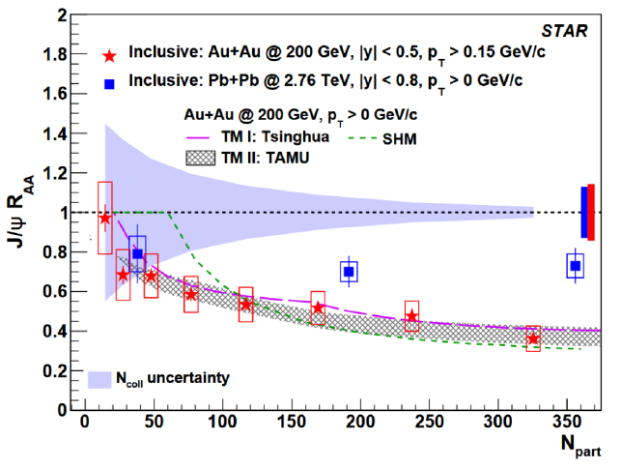
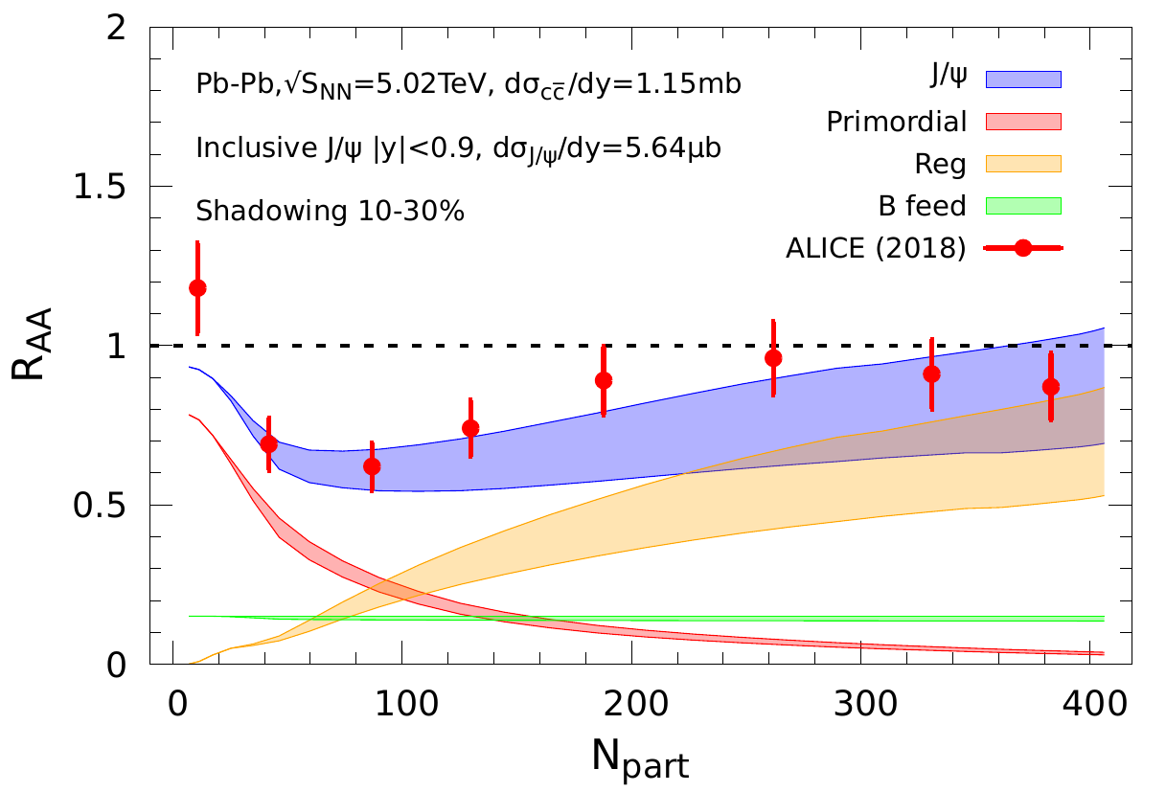
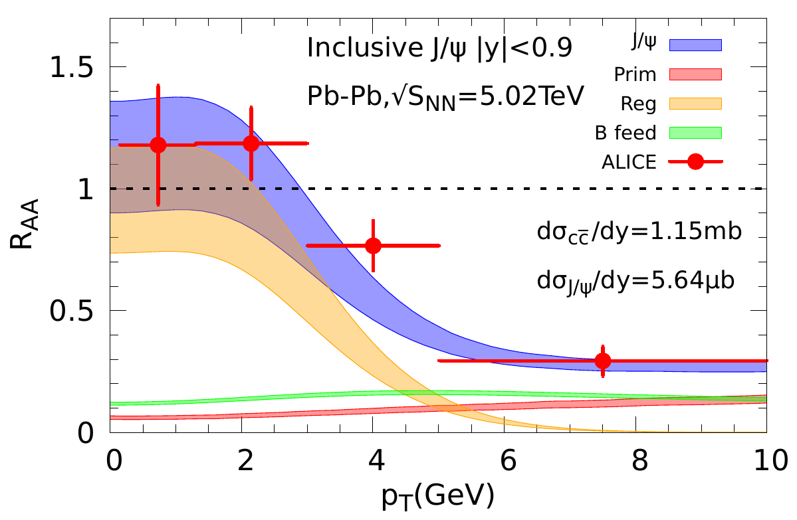
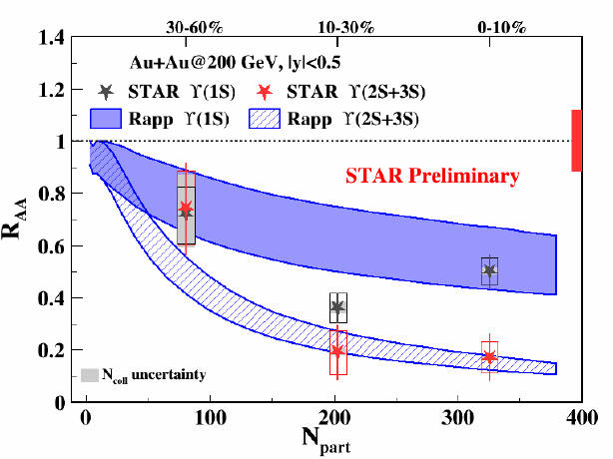
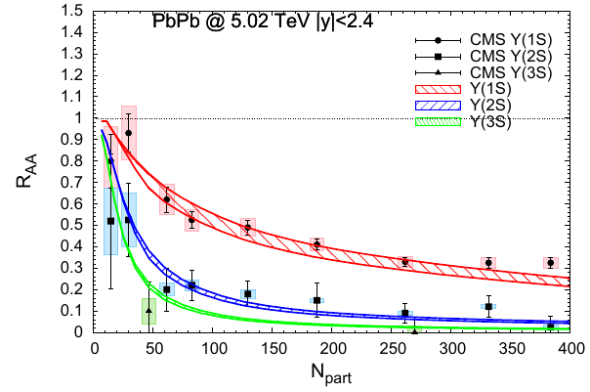
3.2 Snapshot of Quarkonium Transport Results
RHIC LHC: centrality LHC: momentum
mostly suppression
substantial regeneration, concentrated at low p_{T}
Bottomonia mostly
driven by suppression,
regeneration small
even at the LHC

Slide 12
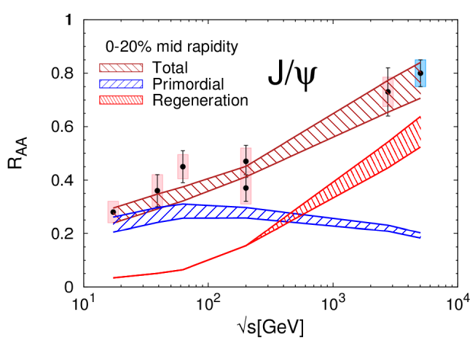
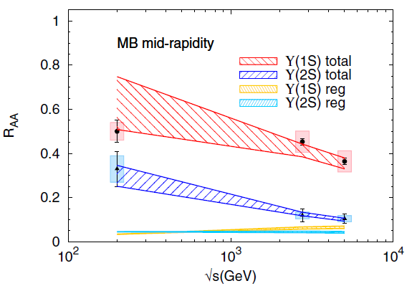
3.3 Excitation Functions: SPS - RHIC - LHC
Charmonium Bottomonium
Gradual increase of total J/ψ R_{AA}
Regeneration and suppression increase
Regeneration concentrated at low p_{T}!
Gradual suppression
Regeneration (N_{ϒ}^{eq}) small
Qualitative difference from J/ψ
[NA50, PHENIX, STAR, ALICE, CMS]

Slide 13
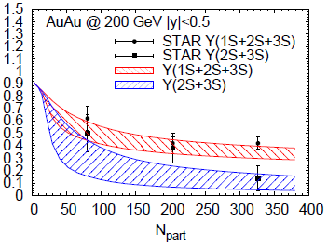
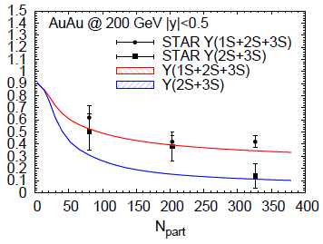
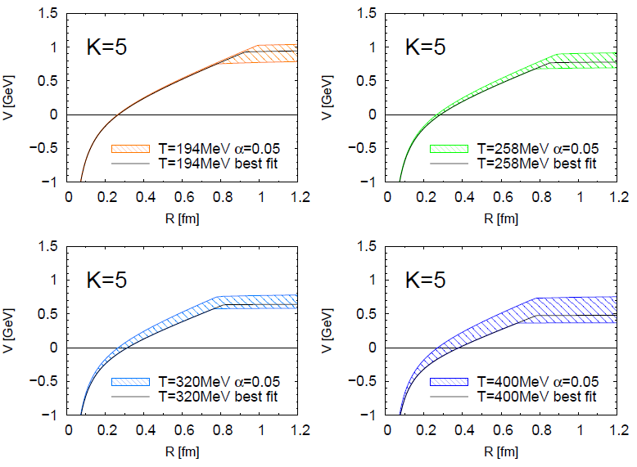
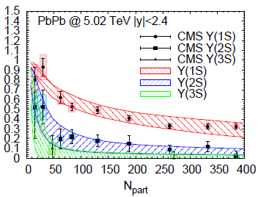
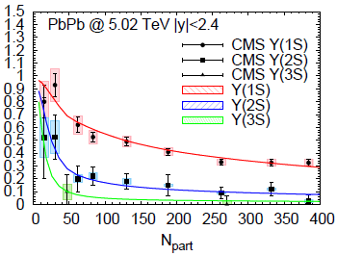
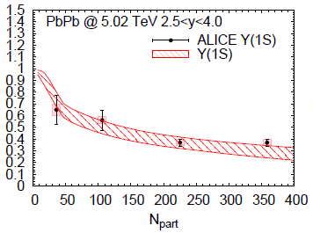
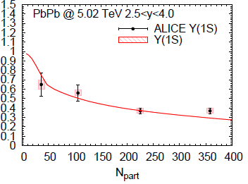
3.4 Statistical Extraction of Heavy-Quark Potential
Fit Results In-Medium Potential
“Strongly-coupled” solution:
remnants of confining force
survive well above T_{c}
Not unique …
c²/dof ≤ 1
[Du,Liu+RR ‘19]

Slide 14
3.5 X(3872)
Does X(3872) production in heavy-ion collisions reveal
internal structure information?
Larger size (molecule vs. tetraquark) ⇒ larger yield -- or else?
With R_{AA}^{exp}(y(2S)) ~ 0.14, R_{AA}(X) compatible with unity
p_{T} > 15GeV might be outside coalescence/regeneration regime

Slide 15
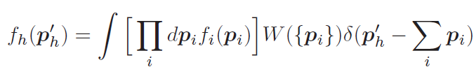
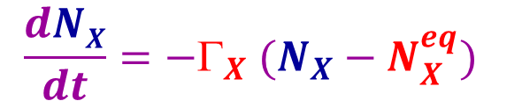
3.5.2 In-Medium X(3872) Production Models
Coalescence Models: partons (f_{i}) projected on hadron wave fct. (W)
[Cho et al ’11, Fontoura et al. ‘19, …]
W=W(s) with hadron radius σ
N_{X} ~ s³ ⇒
N_{mol} >> N_{tetra}
[H. Zhang et al ’20]
Transport Approach:
$$\frac{dNX}{dt}=−Γ_{X} (N_{X}−N_{X}^{eq})$$
[B. Wu et al ’20]
Reaction rate larger for weakly bound molecule
⇒ molecule freeze-out later than tetraquark
Equilibrium limit drops with T ⇒ N_{mol} < N_{tetra}

Slide 16
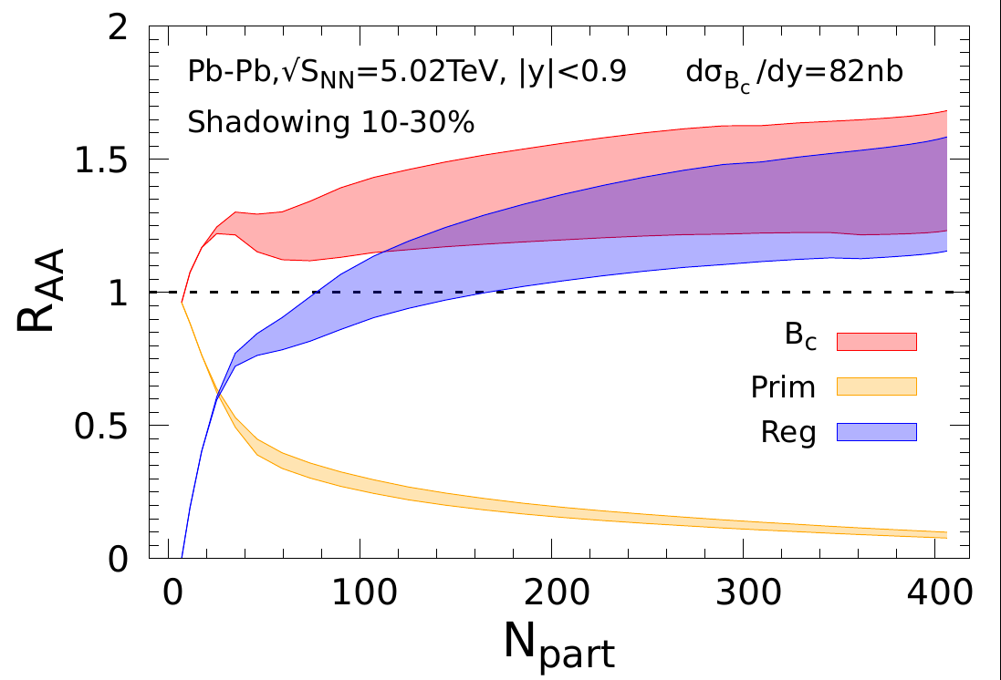
3.6 B_{c}(6275)
Critical “universality test” for transport models
Expect large yields in AA relative to pp [dN_{c}/dy ~ 30 in PbPb(5TeV)]
Need to control pp production cross section (denominator):
R_{AA} (p_{T}) ≡ (dN/dp_{T})_{AA} / N_{coll} (dN/dp_{T})_{pp}
Theory Prediction [Wu et al. ‘21] CMS Data
Predictions appear to agree with data…
caveats: pp cross section, p_{T} range (theory: p_{T} > 0, data: p_{T}^{3m} > 6 GeV)

Slide 17
4.) Summary
Quarkonia probe in-medium QCD force (not temperature)
Remnants of confining force prevail above T_{c}
⇒ quarkonium ground states survive (well) into the QGP
(+ key role in generating strongly coupled QGP)
Semi-classical transport approaches predict interplay of
regenerated J/ψ’s vs. suppressed ϒ’s in heavy-ion collisions
Ψ production tied to c-quark kinetics (reaction rates),
Y production more directly sensitive to in-medium binding (potential)
Ongoing theory efforts to develop + apply quarkonia quantum evolutions,
scrutinizing the validity of semi-classical approaches
[Akamatsu et al, Blaizot et al, Brambilla et al, Gossiaux et al, Strickland et al, …]

Slide 18

2.4 Heavy-Quark Potential Extraction from ϒ Data
Ansatz for
in-med. potential
Parameterize T-dependence of m_{D}~ aT, 1/R_{SB} ~ m_{S}(T;b,g,d)
⇒ determine in-med. binding energies E_{Y}(m_{D},m_{S})
Compute G_{Y} [E_{Y}]
QGP
also requires HQ-medium coupling
perturbative: a_{s} ~ 0.3
non-perturbative: K ≥ 5
_
Q
Q
Deploy transport approach to fit (a,b,g,d; K) to ϒ data at RHIC + LHC
[Du,Liu+RR ‘19]

Slide 19
2.1 Quarkonium Transport in URHICs
0 0.5 5 10
| | | |
fireball time
τ [fm/c]
c
-
c
production +
evolution of
cc wave pack.
c-quark
diffusion
in QGP
~ T_{melt}:
ψ can
form
QGP
kinetics
c+c ↔ ψ
~ T_{pc}:
c and c
hadronize
-
-
hadronic
kinetics
-
t_{form}~1fm/c t_{c}^{eq} ~5fm/c t_{y}^{eq} ~ 1/ G_{y}
[Satz et al, Capella et al, Spieles et al, PBM et al, Thews et al, Grandchamp et al, Ko et al, Zhuang et al, Zhao et al,
Chaudhuri, Gossiaux et al, Young et al, Ferreiro et al, Strickland et al, Brambilla et al, …]

Slide 20
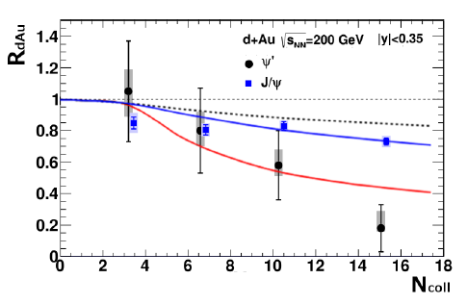
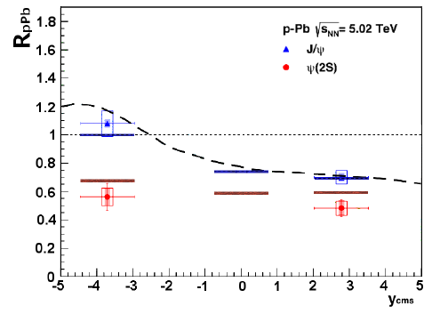
3.5 ψ(2S) in dAu and pPb
d-Au (0.2TeV) p-Pb (5.02TeV)
[PHENIX]
[ALICE]
- - EPS09
noticeable ψ′ and little J/ψ suppression, consistent with “comovers”
supports fireball formation with:
τ_{FB} Γ(ψ′) ~ 1 ⇒ Γ_{avg}(ψ′) ~ 50-100 MeV similar to thermal
τ_{FB} Γ(J/ψ) << 1 ⇒ Γ_{avg}(J/ψ) < 20 MeV widths at T≈ 200MeV
[Ferreiro ‘15]
[Du et al ‘15]

