Slide 1
ACO & AD DCS
Mario Iván Martínez H.

Slide 2
No news.
… sometimes no news is good news

Slide 3
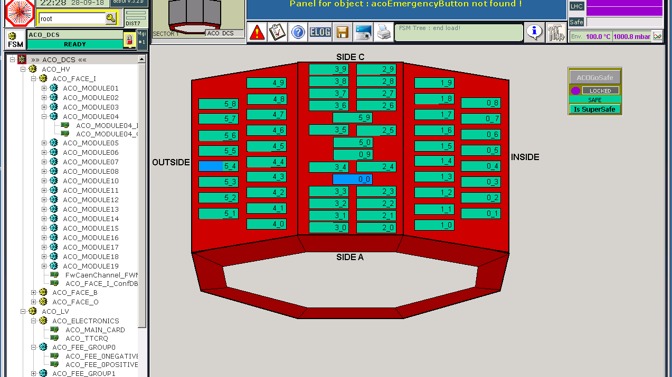
ACORDE UI
120 HV channels
FSM tree
Emergency Button

Slide 4
HV system
Voltage and current monitoring

Slide 5
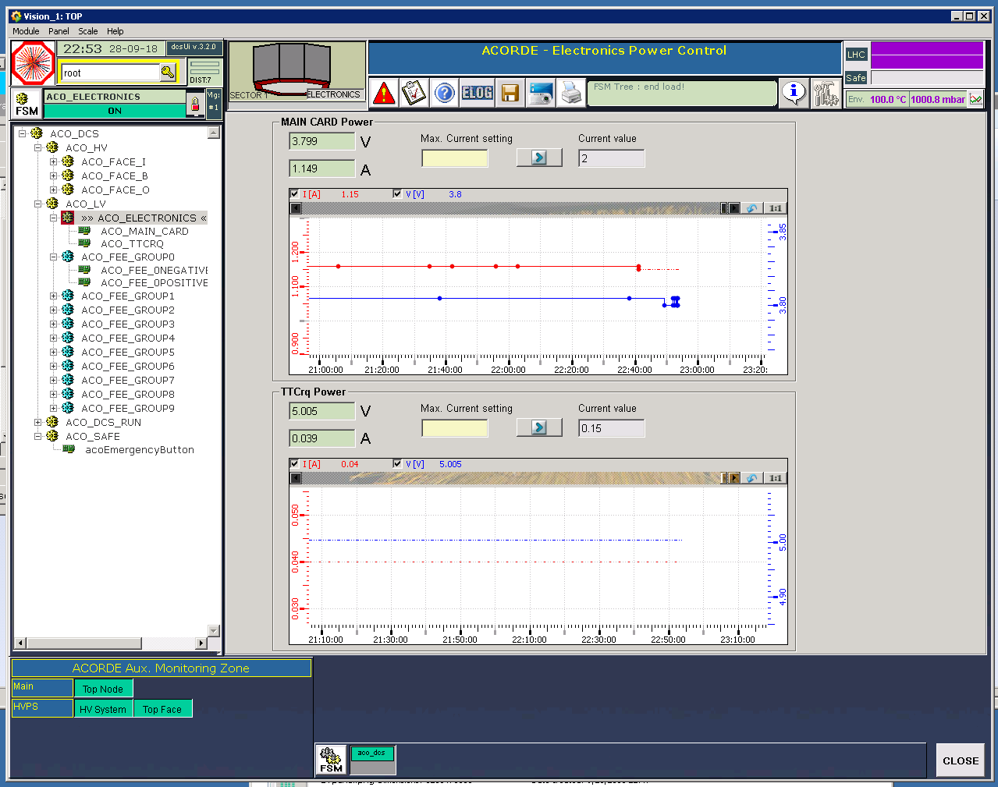
LV

Slide 6
Finite State Machines

Slide 7
ACO DCS
Thanks to
Abraham and Luis
No major issues during LHC18
Though some interventions needed
~ 800 runs this year
Smooth operation of detector during data taking and technical stop periods
No software interventions – only centrally applied patches

Slide 8
AD DCS UI
Thanks to
Juan Carlos

Slide 9
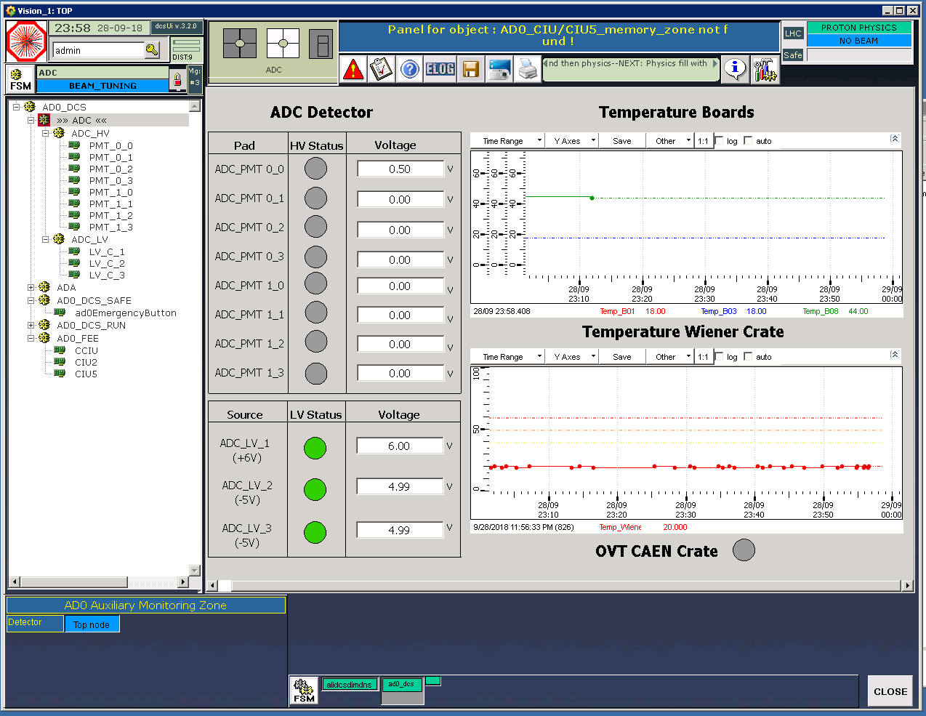
ADC

Slide 10
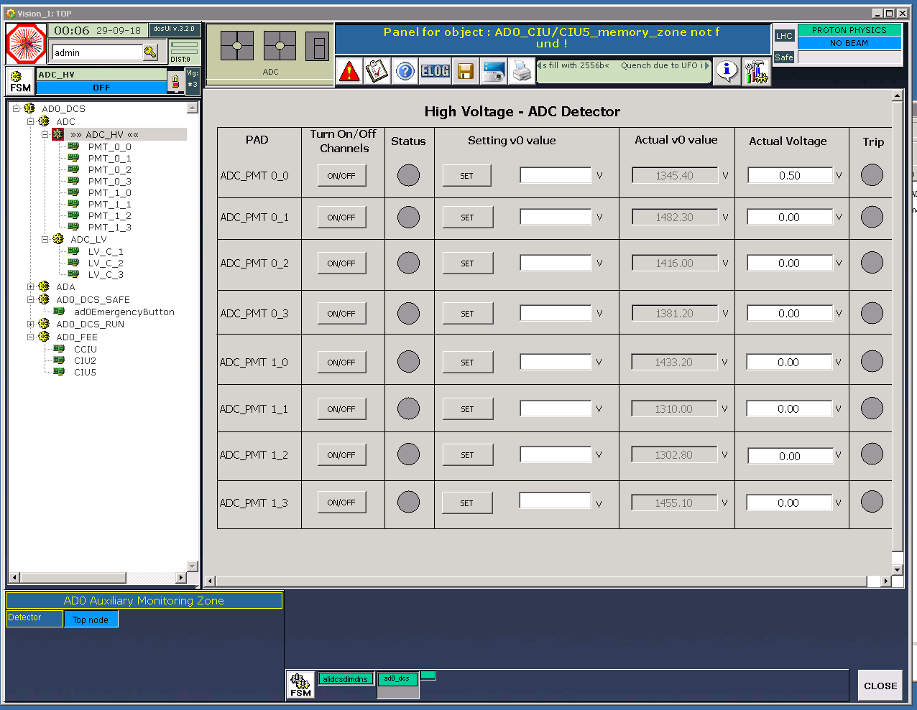
HV

Slide 11
HV trends

Slide 12
AD runs

Slide 13
AD DCS
~ 1,000 runs this year
Smooth operation of detector during data taking and technical stop periods
No software interventions – only centrally applied patches
An issue with the retreival of conditions datapoints by the Shuttle affected about a hundred of AD runs.
Shuttle was not able to retreive values for some apparently random datapoints.
No OCDB objects stored for those runs.
The reason is still not determined.
Reconstruction and MC simulation for those runs could be possible using OCDB objects from the previous (or next) “compatible” run.

Slide 14
Retreival issue on the Shuttle
Shuttle failed retrieving data from AD during this year (period: LHC18)
No apparent pattern, reason still unknown.
Nov. and some dec., 2017 runs that were processed by the shuttle in 2017 did not fail. (Last run processed: 282813 on 11-12-2017).
Last dec., 2017 runs (from 282814 onwards) were processed by shuttle in 2018 (march) and they failed.
See http://alimonitor.cern.ch/shuttle.jsp?filter=&instance=PROD&runrange=282700-283200&time=168
115 runs failed (approx. 6%) (Logbook filter: AD shuttle done: Failed)
4 more failed during and after last TS – before beam was on during last weekend
Error: No entry in DAQ FXS table.
1885 runs OK (Logbook filter: AD shuttle done: Done)
No more fails since 23-sep afternoon (after TS)
New retreival of datapoints – “one at a time”
Some errors are common to several runs (see following slides)
Most common one: E-AliADDataDCS::ProcessData: Missing data points for alias AD0/HV/PMn! n = 2, 3, 5, etc.

Slide 15
Shuttle errors – in order of multiplicity
82 runs had missing PM (HV) datapoints. From run 286124 09/05/2018 22:48 To run 292804 09/09/2018 19:27
E-AliADDataDCS::ProcessData: Missing data points for alias AD0/FEE/CCIU/CentralityADAThrLow! E-AliADDataDCS::ProcessData: Missing data points for alias AD0/FEE/CCIU/CentralityADAThrHigh! E-AliADDataDCS::ProcessData: Missing data points for alias AD0/FEE/CCIU/CentralityADCThrLow! E-AliADDataDCS::ProcessData: Missing data points for alias AD0/FEE/CCIU/CentralityADCThrHigh!
Either, CCIU and CIU’s datapoints missing or all datapoints missing
I-AliShuttle::Log: 2018-04-12 08:02:04 UTC (22151): AD0 - run 284698 - GetFileSources - No entry in DAQ FXS table for id: AD0da_results I-AliADPreprocessor::Process: The following sources produced files with the id AD0da_results Collection name='TList', class='TList', size=0 I-AliShuttle::Log: 2018-04-12 08:02:04 UTC (22151): AD0 - run 284698 - ProcessCurrentDetector - Preprocessor failed. Process returned 1.

Slide 16
However, for most of these runs, different datapoints were missing in the 2 trials the shuttle does before declaring a run as failed.
First trial:
This means PM5 was found in this trial
E-AliADDataDCS::ProcessData: Missing data points for alias AD0/HV/PM3!
E-AliADDataDCS::ProcessData: Missing data points for alias AD0/HV/PM9!
I-AliShuttle::Log: 2018-09-08 04:19:10 UTC (5929): AD0 - run 292693 - ProcessCurrentDetector - Preprocessor failed. Process returned 1.
Second trial:
This means PM3 and PM9 were found in this trial
E-AliADDataDCS::ProcessData: Missing data points for alias AD0/HV/PM13!
I-AliShuttle::Log: 2018-09-08 04:19:19 UTC (5957): AD0 - run 292693 - ProcessCurrentDetector - Preprocessor failed. Process returned 1.

Slide 17
Reconstruction for failed runs
Previous and next runs to a failed one could be used to reconstruct the bad run.
We should compare HV values for these runs, as suggested by Christoph
previous run HV ≈ following run HV
85 bad runs processed
82 have neighbor runs satisfying previous criterion
30 runs do not have an near neighboring good run
From run 283361 (7.03) to 284335 (29.03) all failed.
HV values to be checked in DCS trending plots for PM HV’s

