Slide 1
Physical and experimental basis for radio therapy
Guy Paic
Instituto de Ciencias Nucleares, UNAM

Slide 2
How does radiation interact with matter -

Slide 3
INTERACTIÓN of PARTICLES WITH MATTER
2. Inelastic collisions
The particle collides with the atom ic electrons:
1
1
2
1
1
2
2
2
EXCITATION
IONISATION

Slide 4
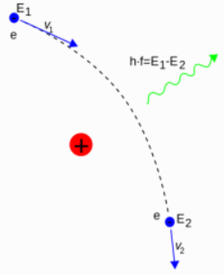
3. Radiative collision - bremstrahlung
The charged particle (electron) is deviated by the positive charge of the nucleus and emits a photon

Slide 5
The particles lose energy in the matter
range
The range is the length (taken rectilinear) in the matter

Slide 6
Interaction of photons with matter
x = length
μ = linear coefficient of attenuation= probability of interaction per unit of length
ATENUATION: N = N₀ e ^{-μ x}
Valid for
monoenergetic photons
N_{O}
N
When the electromagnetic radiation (X-rays or gammas ) enters in a natural medium the photons lose their numbers during their travel in the matter due to absorptions and dispersions

Slide 7
Interaction of particles with matter
2. Inelastic collisions:
The particle provoques:
1
1
2
1
1
2
2
2
EXCITATION
IONISATION

Slide 8
Interactions of Particles with Matter
The fact that particles interact with matter allows us to measure their properties, and reconstruct high energy interactions.
Dominant interaction is due to the electromagnetic force, or coulomb interactions.
Ionization and excitation of atomic electrons in matter are the most common processes.
Radiation can become important, particularly for electrons.
The nuclear interactions play a less significant role

Slide 9
Important to understand
The Photons are losing energy in a stochastic way – that is every photon has a probability to survive after a given thickness of absorber.
Like if I have 100 dices and I decide to remove all the sixes after a throw. I will stay with a given number of dices in play after the first throw. I throw again, and again if I have many dices you can imagine that after many throws (analogous to the thickness of material I will still have dices on the table. This is called the logarithmic absorption
For charged particles the situation is different : every particle is losing energy continuously like a car without engine on a flat road: after a given path it will stop…. It means for each particle we can calculate the Range it will have in a given piece of material due to its energy, mass and charge.

Slide 10
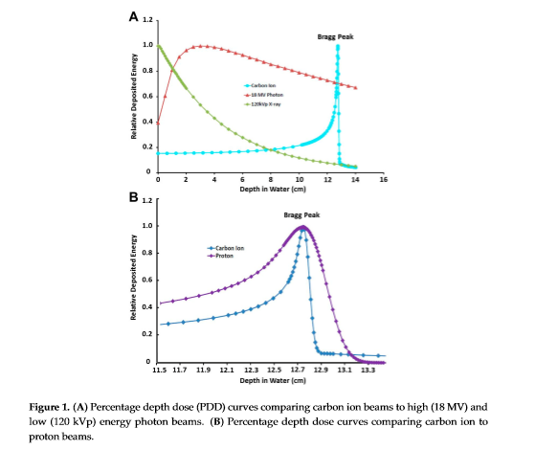
Most important ! The energy loss
The charged particles loose energy continuously but at a different rate:
The slower they move the more energy they loose per unit of path!
A the atomic number of the particle ,q the elementary charge and E is the energy of the particle

Slide 11
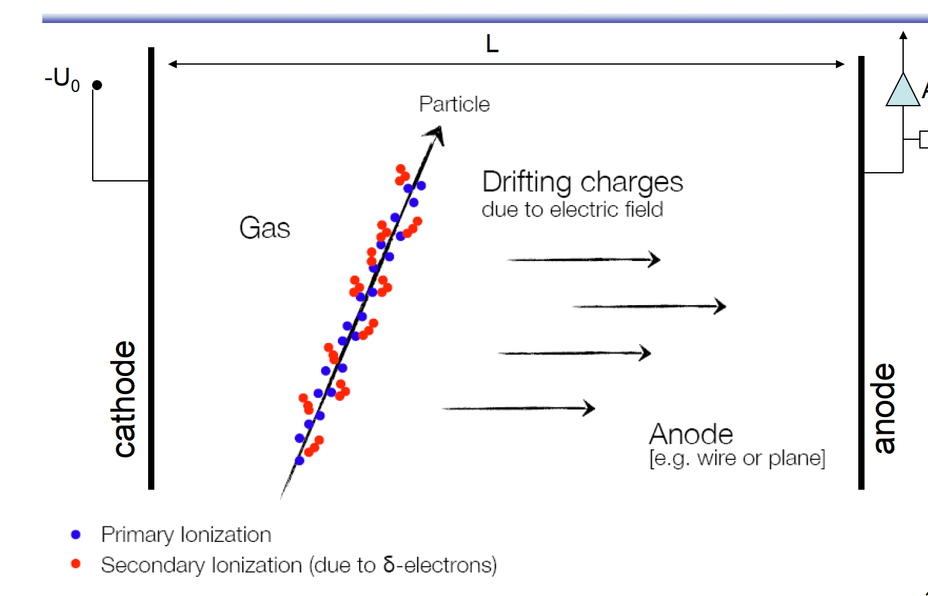
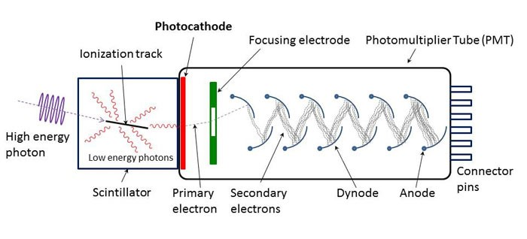
Using the ionisation and/or excitation
The ionisation creates “free” electrons that can be collected
The excitation in some cases emit visible light that can be detected

Slide 12
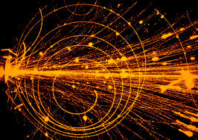
Ionisation plus excitation –streamer chamber

Slide 13
Ionisation in solids – Si detectors

Slide 14
To see the signals we need amplification

Slide 15
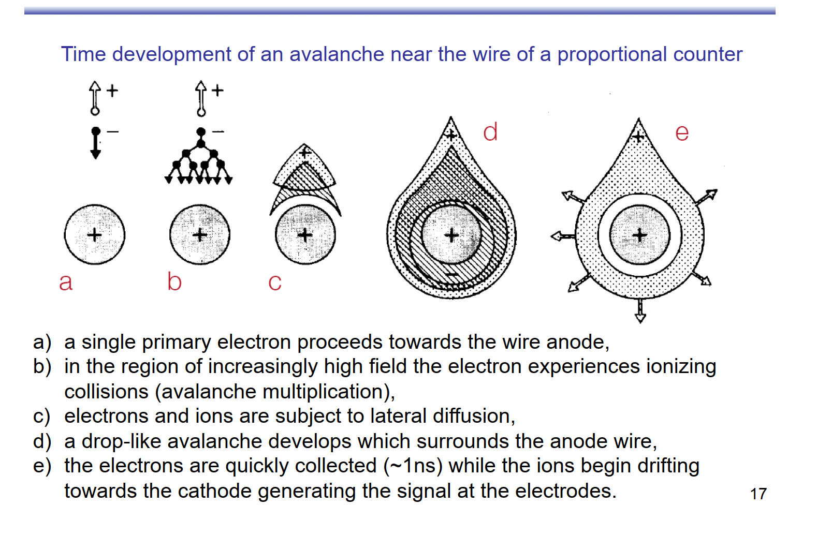
Multiplying the electrons Creating an avalanche in the gas

Slide 17
Multigap resistive plate chambers

Slide 18
Multigap resistive plates

Slide 19
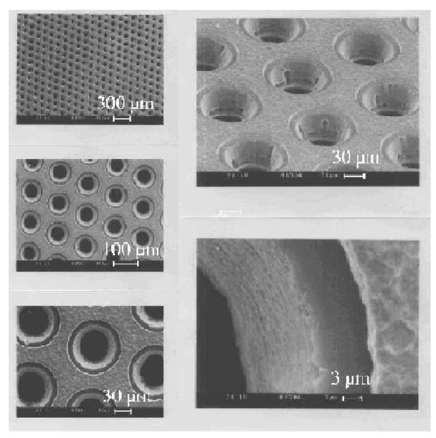
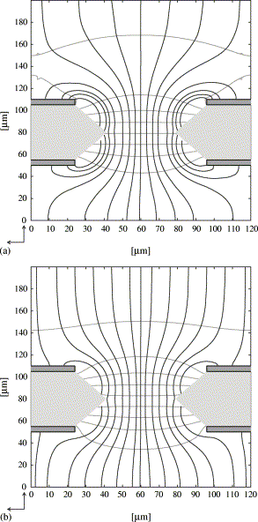
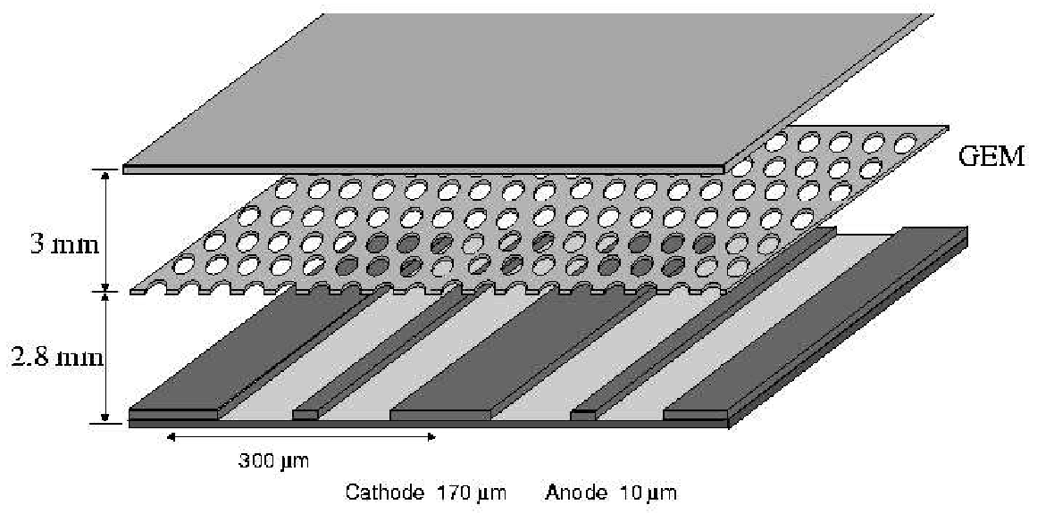
Gas electron multipliers (GEMs)
Thin perforated kapton foil, metal clad on both sides. (~500V)
Field lines squeezed through small gaps. This causes gas amplification in the gap.
Less gas amplification needed near the anode strips.
Invented to rescue MSGC technology.
Interesting applications: with multiple GEM foils no longer need any charge multiplication near anode. Combine GEMs with strip or pad detectors or even Silicon pixel detectors to get thin (and thus fast) particle detectors.
Notes:
Typical amplification GEM ~100
Considered for TESLA TPC

Slide 20
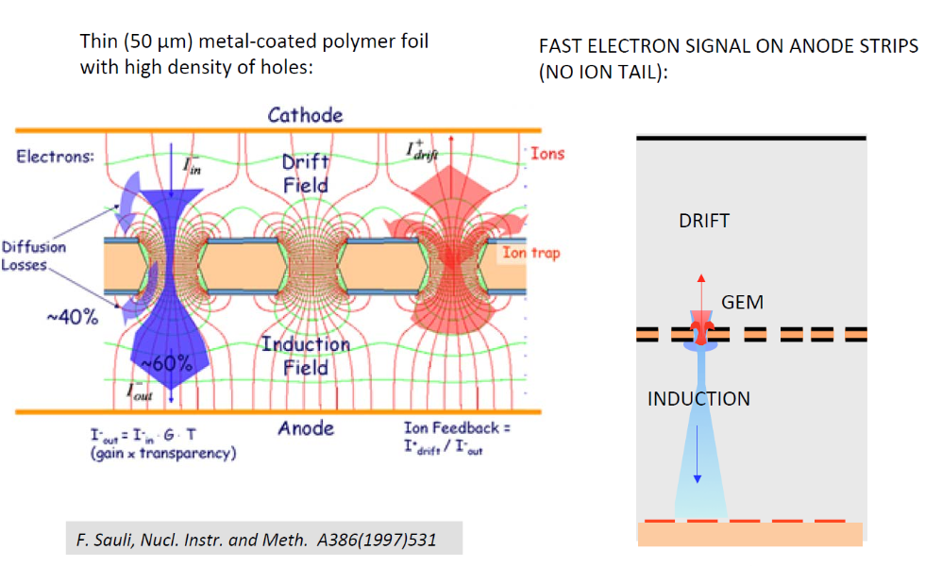
Gem operation

Slide 21
Scintillation Counters
Ionization produced by charged particles can excite atoms and molecules in the medium to higher energy levels
The subsequent de-excitation process produces lights that can be detected and provide evidence for the traversal of the charged particles
Scintillators are the materials that can produce lights in visible part of the spectrum

Slide 22
Scintillation Counters
Two types of scintillators
Organic or plastic
Tend to emit ultra-violate
Wavelength shifters are needed to reduce attenuation
Faster decay time (10⁻⁸s)
More appropriate for high flux environment
Inorganic or crystalline (NaI or CsI)
Doped with activators that can be excited by electron-hole pairs produced by charged particles in the crystal lattice
These dopants can then be deexcited through photon emission
Decay time of order 10⁻⁶sec
Used in low energy detection

Slide 23
Scintillation Counters – Photo-multiplier Tube
The light produced by scintillators are usually too weak to see
Photon signal needs amplification through photomultiplier tubes
Gets the light from scintillator directly or through light guide
Photocathode: Made of material in which valence electrons are loosely bound and are easy to cause photo-electric effect (2 – 12 cm diameter)
Series of multiple dynodes that are made of material with relatively low work-function
Operating at an increasing potential difference (100 – 200 V difference between dynodes

Slide 24
Principle of photomultiplier tubes

