Slide 1
Neutrino Oscillations for the study of the Earth’s interior
Juan Carlos D’Olivo¹ José Arnulfo Herrera Lara¹ Oscar Alfredo Sampayo²
Ismael Romero² Gabriel Zapata²
¹Instituto de Ciencias Nucleares
²Depto. De Física, Universidad Nacional de Mar del Plata

Slide 2
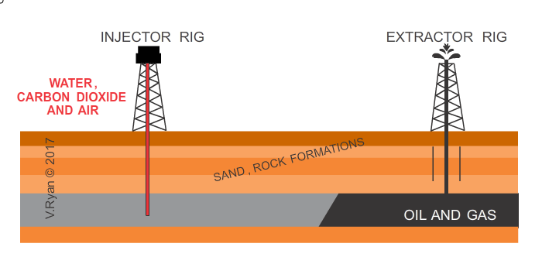

Introduction
Why to study the Earth’s interior?
The knowledge of the composition and inner structure is essential for the understanding of the basic geological phenomena, such as volcanology, earthquakes and mountain formation.
Among other applications, are also the extraction of minerals and the location of oil fields.

Slide 3
What methods are there to study the interior of the Earth?
The two main ways to study the internal composition of our planet are the direct extraction of minerals and rocks from the surface and the study of the propagation of seismic waves.

Slide 4
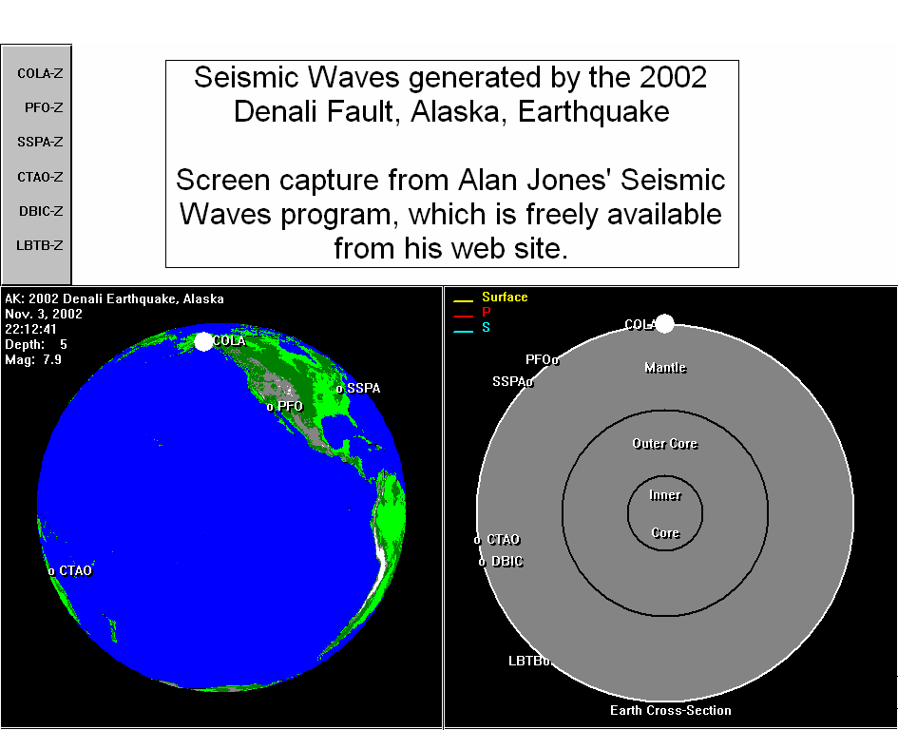

Slide 5
Outer core
Fundamental roles
Convection currents
Tectonic plates
Earth magnetic field
Composition
Composed mainly of iron together with other elements not yet determined. These could be: nickel, oxygen, carbon, silicon, hydrogen and sulfur.

Slide 6
Neutrino oscillations
A way to determine the presence of the elements that constitute the interior of the Earth is to use the phenomenon of neutrino oscillations.
An interesting feature of neutrino oscillations is that the conversion of one flavor to another is affected by the density of electrons that exist in the medium where they propagate. The main motivation of this work was to try to show that the phenomenon of oscillations can help to determine the structural composition of the Earth, in particular that of the outer core.

Slide 7
Neutrino sources
Natural sources:
Sun
Supernova
Big Bang
Atmospheric
Artificial sources:
Nuclear reactors
Accelerators

Slide 8
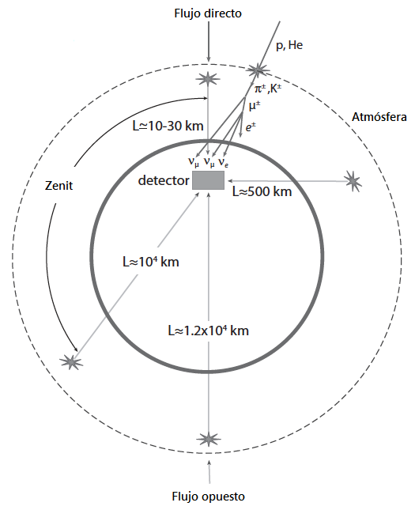
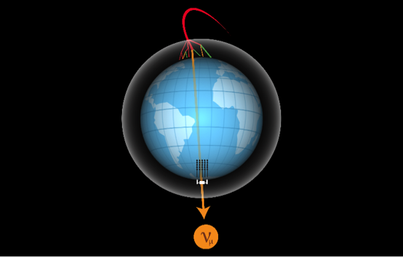

Atmospheric Neutrinos
When the cosmic rays enter the Earth they collide with the nuclei that are in the upper part of the atmosphere. The result of these collisions gives, mainly, the production of pions $π^{±}$ and kaons $K^{±}$. On average, for each electron neutrino there are two neutrinos of the muon.

Slide 9
Neutrino oscillations
Oscillations in vacuum
Principal Oscillations

Slide 10
Neutrino oscillations
Oscillations in vacuum

Slide 11
Neutrino oscillations
Oscillations in matter
The presence of matter in the trajectory of neutrinos can affect the transition probabilities. The result of this interaction is the addition of a potential to the Hamiltonian in the Schrödinger equation.

Slide 12
Neutrino oscillations
Oscillations in matter
By means of a phase transformation in the Schrödinger equation and a few algebraic manipulations, it is possible to get rid of the neutral current term $V_{CC}$ to obtain the Hamiltonian:
with
Matrix element

Slide 14
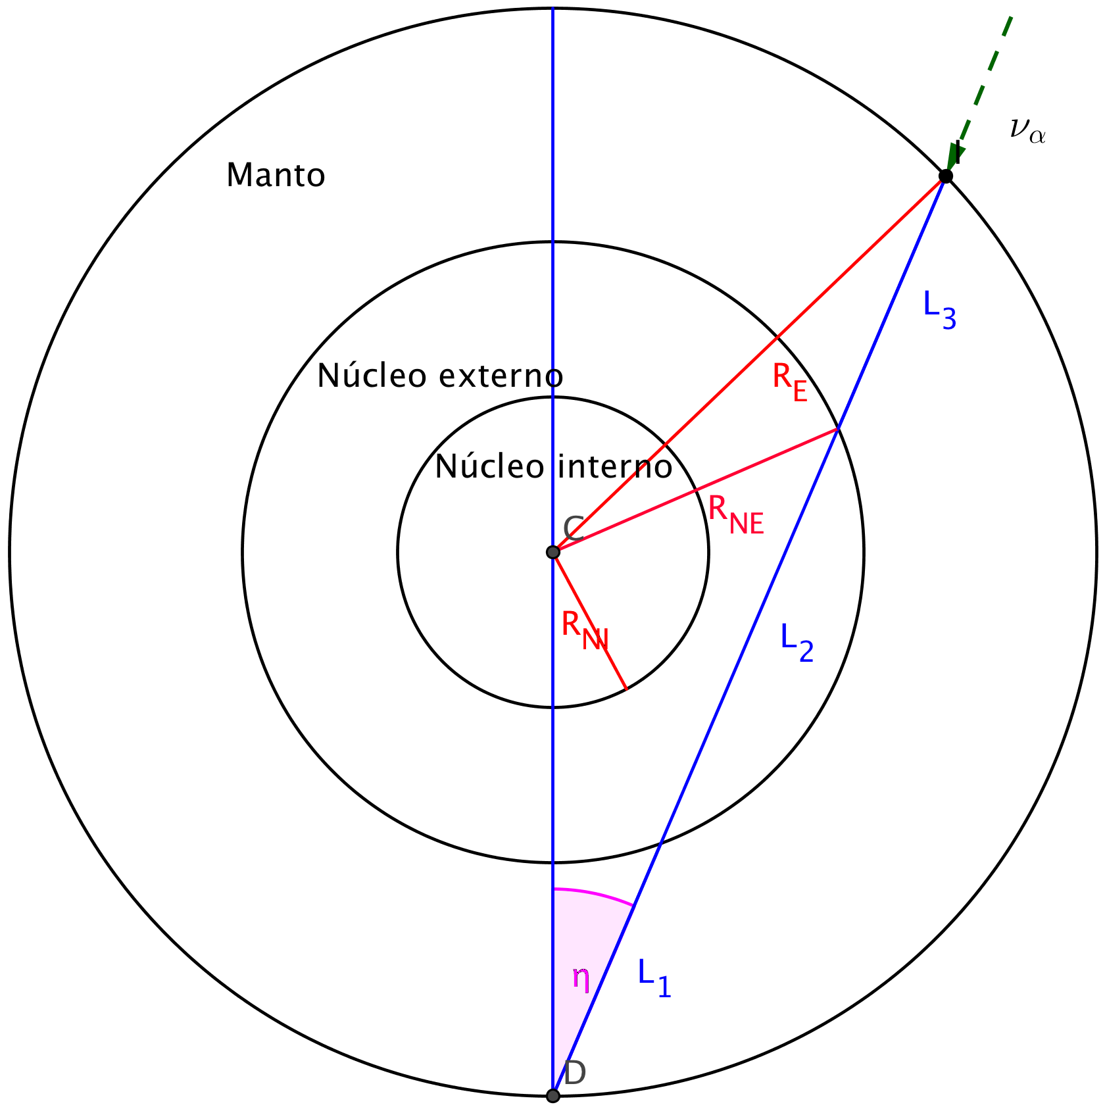
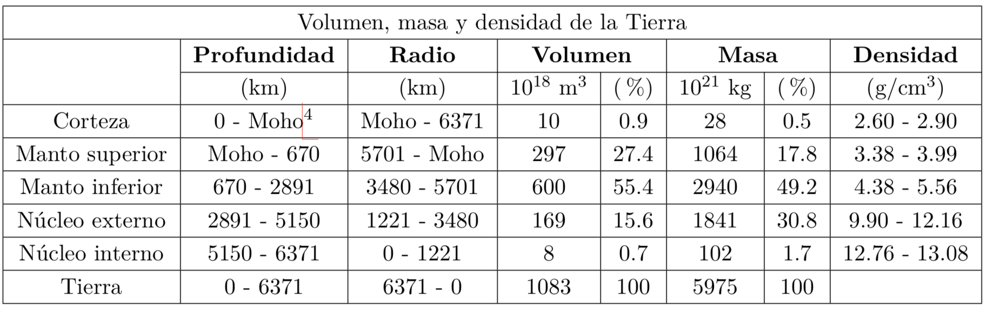

Slide 15

Normal Hierarchy and $θ_{23}<{45}^{°}$

Slide 16
Normal Hierarchy and $θ_{23}<{45}^{°}$

Slide 17
Normal Hierarchy and $θ_{23}<{45}^{°}$

Slide 18
Normal Hierarchy and $θ_{23}<{45}^{°}$

Slide 19

Normal Hierarchy and $θ_{23}>{45}^{°}$

Slide 20
Normal Hierarchy and $θ_{23}>{45}^{°}$

Slide 21
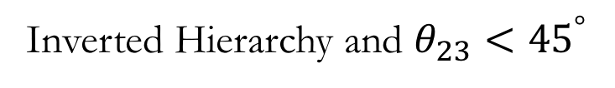
Inverted Hierarchy and $θ_{23}<{45}^{°}$

Slide 22
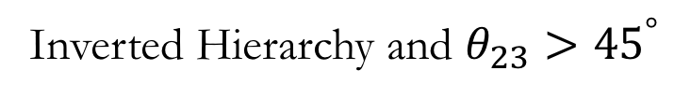
Inverted Hierarchy and $θ_{23}>{45}^{°}$

Slide 24


