Slide 1




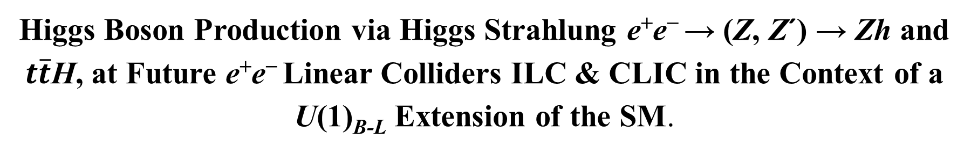
XXXII Reunión Anual de la División de Partículas y Campos de la SMF
Higgs Boson Production via Higgs Strahlung e⁺e⁻ → (Z, Z´) → Zh and $t\overline{t}$H, at Future e⁺e⁻ Linear Colliders ILC & CLIC in the Context of a U(1)_{B-L} Extension of the SM.
Dr. Francisco Ramírez Sánchez*
Dr. Alejandro Gutiérrez Rodríguez*
*Universidad Autónoma de Zacatecas, Unidad Académica de Física, Doctorado en Ciencias Básicas

Slide 2

INTRODUCTION
We study the phenomenology of light h, and heavy H, Higgs boson production and decay in the context of a U(1)_{B−L} (baryon-lepton) extension of the SM with an additional Z′ boson (considering mixture of Z and Z′ bosons) at future e⁺e⁻ linear colliders with center of mass energies of √s = 500 − 3000 GeV and integrated luminosities of L = 500 − 2000 fb⁻¹. We study the Higgs-strahlung processes e⁺e⁻ → (Z, Z′) → Zh, ZH, tth, ttH, considering both the resonant and non-resonant effects. We find that the total number of expected Zh and ZH events can reach ~ 10⁶ and ~ 10⁵, respectively, which is a very optimistic scenario and thus it would be possible to perform precision measurements for both Higgs bosons h and H, as well as for the Z′ boson in future high-energy and high-luminosity e⁺e⁻ linear colliders.
XXXII Reunión Anual de la División de Partículas y Campos de la SMF

Slide 3
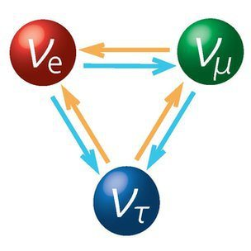
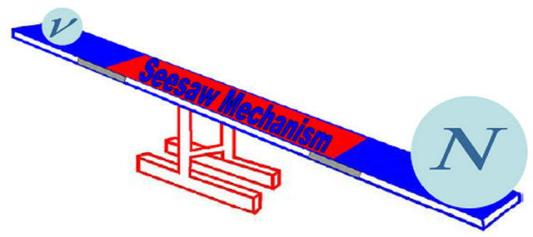
MOTIVATION (The SM is incomplete)
The SM does not explain various phenomena; the solid evidence for the non-vanishing neutrino masses has been confirmed by various neutrino
oscillation phenomena, dark matter, the
hierarchy problem, etc.
The most attractive idea to naturally explain the tiny neutrino masses is the seesaw mechanism, in which a right-handed (RH) neutrino singlet under the SM gauge group is introduced. The gauged U(1)_{B−L} model based on the gauge group SU(3)_{C} × SU(2)_{L} × U(1)_{Y} × U(1)_{B−L} is an elegant and simple extension of the SM in which the RH heavy neutrinos are essential.
XXXII Reunión Anual de la División de Partículas y Campos de la SMF

Slide 4

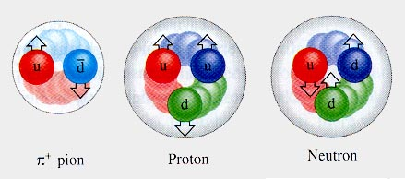
CLEAN ENVIRONMENT
Hadrons are compound objects, the initial state of partons is not uniquely defined, generally they are realized as quantum superposition of states distributed according to the proton structure functions. HCs create a large number of elementary processes. These represent background, and deposit high doses of radiation energy in the detector.
By contrast, the total cross section at LCs is relatively small and they have high sensitivity to electroweak processes, allowing very precise measurements in the Higgs sector, as well as in the search for new physics. The radiation levels are moderate. The process is cleaner with regards to the background, here the particles are elementary, and the initial state is defined at the fundamental level, allowing full reconstruction of the final state from conservation principles.
XXXII Reunión Anual de la División de Partículas y Campos de la SMF

Slide 5
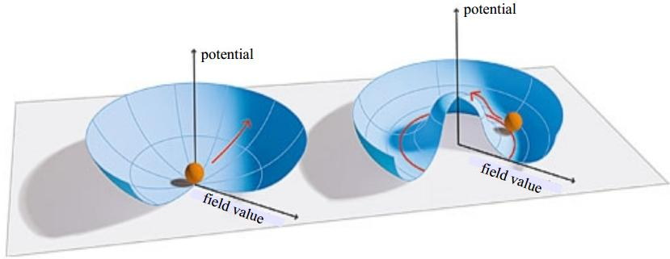
The B-L extension of the SM
The minimal B−L extension of the SM consists of adding a further U(1)_{B−L} gauge group together with a singlet complex neutral scalar field (to break the new symmetry), giving rise to; an extra Z´ boson, three right-handed neutrinos, an additional heavy scalar Higgs boson generated through the U(1)_{B−L} symmetry breaking (O TeV) and giving mass (see-saw) to the SM neutrinos.
XXXII Reunión Anual de la División de Partículas y Campos de la SMF

Slide 6
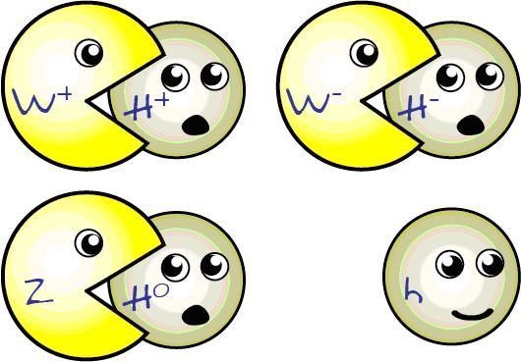

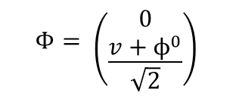
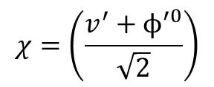
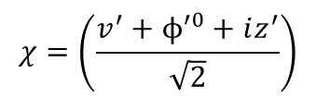
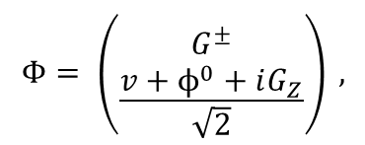
The essence of the extended B-L model
We consider a SU(3)_{C} × SU(2)_{L} × U(1)_{Y} × U(1)_{B−L} model, which is one of the simplest extensions of the SM, where U(1)_{B−L}, represents an additional gauge symmetry. The gauge invariant Lagrangian of this model is given by:
L = L_{s} + L_{YM} + L_{f} + L_{Y}
The model consists of one doublet Φ and one singlet χ complex scalar fields.
$$Φ= \left({G^{±} \atop \frac{v+ϕ^{0}+iG_{Z}}{\sqrt{2}}}\right) ,$$
$$χ=\left(\frac{v^{′}+ϕ^{′0}+iz^{′}}{\sqrt{2}}\right)$$
$$χ=\left(\frac{v^{′}+ϕ^{′0}}{\sqrt{2}}\right)$$
After spontaneous symmetry breaking and minimizing.
$$Φ= \left({0 \atop \frac{v+ϕ^{0}}{\sqrt{2}}}\right)$$
The Lagrangian for the gauge and scalar sector is given by:
$ℒ_{g}=−\frac{1}{4}W_{μν}^{a}W^{aμν}−\frac{1}{4}B_{μν}B^{μν}−\frac{1}{4}B_{μν}^{′}B^{′μν}$,
$$ℒ_{s}={\left(D^{μ}Φ\right)}^{†}\left(D_{μ}Φ\right)+ {\left(D^{μ}χ\right)}^{†}\left(D_{μ}χ\right)−V\left(Φ,χ\right)$$
We consider the most general Higgs potential invariant under these symmetries given by
$$V\left(Φ,χ\right)= m^{2}\left(Φ^{†}Φ\right)+μ^{2}{\left|χ\right|}^{2}+λ_{1}{\left(Φ^{†}Φ\right)}^{2}+λ_{2}{\left|χ\right|}^{4}+λ_{3}\left(Φ^{†}Φ\right){\left|χ\right|}^{2}$$
XXXII Reunión Anual de la División de Partículas y Campos de la SMF

Slide 7
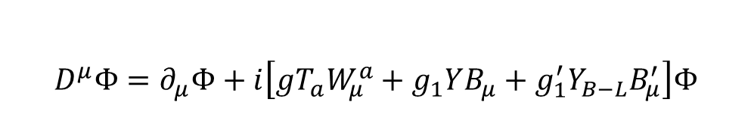

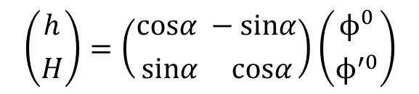
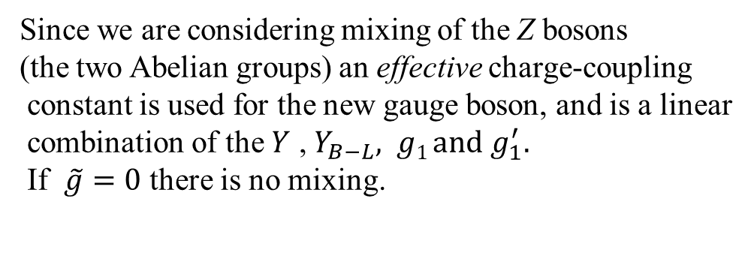
The essence of the extended B-L model
$$D^{μ}Φ=∂_{μ}Φ+i\left[gT_{a}W_{μ}^{a}+g_{1}YB_{μ}+g_{1}^{′}Y_{B−L}B_{μ}^{′}\right]Φ$$
The new covariant derivatives in which we observe
no mixing (pure, minimal) are given by:
$$D^{μ}χ= ∂_{μ}χ+i \left[g_{1}YB_{μ}+g_{1}^{′}Y_{B−L}B_{μ}^{′}\right]χ$$
Since we are considering mixing of the Z bosons
(the two Abelian groups) an effective charge-coupling
constant is used for the new gauge boson, and is a linear
combination of the $Y$ , $Y_{B−L}, g1 and$ $g_{1}^{′}.$
If $\tilde{g}=0$ there is no mixing.
$$D^{μ}=∂_{μ}+i\left[gT_{a}W_{μ}^{a}+g_{1}YB_{μ}+\left(\tilde{g}Y+g_{1}^{′}Y_{B−L}\right)B_{μ}^{′}\right]$$
The electromagnetic charges of the fields are the same as those of the SM and the new “hypercharges” are:
after SSB we get the mass eigenstates matrix (linear combinations of the neutral CP-even Φ⁰ and Φ′⁰) and written as,
$$\left({h \atop H}\right)=\left({cosα −sinα \atop sinα cosα}\right)\left({ϕ^{0} \atop ϕ^{′0}}\right)$$
with the scalar mixing angle α ( - π/2 ≤ α ≤ π/ 2 ). Recent constraints from LHC fix cos α $≅1,$ i.e. $h≅ϕ^{0}$
XXXII Reunión Anual de la División de Partículas y Campos de la SMF

Slide 8
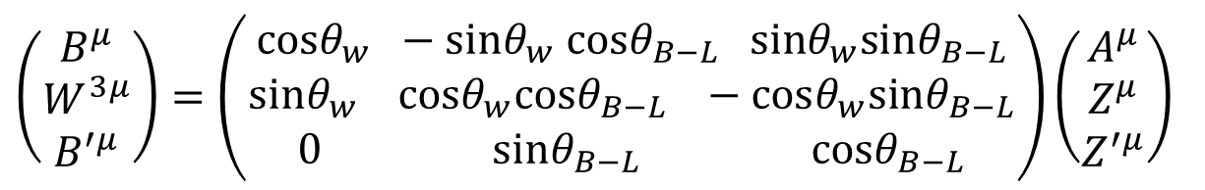
The essence of the extended B-L model and the ILC, CLIC colliders
The extension we are studying is in the Abelian sector of the SM gauge group, so that the charged gauge bosons W± will have masses given by their SM expressions related to the SU(2)_{L} factor only. The other gauge boson masses are not so simple to identify because of mixing. In fact, analogous to the SM, the fields of definite mass are linear combinations of W_{μ}³, B_{μ}, and B′_{µ} .
The relation between the neutral gauge bosons and the corresponding mass eigenstates is given by;
$\left(\begin{matrix}B^{μ} \\ W^{3μ} \\ B^{′μ}\end{matrix}\right)=\left(\begin{matrix}cosθ_{w} −sinθ_{w} cosθ_{B−L} sinθ_{w}sinθ_{B−L} \\ sinθ_{w} cosθ_{w}cosθ_{B−L} −cosθ_{w}sinθ_{B−L} \\ 0 sinθ_{B−L} cosθ_{B−L}\end{matrix}\right)\left(\begin{matrix}A^{μ} \\ Z^{μ} \\ Z^{′μ}\end{matrix}\right)$
with θ_{W,} the Weinberg angle, and θ_{B-L} (− π/4 ≤ θ_{B-L} ≤ π/4 ).
The Higgs-strahlung process e⁺e⁻ → Zh is one of the main production mechanisms of the Higgs boson in future e⁺e⁻ linear colliders such as the ILC and CLIC.
XXXII Reunión Anual de la División de Partículas y Campos de la SMF

Slide 9
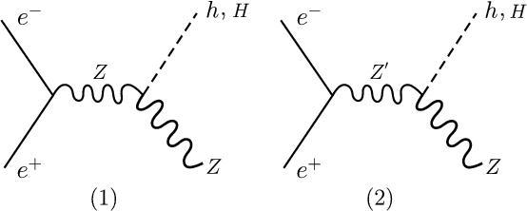
The Process
The Higgs Strahlung Process e⁺e⁻ → Z h and e⁺e⁻ → Z H in the B - L Model
The Feynman diagrams contributing to the processes e⁺e⁻ → (Z, Z′) → Zh and e⁺e⁻ → (Z, Z′) → ZH
The transition amplitude for the production of the SM Higgs boson h in both models is;
XXXII Reunión Anual de la División de Partículas y Campos de la SMF

Slide 10
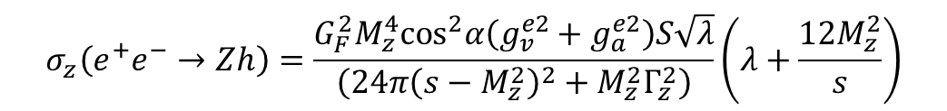
The Process
The cross section σ for the different processes involved in the Higgs–Strahlung B-L model
$$σ_{z}\left(e^{+}e^{−}→Zh\right)=\frac{G_{F}^{2}M_{z}^{4}\cos^{2}α\left(g_{v}^{e2}+g_{a}^{e2}\right)S\sqrt{λ}}{\left(24π{\left(s−M_{z}^{2}\right)}^{2}+M_{z}^{2}Γ_{z}^{2}\right)}\left(λ+\frac{12M_{z}^{2}}{s}\right)$$
$$σ_{\left(z^{′}\right)}\left(e^{+}e^{−}→Zh\right)=\frac{G_{F}^{2}M_{Z}^{6}}{24π}\left({\left(g_{v}^{′e}\right)}^{2}+{\left(g_{a}^{′e}\right)}^{2}\right)\frac{s\sqrt{λ}\left[λ+12{M_{Z^{′}}^{2}}/s\right]}{M_{Z^{′}}^{2}\left[{\left[s−M_{Z^{′}}^{2}\right]}^{2}+M_{Z^{′}}^{2}Γ_{Z^{′}}^{2}\right]} {\left[f\left(θ^{′}\right)cosα+g\left(θ^{′}\right)sinα\right]}^{2}$$
Observe the cos α and the [ f(θ’) cosα +g(θ’) sin α]
The first expression corresponds to the cross section with a Z boson exchange while the next two are the contributions of the B–L model and of the interference, respectively.
XXXII Reunión Anual de la División de Partículas y Campos de la SMF

Slide 11
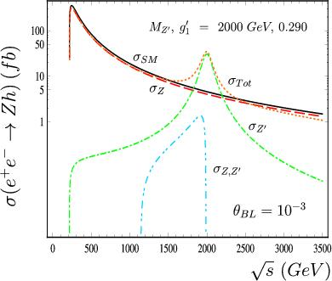
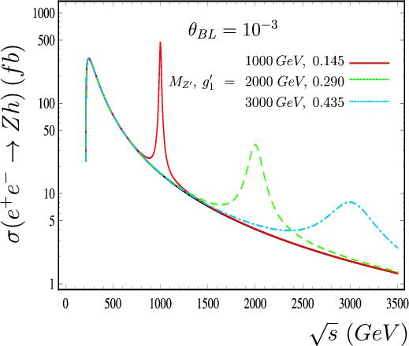
Results and Conclusions
We evaluate the total cross section σ of the process e⁺e⁻ → (Z,Z′) → Zh in the B-L model using the these values for our computation; sin² θ_{W} = 0.23126 ± 0.00022, m_{τ} = 1776.82 ± 0.16 MeV, m_{b}=4.6 ± 0.18 GeV, m_{t} = 172 ± 0.9 GeV, M_{W} = 80.389 ± 0.023 GeV, M_{Z} = 91.1876 ± 0.0021 GeV, Γ_{Z} = 2.4952 ± 0.0023 GeV, M_{h} = 125 ± 0.4 GeV
XXXII Reunión Anual de la División de Partículas y Campos de la SMF

Slide 12
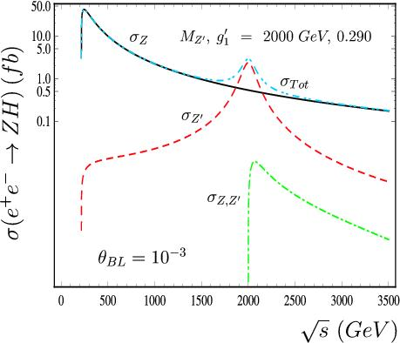
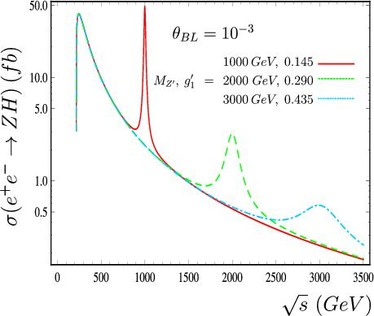
Results and Conclusions
We find that the total number of expected Z_{h} and Z_{H} events can reach 10⁶ and 10⁵, respectively, which is a very optimistic scenario and it would be possible to perform precision measurements for both Higgs bosons h and H, for the Z′ heavy gauge boson, as well as for the parameters of the model θ_{B−L}, g′₁ and α in future high-energy and high-luminosity e⁺e⁻ colliders. In addition, the SM expression for the cross section of the reaction e⁺e⁻ → Zh can be obtained in the decoupling limit when θ_{B−L}, g′₁ and α → 0. Our study complements other on the B−L model and on the Higgs-strahlung processes e⁺e⁻ → (Z, Z′) → Zh and e⁺e⁻ → (Z, Z′) → ZH.
XXXII Reunión Anual de la División de Partículas y Campos de la SMF

Slide 13
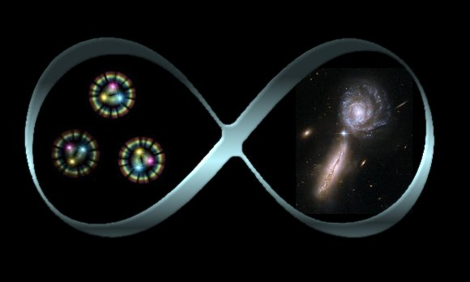



Thanks for your attention
XXXII Reunión Anual de la División de Partículas y Campos de la SMF

