Slide 1
Luminous events and their detection from space with the TUS
XXXII Reunión Anual de la División de Partículas y Campos de la SMF
Oliver Isac Ruiz Hernandez by TUS colaboration (FCFM-BUAP)
Tuesday, May 29, 2018

Slide 2
Content
The “Lomonosov” space project.
TUS detector.
Events selection.
Selection process.
Data reduction.
Interesting events.
Summary.

Slide 3
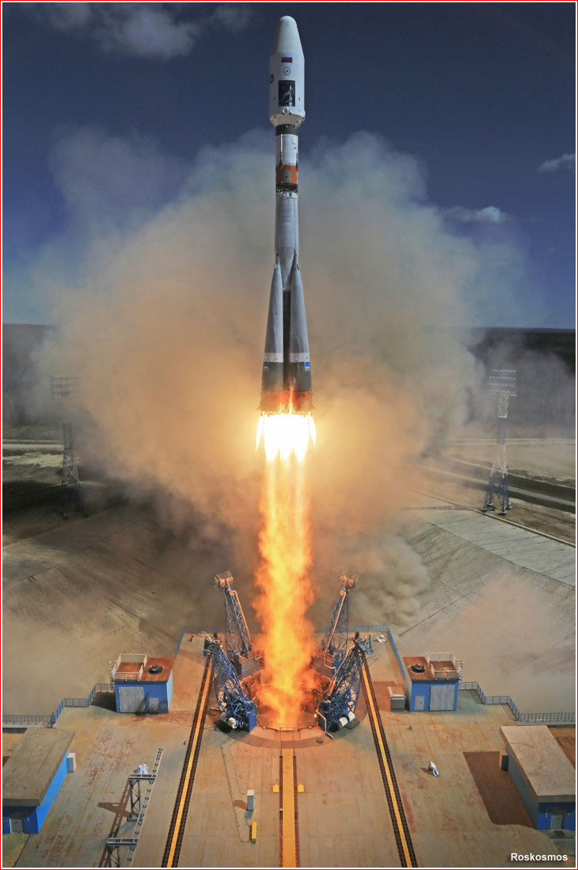
The “Lomonosov” space Project
The “Lomonosov” space project is lead by Lomonosov Moscow State University.
Collaboration:
Russia USA
KOREA DENMARK
SPAIN MEXICO
Some of the principal goals of the experiment are to study:
Ultra-high energy cosmic rays (UHECR) in the energy range of the Greizen-Zatsepin-Kuzmin (GZK) cutoff.
Ultraviolet (UV) transient luminous events in the upper atmosphere.
Multi wavelength study of gamma ray bursts in visible, UV, gamma and X-rays^{[1]}.

Slide 4
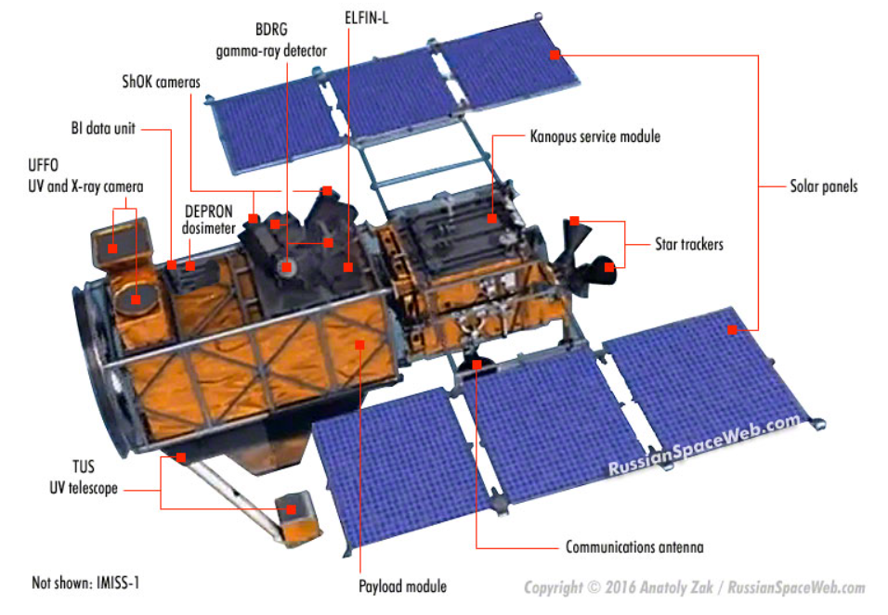
Scientific Instruments
Lomonosov carries a total of eight scientific payloads, including an ultraviolet detector and a telescope for measuring spectra and chemical composition of high-energy cosmic rays.
Some of the scientific instruments are:
BDRG: will be used to locate and monitor celestial sources of gamma radiation.
ShOK: A pair of optical cameras for high-speed photography of light flashes, gamma-ray bursts, as well as satellites and space junk.
UFFO: a X-ray camera and ultraviolet telescope.

Slide 5
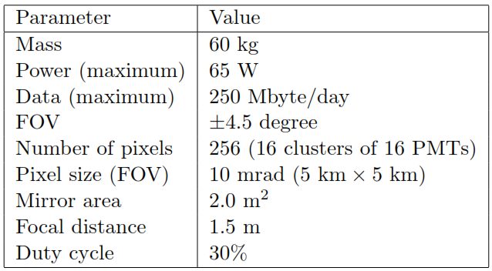
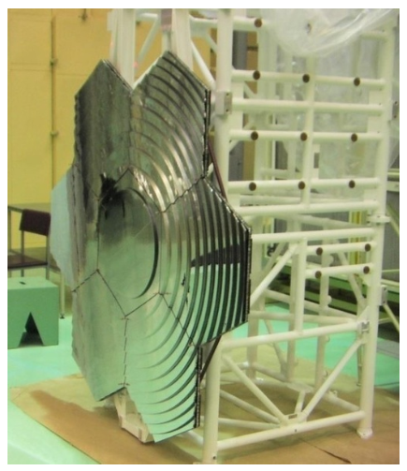
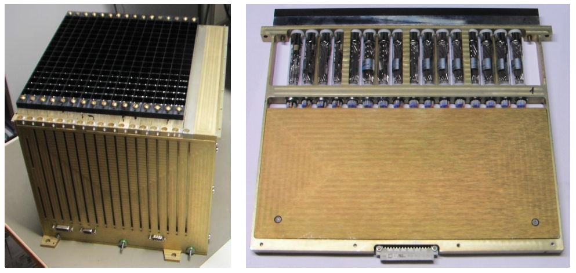
TUS (tracking ultraviolet set-up) detector.
The TUS detector on board the Lomonosov satellite consist of the following elements :
Solar light sensor (SLS).
Photodetector moving system (PDMS).
Segmented mirror-concentrator (SMC).
Photodetector (PD)^{[2]}.
The TUS photodetector (left) and one of the photodetector clusters (right)
TUS detector on board the Lomonosov satellite
TUS segmented mirror-concentrator

Slide 6
Operational modes
The sequence of waveforms is formed by the PDM (photodetector module) boards and provides four types of data (digital oscillograms, DOs) as an output: DO EAS, TLE-1, TLE-2 and METEOR, which correspond to the duration of three distinct physical processes in the atmosphere: extensive air showers, transient luminous events, and micro-meteors respectively.
Temporal characteristics of different DO modes

Slide 7
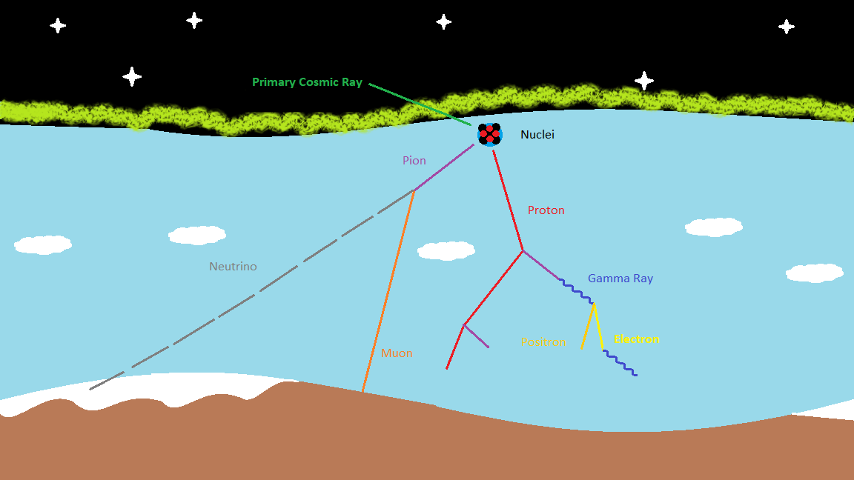
EAS MODE
The Earth´s atmosphere produce cascades of secondary particles, i.e. Extensive Air Showers (EAS), wich can provide information about the primary particle parameters. The bulk of secondary particles in EAS ionize and excite molecules of atmospheric nitrogen and oxygen and lead to the so-called ionization glow, which is most intensive along the EAS axis and resembles a track breacking out in a very short time (about several microseconds).
The fluorescence intensity and its timing along the UV track provide information on EAS cascade developement, direction and energy of primary particles.

Slide 8
Events selection
We analized data from the first semester of 2017, there were analized around 34,000 events, the selection of events was made with the help of custom made programs in Python and a further data reduction, which results in 220 interesting events.
Selection process
Selection by location.
Selection by light background.
Selection by signal to noise ratio.
Data reduction
Background correction.
Gain correction.

Slide 9
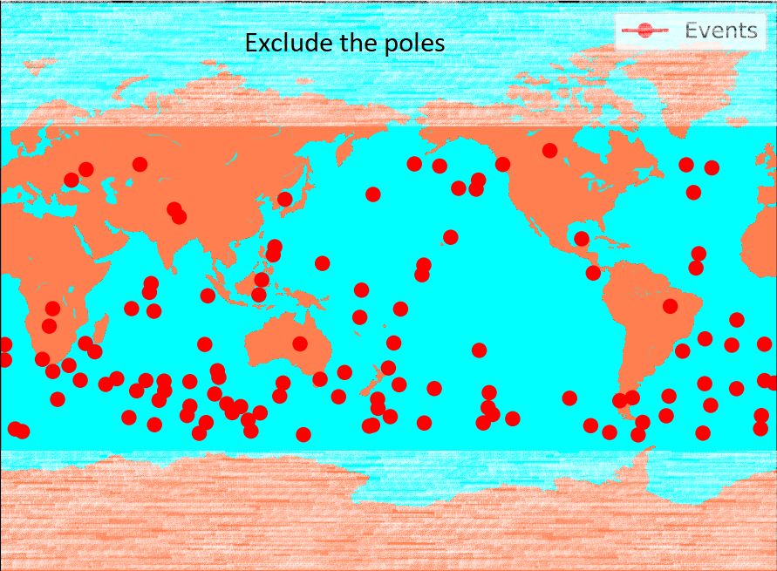
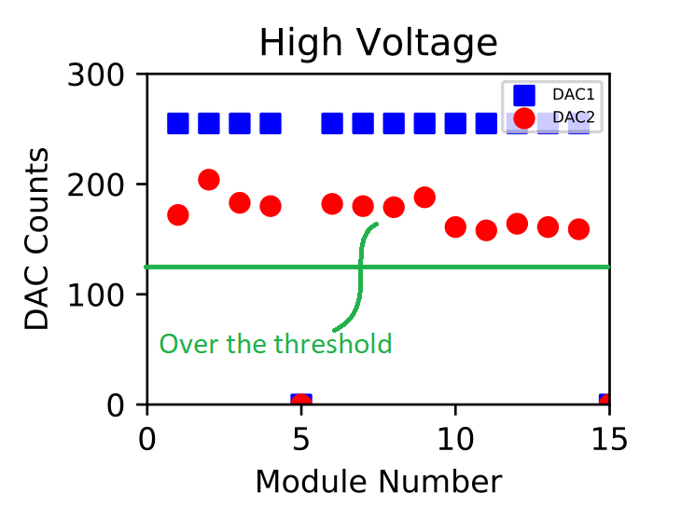
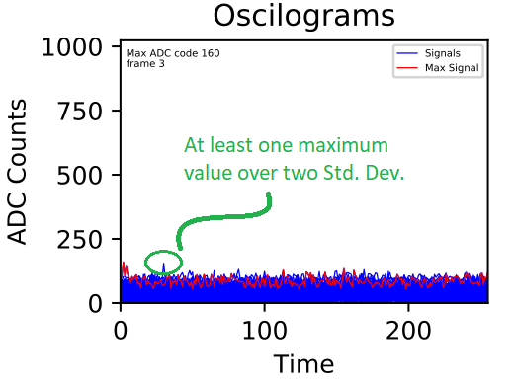
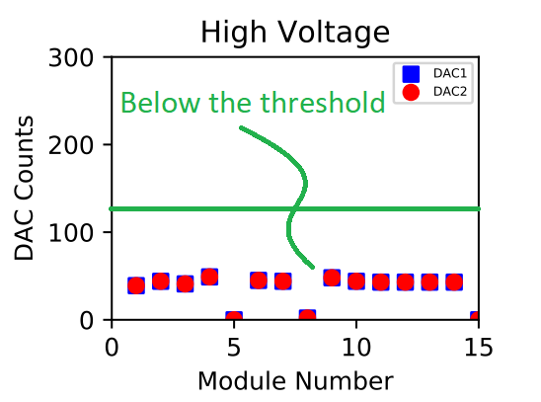
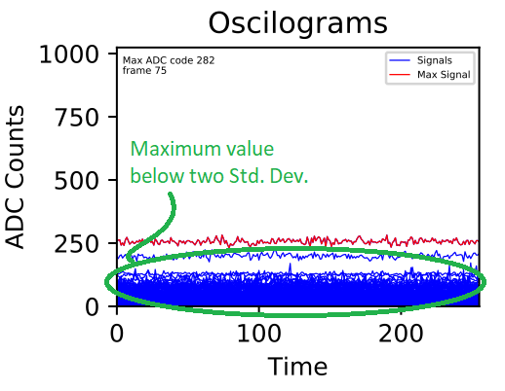
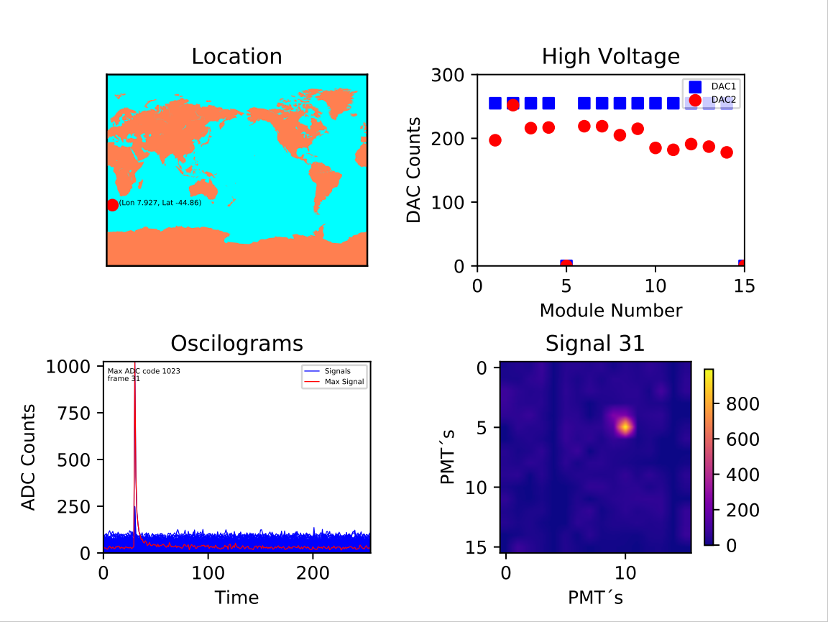
Flow chart
Location
Yes
Yes
No
No
Generate these Images
Light background
Signal to nosie ratio
Candidate to event
Not interesting
Not interesting

Slide 10
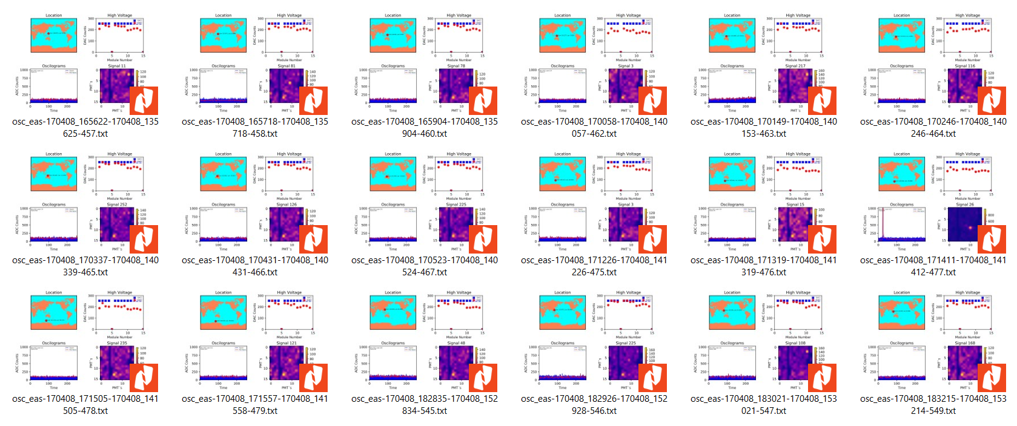
Sample of the previous flow chart
Sample of candidate to event

Slide 11
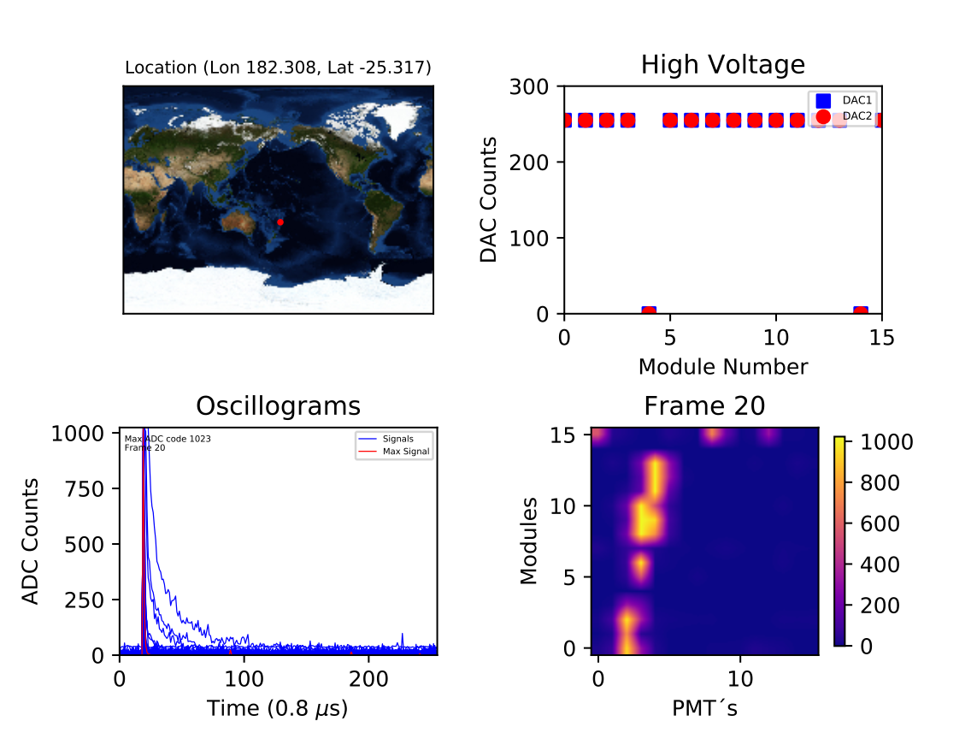
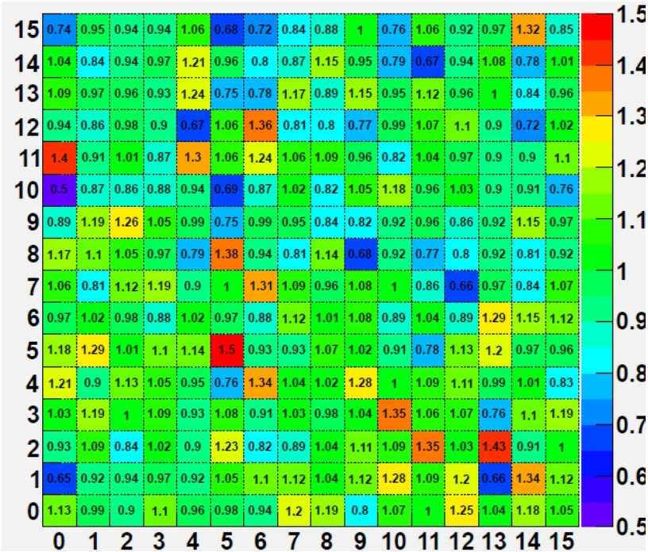
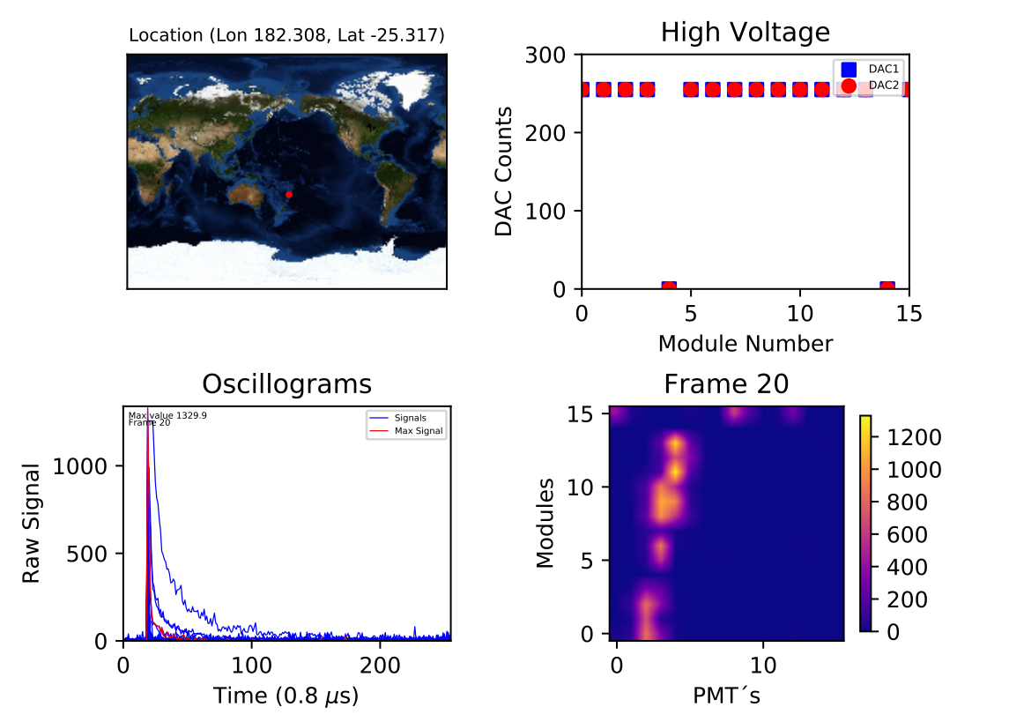
Corrected by Background and Gain correction
Gain matrix
Before correction
After correction

Slide 12
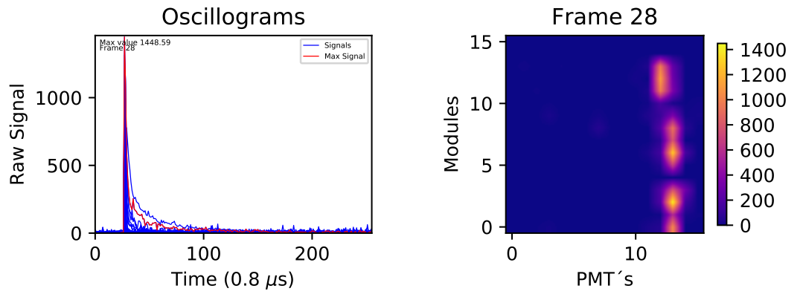
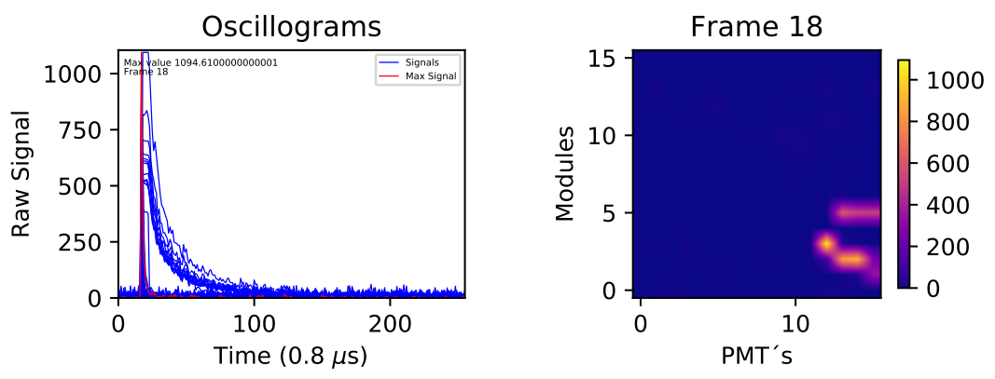
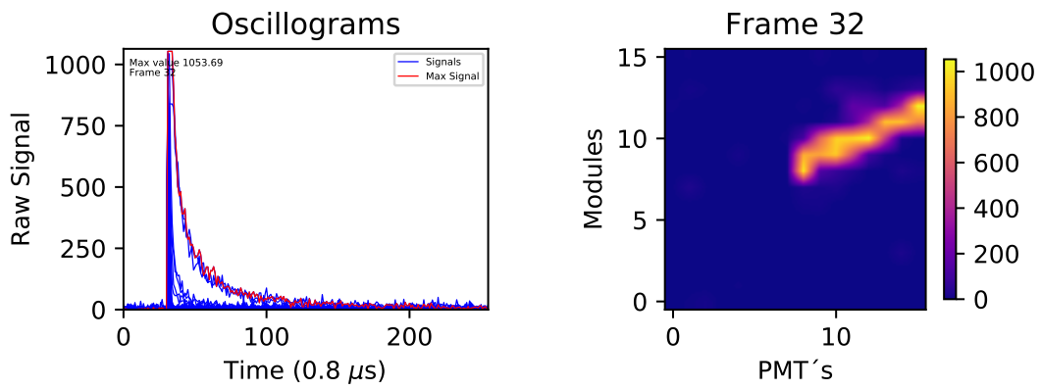
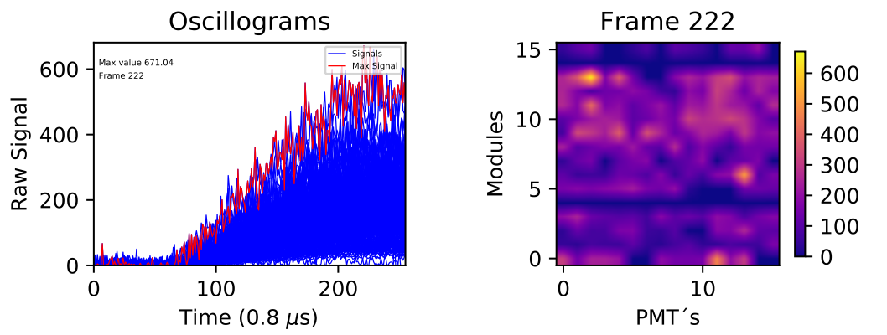
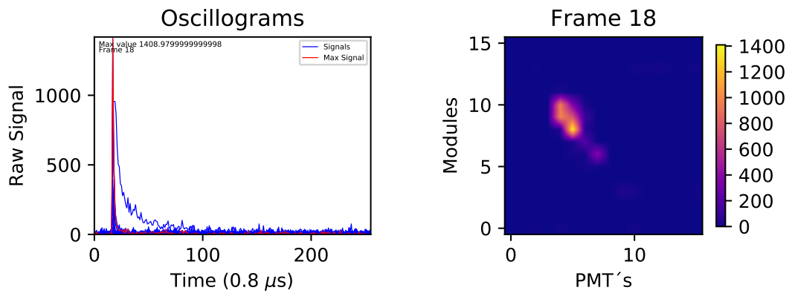
Long track
Preliminary Clasification
Singulars
Point like
Middle track

Slide 13
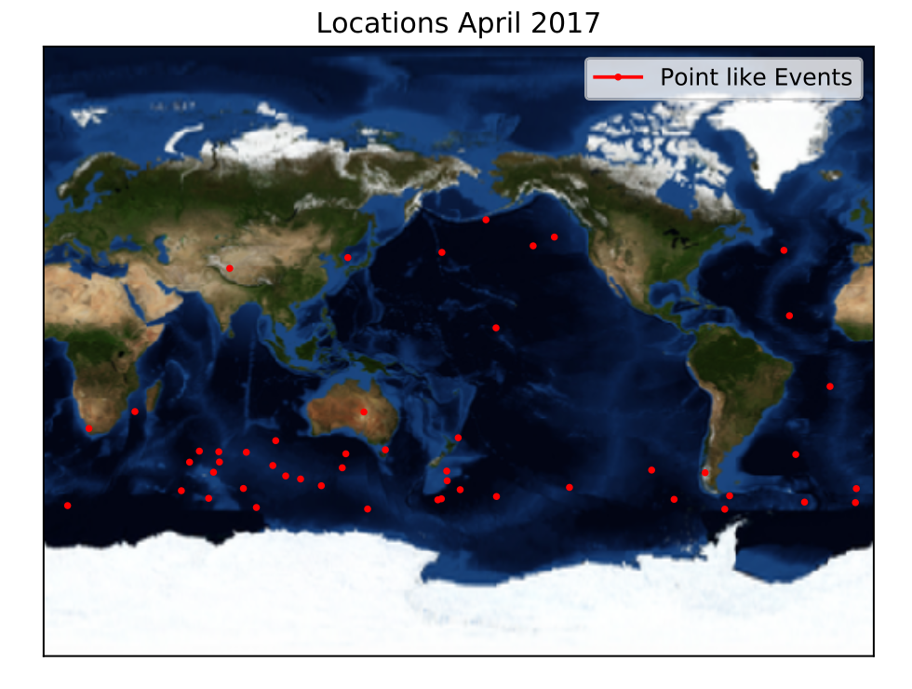
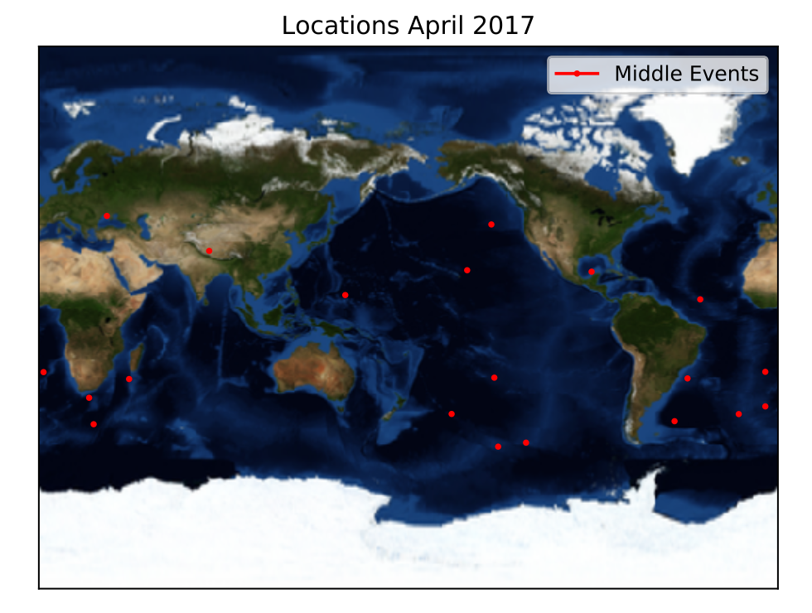
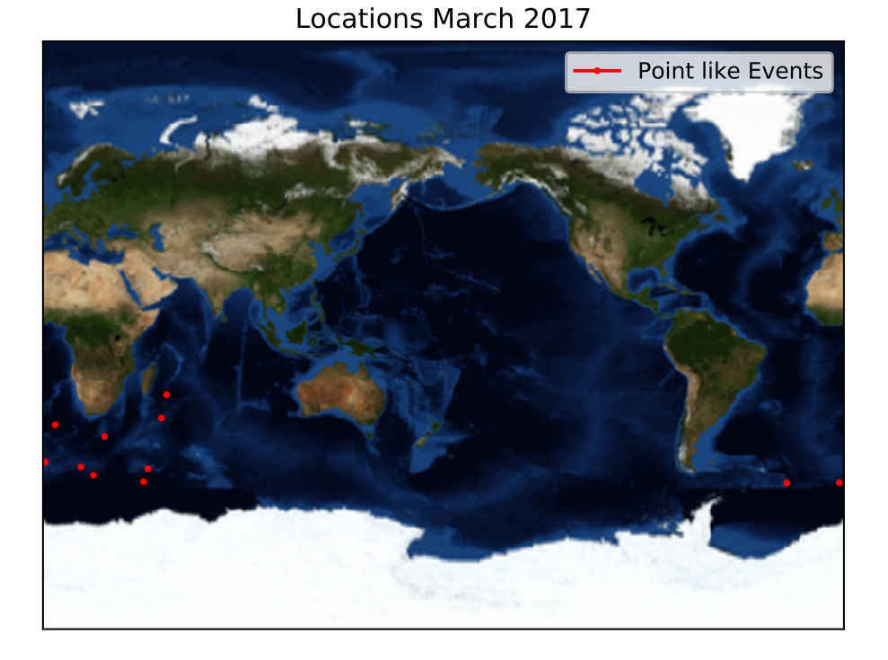
Geographic distributions
Point like events from March 2017
Point like events from April 2017
Middle events from April 2017

Slide 14
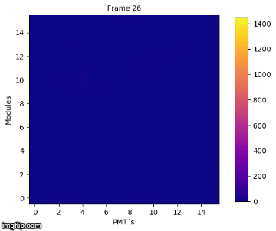
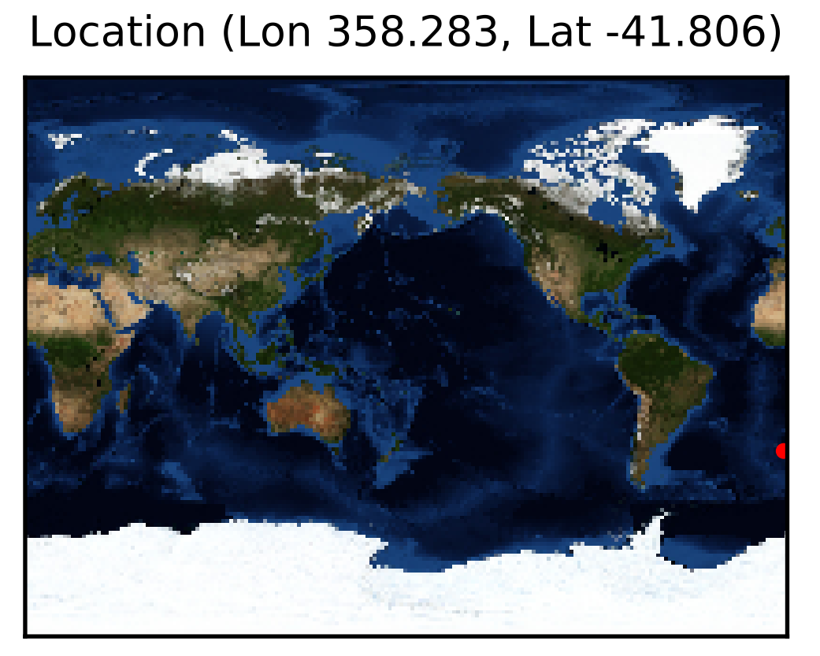
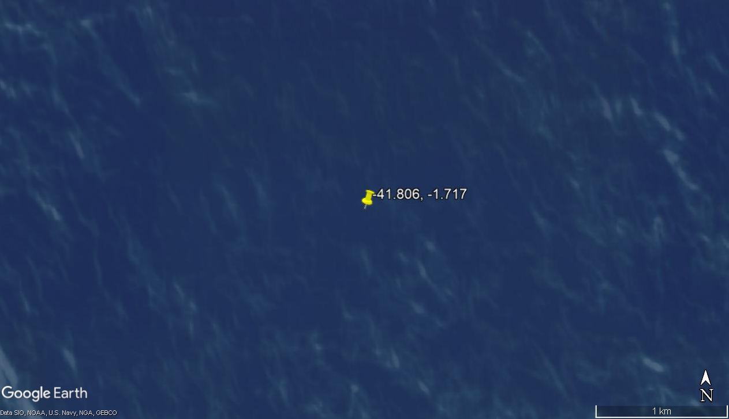
Interesting events
Long track event
03-April-2017
Duration (µs) | Distance Traveled (km) | Maximum Signal | Size Event at frame 28 (km²)
16 | 4.8 | 1448.59 | 400

Slide 15
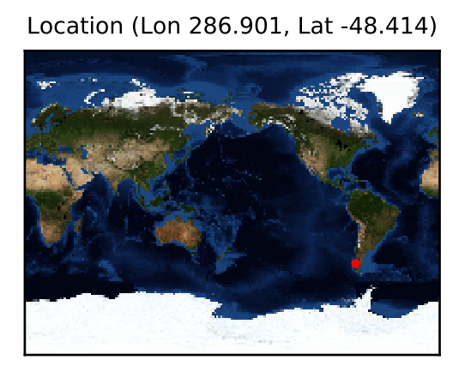
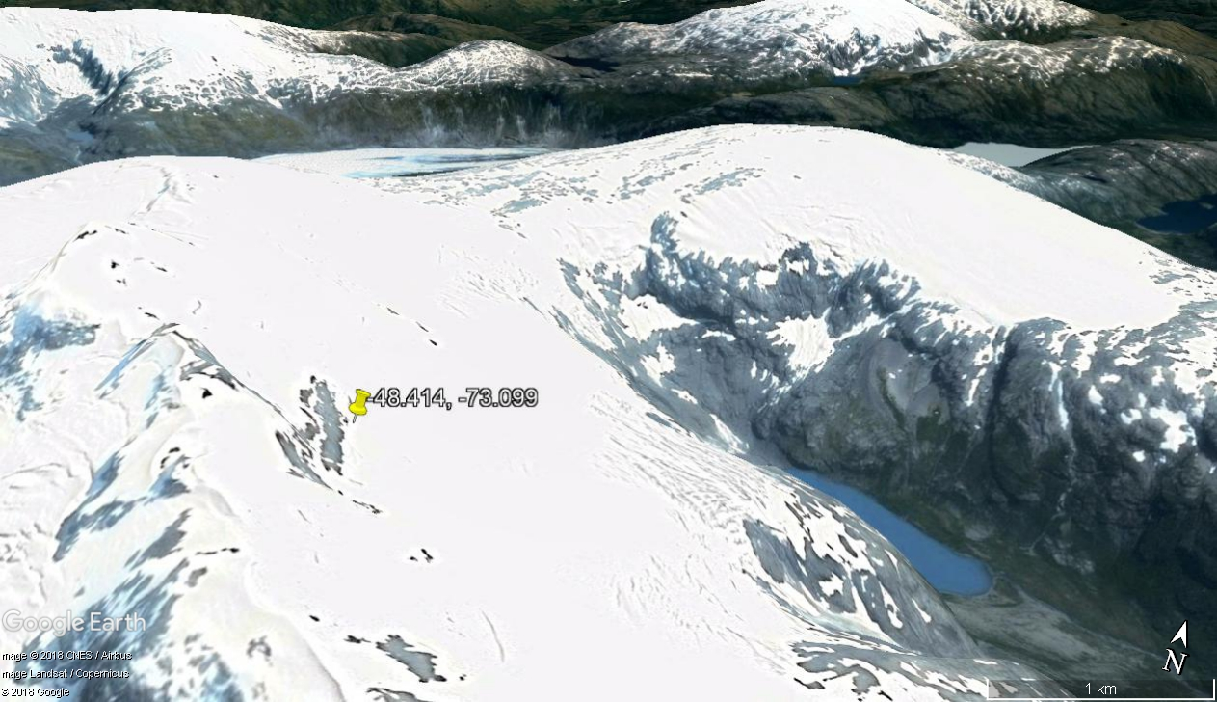
Point like event
18-April-2017
Duration (µs) | Distance Traveled (km) | Maximum Signal | Size Event at frame 18 (km²)
36.8 | 11.04 | 1408.98 | 150

Slide 16
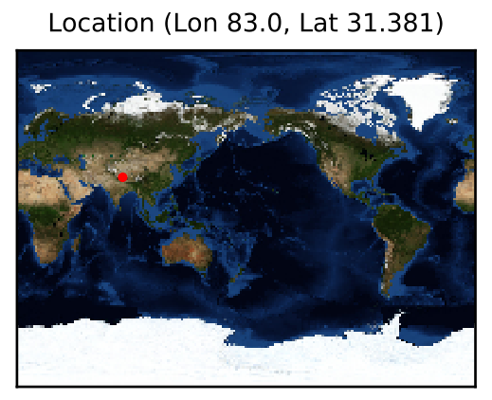
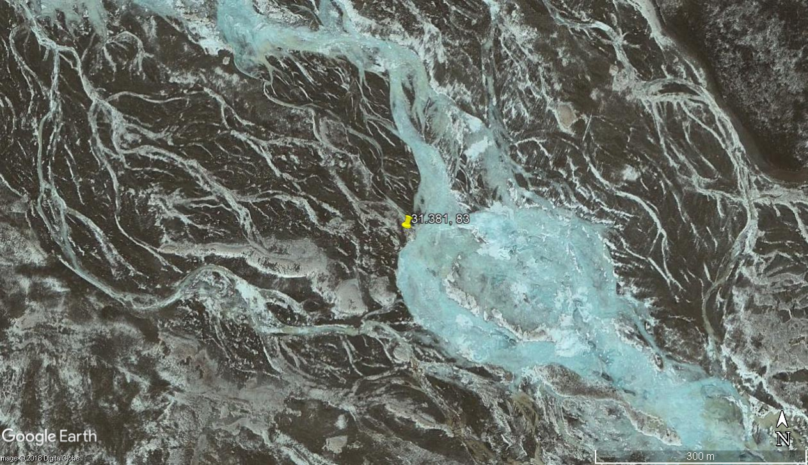
Middle track event
20-April-2017
Duration (µs) | Distance Traveled (km) | Maximum Signal | Size Event at frame 32 (km²)
40 | 12 | 1053.69 | 400

Slide 17
Summary
We presented a brief scheme about the Lomonosov space project, and the TUS detector on board the Lomonosov satellite. We show the general scheme for events selection from TUS and discussed some results from events of the first semester of 2017 of the TUS on EAS operational mode, like a classification and geographic distribution.
we are working on statistical analysis of the maximum value recorded on the event, as well as the analysis of the spatial extention of the interesting events.

Slide 18
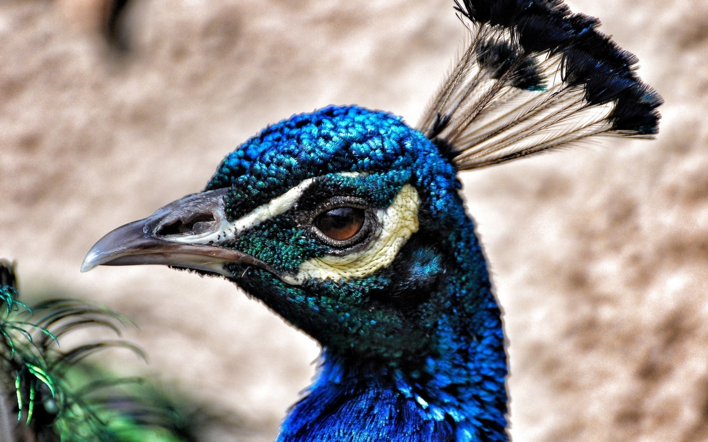
Gracias por su atención

