Slide 1
Induced Gravity: dark energy and dark matter
Jorge L. Cervantes Cota
Electronic coordinates: jorge@nuclear.inin.mx www.astro.inin.mx
XIII MEXICAN SCHOOL OF PARTICLES AND FIELDS

Slide 2
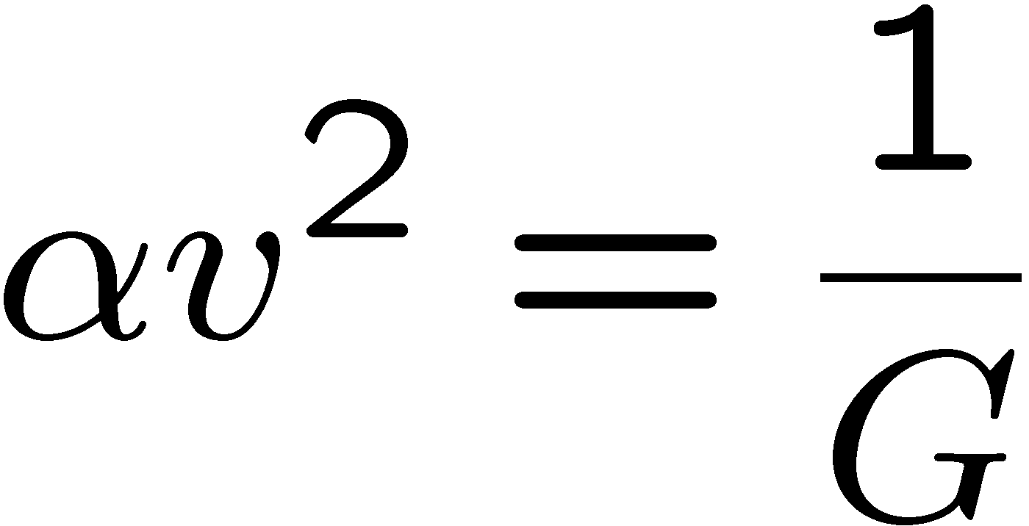
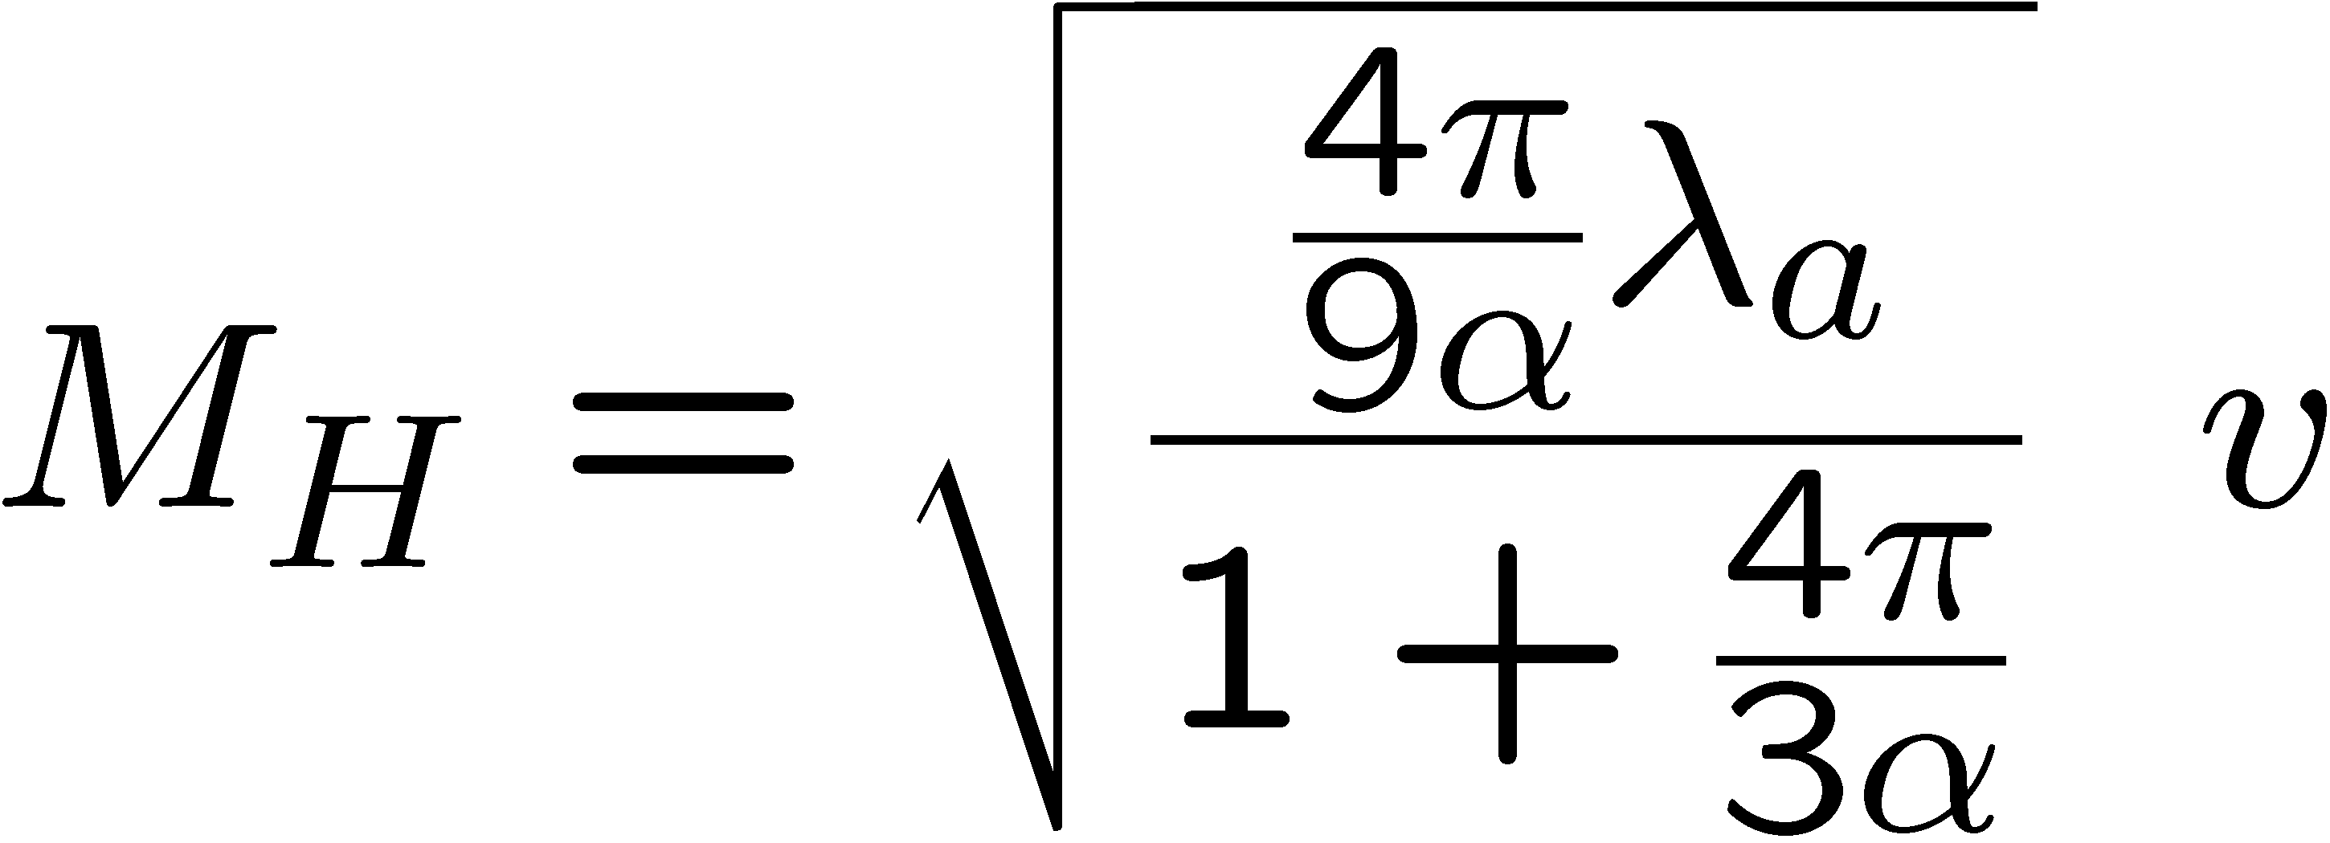
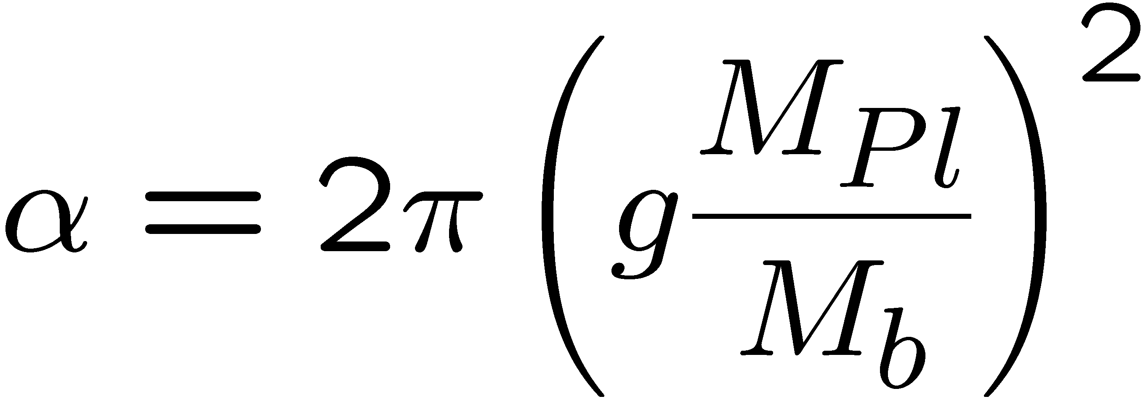
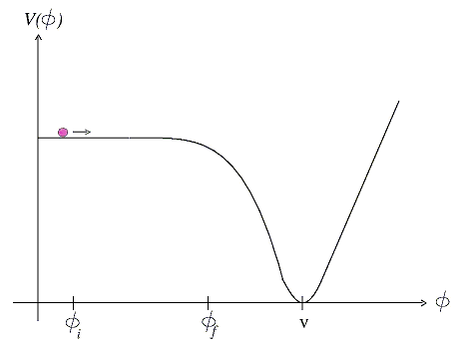
Induced gravity
→

Slide 3
Excited Higgs

Slide 4
Field equations

Slide 5
FRW equations

Slide 6
Initial conditions
Integrating from last scattering (decoupling) to now:

Slide 7
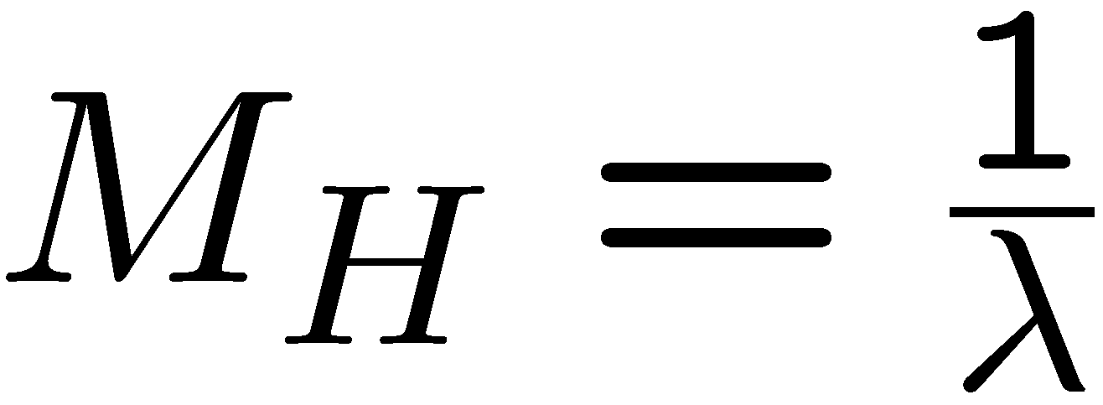
Parameters
cosmological parameters:
→
→
Constraints from local, astrophysical, cosmological measurements
Newtonian limit

Slide 8
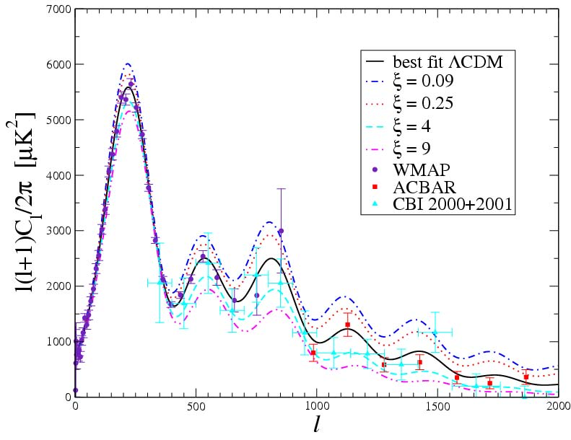
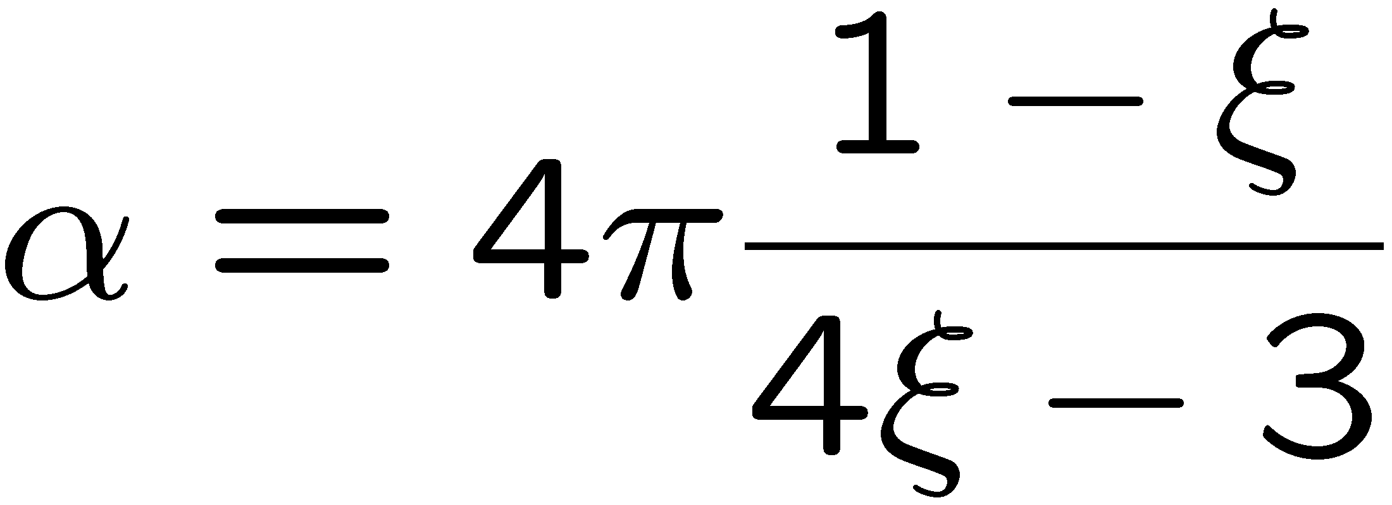
Constraints
K. Umezu, K. Ichiki y M. Yahiro, PRD 72 044010 (2005)

Slide 9
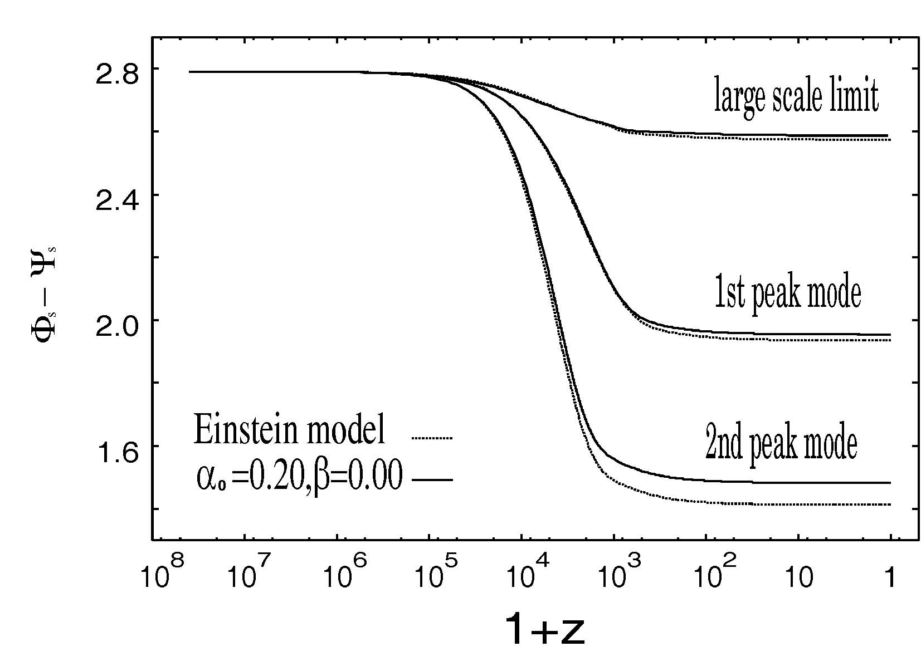
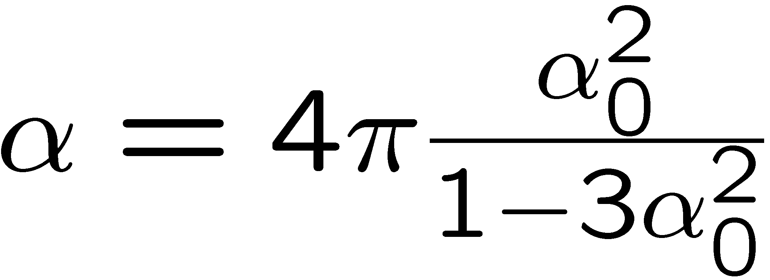
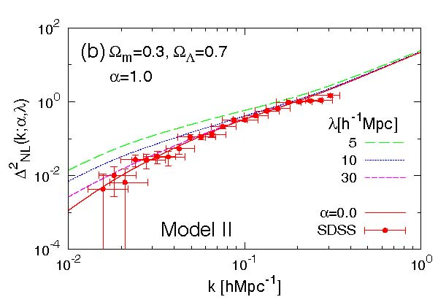
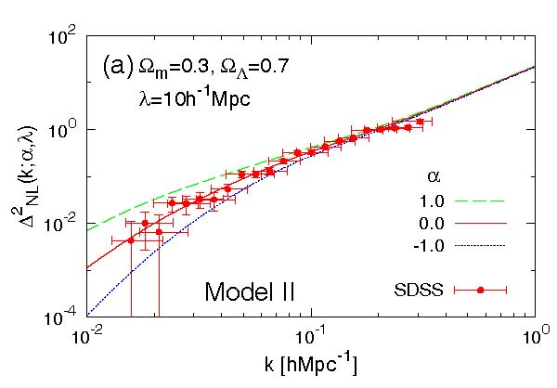
More constraints...
R. Nagata, T. Chiba y N. Sugiyama, PRD 66 103510 (2002)
A. Shirata et. al., PRD 71 064030 (2005)

Slide 10
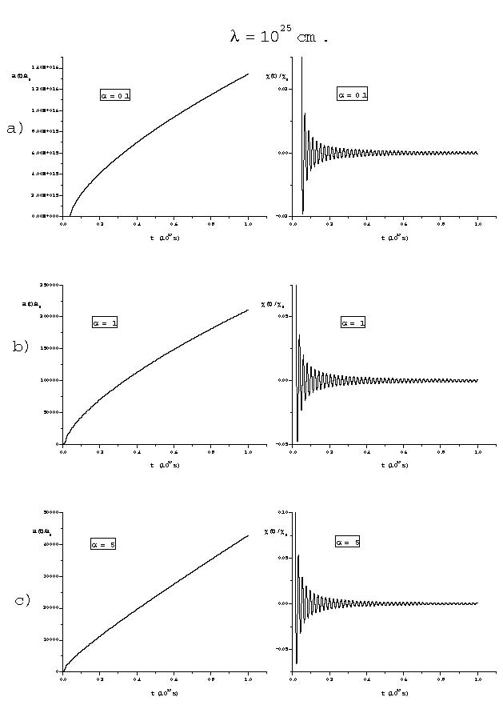
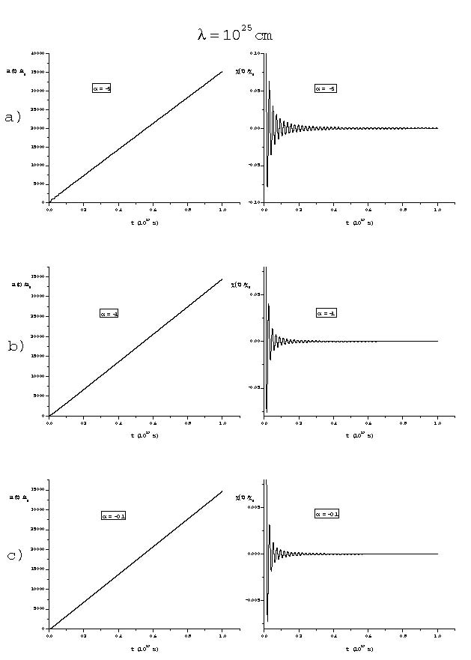
Chosen parameters

Slide 11
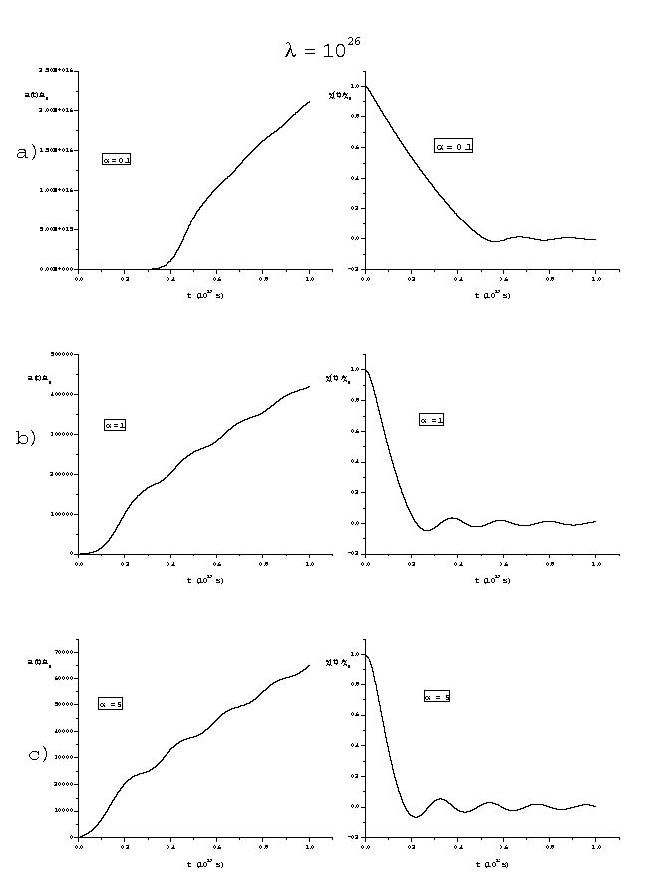
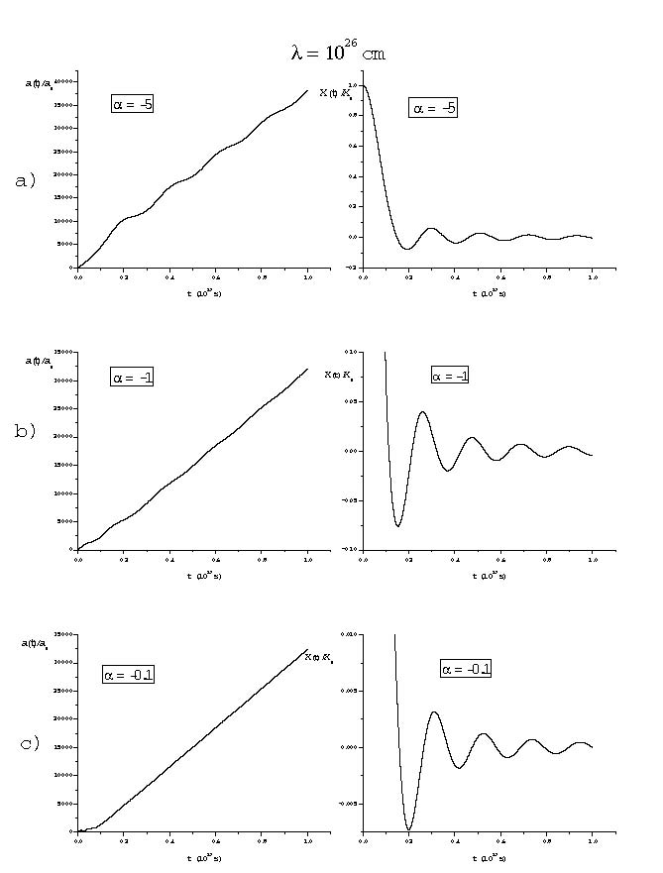
results, λ=10²⁶ cm

Slide 12
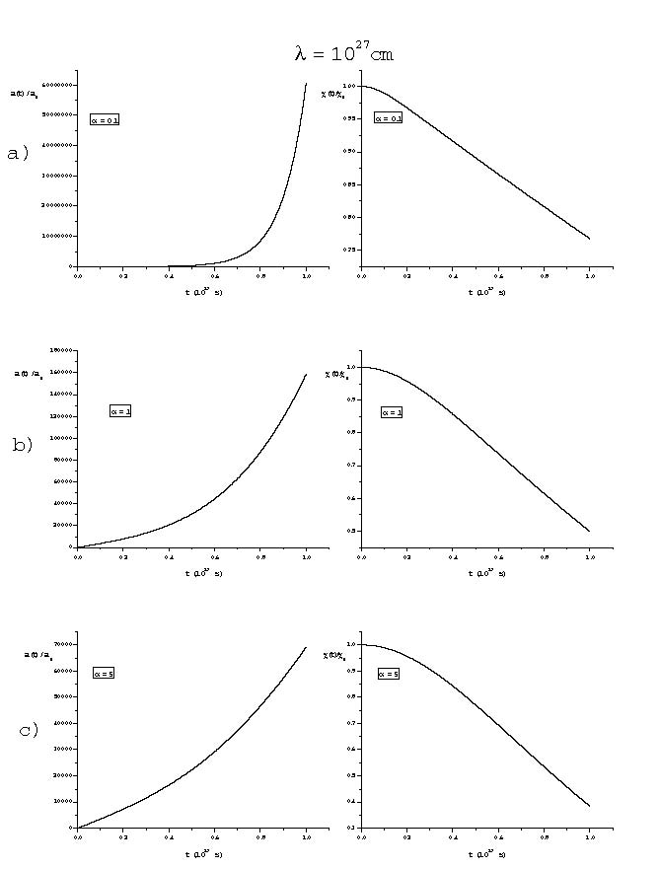
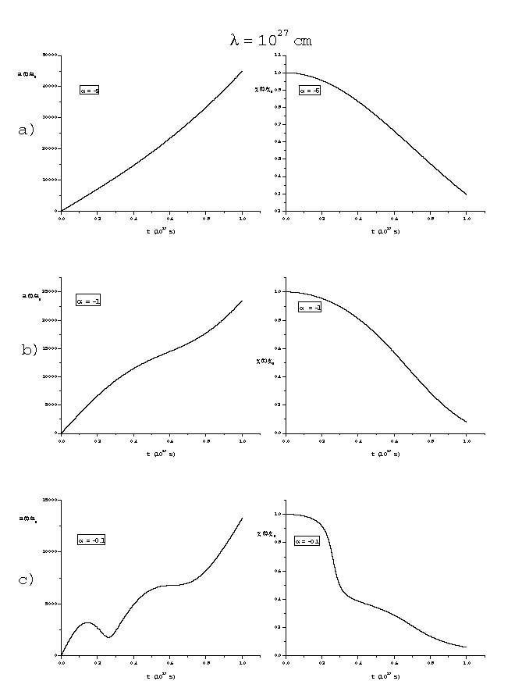
results, λ=10²⁷ cm

Slide 13
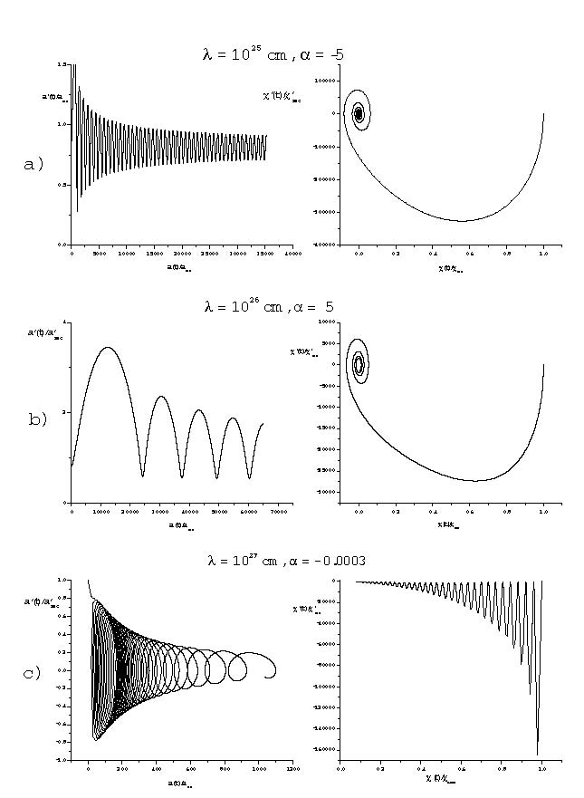
Phase space

Slide 14
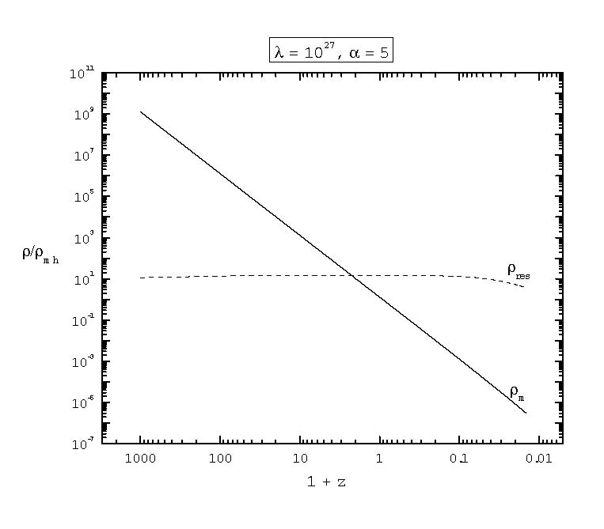
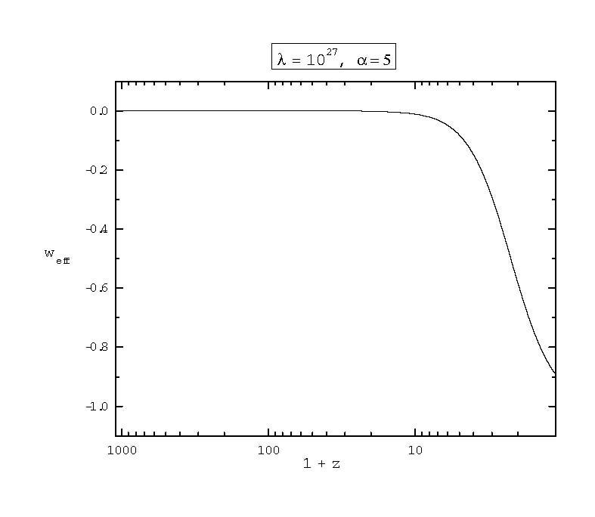
Evolution of ρ_{eff} y w_{eff}
Effective equation of state

Slide 15
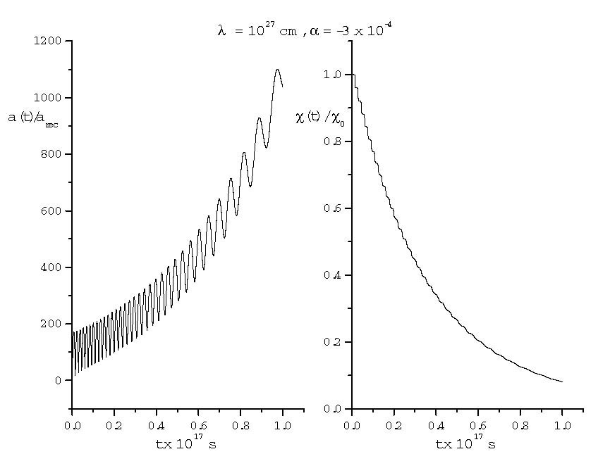
results, λ=10²⁷ cm, α=-3x10⁻⁴
K-essence

Slide 16
The best fitted parameters

Slide 17
More results

Slide 18
Conclusions
The induced gravity model can achieve a successful quintessential scenario, but some parameters need some fine tuning. For some values of α, the scale factor grows oscillating and this predicts some periodic pattern in the structure formation of the Universe.
Jorge Cervantes jorge@nuclear.inin.mx

