Slide 1
Antineutrino detector in México: An invitation
Ildefonso León Monzón
Universidad Autónoma de Sinaloa
CINVESTAV

Slide 2
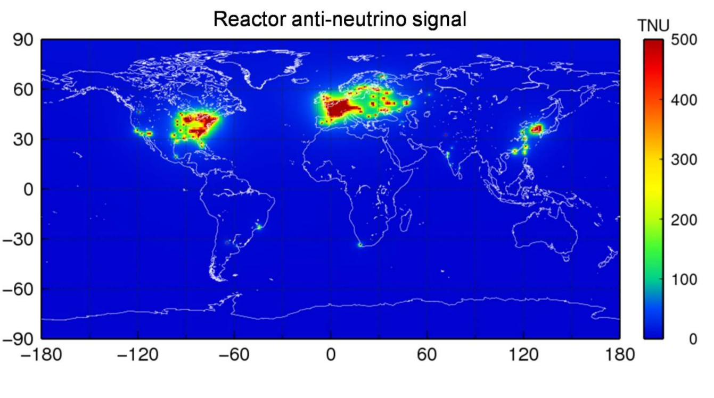
Source of antineutrinos
Antineutrino sources around the world

Slide 3
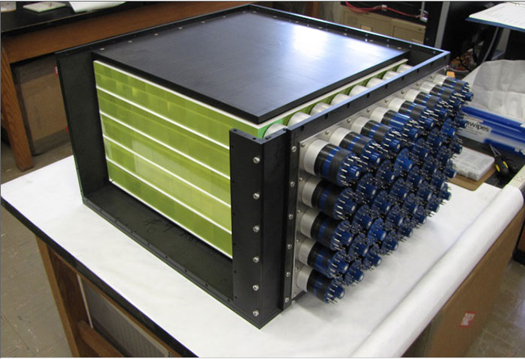
Example: miniCHANDLER

Slide 4
Proposal
Polystyrene, Polyvinyl-Toluene or Gel (new material)
Home made Plastic scintillator: PPO + POPOP
One ton and segmented: 10 kilograms per segment.
Loaded with Gd, at least 1% by weight
Different solutions: Salts, Metal-Organic, dissolved in different polymers…

Slide 5
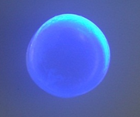
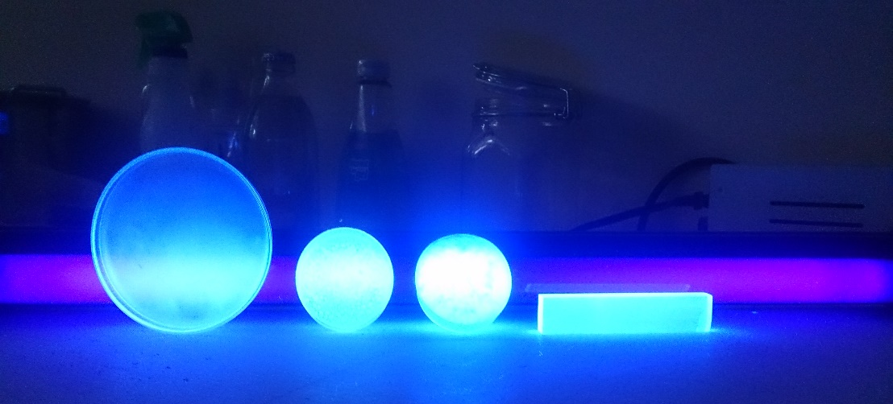
Scintillator produced by the group
Scintillator with Gd: 1% by weight
Gel (Colloidal) and plastic scintillator

Slide 6
Detector geometry
Blocks of 10 litres per segment, the PMT will be coupled directly, 2 PMT per block.
Or Bars with a length of 1 meter, cylindrical with a diameter of 2 inches, and 2 PMT per bar and WLS fibres.
PMTs for this kinf of application are cheap, 400 dollars/PMT

Slide 7
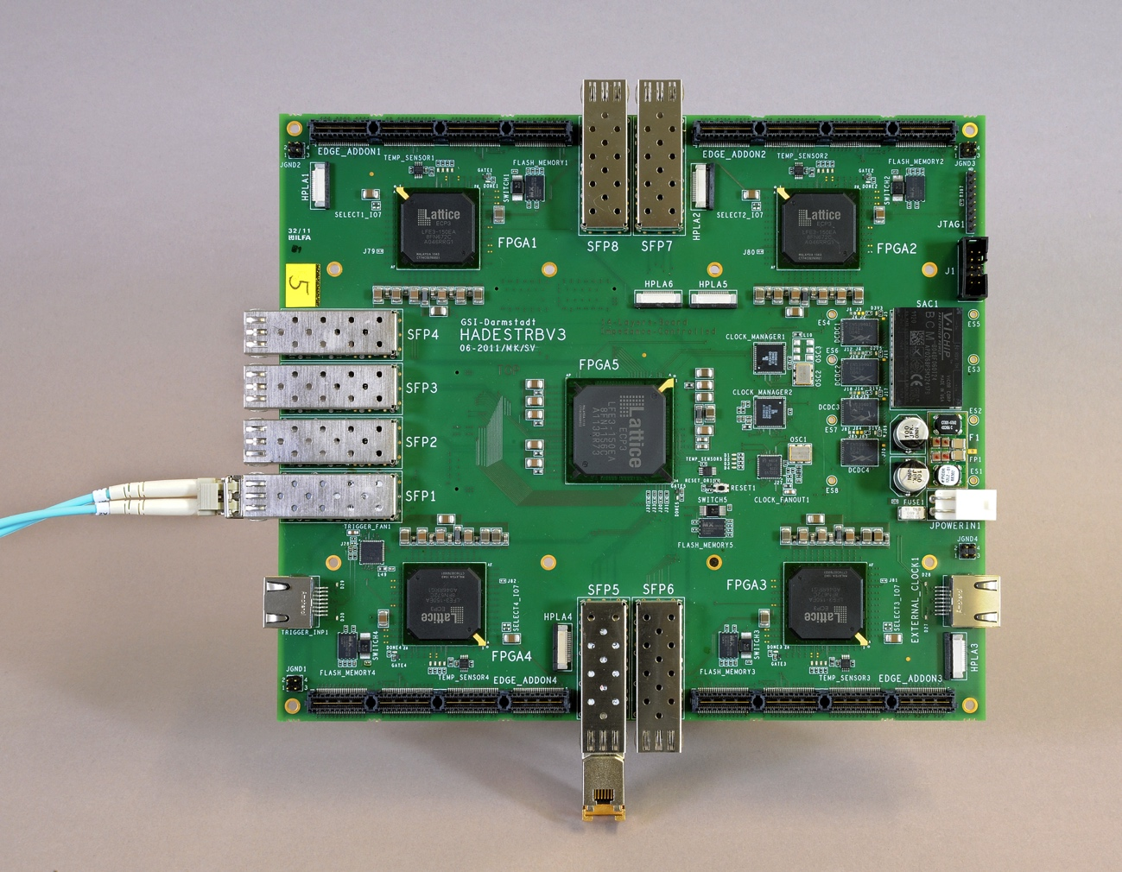
Read Out with TRB3 from GSI: 256 channels for Time and Charge measurement.
Aproximate cost for the project: 250K

Slide 8
Thank you

