Slide 1


Charmonia & Bottomonia in a Contact Interaction
Marco Antonio Bedolla Hernández
Advisor: Adnan Bashir
COLLABORATOR: Javier Cobos
Instituto de física y matemáticas
UMSNH
November 2016

Slide 2
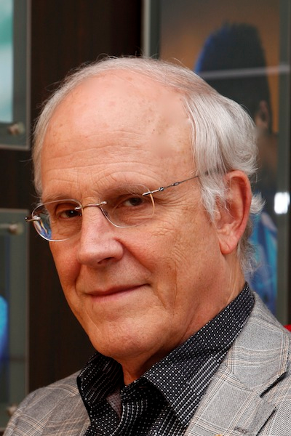

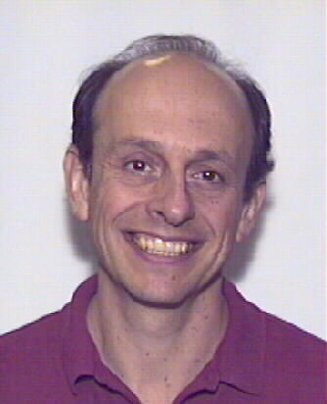
QCD and Hadron Physics
QCD is the theory of quarks, gluons and their interactions.
QCD is a powerful tool in the description of large momentum transfer experiments due to asymptotic freedom.
The properties of confinement and chiral symmetry breaking in the non perturbative sector of QCD are not obvious from the QCD Lagrangian: these emerging phenomena are extremely important to study the spectrum of the observed hadrons, as well as their static and dynamic properties, starting from quarks and gluons.
David Gross and Frank Wilczek Phys. Rev. D 8, 3633(1973)
David Politzer Phys. Rev. Lett. 30, 1346 (1973)
Notes:
Nobel after aymptotic freedom 2004

Slide 3
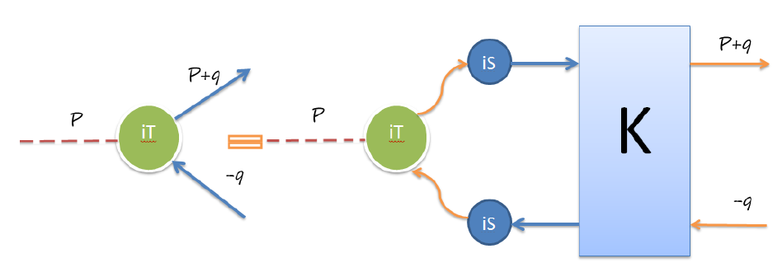
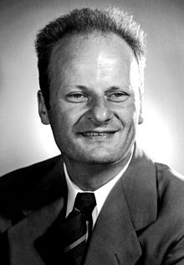


Bethe-Salpeter Equation
Bound states correspond to poles in n-point functions.
A meson appears as a pole in the two-quark, two antiquark Green function → Bethe-Salpeter Equation.
E. E. Salpeter Phys. Rev. 84, 1226 (1951)
E. E. Salpeter and H. A. Bethe Phys. Rev. 84, 1232 (1951)
Notes:
Quarks and gluons are not free– This makes QCD unique: the elementary constituents are not the asymptotic states of the theory.
Study of Hadrons Physics in terms of QCD degrees of freedom; and test our understanding of non perturbative QCD. The x(q;P) describes the coupling of the bound state of a quark and antiquark

Slide 4
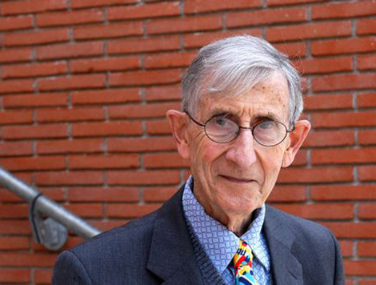
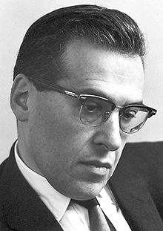
Schwinger-Dyson Equations (SDE)
Schwinger-Dyson equations (SDE) are the equations of motion of a quantum field theory.
They provide a generating tool for perturbation theory.
They are non pertubative in nature and can be used to study:
  Confinement of quark and gluons.
  Dynamical chiral symmetry breaking.
  Hadrons as bound states.
F. J. Dyson The S-Matrix in Quantum Electrodynamics
Phys. Rev. 75, 1736(1949)
J. Schwinger, On Green’s Functions of Quantized Fields I, II, PNAS 37 452–459 (1951)
Notes:
Referencias originales

Slide 5
Schwinger-Dyson Equations (SDE)
SDE are an infinite set of coupled nonlinear integral equations for the n-point Green functions.
The structure of these equations is such that they relate n-point Green functions to n+1-point Green functions.
Their derivation does not require the coupling strength to be small. Therefore, they are ideally suited to combine infrared and ultraviolet properties of QCD.
However, we need to introduce a truncation scheme for the complete tower of these equations, while faithfully maintaining the fundamental QCD properties.
Notes:
We have an infinite set of coupled nonlinear integral equations for the n-point functions
Need to introduce a truncation scheme for the tower of integral equations
Try to incorporate general properties of the theory (such as chiral symmetry breaking pattern, etc.

Slide 6
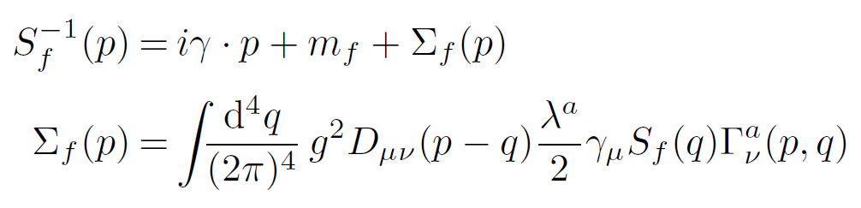
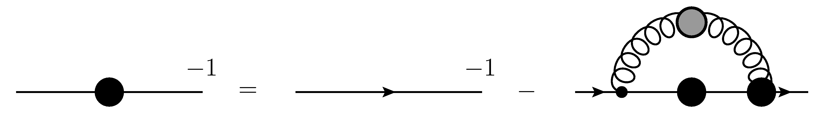
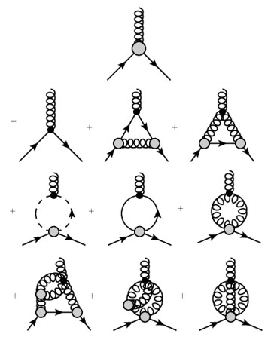
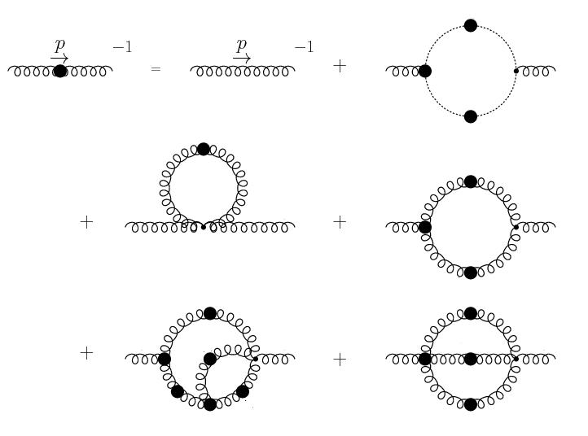
Schwinger-Dyson Equations (SDE)
Quark
SDE:
Notes:
We have an infinite set of coupled nonlinear integral equations for the n-point functions
Need to introduce a truncation scheme for the tower of integral equations
Try to incorporate general properties of the theory (such as chiral symmetry breaking pattern, etc.

Slide 7
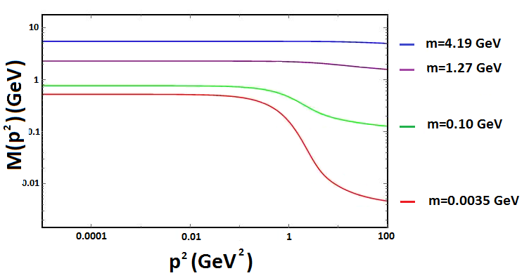
Schwinger-Dyson Equations (SDE)
With a phenomenology based ansatz for the kernel of the gap
equation, we can study the running mass function of quarks.
Notes:
I am showing the results of the Gap Mass equation with a model with relative momentum dependance. As we can see, for heavy masses the mass generated dynamically can be neglegted and it is possible that we can work for heavy quarks using this model

Slide 8
Axial-Vector Ward-Takahashi Identity
Axial vector Ward-Takahashi identity in the chiral limit
encodes the chiral symmetry properties of QCD & relates the
kernel in the meson BSE to that in the quark SDE.
This guarantees a massless pion in the chiral limit when chiral
symmetry is broken dynamically.
Notes:
Is essential when computing properties of the pion, it is satisfied if and only if the model is regularized so as to ensure there are not quadratic or logaritmic divergens, to have chiral symmetry

Slide 9
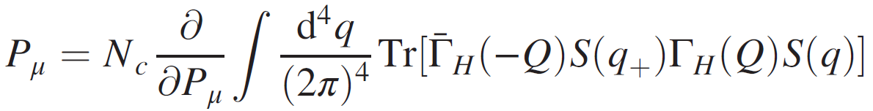
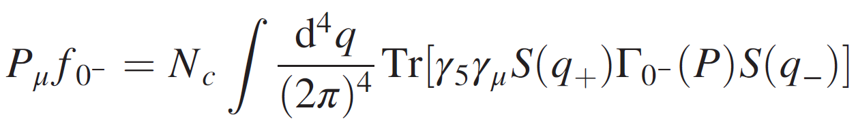
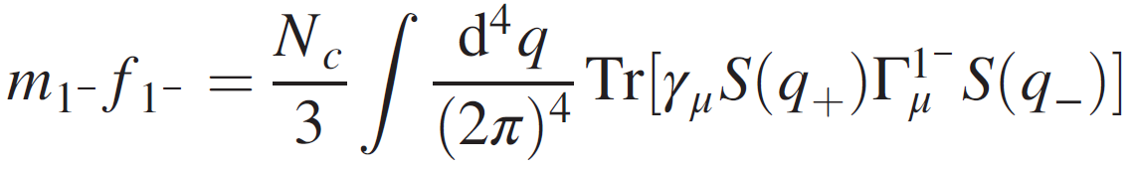
Normalization Condition
Since the BSE is a homogeneous equation, its amplitudes have to be normalized by a separate condition
Once the amplitudes have been normalized canonically, it is possible to calculate observables such as the leptonic and vector decay constants

Slide 10
Contact Interaction
We use a contact interaction model mediated by a vector-vector interaction employed in:
L. Xiomara Gutiérrez, et. al., Phys. Rev. C81, 065202 (2010);
Phys. Rev. C82, 065202 (2010);
Phys. Rev. C83, 065206 (2011).
This model provides a simple scheme to exploratory studies of the spontaneous chiral symmetry breaking and its consequences like:
  Dynamical mass generation.
  Quark condensate.
  Goldstone bosons in chiral limit.
  Confinement.
Notes:
It a model which is independent of relative momentum
En el segundo se calcula para el meson rho

Slide 11
Contact Interaction
L. Xiomara Gutiérrez, et. al., Phys. Rev. C81, 065202 (2010);
H.L.L. Roberts, et. al., Phys. Rev. C82, 065202 (2010);
Phys. Rev. C83, 065206 (2011).
Few Body Syst. 51, 1 (2011)
C. Chen, et. al., Few Body Syst. 53, 293 (2012)
“Elastic and Transition Form Factors of the Δ(1232)”,
J. Segovia, C. Chen, I.C. Cloet, C.D, Roberts, S.M. Schmidt, S. Wan,
Few Body Sys. 55, 1 (2014).
“Insights into the γ*N → Δ Transition”,
J. Segovia, C. Chen, C.D, Roberts, S. Wan,
Phys. Rev. C88. 3, 032201 (2014).
“Nucleon and Roper Electromagnetic Elastic and Transition Form Factors”,
D.J. Wilson, I.C. Cloet, L. Chang, C.D, Roberts,
Phys. Rev. C85. 3, 025205 (2012).
Notes:
In the first three ones the CI wes developed in computing some properties of the pion and rho: masses, decay constants, form factors, etc
The seconds the contact interaction was used in the Faddevv equation and a third quark flavor was added (the s) quark
Finally, in the last papers some of different application into the transitions and the properties of form factors were calculated using the contact interaction

Slide 12
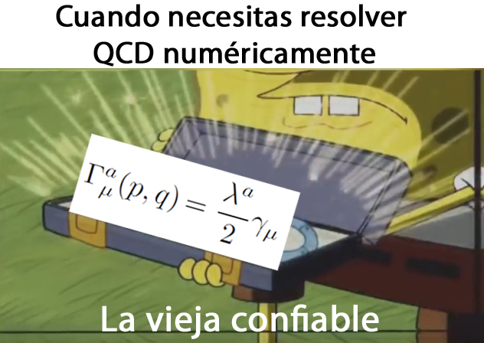
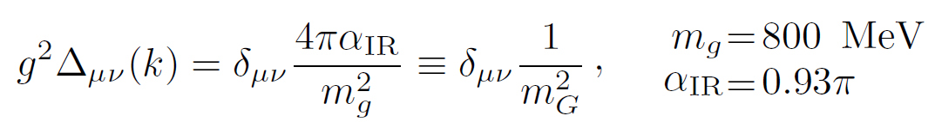
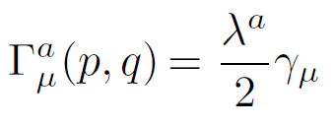
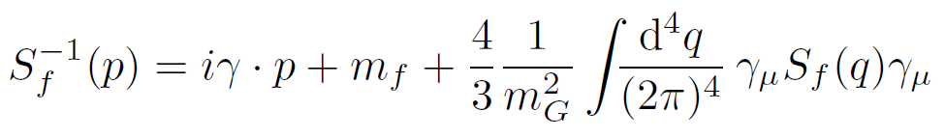

Contact Interaction
Gluon
propagator:
P. Boucaud et. al., Few Body Syst. 53, 387 (2012).
Quark-gluon vertex:
Gap
equation:
General form of the solution:
Notes:
Mg es una estimación para la masa del gluón, la alfair estima el valor a momento cero de la constante de acoplamiento en QCD, la flecha es después de hacer una regularización de Poincaré

Slide 13
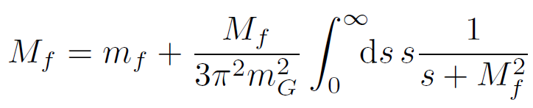
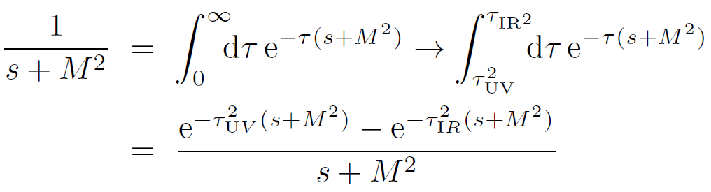
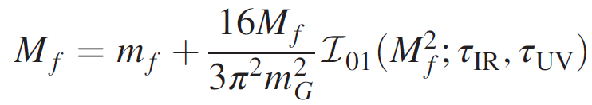
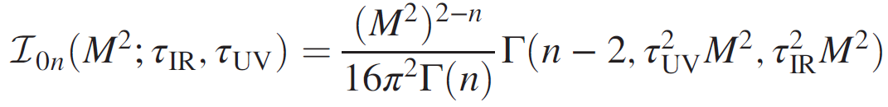
Contact Interaction
Solution is:
Proper time
regularization:
Where:
Notes:
Mg es una estimación para la masa del gluón, la alfair estima el valor a momento cero de la constante de acoplamiento en QCD, la flecha es después de hacer una regularización de Poincaré, tau_ir diferente de cero implementa confinamiento al eliminar el polo, tau ir es el regulador, no puede ser eliminado pero juega un rol dinámico y ajusta la escala para nuestras dimensiones

Slide 14
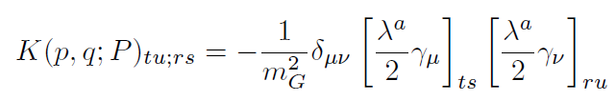
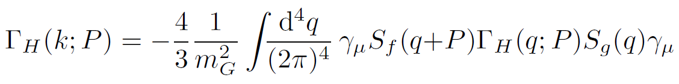
Contact Interaction
For our contact interaction model:
Thus the BSE for a meson is:
What are the BSA for different mesons?

Slide 15
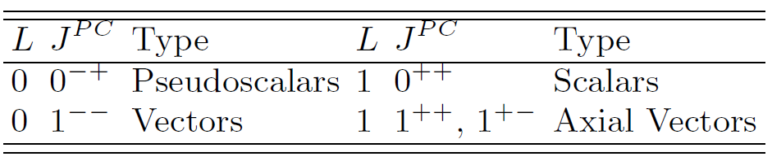
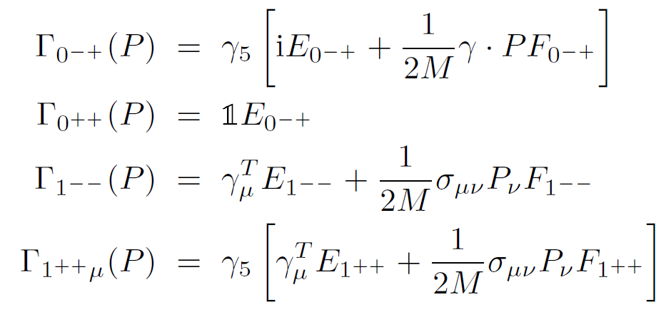
Bethe-Salpeter Amplitudes within a CI
Classification of mesons:
BS-amplitudes:

Slide 16
Charmonia
m_{g}=0.8 | Λ_{UV}=2.778 | Λ_{IR}=0.24 | m_{c}=0.956 | α_{IR}=0.146
Masses are in GeV | m_{ηc}(1S) | m_{J/Ψ} (1S) | m_{χc0}(1P) | m_{χc1}(1P)
PDG(2010) | 2.983 | 3.096 | 3.414 | 3.510
Contact Interaction | 2.949 | 3.128 | 3.327 | 3.355
Munczek (1993) | 2.821 | 3.1 | 3.605 | -----
Souchlas (2010) | 3.02 | 3.19
Souchlas (2010) | 3.04 | 3.24
Krassnigg (2011) | 2.928 | 3.111 | 3.321 | 3.437
El-Bennich (2014) | 3.065
El-Bennich (2014) | 3.210
Decay constants (GeV) (g_{so}=0.08)
PDG(2010) | 0.361 | 0.416
Contact Interaction | 0.305 | 0.217
Krassnigg (2011) | 0.399 | 0.448
Souchlas (2010) | 0.239 | 0.198
Souchlas (2010) | 0.387 | 0.415

Slide 17

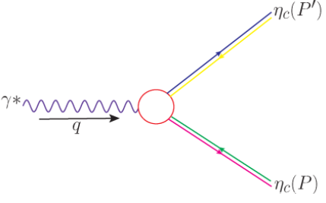
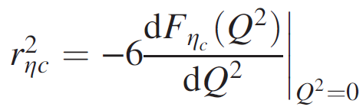
Elastic Form Factor
The pseudoscalar mesons have only one form factor
And the associated charge radius is defined by

Slide 18
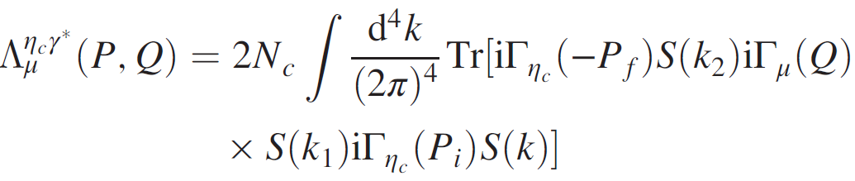
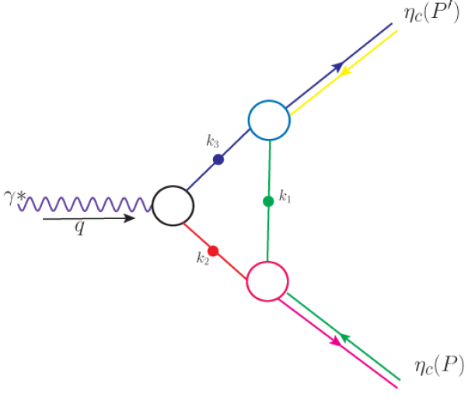
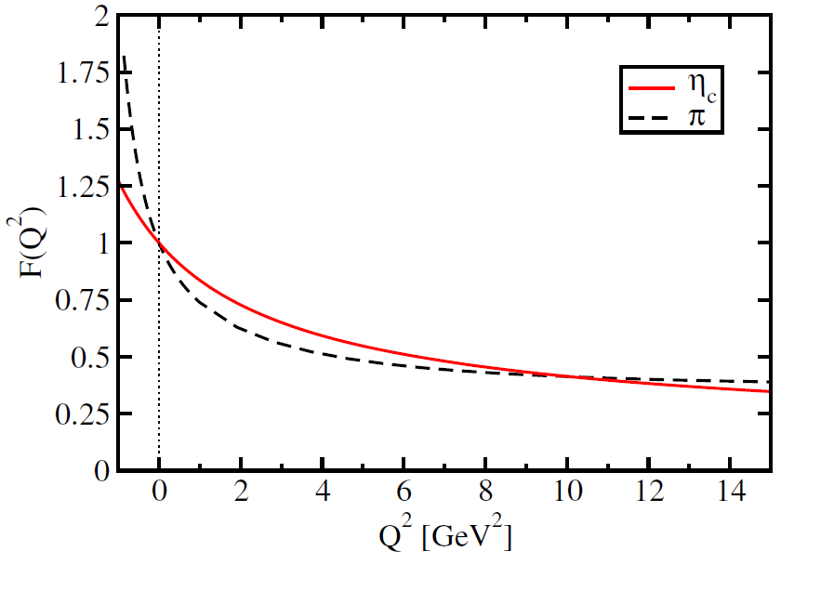
Elastic Form Factor
In the impulse approximation approach the vertex reads

Slide 19
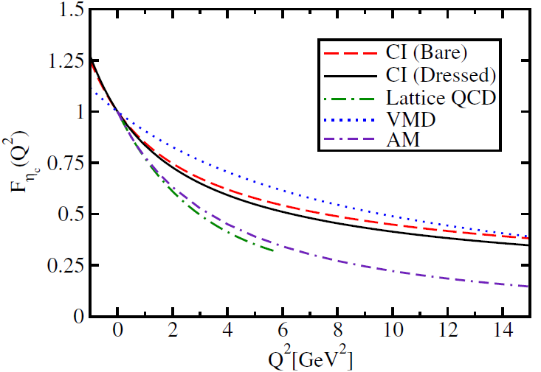
Elastic Form Factor
Charge Radius
Schwinger-Dyson Equations | 0.219fm
Lattice | 0.25fm
Contact Interaction | 0.21fm
VDM | 0.156fm
Algebraic Model | 0.256 fm

Slide 20
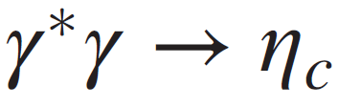
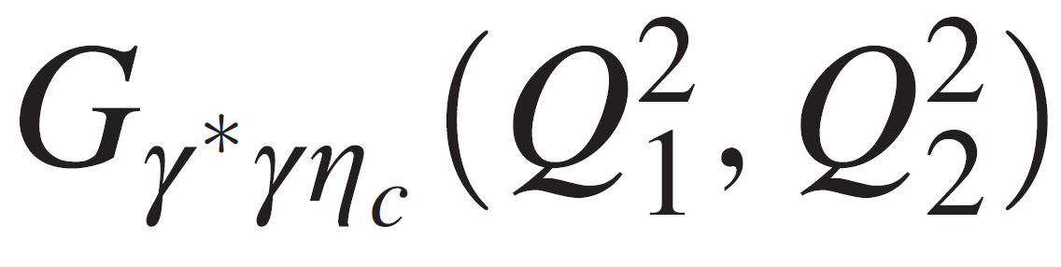
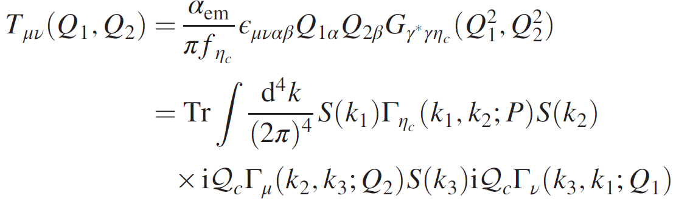
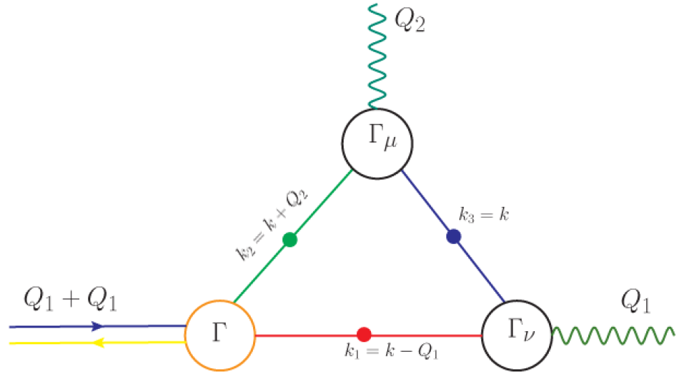
Transition Form Factor
The interaction vertex describing the transition is parametrized with one form factor

Slide 21
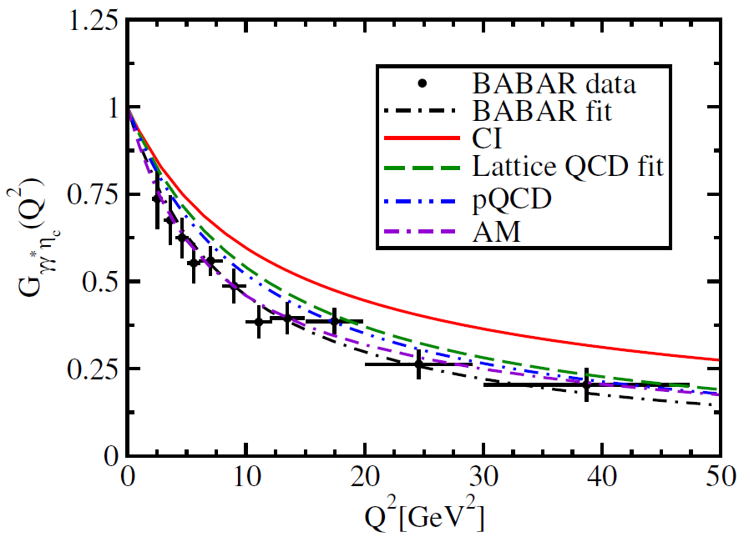
Transition Form Factor
Interaction Radius
BABAR | 0.166fm
Lattice | 0.141fm
Contact Interaction | 0.133fm
Algebraic Model | 0.170 fm

Slide 22
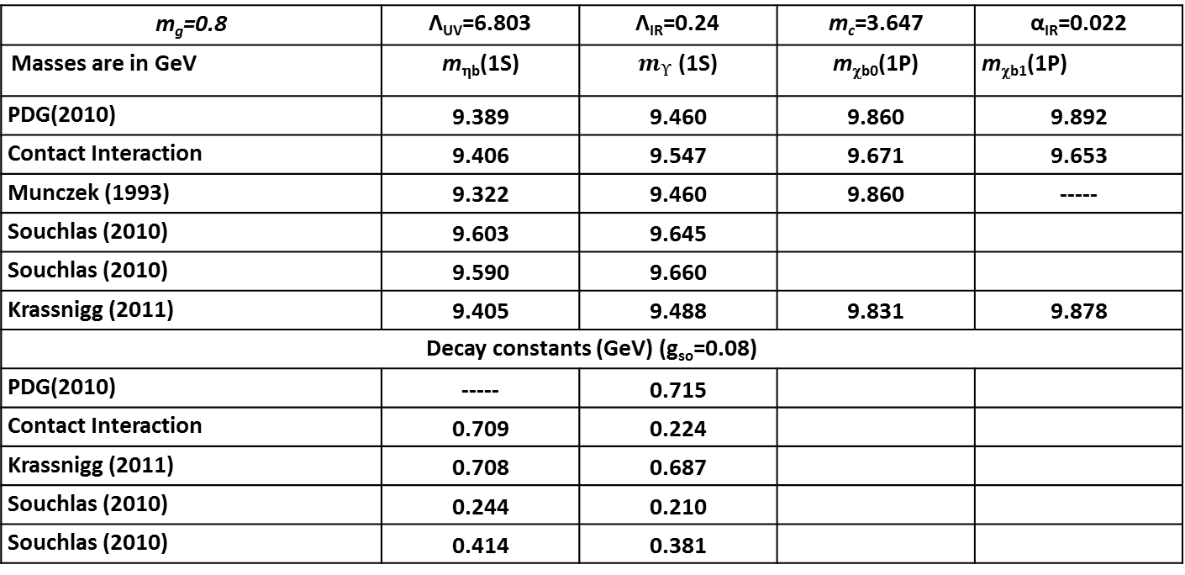
Bottomonia
m_{g}=0.8 | Λ_{UV}=6.803 | Λ_{IR}=0.24 | m_{c}=3.647 | α_{IR}=0.022
Masses are in GeV | m_{ηb}(1S) | $m_{ϒ}$ (1S) | m_{χb0}(1P) | m_{χb1}(1P)
PDG(2010) | 9.389 | 9.460 | 9.860 | 9.892
Contact Interaction | 9.406 | 9.547 | 9.671 | 9.653
Munczek (1993) | 9.322 | 9.460 | 9.860 | -----
Souchlas (2010) | 9.603 | 9.645
Souchlas (2010) | 9.590 | 9.660
Krassnigg (2011) | 9.405 | 9.488 | 9.831 | 9.878
Decay constants (GeV) (g_{so}=0.08)
PDG(2010) | ----- | 0.715
Contact Interaction | 0.709 | 0.224
Krassnigg (2011) | 0.708 | 0.687
Souchlas (2010) | 0.244 | 0.210
Souchlas (2010) | 0.414 | 0.381

Slide 23
Elastic Form Factor

Slide 24
Transition Form Factor

Slide 25
Dimensionless Coupling Constant

Slide 26
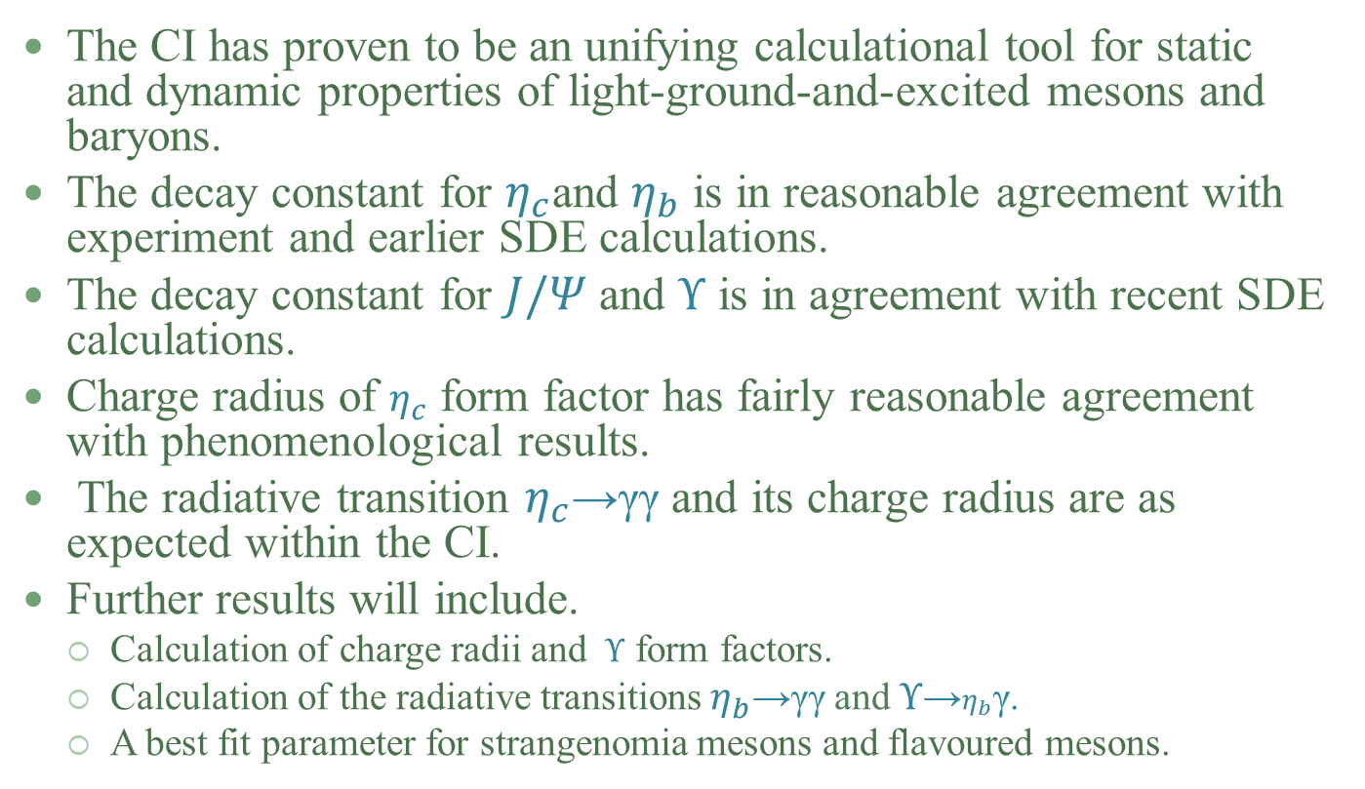
Final Remarks
The CI has proven to be an unifying calculational tool for static and dynamic properties of light-ground-and-excited mesons and baryons.
The decay constant for $η_{c}$and $η_{b}$ is in reasonable agreement with experiment and earlier SDE calculations.
The decay constant for $J/Ψ$ and $ϒ$ is in agreement with recent SDE calculations.
Charge radius of $η_{c}$ form factor has fairly reasonable agreement with phenomenological results.
The radiative transition $η_{c}$→γγ and its charge radius are as expected within the CI.
Further results will include.
  Calculation of charge radii and $ϒ$ form factors.
  Calculation of the radiative transitions $η_{b}$→γγ and$ϒ$→$η_{b}\text{γ}$.
  A best fit parameter for strangenomia mesons and flavoured mesons.

