Slide 1
ACORDE & AD DCS UPDATE
Dr. Mario Iván Martínez Hernández
FCFM – BUAP

Slide 2
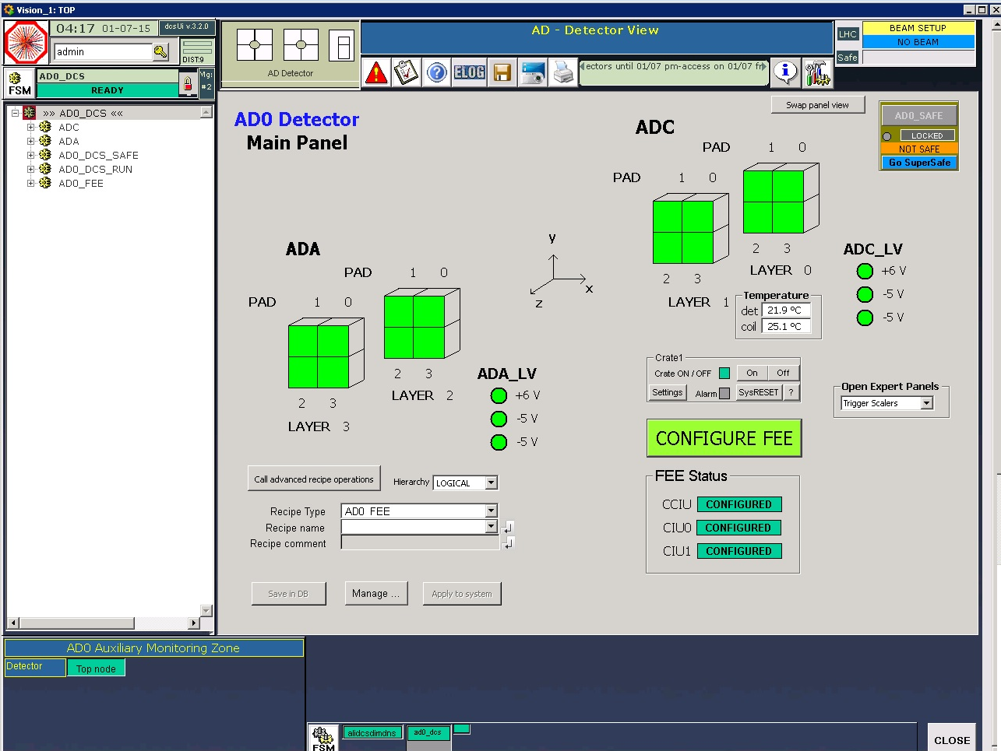
AD0 DCS
Created Jan-2015
  MI Martínez, resposible
  JC Cabanillas, Ph.D. student, UAS
  Other contributors: Sasha, Christoph, Ombretta, Peter, Raphael, etc.
Integrated and in operation since the start of Run II
M&O for ad0_dcs
Web monitoring panel
Some issues
Current activities
Planning

Slide 3
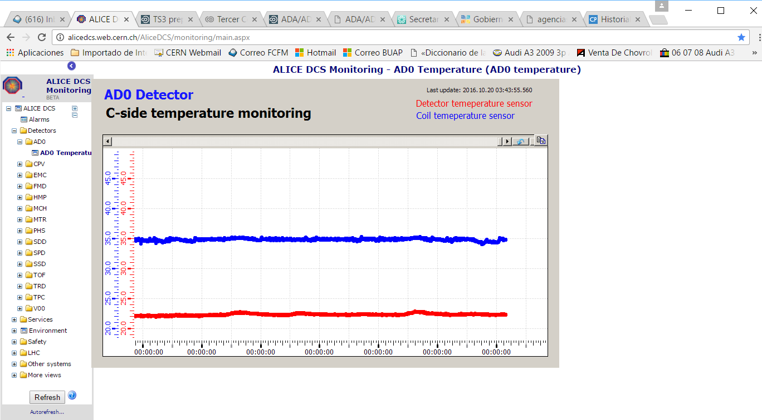
ADC temperature monitoring

Slide 4
Issues
Configuration DB errors while writing
  DB connection now kept permanently open (from the central DCS side)
  Connection initialization whenever recipes are loaded (from the AD DCS side)
Magnet transition procedure

Slide 5
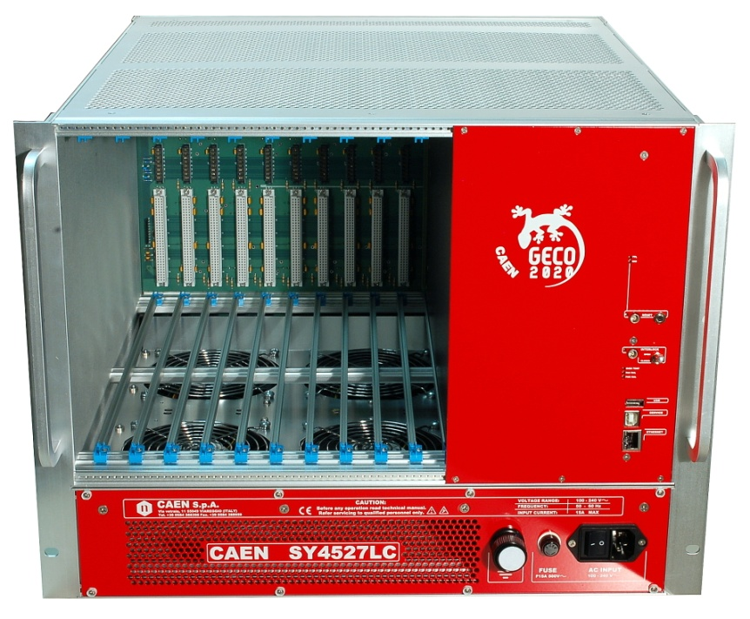

Current activities (1)
Integration of new CAEN crate (SY4527LC) to the DCS software
  To verify it is actually completely compatible with actual software
  Dedicated PC and A1535DN LV board for test

Slide 6
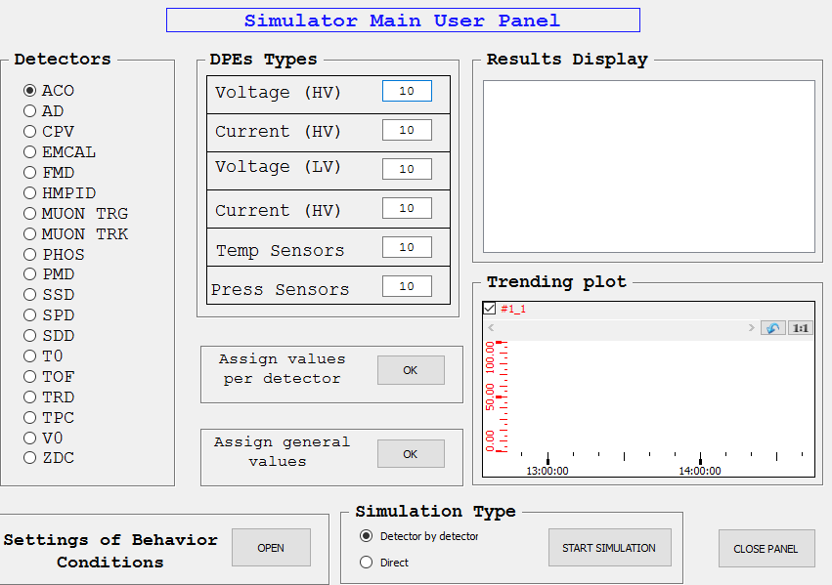
Current activities (2)
Simulation of data point values archiving
  To test continuous writing to DB for Run3
  (JC Cabanillas)

Slide 7
Planning (EYETS)
21 weeks – 5 Dec. 2016 to 30 Apr. 2017
Installation of CAEN crate @CR4
Add control of CAEN and VME crates properties (panels)*
WinCC & Framework update*
…
* TBD

Slide 8
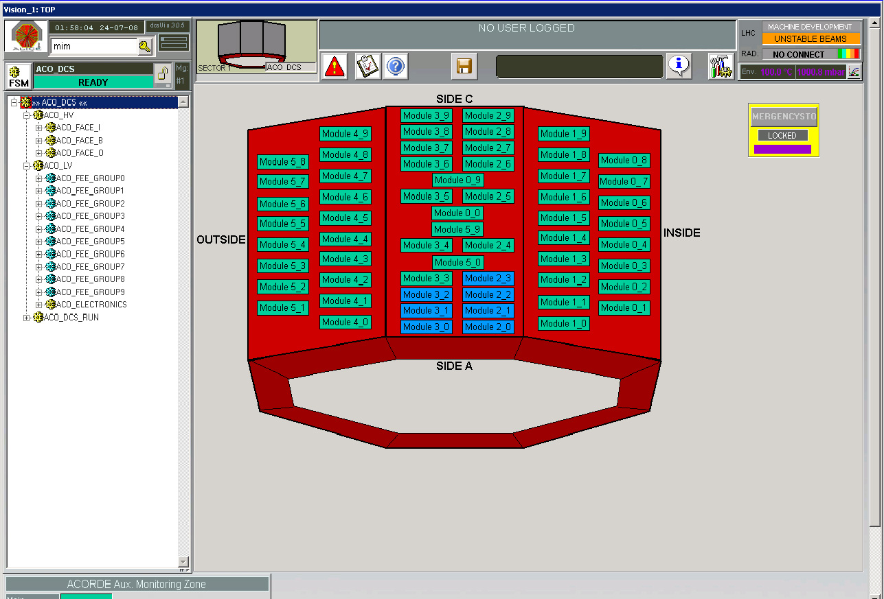
ACO DCS
Created 2007
  MI Martínez, resposible
  Lot of people have contributed since, specially ACC people
Integrated and in operation since ALICE calibration – end 2007
A3486 DC power supply (basic) control
M&O for aco_dcs

Slide 9
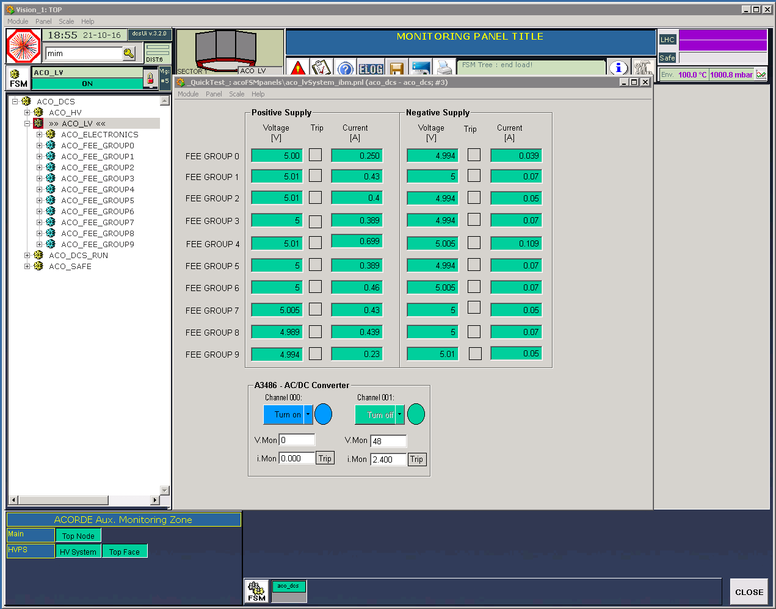
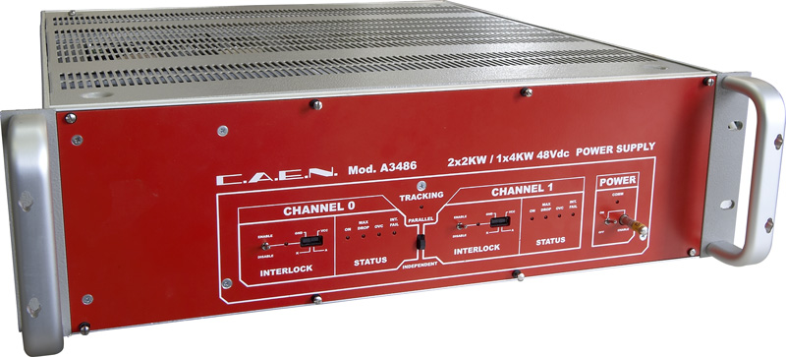
A3486 control
Power supply (48 V) module for EASY crate (LV boards)

Slide 10
Planning (EYETS)
WinCC & Framework update*
Force the use of recipes*
Web monitoring*
Enhance A3486 control and automation (FSM)*
CAEN crate control*
…
* TBD

