Slide 1
Report
Tania Martínez Cortés
24th September 2016
DESY
Catch up on:
Bachelor Thesis
Subjects
To do

Slide 2
Summer Stay at DESY
Hamburg
19th July – 08th September 2016

Slide 3
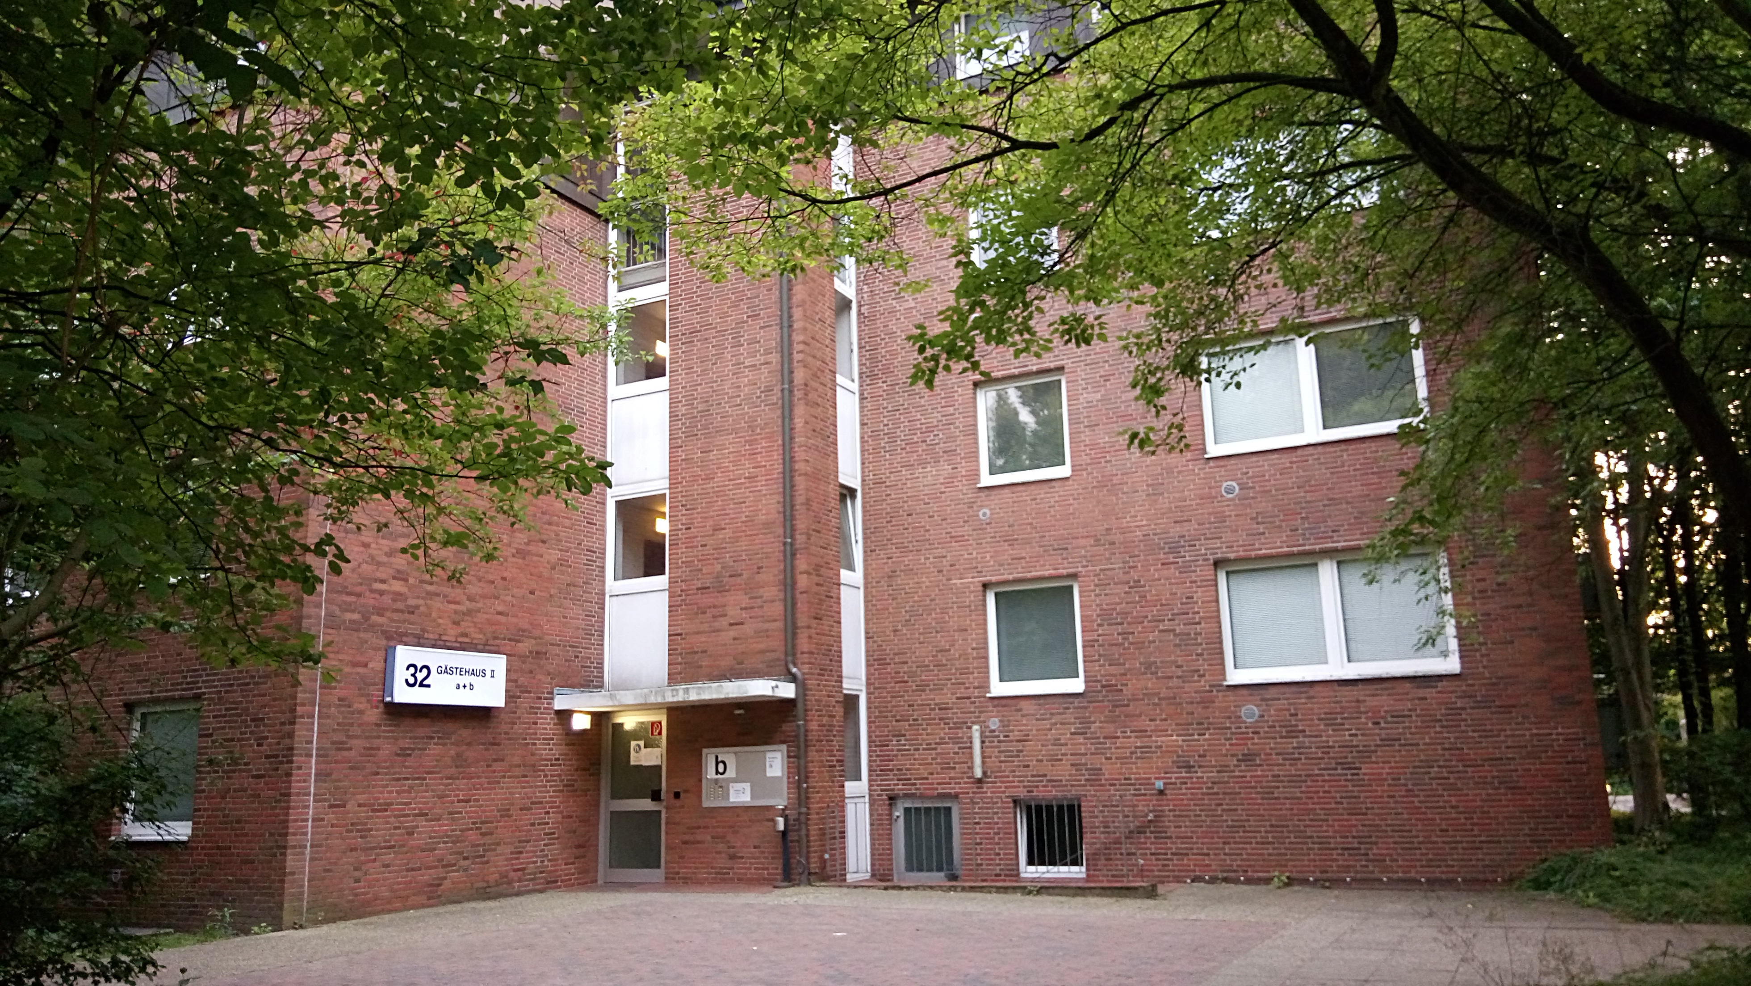
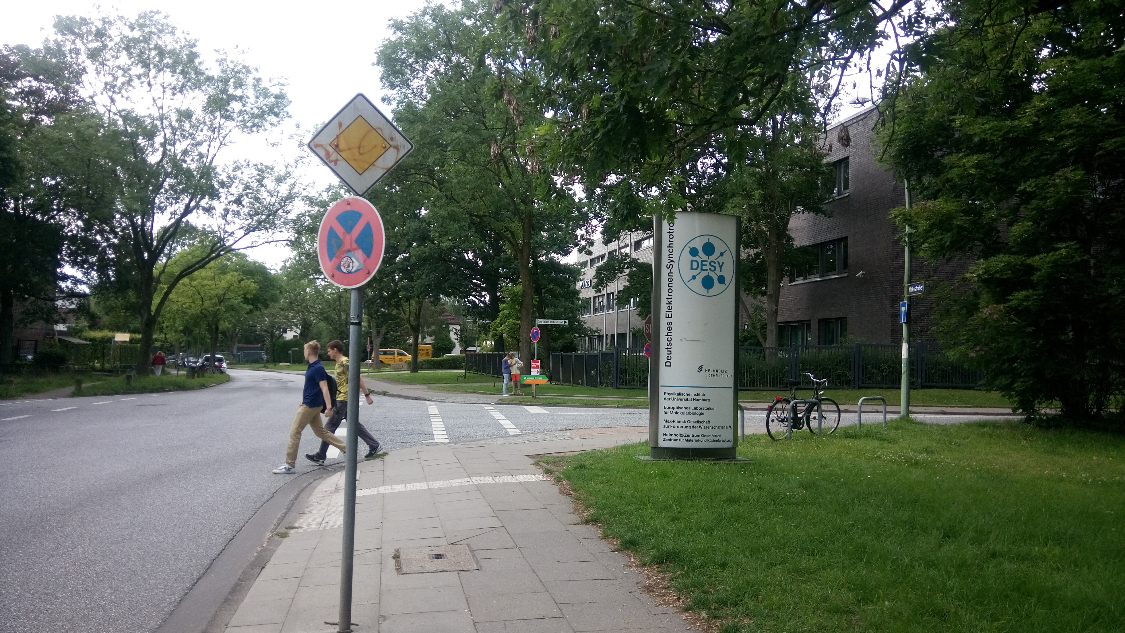
Summer student schedule.
 | First Week
Accommodation at DESY
Notes:
Fisrt Arrival at DESY
Access to the hostel rooms is provided with a key card which is obtained at the Hostel Office o at the main Gate Notkestrasse.

Slide 4
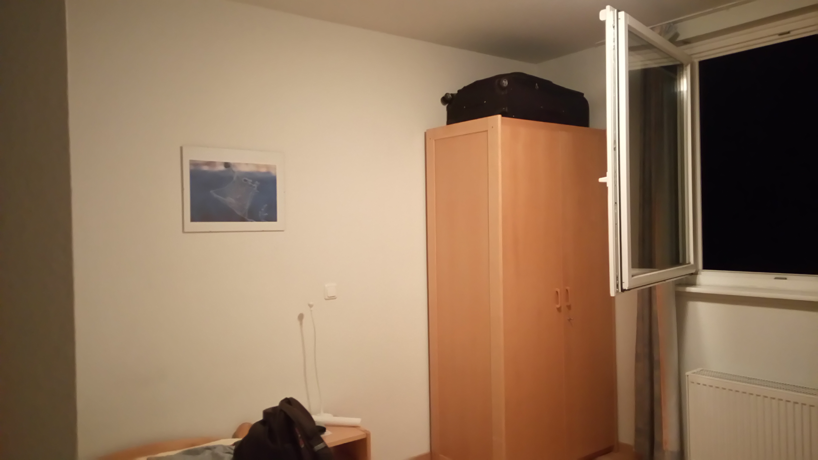
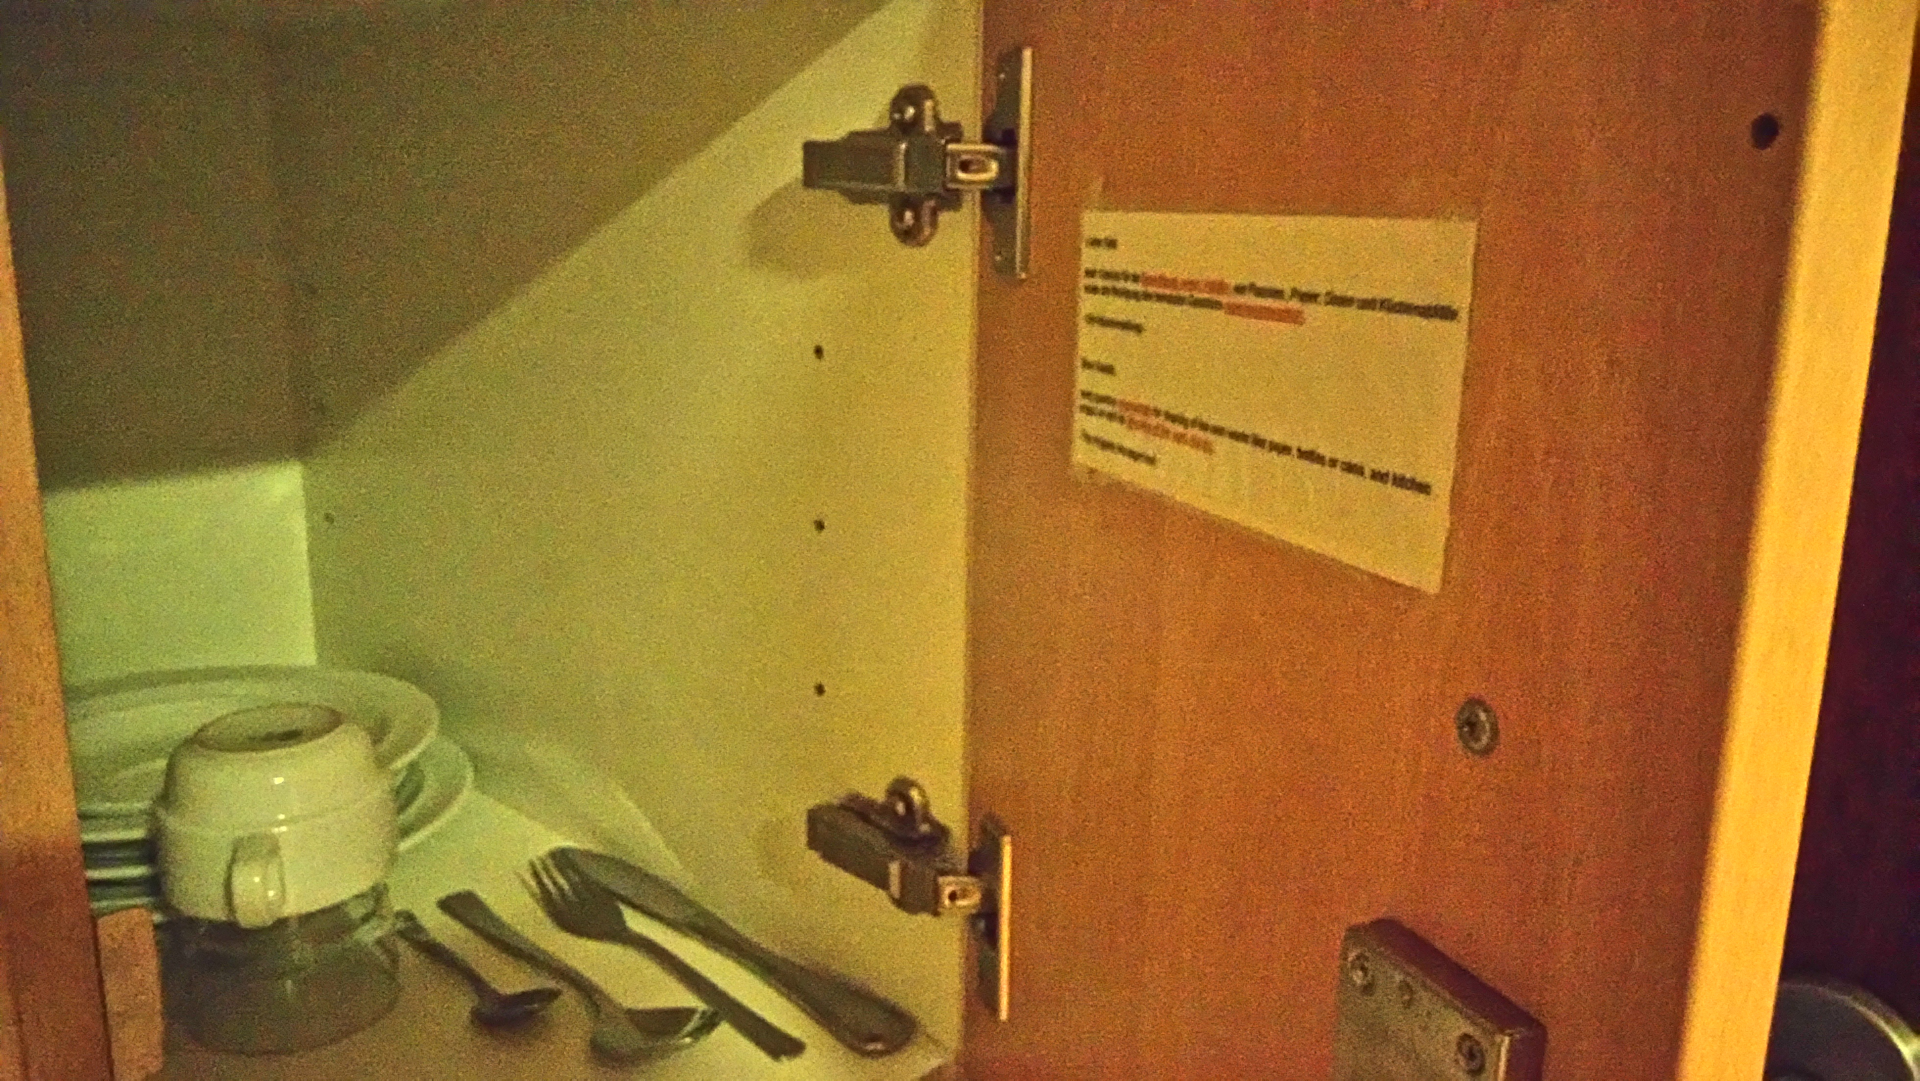
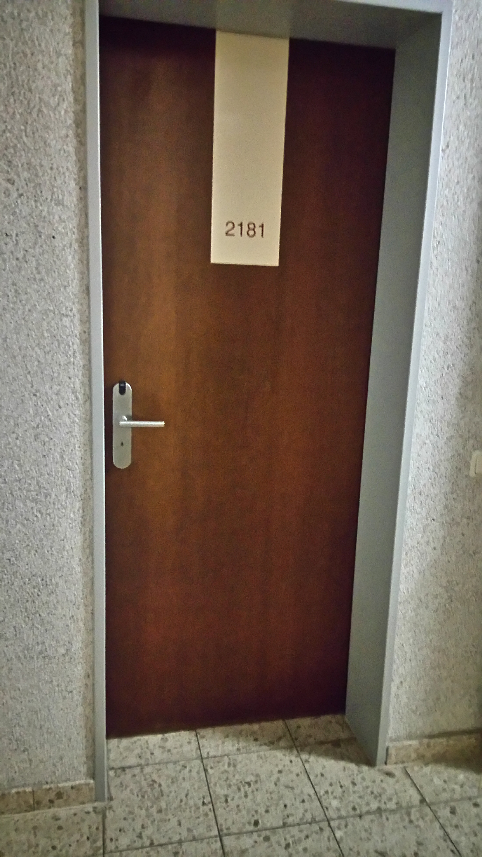
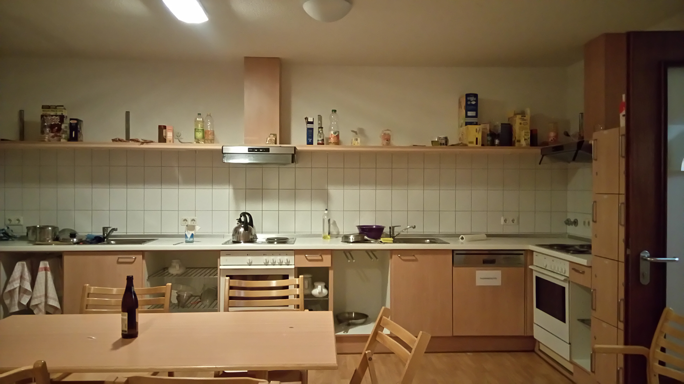
Summer student schedule.
 | First Week

Slide 5
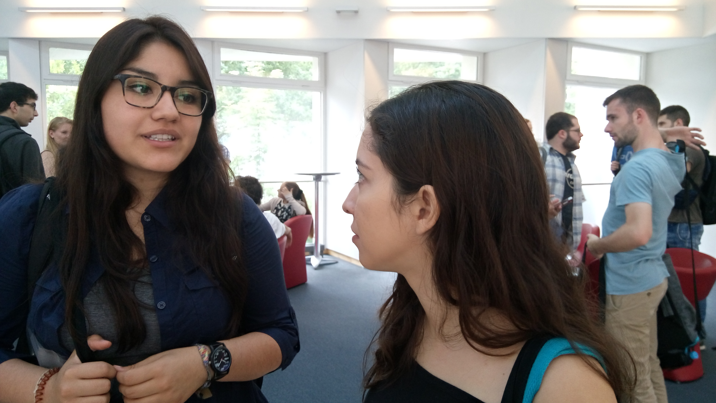
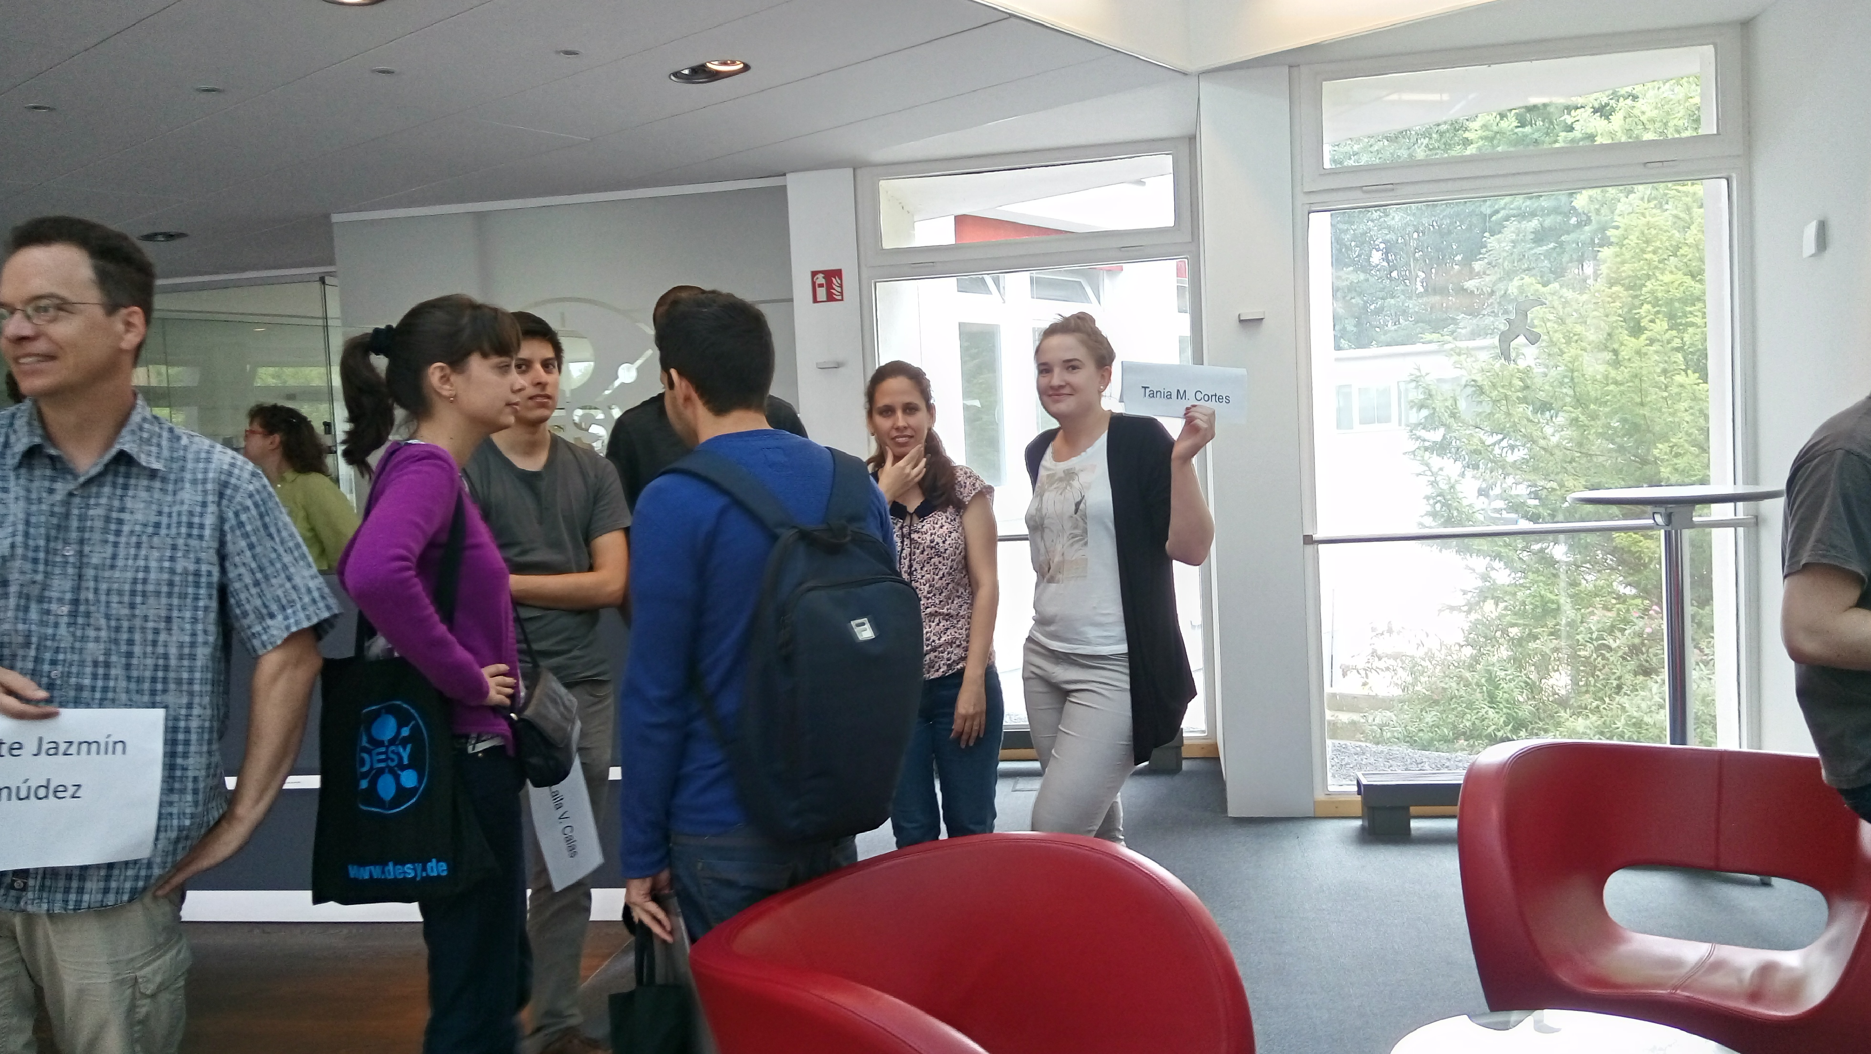
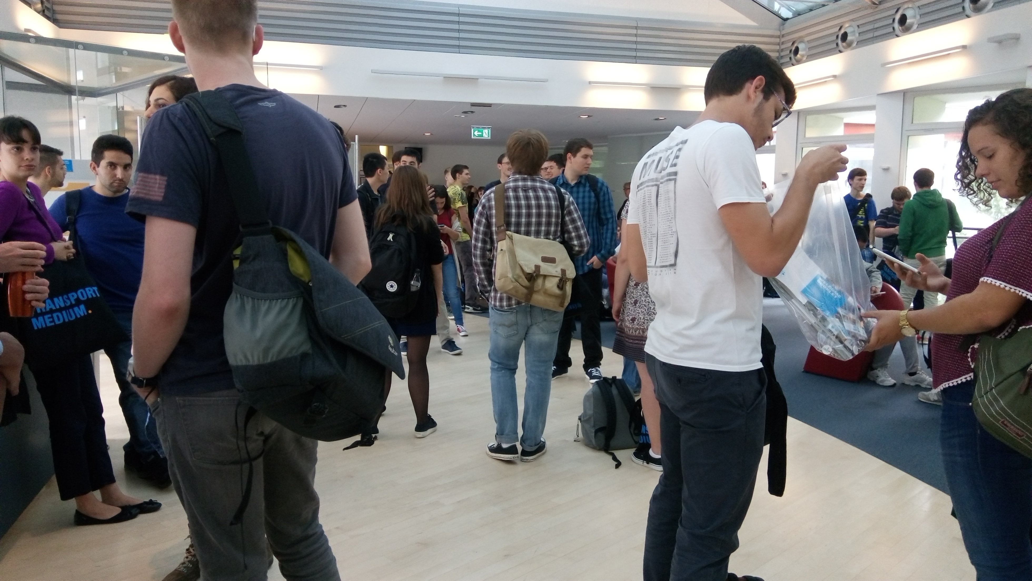
Summer student schedule.
Plan for the first day 19th July 2016
Welcome session
Notes:
when: at 10:00
where: DESY auditorium
After some introductory talk there is some administrative procedure in the foyer

Slide 6
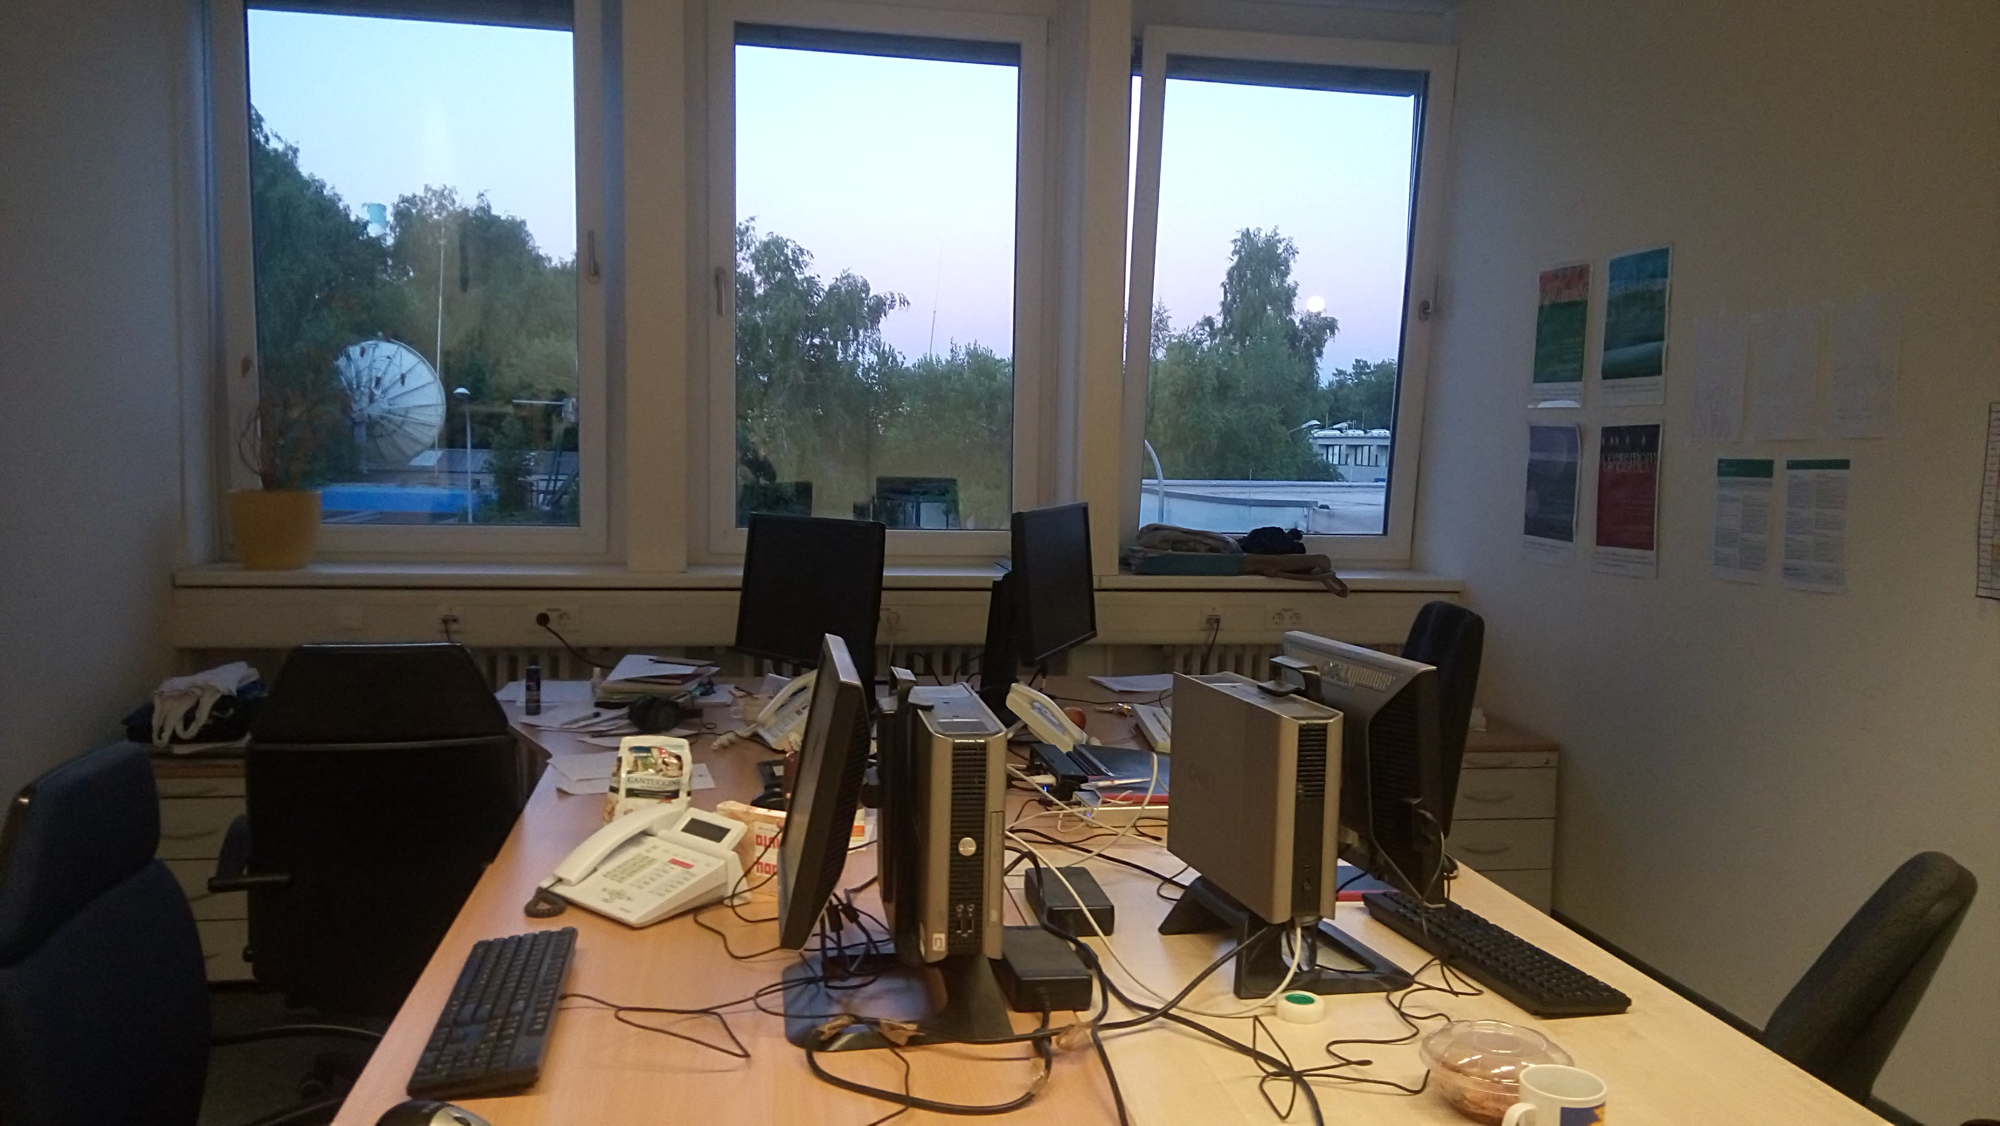
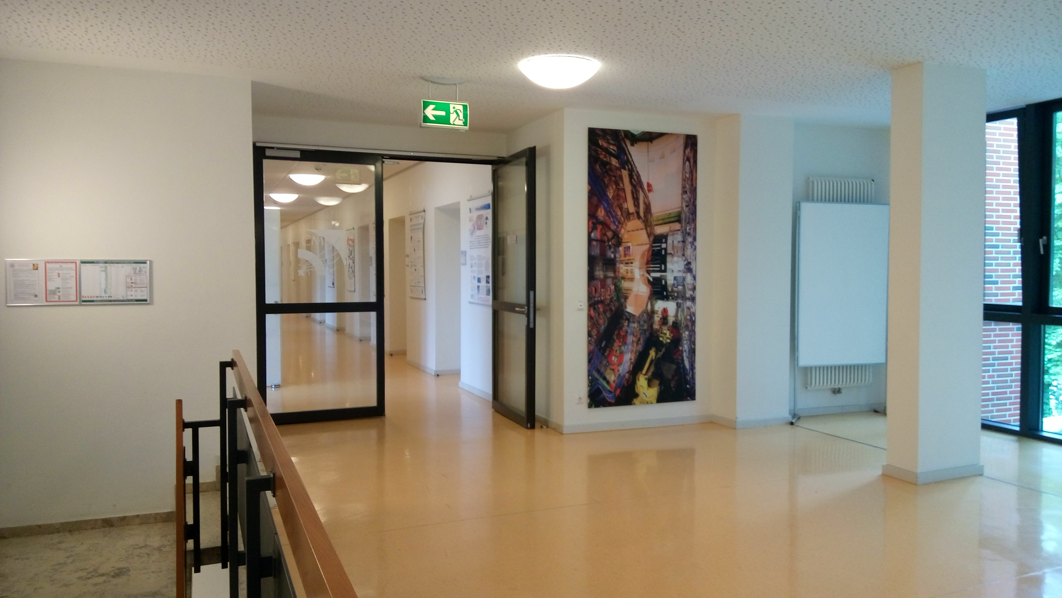
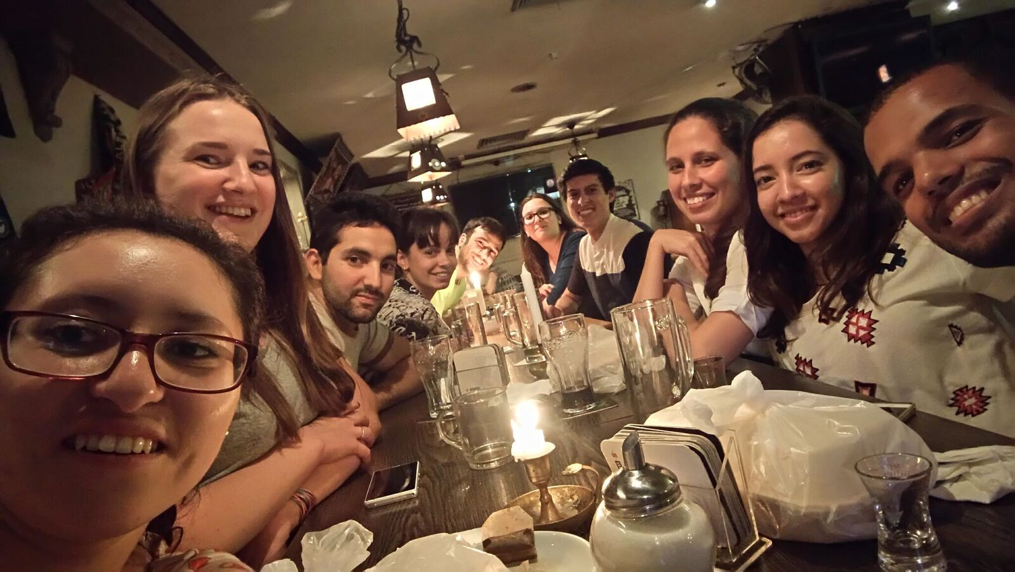
Summer student schedule.
Supervisor Hannes Jung

Slide 7
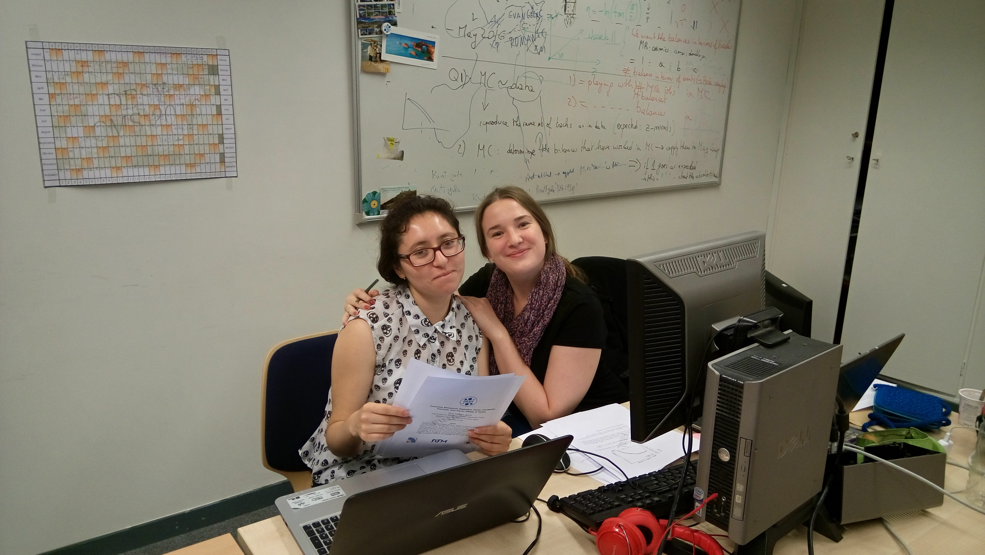
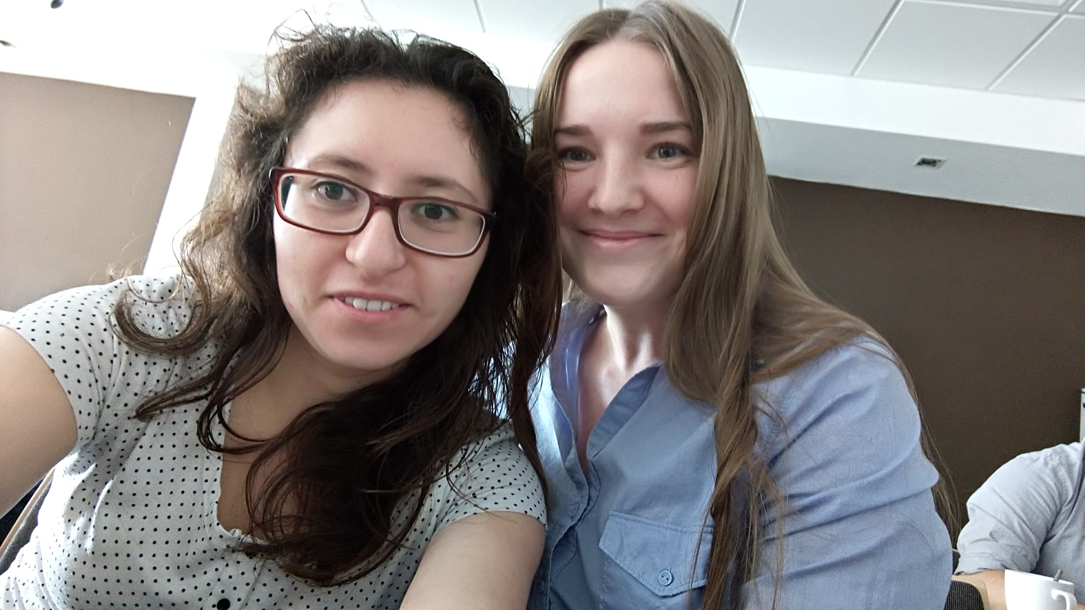
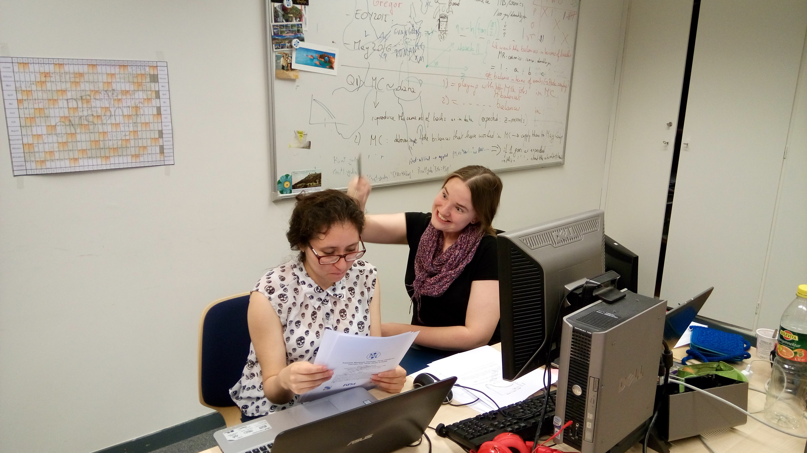
Summer student schedule.
Supervisor Aleksandra Lelek

Slide 8
Project

Slide 9
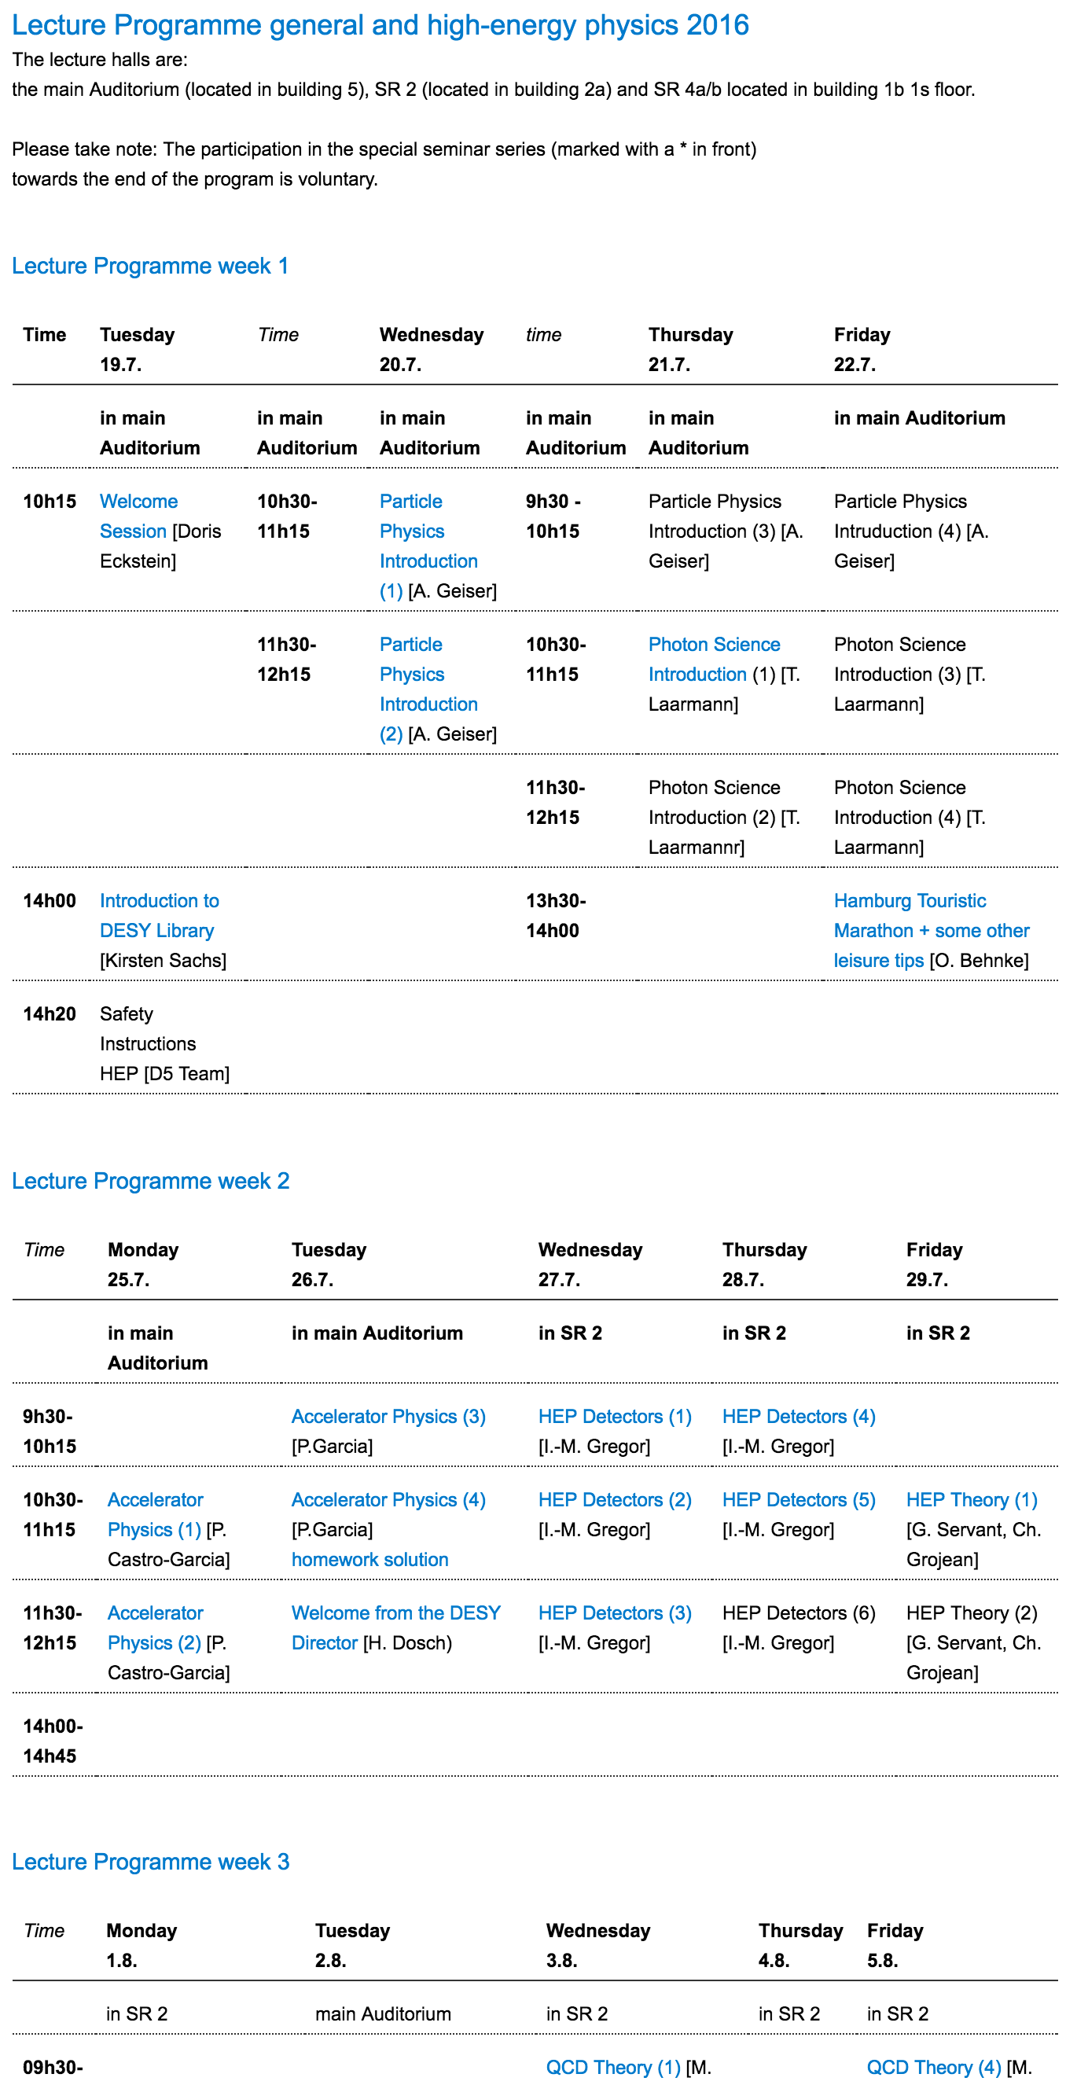
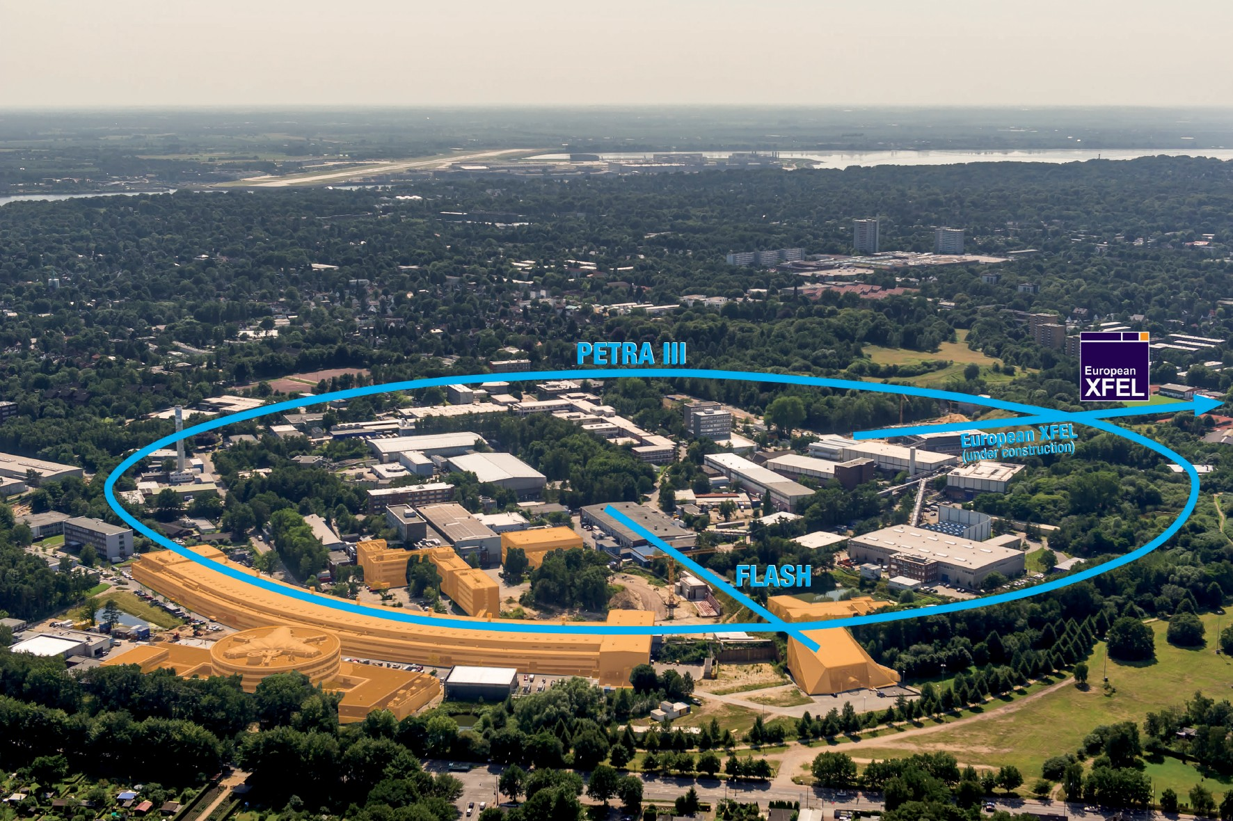
Summer student schedule.
 | August
Lectures High-energy physics Tours Hera Petra XFEL
Notes:
Fisrt Arrival at DESY
Access to the hostel rooms is provided with a key card which is obtained at the Hostel Office o at the main Gate Notkestrasse.

Slide 11
Done
Puebla
12th – 23rd September 2016

Slide 12
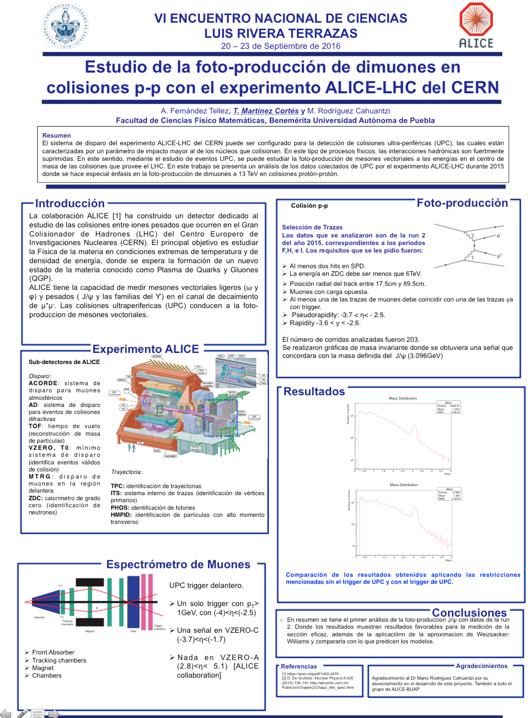
LRT Poster

Slide 13
To do
Catch up on:
Bachelor Thesis
Subjects

