Slide 1
Prompt photon yield and $v_{2}$ coefficient from gluon fusion induced by magnetic field
Jorge David Castaño Yepes
Instituto de Ciencias Nucleares, UNAM
ISMD 2017, Tlaxcala.

Slide 2
Photons in Heavy-Ion Collisions
[Credits: Chun Shen, McGill University]

Slide 3
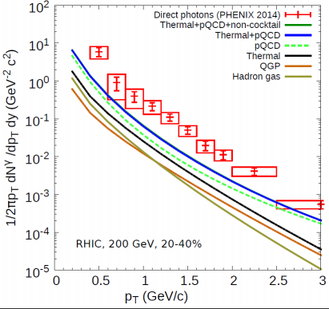
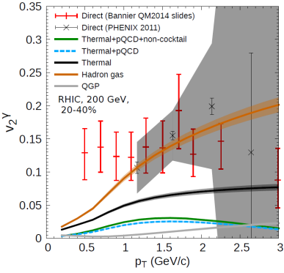
Photon Excess
[Jean-François Paquet et al. Phys. Rev. C 93, 044906 ]

Slide 4
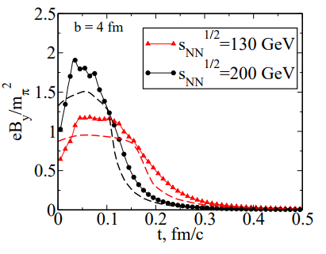
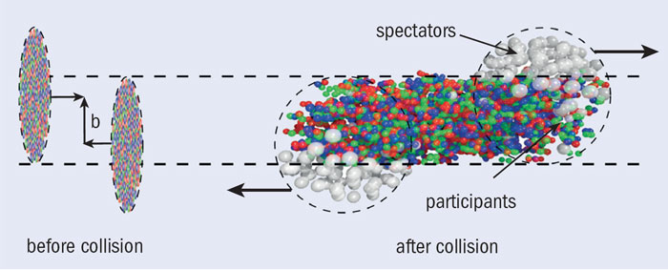
Magnetic Fields in Heavy-Ion Collisions
[Credits: Alberica Toia, University of Padua/INFN- CERN Courier]
[V. Skokov et al. Int. J. Mod.Phys. A24 (2009) ]
Source of photons in the early stages of the collision.
Magnetic field breaks the spatial symmetry.

Slide 5
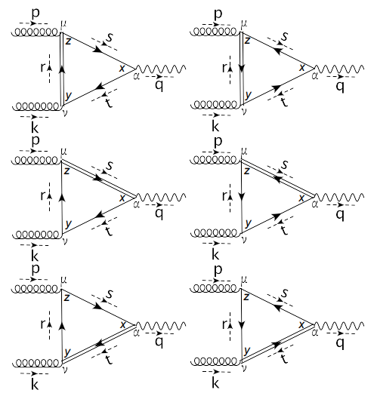
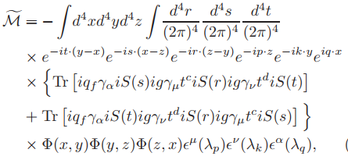
Gluon Fusion
If $B=0$, $\tilde{M}=0$ (Furry’s Theorem).
If all the quarks are in the $LLL$, $\tilde{M}=0$(only parallel structures in the trace).
Dominant contribution : 1 quark in the $1LL$ and 2 quarks in the $LLL$.

Slide 6
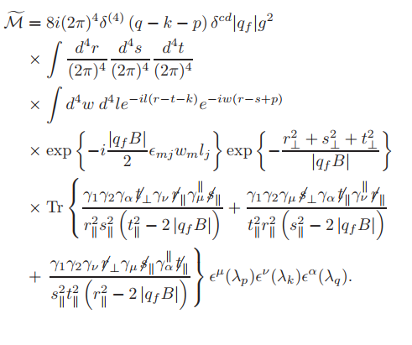
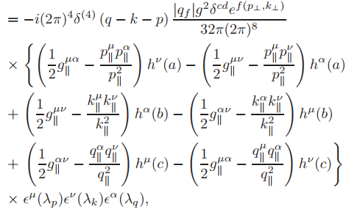

Slide 7
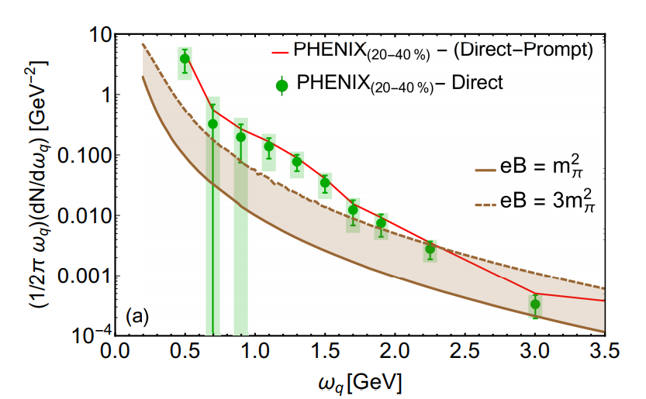
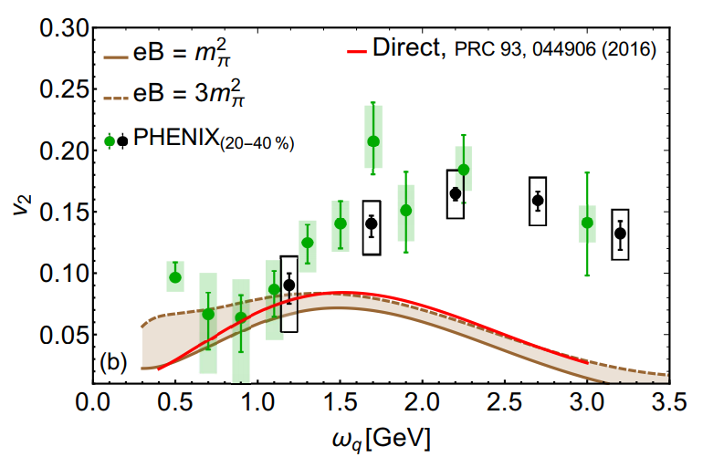
(weighed average)

Slide 8
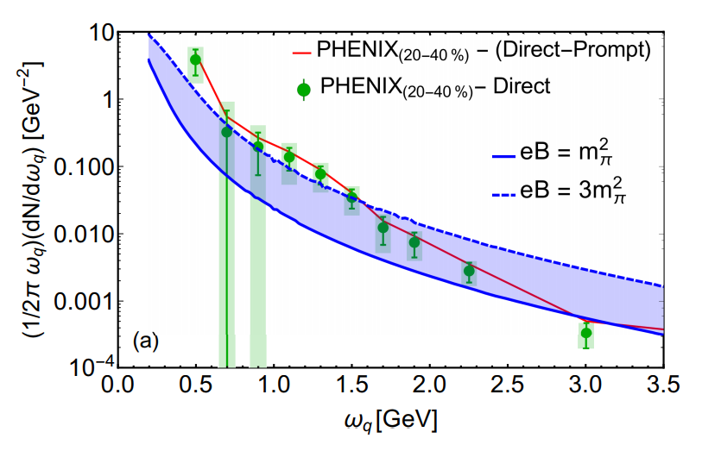
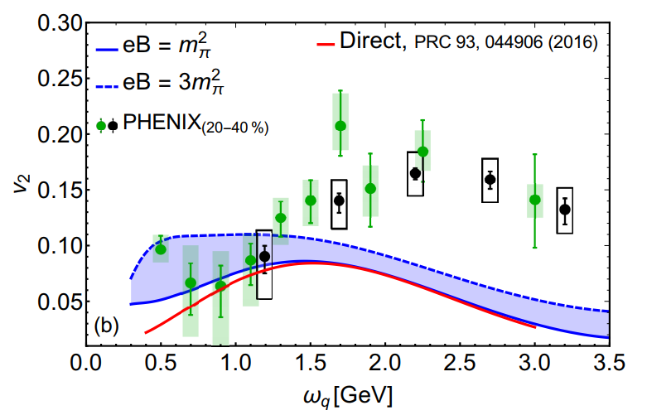
Flow Velocity: Accounts the sudden change in the pressure.
A complete descriptions needs to take in account the mediums dispersive (refraction index).
$$σ→∞$$

Slide 9
Conclusions
We have shown that the magnetic field in the early stages of the collisions may be an important source of photons.
The presence of intense magnetic fields open new channels for the photon production (gluon fusion) in heavy ions collisions.
Our calculations provide a better description of the yield and the elliptic flow at the lowest end of the spectrum.

Slide 10
Thanks !

