Slide 1
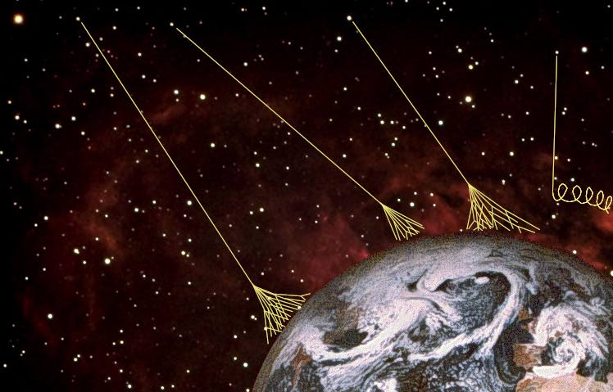
Test of hadronic models of High Energy (SIBYLL 2.3) using KASCADE-Grande Data
Flash Talk
David Rivera Rangel. IFM-UMSNH
Dr. Juan Carlos Arteaga Velázquez. IFM-UMSNH
hadronic Models test Tlaxcala, Tlaxcala 11/09/2017
Notes:
1

Slide 2

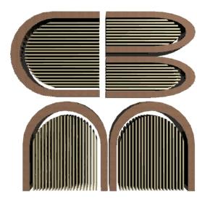
PURPOSE
Test hadronic models post-LHC using the muon component of an Extended Air Shower (EAS).
Compare the predictions made by the hadronic model SIBYLL 2.3 with the KASCADE-Grande data.
Explore the relation of the error with the espectral index.
Pruebas de modelos hadrónicos Morelia, Michoacán 03/07/2017

Slide 3

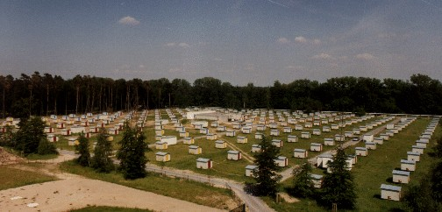

COMPONENTS
KASCADE
KIT
110 a.s.l
49°N 8°E
Pruebas de modelos hadrónicos Morelia, Michoacán 20/12/\2016

Slide 4
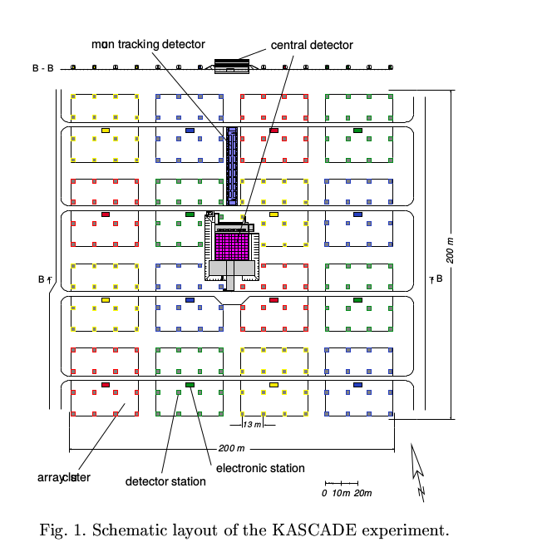
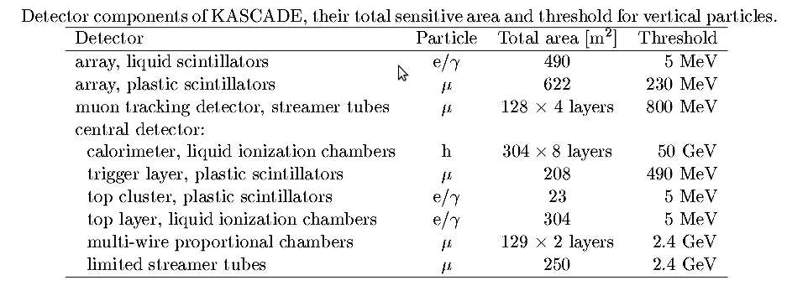
COMPONENTS
KASCADE
Pruebas de modelos hadrónicos Morelia, Michoacán 20/12/\2016

Slide 5
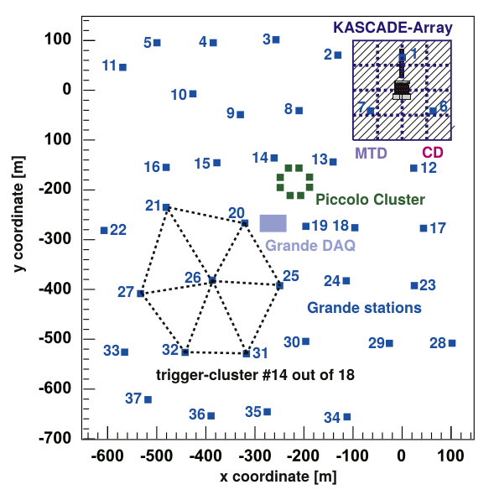
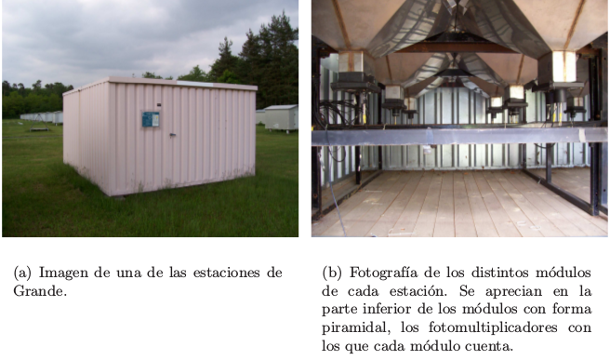
COMPONENTS
Grande
Pruebas de modelos hadrónicos Morelia, Michoacán 20/12/\2016

Slide 6
MUON DENSITY
Pruebas de modelos hadrónicos Morelia, Michoacán 03/07/2017

Slide 7
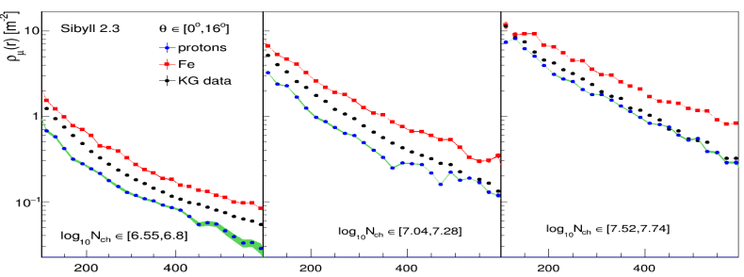
MUON DENSITY
Pruebas de modelos hadrónicos Morelia, Michoacán 03/07/2017

Slide 8
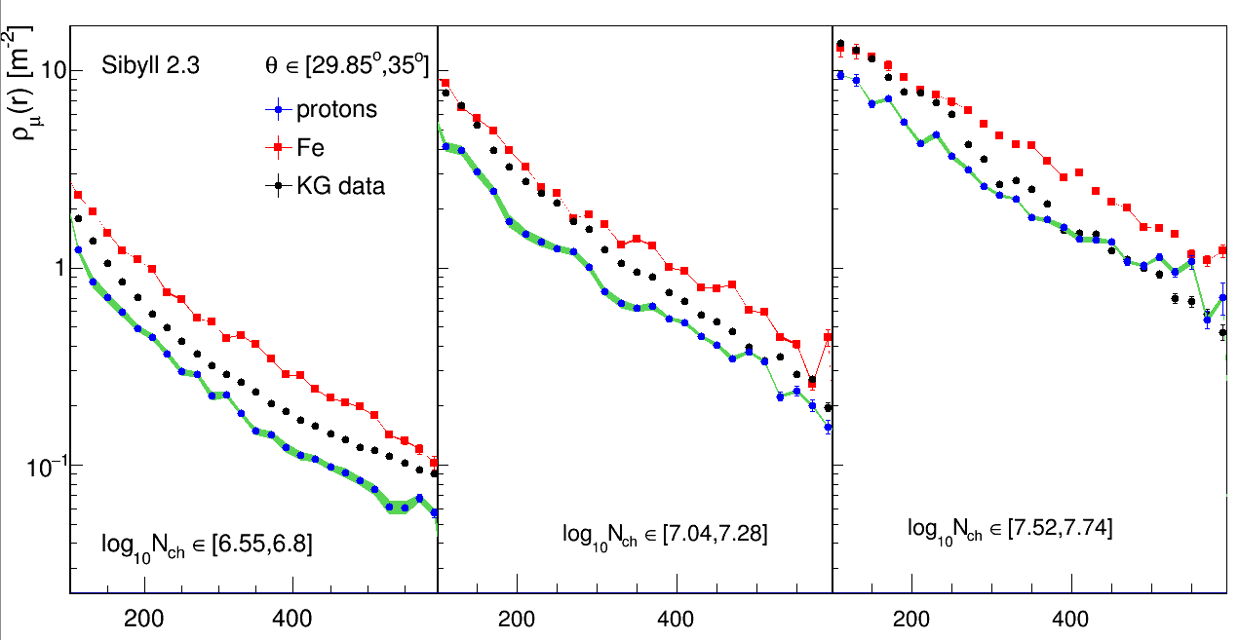
MUON DENSITY
Pruebas de modelos hadrónicos Morelia, Michoacán 03/07/2017

Slide 9
MUONS VS CHARGED PARTICLES
Pruebas de modelos hadrónicos Morelia, Michoacán 03/07/2017

Slide 10
ENERGY VS CHARGED PARTICLES
Pruebas de modelos hadrónicos Morelia, Michoacán 03/07/2017

Slide 11
SUMMARY
We have found discrepancies betwen the predictions made by the hadronic model post-LHC (SIBYLL 2.3) and the data provided by KASCADE-Grande.
A further analysis could be done by the study of the atenuation length. (See Dr. Arteaga talk)
Pruebas de modelos hadrónicos Morelia, Michoacán 03/07/2017

Slide 12
REFERENCES
    The Cosmic-Ray Experiment. T. Antoni et. al.
    The KASCADE-Grande Experiment. W. D. Apel et.al.
    CORSIKA a Monte Carlo code to simulate extensive air-shower. D. Heck et al.
    Confronting the EPOS-LHC model predictions on the charged particle and muon attenuation lengths of EAS with the measurments of the KASCADE-Grande observatory. J.C. Arteaga-Velázquez et al.
Pruebas de modelos hadrónicos Morelia, Michoacán 03/07/2017

