Slide 1
Sound waves in hadronic matter
G. Wilk, NCNR, Warsaw, Poland
and
Z. Włodarczyk, UJK, Kielce, Poland
XLVI International Symposium on Multiparticle Dynamics
Tlaxcala City, Mexico, September 11-15, 2017.

Slide 2
Content:
Introduction: log-periodic oscillations decorating
quasi-power-like Tsallis distributions
➔ scale-invariance ➔ complex power index?
(2) Or, rather, ➔ log-periodically oscillating scale parameter
(temperature)?
(3) If so, one is dealing with sound waves in hadronic matter
➔ self-similarity.
(4) Possible experimental confirmation.

Slide 3
(1)
(*) The large transverse momentum distributions of particles observed in all LHC experiments exhibit a quasi-power-like behavior following the two-parameter Tsallis distribution with a scale factor T and nonextensivity q.

Slide 4
(1)

Slide 5
(1)
(*) The large transverse momentum distributions of particles observed in all LHC experiments exhibit a quasi-power-like behavior following the two-parameter Tsallis distribution with a scale factor T and nonextensivity q.
(*) However, looking at the ratios of the measured cross-sections to their phenomenological power-like fits, R = f_{data}(p_T)/f _{fit}(p_T), one discovers some log-periodic oscillations in R.

Slide 6
(1)
Tsallis distribution decorated with log-periodic oscillation

Slide 7
(1)
(*) The large transverse momentum distributions of particles observed in all LHC experiments exhibit a quasi-power-like behavior following the two-parameter Tsallis distribution with a scale factor T and nonextensivity q.
(*) However, looking at the ratios of the measured cross-sections to their phenomenological power-like fits, R = f_{data}(p_T)/f _{fit}(p_T), one discovers some log-periodic oscillations in R.
(*) This is a rather subtle effect, but it shows itself in all experiments, at
all energies (provided that the range of transverse momenta observed is large enough) and also in reactions with nuclei where they grow with increasing centrality of the collision, it cannot be erased by any reasonable change of fitting parameters – in what follows we shall assume it to be real.

Slide 8
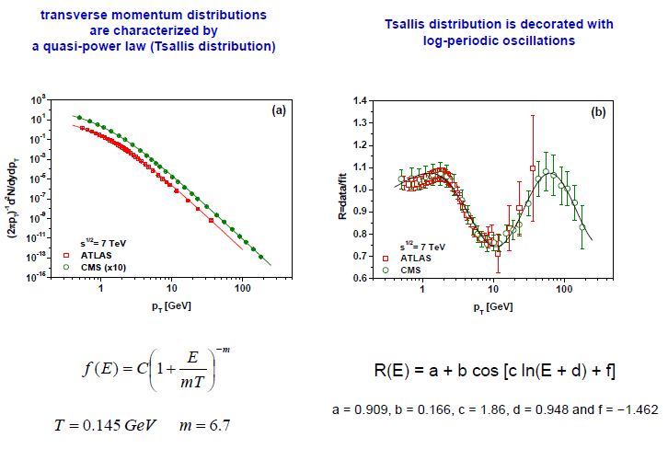
Differens
(1)
Different experiments

Slide 9
Differens
(1)
Different energies

Slide 10
(1)
Different collision systems
Ratio of the values of b/a parameters in R(E) as a function
of number of collisions per participant nucleon, Ncoll/Npart.

Slide 11
(1)
(*) The large transverse momentum distributions of particles observed in all LHC experiments exhibit a quasi-power-like behavior following the two-parameter Tsallis distribution with a scale factor T and nonextensivity q.
(*) However, looking at the ratios of the measured cross-sections to their phenomenological power-like fits, R = f_{data}(p_T)/f _{fit}(p_T), one discovers some log-periodic oscillations in R.
(*) This is a rather subtle effect, but it shows itself in all experiments, at all energies (provided that the range of transverse momenta observed is large enough), in reactions with nuclei where they grow with increasing centrality of the collision, it cannot be erased by any reasonable change of fitting parameters – in what follows we shall assume it to be real.
(*) In fact, such oscillations are seen in all branches of physics whenever one deals with power-like distributions. They are usually attributed to a discrete scale invariance (connected with a possible fractal structure of the process under consideration) and are described by introducing a complex power index.

Slide 12
Scale invariance
(1)
if for some function O(x), one finds that
O(λx) =μO(x)
then it is scale invariant and its form follows a simple power law,
O(x) = Cx^{-m} with m = -ln μ/ ln λ
This relation can be written as
μλ^{m} = 1 =
where k is an arbitrary integer. It means therefore that, in general,
m = −ln μ/ ln λ + i2πk/ ln λ,
i.e., it is a complex number, the imaginary part of which signals a hierarchy of scales leading to
Log-periodic oscillations

Slide 13
(1)
BG distribution
If the scale parameter is dependent on variable
(preferential attachment)
Tsallis distribution
dE → finite
scale
invariant
relation

Slide 14
R(E) = a + b cos [c ln(E + d) + f]

Slide 15
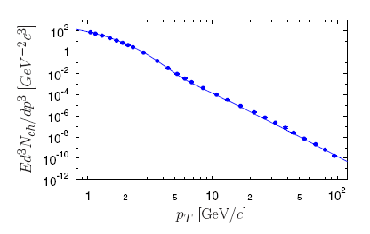
(1)
Alternative - Two-component model ?
ALICE
Pb+Pb at 2.76 TeV, c=0-5%
?
G.G.Barnafoldi et al., JPCS612(2015)012048
A „soft+hard” model…”

Slide 16
(2)
(*) However, one can also describe these oscillations by allowing for some specific log-periodic oscillations of the scale parameter T (both approaches are numerically equivalent).

Slide 17
log-periodic scale parameter T
(2)
Stochastic equation for the temperature evolution in Langevin formulation with energy dependent noise
leads to
which for the noise
(and relaxation time
)
is just an equation for the damping harmonic oscillator and has a solution
We could equivalently assume the energy independent noise,
but allow for the energy dependent relaxation time

Slide 18
(3)
(*) However, one can also describe them by allowing for some specific log-periodic oscillations of the scale parameter T (both approaches are numerically equivalent).
(*) We shall argue that this could be connected with the propagation of some sound waves in hadronic matter.

Slide 19
(3)
(*) However, one can also describe them by allowing for some specific log-periodic oscillations of the scale parameter T (both approaches are numerically equivalent).
(*) We shall argue that this could be connected with the propagation of sound waves in hadronic matter.
In particular:
The Fourier transform of the log-periodically oscillating T
represents some log-periodic acoustic wave forming in the source.
The corresponding wave equation has self-similar solutions of the second kind connected with the so called intermediate asymptotic (observed in phenomena which do not depend on the initial conditions because sufficient time has already passed, although the system considered is still out of equilibrium).

Slide 20
(3)
(*) However, one can also describe them by allowing for some specific log-periodic oscillations of the scale parameter T (both approaches are numerically equivalent).
(*) We shall argue that this could be connected with the propagation of sound waves in hadronic matter.
In particular:
The Fourier transform of the log-periodically oscillating T
represents some log-periodic acoustic wave forming in the source.
The corresponding wave equation has self-similar solutions of the second kind connected with the so called intermediate asymptotic (observed in phenomena which do not depend on the initial conditions because sufficient time has already passed, although the system considered is still out of equilibrium) .
Both in p+p and Pb+Pb one deals with an inhomogeneous medium with the density and
the velocity of sound both depending on the position in the way which seems to be
supported by experimental results.

Slide 21
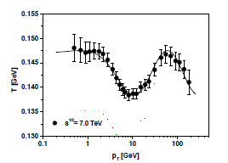
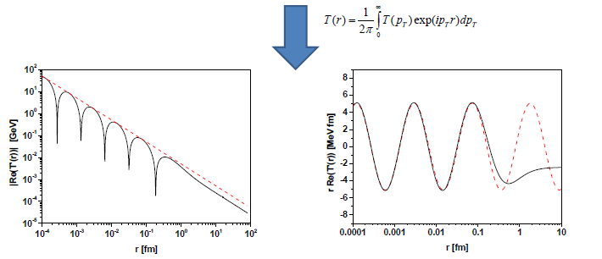
(3)
Temperature oscillations and sound waves in hadronic matter
------ T(r)=0.005/r
------ T(r)=5.1sin(2π)/3.2ln(1.24r)

Slide 22
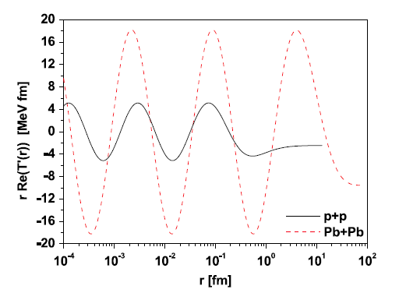
(3)
Comparison of different collision systems:
p-p and Pb-Pb
(most (most central)
collisions

Slide 23
(3)
Temperature oscillations and sound waves in hadronic matter
where K=K(r)=ω/c(r)

Slide 24
(3)
Self similar solution

Slide 25
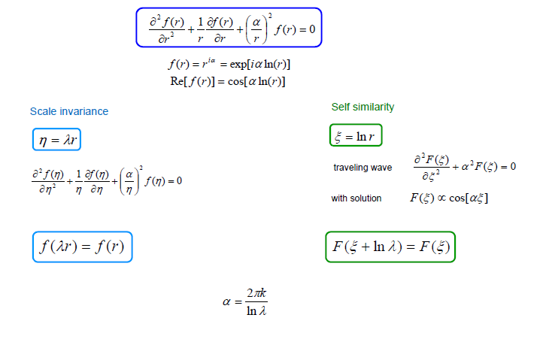
(3)
Remarks: Correspondence between scale invariance and self similarity
sin[αξ]

Slide 26
(4)
Consequences (1)
(*) The space picture of the collision (in the plain
perpendicular to the collision axis and located at
the collision point) presented shows the existence
of some regular (on the logarithmic scale) structure
for small distances.
(*) It starts to weaken quite early (at r ∼ 0.1 fm) and essentially disappears when r reaches the dimension of the nucleon, i.e., for r ∼ 1 fm.
(*) For central Pb + Pb collisions we observe ∼3.6 times bigger amplitude and ∼1.15 longer period of oscillations. With decreasing centrality the amplitude decreases smoothly reaching practically the same value as for p + p collisions . With the parameters used we have, in the region of regular oscillations, that

Slide 27
(4)
Consequences (2)
(*) Longer period of oscillations in Pb + Pb
collisions means a smaller value of the
parameter α in
in p + p collisions.
(*) Because ω/c(r) = α/r ➔ the velocity of sound c(r) = (ω/α)r
➔ velocity of sound in the nuclear environment (Pb + Pb) is greater
than in p + p.
(*) This, in turn, means that the refractive index n(r) = c₀ /c(r) at position r in
nuclear collisions is smaller than in collisions of protons.
(*) In both cases we encounter an inhomogeneous medium with r-dependent c(r)
and n(r).

Slide 28
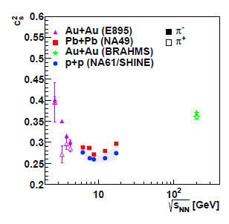
(4)
Confrontation with experimental observations (1)
(*) In nuclear collisions one observes a higher speed of sound c_{s}² (used as a parameter in the equation of state of hadronic matter described by a hydrodynamical model)
Compilation of the energy
dependence of sound velocities
c_{s}² obtained from the widths
of π− rapidity spectra
[ PoS DIS2014(2014) 018]

Slide 29
(4)
Confrontation with experimental observations (2)
(*) This should be expected.
Consider the connection of the isothermal compressibility of the nuclear matter
and fluctuations of the multiplicity of produced secondaries represented by the relative variance, ϖ , of the multiplicity fluctuations ( ρ ₀ = ⟨N⟩/V denotes the equilibrium density for N particles with mass m located in volume V ).
This allows the velocity of sound to be expressed by fluctuations of multiplicity because one has :
Note: higher velocity of sound corresponds to lower fluctuations of multiplicity.

Slide 30
(4)
Confrontation with experimental observations (3)
Higher velocity of sound corresponds to lower fluctuations of multiplicity,
this seems to be observed:
Fluctuations (omega) decreases with number of wounded nucleons.

Slide 31
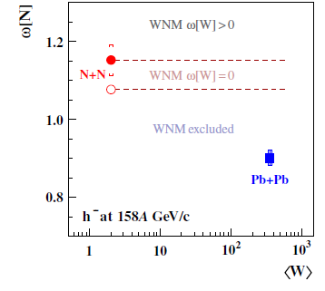
(4)
Confrontation with experimental observations (4)
This agrees also with the recently obtained values $\frac{{\overline{ω}}_{p+p}}{{\overline{ω}}_{Pb+Pb}}≅1.29 ±0.04$
[ Eur. Phys. J. C 76 (2016) 635 ]
Scaled variance of the multiplicity distribution of negatively charged hadrons, ω, as a function of the mean number of wounded nucleons <W>. Results for inelastic p+p (NA61/SHINE) interactions (ﬁlled circles) and the 1% most central Pb+Pb (NA49 [6]) collisions (squares).
Fluctuations (represented by ω) decreases with number of wounded nucleons.
These results can be connected with the pair correlation function, g(2), because the scaled variance can be written as
J. Phys. Conf. Ser. 5 (2005) 23 ➔ for central nuclear collisions the number of binary collisions exceeds that of wounded nucleons and correlation function becoming negative which means smaller fluctuations of multiplicity.

Slide 32
(4)
Confrontation with experimental observations (5)
(*) In nuclear collisions participate N_{part} nucleons (wounded nucleons) experiencing N_{coll} binary NN collisions. In Glauber picture : N_{coll} ~ (N_{part})^{4/3} .
(*) Incompresability is proportional to the energy density:
(1/κ ) ~ ε =N_{part} ε₀ + ( N_{coll} - N_{part} )ε₁
[ ε₀ - energy produced by participating nucleons , ε₁ ₋energy produced in. the remaining binary collisions; note that, approximately, nucleon interacts many times and in first interaction it releases energy ε_{0,} in each additional collision energy ε₁ (on the average) ]
(*) Incompresability of nuclear matter exceed incompresability of hadronic matter and sound speed ratio is given by
(*) For central Pb+Pb ccollisions (with N_{part} $≅200,$ $[$c_{PbP} /c_{pp} ]² ~1.3 and
N_{coll} /N_{part} ~[N_{part} ]^{1/3} ) we estimate that

Slide 33
Concluding Remarks - 1
(*) Transverse momentum distributions are characterized by a quasi-power law
(Tsallis distribution) decorated with log-periodic oscillations.
(*) This means that either: the system and/or the underlying physical
mechanisms have characteristic scale invariance behavior. The discrete
scale invariance and its associated complex exponents can appear
spontaneously, without a pre-existing hierarchical structure.
(*) Or that: we observe a sound wave in hadronic matter (resulting in the
temperature oscillations) which has self similar solution (in log-periodic
form).
(*) This, in turn, can have some interesting experimental consequences.

Slide 34
Concluding Remarks - 2
Further reading (GW&ZW): Physica A 413 (2014) 53 ;
Entropy 17 (2015) 384;
Chaos,Sol.& Frac., 81 (2015) 487 ;
Physica A 486 (2017) 579.
Also: D.A. Fogaça et al. Nucl. Phys. A 819 (2009) 150 [Sound waves and solitons in hot
and dense nuclear matter];
G.I. Barenblatt and Ya.B. Zeldovich, Ann. Rev. Fluid Mech. 4 (1972) 285 [Self-
Similar Solutions as Intermediate Asymptotics];
D.Sornette, Phys. Rep. 297 (1998)239 [Discrete-scale invariance and complex
dimensions]

Slide 35
Gracias por su atención
Thank you for your attention
and I look forward to your comments and questions

