Slide 1


Bottomonia physics at RHIC
and LHC energies
Georg Wolschin
Heidelberg University
Institut für Theoretische Physik
Philosophenweg 16
D-69120 Heidelberg

Slide 2
Topics
1. Introduction: ϒ suppression in the Quark-Gluon Plasma
2. Model for bottomonium suppression
2.1 Complex potential: Screening and damping
2.2 Gluon-induced dissociation
2.3 Hydrodynamic expansion
2.4 Feed-down cascade
2.5 Relativistic Doppler effect; p_{T}-dependent results vs. data
3. Comparison with centrality-dependent data
3.1 193 GeV UU: STAR @ RHIC
3.2 2.76 TeV PbPb: CMS and ALICE @ LHC
4. Prediction for 5.02 TeV PbPb
5. Conclusion

Slide 3
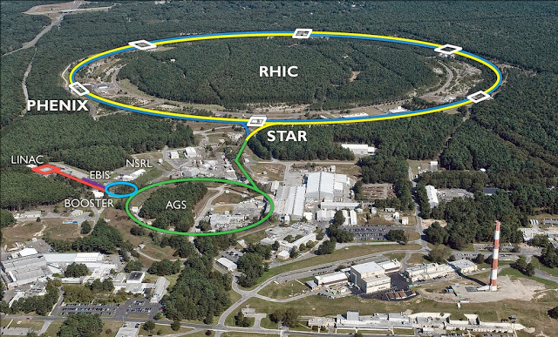
1. Quarkonia at the Relativistic Heavy Ion Collider, BNL
e.g. Au+Au collisions @ √s_{NN}= 200 GeV center of mass energy

Slide 4
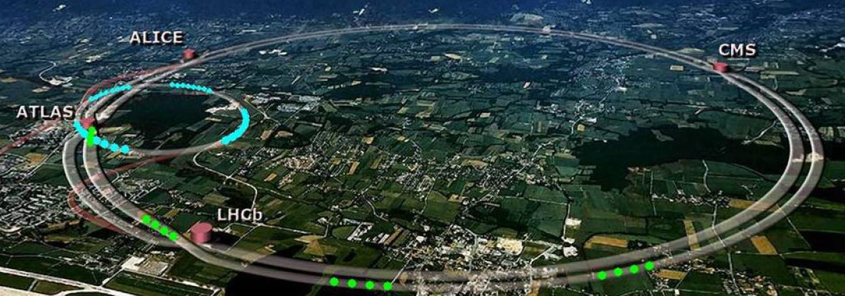
Quarkonia physics at the Large Hadron Collider, CERN
p+p @ 7,8,13,(14) TeV
Pb+Pb @ 2.76 TeV 2011/12 Run 1
@ 5.02 TeV Oct. 2015 Run 2
(design energy 5.52 TeV)
p+Pb @ 5.02 TeV 2012/13
@ 5.02, 8.16 TeV 2016

Slide 5
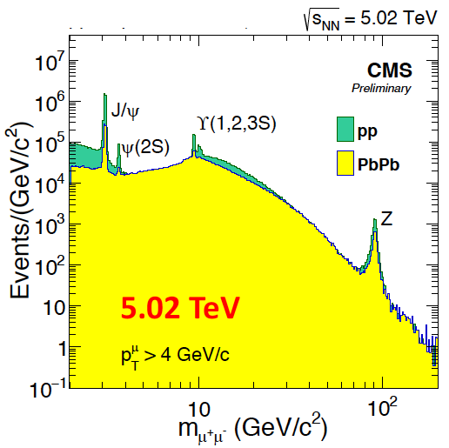
ϒ suppression in PbPb @ LHC
ϒ suppression as
a sensitive probe for
the QGP
No significant effect
of regeneration
m_{b}≈ 3m_{c} cleaner
theoretical treatment
More stable than J/ψ
E_{B}(ϒ_{1S}) ≈ 1.10 GeV
E_{B}(J/ψ) ≈ 0.64 GeV
CMS Collab., Hard Probes Wuhan (2016); CMS-PAS-HIN-16-023 (2016)

Slide 6
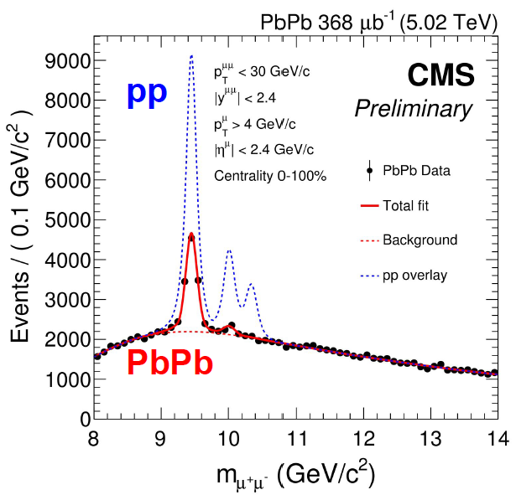
ϒ(nS) suppression in 5.02 TeV PbPb @ LHC:
A clear QGP indicator
1. ϒ(1S) ground state is suppressed in PbPb:
R_{AA} (ϒ(1S)) = 0.36 ± 0.014 ± 0.048, min. bias
  2. ϒ(2S, 3S) states are >3 times stronger
suppressed in PbPb than Y(1S)
R_{AA}(ϒ(2S)) = 0.104 ± 0.021 (stat.) ± 0.014
R_{AA}(ϒ(3S)) < 0.071 at 95 % CL
CMS-PAS-HIN-16-023 (2016)

Slide 7
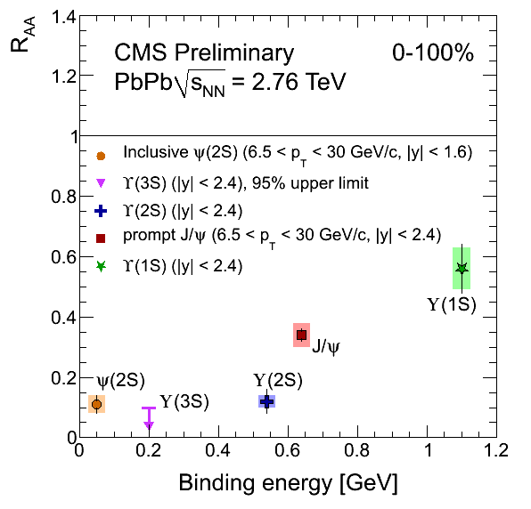
Sequential suppression of ϒ(nS) and J/ψ states (2.76 TeV)
© G. Roland / CMS

Slide 8
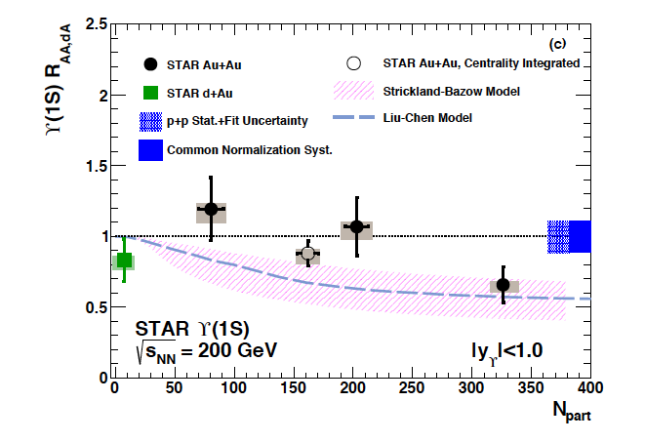
ϒ(nS) states are suppressed in 200 GeV AuAu @ RHIC
R. Vértesi, Nucl. Part. Phys. Proc. 276 (2016) 269: Dielectron data

Slide 9
2. The model: Screening, Gluodissociation and Collisional broadening of the ϒ(nS) states
Debye screening of all states involved: Static suppression
The imaginary part of the potential (effect of collisions)
contributes to the broadening of the ϒ(nS) states: damping
Gluon-induced dissociation: dynamic suppression,
in particular of the ϒ(1S) ground state due to the large
thermal gluon density
Reduced feed-down from the excited ϒ/χ_{b} states to ϒ(1S)
substantially modifies the populations: indirect suppression
F. Vaccaro, F. Nendzig and GW, Europhys.Lett. 102, 42001 (2013); J. Hoelck and GW, to be publ.
F. Nendzig and GW, Phys. Rev. C 87, 024911 (2013); J. Phys. G41, 095003 (2014)
F. Brezinski and GW, Phys. Lett.B 70, 534 (2012)

Slide 10
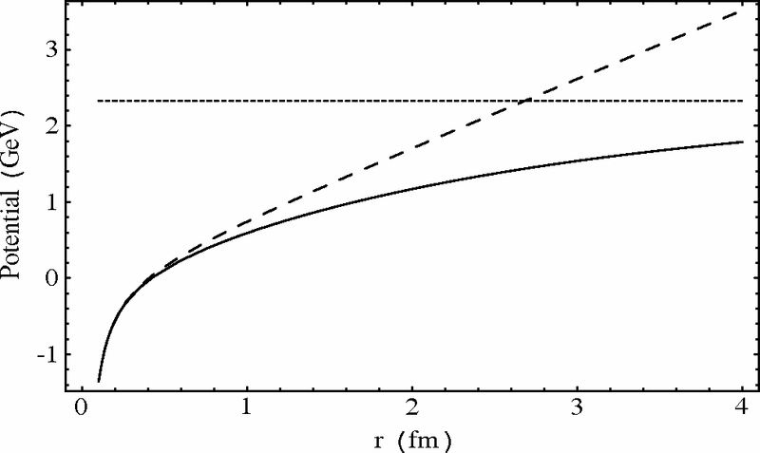
Screening in a nonrelativistic potential model
Proposal Matsui&Satz 1986: At high temperatures in the Quark-Gluon
medium, the Cornell-type real quark-antiquark potential is ‘color-screened‘,
analogously to the Debye screening in an electromagnetic plasma
σ string tension, κ= (4α_{s} /3) Coulomb-parameter
Debye length
Heavy mesons can “melt” in the hot medium,
But there are the important effects of damping,
gluodissociation and reduced feed-down

Slide 11
2.1 Screening and damping treated in a nonrelativistic potential model
Screened potential: m_{D} = Debye mass,
α_{nl}(T): the strong coupling constant α_{s} at <1/r>_{nl} (T)
C_{F} = (N_{c}² - 1) / (2N_{c})
σ ≈ 0.192GeV² the string tension(Jacobs et al.; Karsch et al.)
Imaginary part: Collisional damping (Laine et al. 2007, Beraudo et al. 2008,
Brambilla et al. 2008) for 2πT >> <1/r>; different form
for 2πT << <1/r>.

Slide 12
Radial wave function of Υ(1S) at temperatures T
Solutions of the Schoedinger equation with complex
potential V(r,T,α_{s}) for the radial wave functions g_{nl}(r,T),
From: J. Hoelck and
GW, unpublished

Slide 13


2.2 Gluon-induced dissociation
Born amplitude for the interaction of gluon clusters according to
Bhanot&Peskin in dipole approximation / Operator product expansion,
extended to include the screened coulombic + string eigenfunctions
as outlined in Brezinski and Wolschin, PLB 70, 534 (2012)
for the Gluodissociation cross section of the Y(nS) states, and correspondingly for the χ_{b}(nP) states.
13

Slide 14
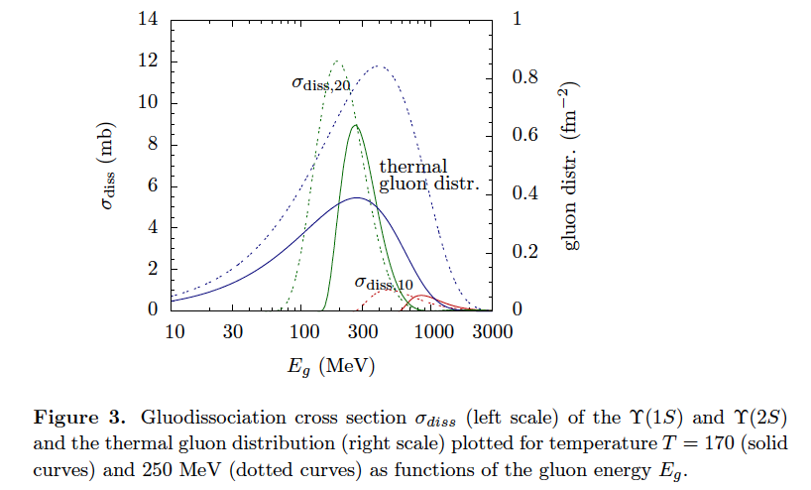
Gluodissociation cross section
F. Nendzig and GW, J. Phys. G41, 095003 (2014)

Slide 15

Thermal gluodissociation cross section
Average the gluodissociation cross section over the Bose-Einstein
distribution of the thermal gluons in the QGP to obtain the dissociation
width at temperature T for each of the six bottomia states involved
(g_{d} = 16)
With rising temperature, the peak of the gluon distribution moves to larger gluon
energies E_{g}, whereas the dissociation cross sections move to smaller E_{g}, giving
rise to a maximum in the gluodissociation width for fixed coupling α_{s}.
(Larger cross sections at higher temperatures due to running coupling counteract.)

Slide 16
Damping and
gluodissociation widths
for six bottomia states
Γ_{tot}(T) = Γ_{damp}(T) + Γ_{diss}(T)
F. Nendzig and GW, J. Phys. G41, 095003 (2014)

Slide 17
2.3 Hydrodynamic expansion (ideal)
Temperature
profile for
central collisions
at different
times τ
Use total decay widths
Γ_{tot}(b,x,y) of the bottomia states for each impact parameter b and time step t in the transverse (x¹,x²) plane

Slide 18
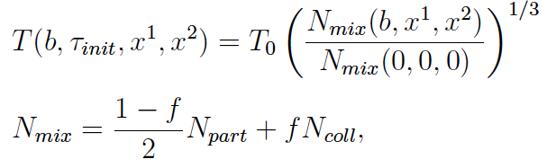


Dynamical fireball evolution
Dependence of the local temperature T on impact parameter b, time t,
and transverse coordinates x, y evaluated in ideal hydrodynamic calculation
with transverse expansion
f = 0.145
The number of produced -pairs is proportional to the number
of binary collision, and the nuclear overlap
QGP suppression factor (without feed-down and CNM effects):
18

Slide 19
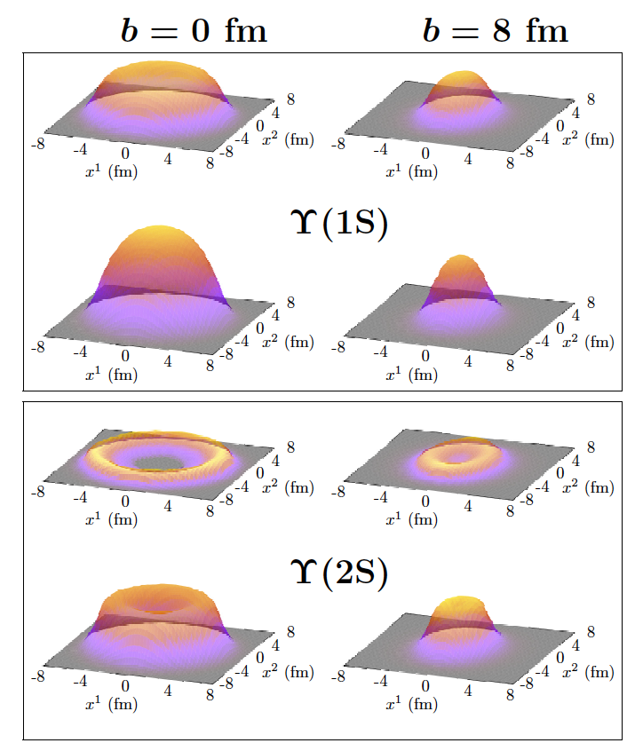
Integrand
in the
transverse
plane
p_{T} = 0
p_{T} = 12 GeV/c
p_{T} = 0
p_{T} = 12 GeV/c
J. Phys. G41,
095003 (2014)

Slide 20
2.4 Feed-down cascade
including χ_{nP} states; relative initial populations in pp computed using an
inverted cascade from the final populations measured by CMS and CDF( ).
Feed-down is reduced if excited states are screened or depopulated
N_{initial}
3S: 0.324
2S: 0.367
1S: 0.373
N_{initial}
2P: 0.881
1P: 1.084
20
20

Slide 21
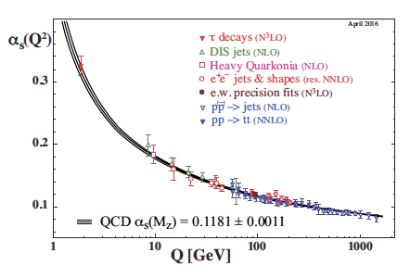
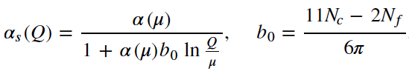
More model ingredients
Consider running of the coupling
Transverse momentum distribution
of the ϒ included, <p_{T}> ≈ 6 GeV/c
Relativistic Doppler effect included
T_{c} = 160 MeV
© K. Bethke 2016
F. Nendzig and GW, J. Phys. G41, 095003 (2014)
α_{nl}(T) depends on the solution g_{nl}(r,T) of the Schrödinger eq.: Iterative solution

Slide 22

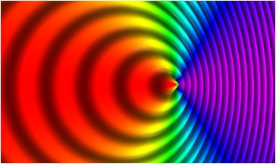
Relativistic Doppler effect
For a finite relative velocity between the expanding QGP and the bottomium states the relativistic Doppler shift results in an angle-dependent effective temperature
with the angle θ between the medium velocity u (in the bottomium restframe) and the direction of the incident light parton. This effective temperature is anisotropic: blue-shifted for θ ≈ 0°, red-shifted in the opposite direction.
θ = 180°
θ = 0°, blueshift
redshift
u = 0.7 c
This has a significant effect on the transverse momentum distributions of the ϒ‘s:
It leads to more suppression in the high-p_{T} region.

Slide 23
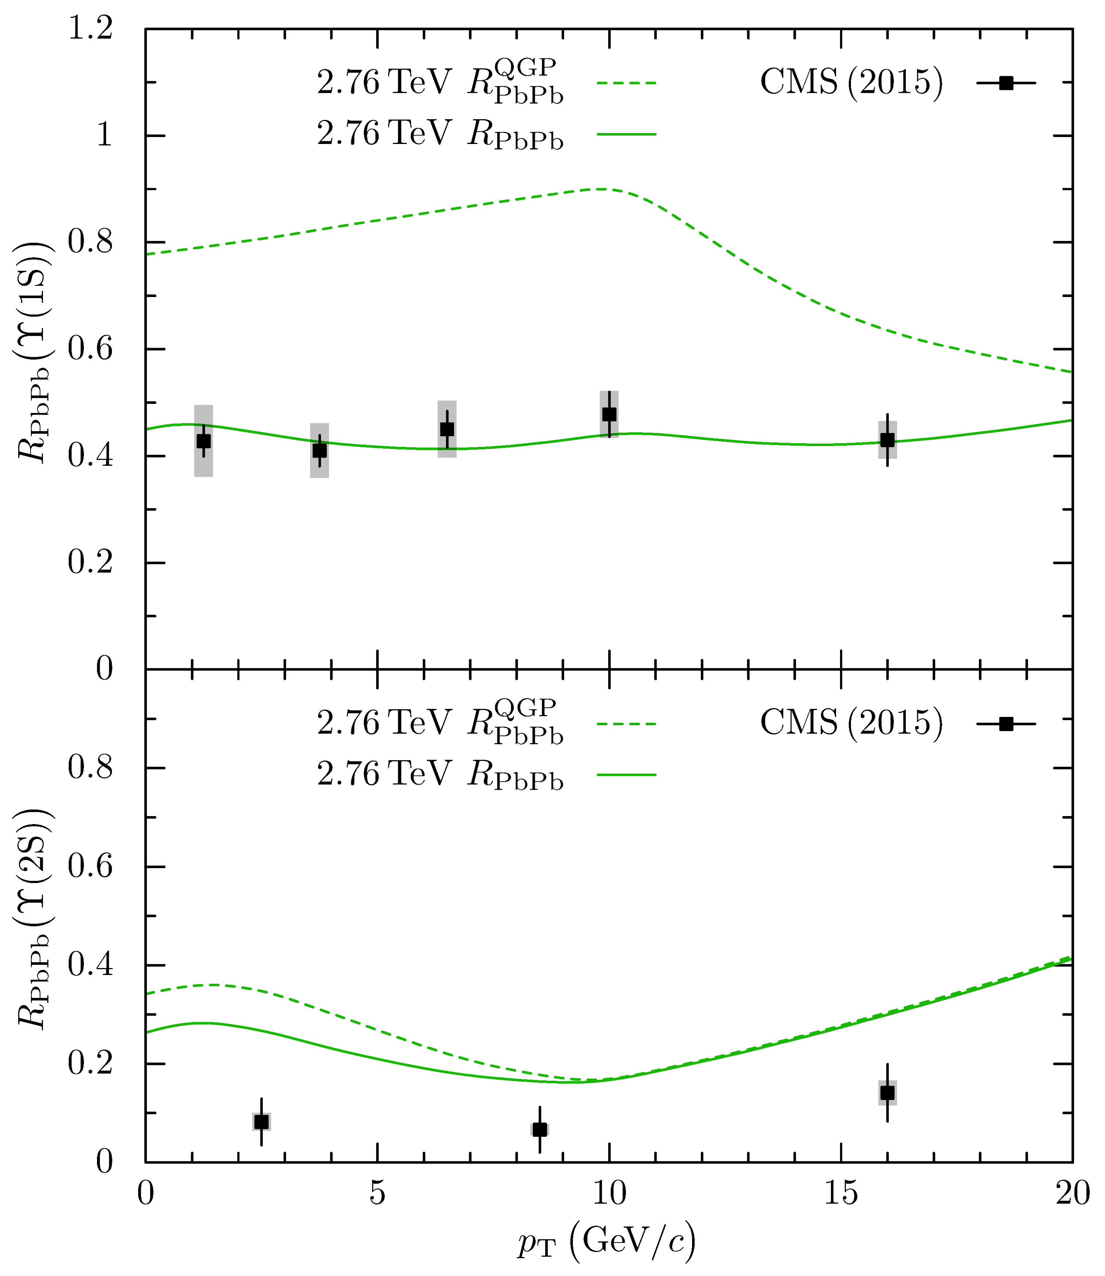
Transverse momentum dependence of ϒ(1S) suppression in PbPb at 2.76 TeV: Width-averaging
The ϒ(1S) suppression is mostly
reduced feed-down (31% in-medium),
the ϒ(2S) suppression primarily
in-medium (94% in min. bias)
ϒ(1S)
⬅
In-medium suppression only
⬅
Including reduced feed-down
(t_{F}= 0.4 fm/c; prel. CMS data 2015)
J. Hoelck, F. Nendzig and GW,
Phys. Rev. C 95, 024905 (2017)
ϒ(2S)
Reduced feed-down only relevant
for Y(1S), not for excited states
23

Slide 24
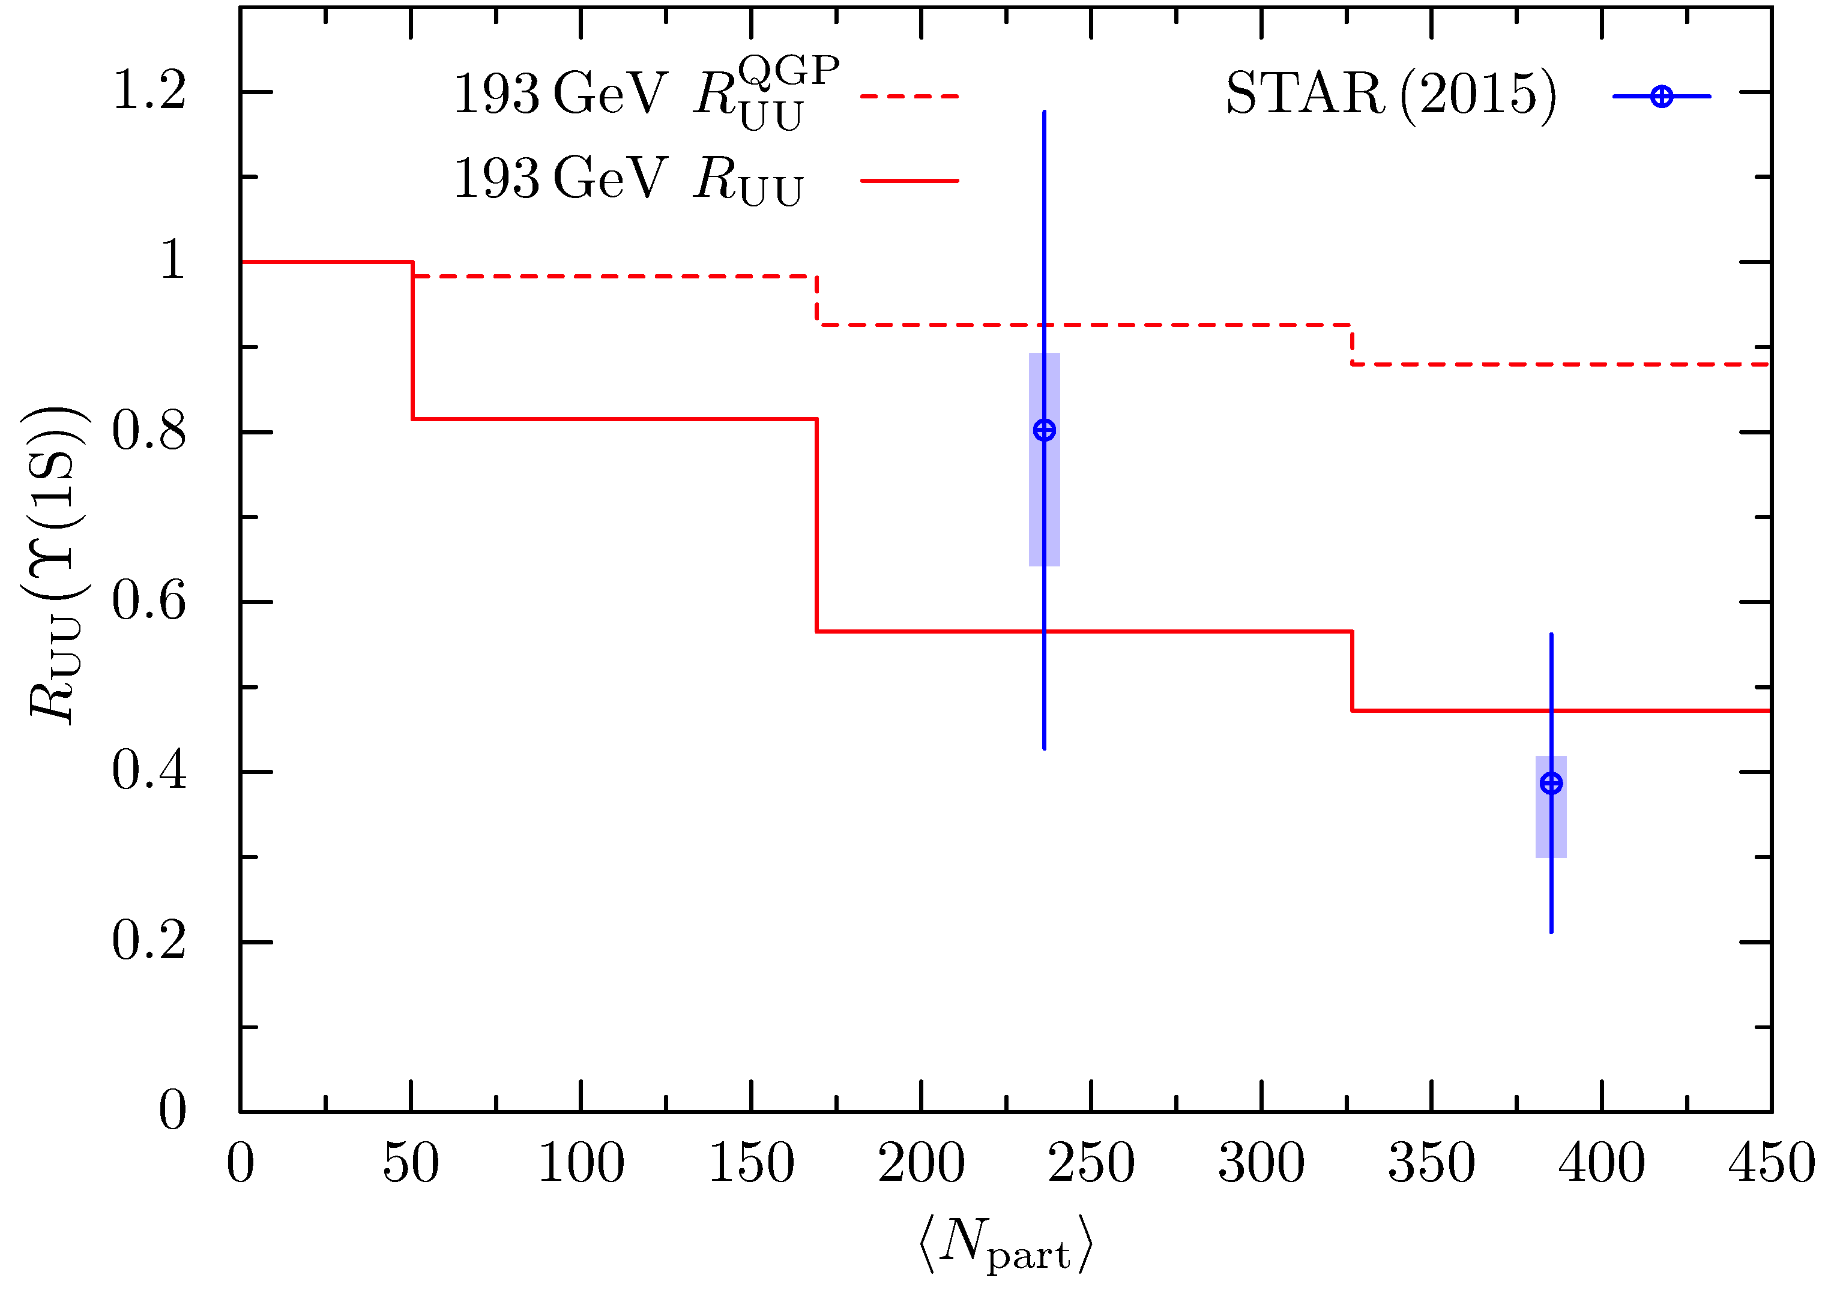


3. Comparison with centrality-dependent data
3.1 Theoretical vs. exp. (STAR) ϒ(1S)-suppression factors:
Centrality dependent, p_{T}- integrated
193 GeV UU RHIC
t_{F}= 0.4 fm/c: ϒ formation time
T₀= 417 MeV: central temp.
at b = 0 and t = t_{F}
ϒ(1S)
J. Hoelck, F. Nendzig and GW,
Phys. Rev. C 95, 024905 (2017)
24

Slide 25
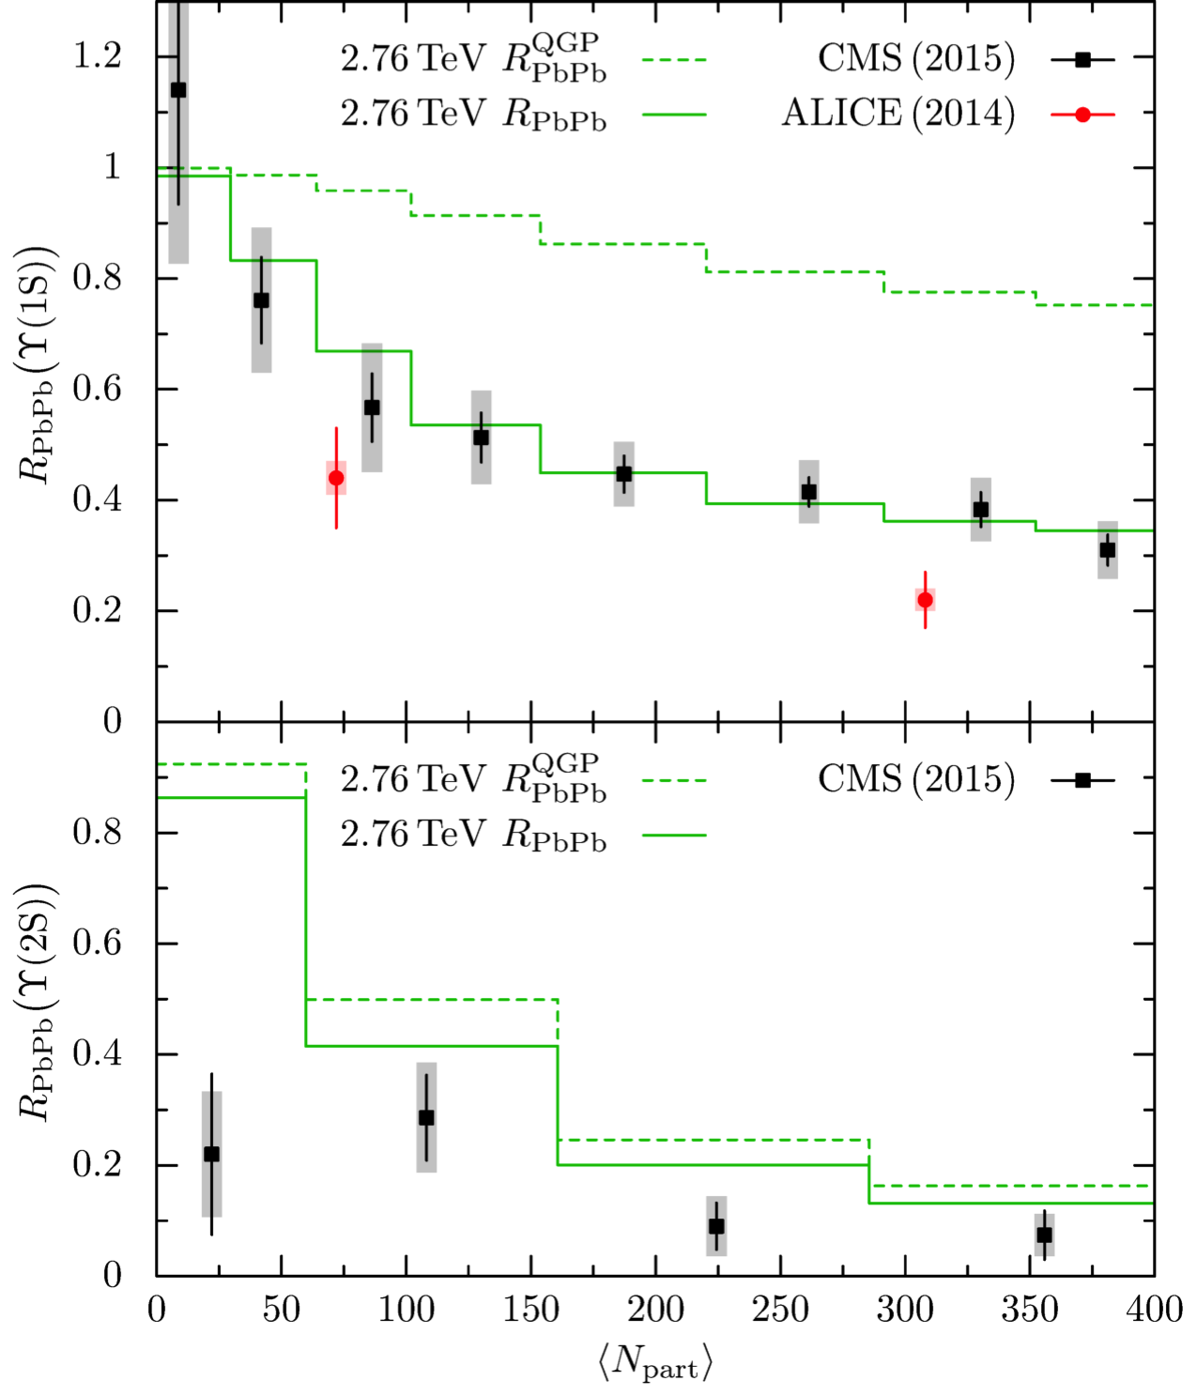
3.2 2.76 TeV PbPb: CMS and ALICE
2.76 TeV PbPb LHC
t_{F}= 0.4 fm/c: ϒ formation time
T₀= 480 MeV: central temp.
at b = 0 and t = t_{F}
ϒ(1S)
Room for additional suppression mechanisms for the excited states: Hadronic dissociation, mostly by pions, is one possibility. Thermal pions are in-sufficient; direct pions may contribute,
and electromagnetic dissociation.
ϒ(2S)
J. Hoelck, F. Nendzig and GW,
Phys. Rev. C 95, 024905 (2017)
25

Slide 26




2.76 TeV PbPb: Electromagnetic field effects
t_{F}= 0.4 fm/c: ϒ formation time
T₀= 480 MeV: central temp.
at b = 0 and t = t_{F}
QGP conductivity: σ = 5.8 MeV
ϒ(1S)
ϒ(2S)
No significant em. field effects:
Although the field decays in the medium on a time scale that is
larger than t_{F}, the magnitude
is considerably reduced such
that it can not produce additional suppression
CMS data: Phys. Lett. 770, 357 (2017)
J. Hoelck and GW,
submitted to EPJA
26

Slide 27
4. Prediction for ϒ suppression at 5.02 TeV vs. prel. CMS data
Prel. CMS data from QM2017, Chicago
T_{max} @ t_{F}: 513 MeV
< 10% higher suppression at
5.02 TeV vs 2.76 TeV: within
experimental error bars
J. Hoelck and GW (2017)
27

Slide 28
5. Conclusion ϒ suppression
The suppression of the ϒ(1S) ground state in PbPb collisions at LHC energies through gluodissociation, damping, screening, and reduced feed-down has been calculated as function of p_{T ,} and centrality, and is found to be in good agreement with the CMS result. Screening is not decisive for the 1S state except for central collisions.
The ϒ(1S) suppression is mostly reduced feed-down, the ϒ(2S) primarily in-medium. The prediction for 5.02 TeV PbPb gives good results cp. to prel. CMS data.
The enhanced suppression of ϒ(2S, 3S) leaves room for additional suppression mechanisms, in particular for peripheral collisions where discrepancies to the CMS data persist. Electromagnetic effects are not strong enough. Hadronic dissociation of the excited states or other cold nuclear matter (CNM) effects may be relevant.
28

Slide 29

Thank you for your invitation and attention !
29

