Slide 1
Asymptotic analysis of the parton branching equation at LHC energies
Wei Yang Wang
HEP Group
National University of Singapore (NUS)
ISMD2017
15/09/2017

Slide 2
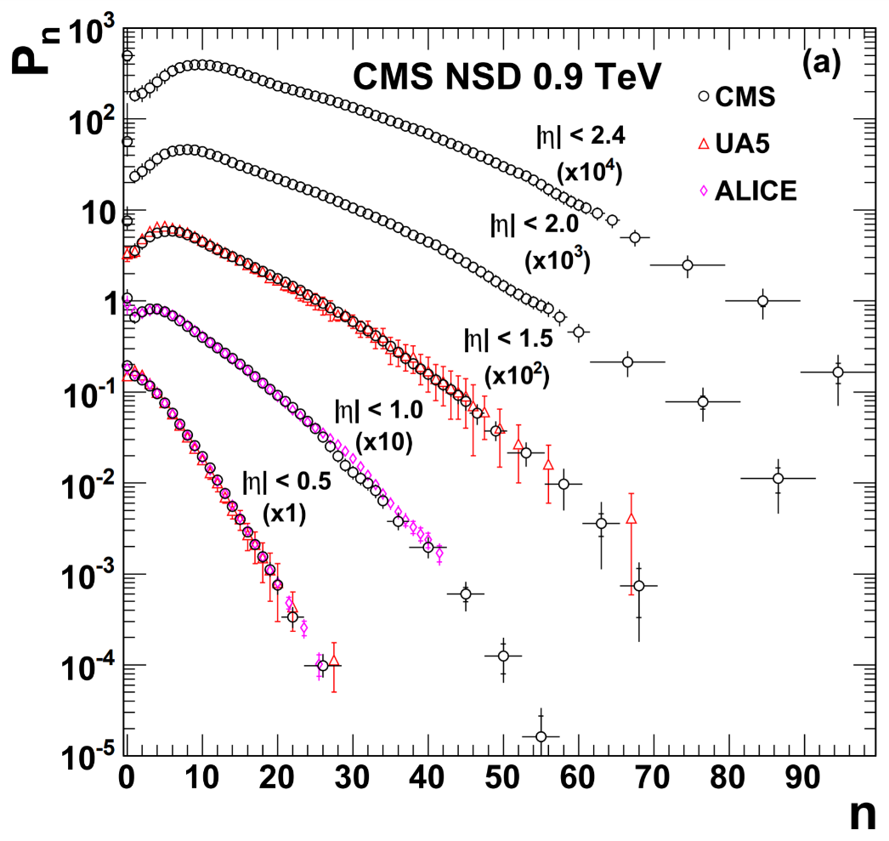
Multiplicity Distributions
Parton branching equation describes the cascade of quarks and gluons through basic branching processes, eventually forming charged hadrons
Basic global observable (P(n) probability of observing n charged hadrons in an event)
Charged particle multiplicity distributions at the LHC:
ALICE, ATLAS, CMS
wide |𝜂| at various c.m. energies
[CMS Collaboration, JHEP01 (2011) 079]

Slide 3
Multiplicity Distributions
Reveals underlying correlations in particle production
Independent emission of single particles → Poisson
Thermal source → broader distribution e.g. Negative Binomial Distribution (NBD)
Correlations mainly short range in rapidity (cluster decays…)
Some long range correlations that increases with c.m. energy (much weaker in e⁺e⁻ collisions)
[CMS Collaboration, JHEP01 (2011) 079]

Slide 4
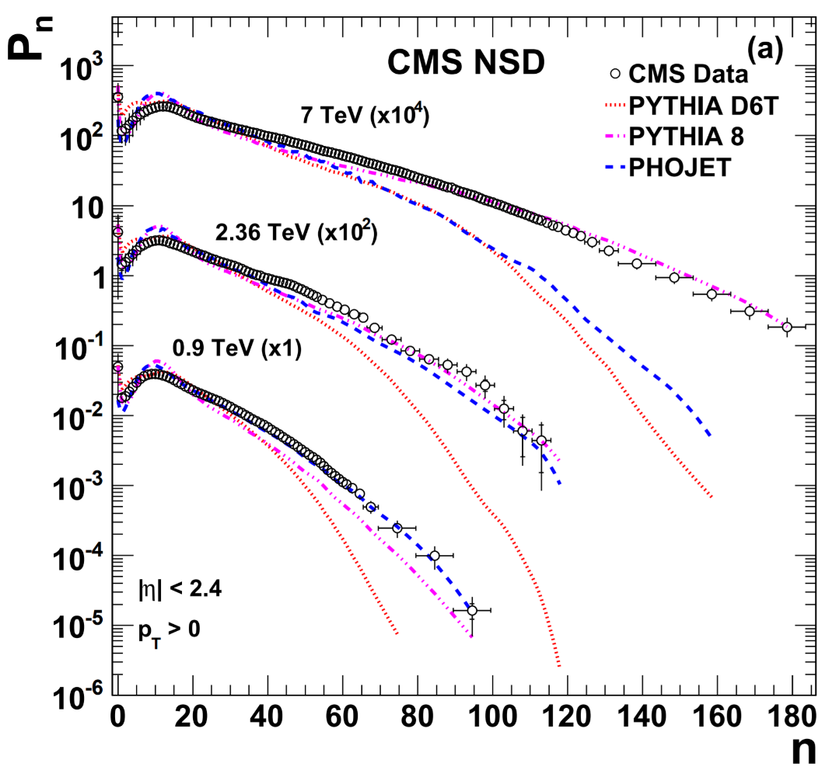
Multiplicity Distributions
Popular models:
Monte Carlo (QCD + QCD inspired phenomenological models e.g. MPI)
Large multiplicity tails difficult to describe (especially without MPI)
[CMS Collaboration, JHEP01 (2011) 079]

Slide 5
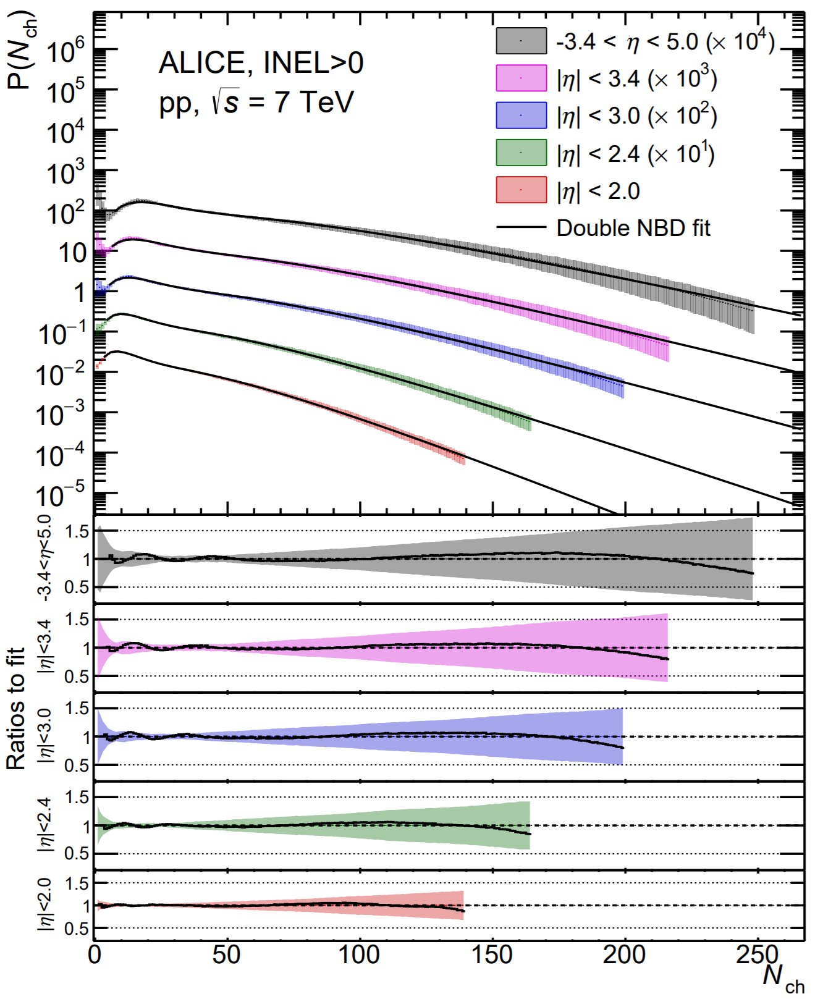
Multiplicity Distributions
Popular models:
Statistical models (e.g. NBD, double NBD)
Single NBD does not reproduce the rise n<10 and “shoulder” n∼20
Low n dominated by diffractive events
IP Glasma model (CGC) → NBD (k∝Q_{s}S⊥)
Double NBD fits better but meaning not clear
[ALICE Collaboration, arXiv:1708.01435, 2017]

Slide 6
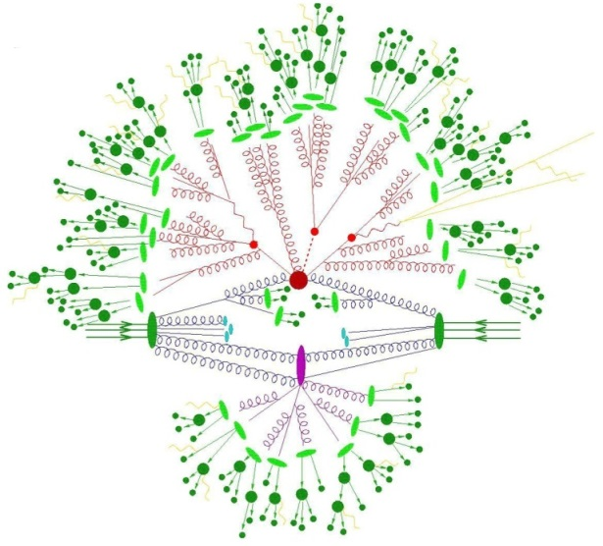
QCD-based parton branching models
Parton Branching Models (Giovannini, 1979)
Describes the cascade of quarks and gluons eventually forming charged hadrons
NBD arises from the Markov branching process of quark bremsstrahlung
Generalised Multiplicities Distribution (GMD)
Asymptotic Multiplicity Distribution (AMD)

Slide 7
QCD branching processes
Giovannini, 1979
Closed form solution difficult to obtain.
Assume quark pair production negligible (B = 0)

Slide 8
Generalised Multiplicity Distribution (GMD)
✕ Ã/A (k=mÃ/A)
[chan, chew, Z. Phys. C 55 (1992) 503]
[Wang, Leong, Ng, Dewanto, Chan, Oh, Proceedings of the Conference in Honour of the 90th Birthday of Freeman Dyson (2014), 400]

Slide 9
QCD branching processes
Giovannini, 1979
Expect to be more important at high energies like at LHC
Difficult to get closed form solution.
Asymptotic solution possible.

Slide 10
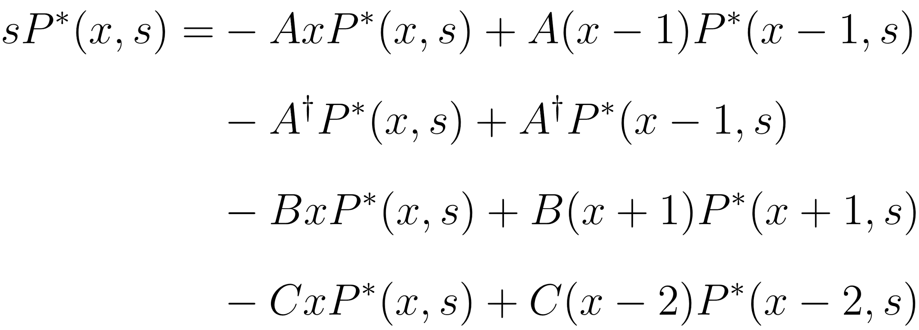
Asymptotic Multiplicity Distribution
Solution obtained by performing a Laplace transform (n ∼ x)
Defining
Taylor expansion of L(x+δx) about x

Slide 11
Asymptotic Multiplicity Distribution
Inverse Laplace transformation + saddle point approximation

Slide 12
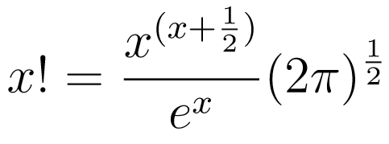
Asymptotic Multiplicity Distribution
Solution
Stirling approximation
+ replacing with original physical parameters

Slide 13
Asymptotic Multiplicity Distribution
Reduces to GMD when B=C=0 (i.e. negligible quark pair production and 4-gluon vertex)
Further reduces to NBD when k’=0 (i.e. no initial gluons)

Slide 14
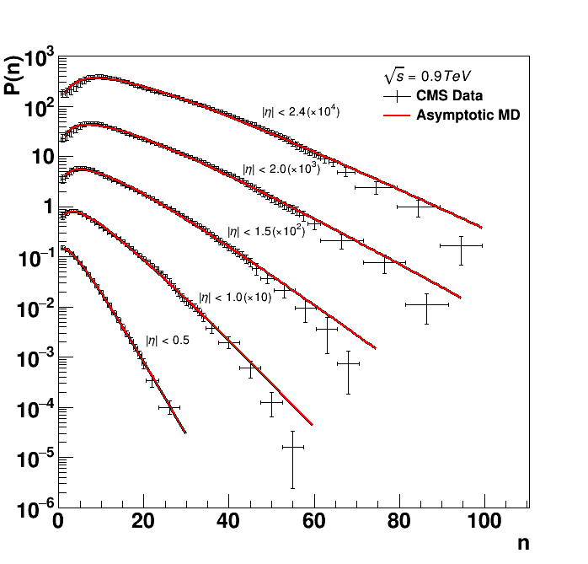
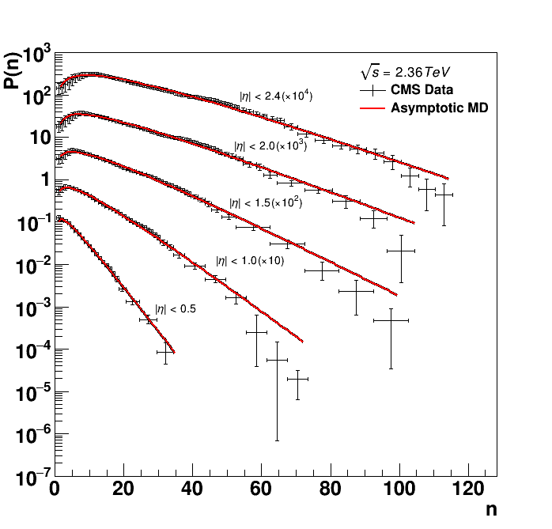
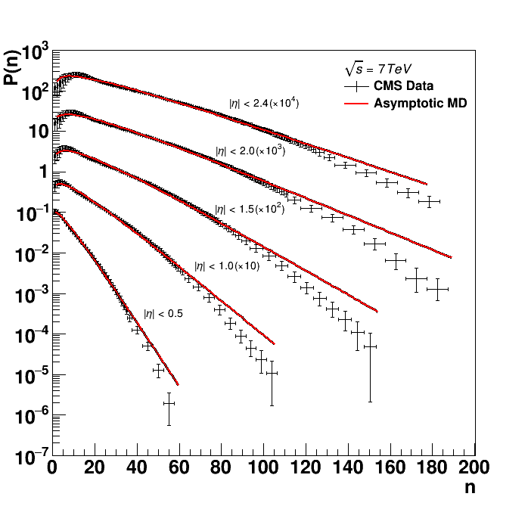
LHC data
CMS charged particle multiplicity distribution
0.9 TeV
2.36 TeV
7 TeV

Slide 15
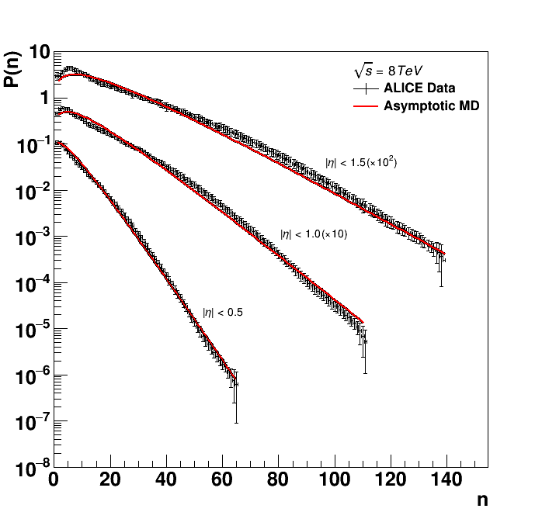
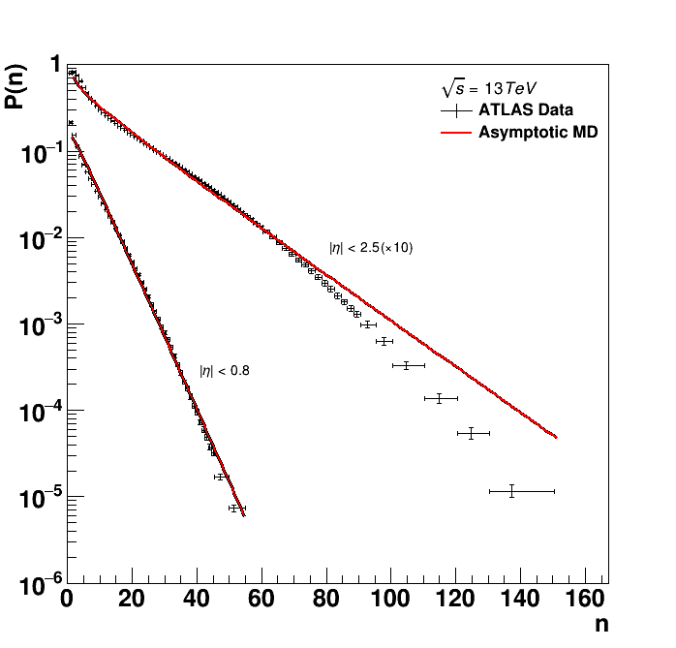
LHC data
ALICE (8 TeV)
ATLAS (13 TeV)

Slide 16
Summary
An asymptotic solution (AMD) to the parton branching equation including 4 branching processes can be derived using the Laplace transformation and saddle point approximation
AMD is reducible to the GMD and NBD in the limits of parameter values
Applied to 0.9, 2.36, 7, 8, 13 TeV data from ALICE, ATLAS, CMS

Slide 17
Thank you for your attention!

