Slide 1
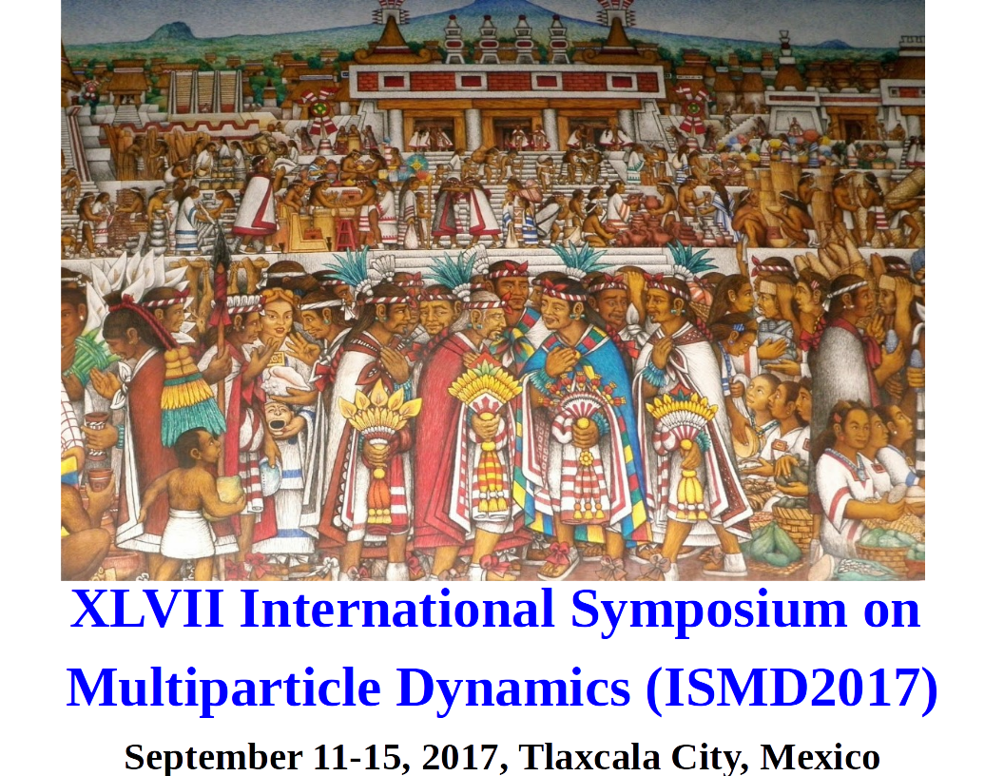


Forward-Backward multiplicity correlation: a tool to study general properties of the pp events
Edgar Dominguez Rosas
Instituto de Ciencias Nucleares
Universidad Nacional Autónoma de México

Slide 2
Outline
Definition of Correlation
Motivation
  Previous Measurement
  Multiple Parton interactions and Colour Reconnection
Initial Conditions
Generated Events
  Soft and Hard QCD process
  Multiple Parton Interaction (nMPI)
  Colour Reconnection (CR)
Conclusions

Slide 3
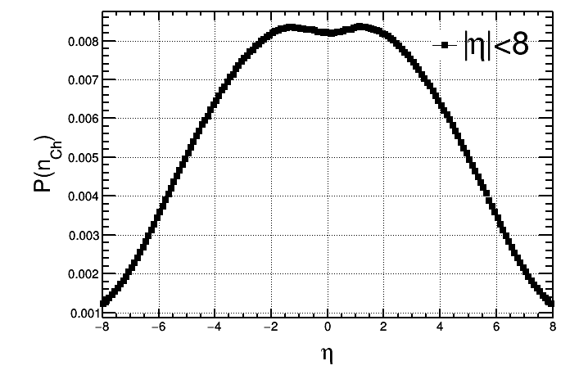
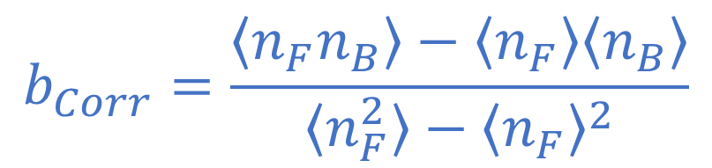



Definition of the F-B Correlation
The Correlation is theoretically defined event by event, comparing the integrad density of particles produced in different ranges of pseudorapidity;
$$b_{Corr}=\frac{\left\langle n_{F}n_{B}\right\rangle −\left\langle n_{F}\right\rangle \left\langle n_{B}\right\rangle }{\left\langle n_{F}^{2}\right\rangle −{\left\langle n_{F}\right\rangle }^{2}}$$
$$η_{gap}$$
$$δη$$
$$δη$$

Slide 4



Motivation: Historical measurements of b_{Corr}
Collisions in ISR, PETRA (Phys.Rev. D34 (1986) 3304), “suggests the direct and independent production of hadrons.”
Collisions pp in ISR (Nucl.Phys. B132 (1978) 15), “In the framework of the cluster model we interpret the observed correlations as correlations between the clusters.”
Collisions in (Phys.Lett. B123 (1983) 361), “We find that the bulk of the charged particles are produced from clusters with the same average size independent of observed multiplicity”.
Collisions Au-Au in RIHC (Phys.Rev.Lett. 103 (2009)172301), “ A large long-range correlation is observed in central Au-Au collisions that vanishes for 40–50% centrality ”.
Collisions pp in ALICE and ATLAS at CERN (JHEP 05 (2015) 097, JHEP 07, 019 (2012))
$$e^{+}e^{−}$$
$$p\overline{p}$$
$$Sp\overline{p}S$$

Slide 5
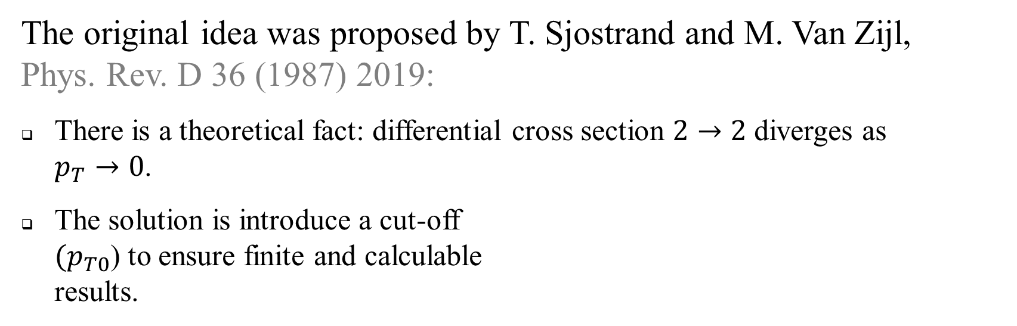
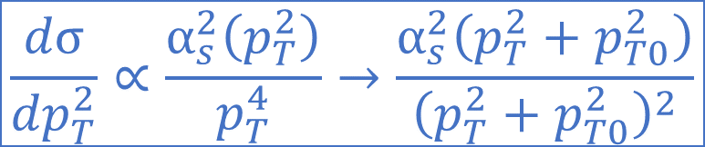
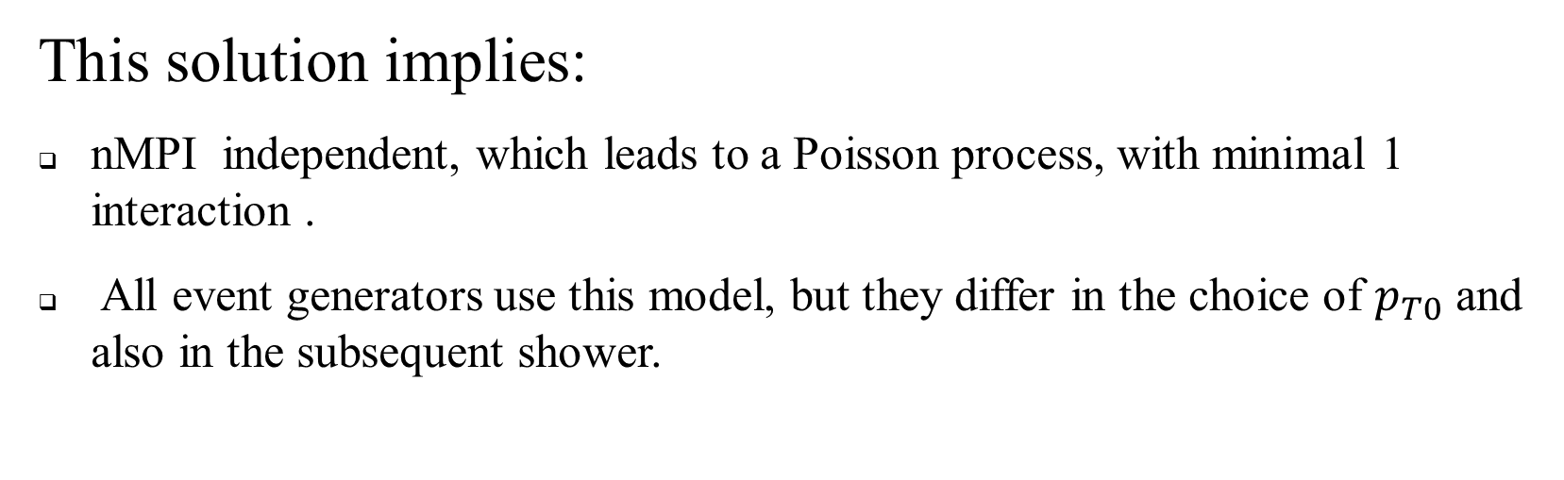
Motivation: Modeling Multiple parton interactions
The original idea was proposed by T. Sjostrand and M. Van Zijl, Phys. Rev. D 36 (1987) 2019:
There is a theoretical fact: differential cross section $2→2$ diverges as $p_{T}→0$.
The solution is introduce a cut-off $(p_{T0}$) to ensure finite and calculable results.
$$\frac{dσ}{{dp}_{T}^{2}}∝\frac{α_{s}^{2}\left(p_{T}^{2}\right)}{p_{T}^{4}}→\frac{α_{s}^{2}\left(p_{T}^{2}+p_{T0}^{2}\right)}{{\left(p_{T}^{2}+p_{T0}^{2}\right)}^{2}}$$
This solution implies:
nMPI independent, which leads to a Poisson process, with minimal 1 interaction .
All event generators use this model, but they differ in the choice of $p_{T0}$ and also in the subsequent shower.
arXiv:1410.3012

Slide 6
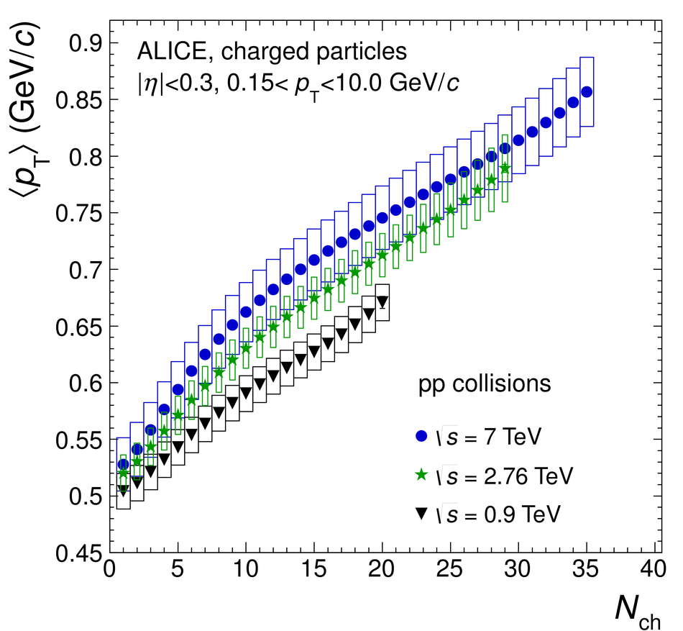
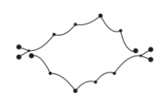
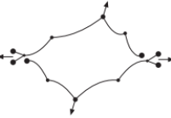
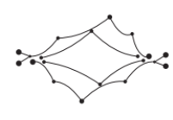
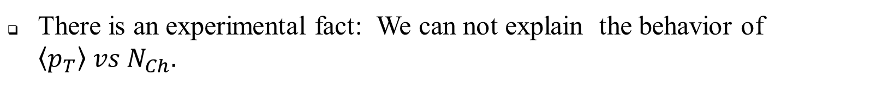
Motivation: Modeling Colour Reconnection
There is an experimental fact: We can not explain the behavior of $\left\langle p_{T}\right\rangle vs N_{Ch}.$
Solution? Many solutions, one of them is CR!
Phys.Lett. B209 (1988) 90-94
Phys. Lett. B 727 (2013) 371-380

Slide 7
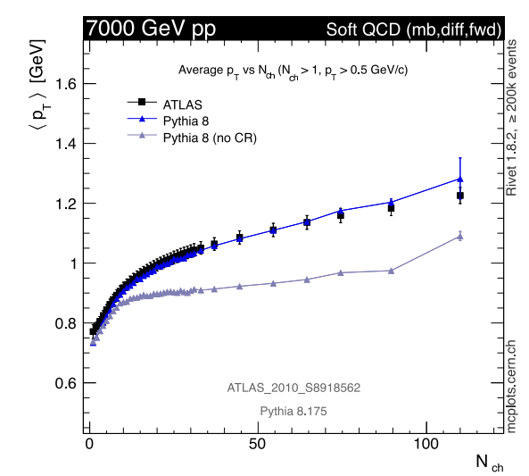
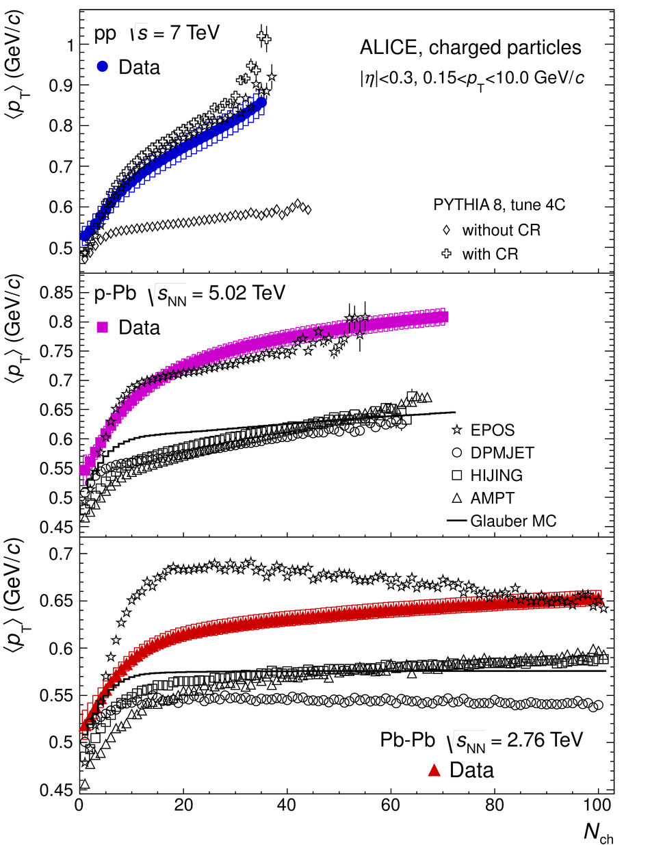

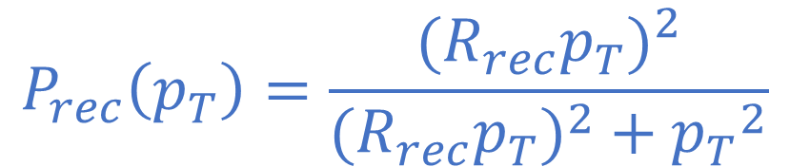
Motivation: Modeling Colour Reconnection
Models of Color Reconnection:
There are different models of CR, one of them is based in the scheme of parton interaction. They are classified by which nMPI system they belong to in function of the transverse moment. The strength of reconnection is defined by,
arXiv:1310.8073
$$P_{rec}\left(p_{T}\right)=\frac{{{(R}_{rec}p_{T})}^{2}}{{{(R}_{rec}p_{T})}^{2}+{p_{T}}^{2}}$$
$$p_{T}↓ ⟹ P_{rec} ↑$$
Phys. Lett. B 727 (2013) 371-380

Slide 8
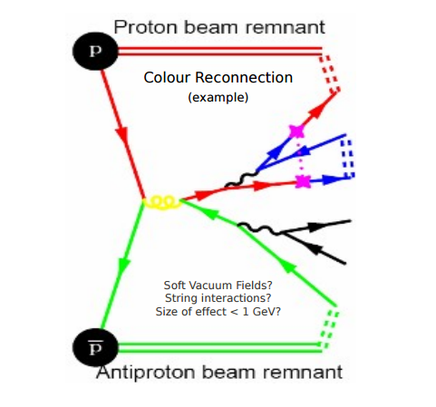
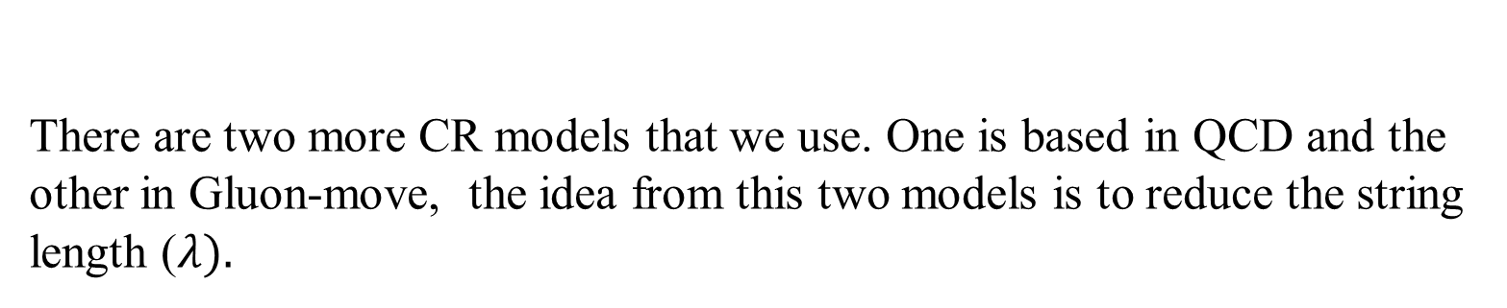
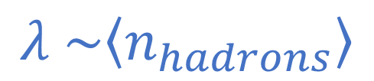
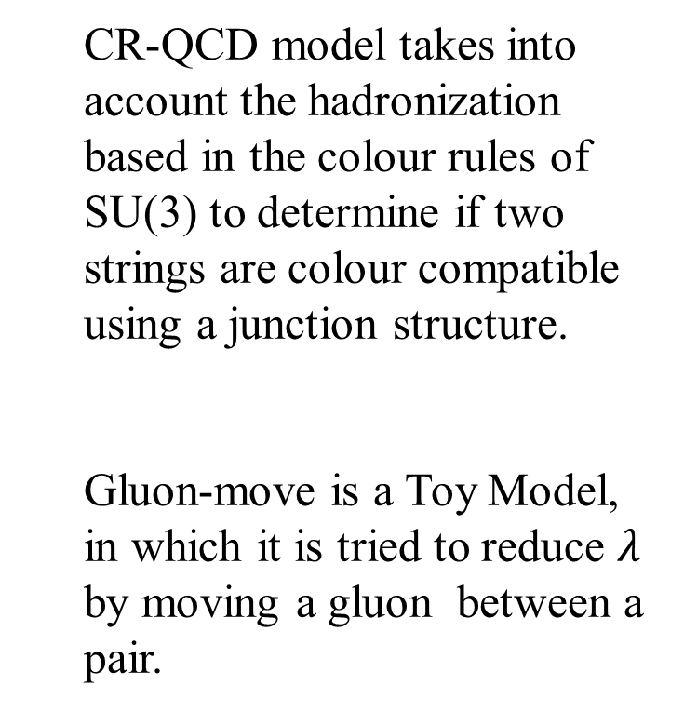
Motivation: Modeling Colour Reconnection
There are two more CR models that we use. One is based in QCD and the other in Gluon-move, the idea from this two models is to reduce the string length ($λ).$
$$λ \sim \left\langle n_{hadrons}\right\rangle$$
  CR-QCD model takes into account the hadronization based in the colour rules of SU(3) to determine if two strings are colour compatible using a junction structure.
  Gluon-move is a Toy Model, in which it is tried to reduce $λ$ by moving a gluon between a pair.
arXiv1507.02091
arXiv1407.6653

Slide 9
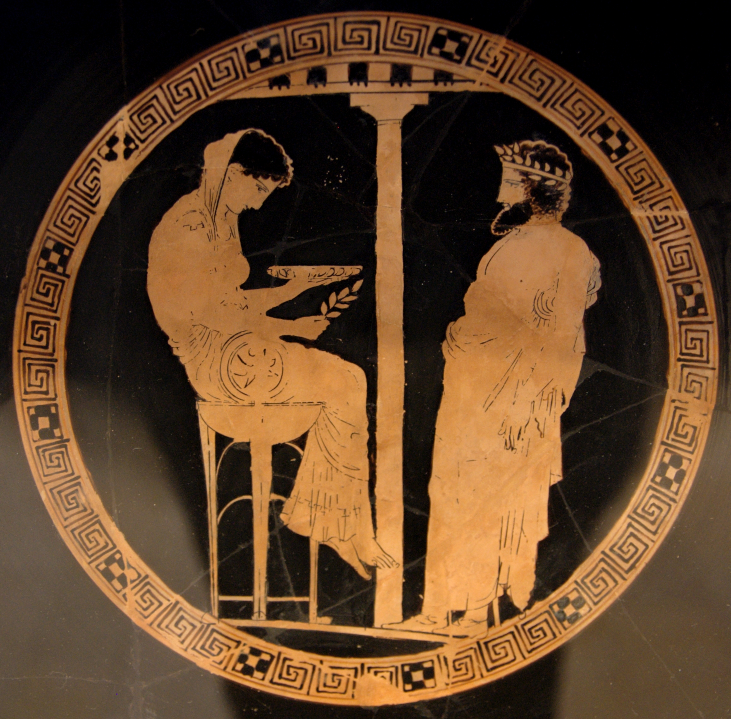
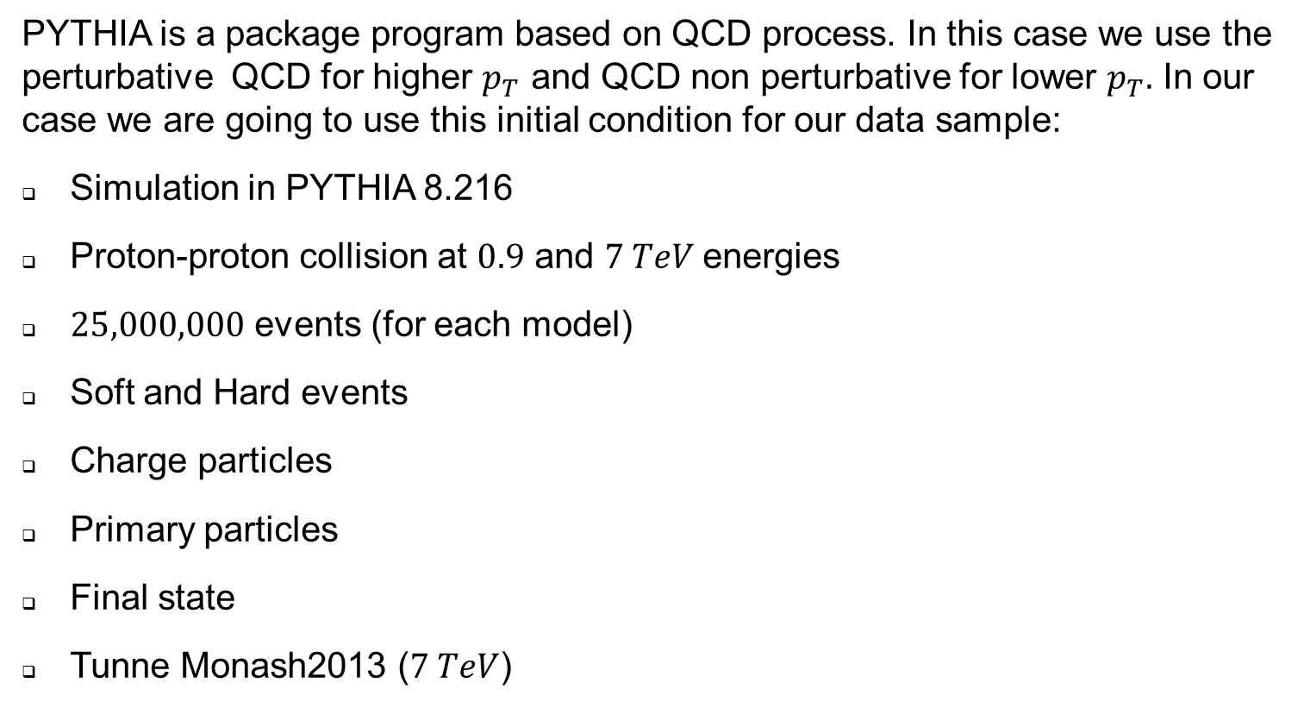
PYTHIA event generator
PYTHIA is a package program based on QCD process. In this case we use the perturbative QCD for higher $p_{T}$ and QCD non perturbative for lower $p_{T}.$ In our case we are going to use this initial condition for our data sample:
Simulation in PYTHIA 8.216
Proton-proton collision at $0.9$ and $7 TeV$energies
$25,000,000$ events (for each model)
Soft and Hard events
Charge particles
Primary particles
Final state
Tunne Monash2013 ($7 TeV$)

Slide 10
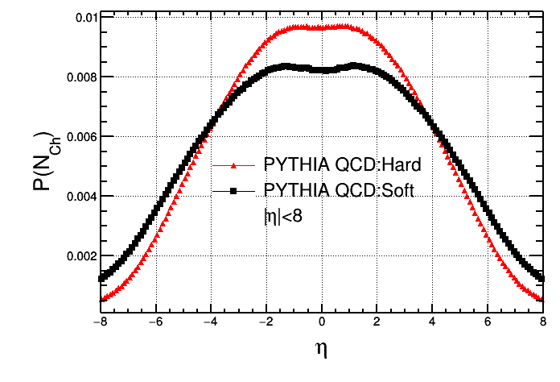
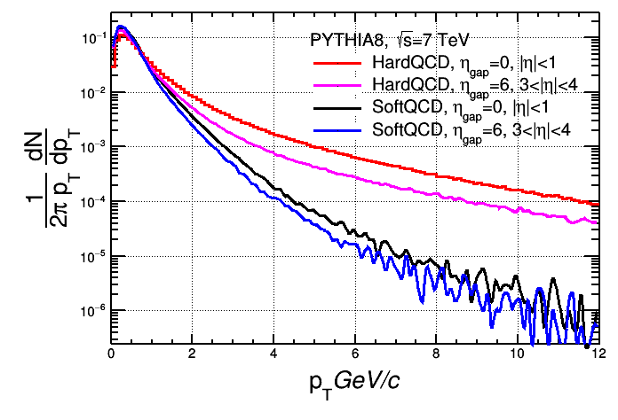
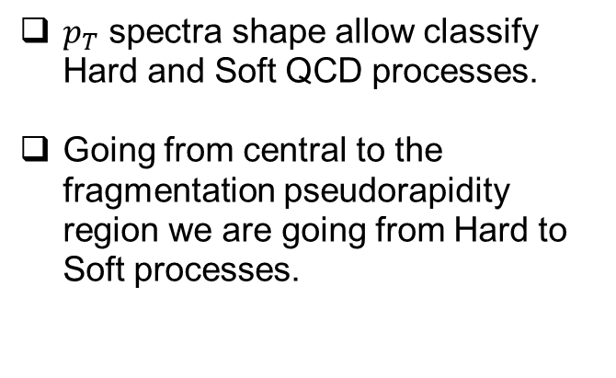
Pseudorapidity and pT for Soft and Hard
Hard processes has an enhancement in the central region
Differences on pseudorapidity distributions means different kind of QCD processes
$p_{T}$ spectra shape allow classify Hard and Soft QCD processes.
Going from central to the fragmentation pseudorapidity region we are going from Hard to Soft processes.

Slide 11
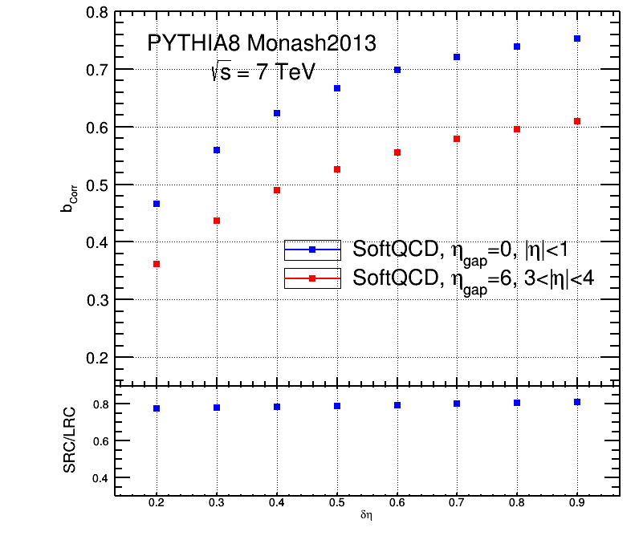
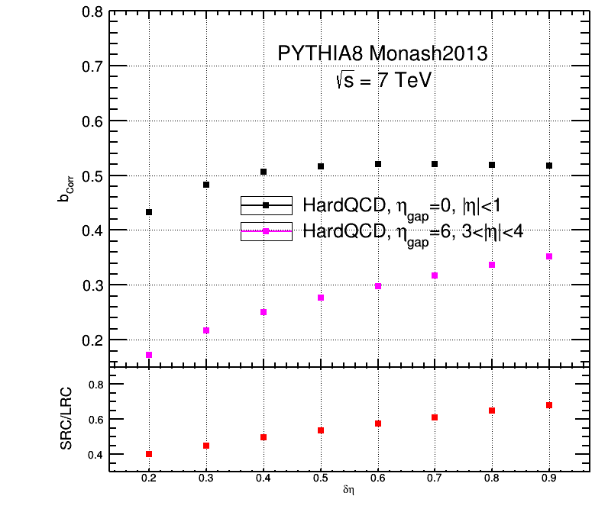

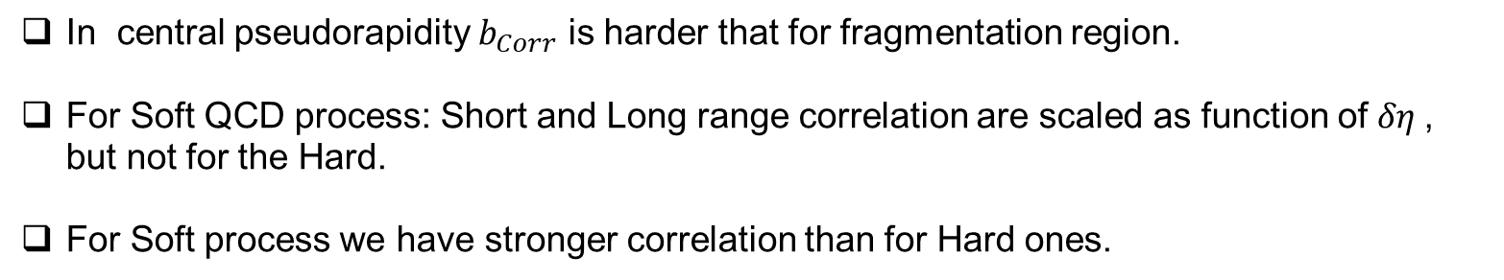






Short and Long range correlations
$$b_{Corr}$$
$$b_{Corr}$$
$$\frac{SRC}{LRC}$$
$$\sim cte$$
$$\frac{SRC}{LRC}$$
$$δη$$
$$δη$$
In central pseudorapidity $b_{Corr}$ is harder that for fragmentation region.
For Soft QCD process: Short and Long range correlation are scaled as function of $δη$, but not for the Hard.
For Soft process we have stronger correlation than for Hard ones.

Slide 12
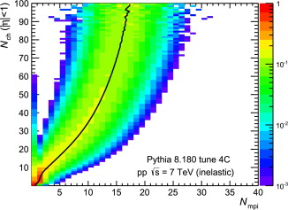
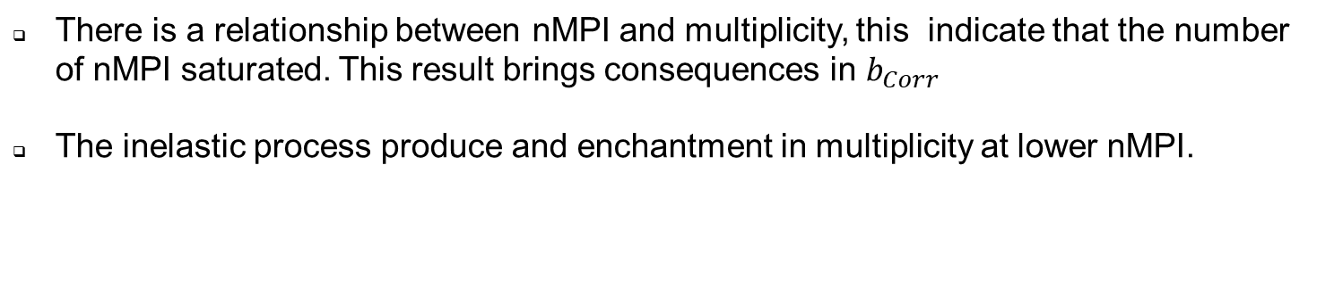
Multiplicity vs nMPI
Nucl.Phys. A941 (2015) 78-86
There is a relationship between nMPI and multiplicity, this indicate that the number of nMPI saturated. This result brings consequences in $b_{Corr}$
The inelastic process produce and enchantment in multiplicity at lower nMPI.

Slide 13
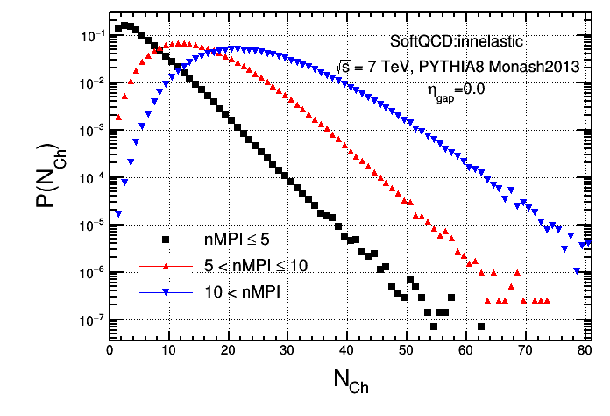
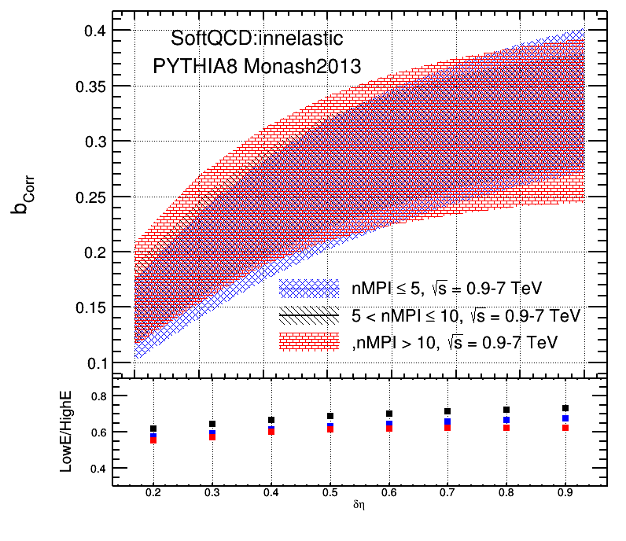



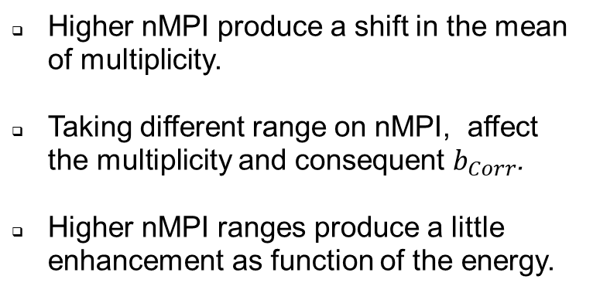
Correlations as function nMPI and energy
$$b_{Corr}=a+c\left(log\left(Energy\right)\right)$$
$$b_{Corr}$$
Higher nMPI produce a shift in the mean of multiplicity.
Taking different range on nMPI, affect the multiplicity and consequent $b_{Corr}$.
Higher nMPI ranges produce a little enhancement as function of the energy.
$$δη$$

Slide 14
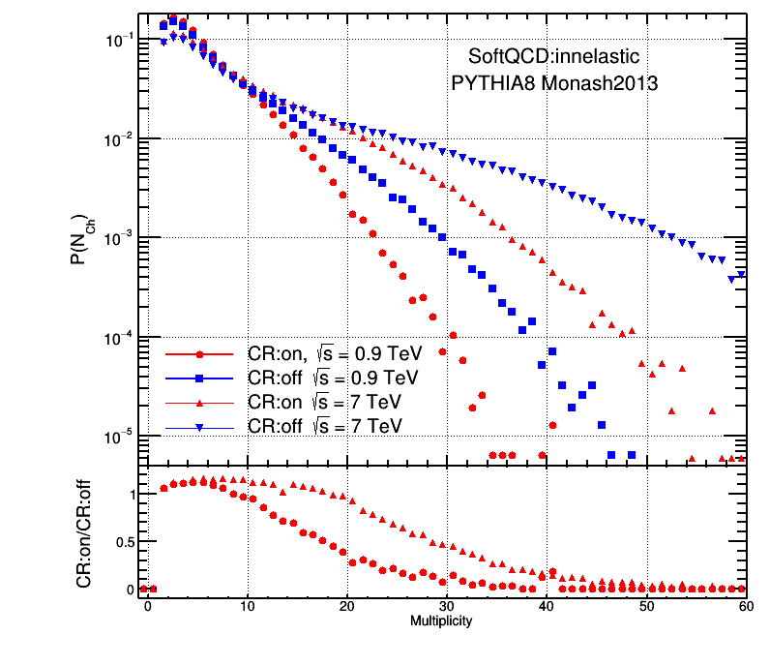
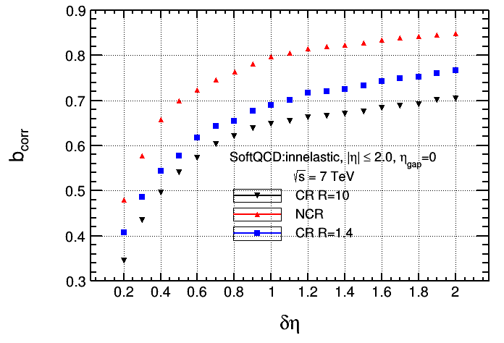





Correlations and Colour Reconnection (nMPI-model)
$${P(n_{Ch})}_{}$$
$$b_{Corr}$$
$$\frac{CR}{noCR}$$
$$δη$$
$$Multiplicity$$
The multiplicity is reduced by the influence of CR-nMPI.
The effect of CR-nMPI increase as the energy does.
The correlation decrease in not a linear way with the increase of CR.
.

Slide 15
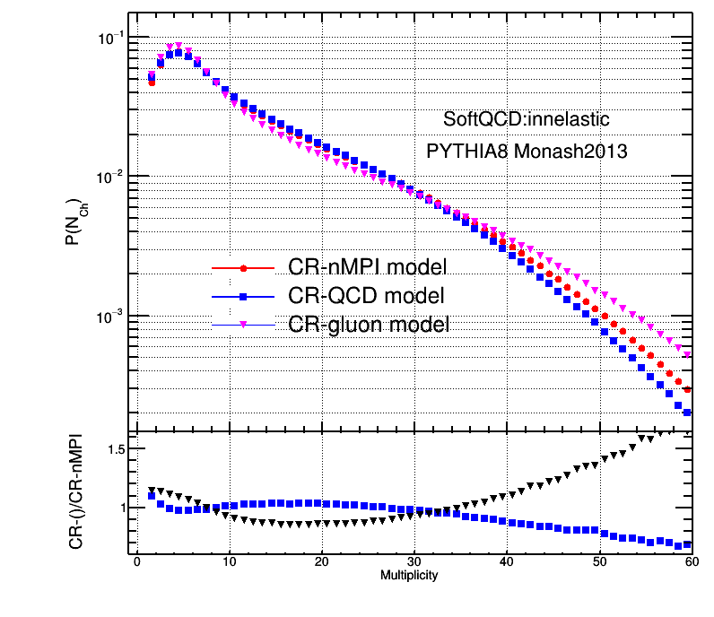
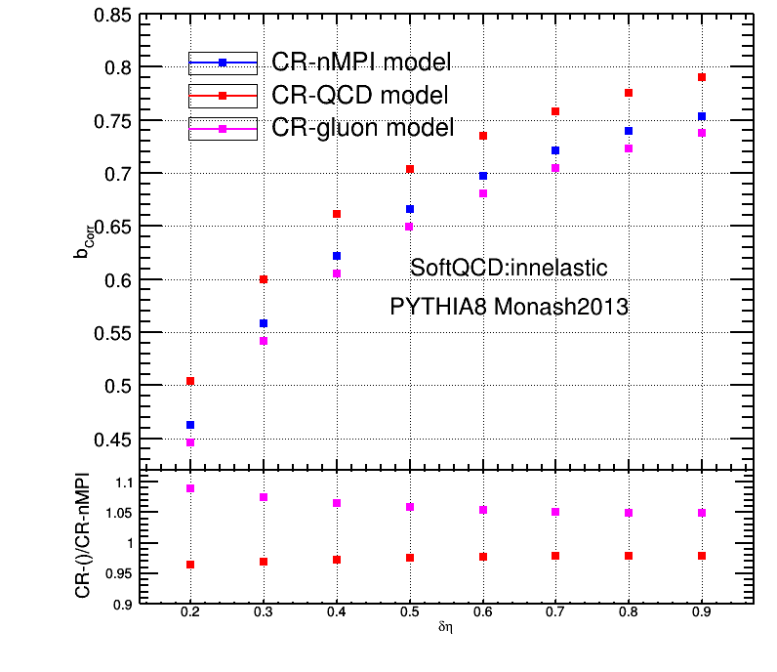



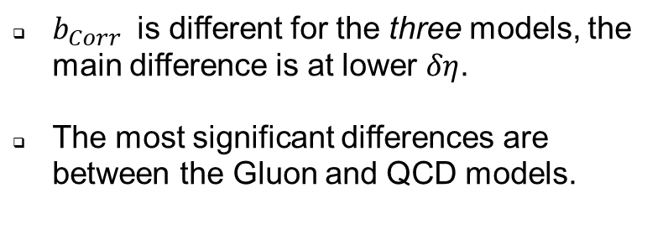

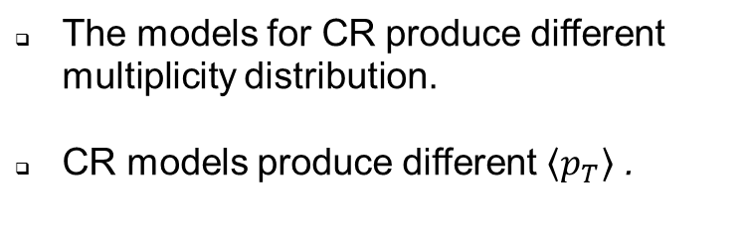


Correlation and models of CR
$${P(n_{Ch})}_{}$$
$$b_{Corr}$$
$$\frac{QCD−Gluon}{nMPI}$$
$$\frac{QCD−Gluon}{nMPI}$$
$$Multiplicity$$
$$δη$$
The models for CR produce different multiplicity distribution.
CR models produce different $\left\langle p_{T}\right\rangle$ .
$b_{Corr}$ is different for the three models, the main difference is at lower $δη$.
The most significant differences are between the Gluon and QCD models.

Slide 16
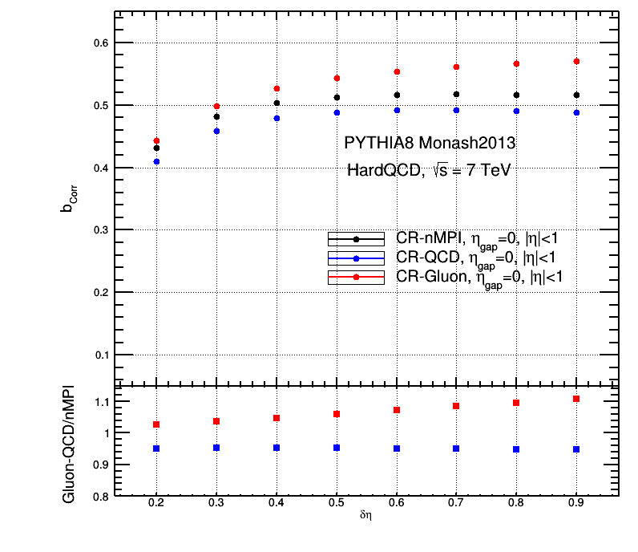
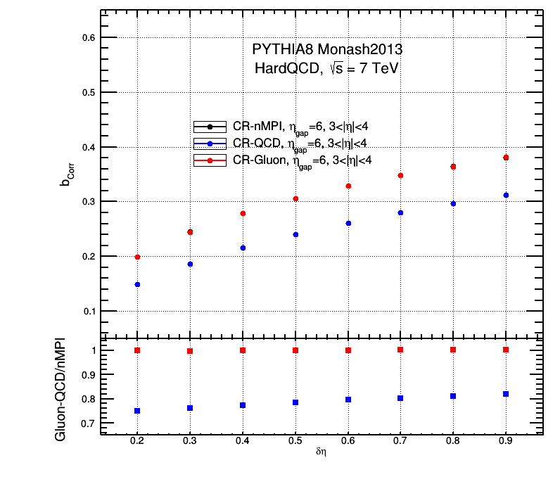





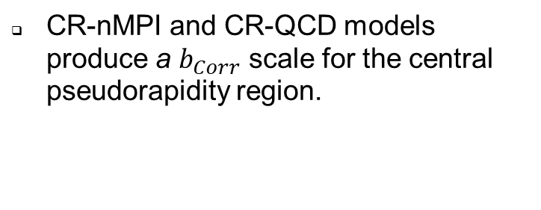

SRC and LRC for CR models
$$b_{Corr}$$
$$b_{Corr}$$
$$\frac{QCD,Gluon}{nMPI}$$
$$\frac{QCD,Gluon}{nMPI}$$
$$δη$$
$$δη$$
CR-nMPI and CR-QCD models produce a $b_{Corr}$ scale for the central pseudorapidity region.
CR-nMPI and CR-Gluon models produce the same correlation at fragmentation region.

Slide 17
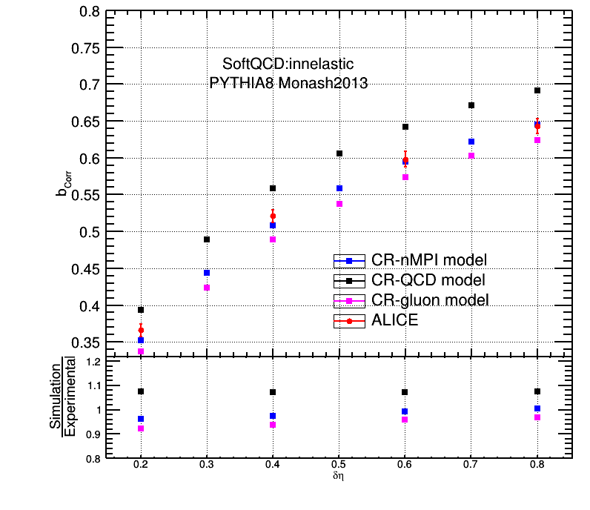
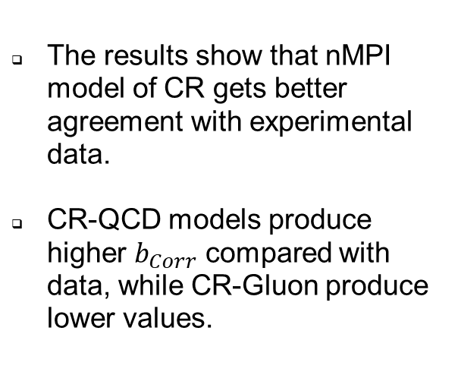


Correlations from models vs data
The results show that nMPI model of CR gets better agreement with experimental data.
CR-QCD models produce higher $b_{Corr}$ compared with data, while CR-Gluon produce lower values.
$$b_{Corr}$$
$$δη$$

Slide 18
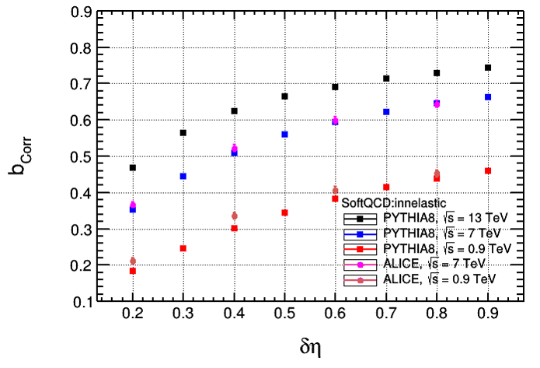


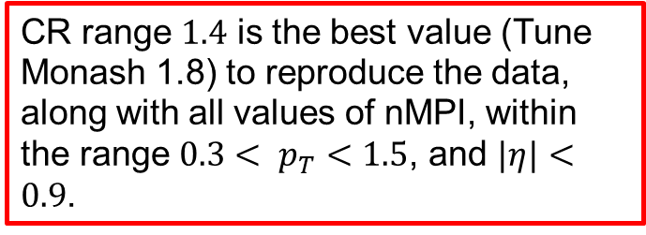
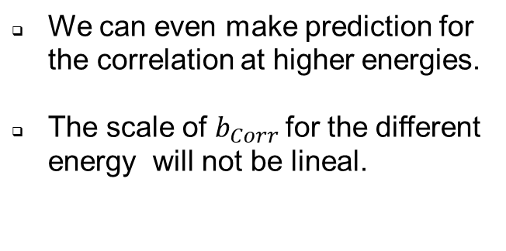
Correlation for higher energy
$$b_{Corr}$$
$$δη$$
CR range $1.4$ is the best value (Tune Monash 1.8) to reproduce the data, along with all values of nMPI, within the range $0.3< p_{T}<1.5$, and $|η|<0.9$.
We can even make prediction for the correlation at higher energies.
The scale of $b_{Corr}$for the different energy will not be lineal.

Slide 19
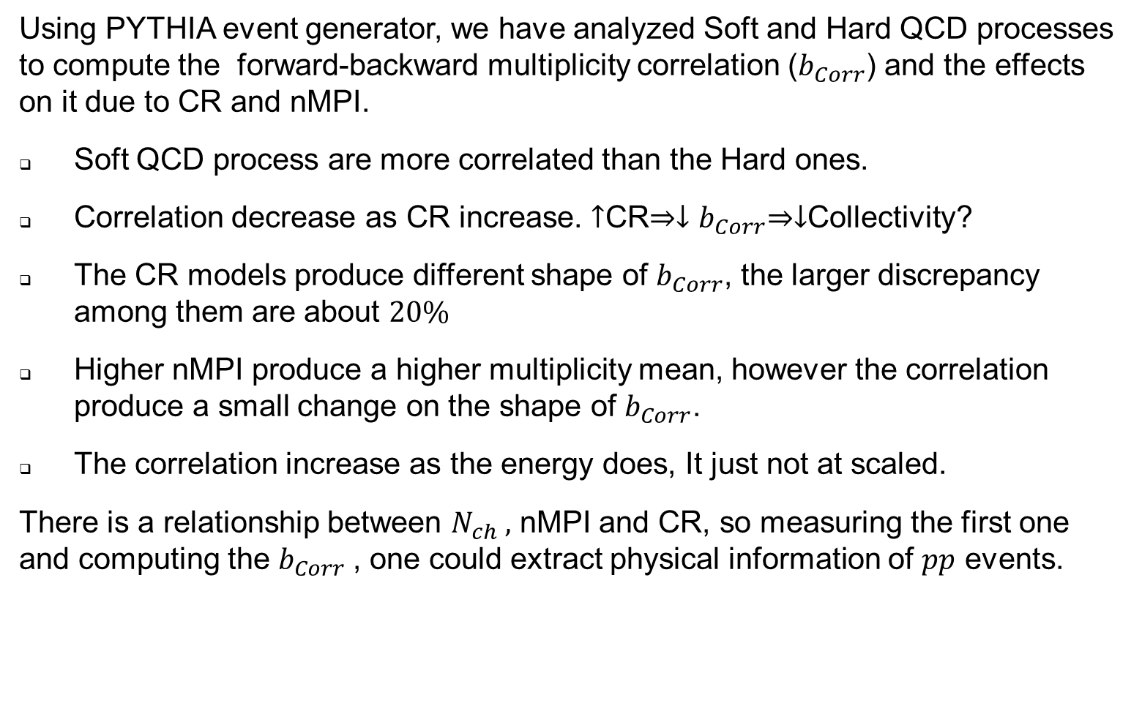
Conclusions
Using PYTHIA event generator, we have analyzed Soft and Hard QCD processes to compute the forward-backward multiplicity correlation ($b_{Corr}$) and the effects on it due to CR and nMPI.
Soft QCD process are more correlated than the Hard ones.
Correlation decrease as CR increase. $↑$CR$⇒{↓b}_{Corr}⇒↓$Collectivity?
The CR models produce different shape of $b_{Corr}$, the larger discrepancy among them are about $20\%$
Higher nMPI produce a higher multiplicity mean, however the correlation produce a small change on the shape of $b_{Corr}$.
The correlation increase as the energy does, It just not at scaled.
There is a relationship between $N_{ch} ,$ nMPI and CR, so measuring the first one and computing the $b_{Corr}$, one could extract physical information of $pp$ events.

