Slide 1
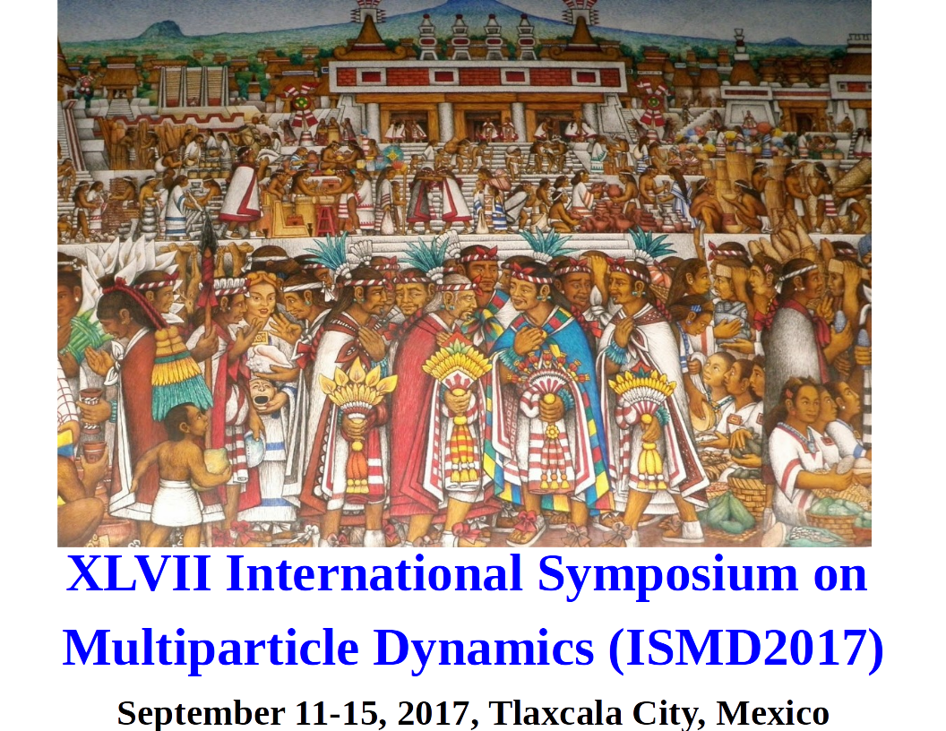
Study of high muon multiplicity cosmic events with the ALICE-LHC Experiment
Arturo Fernández Téllez, for the ALICE Collaboration
Faculty of Physics and Mathematics - Autonomous University of Puebla (BUAP, México)

Slide 2
Content
Physics Motivation
Experimental setup / trigger configuration
Atmospheric muon multiplicity distribution (MMD)
Monte Carlo studies
Summary and conclusions

Slide 3
Motivations
Use of collider detectors for cosmic-ray studies was pioneered by LEP experiments ALEPH, DELPHI and L3.
Small apparatuses
Muons crossing the rock
High performance detectors
tracking
magnetic field

Slide 4
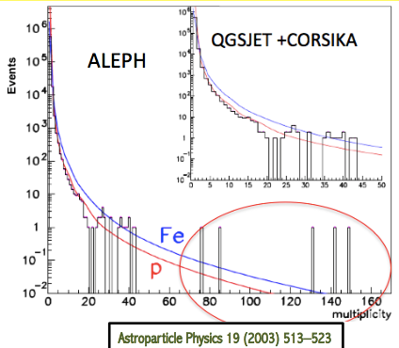
Motivation
LEP experiments were pioneers in the study of atmospheric muon bundles: ALEPH, Astro-particle Physics 19 (2003) 513–523 and DELPHI, Astro-particle Physics 28 (2007) 273–286
ALEPH: These muon bundles are well described at low intermediate multiplicity, but not the high muon multiplicity events.
DELPHI: “Even the combination of extreme assumptions of highest measured flux value and pure iron spectrum fails to describe the abundance of high multiplicity events”.
Cosmic-ray energy coverage: 10¹³ - 10¹⁸ eV

Slide 5
Origin of Muon Bundles
Significant uncertainties in models of CR
Primary composition & hadronic interaction
Attempts:
Quark-Gluon Plasma? Ridky hep-ph/0012068, Astropart. Phys., 17, 355 (2002)
Nuclear Effects? Klein nucl-ex/0611040 (2008)
Quark-Gluon Matter? Petrukhin, Nucl.Instrum.Meth. A742, 228-231(2014)
Strangelets? Rybczynski, W︎lodarczyk, Wilk hep-ph/0410064, APJ 839 31 (2017)

Slide 6
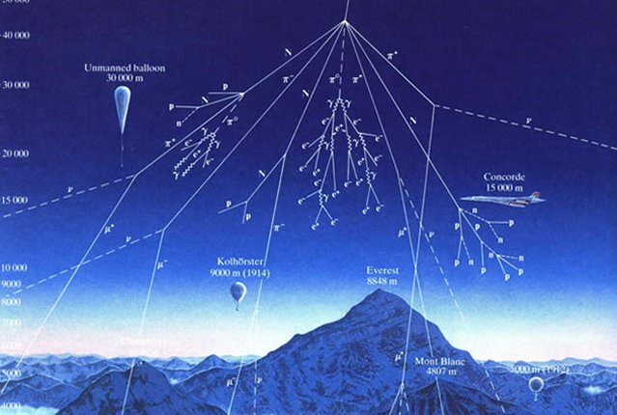
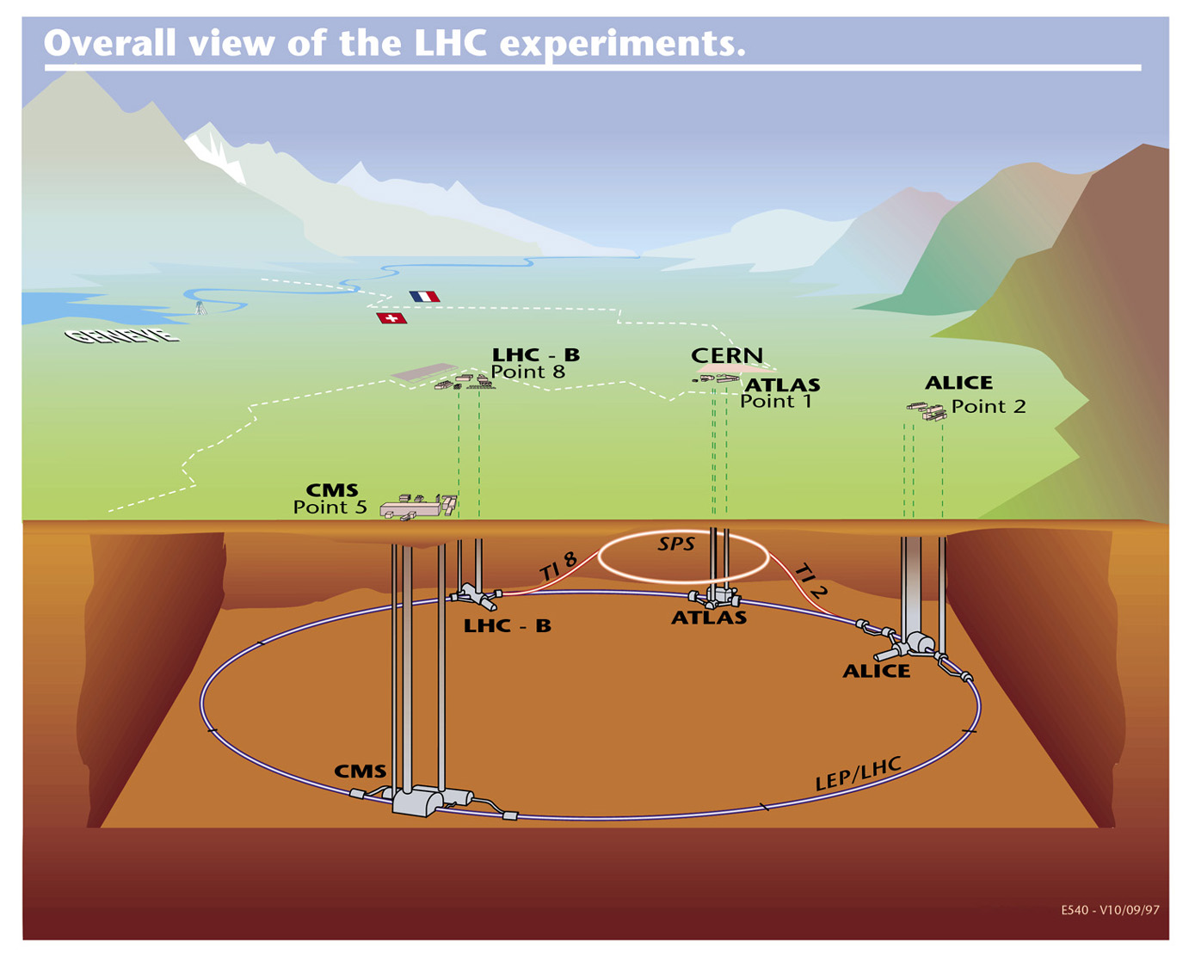
Detection of cosmic muons at LHC
ALICE is located at LHC Point2 52m underground (28m rock above)
Muon energy threshold ~16 GeV

Slide 7
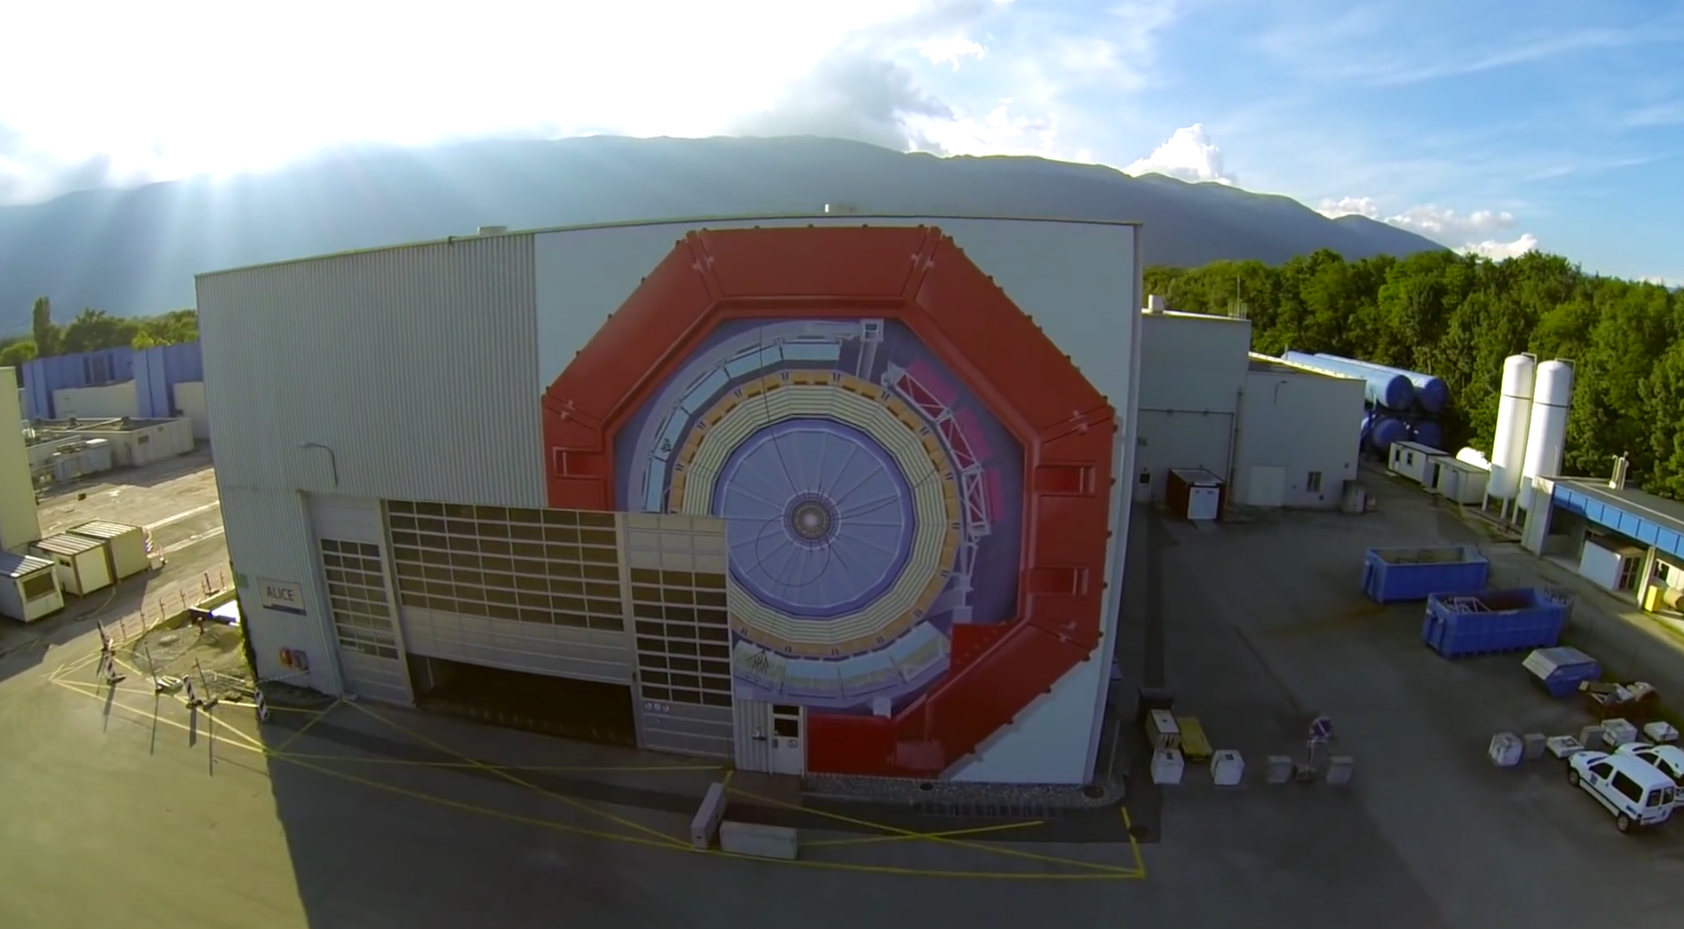
Experimental setup
ALICE is designed to the study of strongly interacting matter in ultra-relativistic heavy-ion collisions at the CERN Large Hadron Collider (LHC)
μ
Besides the heavy-ion physics program, ALICE has a dedicated physics group interested in Cosmic-ray physics.

Slide 8
Experimental setup
AD*
~20m from I.P.
AD*
~20m from I.P.
* trigger detector installed for Run 2 (p-p diffractive studies)

Slide 9
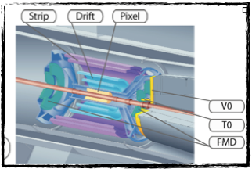
Experimental setup
Trigger
ITS: Inner tracking System. It brings a precise separation of primary particles and those from weak decays or from interactions with material. Three layers: SPD, SDD and SSD. It is used for vertex determination.
AD*
~20m from I.P.
AD*
~20m from I.P.
* trigger detector installed for Run 2 (p-p diffractive studies)

Slide 10
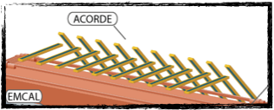
Experimental setup
Trigger
the Alice COsmic Ray DEtector is used to trigger on atmospheric muons. It consists of an array of 60 scintillators module located on the three top octants of the magnet. This trigger is used for calibration and alignment of the central barrel detectors. These events are being used for cosmic ray studies.
AD*
~20m from I.P.
AD*
~20m from I.P.
* trigger detector installed for Run 2 (p-p diffractive studies)

Slide 11
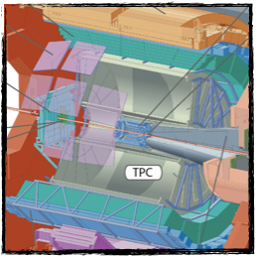
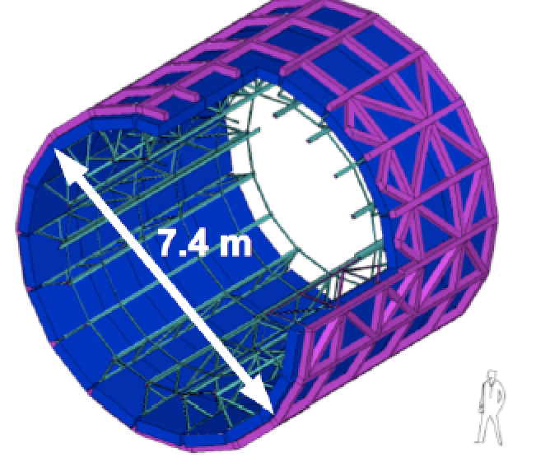
Experimental setup
TOF: has a cylindrical shape, covering polar angles between 45 degrees and 135 degrees over the full azimuth. It measures the time of flight of the particles (for PID) in the central barrel with a resolution of 100 ps.
Trigger
AD*
~20m from I.P.
AD*
~20m from I.P.
* trigger detector installed for Run 2 (p-p diffractive studies)

Slide 12
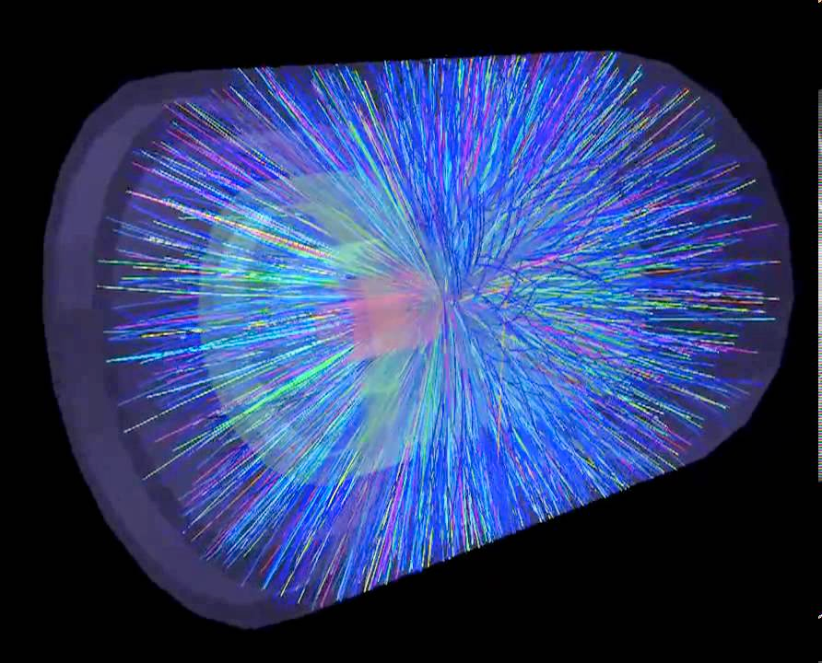
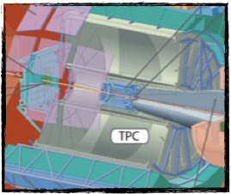
Experimental setup
Readout
AD*
~20m from I.P.
TPC: Excellent tracking capabilities in a high track density environment. It is used for particle identification (dE/dx) over a broad pT interval (hundreds of MeV/c up to tens of GeV/c).
AD*
~20m from I.P.
* trigger detector installed for Run 2 (p-p diffractive studies)

Slide 13
Atmospheric muon multiplicity distribution (MMD): data sample
Between 2010 and 2013, ALICE collected 30.8 days of dedicated cosmic-ray data.
A logical OR among the trigger signals of ACORDE, TOF and SPD was configured to generate the cosmic-ray trigger of ALICE.

Slide 14
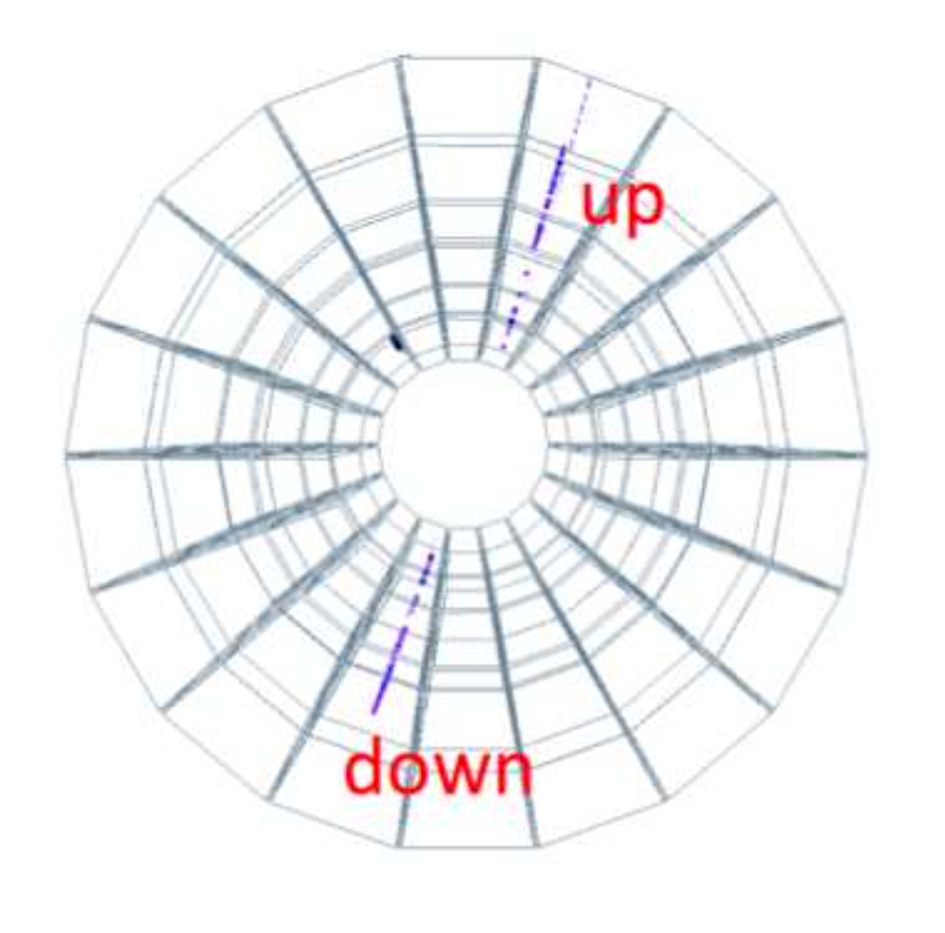
Atmospheric muon multiplicity distribution (MMD): reconstruction of atmospheric muons
The TPC reconstructs a single muon with two tracks (up and down).
A specific algorithm has been worked out to obtain the whole track of the muon.
Monte Carlo events and data of high multiplicity have been used to optimized the parameters of the matching algorithm.

Slide 15
Analysis cuts
To accept a track
> 50 space points in the TPC (out of a maximum of 159)
p > 0.5 GeV/c
if multi-muon, parallelism cut cos(ΔΨ) > 0.990
To match an up track with a down track
d_{ca} < 3cm in the mid horizontal TPC plane
Matched muon: up and down tracks matched
Single-track muon: a track satisfying all cuts but distance d_{ca}
Cut efficiency checked with MC simulations

Slide 16
Data sample for cosmic-ray studies
Data taken between 2010 and 2013 during no-beam periods
OR of ACORDE, TOF and SPD triggers
with and without magnetic field (0.5 T)
integrated live time 30.8 days
~ 22.6M events with at least 1 reconstructed muon in TPC
Multi-muon event: N_{μ} > 4 in TPC
7487 multi-muon events
All events with a zenith angle θ<50° are kept for further analyses

Slide 17
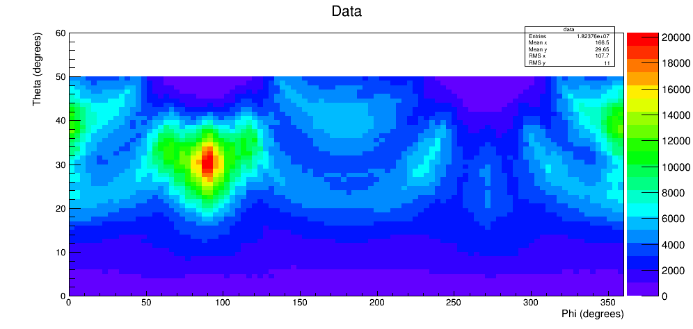
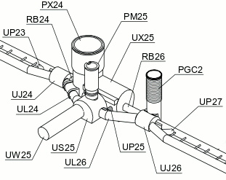
Muon angular distribution
ALICE
Y
θ
Z
ϕ
X

Slide 18
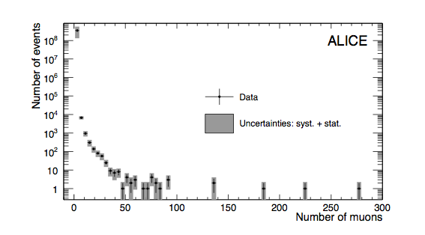
Atmospheric muon multiplicity distribution (MMD)
Smooth distribution up to #μ < 70 and 5 events with more
than 100 atmospheric muons (HMM)

Slide 19
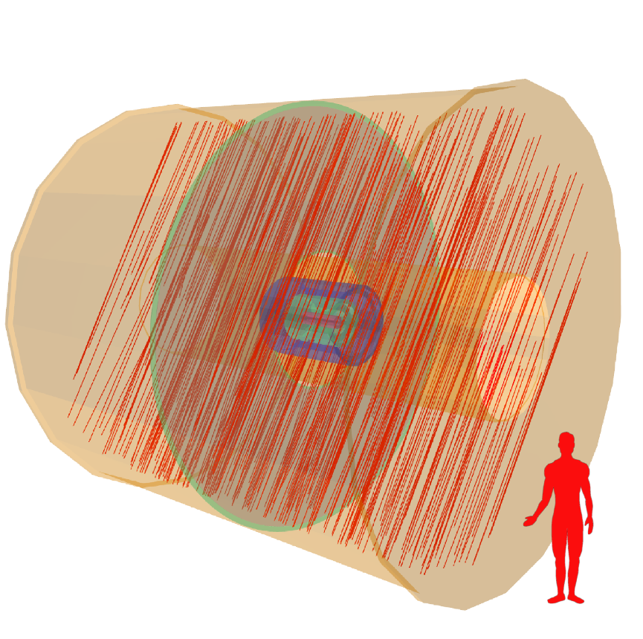
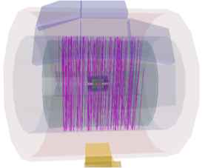
Atmospheric muon multiplicity distribution (MMD): display of two HMM events
ALICE collected 5 events with more than 100 atmospheric muons
during 30.8 days of data taking

Slide 20
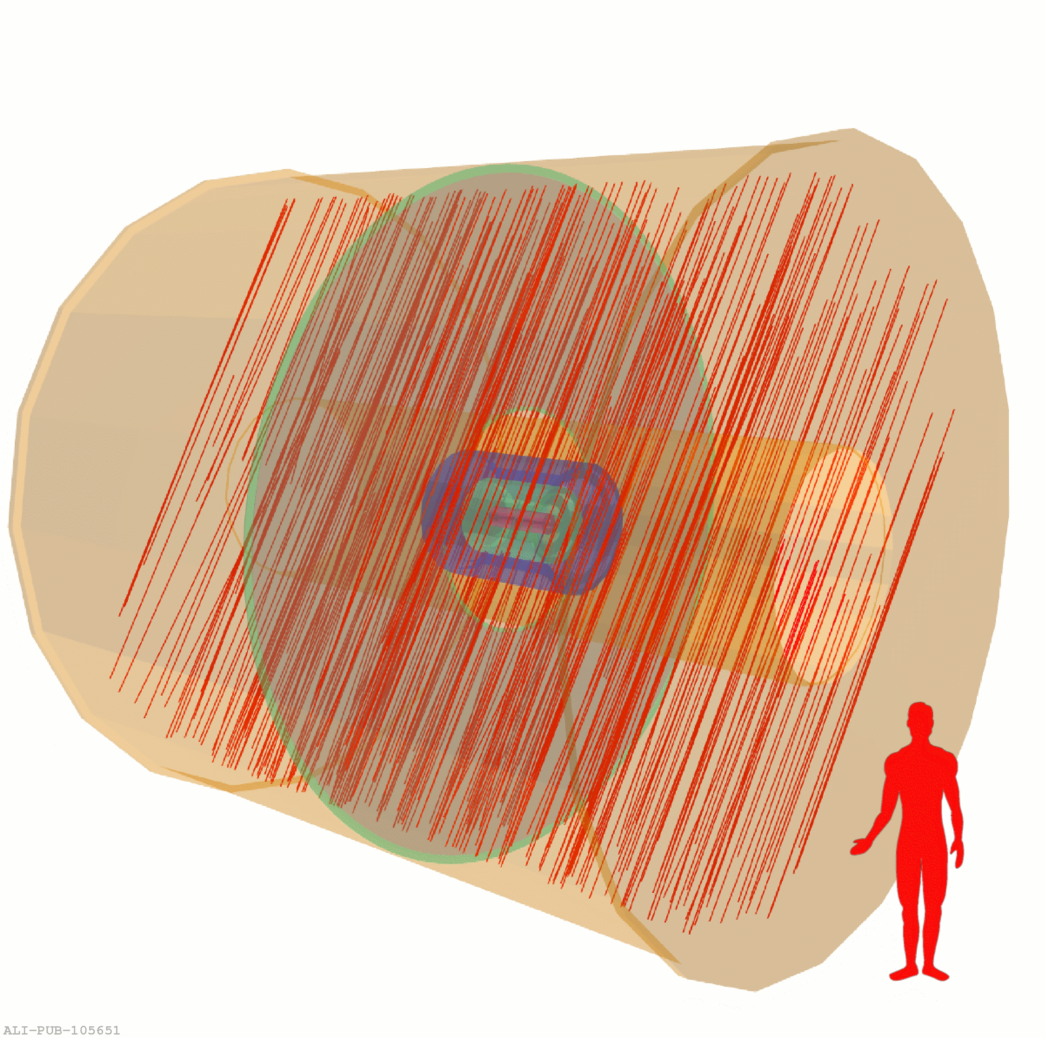
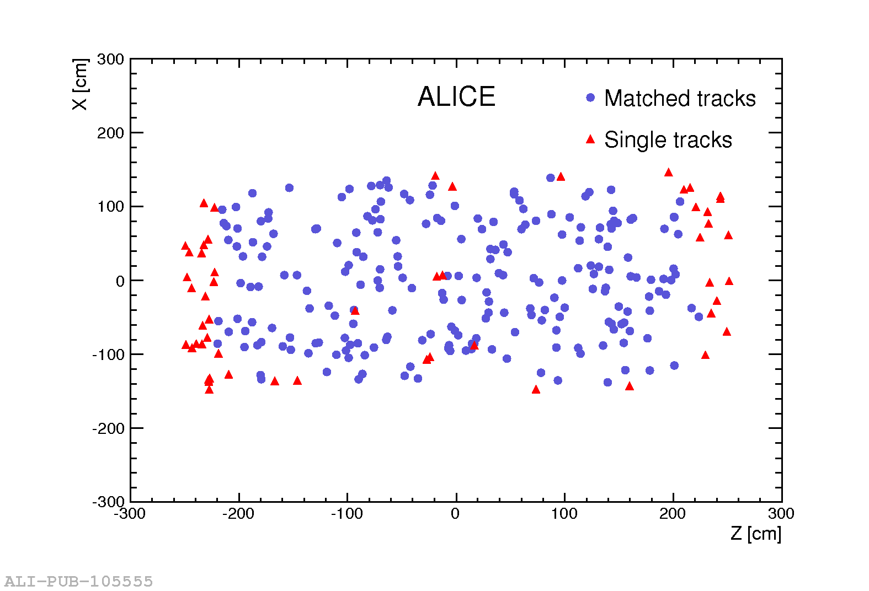
High Muon Multiplicity event display
ALICE Coll., JCAP 01 (2016) 032
High Muon Multiplicity (HMM) event with 276 muons

Slide 21
Monte Carlo studies
To study the MMD, simulated events equivalent to 30.8 days of live time were generated:
Corsika 6990 with QGSJET-II-03 model
Two independent samples: pure proton (lighter composition) and Fe (extremely heavy composition)
Energy of the primary cosmic-ray: 10¹⁴ < E < 10¹⁸ eV
Usual power law spectrum E^{-γ} with γ = 2.7 for energies below the knee and γ = 3.0 for energies above the knee.
Total (all-particle) flux of cosmic-rays with poly-gonato model taken from J. R. Hörandel, Astropart. Phys.19 (2003) 193-220
The core of each shower was scattered with a random flat distribution at surface level, in an area of 205 x 205 m² centered around the ALICE apparatus.

Slide 22
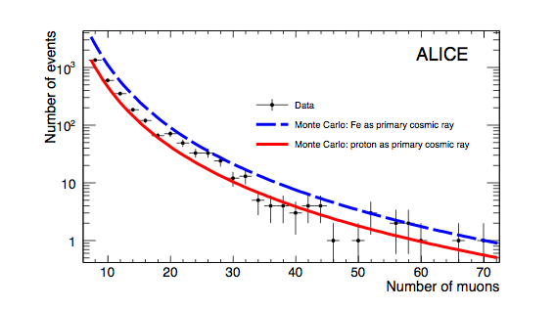
Monte Carlo studies
The simulated distributions
obtained with proton and iron primary cosmic-rays were fitted with a power-law function.
The data approach the proton curve (low multiplicities).
High multiplicity data lie closer to the iron curve.
.

Slide 23
Monte Carlo studies
MC HMM events (muon multiplicity >100) reconstructed by the ALICE-TPC are due to primary cosmic-rays with energies larger than 10¹⁵ eV for both proton and iron.
To estimate the rate of these events with Monte Carlo models, a simulation of one complete year of effective data taking was done, using:
Corsika 6990 (QGSJET II-03) and 7350 (QGSJET II-04 tuned with LHC data)
Energy of the primary cosmic-ray: 10¹⁴ < E < 10¹⁸ eV

Slide 24
Monte Carlo studies: comparison with data
Pure iron sample simulated with QGSJET II-04 model reproduces HMM event rate in close agreement with the measured value.
Independent of the version model, the rate of HMM events with pure proton cosmic-ray composition is more difficult to reproduce.
This result is compatible with recent measurements which suggest that the composition of the primary cosmic-ray spectrum with energies larger than 10¹⁶ eV is dominated by heavier elements: Phys. Rev. Lett. 107 (2011) 171104.

Slide 25
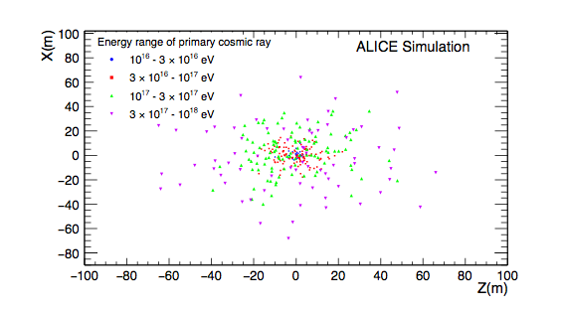
Monte Carlo studies: core location of HMM
Distance between ALICE and the core of the shower for all the HMM events found in 5 years of simulated data.
Shower core on average falls further from ALICE location for primaries with E > 3 x 10¹⁷ eV

Slide 26
Conclussions (1)
The MMD of ALICE at low and intermediate multiplicities are well reproduced by Monte Carlo using Corsika 6990 (QGSJET II-03 model)
Our results suggest a mixed-ion primary cosmic-ray composition with an average mass that increases with energy.
This confirms the reliability of cosmic data taking and its explanation with simulation programs, allowing us to face the study of HMM events.

Slide 27
Conclussion (2)
In 30.8 days ALICE found 5 HMM events (muon multiplicity >100). These type of events were also found by Aleph and Delphi.
Observed rate of HMM events is consistent with the predicted by Corsika 7350 (QGSJET II-04 model) using pure Fe composition and primary energy larger than 10¹⁶ eV.
This is the first time that the rate of HMM events has been satisfactory reproduced using conventional hadron interaction models (an observation that places significant constraints on alternative, more exotic, production mechanisms)

Slide 28
Back-up

Slide 29
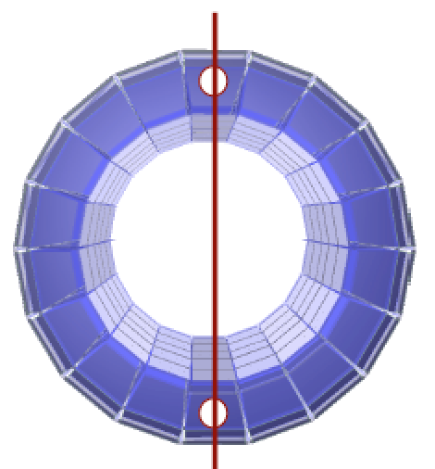
Trigger configuration for cosmic-ray detection
back to back
back to back + 1, 2 or 3 pads
TOF has an effective area of detection of 160 m².
Full φ and 45⁰ ≤ θ ≤ 135⁰ coverage. (ALICE ref. system)
Time resolution less than 100 ps.
Efficiency around 95%.

Slide 30
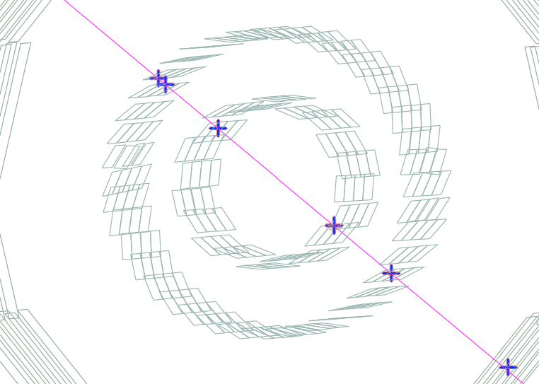
Trigger configuration for cosmic-ray detection
The SPD was incorporated into the trigger by requiring a coincidence between signals in the top and bottom halves of the outermost layer.

Slide 31
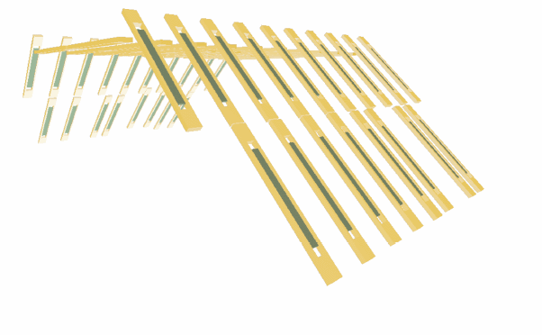
Trigger configuration for cosmic-ray detection
Each module consists of two superimposed plastic scintillators paddles.
A requirement of 4-fold coincidence of ACORDE modules is required to generate the cosmic trigger.

