Slide 1
Experimental Overview on Heavy Quark Probes in Hot QCD Medium
Cesar Luiz da Silva
Los Alamos National Lab
ISMD-2017 - Tlaxcala

Slide 2
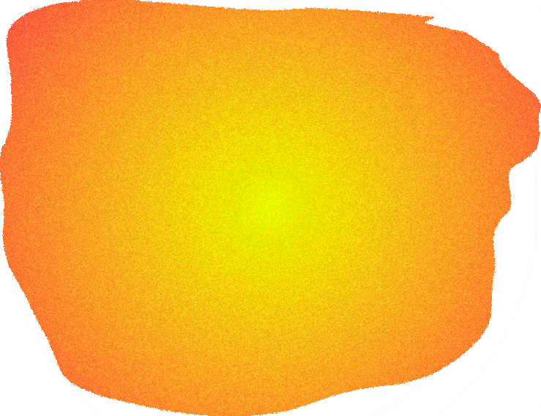
QGP Tomography with Heavy Quarks
Heavy quark gun
QGP
QGP medium needs to have a large volume: heavy ion collisions
Probe needs to be formed and not shower in the vacuum before QGP formation: τ_{HF_FORM} <0.07 fm, τ_{QGP} ~ 0.6 fm
Needs different quark mass scales: charm and bottom quarks
Probe from p_{T} < m_{Q} to p_{T}>> m_{Q}

Slide 3
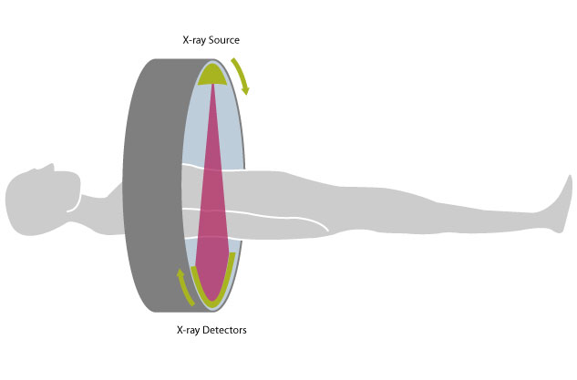
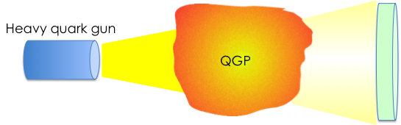
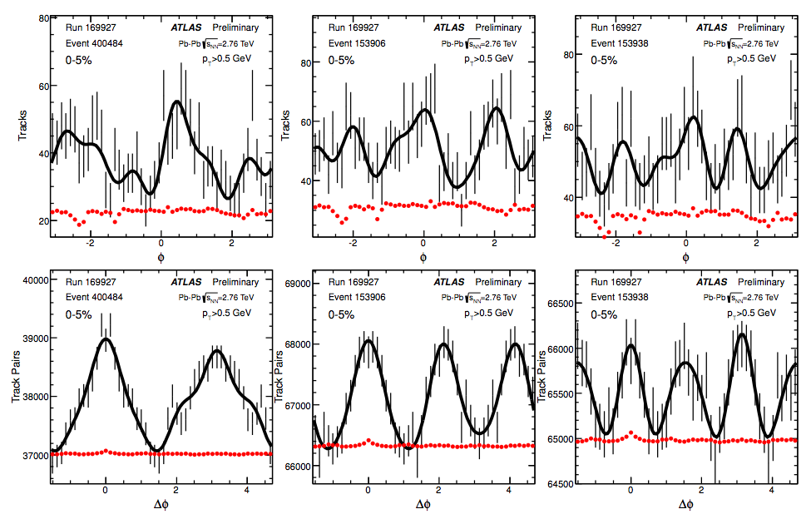
Are Nuclear Physicists Well Paid for This ?
MEDICAL TOMOGRAPHY
QGP TOMOGRAPHY
Good control, well know source ?
Medium to probe expands almost at the speed of light
Medium geometry change every event
Good control, well know source
Medium to probe (patient) is still
Patient is the same for many events
Event a
Event b
Event c
ATLAS

Slide 4
QGP Tomography
HF
Source intensity (cross section) measured in p+p collisions.
detector
Needs to understand how the source is affected by the nucleus immediately after the collision (initial state effects). Studied in small systems (p+A, d+A, …)
HF
nucleus
QGP tomography done in A+A collisions. Measurements are
nuclear modification factor
Fourier expansion of particle azimuthal asymmetries
HF
QGP
nucleus
(event plane meth.)

Slide 5
HF
detector
Understanding the source in p+p collisions

Slide 6
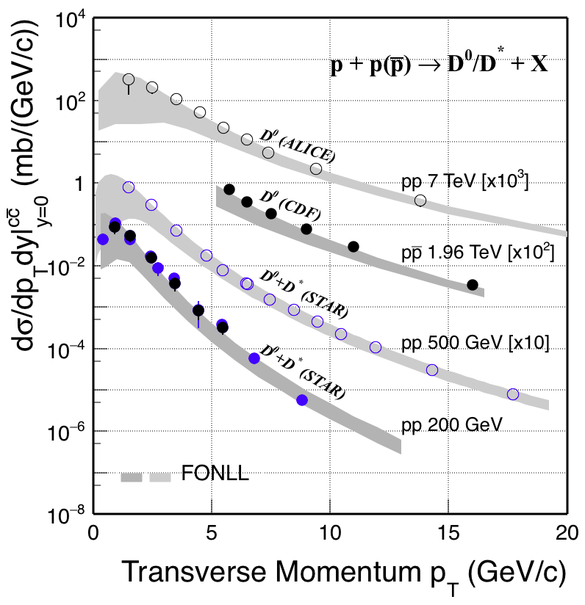
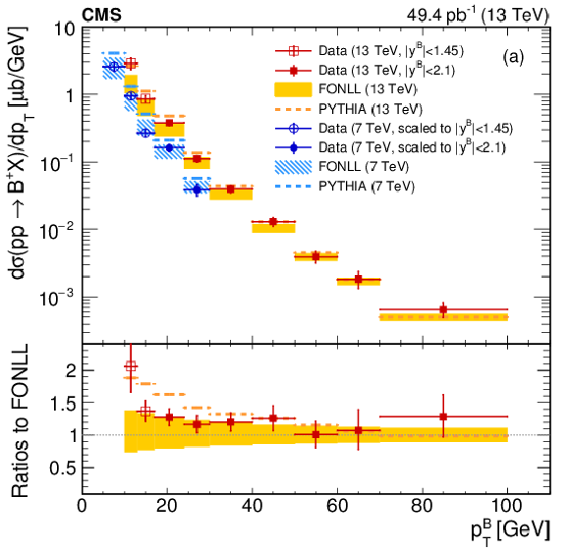
Heavy Quark in p+p
Charm
Bottom
Data has much better constraint than current theoretical uncertainties.

Slide 7
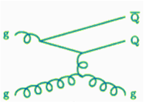
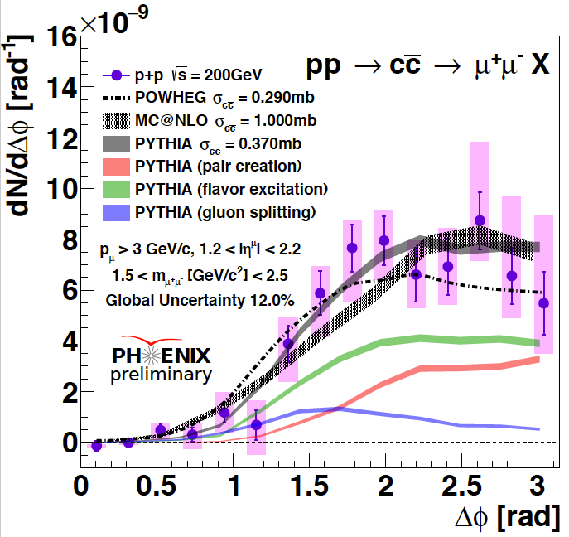
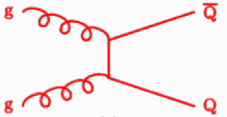
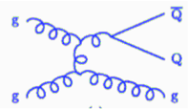
Heavy Quark Formation
Data can also start to constrain HF production sources.

Slide 8
HF
nucleus
Initial State studies in small systems.

Slide 9
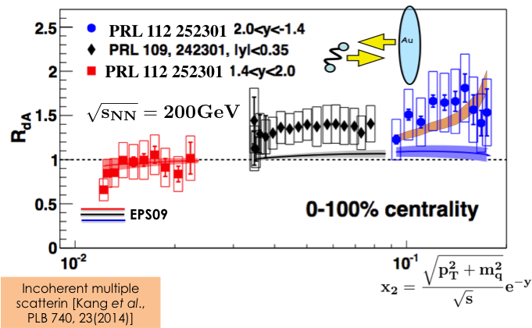
Initial State Effects at RHIC
c,b -> μ,e
RHIC data shows HF enhancement not described by EPS09.
Incoherent multiple scattering can describe enhancement.

Slide 10
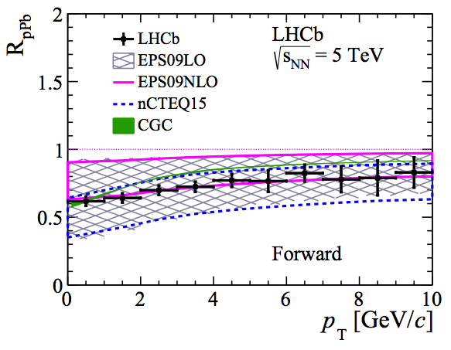
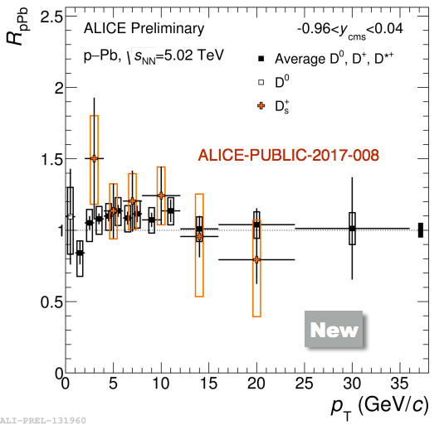
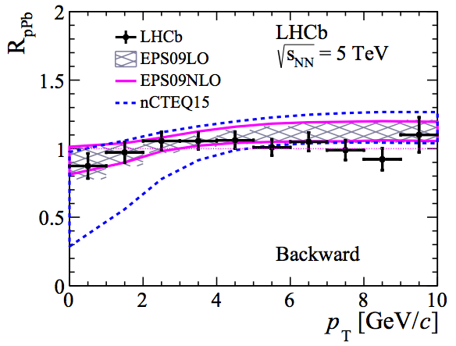
Initial State Effects in p+Pb->D at LHC
small-x
mid-rapidity
large-x
1.5<y<4.0
-5.0<y<-2.5
Modest initial state effects at LHC at mid- and backward-rapidity.
Clear suppression at small-x region.

Slide 11
HF
QGP
nucleus
Probing QGP in heavy ion collisions.

Slide 12
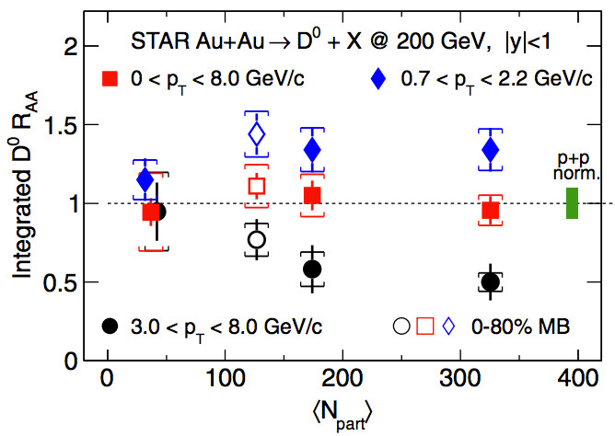
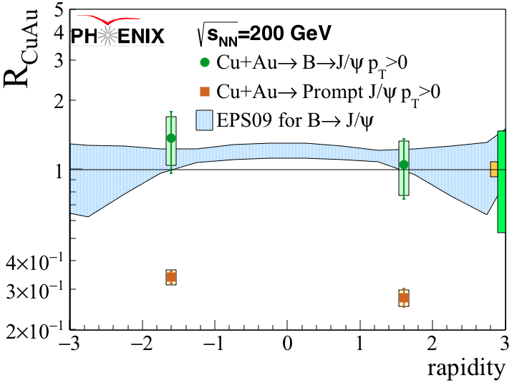
HF Binary Scaling
charm
bottom
Number of heavy-quarks is conserved in heavy ion collisions at RHIC
Medium only alter momentum distribution
Bound state J/ψ is broken in medium.

Slide 13
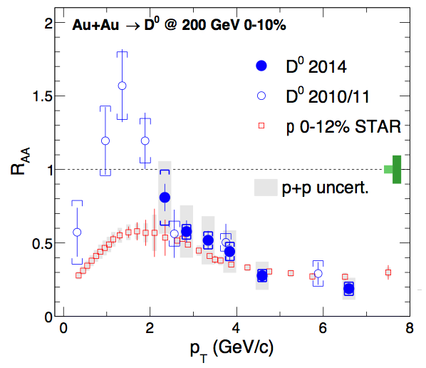
Quark-mass Dependency
STAR
Energy lost in QGP expected to depends on the quark-mass
ΔE(u,d) > ΔE(c) > ΔE(b)
Is that apply only for p_{T}< 2 GeV/c ??

Slide 14
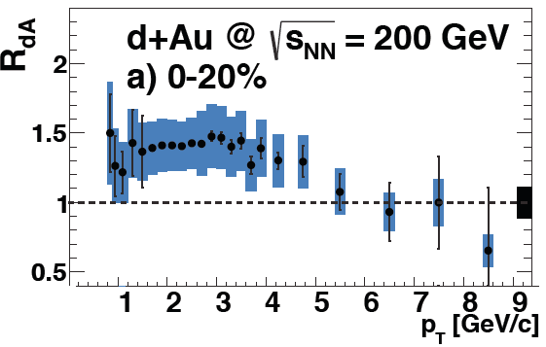
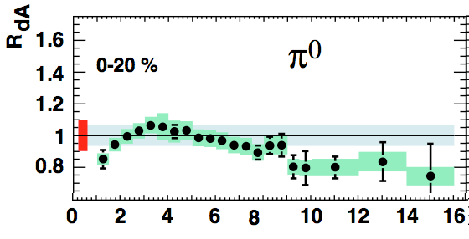
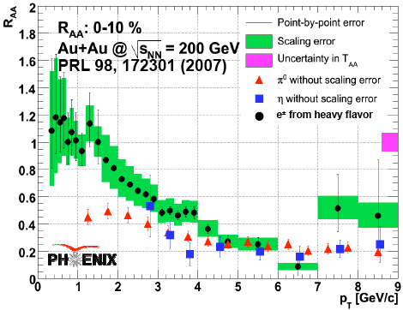
Initial state effects in R_{AA}
PHENIX
PHENIX
e from HF
Different suppression at low p_{T} but same difference is seen in d+Au collisions.
Same suppression at high p_{T.}

Slide 15
Removing initial state effects from R_{AA} ?
J. Matthew Durham, PhD thesis, Stony Brook University (2011)
Same nuclear modification for light, charm and bottom quarks (high p_{T} e_{HF}) !
Maybe the mass dependency is relevant only for p _{T}<<m_{Q.}

Slide 16
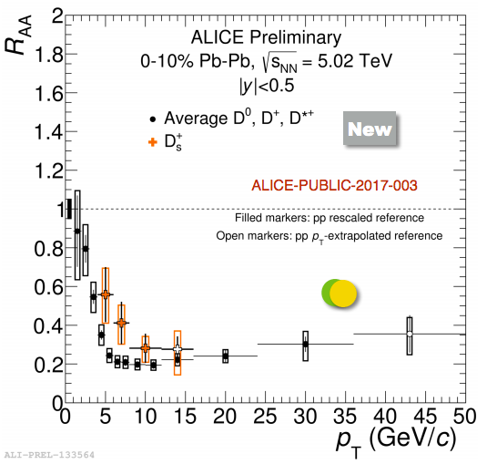
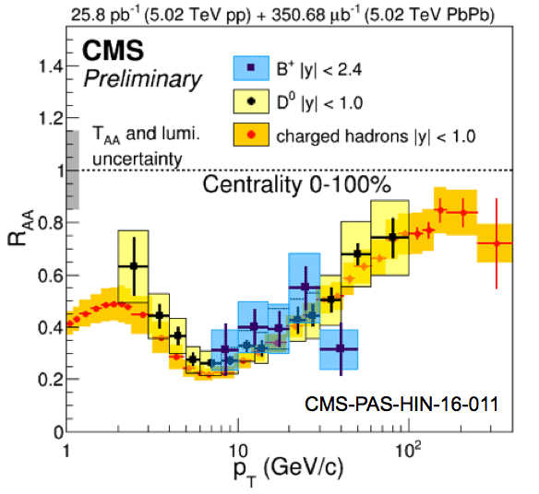
Nuclear Modification at LHC
Same high p_{T} suppression for all quark masses and RHIC.
Hints that charm is less suppressed than light-quark at low p_{T}.
Slightly larger R_{AA} for Ds, hint for coalescence in QGP.

Slide 17
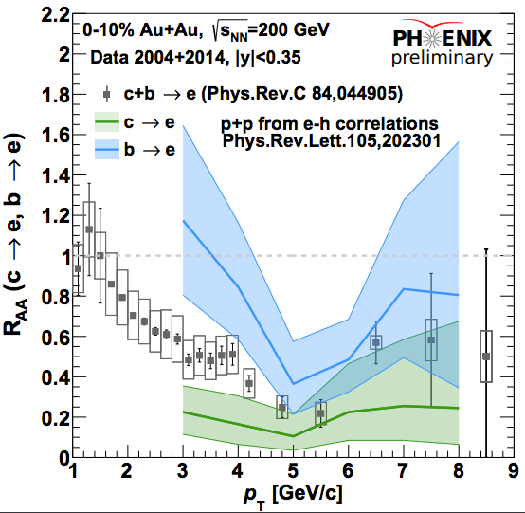
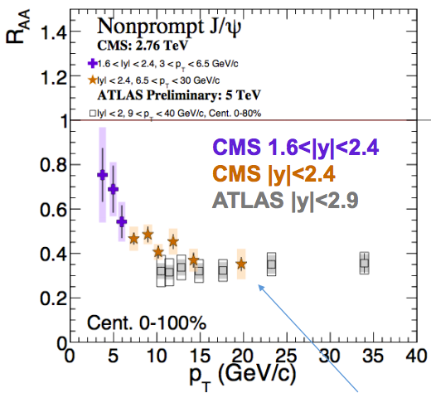
Looking at bottom-quarks R_{AA}
RHIC
LHC
Quark mass dependency starts to be evident for low p_{T}<m_{b} (~4.5 GeV)
Assuming initial state is the same for charm and bottom-quarks.

Slide 18
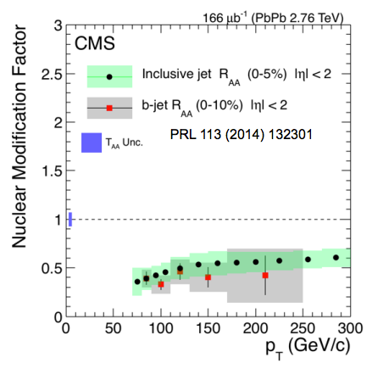
b-tagged di-jet imbalance
Gluon and b-jets have the same nuclear modification.
Are b-jets mainly gluon splitting ?
Does the quark-mass really matter at p_{T}>80 GeV/c ?

Slide 19
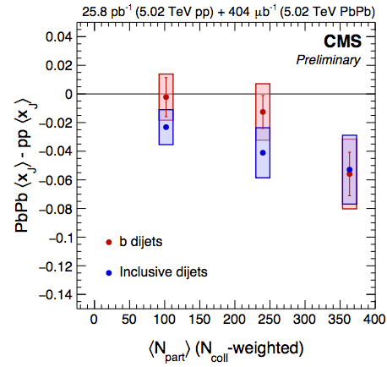
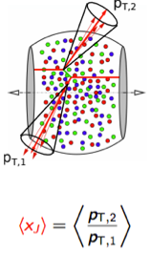
b-tagged di-jet imbalance
Di-jets have momentum imbalance modified in the medium.
Back-to-back b-tagged di-jets may (in principle) be dominated by gluon fusion.
But gluon and b-tagged di-jets are are undistinguishable relative to imbalance modification.

Slide 20
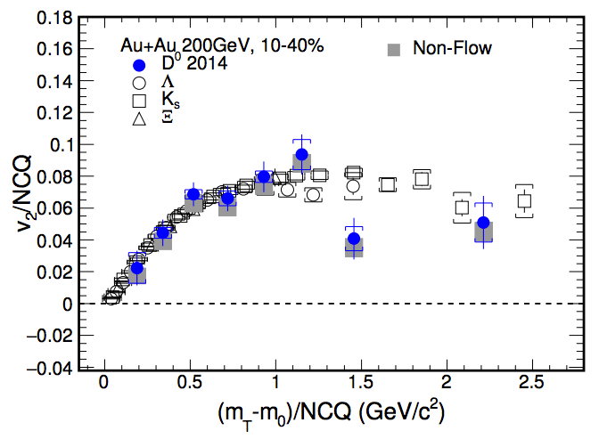
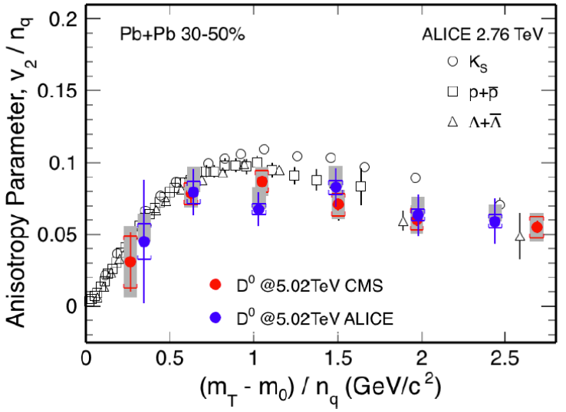
D-meson Azimuthal Anisotropy
RHIC
LHC
STAR
v2/NCQ scaling for light and charm quarks.
Result suggests strong coupling of charm-quarks with medium or thermalizes as light quarks.
But small systems results indicates initial geometry may be important.

Slide 21
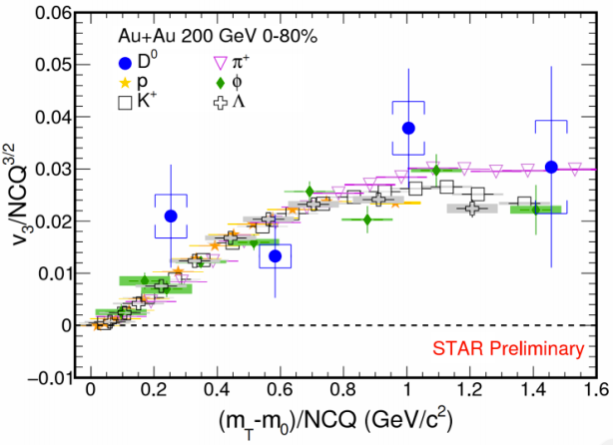
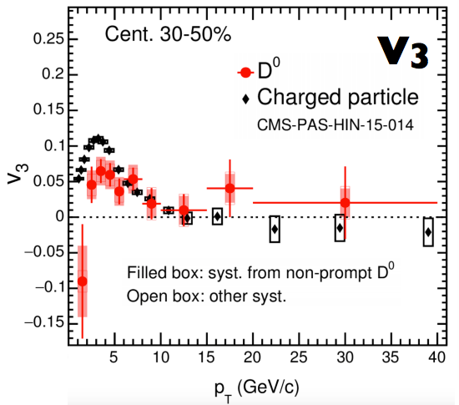
D-meson Azimuthal Anisotropy
RHIC
LHC
Hint of same scaling in triangular flow v3 at RHIC
Significant v3 at LHC

Slide 22
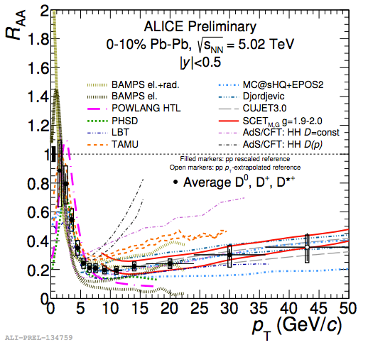
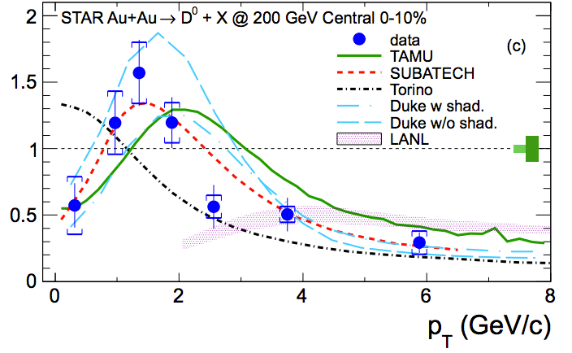
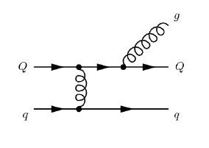
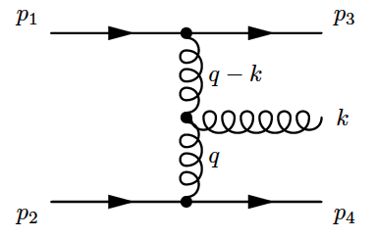
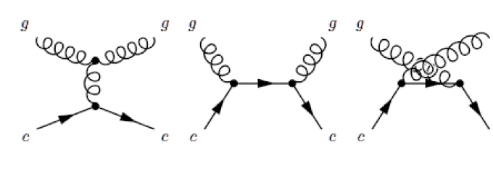
Comparison with Models
R_{AA}
Radiative Energy Loss
+
Collisional Energy Loss
Both needed to describe R_{AA}

Slide 23
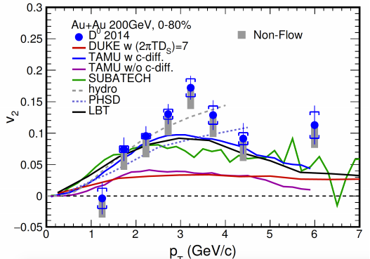
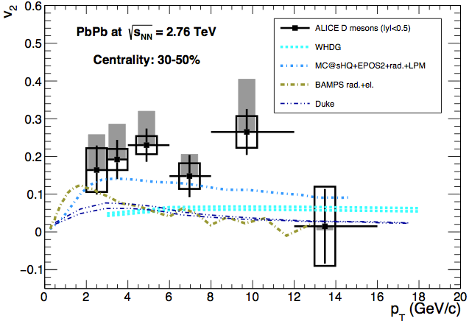
Comparison with Models
Needs charm diffusion to describe anisotropy

Slide 24
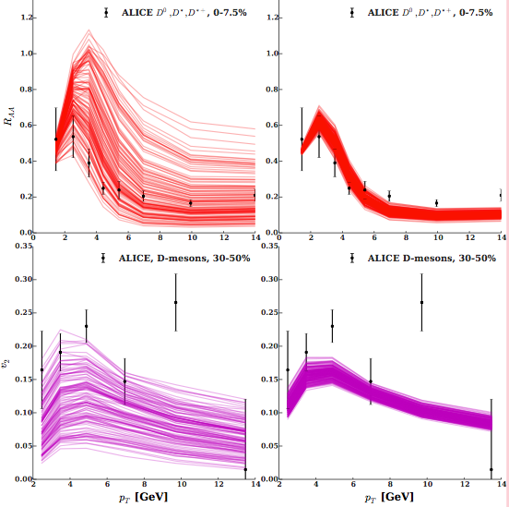
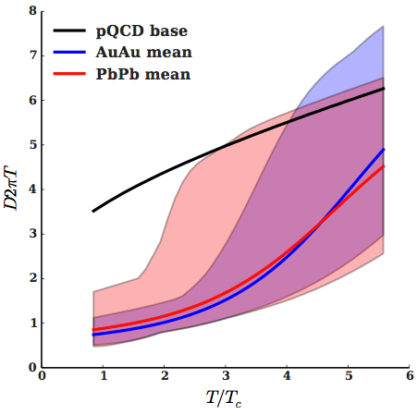
QGP parameters from data + models
Extract QGP properties from model-to-data Bayesian analysis.
Diffusion coefficient
^{PRC94 (2015)}

Slide 25
QUARKONIA

Slide 26
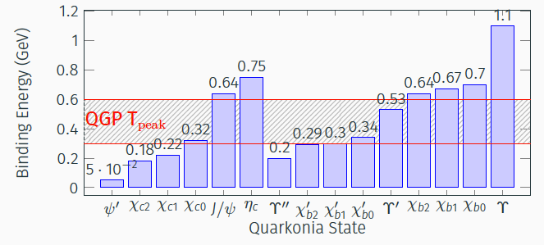
Medium Thermometer
Just look at who breaks in the medium or not.

Slide 27
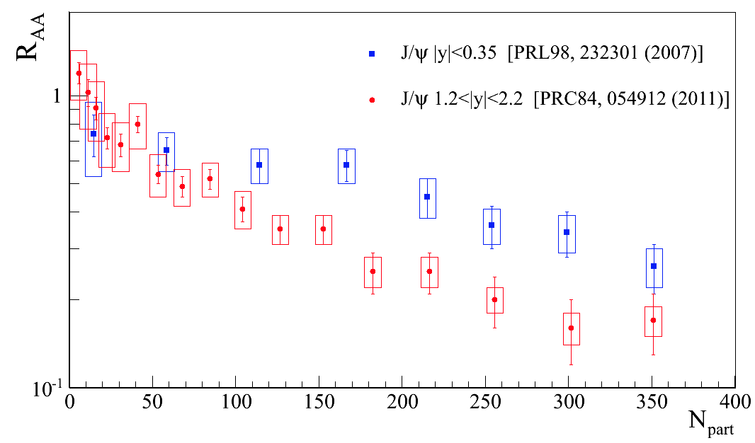
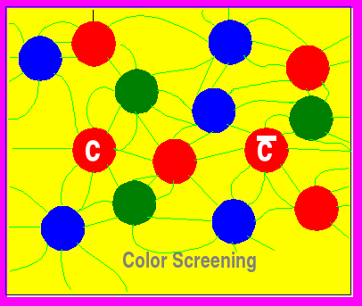
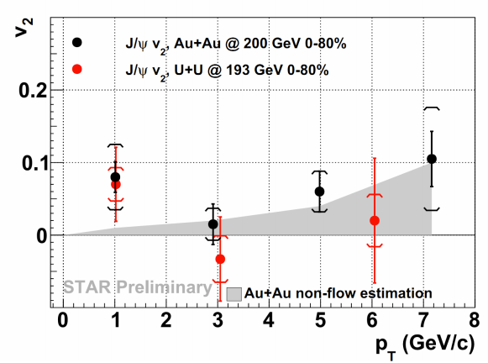
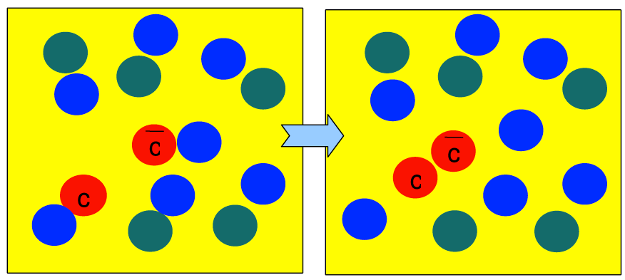
J/ψ Breaking/Coalescence
RHIC
r_{d}
Positive v₂ indicates coalescence from flowing charm-quarks.

Slide 28
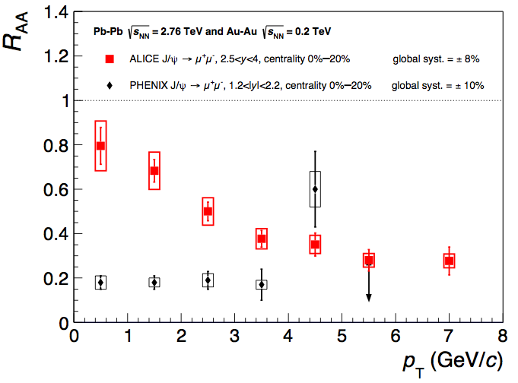
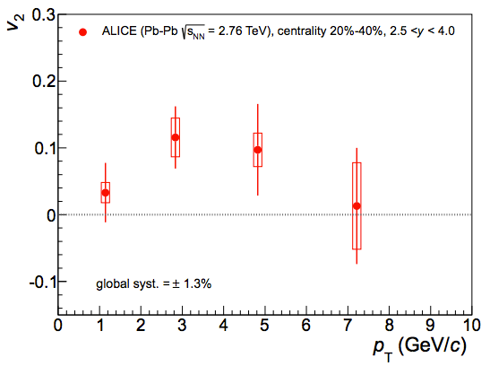
J/ψ Breaking/Coalescence
LHC
r_{d}
Positive v₂ indicates coalescence from flowing charm-quarks.

Slide 29
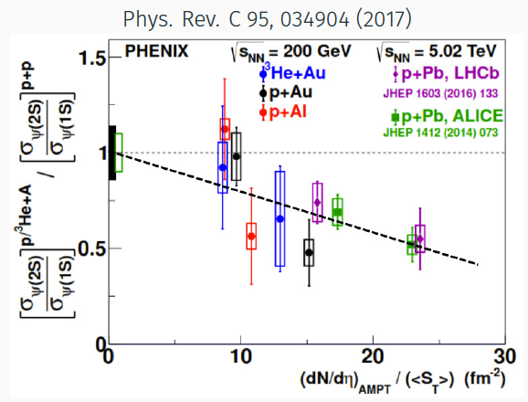
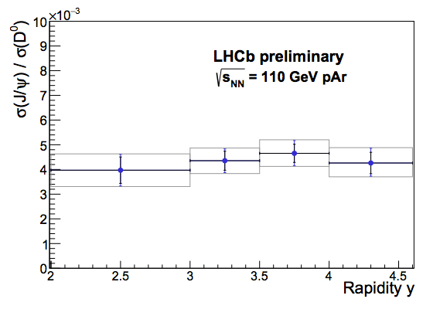
Relative breaking
Ratio btw.
  Quarkonia states or
  quarkonia/open quark
  removes initial state effects

Slide 30
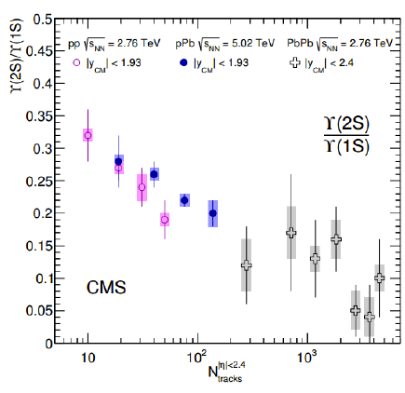

Bottomonium
Don’t expect coalescence for bottomonium
Local particle density (regardless the system) seems dominates breaking
Important to check energy dependence at RHIC

Slide 31






FUTURE
PHENIX
LHC upgrades
SPHENIX

Slide 32
CONCLUSIONS
Data produced at RHIC and LHC already have uncertainties smaller than theoretical calculation
Models can be used not for “predictions” but to use the data for QGP characterization
Needs to experimentally explore more p_{T}<m_{Q}
Explore correlations to understand any possible subtle differences between light and heavy energy loss at high p_{T}
BE VERY CAREFUL WITH INITIAL STATE EFFECTS
Seems that local particle density is the sole cause of quarkonia breaking

Slide 33
BACKUP SLIDES

Slide 34



Initial State Effects in p+Pb at LHC
c,b -> μ
D-mesons
c,b -> μ
Small-x
Large-x
D-mesons
D-mesons
1.5<y<4.0
-5.0<y<-2.5
More modest initial state effects at LHC at mid-rapidity.

Slide 35



DIS
p+A
Coherent suppression
Coherent suppression
Cronin enhancement
For x<0.01, l_{probe} > nuclear thickness
Final-state
energy loss
Initial-state
energy loss
Q²
Q²
Final-state
energy loss

Slide 36


