Slide 1

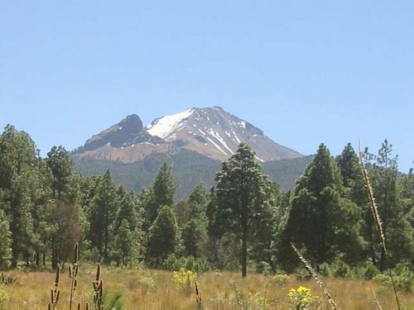
Continuum threshold and Polyakov loop as deconfinement order parameters.
M. Loewe, Pontificia Universidad Católica de Chile (PUC) and CCTVAL, Valparaíso
J. P. Carlomagno: Universidad Nacional de La Plata,
Argentina

Slide 2
This talk is based on the article:
“Comparison between the continuum threshold and the Polyakov loop as deconfinement order parameters”
J. P. Carlomagno and M. Loewe
Phys. Rev D95, 036003 (2017)
I acknowledge support from Fondecyt under grants 1130063 and 1170107

Slide 3
As it is well known we expect the occurence
of deconfinement (and chiral symmetry restoration) phase transitions, induced by thermal and density effects.

Slide 4
In the past, we have used the thermal evolution of the continuum threshold (QCD Sum Rules Approach) as an effective deconfinement order parameter.
(A. Ayala, C. A. Dominguez and M. Loewe: QCD Sum Rules at finite temperature: a Review, Adv.High Energy Phys. 2017 (2017) 9291623 )
In any hadronic channel you may explore you will find the following picture

Slide 5
Realistic Spectral Function
Im Π
s₀
s ≡ E²

Slide 6
Realistic Spectral Function (T)
Im Π
S₀(T)
s ≡ E²

Slide 7
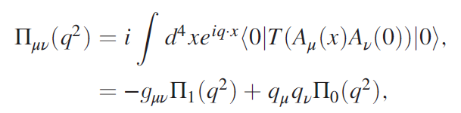

To be more specific, let us consider the correlator
with
Invoking the OPE

Slide 8
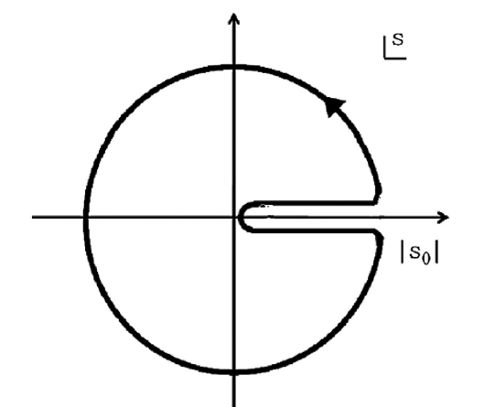
And considering Cauchy’s Theorem
We get a set of FESR

Slide 9
Confinement effects are parametrized through quark and
gluon condensates
The red area denotes
the quark condensate
The red area denotes
the gluon condensate
(infrared dynamics)
There are many other
Condensates…..

Slide 10
Here we have the
four-quark condensate
Dimension 6
In principle there are several condensates of increasing
order. In this way we will get an expansion of the form

Slide 11


d=4, a renormalization group invariant object
d = 6, in the vacuum saturation approximation
The thermal extension is fairly straightforward. Wilson coefficients remain T-independent, leading order in α_{s}, whereas the condensates become T-dependent.

Slide 12
There are important differences when the
QCD Sum Rules are extended to finite T:
1) The vacuum is populated (a thermal vacuum)
2) A new analytic structure in the complex
s-plane appears, due to scattering. This effect turns out to be very important

Slide 13
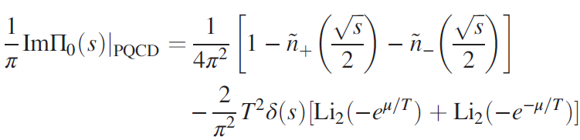


Spectral function in perturbative QCD, finite T and μ
where
In the hadronic sector

Slide 14
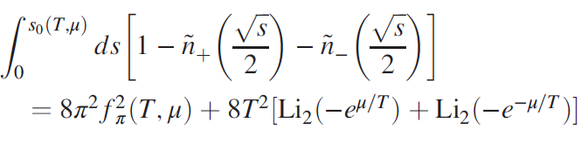
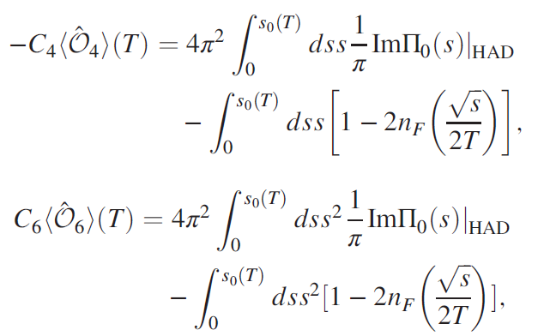
In this way we get

Slide 15
Let us now go into the second part of this story:
The connection with the (trace) of the Polyakov loop
as a deconfinement order parameter, in the frame
of nonlocal Nambu-Jona-Lasinio models (pNJL)
As we will see both the continuum threshold (QCD
SR approach) and the pNJL persepective will provide
us with essentially the same informarion, beeing
consistent to each other

Slide 16
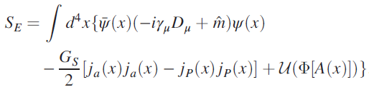

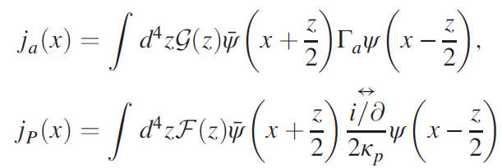



Let us consider a nonlocal chiral SU(2) quark including quark couplings to color gauge fields. The euclidean effective action is
With the non local currents

Slide 17
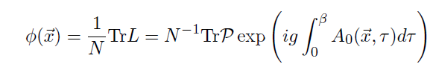


The Polyakov loop is defined as
Under global Z(N) transformations it transforms as
The vacuum has an N-degeneration
Each election of
j breaks the Z(N)
symmetry

Slide 18

Comments (and facts):
The Polyakov loop potential simulates the self gluon interaction
The scalar-isoscalar of the j_{a}(x) current will generate a momentum dependent quark-mass.
The “momentum” current j_{P}(x) is responsible for a momentum
dependent quark wave-function renormalization Z(p) (WFR). This is necessary in order to compare the mass parameter (in the quark propagator) with lattice results.
S. Noguera and N.N. Scoccola Phys. Rev. D 78, 114002 (2008);J.P. Carlomagno, D. Gomez Dumm, and N.N. Scoccola, Phys. Rev. D 88, 074034 (2013).

Slide 19
The trace of the Polyakov loop is an exact order parameter for a pure Gluon-theory. It becomes an approximate object when quarks are introduced. The phase transition becomes a crossover.
The trace of the Polyakov loop is an approximate order parameter for the center of SU(3)_{c} = Z₃. Breaking of Z₃ has to do with deconfinement.
The potentials must reproduce, at high temperature, the pressure of an ideal gas (with the corresponding degrees of freedom) and, at small temperatures they must have a smooth correspondence with lattice results.
Finally: Non-local versus local NJL models: we get a much better agreement with lattice results (for the behavior of the quark propagators). In the non-local version, chiral symmetry restoration and deconfinement occure at the same critical temperature.

Slide 20

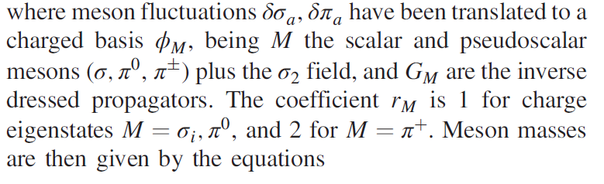



Normally, you perform a bosonization of the theory. introducing
two scalar fields and a triplet of pseudoscalars fields, integrating
out the quark fields
Physical sates have to be normalized through
where

Slide 21

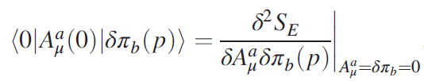
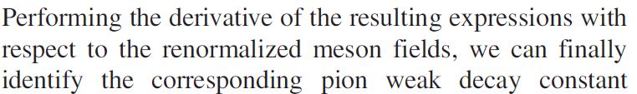
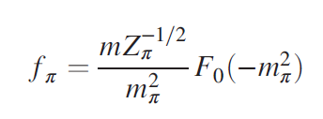
The weak decay constants of pseudoscalar mesosn
where

Slide 22
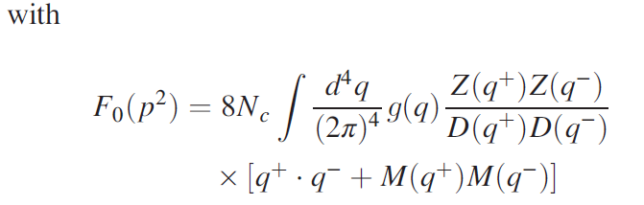
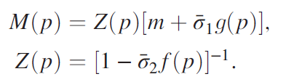
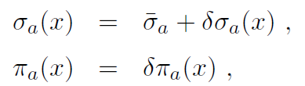
Where we have expanded

Slide 23

Some comments about the Polyakov loop
potential
There are several versions on the market: Logarithmic expression based on the Haar measure of SU(3); Polynomial a la Landau-Ginzburg; Fukushima, Haas et al
…

Slide 24
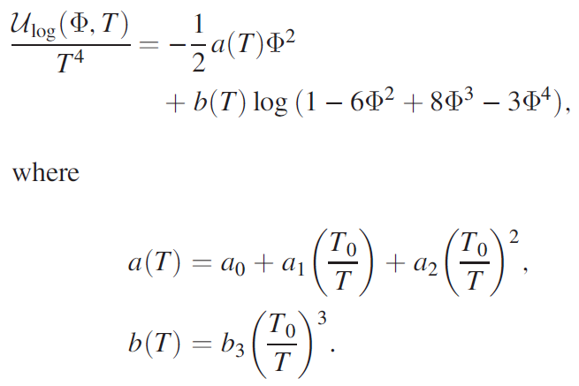
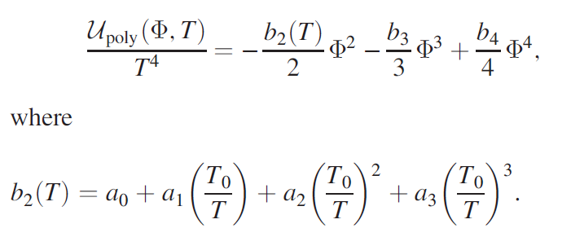
In detail

Slide 25

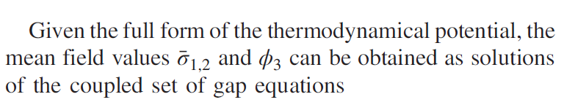
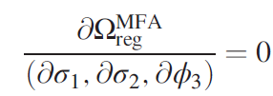
The configuration with the largest weight in the path integral corresponds
to the mean field approximation.
Eventually we found for the real part of the thermodynamical potential

Slide 26
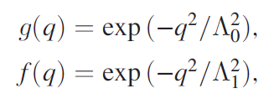
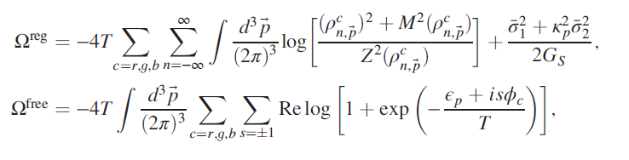

We have used Gaussian regulators. All parameters fixed from lattice.
In the previous page we introduced
where

Slide 27
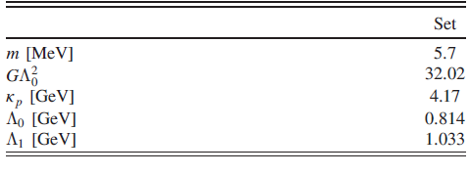
The set of parameters we have used, fixed from the
agreement with the lattice results

Slide 28
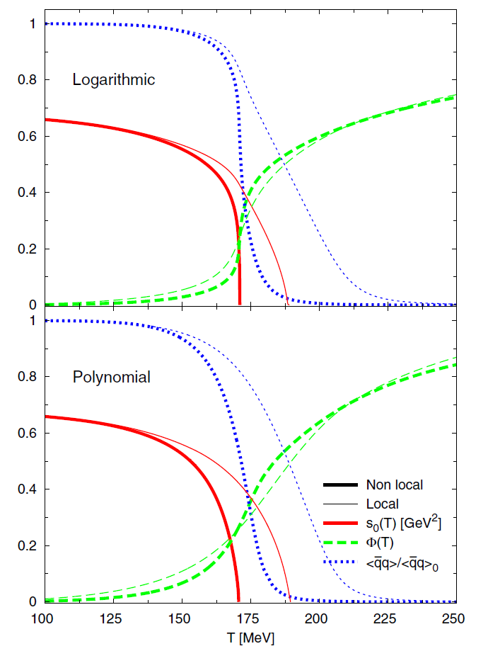
C
Continuum threshold (red solid
line), Trace of the Polyakov loop
(green dashed line) and the Nor-
malized quark condensate (blue
dotted line) as function of tempe-
rature for the non local (thick line)
and local PNJL (thin line) at zero
chemical potential for logarithmic
(upper panel) and polynomial
(lower pannel) effective potentials.

Slide 29
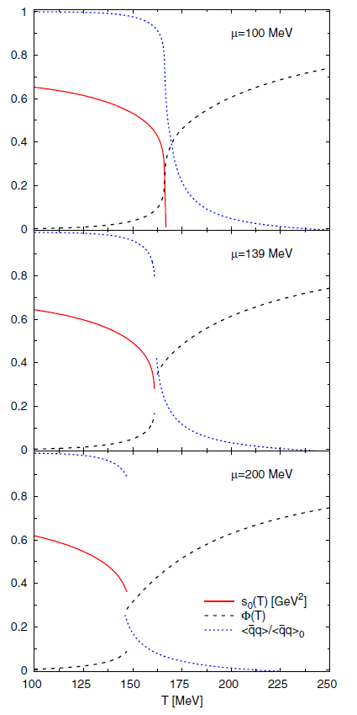
When the chemical potential
becomes bigger than 139 MeV,
We have a 1st order phase transition. For higher values of μ
we see the ocurrence of the
Quarkyonic phase: Chiral
Symmetry has been restored
but the system is still confined

Slide 30
Conclusions?
We showed that the continuum threshold
and the Polyakov loop (the trace of the Polyakov
loop) provide us with the same information.
A consistente picture for the critical temperature,
In agreement also with chiral symmetry restoration.
THANK YOU

