Slide 1
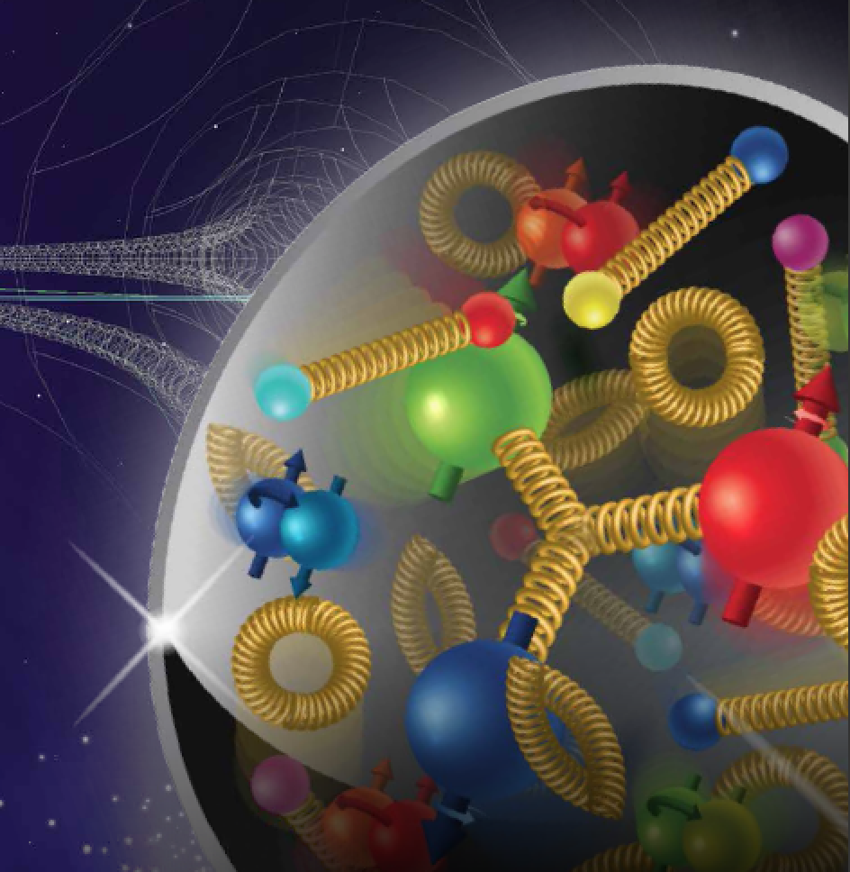


Salvatore Fazio
Brookhaven National Lab
Physics Opportunities at a Future Electron-Ion Collider
XLVII International Symposium on Multiparticle Dynamics
Sep. 11-15, 2017, Tlaxcala City (Mexico)
Notes:
S. Fazio – Brookhaven National Laboratory

Slide 2
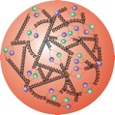

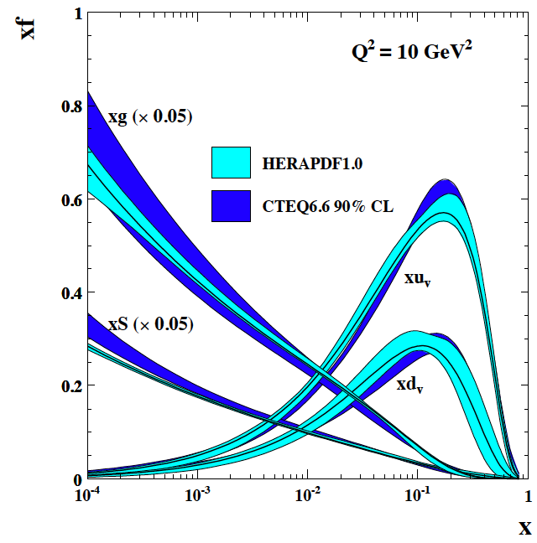
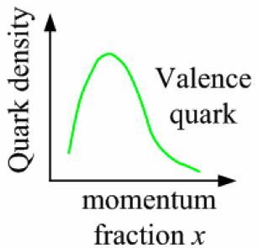
What do we Know?
HERA (the previous e+p collider) studied in details the one-dimensional picture of a free proton
higher
√s
?
HERA discovery:
Gluon density dominates at x<0.1
Proton:
Quark-Masses: ~1% M_{p}
Proton mass completely generated by QCD dynamics
All strongly interacting matter is an emergent consequence of many-body quark-gluon dynamics
→ Need a high resolution microscope to resolve quark and gluon structure in multidimensions

Slide 3

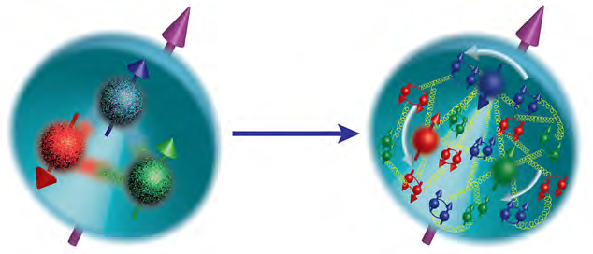

Most Compelling Physics Goals
How are sea quarks and gluons, and their spins, distributed
in space and momentum inside the nucleon?
How do the nucleon properties emerge from them and
their interactions?
What happens to the gluon density in nuclei?
Does it saturate at high energy?
gluon
emission
gluon recombination
?
Does this saturation give rise to a gluonic matter with universal properties in all nuclei, even proton?
=
How does a dense nuclear environment affect the quarks and gluons, their correlations and interactions?
How do color-charged quarks and gluons, and colorless jets, interact with a nuclear medium?
How do the confined hadronic states emerge from these quarks and gluons?
How do the quark-gluon interactions create nuclear binding?

Slide 4
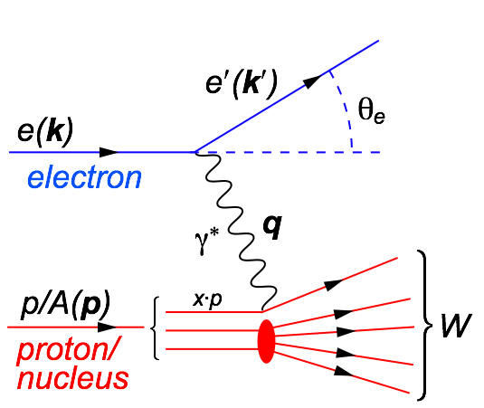
Our Tool: Deep Inelastic Scattering
Kinematics:
Measure of resolution power
Measure of inelasticity
Measure of momentum fraction of struck quark
Center-of-mass energy of electron-hadron system
All variables are correlated:
DIS:
As a probe, electron beams provide unmatched precision of the electromagnetic interaction
Direct, model independent, determination of kinematics of physics processes
Indirectly probes gluons with high precision

Slide 5
Ingredients for a High Resolution “Femtoscope”
Large center-of-mass coverage:
Access to wide kinematic range in x and Q²
Polarized electron and hadron beams:
access to spin structure of nucleons and nuclei
Spin vehicle to access the 3D spatial and momentum structure of the nucleon
Full specification of initial and final states to probe q-g structure of NN and NNN interaction in light nuclei
Nuclear beams:
Accessing the highest gluon densities → amplification of saturation phenomena
High luminosity:
Detailed mapping the 3D spatial and momentum structure of nucleons and nuclei
Access to rare probes
All these requirement can be addressed by a future Electron-Ion Collider

Slide 6
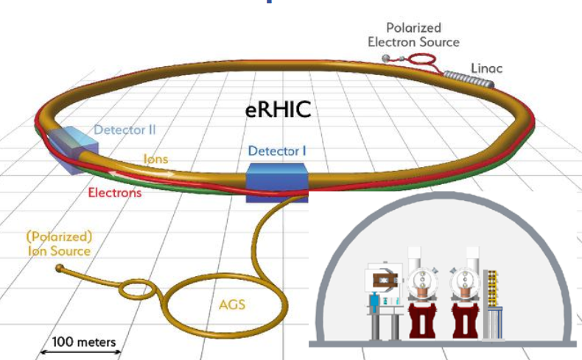
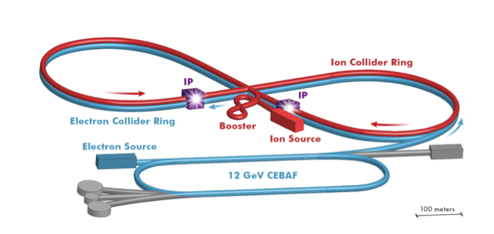
Two proposals for realization of the Science Case
The Electron Ion Collider
For e-N collisions at the EIC:
Polarized beams: e, p, d/³He
Luminosity L_{ep} ~ 10³⁴ cm⁻²sec⁻¹
  100-1000 times HERA
√s = 20-100 (145) GeV
For e-A collisions at the EIC:
Wide range in nuclei
Luminosity per nucleon same as e+p
Variable center of mass energy
eRHIC
Brookhaven National Lab
World’s first
Polarized electron-proton/light ion
and electron-Nucleus collider
Both designs use DOE’s significant investments in infrastructure
JLEIC
Thomas Jefferson National Lab

Slide 7
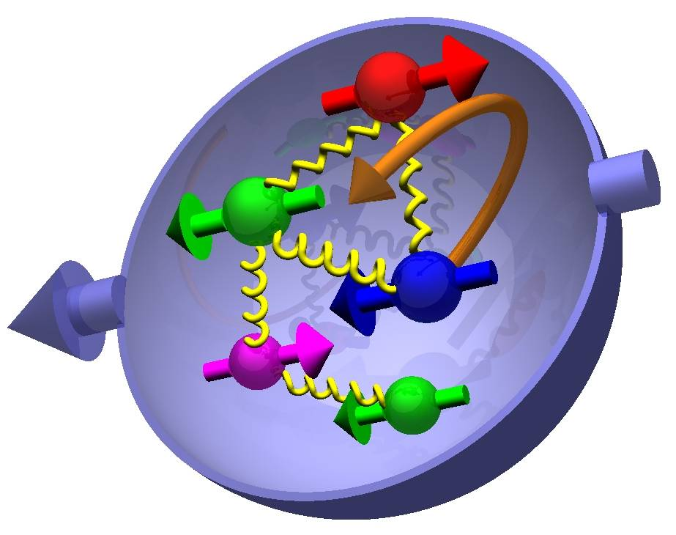

Spin Physics
what is the polarization of gluons at small x where they are most abundant?
what is the flavor decomposition of the polarized sea depending on x?
The Holy Grail
Determine quark and gluon contributions to the proton spin
The Spin Sum Rule

Slide 8

Proton’s Helicity Structure
Jaffe and Manohar “sum rule” [Nucl. Phys. B337, 509 (1990)]
gluon
spin
Σ_{q}Δq
L_{g}
Σ_{q}L_{q}
δq
total u+d+s
quark spin
angular
momentum
ΔG
What we know:
DIS (fixed targ.) + RHIC (till 2009)
[arXiv:1404.4293]
First time a significant
non-zero Δg(x)
RHIC: All data until 2015 factor 2 reduced uncertainties at x ~ 10⁻³
Impact of an EIC:
The x-range will be extended by two orders of magnitude, allowing an extremely precise measurement in the earlier poorly known area

Slide 9

The Spin Sum Rule
Jaffe and Manohar “sum rule”
[R. L. Jaffe and A. V. Manohar, Nucl. Phys. B337, 509 (1990)]
After EIC:
spin puzzle will be solved
gluon
spin Δg
✔
total quark
spin ΔΣ
✔
Δq & Δg measured in inclusive data via fits to the polarized structure function g₁
1/2 -
Gluon
-
Quarks
=
orb. angular momentum
9

Slide 10
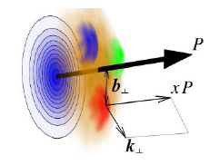

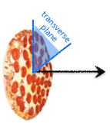
EIC: the Ultimate Multi-dimension Experience!
Proton Imaging
what is the spatial distribution of
quarks and gluons in nucleons/nuclei?
understand deep aspects of gauge
theories revealed by k_{T} dep. distr’n
possible window to
orbital angular momentum
Proton Structure:
PDFs do not resolve transverse coordinate or momentum space
In a fast moving nucleon the longitudinal size squeezes like a “pizza” but transverse size remains about 1 fm

Slide 11
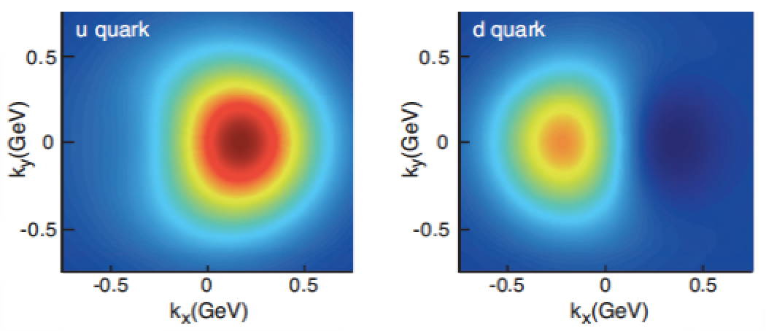
Multi-dimensional Imaging of Quarks and Gluons
Wigner functions
offer unprecedented insight into confinement and chiral symmetry breaking
W(x,b_{T},k_{T})
Momentum
space
Coordinate
space
∫d²b_{T}
∫ d²k_{T}
f(x,k_{T})
f(x,b_{T})
Spin-dependent 3D momentum space
images from semi-inclusive scattering
→ TMDs
Spin-dependent 2D coordinate space (transverse) + 1D (longitudinal momentum) images from exclusive scattering
→ GPDs
Direct access to W(x,b_{T},k_{T})
for gluons through diffractive di-jets measurements at an EIC under investigation

Slide 12
Spatial Imaging
Exclusive Vector Meson (real photon) production
Fourier transform of |t|-differential cross sections
Very precise imaging evolving in x and Q²
DVCS gives quarks (gluons only via Q²-evolution)
J/Psi gives direct access to gluons (mass provides hard scale)
Light VMs provide quark-flavor separation
pion cloud effects
(high b_{T})
Transversely polarized protons: sin(Φ_{Τ}−φ_{Ν})
gives access to GPD E
Access to orbital angular momentum through “Ji sum rule”
Theory curves show different assumptions for GPD E
[X.D. Ji, Phys. Rev. Lett. 78, 610 (1997)]

Slide 13
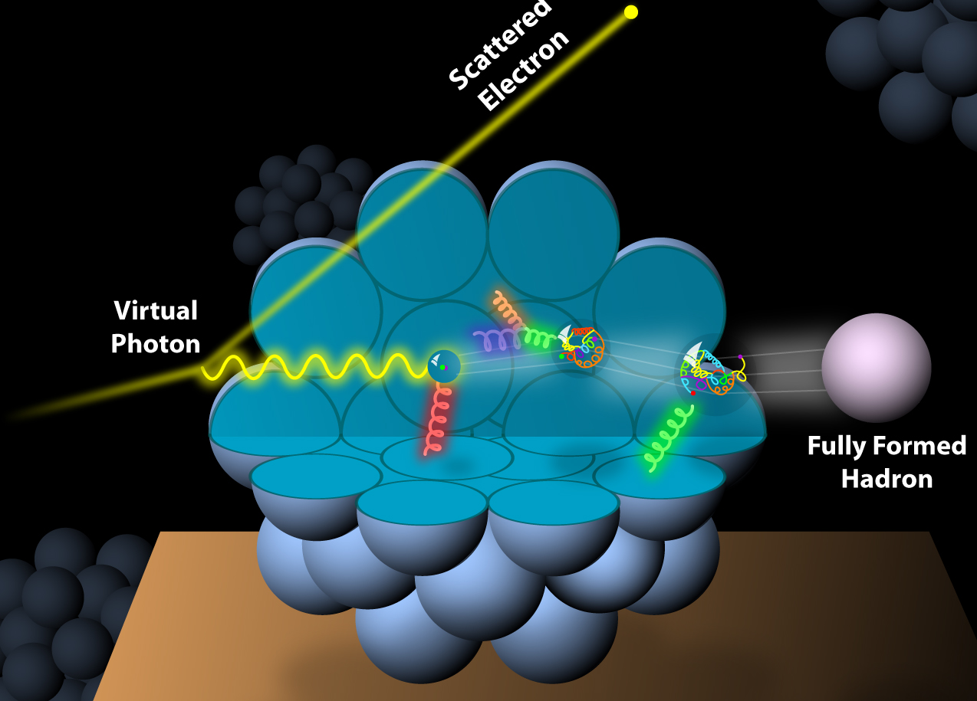
And What About Nuclei?
Incoming
Electron Beam
How does the nuclear environment affect the distribution of quarks and gluons and their interaction in nuclei?
Where does the saturation of the gluon density set in?

Slide 14
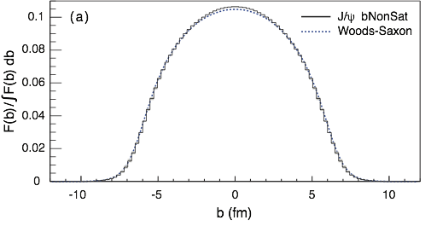
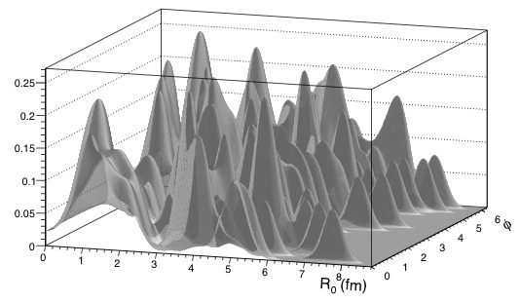
Imaging the Gluons in Nuclei
Diffractive vector meson production:
e + Au → e′ + Au′ + J/ψ
Fourier Transform
PRC 87 (2013) 024913
  Hot topic:
      Lumpiness of source?
      Just Wood-Saxon+nucleon g(b_{T})
      coherent part probes “shape of black disc”
      incoherent part (large t) sensitive to “lumpiness” of the source [= proton] (fluctuations, hot spots, ...)
possible Source distribution with b_{T}^{g} = 2 GeV⁻²

Slide 15
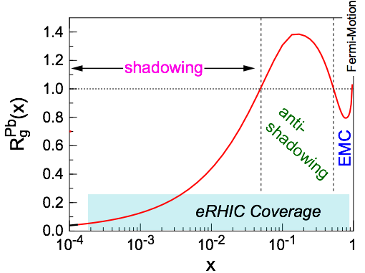
Nuclear PDFs
Inclusive DIS on e+A analog to e+p:
quark+anti-quark
gluons
(or tag on F₂-charm)
Ratio: F₂(x,Q²)_{Pb}/F₂(x,Q²)_{p}
Theory/models have to be able to describe the structure functions and their evolution
Aim at extending our knowledge on structure functions into the realm where gluon saturation effects emerge ⇒ different evolution
DGLAP:
predicts Q² but not A-dependence and x-dependence
Saturation models:
predict A-dependence and x-dependence but not Q²
→ Need: large Q² lever-arm for fixed x, A-scan

Slide 16
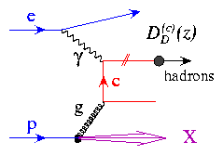
Reduced Cross Section & F_{L} (e+Au)
Inclusive DIS
Quark charm production
Charm production:
Novel probe!
Direct access to gluons at medium to high x by tagging photon-gluon fusion
  Higher c.o.m. energy constrains gluons at mid- and low-x
  Fitting the charm pseudo-data has a dramatic effect at high-x
E.C. Aschenauer, S. F., M.A.C. Lamont, H. Paukkunen, P. Zurita
[arXiv:1708.05654]

Slide 17
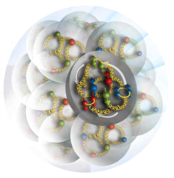
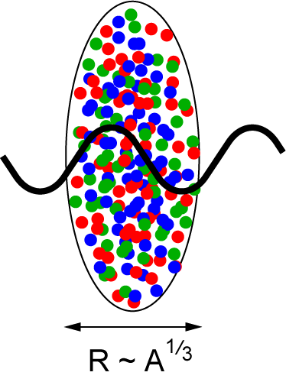
A Window into the Saturation Regime
gluon
emission
gluon recombination
?=?
L ~ (2m_{N} x)⁻¹ > 2 R_{A} ~ A^{1/3}
Probe interacts
coherently with all nucleons
Ca
p
Gold: 197 times smaller effective x !
Complementary measurements at other facilities.
LHC, HL-LHC, RHIC:
  study saturation in pA collisions: UPC, di-hadron correlations, open charm at forward rapidities (lower x)
  → universality
  Effects of saturation on ion-ion collisions.
LHeC, VHEeP, FCC-eh: Access lower x.
EIC will map the transition between a non-saturated and a saturated regime with high precision, by making use of a large range of nuclei and spin
With its flexible ion source we will be able to measure the A-dependence of the saturation scale Q_{s}(x)
→ a fundamental landmark of QCD

Slide 18
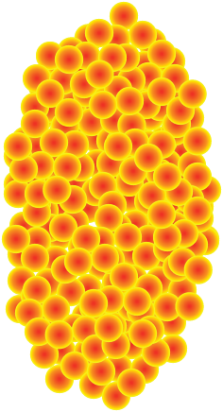
Saturation – Key Observables
Di-Hadron Correlations
side-view:
jet-1
beam-view:
p
A
π
jet-2
Low gluon density (ep):
pQCD predicts 2→2 process
⇒ back-to-back di-jet
High gluon density (eA):
2 → many process
⇒ expect broadening of away-side

Slide 19
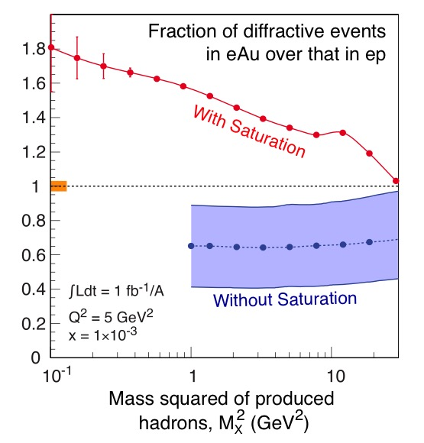
Inclusive diffraction:
Saturation: Key Observables
Diffraction
High sensitivity to gluon density in linear regime σ~[g(x,Q²)]²
Exclusive VMP
Transition in M_{x}
Φ meson production

Slide 20

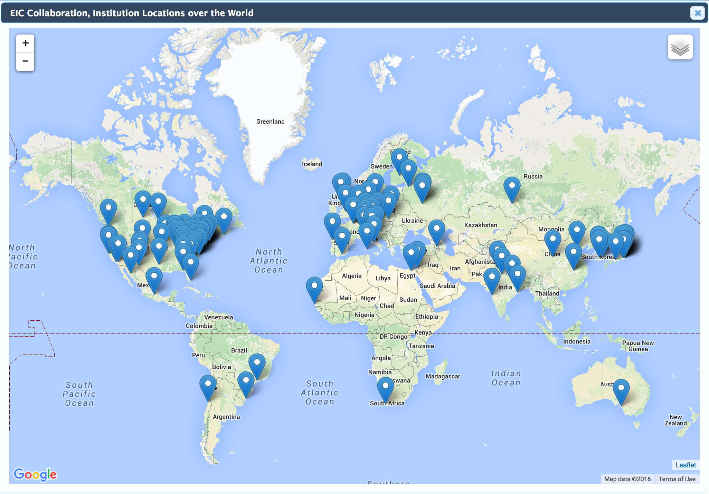
Electron-Ion Collider Project
In the 2015 Long Range Plan, the American National Science Advisory Committee (NSAC) recommended the realization of an EIC as top priority
“We recommend a high-energy high-luminosity polarized EIC as the highest priority for new facility construction following the completion of FRIB”
http://science.energy.gov/~/media/np/nsac/pdf/2015LRP/2015_LRPNS_091815.pdf
Next Steps:
A review of the project by the National Academy of Science (NAS) is ongoing, and a report is expected by spring next year.
EIC is an International enterprise!
Currently 705 members from 157 institutions from 29 countries from 6 world regions
North America: 46% - Europe: 32% - Asia: 16%
South America 2% - Africa 2% - Oceania 2%
Continuously growing!
Sign up and join us on EICUG.ORG

Slide 21

Conclusions
An EIC will allow us to obtain the answers to the big questions discussed
  Solve the proton spin puzzle
  3D imaging in momentum and coordinate space of nucleons and nuclei
  How visible matter emerges from quarks and gluons?
  Map the region of the transition from non-saturated to saturated regime
R&D ongoing for a collider detector with high resolution, wide acceptance and particle identification
EIC White Paper: 3rd edition
Report on the energy dependence of key measurements just released
→ New ideas are constantly explored
An EIC will profoundly impact our understanding of nucleon structure
The full completion of the physics program is uniquely tied to a future high energy, high luminosity, polarized ep / eA collider
The EIC White Paper
Eur. Phys. J. A (2016) 52: 268
Case for higher energy
arXiv:1708.01527

Slide 22
Back up

Slide 23
Spatial Imaging
Deeply Virtual Compton Scattering
e’
γ
e
γ_{L}*
(Q²)
x+ξ
x-ξ
~
E.C. Aschenauer, S. Fazio, D. Mueller, K. Kumericki arXiv:1304.0077
~
p
H, H, E, E (x,ξ,t)
p’
t
HERA results limited by lack of statistics
EIC: the first machine to measure cross sections and asymmetries
DVCS → production of a real photon
Experimentally clean
EIC will provide sufficient luminosity to bin in multi-dimensions
Wide x and Q² range needed to extract GPDs
Luminosity: 10 fb⁻¹
5% systematic uncertainties
Experimental effects accounted

Slide 24
Spatial Imaging
Unpolarized
sea-quarks
Polarized
sea-quarks
gluons
Shift due to GPD E

Slide 25
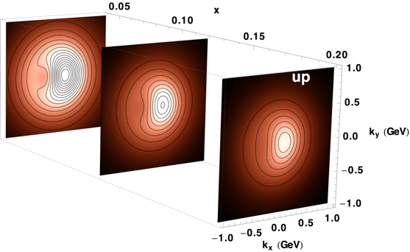
Imaging in Momentum Space
Semi-Inclusive Deep Inelastic Scattering
u-quark
Transverse Momentum distributions
(TMDs)
Precise partonic imaging
in transverse momentum space
Evolution in x (and Q²)
An EIC will explore the fundamental dynamical structure of hadrons

Slide 26
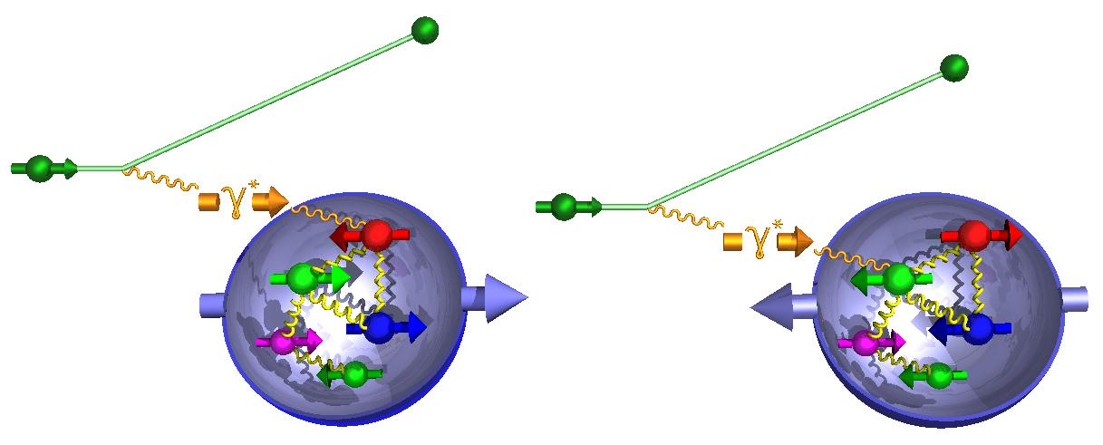
Proton’s helicity structure - Δg
It is measured in inclusive data via spin asymmetry:
A_{LL} -> Δq
Δg(x,Q²)=g (x,Q²)-g (x,Q²)
g₁ scaling violation
world data
till EIC

Slide 27
Proton’s helicity structure
DIS scaling violations mainly determine Δg at small x
furthermore SIDIS data provide detailed flavor separation of sea quark
yet, small x behavior completely
unconstrained
→ determines x-integral,
which enters proton spin sum
plots includes only low electron-beam energies → can be pushed to x=10⁻⁴ with 20 x 250 GeV data
dramatic reduction
of uncertainties:
Constrains on hardware:
(SI)DIS @ eRHIC limited by systematics
  rel. lumi, polarimetry, detector performance need to be well under control
QED radiative corrections

