Slide 1




Jet-related 2-particle (γ-h,h-h) Correlations : Recent PHENIX Developments
Justin Frantz ISMD 17
9/12/2017

Slide 2
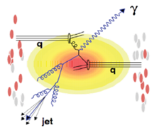
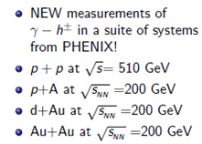
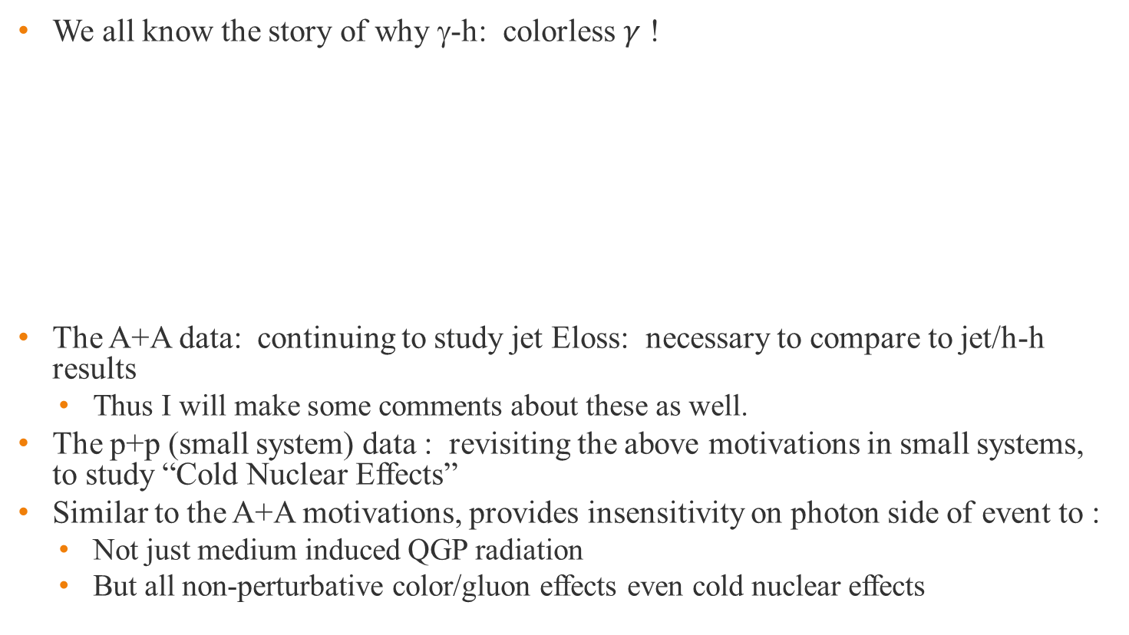
Direct Photon-Hadron and h-h Correlations
We all know the story of why γ-h: colorless $γ$ !
The A+A data: continuing to study jet Eloss: necessary to compare to jet/h-h results
  Thus I will make some comments about these as well.
The p+p (small system) data : revisiting the above motivations in small systems, to study “Cold Nuclear Effects”
Similar to the A+A motivations, provides insensitivity on photon side of event to :
  Not just medium induced QGP radiation
  But all non-perturbative color/gluon effects even cold nuclear effects

Slide 3
A+A Results
QGP Eloss studies

Slide 4
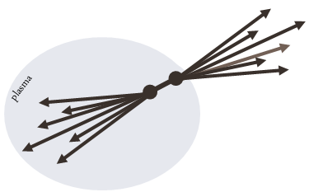
HI: Using 2-p Correlations for E_{loss}
As a tool for studying jet Eloss, “high” (mid) p_{T} 2PC remain important
Allows for study of lowest Q² possible (a la sPHENIX) E_{jet}= 5-20 GeV (Jet Reco systematics large there) sPHENIX
Lots of new 2-p results at Hard Probes/QM17 conference! Alive and healthy set of measurements
Used in combination with Jet Reco (best case)
But also by itself at low pt where jet reco is not possible

Slide 5

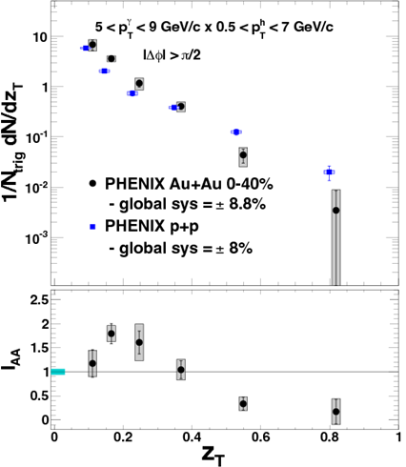
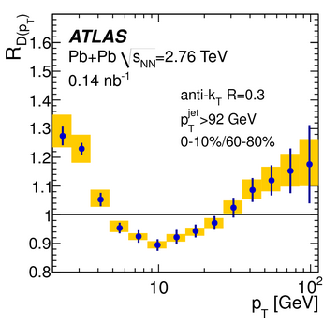
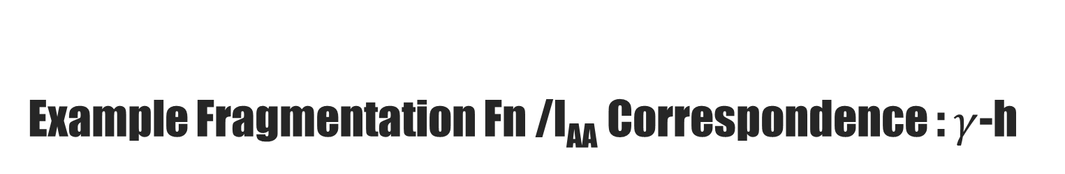
Example Fragmentation Fn /I_{AA} Correspondence : $γ$-h
LHC Measure Reco Jets (Much higher p_{T}) look at z = p_{i}/p_{jet}
Normalized per-found jet (so suppression implicit)
Enhancement/Suppression
2PC γ-h: use
PHENIX RESULT
PRL 111, 32301
Run 7+10
? see later
PLB 739 (2014) 320–342
even more info in IAA
z = ~1

Slide 6
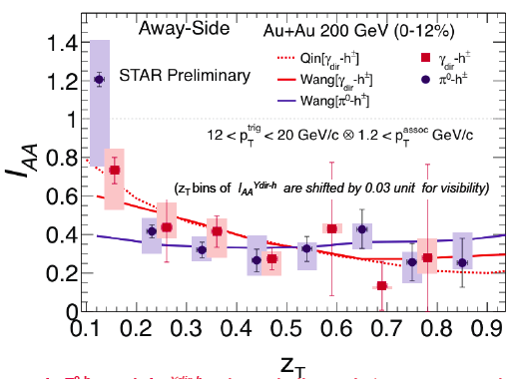
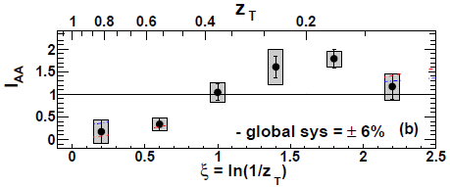
Status γ-h Last Year: STAR also measures
Qualitatively similar (rise at low z → enhancement)
  But sizable disagreement @ low z if expect FF AuAu/pp universal?
Different jet E & Min pt Difference 1.2 STAR vs 0.5 PHENIX
Disagreement could tell us INTERESTING PHYSICS – RESOLVE?
  Non FF mod (IAA) universality: pT matters not z (medium scale?)
  OR: E_{loss} for low Ejet different!
PHENIX: γ p_{T} 5-9 GeV/c
p_{T} ^{assoc} ~ 0.8 GeV/c
STAR: PLB B760 (2016) 689-696
PHENIX
PRL 111, 32301
0-20% Au+Au
γ-h I_{AA}
6

Slide 7
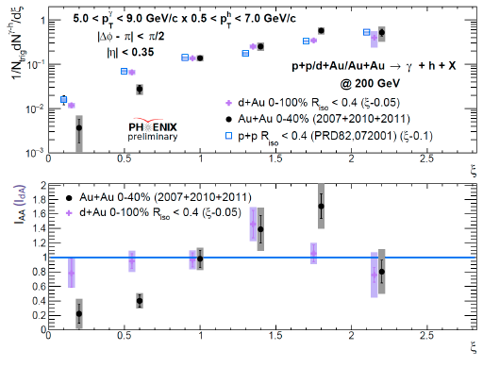

New PHENIX Measurements!
Resolve question? STAR / PHENIX measure same pT ranges: still not completed
PHENIX: Remeasure, improve statistics cross check in d+Au
H. Ge HP 16
New data confirms some points “extrapolated” from old data
Recall the Method

Slide 8
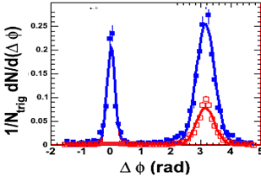

2-p/γ-h STATISTICAL method
γ-h: double subtraction of 2-p measurements
γ
π⁰
Y_{direct} ∝
C_{incl} -
C_{decay} -
Bkg_{incl} (Flow)
- [ ]
Bkg_{decay}(Flow)
Y_{xxx} ∝
Norm
Bkg(Flow)
+v₃ + v₄…
Subtraction w/ flow modulation included (low p_{Tassoc})
  Underlying event level still relevant → Abs.Norm/ subtraction method
  In low multiplicity (p+p, d+Au) we can apply a standard isolation cut
    e.g. E_{R=0.3}/E < 10%

Slide 9
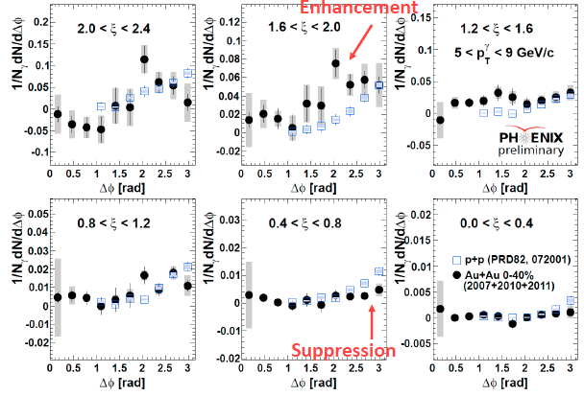
How results look in Dphi
H. Ge HP 16

Slide 10
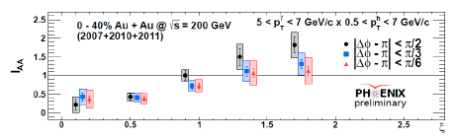
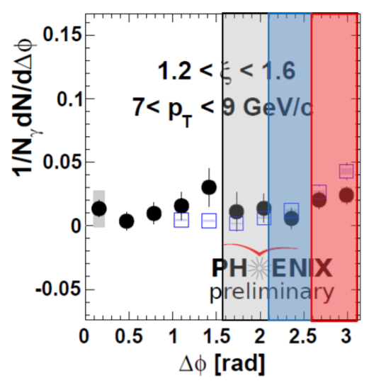
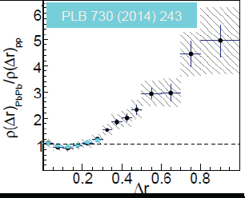
Low z enhancement details: angle
Most enhancement in largest angular regions:
Recall CMS Result

Slide 11
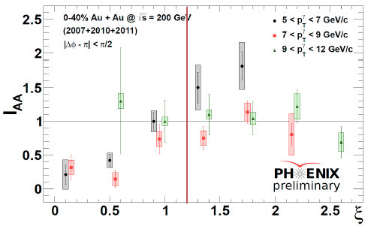

Low z enhancement details p_{T}
PT$γ$ dependence shows smaller enhancement at larger trigger
  remember enhancement must be measured relative to overall suppressed jet level – still there for other trigger pt bins

Slide 12
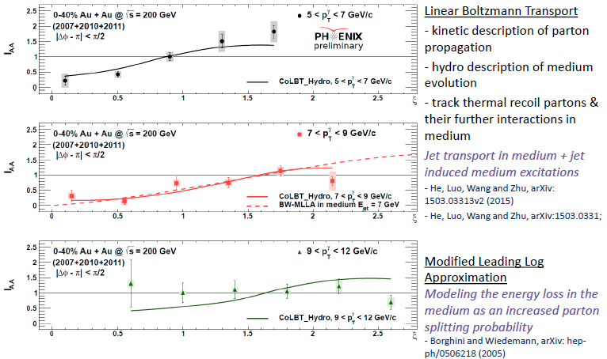
Comparisons to Theory
New calculations by LBT ~match data → enhancement E recovery

Slide 13
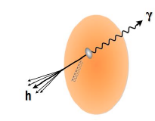
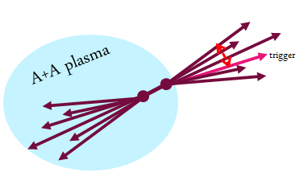
Comparing h-h to γ-h
γ-h is clean but low statistics
h-h should be able to probe similar physics and has more statistics
  but have been limited by lack of confidence in background subtraction
  New bkg subtraction techniques developed starting to gain confidence
Surface bias: but this can be a positive– why it’s good to have both

Slide 14
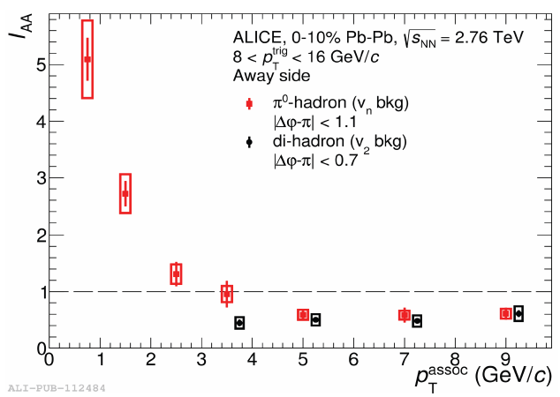
Same features ? accessed in h-h
Statistical precision good enough for low enhancement in PHENIX result
ALICE Xinye Peng HP’16: Interesting new results comparable p_{T} region to PHENIX results – π⁰-h –> very precise
Awayside suppression/enhancement—enhancement is very large !

Slide 15
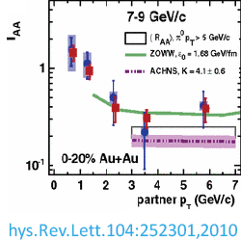
High z enhancement → I_{AA}?
Common point brought up: no enhancement in IAA across all experiments not just PHENIX at high z– why?
PLB 739 (2014) 320–342

Slide 16
Same features ? accessed in h-h
Statistical precision good enough for low enhancement in PHENIX result
ALICE Xinye Peng HP’16: Interesting new results comparable p_{T} region to PHENIX results – π⁰-h
Awayside suppression/enhancement—enhancement is very large !

Slide 17
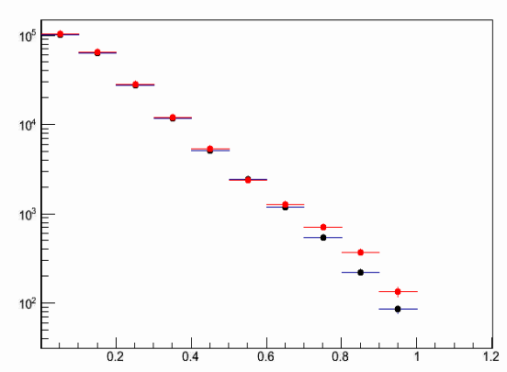
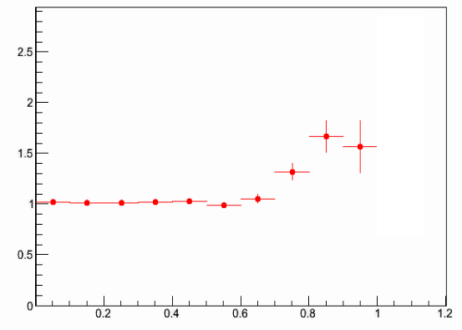

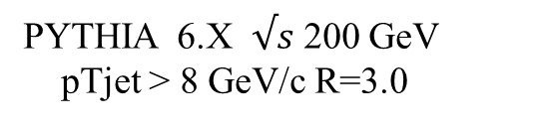
Quick non-PHENIX PYTHIA Study
Presumably it’s washed out by the trigger p_{T} not usually corresponding to the whole jet p_{T}
I wanted to get a quick answer to whether we could see such a thing happen in PYTHIA
  1) Chose sample of p_{T}> 8 GeV R=3.0 jets
  2) Enhanced high z fragmenting jets with simple weights
  3) looked to see if I_{AA} did or didn’t show any difference?
PYTHIA 6.X $√s$ 200 GeV
pTjet > 8 GeV/c R=3.0
$$\frac{dN}{dz}$$
Ratio
Red: High z weighted
Black: Normal
z = p_{Ti} ∙ p_{Tjet}/p_{Tjet}²
z
z

Slide 18
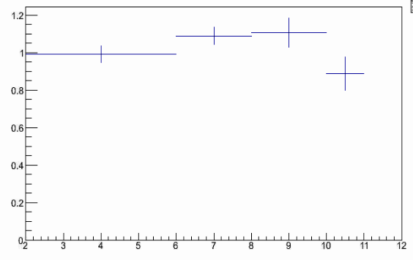
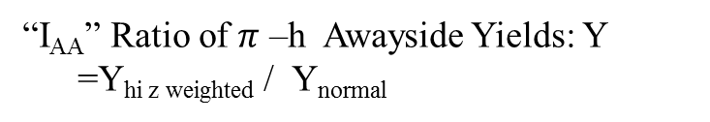
PYTHIA: expect washout?
The Ratio of IAA’s in the same set of events (e.g. same high z weighting) indeed shows a lower modification than the fragmentation function
Still a small rise? But definitely lower than for D(z)
FF Ratio
“IAA Ratio”
D^{hi z wt} (z) / D_{normal}(z)
“I_{AA}” Ratio of $π$ –h Awayside Yields: Y
=Y_{hi z weighted} / Y_{normal}
z
Interesting to follow up this study in more detail…
p_{T assoc}

Slide 19
Back to New PHENIX Measurements!
PHENIX: Remeasure, improve statistics cross check in d+Au
Systematic errors do not allow us to study even cold nuclear effects w/ IAA
  Look to other observables for small systems.
H. Ge HP 16
New data confirms some points “extrapolated” from old data
Recall the Method

Slide 20
p+p/p+A Results
“Cold” non-perturbative QCD studies
Lately QGP in small system? → Jet Eloss too?
Very different focus here!

Slide 21
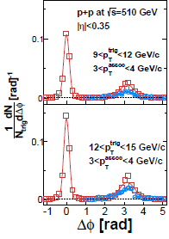
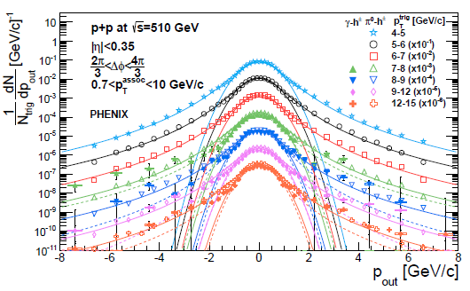


New(er) PHENIX 2p Width Ana p+p/p+A
Instead of I_{AA}: PHENIX 500 GeV Data measure awayside peak widths in terms of p_{out} for both $γ$-h and h-h

Slide 22
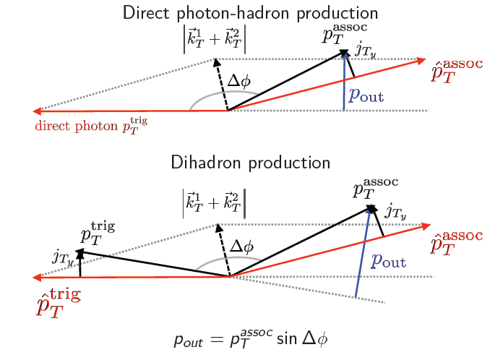
pout γ-h/h-h: different systematics
(nicer than)

Slide 23
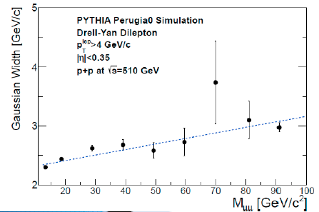
PHENIX 2p Width Ana p+p/p+A
Hard – Soft Boundaries (Separate components)
MOTIVATION: TMD Factorization predicts this peak width broadens w/ hard scale (p_{T})
_{Can we see this?}
Drell-Yan

Slide 24
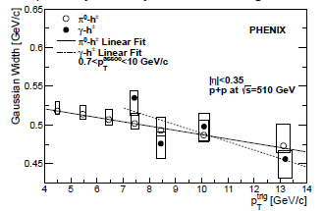
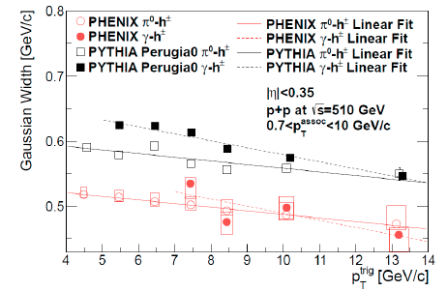
Results : p+p 510 GeV
Both γ-h/h-h yield consistent results – cross check
Widths fall with pT trigger
Reminder
Remember theory expectation was that this should decrease
Current perturbative (e.g. TMD) interpretation underway by theorists.
– interesting twist – PYTHIA reproduces

Slide 25
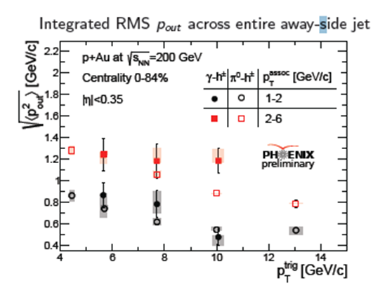
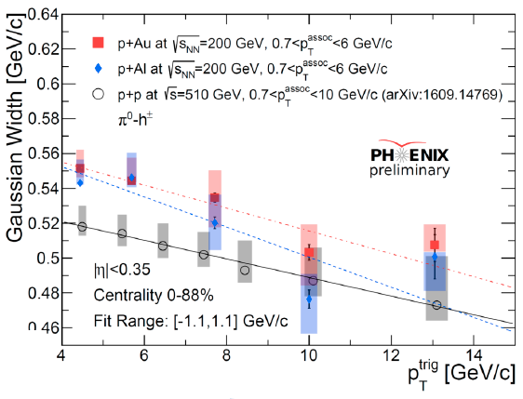
Similar effects in p+A?
Take a look at nuclear systems: stronger Non-perturb gluon effects?
Indeed Same effect but is stronger in p+Au?
Look at slightly higher momentum associated particle: even much stronger effect! Note the different root(s) energy (but should be property of jet scale)
-200 GeV Ana underway: will address another way in a moment

Slide 26
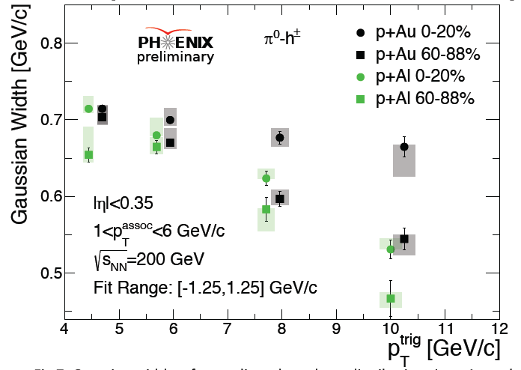
Centrality p+A p_{out} evolution results
First look at set of results discussed at QM’17 Joe Osborn talk
Widths are wider in p+A and wider with larger centrality (seen previously in “k_{T}” measurements)
First RHIC measurement of “CNM” width dependencies on system/centrality !?!

Slide 27
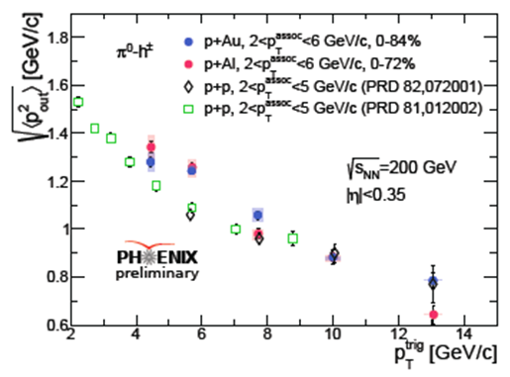
Just a p+p reference issue?
Probably not: use another variable that we have 200 GeV p+p data for--: just total p_{out} RMS
System size difference less, but clear broadening @ ~4 GeV in p+A

Slide 28
Looking towards future & back to HI
This is a nice development!
  Related to ”k_{T} “ physics that has always been hard to understand going back to Tevatron data. -- now with an interested set of theorists!
  Relevant for important EIC physics (TMD’s)
  back to the point about searching for QGP-like Eloss in small systems:
    CNM effects like this probably need understood at a better level if we want a definitive statement on Eloss in small systems

Slide 29
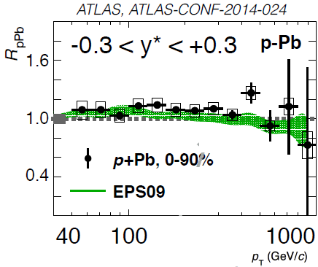
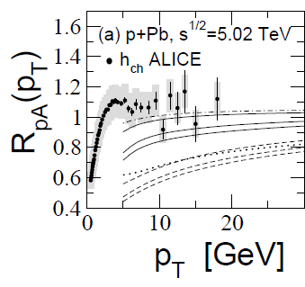
Collectivity in p+A → Eloss too?
Signatures of collectivity in p+A established
Eloss ? Single particle/jet R_{pA} / R_{dA} suffer from “Ncoll” systematics
Eloss signatures could just be too small to see
LOOK @ INTERMEDIATE PT E_{jet} = [5-15] 2pc
Zakarov 1311.1159
Lots of things to be resolved:
Cold Effects +Hot
Can we see more studies like this?

Slide 30
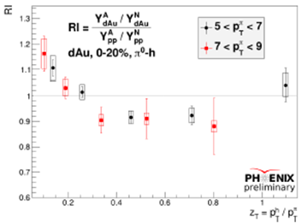
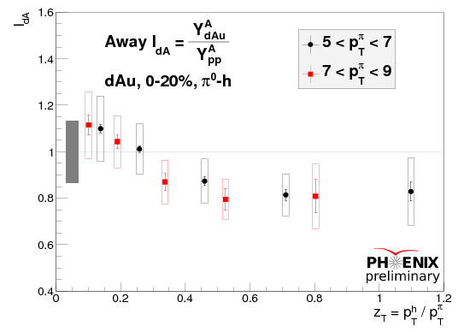
A suppression signature in d+Au?
Reminder: PHENIX RI result in d+Au reminiscent of Au+Au behavior but much smaller.
RI uncertainty cancellations allows statistical significance for small effect
THIS OBSERVABLE IS SENSTIVE TO BROADENING
Input from theory new pout observables → inform Eloss vs cold matter conclusions
Remember
Look here

Slide 31
Conclusions
New 2-particle jet data is available and interesting
New PHENIX Gamma-Jet data confirms previous picture with unresolved question but interesting physics:
  Comparing to STAR AuAu: Interesting CONCLUSIONS from comparison: low Ejet Eloss diff or FragFn Mod function of pt not z-universal
  Still need to check if there’s quantitative tension?
High z rise feature in jet-reco results is likely washed out in 2-p correlations I_{AA}
New g-h/hh pout broadening evolution results from phenix in p+p and p+A have many interesting implications!

Slide 32
Backup

Slide 34
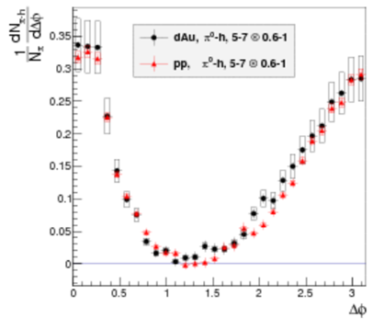

NS/AS Ratios: A Nice Observable for searching for E_{loss} in small systems?
Assume well-known surface bias picture for Au+Au should apply to a smaller d+Au
Look for Differences in Awayside Modification compared to Nearside
A+A plasma
trigger
p+A?
Black
Red

