Slide 1
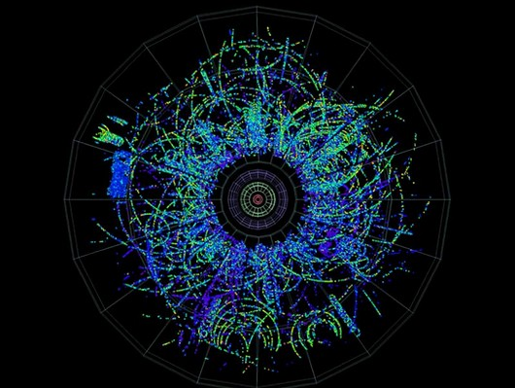
Collectivity in small systems ?
Collectivity in small systems !
Collectivity in small systems !
(depends on what you mean by 'collectivity')
pPb 5.02 TeV
December 2012
Is there collectivity in small dense systems (central pA) ?
What about small dilute systems (MinBias pp) ??
Why does it matter ???

Slide 2
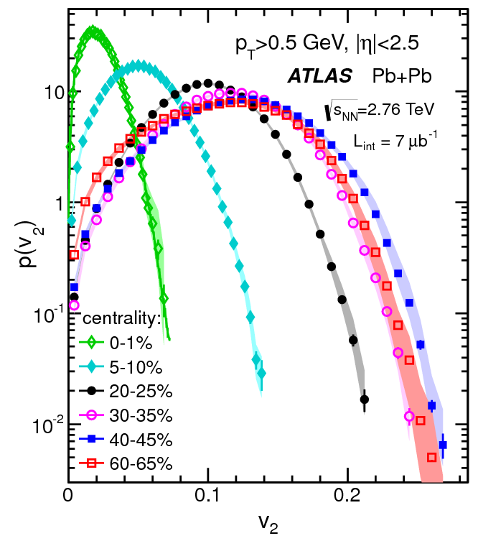
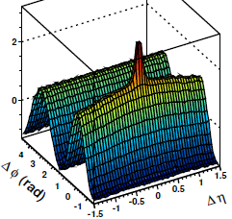
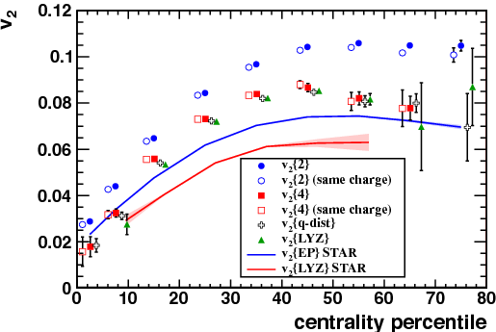
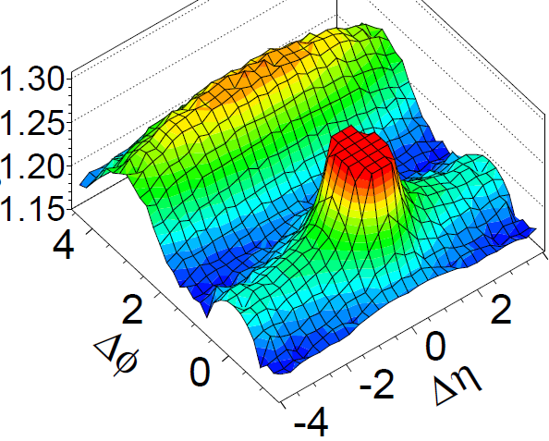
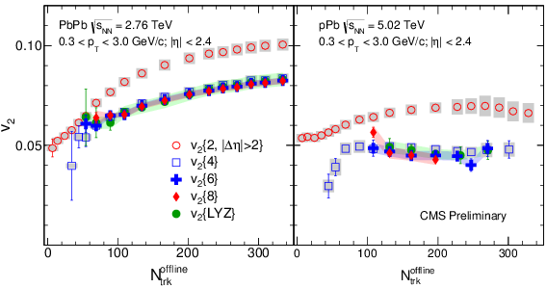
Collectivity
weak definition:
  SIMILAR effect for ALL particles (of some kind, say p_{T}/PID) in (almost) ALL events
  Collectivity is experimentally proven in AA & pA
EbE P(v₂)
'Ridge'
all h± in all events
PbPb 10-20%
'Jet'
some h± in some events
v₂{2}< v₂{4}≈v₂{6}≈ … ≈v₂{∞}
pPb 5 TeV
AA definitely coll.
pA practically certain
Teaser:
are jets in e+e-
'weakly collective' ?

Slide 3
Collectivity in large systems: AA
strong definition: {'thermo' + 'hydro'} - dynamics
  emerging-f(t)- in strongly interacting matter with density/pressure gradients
Collectivity is consistent with ≈ all data in AA to (very) good accuracy
  thermo-dynamics:
    particle ratios (Statistical Model) to 10-30%
  hydro-dynamics:
    LO: radial (v₀) & elliptic (v₂) flow for > 95% of all particles (p_{t} < few GeV)
    NLO: higher harmonics v_{n}, PID (m dependence) of v_{n} ('mode mixing' of v₀ & v₂)
    NNLO: non-linear mode mixing (v_{n}≠ ε_{n}), factorization violation r(p_{T}), EbE P(v_{n}), …
  thermo + hydro:
    HBT f(T, β): (R(m_{T}), R(N_{ch}^{1/3}), R_{out}/R_{side} ≈ 1)
'Standard Model' of heavy ion physics

Slide 4
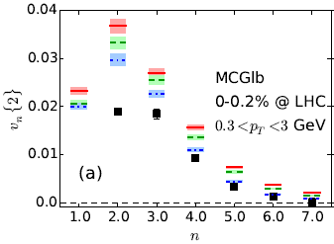

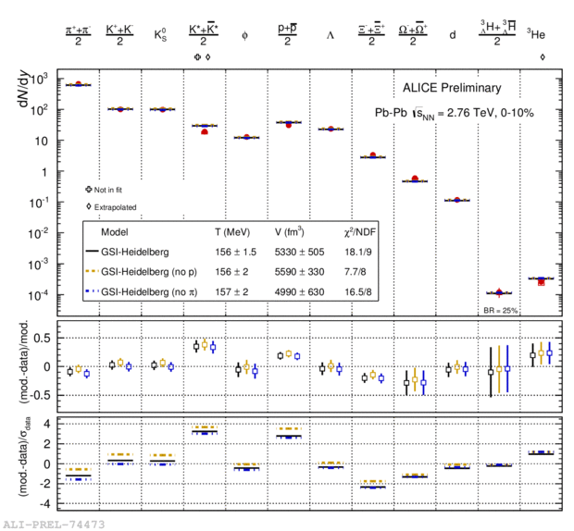
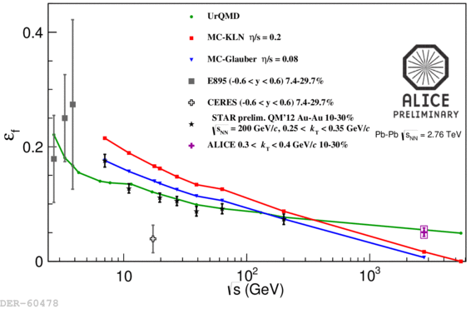
Tensions (presumably work in progress, not cracks)
p/π ratio, ultra-central v_{n}, HBT ε_{f}, …
Ultra-central v_{n}
SM fits to particle ratios
Azimuthal HBT: ε @ freezeout
few, if any(*), doubt that we have 'strong collectivity' in (central) AA
'the ideal liquid sQGP'
* at least until early 2015 http://arxiv.org/abs/1502.05572 .(AMPT ‘escape’ hypothesis)

Slide 5
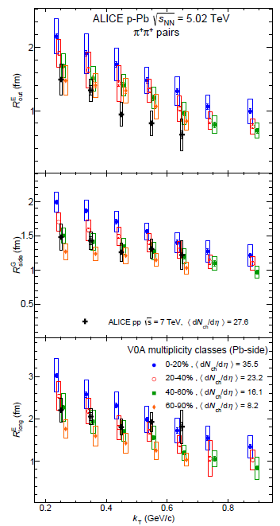
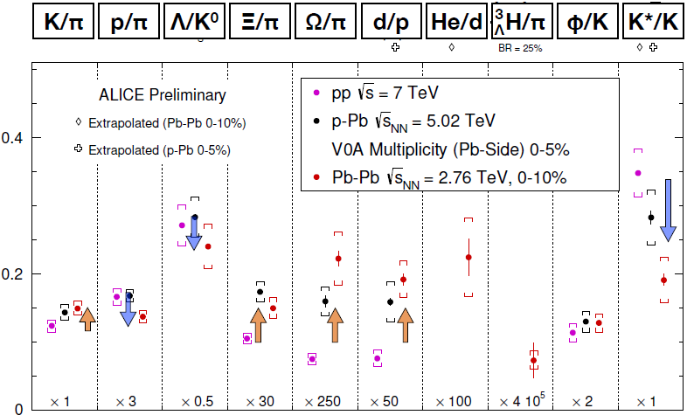
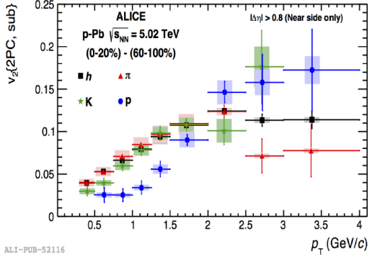
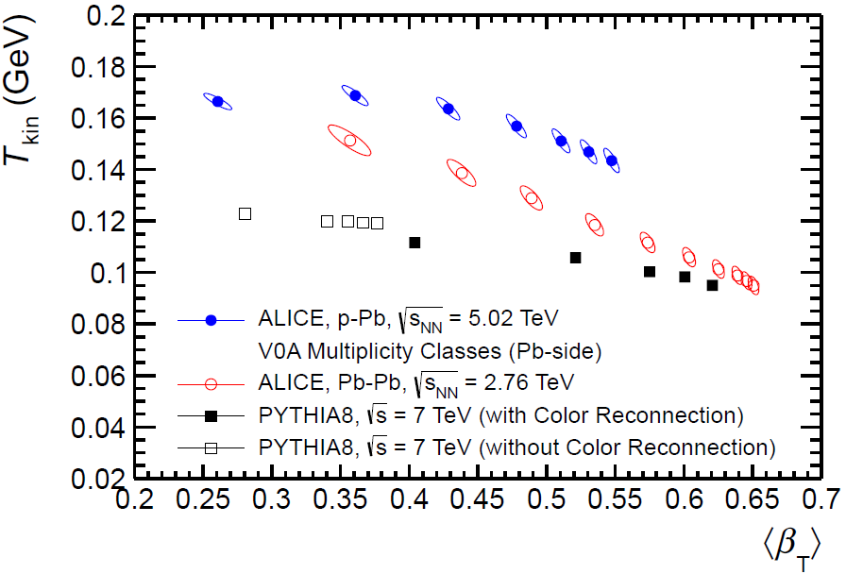
Collectivity in small dense systems: 'central' pA
Collectivity consistent with ≈ all data in central pA to reasonable accuracy
  thermo-dynamics: particle ratios (SM, γ_{s}=1!) to ≈ 20-30%
  hydro-dynamics: pA, dA, ³He-A
    LO: radial & elliptic flow
    NLO: higher harmonics v_{n}, PID v_{n}
    NNLO?: factorization violation r(p_{T})
  thermo + hydro:
    HBT (R(m_{T}), R(N_{ch}^{1/3}), R_{out}/R_{side} ≈ 1)
HBT: R vs K_{T}
NNLO: Factorization test
R_{out}
NLO: PID v₂
The experimental support for 'strong collectivity' is not really worse than AA
only somewhat less tested ..
particle ratios pp, pA, AA
R_{side}
LO: BW fit: T_{kin} vs β
R_{long}

Slide 6
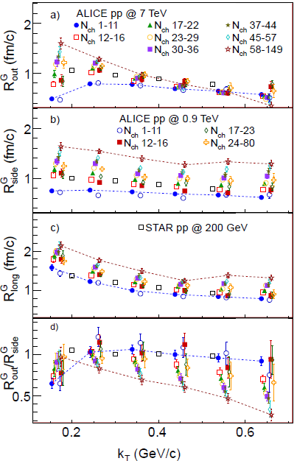
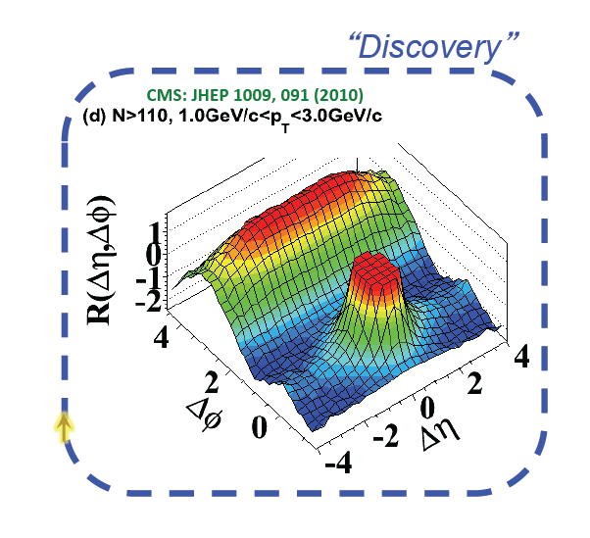
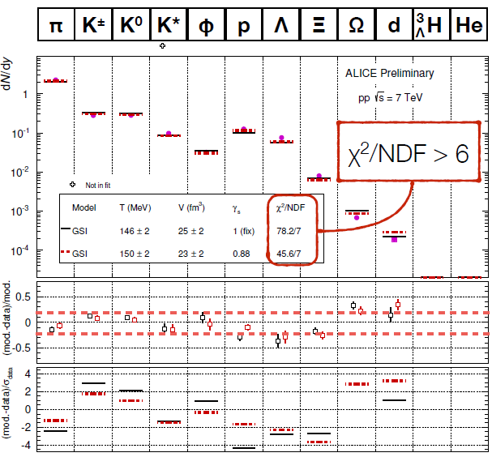
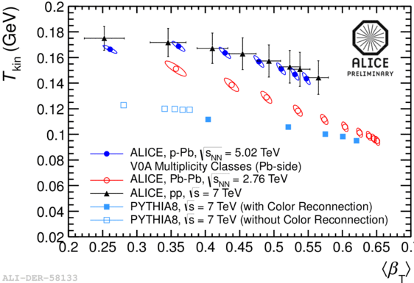
Collectivity in small dense systems: 'central' pp
Collectivity consistent with data in high N_{ch} pp ??
  thermo-dynamics: MB particle ratios to ≈20-40% γ_{s} < 1!
  hydro-dynamics:
    LO: radial & elliptic flow ?
    NLO: not yet tested
    NNLO: not yet tested
  thermo + hydro:
    HBT (R(m_{T}), R(N_{ch}^{1/3}), R_{out}/R_{side} ≤ 1)
HBT: R vs K_{T}
R_{out}
The Ridge
R_{side}
particle ratios pp, pA, AA
particle ratios in MB pp
The experimental support for 'strong collectivity' is much less tested ..
but were it has been tested, at high N_{ch}, it looks not so bad !
R_{long}
BW fit: T_{kin} vs β
R_{out}/R_{side}

Slide 7
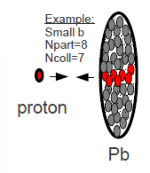
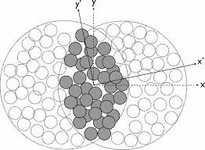
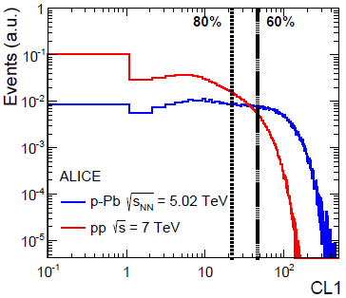
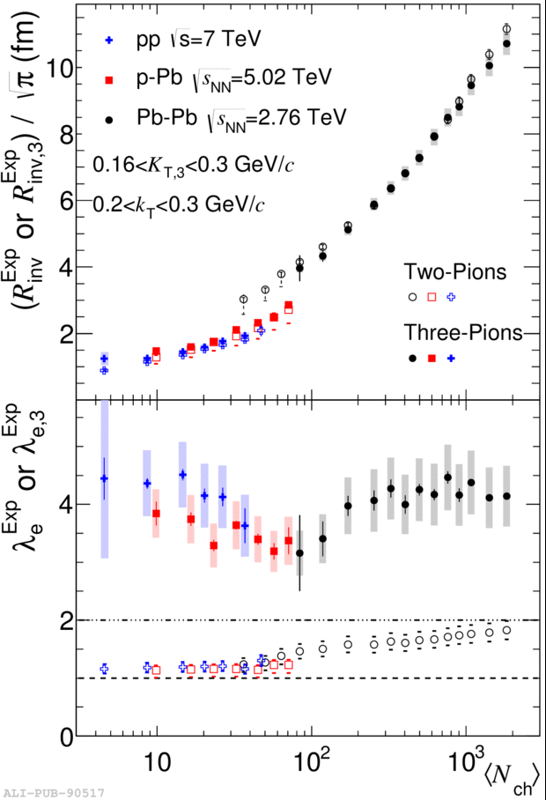
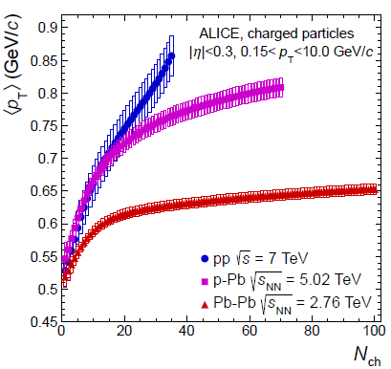
A priori: pp ≈ pA @ same dN/dy
LO pp = pA: N_{ch}, transverse size & shape => Initial State ε(x,y) similar:
  experimentally verified: final state R(pp) ≈ R(pA) < R(AA) @ same N_{ch} (≈ N_{part})
  IF there is collectivity in central pA, THEN there is no reason why not in 'central' pp
NLO pp ≠ pA: some differences expected
  MPI vs N_{coll}, transverse ε-profile,
  dσ/dN => bias, jet fraction, ..
<p_{T}> vs N_{ch}
HBT:
R vs N_{ch}
BW fit: T_{kin} vs β
pp closer to pA than pA to AA
as expected…

Slide 8
Facts & 'Fiction'
Experimental facts:
  weak collectivity proven in AA, essentially proven in pA, not known in pp
    'all particles in all events' must be part of any physics model
  strong coll. (thermo & hydro) compatible with vast majority of data in AA & pA
    some areas need work, some tests missing in pA (NNLO)
  limited data in pp at high N_{ch}, but compatible with SC !
    final state (HBT, p_{T}-spectra (v₀), ridge (v₂), part. ratios ): pp ≈ pA @ same N_{ch}
Hypothesis: There IS* collectivity in small systems at high N_{ch} !
  1) pA ≈ AA: mostly based on measurements (@same N_{ch})
    many similar phenomena <=> similar underlying physics
  2) pp ≈ pA: based on a priori expectations, increasingly on measurements
    similar IS & FS in pp and pA @ same dN/dy => similar collective physics
    mind the jet-bias in pp !
  3) ≈ ≠ =: differences are interesting and important to study !
    finite size/finite time/non-equilibrium effects teach us about dynamics
* of the same type as in large systems, i.e. AA

Slide 9
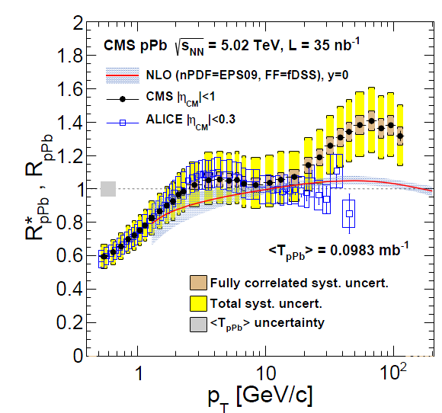
What about ‘hard Probes’ ?
Conventional Wisdom: Not (non-trivially) modified in pA, pp
  beware of confounding CNM effects & limited accuracy !!
    how to disentangle IS/CNM from sQGP in pp/pA if there is no comparison data ?
  only quantitative comparison between expectation(theory) and data will tell !!
    how much jet-quenching/quarkonia melting would actually be expected ??
J/Ψ & Ψ’ R_{pA} vs p_{T}
Syst. error in MB ~ ±10-20%

Slide 10
pA ≈ AA: Objections
sQGP: no ideal liquid w/o jet-quenching (energy loss) (conformal scaling ?)
  hydro is dimensionless (K_{n} = λ/R << 1),
    R = 1-2 fm may be big: τ₀(<0.2 fm/c?), η/S ≈ 0 => λ ≈ 0; 1/<p_{t}> ≈ 0.3 fm
  energy loss has dimension: ΔE ~ (Δx-a)^{n}, Δx = path length, a = formation length
    ΔE_{pA} > 1/5 x ΔE_{AA} (n = 1, a = 0), and possibly much more
    is measured R_{pPb} (in)compatible with quantitative expectations for ΔE ?
hydro not applicable (large K_{n}, large gradient/viscosity corrections, ..)
  Why then does it still give a ‘correct’ answer ??
  we may need different TH tools, not necessarily different physics ?
    'hydro' : physics driven by gradients in SI matter
    smoothly extends into 'partial hydro/decoupling/non-equilibrium' regime ?
difference is size is significant, but not huge !
  made up (largely ?) by higher density ?
Thermalisation study
1601.03283

Slide 11
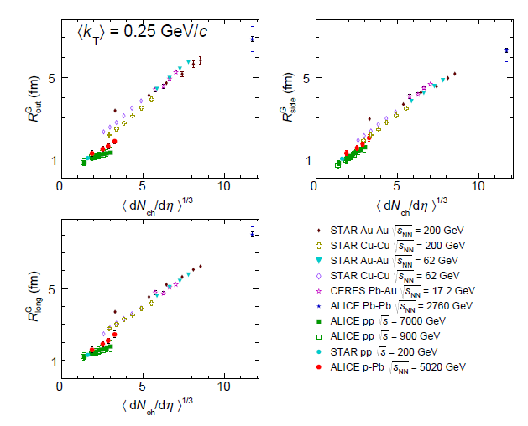
HBT radii pp, pA, AA
R_{CuCu}^{RHIC} ≈ 2R_{pPB}^{LHC} ≈ pp

Slide 12
pA ≈ AA: Objections
similar phenomena ≠> same physics
  counter examples:
    elliptic flow: v₂(< 2 GeV) = hydro (Δρ/Δx), v₂(> 10 GeV) quenching (ρ)
    linked by geometry and SI matter, but driven by distinct physics
    radial flow: AA hydro, pp: Color Reconnection ?
      'hydrodynamics' similar (emission from boosted system T, β), dynamics different
  likelihood argument: better if many independent phenomena are involved
    'razor': What looks more natural & simple: different or similar physics ?
  we should not jump to conclusions, either way, but …

Slide 13



Is it a Rose ?
Summary Part I:
similar phenomenology (measured or expected) in
pp, pA and AA
likely based on similar physics:
inhomogeneous, dense, strongly interacting matter
SM: drop of ideal liquid sQGP: thermo + hydro dynamics
B-SM: cloud of grey/black mist (sMOG): non-eq. kinetics 1502.05572
If it looks like a rose
+ smells, + feels,
+ pricks, + tastes, + .. like a rose

Slide 14
II) Why is it interesting ?
'Looking under the hood': what makes the sQGP tick ?
  stat. mechanics (thermo & hydro) hide very well the details: d.o.f & dynamics
    strength & limitation: same results for different underlying 'stuff' (theories/models)
    thermal system knows nothing about how and why it arrived in equilibrium
  go towards and beyond the limits of thermo & hydro
    study deviations due to finite size/finite time (=> small systems)
'Looking for the transition': how does collectivity emerge f(r, t) ?
  change size & lifetime & density (pp -> pA -> AA)
'Looking for the beginning': universal aspects of soft QCQ ?
  looking for connection & smooth evolution from
  MB pp(e⁺e⁻) to central AA, with pA the bridge in between

Slide 15
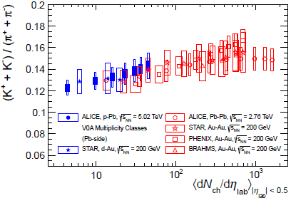
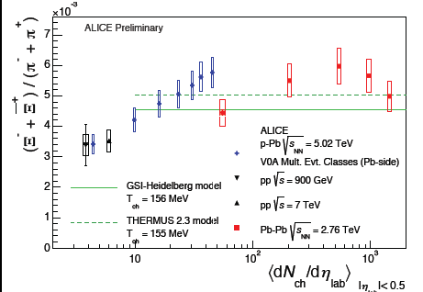
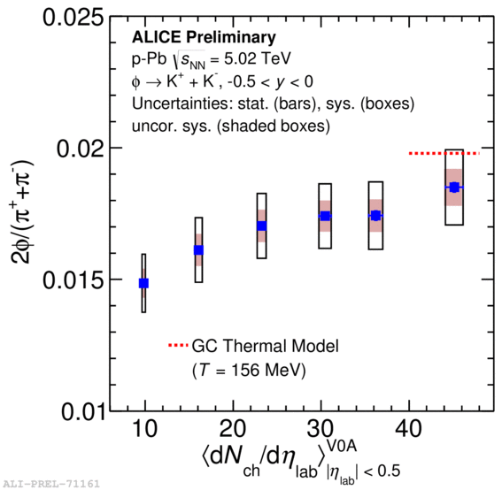
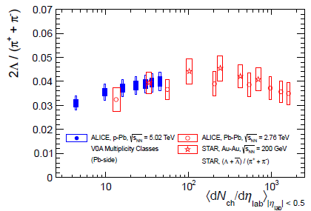
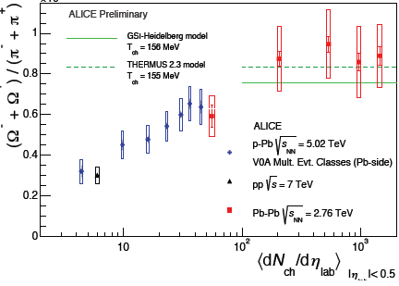
Strange Developments in pA
'strangeness enhancement'
all particles reach thermal values, EXCEPT Ω ?
phi follows neither γ_{s} nor r_{c} model ?

Slide 16
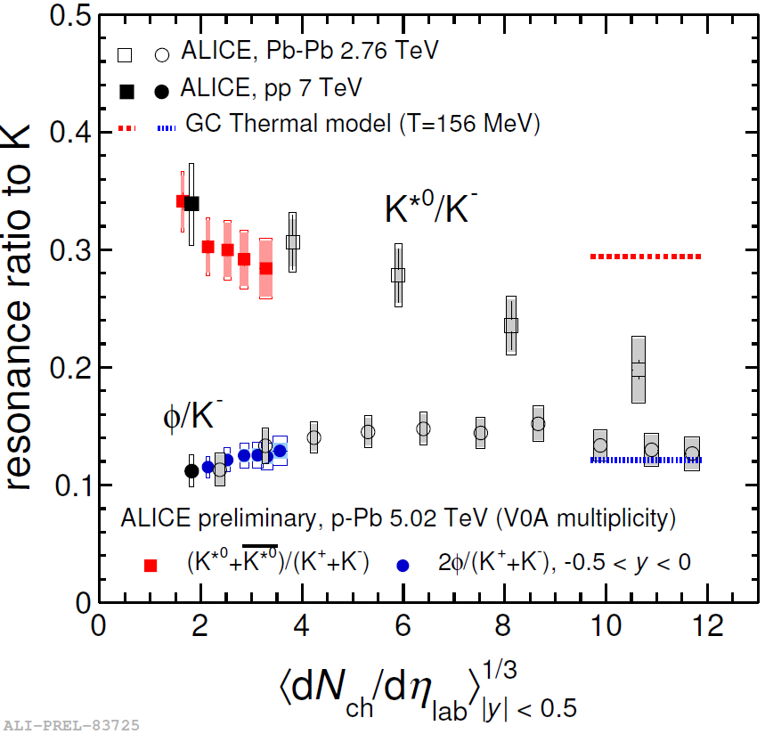
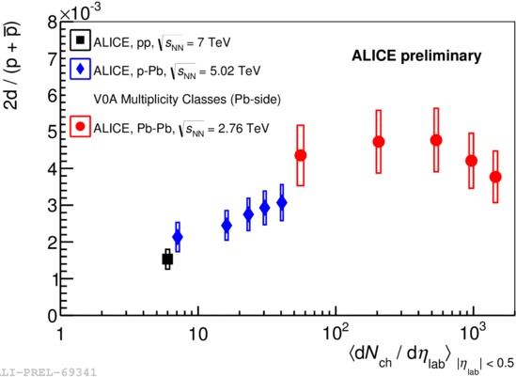
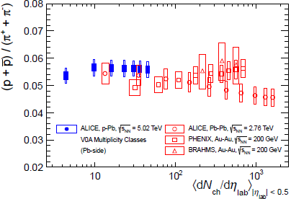
Other ‘Developments’
Final state chemistry ?
  K* : decay + scattering
    or sequential freeze-out (lower T_{chem})
  p/π: B annihilation (= seq. freezeout)
light nuclei d,(³He)
  pp x 2, reaches ≈ SM value
  canonical suppression ?
  Coalesence ? (but B₂(N_{ch}) ≠ c ?)
do we see dynamics at work
while reaching (leaving) thermodynamics ??

Slide 17
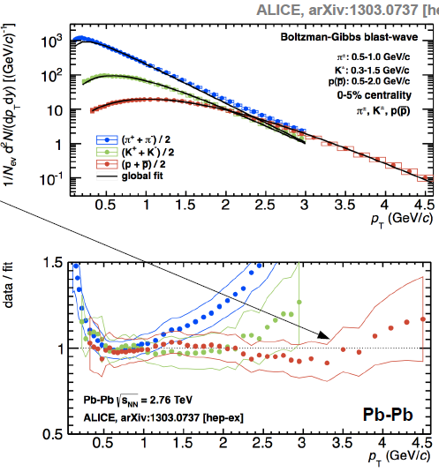
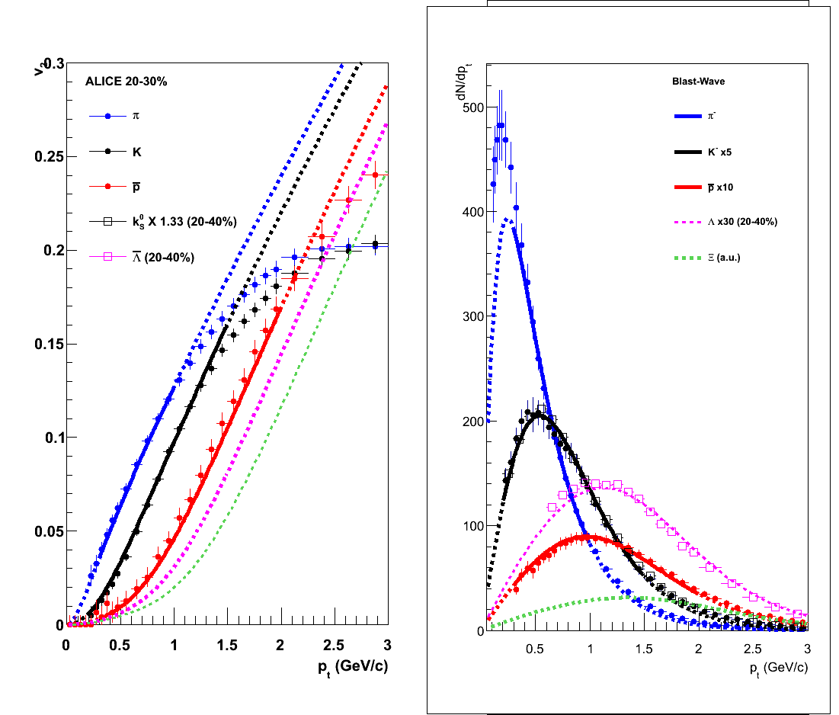
Hydro in PbPb
ideal (BW) hydro ≈ ok < 1-2 GeV(p, K), > 3-4 GeV (p, Λ, ..) in both p_{T} and v₂
  deviations above: 'smooth decoupling ?'

Slide 18
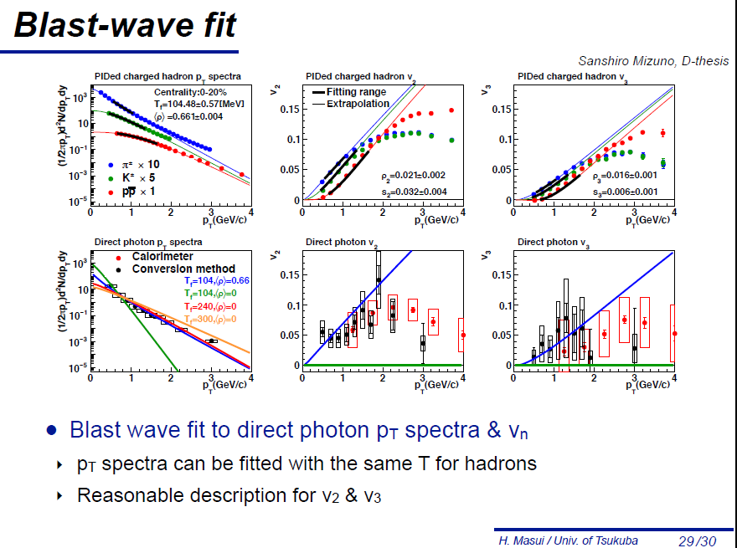
https://n-ext.inha.ac.kr/indico/event/13/contribution/14/material/slides/0.pdf
'Decoupling' at RHIC at somewhat lower p_{T}

Slide 19
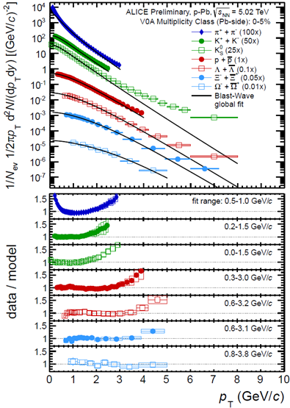
Radial Flow in pPb
earlier 'decoupling'
T_{kin} ≈ T_{chem}
β,T_{kin}(π,K,p) ≈ β,T_{kin}(Ξ, Ω)
(d, 3He) in PbPb compatible with flow
d in pPb compatible with coalescence
no (or little) hadronic rescattering ?
clear & direct view on the sQGP ??

Slide 20
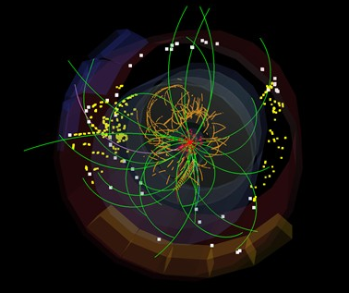
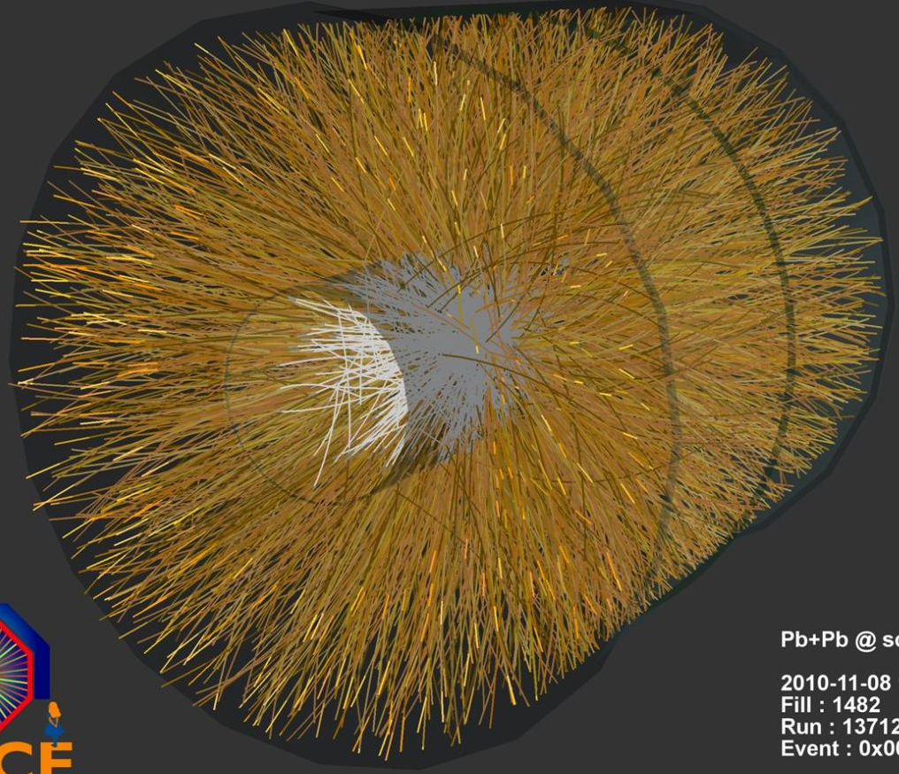
Natures challenge to HI physics
?
=
7 TeV pp Min Bias
> 2013: central pA ~ peripheral AA
(largely) accepted & assimilated : small droplet of sQGP (-like) stuff
conformal invariance, hydro & thermo ‘at its limits’
> QM 2015: no end in sight ?
Thermo & hydro in MinBias pp ??

Slide 21
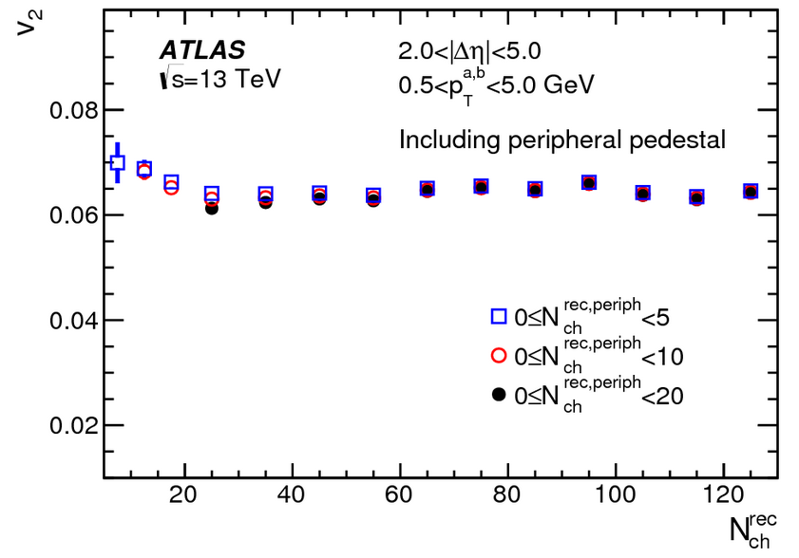
Continuous & smooth down to dN/dy ~ 0 !
‘Elliptic flow’
‘Radial flow’
MinBias N_{rec} ~ 15
‘Hadrochemistry’
Charge Balance Functions
HBT
k_{T} dependence

Slide 22
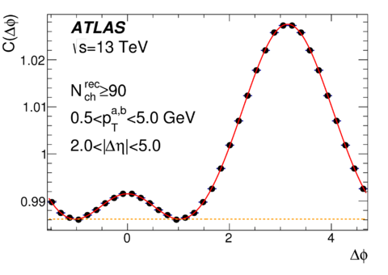
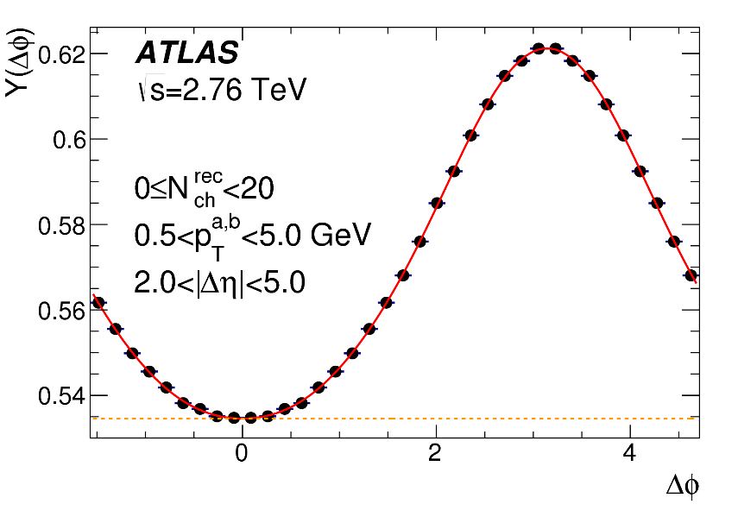
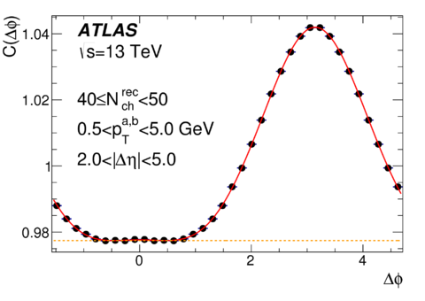
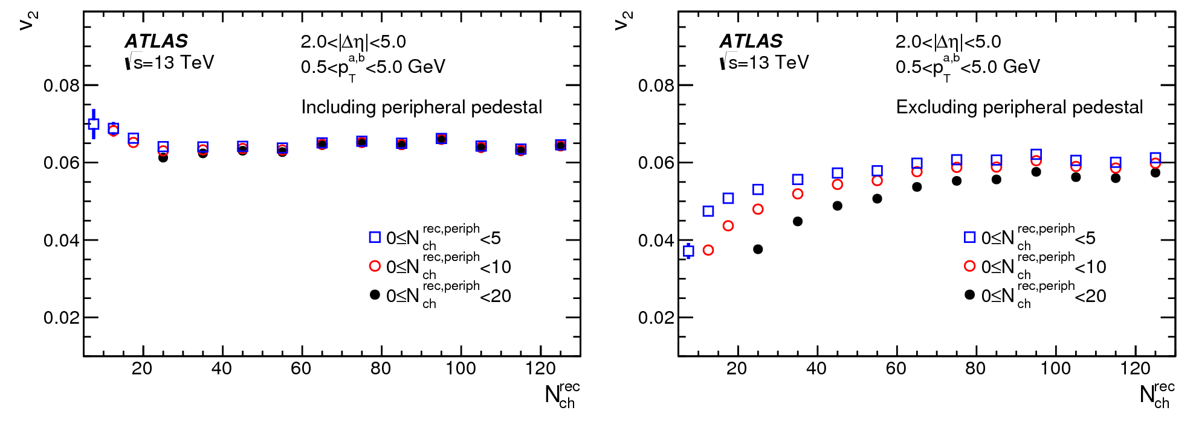
Need to know what to look for..

Slide 23
‘Continuum Physics’
Continuity/similarity between large/dense & small/dilute systems
  ‘so-so’: different physics (e.g. IS <-> FS) happens to have same phenomenology
    different physics for different observables (CR -> radial flow, CGC -> elliptic fl.) ?
  ‘RiaR’: same underlying strong interaction dynamics for all systems/observables
    most economic, should be tried unless/until shown to be insufficient
S-Canonical: physics the same, volume different
What exactly IS the (microscopic) physics ?
Phase Space or Dynamics ?? (1601.01454)
Hadronic or Partonic ?? (φ)
What connection, if any, between thermo & hydro ?
pp:pA:AA
dN/dy= 1:10:100
dN/dy^{1/3}= 1:2:5
JYO: http://arxiv.org/abs/1106.4356
D. Teany http://arxiv.org/abs/1312.6770

Slide 24

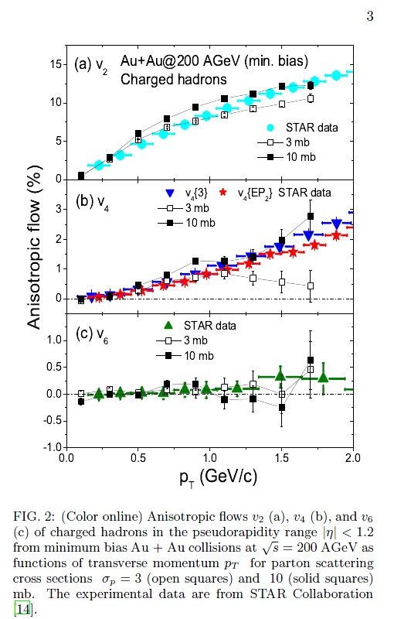
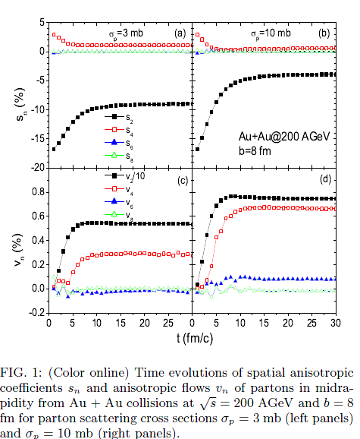
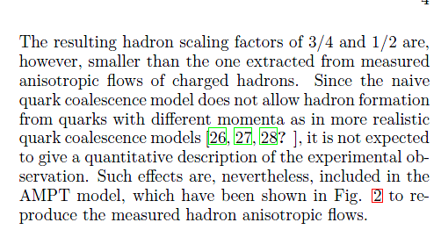
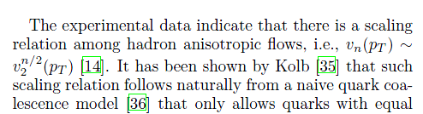
The unreasonable success of AMPT
nucl-th/0312124
AMPT in 2003 had correct higher harmonics (v₃, v₄, ..)
i.e. initial state fluctuations and nonlinear hydro,
and nobody noticed !!

Slide 25
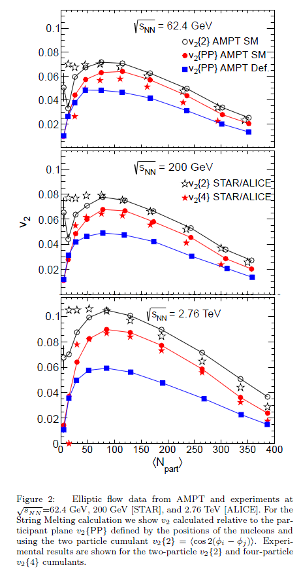
Almost as good as hydro
NNLO: mode mixing in EP correlations
http://arxiv.org/abs/1210.0512
LO: v₂
1508.03306

Slide 26
No problem with small systems
http://arxiv.org/abs/1404.4129

Slide 27
Double humped near side peak shape

Slide 28
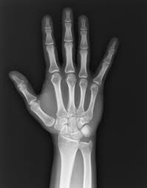
What makes AMPT tick ?
Dynamics is definitely oversimplified and probably wrong
                ‘Micky Mouse billiard balls’ with tons of parameters
  however, the hydrodynamics seems correct !
    what counts is ‘lots of interacting stuff’ (string melting + few mb σ)
Common wisdom: AMPT = (a) kinetic transport underlying hydro
  and as such smoothly extrapolates to dilute & small systems with large K
Monkey wrench: ‘Anisotropic parton escape is the dominant source’ (1502.05572)
escaping
d-Au
interacting
Au-Au
Information is in the
‘non-interacting’ rays !
<N_{col}> = 5 (1) in AuAu(dAu)

Slide 29
Pressure or Density tomography ?
sQGP Hydro model:
  IS density homogeneities => pressure gradients => momentum anisotropy => spatial anisotropy dN/dφ
  requires strong FSI, dense & large systems (small #K), low visc. ‘ideal liquid’
sMOG X-ray model: sMOG=Mist Of Gray stuff
  IS density homogeneities => direct image by scattering
  requires some FSI
    no problem with small or dilute systems (dilute = small contrast)
Open questions for X-ray model:
  is a) and b) actually really different ?
  radial flow ? mass dependence of v₂ ? HBT Space-time correlation ?
    ‘free streaming + late Cooper-Frye’ = radial flow + HBT (1504.02529)
sQGP or sMOG:
Crucial question in our field, which (for me) is not sufficiently seriously discussed..

Slide 30
Questions from small & dilute systems
Acknowledge and ‘explain’ the size/density systematics
  Factorize and separate into different pp and AA physics (eg CR , hydro) ?
    naturally & economically, without epicycles..
    where to put pA ?
  Incorporate into the current thermo & hydro sQGP ‘ideal liquid’ picture ?
    extend the ‘dense matter’ framework down to zero density ?
    extend the ‘dilute transport’ framework up to central AA ? (AMPT like ?)
    ‘probabilistic’ hydro (#/coll/particle << 1) ? Ok for thermo (< 1 Omega/evt even in 4π at SPS)
  Require paradigm shift ?
    different but unified view(model/interpretation, ..) of soft multi-particle QCD

Slide 31
Summary Hypothesis: The physics underlying 'collectivity' signals is the same in AA, pA, and pp:
It is a generic property of all strongly interacting many-body systems.
MANY similar/identical observations(@ similar N_{ch}), no inconsistency (?), ..
  1) particle ratios (γ_{s} -> 1)
  2) p_{T}-spectra (radial flow),
  3) anisotropic flow: v_{n} ~ ε_{n}, v_{n}(p, d, ³He), v_{n}(b), v_{n}(p_{T}), v₂(LYZ), v_{n}(PID)
  4) HBT r(N_{ch}, m_{T})
.. make the hypothesis increasingly more likely (but not proven, yet !)
  a most 'natural' assumption, to be proven wrong rather than right
  subtle is the lord, but malicious he is not
What is is the 'underlying dynamical physics' ?
  sQGP: thermo + hydro dynamics ('at the edge') ?
  sMOG: strongly interacting FS matter with density gradients (1502.05572)
  CGC+CR+.: weakly int. dense IS matter + some conspiracies (also in AA !!)
  ???
Why should we care ?
  leave the comfort zone of infinite size equilibrium to study dynamics
    from small & dilute -> large & dense: emergence & limits of 'collectivity'
  looking 'under the hood' is mandatory, whatever we may find !

Slide 32
backup

Slide 33

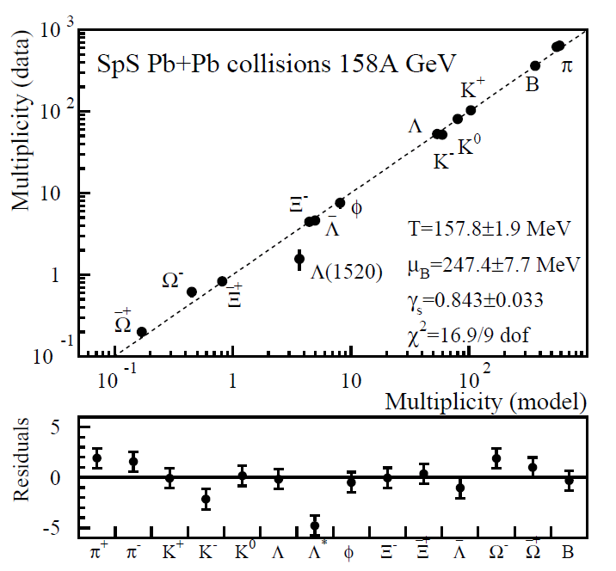

pp-pA-AA: Similarities & Differences
Similar Particle Production
  Striking & very non-trivial similarities between pp(e+e-) and AA
  Striking & very non-trivial difference ('strangeness enhancement):
Different Explanations & no connection (in general):
  Born (pp) <-> Evolving (AA) into equilibrium
  γ_{s}(GC) or r_{c} (SC) are fudge factors , i.e. not predicted/calculable as f(√(s),dn/dy, ..)
  Core-Corona: e⁺e⁻ and pp ??
PbPb SPS
e⁺e⁻ LEP
Particle Production:
Data versus Thermal Model

Slide 34




Known, but often ignored
No quantitative interpretation which smoothly describes small & large
  despite evident relevance for understanding HOW we reach thermal ratios..
pp, dA, AA RHIC
pp 200 GeV
Particle production:
Data /Thermal Model
Particle production:
γ_{s} vs dN_{ch}/dy
Star http://arxiv.org/abs/0808.2041
Phenix http://arxiv.org/abs/1005.3674
STAR http://arxiv.org/abs/nucl-ex/0607033

Slide 35



Momentum Spectra
Known, but not really understood
pp, dA, AA RHIC
Radial Flow fit (BW):
T & <β> vs dN_{ch}/dy
pp 200 GeV
Radial Flow fit (BW):
Data/Fit (π,K,p)
Star http://arxiv.org/abs/0808.2041

Slide 36







BW + Resonances (DRAGON 1502.01247)
Qual. similar, quant. diff.
π/K to 2-2.5 GeV
p to > 4.5 GeV
(Φ,Λ), Ξ, Ω require
higher T, lower β
(like at RHIC)
K⁰
p
φ

Slide 37




Real Hydro: IP-Glasma + Music (1502.016750)
Data/Model (almost too perfect !)
  note that low p_{T} pion excess !!

Slide 38



Real Hydro Comparison
Hydro + AB does very well
(T, β, v_{n})
VISHNU(Hydro + URQMD)1501.03286,
AfterBurner important:
incr. radial flow in hadron phase
=> explain differential freeze-out T_{kin} ?
=> meson-baryon crossing in v₂ ?
Would be interesting to see where data & (hydro + AB) deviate:
- Does it coincide in p_{T} & v_{n}
- Higher decoupling p_{T} for large mass ?
Ξ

Slide 39



What happens after Hydro ?
mass matters, up to a point (again, p_{T} ≈ v₂)..
  presumably, 'falling out of hydro' is a smooth process (over large p_{T} range)
    do we need new physics (eg coalescence) at intermediate p_{T} (4-10 GeV) ?
    or a smooth transition between hydro and jets ?

Slide 40



Will the φ tell ?
NCQ scaling in 40-50%
or
it's breaking in 10-20%
could be a (m, σ) effect in the HG !
If only we could switch off the HG..
φ = p
HG push ?
HG push on p ?
φ = p
HG push ?
φ = π
NCQ scaling ?

