Slide 1

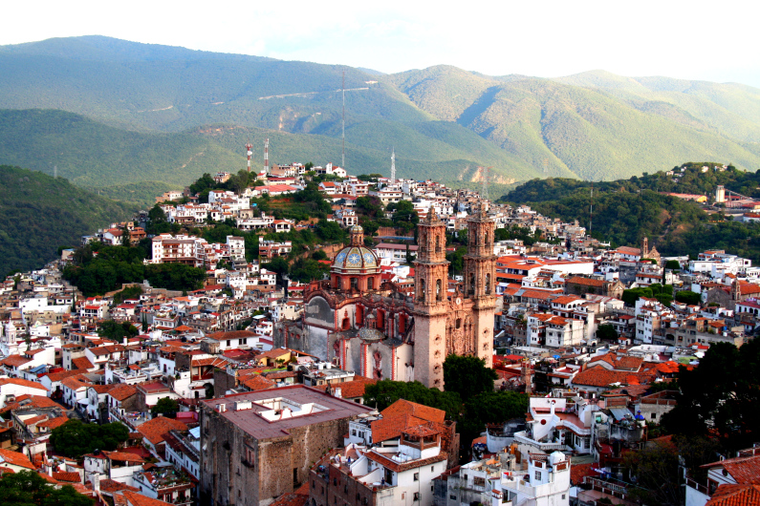
Geometrical scaling in hadronic collisions
Michał Praszałowicz
M. Smoluchowski Inst. of Physics
Jagiellonian University, Kraków, Poland
Taxco 20.01.2016.

Slide 2
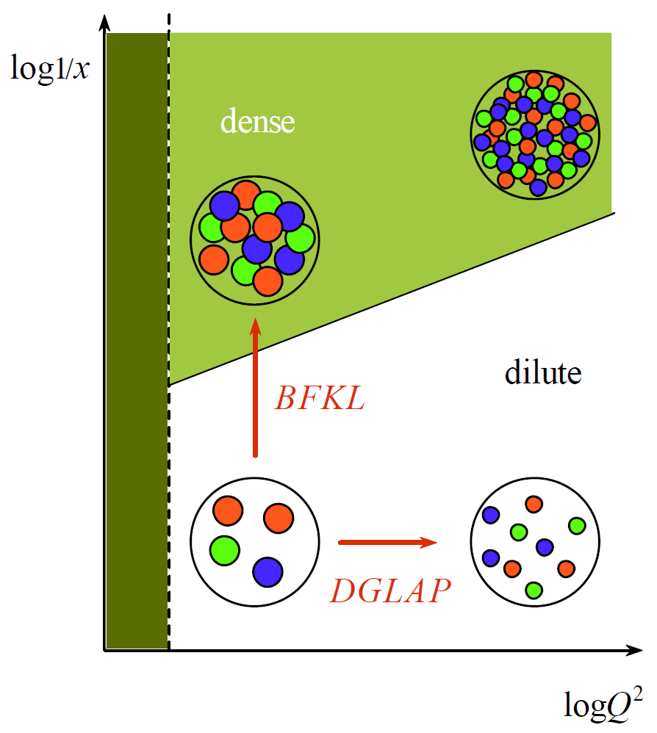

DGLAP vs BFKL Evolution
small x
large W
Y =
Balitsky, Fadin,
Kuraev, Lipatov
Balitsky, Kovchegov
Balitski-Kovchegov (BK)
large x
small W

Slide 3
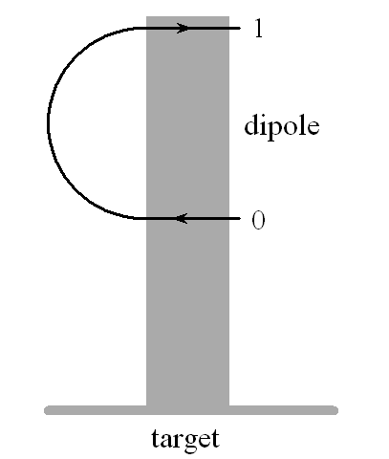

Dipole Picture
BFKL equation has very simple form and interpretation in the
dipole picture of A. Mueller
A.H. Mueller and J.-w. Qiu,
Nucl. Phys. B 268 (1986) 427
Y = log 1/x

Slide 4
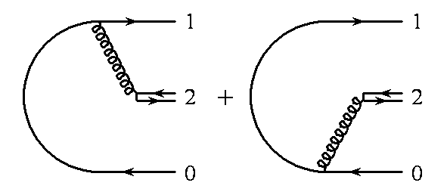
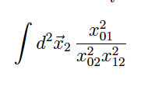
Gluon Emission in the Dipole Picture
large N_{c}
dipole emission kernel is very simple
reproduces BFKL equation

Slide 5
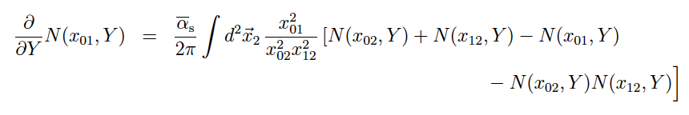



BK Equation
Y.V. Kovchegov, Phys. Rev. D 61 (2000) 074018
rewrite in terms of a Fourier transform:
here χ is a BFKL characteristic function
there exists a theorem from the ‘30 (Fisher, Kolomogorov, Petrovsky, Piscounov)
that non-linear equations of this sort have asymptotically travelling wave solutions

Slide 6

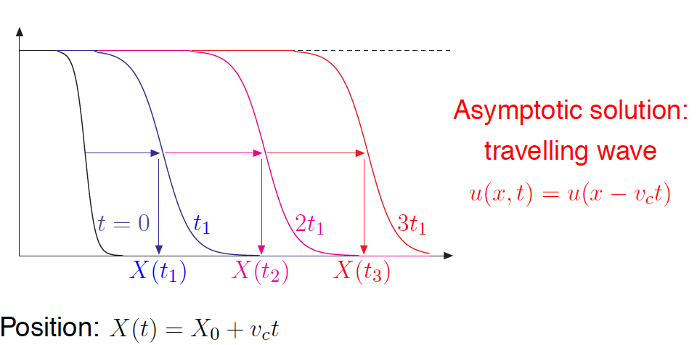
Travelling waves
S. Munier, R.B. Peschanski
PRL 91 (2003) 232001
PRD 69 (2004) 034008
identify
1937
u(x,t)
x
© G. Soyez

Slide 7
Travelling waves
S. Munier, R.B. Peschanski
PRL 91 (2003) 232001
PRD 69 (2004) 034008
identify
1937
u(x,t)
© G. Soyez

Slide 8
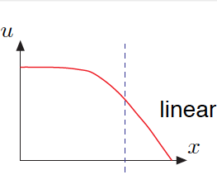
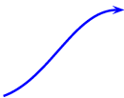




Travelling waves
same as
initial
contition
© G. Soyez

Slide 9


Travelling waves
same as
initial
contition
velocity:
© G. Soyez

Slide 10

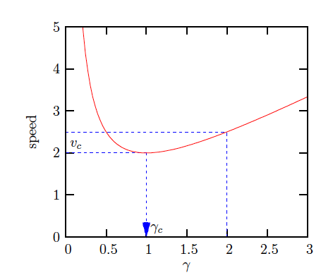
Travelling waves
slowest mode γ_{c}
fast
mode
solution is driven by the slowest mode

Slide 11


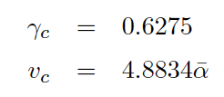
Travelling waves in QCD
Mellin transform:
minimal velocity:

Slide 12

Travelling waves in QCD
Mellin transform:
minimal velocity:
travelling wave condition:
Y = log 1/x

Slide 13

Travelling waves in QCD
Mellin transform:
minimal velocity:
travelling wave condition:
scaling
variable
saturation scale:

Slide 14
Conlusions
Nonlinear BK equation generates sauration scale Q_{s}(x)

Slide 15
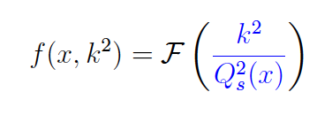
Travelling waves in QCD imply Geometrical Scaling

Slide 16
Conlusions
Nonlinear BK equation generates sauration scale Q_{s}(x)
In the region with no other scales Geometrical Scaling emerges

Slide 17
Deep Inealstic Scattering

Slide 18

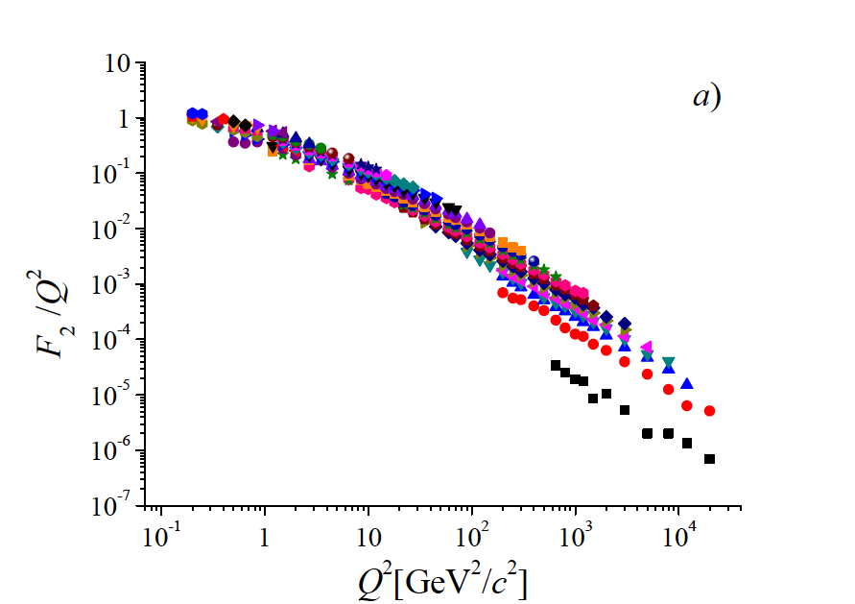
Saturation scale: energy and x dependence
A.M. Stasto, K. J. Golec-Biernat,
J. Kwiecinski
PRL 86 (2001) 596-599
M.Praszalowicz and T.Stebel
JHEP 1303, 090 (2013)
arXiv:1211.5305 [hep-ph]
and
JHEP 1304, 169 (2013)
arXiv:1302.4227 [hep-ph]

Slide 19

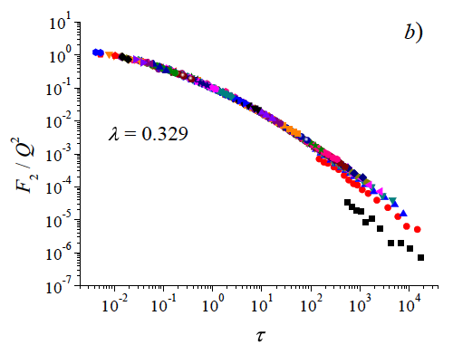
Saturation scale: energy and x dependence
λ = 0.329 ± 0.005
up to x = 0.08 (!)
large x
more ”sophisticated” scaling
variables do not work well

Slide 20
Conlusions
Nonlinear BK equation generates sauration scale Q_{s}(x)
In the region with no other scales Geometrical Scaling emerges
GS works well in DIS up to relatively large x ~ 0.08 with λ ~ 0.33

Slide 21
proton-proton @ LHC

Slide 22

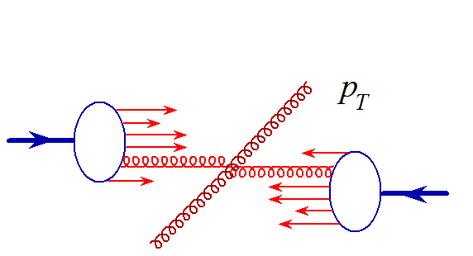

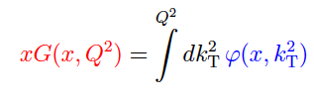
Basics of geometrical scaling
Gribov, Levin Ryskin, High p_{T} Hadrons In The Pionization Region In QCD. Phys.Lett.B100:173-176,1981.
gluon distribution
unintegrated glue
Kharzeev, Levin
Phys.Lett.B523:79-87,2001.
Notes:
Parton-hadron duality

Slide 23


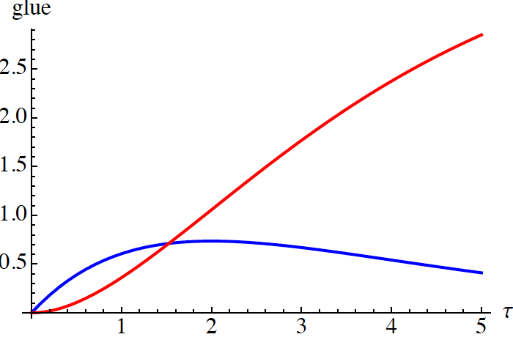
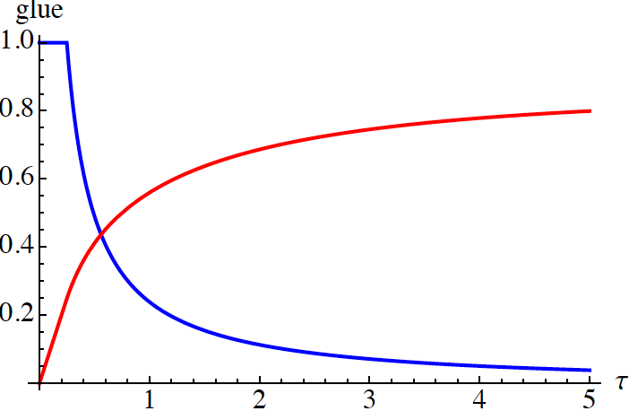

Basics of geometrical scaling
gluon distribution
unintegrated glue
Golec-Biernat – Wuesthoff (DIS) Kharzeev – Levin (AA)
scaling variable

Slide 24

Basics of geometrical scaling
for y ~ 0 (central rapidity) i.e. for x₁ ~ x₂ = x and for symmetric systems

Slide 25



Basics of geometrical scaling
for y ~ 0 (central rapidity) i.e. for x₁ ~ x₂ = x and for symmetric systems

Slide 26


Basics of geometrical scaling
for y ~ 0 (central rapidity) i.e. for x₁ ~ x₂ = x and for symmetric systems

Slide 27

Basics of geometrical scaling
for y ~ 0 (central rapidity) i.e. for x₁ ~ x₂ = x and for symmetric systems

Slide 28

Basics of geometrical scaling
for y ~ 0 (central rapidity) i.e. for x₁ ~ x₂ = x and for symmetric systems

Slide 29
Basics of geometrical scaling
for y ~ 0 (central rapidity) i.e. for x₁ ~ x₂ = x and for symmetric systems
saturation scale = gluon density
per transverse area

Slide 30
Basics of geometrical scaling
for y ~ 0 (central rapidity) i.e. for x₁ ~ x₂ = x and for symmetric systems
parton – hadron duality:
power-like growth of
particle multiplicity
saturation scale = gluon density
per transverse area

Slide 32
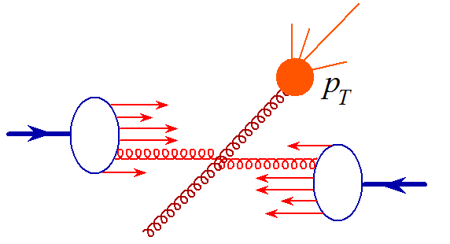

Slide 33
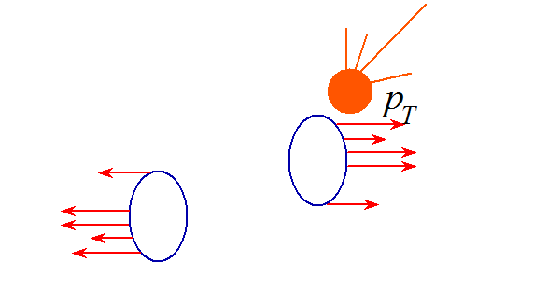

Slide 34
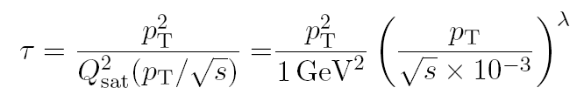
Geometrical scaling of p_{T} distributions
L. McLerran, M. P. Acta Phys.Polon.B41:1917,2010, B42:99,2011
M. P. Phys.Rev.Lett.106:142002,2011, Acta Phys.Pol. B42 (2011) 1557-1566 Phys.Rev. D87 (2013) 071502(R)

Slide 35

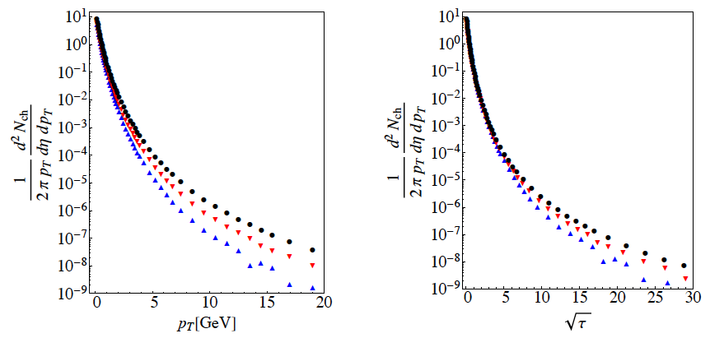
Determination of lambda
ALICE 1307.1093 [nucl-ex], Eur.Phys.J C73 (2013) 2662
inelastic

Slide 36
Determination of lambda

Slide 37
Determination of lambda

Slide 38
Determination of lambda

Slide 39
Determination of lambda

Slide 40
Determination of lambda

Slide 41
Conlusions
Nonlinear BK equation generates sauration scale Q_{s}(x)
In the region with no other scales Geometrical Scaling emerges
GS works well in DIS up to relatively large x ~ 0.08 with λ ~ 0.33
In pp GS works for multiplicity distributions with with λ ~ 0.22 (!)

Slide 42
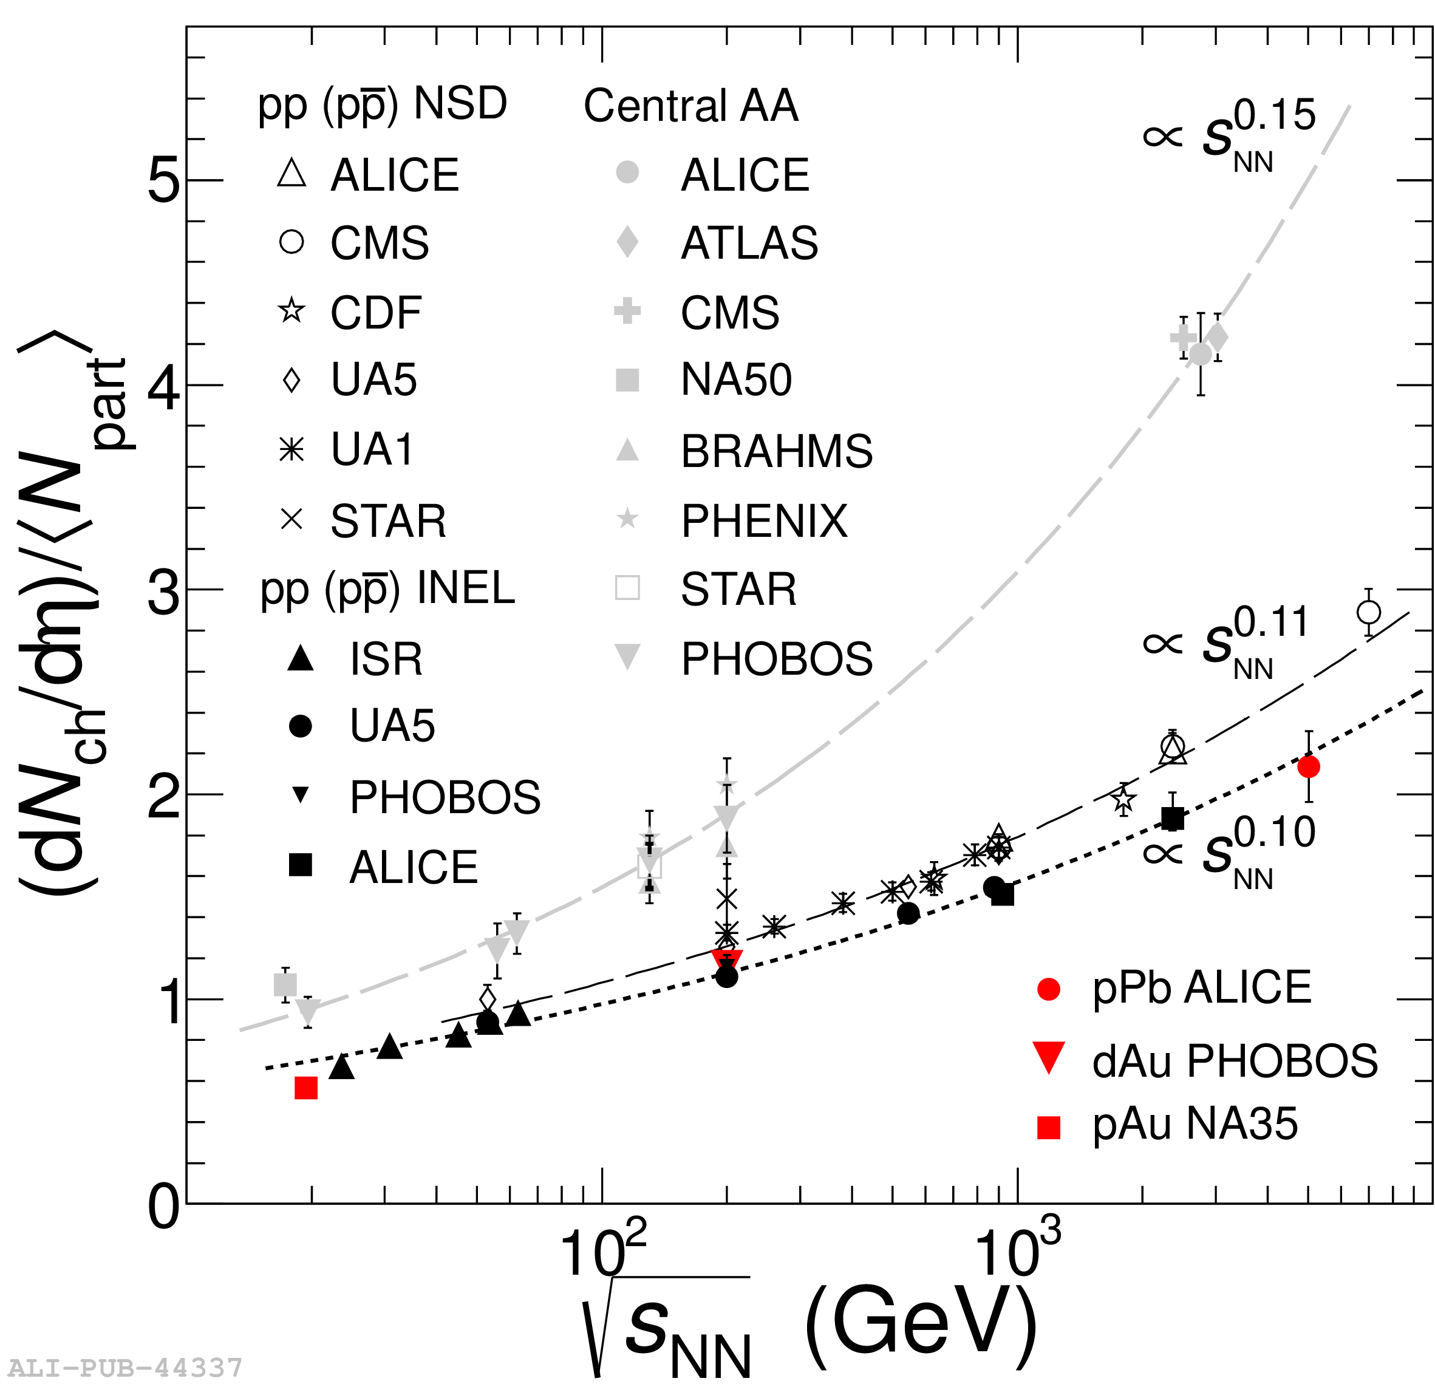
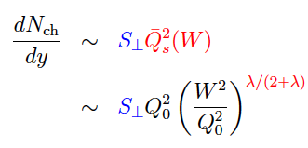
Power-like growth of multiplicity
http://th-www.if.uj.edu.pl/school/2014/talks/braun-munzinger_1.pdf
plot: P. Braun-Munzinger,
54 Cracow School of
Theoretical Physics
(from ALICE-PUB-44337)
transverse area is
energy indpendent
Notes:
Different powers depending on the process (inelastic, NSD, HI)

Slide 43
Conlusions
Nonlinear BK equation generates sauration scale Q_{s}(x)
In the region with no other scales Geometrical Scaling emerges
GS works well in DIS up to relatively large x ~ 0.08 with λ ~ 0.33
In pp GS works for multiplicity distributions with with λ ~ 0.22 (!)
As a consequence total multiplicity grows with energy as s^{0.1}

Slide 44
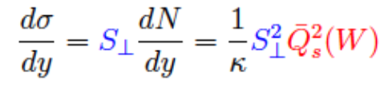
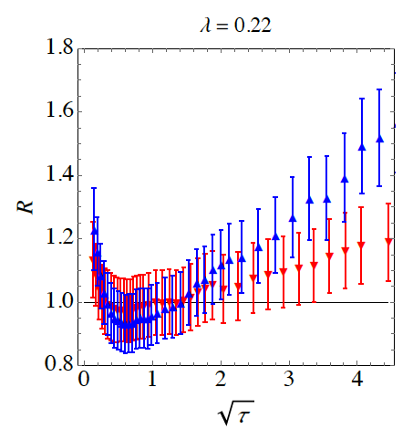
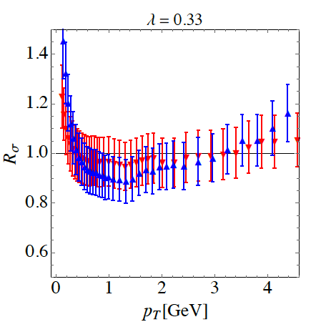

What should scale in pp?
multiplicity cross-section
σ_{MB}

Slide 45
Conlusions
Nonlinear BK equation generates sauration scale Q_{s}(x)
In the region with no other scales Geometrical Scaling emerges
GS works well in DIS up to relatively large x ~ 0.08 with λ ~ 0.33
In pp GS works for multiplicity distributions with with λ ~ 0.22 (!)
As a consequence total multiplicity grows with energy as s^{0.1}
In pp diff. cross-section scales better with λ compatible with DIS

Slide 46
continue
with multiplicity scaling…

Slide 47
Violation
of Geometrical Scaling

Slide 48
Violation of GS for y ≠ 0
M. P. Phys.Rev. D87 (2013) 071502(R)
x₁ can be large, so that gluons in 1 are dilute
x₂ is then small in the dense region

Slide 49


Kinematical range of GS in pp

Slide 50

Kinematical range of GS in pp
transverse momentum schould be larger
than some nonperturbative scale Λ

Slide 51
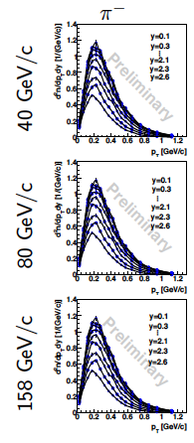
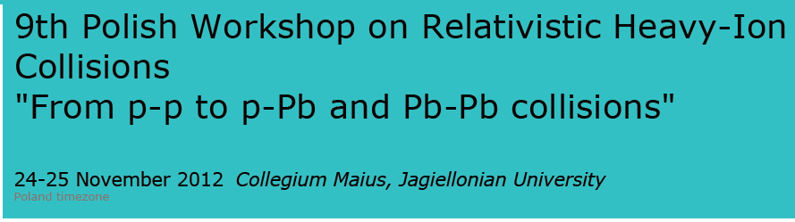
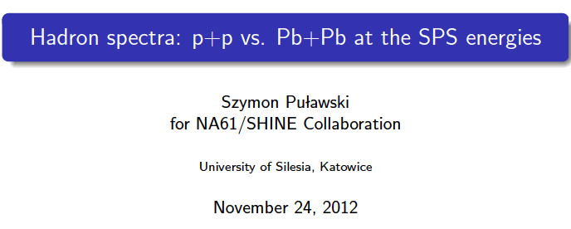
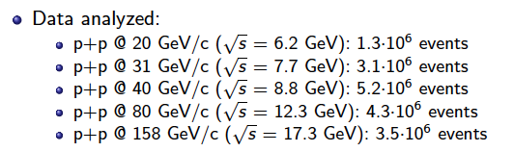
NA61 Shine data

Slide 52
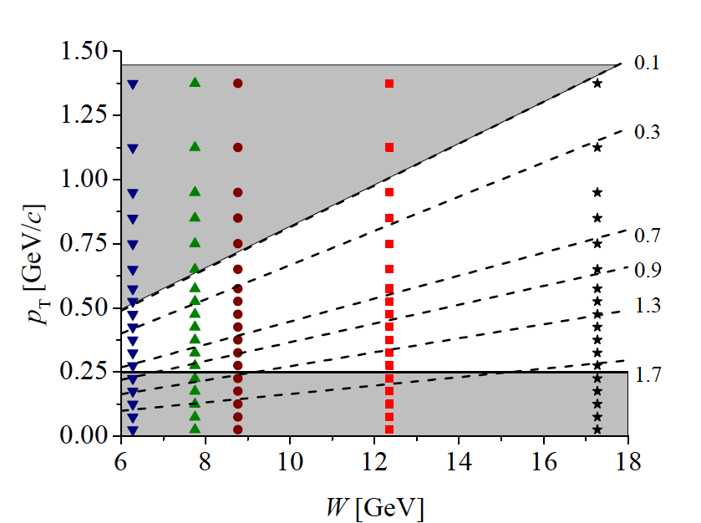
NA61 kinematical range

Slide 53
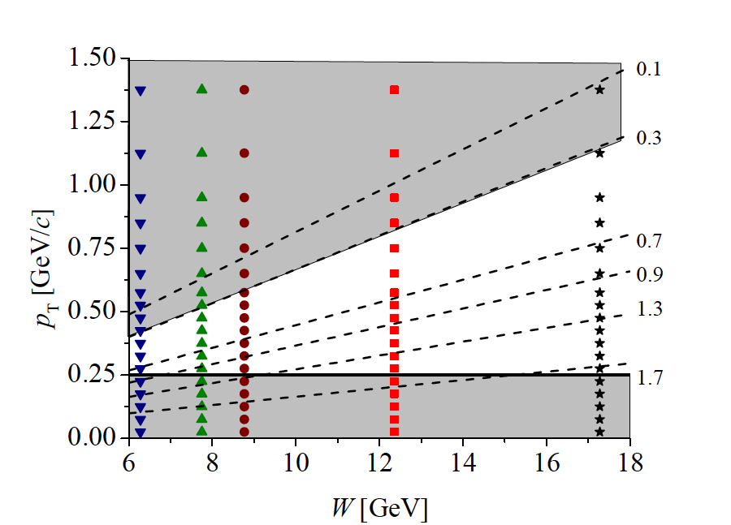
NA61 kinematical range

Slide 54
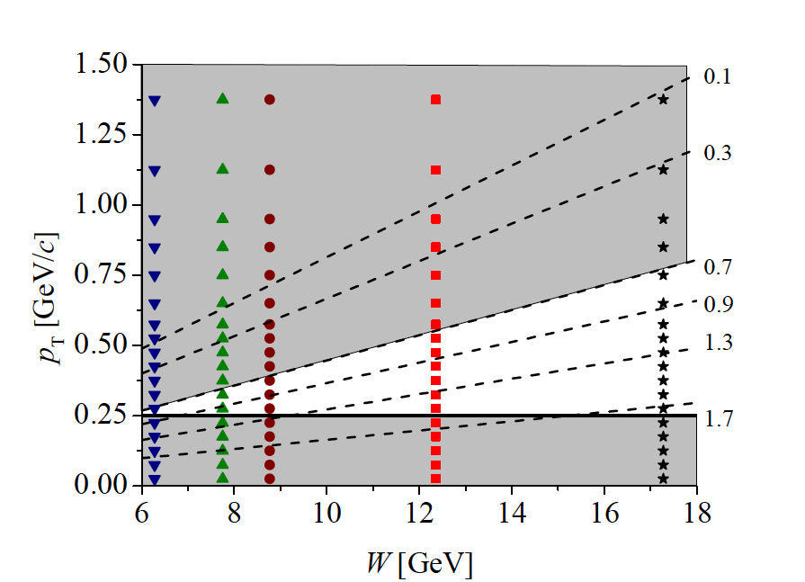
NA61 kinematical range

Slide 55
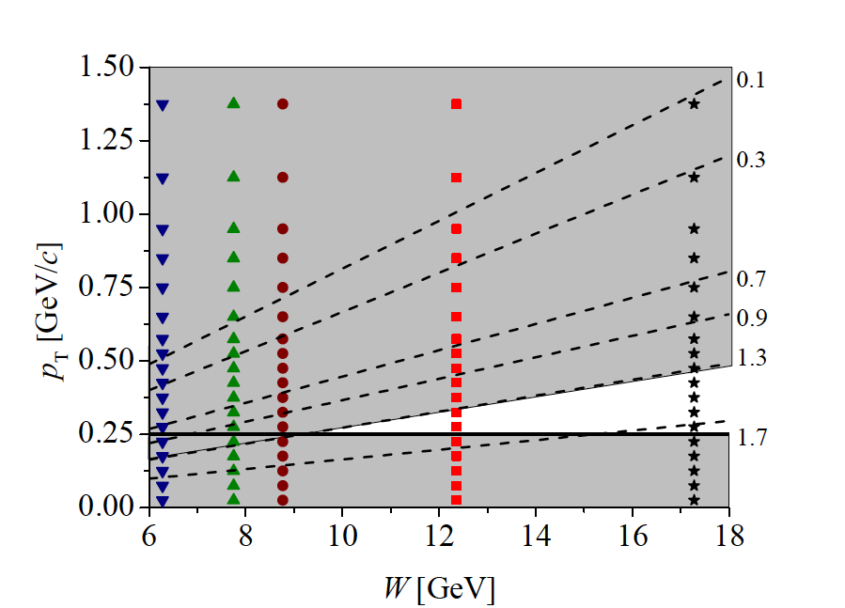
NA61 kinematical range

Slide 56
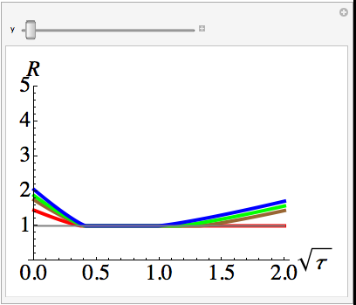
6.28
7.75
8.77
12.36

Slide 57
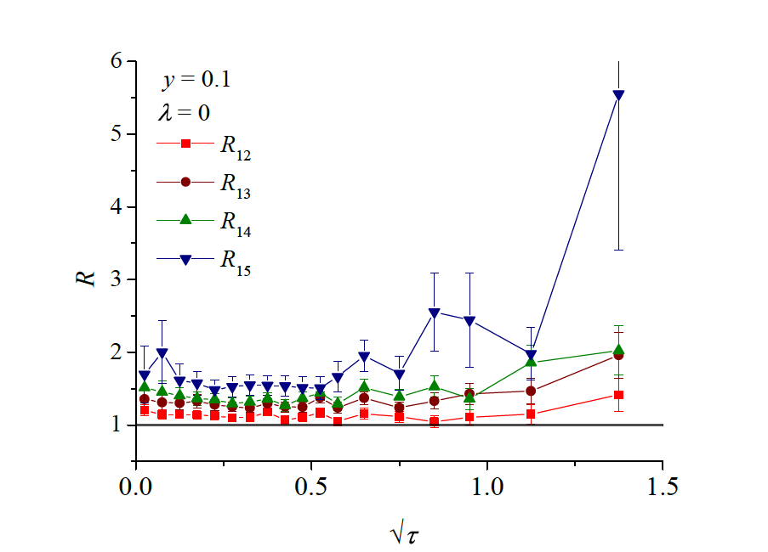
p_{T}

Slide 58
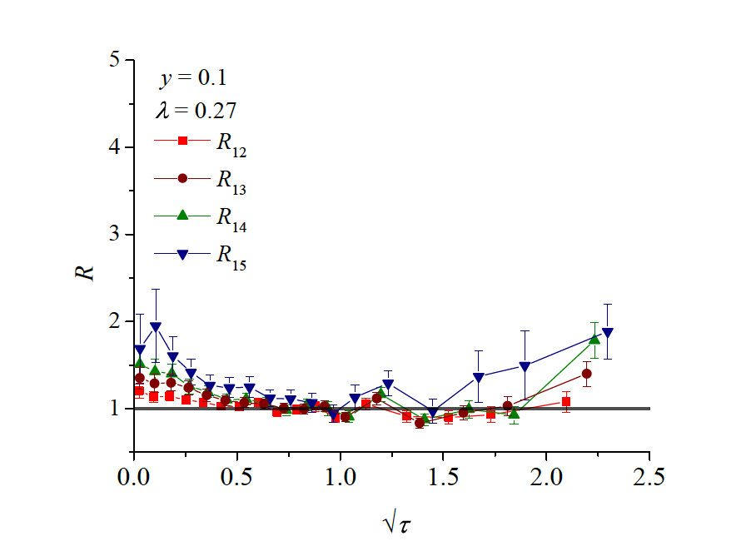

Slide 59
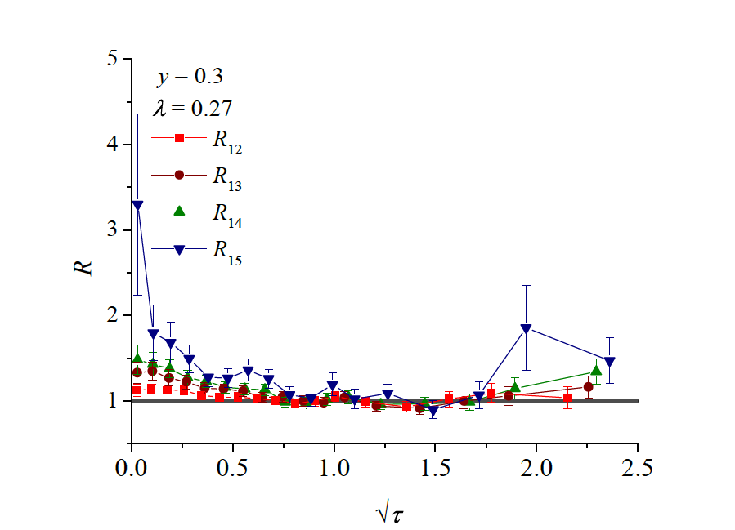

Slide 60
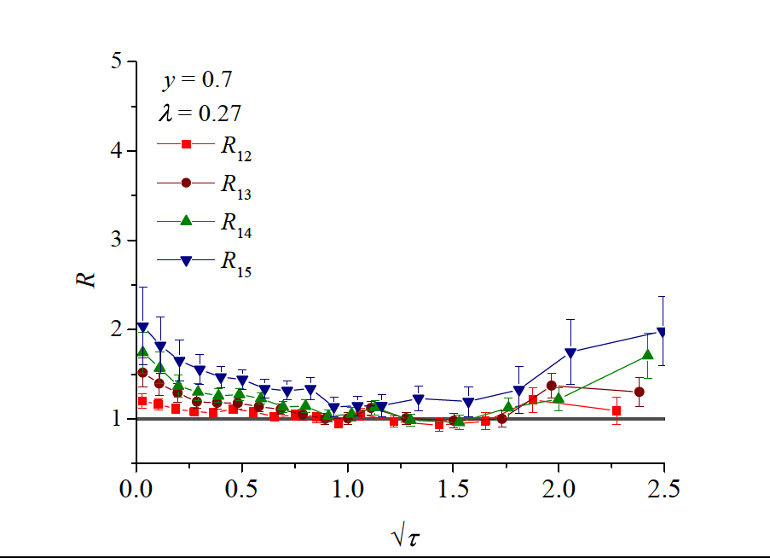

Slide 61
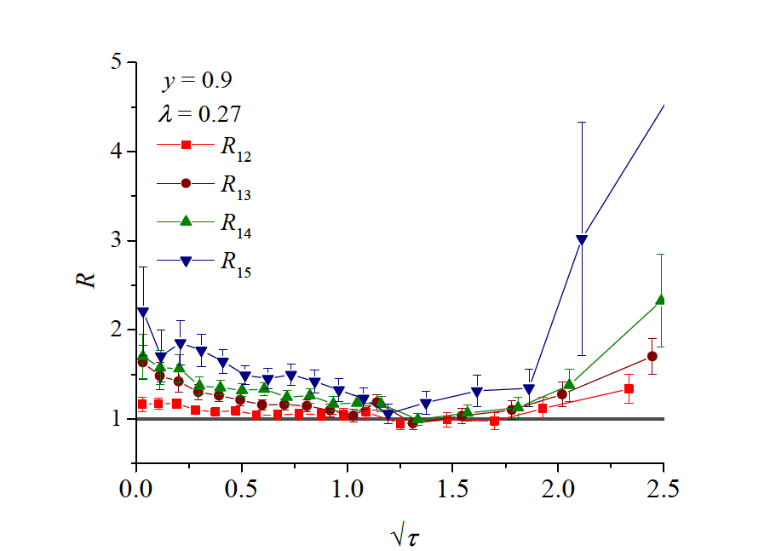

Slide 62
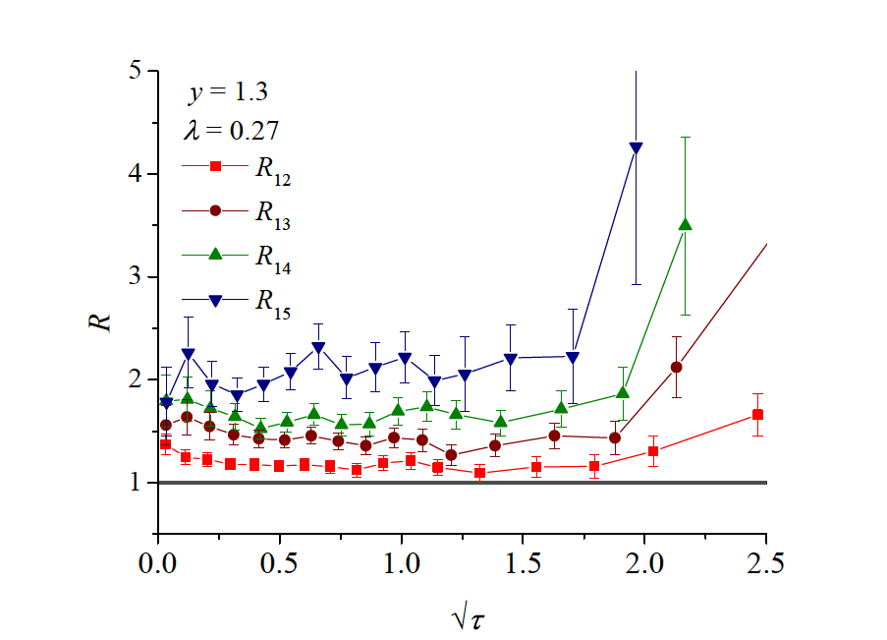

Slide 63
Conlusions
Nonlinear BK equation generates sauration scale Q_{s}(x)
In the region with no other scales Geometrical Scaling emerges
GS works well in DIS up to relatively large x ~ 0.08 with λ ~ 0.33
In pp GS works for multiplicity distributions with with λ ~ 0.22 (!)
As a consequence total multiplicity grows with energy as s^{0.1}
In pp diff. cross-section scales better with λ compatible with DIS
For y ≠ 0 violation of GS is seen as expected

Slide 64
Fluctuations
of the saturation scale

Slide 65
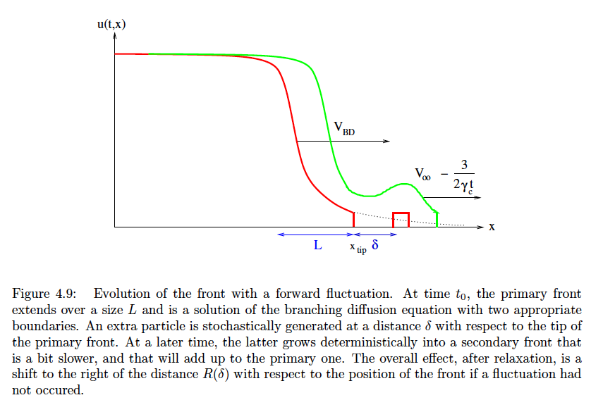
Fluctuations in stat. phys.
S. Munier, habilitation

Slide 66
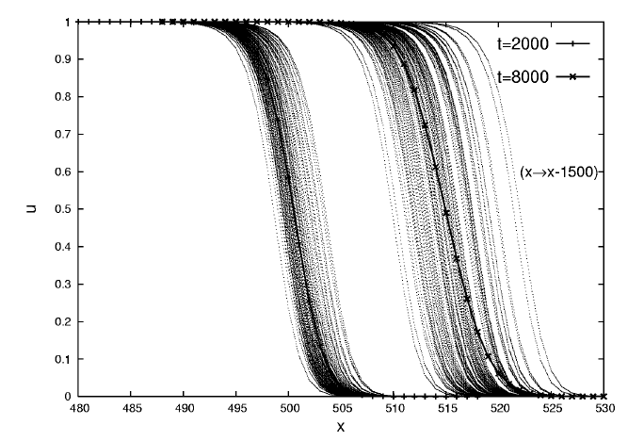

Slide 67
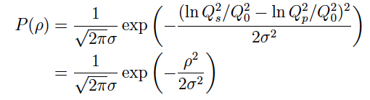


Fluctuations in QCD
Fluctuating saturation scale
„average” (fixed) proton saturation scale
What is sigma? Iancu, Mueller and Munier
(Phys.Lett. B606 (2005) 342-350):

Slide 68
Conlusions
Nonlinear BK equation generates sauration scale Q_{s}(x)
In the region with no other scales Geometrical Scaling emerges
GS works well in DIS up to relatively large x ~ 0.08 with λ ~ 0.33
In pp GS works for multiplicity distributions with with λ ~ 0.22 (!)
As a consequence total multiplicity grows with energy as s^{0.1}
In pp diff. cross-section scales better with λ compatible with DIS
For y ≠ 0 violation of GS is seen as expected
One expects fluctuations of Q_{s} with width that may depend on y

Slide 69

Fluctuations in QCD
small sigma
large sigma

Slide 70
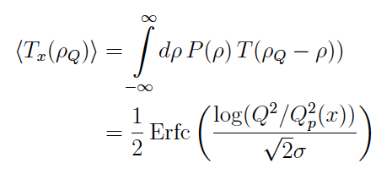
Fluctuations in QCD

Slide 71

Fluctuations in QCD
new scaling variable:
σ² ~ log(1/x) – dffusive scaling
σ² = const. – regular geom. scaling

Slide 72
Conlusions
Nonlinear BK equation generates sauration scale Q_{s}(x)
In the region with no other scales Geometrical Scaling emerges
GS works well in DIS up to relatively large x ~ 0.08 with λ ~ 0.33
In pp GS works for multiplicity distributions with with λ ~ 0.22 (!)
As a consequence total multiplicity grows with energy as s^{0.1}
In pp diff. cross-section scales better with λ compatible with DIS
For y ≠ 0 violation of GS is seen as expected
One expects fluctuations of Q_{s} with width that may depend on y
For y – independent width GS is preserved

Slide 73
Application to particle
production at the LHC

Slide 74

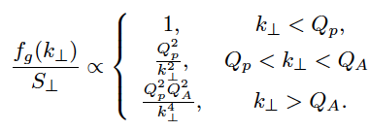


Color Glass Condensate in pPB
Gribov, Levin Ryskin,
High p_{T} Hadrons In The Pionization Region In QCD.
Phys.Lett.B100:173-176,1981.
stolen from Bozek, Bzdak, Skokov

Slide 75
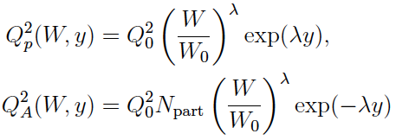

Color Glass Condensate in pPB
stolen from Bozek, Bzdak, Skokov

Slide 76
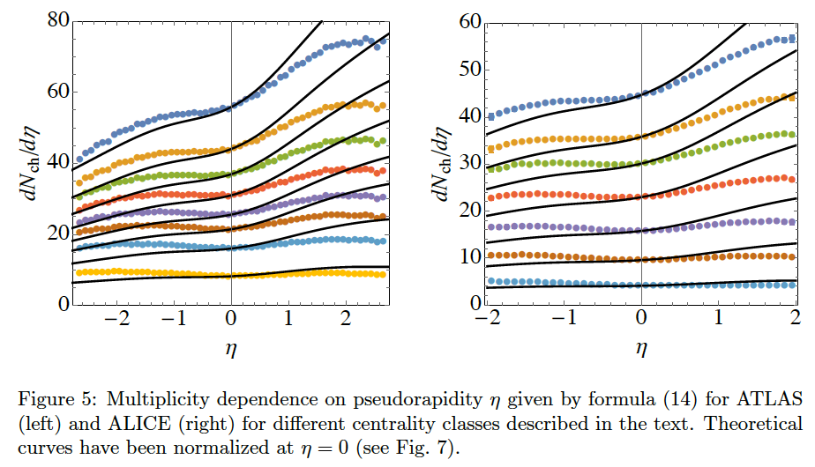
Color Glass Condensate in pPB
L.McLerran and MP

Slide 77
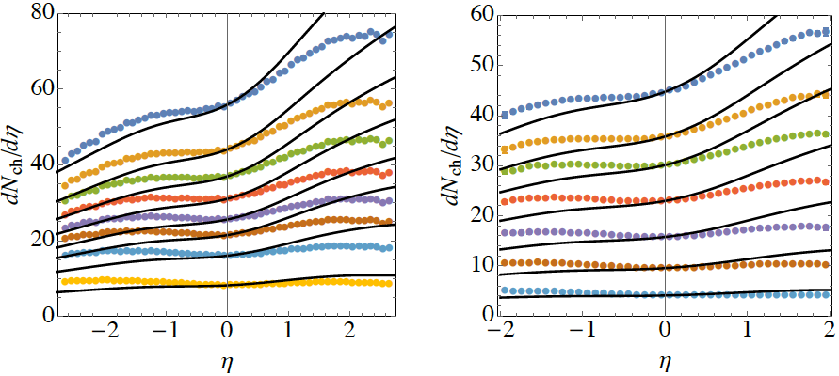
Fluctuations for pPb
without fluctuations

Slide 78

Fluctuations for pPb
σ = 1.55
with fluctuations

Slide 79
Conlusions
Nonlinear BK equation generates sauration scale Q_{s}(x)
In the region with no other scales Geometrical Scaling emerges
GS works well in DIS up to relatively large x ~ 0.08 with λ ~ 0.33
In pp GS works for multiplicity distributions with with λ ~ 0.22 (!)
As a consequence total multiplicity grows with energy as s^{0.1}
In pp diff. cross-section scales better with λ compatible with DIS
For y ≠ 0 violation of GS is seen as expected
One expects fluctuations of Q_{s} with width that may depend on y
For y – independent width GS is preserved
One can explain dN/dy in pPb with large p fluctuations: σ ~ 1.5

Slide 80



Normalization
ATLAS ALICE

Slide 81



Fluctuations in pp
Bzdak, Dusling

Slide 82

Fluctuations in pp
Bzdak, Dusling

Slide 83
Conlusions
Nonlinear BK equation generates sauration scale Q_{s}(x)
In the region with no other scales Geometrical Scaling emerges
GS works well in DIS up to relatively large x ~ 0.08 with λ ~ 0.33
In pp GS works for multiplicity distributions with with λ ~ 0.22 (!)
As a consequence total multiplicity grows with energy as s^{0.1}
In pp diff. cross-section scales better with λ compatible with DIS
For y ≠ 0 violation of GS is seen as expected
One expects fluctuations of Q_{s} with width that may depend on y
For y – independent width GS is preserved
One can explain dN/dy in pPb with large p fluctuations: σ ~ 1.5
Two particle correlations may also be explained by Q_{s} flctuations

Slide 84

Fluctuations in pp: CGC
McLerran, Tribeddy
Other fluctuation sources are built in:
Q_{sat} vs. S_{T}
fluctuations in impact parameter

Slide 85
Conlusions
Nonlinear BK equation generates sauration scale Q_{s}(x)
In the region with no other scales Geometrical Scaling emerges
GS works well in DIS up to relatively large x ~ 0.08 with λ ~ 0.33
In pp GS works for multiplicity distributions with with λ ~ 0.22 (!)
As a consequence total multiplicity grows with energy as s^{0.1}
In pp diff. cross-section scales better with λ compatible with DIS
For y ≠ 0 violation of GS is seen as expected
One expects fluctuations of Q_{s} with width that may depend on y
For y – independent width GS is preserved
One can explain dN/dy in pPb with large p fluctuations: σ ~ 1.5
Two particle correlations may also be explained by Q_{s} flctuations
P(N_{ch}) in pp in CGC also requires Q_{s} flctuations

Slide 86
Conlusions
Nonlinear BK equation generates sauration scale Q_{s}(x)
In the region with no other scales Geometrical Scaling emerges
GS works well in DIS up to relatively large x ~ 0.08 with λ ~ 0.33
In pp GS works for multiplicity distributions with with λ ~ 0.22 (!)
As a consequence total multiplicity grows with energy as s^{0.1}
In pp diff. cross-section scales better with λ compatible with DIS
For y ≠ 0 violation of GS is seen as expected
One expects fluctuations of Q_{s} with width that may depend on y
For y – independent width GS is preserved
One can explain dN/dy in pPb with large p fluctuations: σ ~ 1.5
Two particle correlations may also be explained by Q_{s} flctuations
P(N_{ch}) in pp in CGC also requires Q_{s} flctuations

Slide 87
Conlusions
Nonlinear BK equation generates sauration scale Q_{s}(x)
In the region with no other scales Geometrical Scaling emerges
GS works well in DIS up to relatively large x ~ 0.08 with λ ~ 0.33
In pp GS works for multiplicity distributions with with λ ~ 0.22 (!)
As a consequence total multiplicity grows with energy as s^{0.1}
In pp diff. cross-section scales better with λ compatible with DIS
For y ≠ 0 violation of GS is seen as expected
One expects fluctuations of Q_{s} with width that may depend on y
For y – independent width GS is preserved
One can explain dN/dy in pPb with large p fluctuations: σ ~ 1.5
Two particle correlations may also be explained by Q_{s} flctuations
P(N_{ch}) in pp in CGC also requires Q_{s} flctuations
GS for average transverse momentum and the interaction radius
GS in HI for different centrality classes

Slide 88
Average
transverse momentum

Slide 89

Average transverse momentum

Slide 90

Average transverse momentum

Slide 91




Mean p_{T} as a function of N_{ch}
<p_{T}>(N_{ch}) – correlations are sensitive to the fine details of dynamics
difficult to describe by untuned MonteCarlos
possible sign of phase transition
Notes:
Correlations

Slide 92

Mean p_{T} as a function of N_{ch}

Slide 93

Mean p_{T} as a function of N_{ch}
interaction radius

Slide 94

Mean p_{T} as a function of N_{ch}
interaction radius
phenomenological formula:
nonperturbaitive
coefficient
α, β do not depend on energy, do depend on particle species

Slide 95


Interaction radius
A. Bzdak, B. Schenke, P. Tribedy and R. Venugopalan,
Initial state geometry and the role of hydrodynamics in proton-proton, proton-nucleus and deuteron-nucleus collisions,
Phys. Rev. C 87 (2013) 064906, [arXiv:1304.3403 [nucl-th]].

Slide 96



Scaling of mean p_{T}
scaling variable
parton-hadron duality
CMS Collaboration, Eur. Phys. J. C72 (2013) 2164, C74 (2014) 2847

Slide 97


Energy dependence of mean p_{T}

Slide 98
Energy dependence of mean p_{T}

Slide 99

Mean p_{T} scaling
ALICE Collaboration, Phys. Lett. B727 (2013) 371 [arXiv:1307.1094 [nucl-ex]]
pp 7 TeV
pp 2.76 TeV
pPb 5.02 TeV
pp 0.9 TeV

Slide 100

Mean p_{T} scaling
ALICE Collaboration, Phys. Lett. B727 (2013) 371 [arXiv:1307.1094 [nucl-ex]]
pp 7 TeV
pp 2.76 TeV
pPb 5.02 TeV
pp 0.9 TeV

Slide 101

Effective R dependence on W
0.9 TeV
2.76 TeV
7 TeV
rescaled
CGC calculation

Slide 102
Mean p_{T} vs. interaction radius R
fit α, β and γ to 7 TeV and then use R from Fig.

Slide 103

Mean p_{T} vs. interaction radius R
fit α, β and γ to 7 TeV and then use R from Fig.
pp 7 TeV
pp 2.76 TeV
pp 0.9 TeV

Slide 104

Effective R dependence on W
0.9 TeV
2.76 TeV
7 TeV
rescaled
CGC calculation

Slide 105


Mean p_{T} vs. interaction radius R
fit α, β and γ to 7 TeV and then use R from Fig.
pp 7 TeV
pp 2.76 TeV
pp 0.9 TeV

Slide 106
Conlusions
Nonlinear BK equation generates sauration scale Q_{s}(x)
In the region with no other scales Geometrical Scaling emerges
GS works well in DIS up to relatively large x ~ 0.08 with λ ~ 0.33
In pp GS works for multiplicity distributions with with λ ~ 0.22 (!)
As a consequence total multiplicity grows with energy as s^{0.1}
In pp diff. cross-section scales better with λ compatible with DIS
For y ≠ 0 violation of GS is seen as expected
One expects fluctuations of Q_{s} with width that may depend on y
For y – independent width GS is preserved
One can explain dN/dy in pPb with large p fluctuations: σ ~ 1.5
Two particle correlations may also be explained by Q_{s} flctuations
P(N_{ch}) in pp in CGC also requires Q_{s} flctuations
GS for average transverse momentum and the interaction radius

Slide 107
Geometrical Scaling
in Heavy Ion Collisions
Notes:
Why should it survive hydro?

Slide 108

GS in HI: centrality
number of participants
N_{part} ~ V
small centrality large centrality

Slide 109




GS in HI: centrality dependence
Geometrical Scaling of Direct-Photon Production
in Hadron Collisions from RHIC to the LHC
Christian Klein-Bösing, Larry McLerran arXiv:1403.1174
Scaling of the saturation scale:

Slide 110


GS in HI

Slide 111

Energy Scaling in HI
energy scaling works quite well, why?

Slide 112

Centrality Scaling in HI

Slide 113
Conlusions
Nonlinear BK equation generates sauration scale Q_{s}(x)
In the region with no other scales Geometrical Scaling emerges
GS works well in DIS up to relatively large x ~ 0.08 with λ ~ 0.33
In pp GS works for multiplicity distributions with with λ ~ 0.22 (!)
As a consequence total multiplicity grows with energy as s^{0.1}
In pp diff. cross-section scales better with λ compatible with DIS
For y ≠ 0 violation of GS is seen as expected
One expects fluctuations of Q_{s} with width that may depend on y
For y – independent width GS is preserved
One can explain dN/dy in pPb with large p fluctuations: σ ~ 1.5
Two particle correlations may also be explained by Q_{s} flctuations
P(N_{ch}) in pp in CGC also requires Q_{s} flctuations
GS for average transverse momentum and the interaction radius
GS in HI for different centrality classes

Slide 114
Conlusions
Nonlinear BK equation generates sauration scale Q_{s}(x)
In the region with no other scales Geometrical Scaling emerges
GS works well in DIS up to relatively large x ~ 0.08 with λ ~ 0.33
In pp GS works for multiplicity distributions with with λ ~ 0.22 (!)
As a consequence total multiplicity grows with energy as s^{0.1}
In pp diff. cross-section scales better with λ compatible with DIS
For y ≠ 0 violation of GS is seen as expected
One expects fluctuations of Q_{s} with width that may depend on y
For y – independent width GS is preserved
One can explain dN/dy in pPb with large p fluctuations: σ ~ 1.5
Two particle correlations may also be explained by Q_{s} flctuations
P(N_{ch}) in pp in CGC also requires Q_{s} flctuations
GS for average transverse momentum and the interaction radius
GS in HI for different centrality classes

Slide 115
BACKUP SLIDES
Taxco

Slide 116

BK Equation in the Dipole Picture
BFKL equation has very simple form and interpretation in the
dipole picture of A. Mueller
A.H. Mueller and J.-w. Qiu,
Nucl. Phys. B 268 (1986) 427
Y = log 1/x

Slide 117
Gluon Emission in the Dipole Picture
large N_{c}
dipole emission kernel is very simple
reproduces BFKL equation

Slide 118


BFKL Eq. in the Dipole Picture

Slide 119

BFKL Eq. in the Dipole Picture
= x₁₀
[N(x₀₀ , Y ) + N(x₁₀ , Y ) − N(x₀₁ , Y )]
no singularities at e.g. 2 0 due to color transparency: N(0,Y)=0

Slide 120

BK Equation
I. Balitsky,
Nucl. Phys. B 463 (1996) 99
Y.V. Kovchegov,
Phys. Rev. D 60 (1999) 034008
double scattering stops rapid growth of the amplitude with Y
note that [….] = 0 for N 1

Slide 121



Wounded Nucleon Model in pPb

Slide 122

Wounded Nucleon Model in pPb

Slide 123
END

