Slide 1
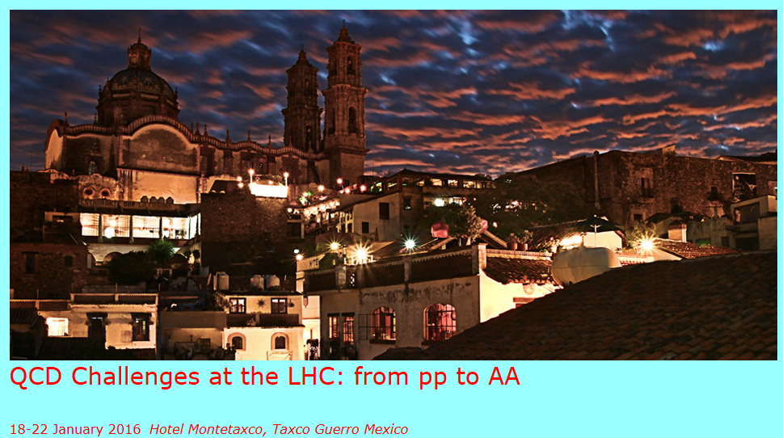
QGP in pp collisions?
Experimental and theoretical questions
P. Christiansen (Lund University)

Slide 2
Introduction
My understanding of this workshop
  The aim of this workshop is to be speculative,
  but also to be concrete!
Niels Bohr quotes
  Never express yourself more clearly than you are able to think
  Every sentence I utter must be understood not as an affirmation, but as a question
This is a talk that is trying to convey some ideas painted with a broad brush

Slide 3
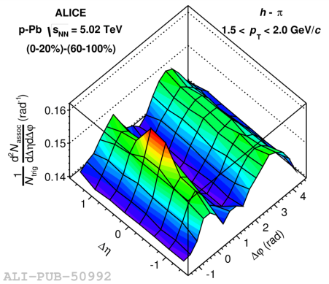
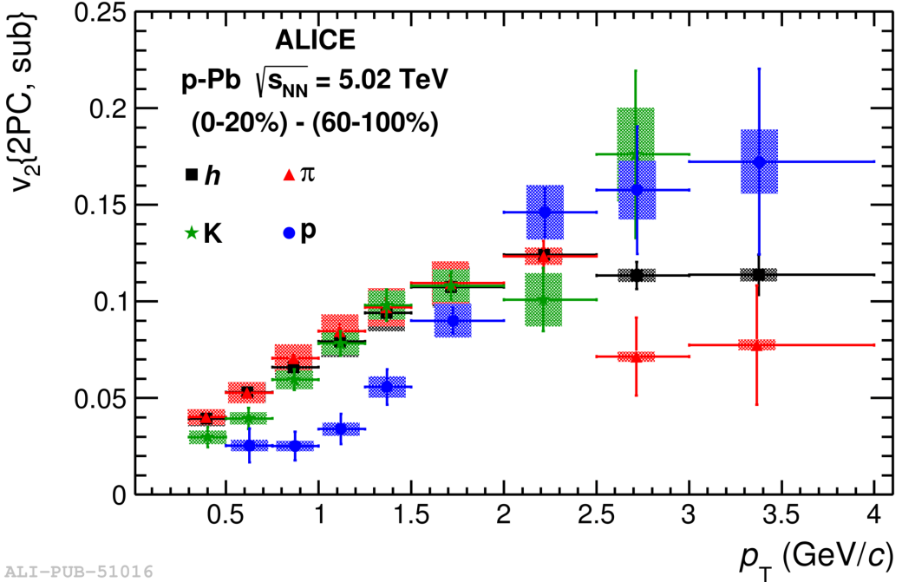
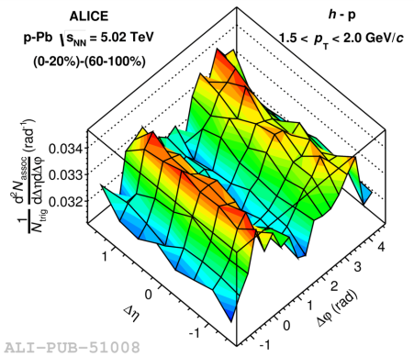
Ridges are abundant in hadronic collisions: Pb-Pb, p-Pb, and pp!
Fourier coefficients:
Phys. Lett. B 726 (2013) 164–177
And show a clear mass ordering

Slide 4
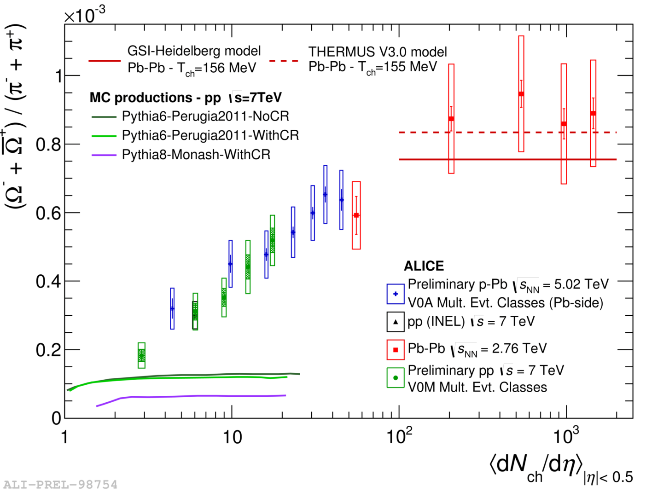
Integrated ratios vs multiplicity
Thermal
medium?
e⁺+e⁻-like
Are we observing the onset of thermalization in small systems?

Slide 5
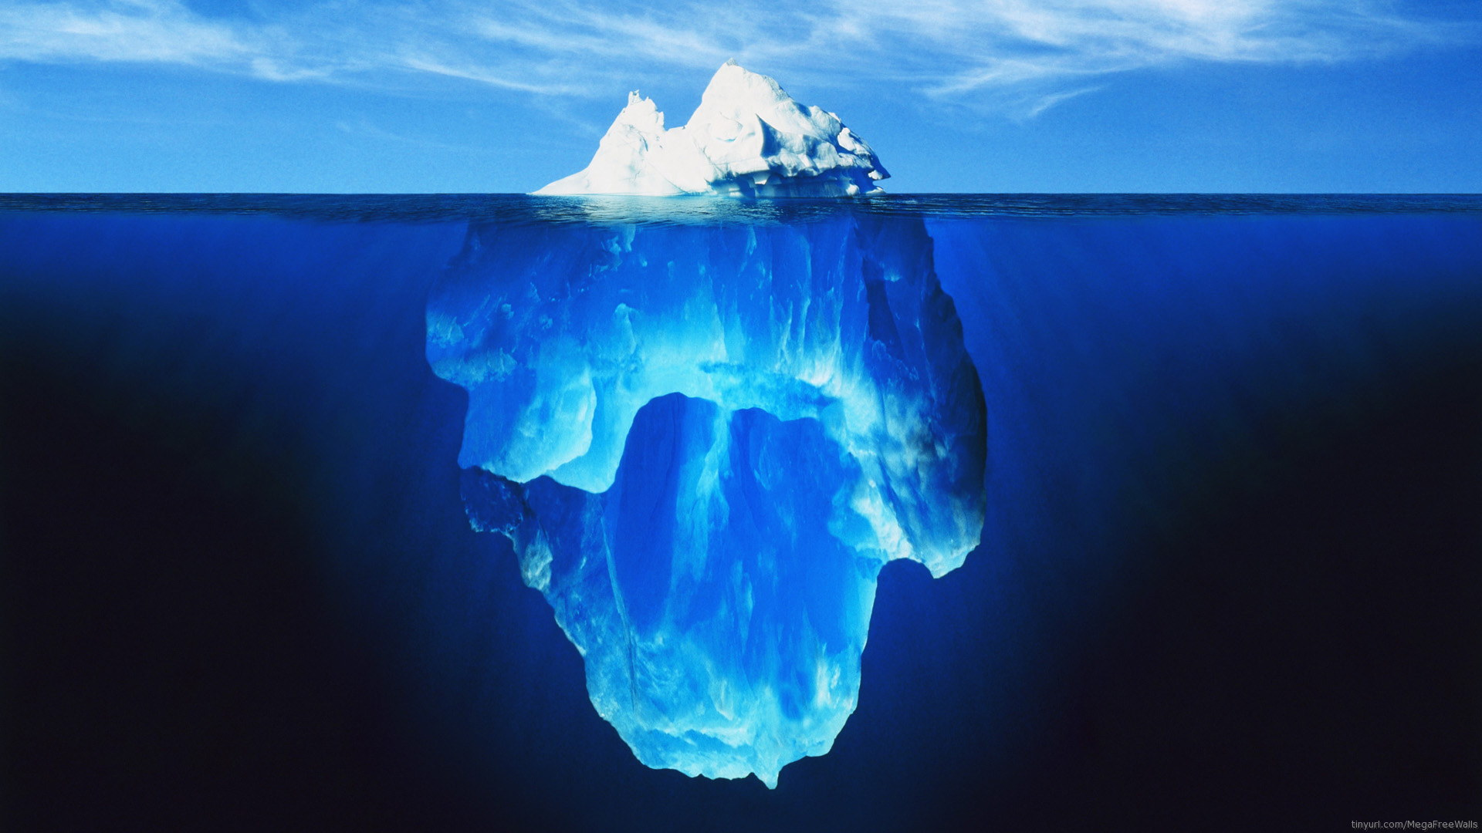
Soft QCD
@ LHC?
It at least seems that everywhere we look new effects are observed!

Slide 6
Outline
Experimental side:
  QGP vs QCD: an example of the difference before 2012 (p-Pb ridge and flow-like signatures)
  How different are pp and AA collisions?
  How can we separate hard and soft physics in pp collisions?
Theoretical side
  Can a small system be macroscopic?
  Are QGP effects abundant in hadronic collisions?

Slide 7
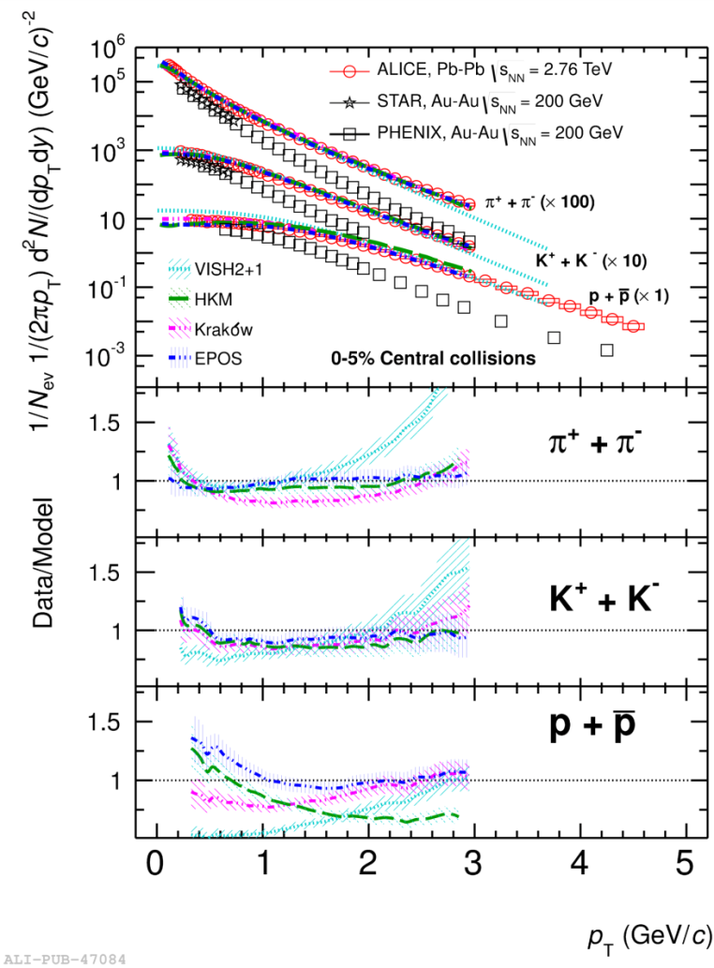
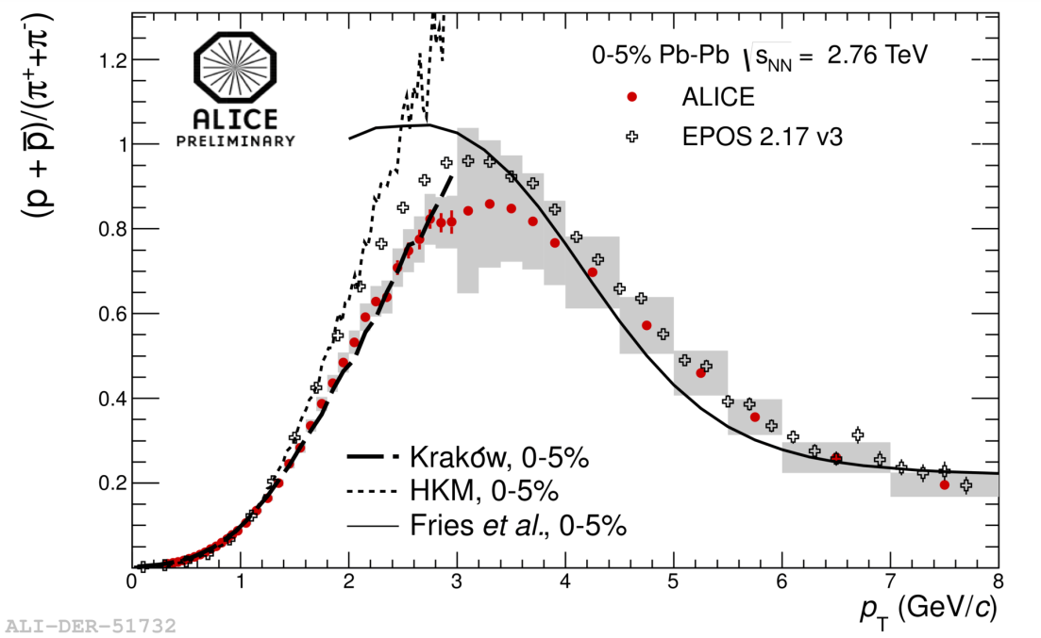
Central Pb-Pb: initial state + hydro + thermal model
Pb-Pb 0-5%
Pb-Pb 0-5%
Krakow: PRC85, 064915 (2012)
HKM: PRC87, 024914 (2013)
Fries: PRL90, 202303 (2003) and private communication
EPOS: PRL109, 102301 (2012) and private communications
Phys. Rev. Lett. 109, 252301 (2012)
Near ideal hydrodynamics with some implementation of the hadronic phase describes well p_{T} spectra in central collisions
No explicit QCD (initial density and hadronic spectrum)

Slide 8
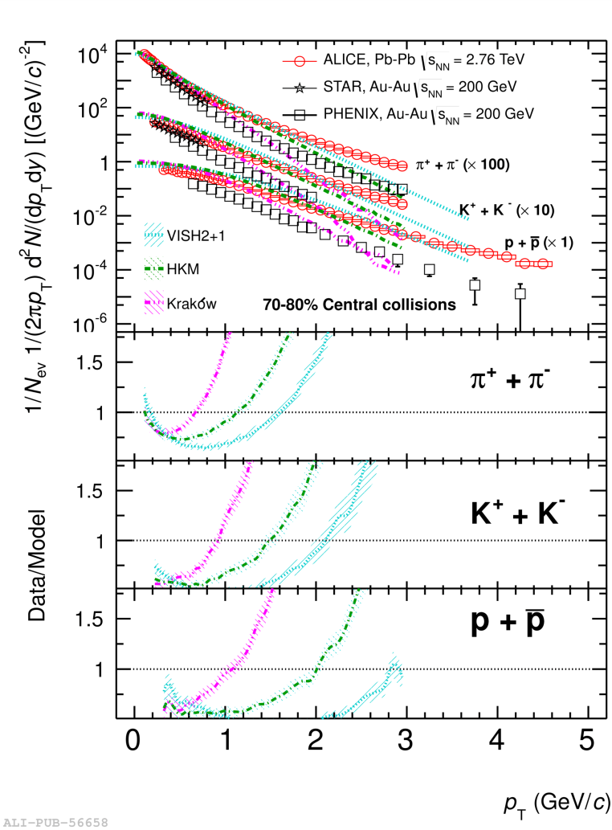
The same picture fails in peripheral collisions
Pb-Pb 0-5%
Pb-Pb 70-80%
QGP?
QCD?
Phys. Rev. Lett. 109, 252301 (2012)
Phys. Rev. C 88 (2013) 044910
The same models fail to describe the p_{T} spectra in peripheral collisions
Typically hydro has not been expected to work in peripheral collisions but if it is at work in p-Pb and pp collisions should it not work there?

Slide 9
Some thoughts on the implications of QGP modelling
Hydrodynamics needs large Xsections
  The mean free path, λ = 1/(ρσ), has to be significantly smaller than the system size
Statistical thermal model needs large Xsections
  Processes has to be driven towards equilibrium quickly
    Initial state u/d/s chemistry is forgotten
Hydrodynamics and the statistical thermal model in some sense tells the same story about the created medium
The lack of entropy production is also similar
  Expansion: ideal hydrodynamics is reversible
  Hadronization: Xover phase transition is reversible
  Entropy is mainly generated in the initial state (?)

Slide 10
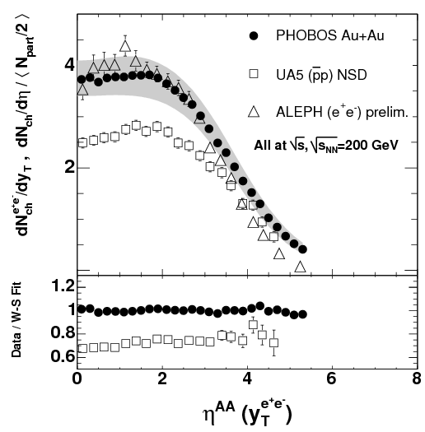
Particle production in AA, pp, and e⁺e⁻ → qq̅
Particle production in pp and AA collisions are not that different
  Is this because entropy is only generated in the initial state?
Surprisingly AA is like e⁺e⁻ → qq̅ at the same energy
  when ee is analyzed along “jet” axis(=“beam” axis)
  Let us start to see how they compare at LHC!

Slide 11
e⁺e⁻→qq̅ vs pp/AA
Since the CERN ISR days people have speculated on the relationship between ee (short for e⁺e⁻→qq̅) and pp
  http://cerncourier.com/cws/article/cern/46540

Slide 12
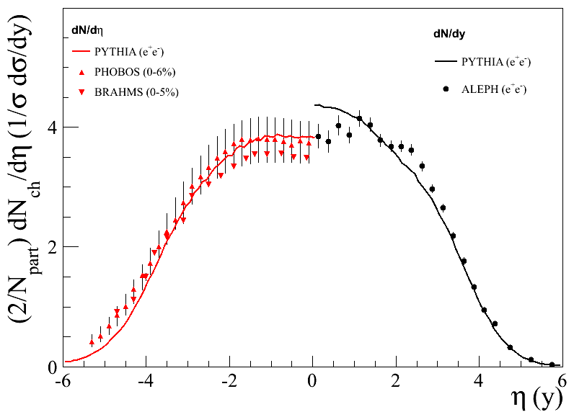
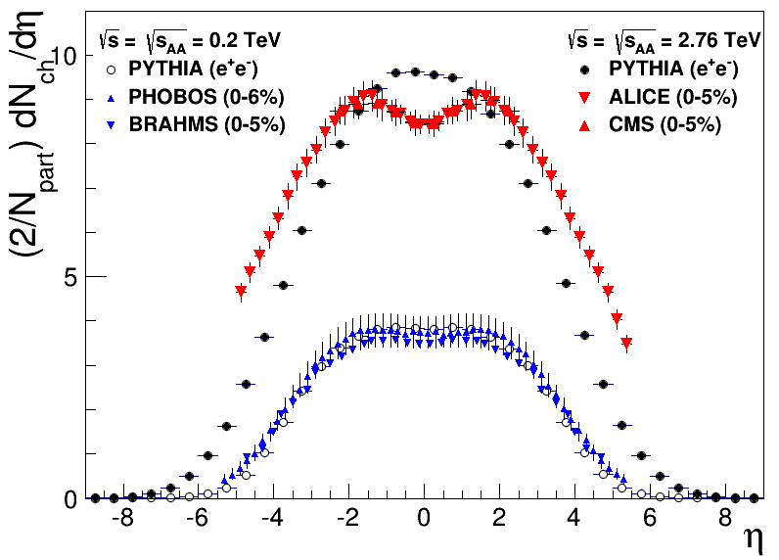
PYTHIA vs AA at LHC: dN/dη
Left: PYTHIA ee vs experimental data for RHIC energies
Right: PYTHIA ee vs experimental data for LHC
Note here that p_{T} is different (next slide) implying maybe that agreement depends on if one uses rapidity or η

Slide 13
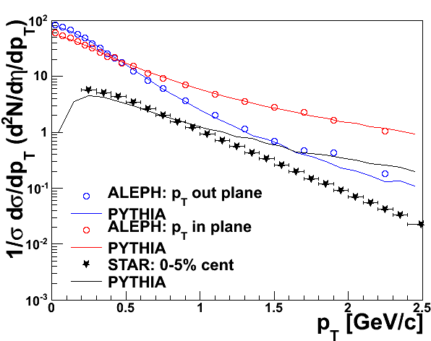
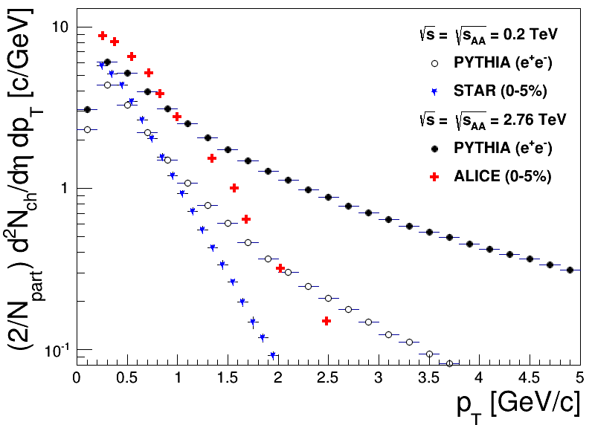
PYTHIA vs AA at LHC: dN/dp_{T}
Left: PYTHIA ee vs experimental p_{T} spectra at RHIC
Right: PYTHIA ee vs p_{T} spectra at LHC
In both cases the origin of the discrepancy is well understood since for pp/AA the p_{T} goes via large momentum transfer while for ee it goes via radiation

Slide 14
Lesson from e⁺e⁻ → qq̅
The initial energy density in AA collision is surprisingly small. It is hard to imagine a simpler baseline than ee.
But this also seems to go the same way as the previous ideas I mentioned:
  QCD does generate a lot of entropy
The partonic final state for ee is simple = perturbative, while for pp and AA it is non-perturbative → can we get a simpler picture?
And what about pp?

Slide 15
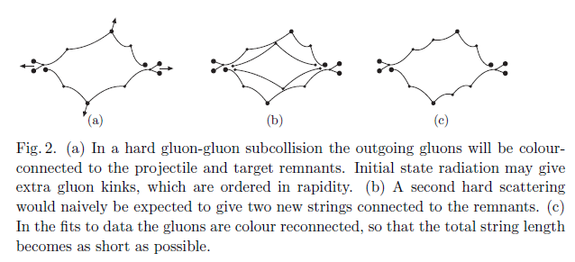
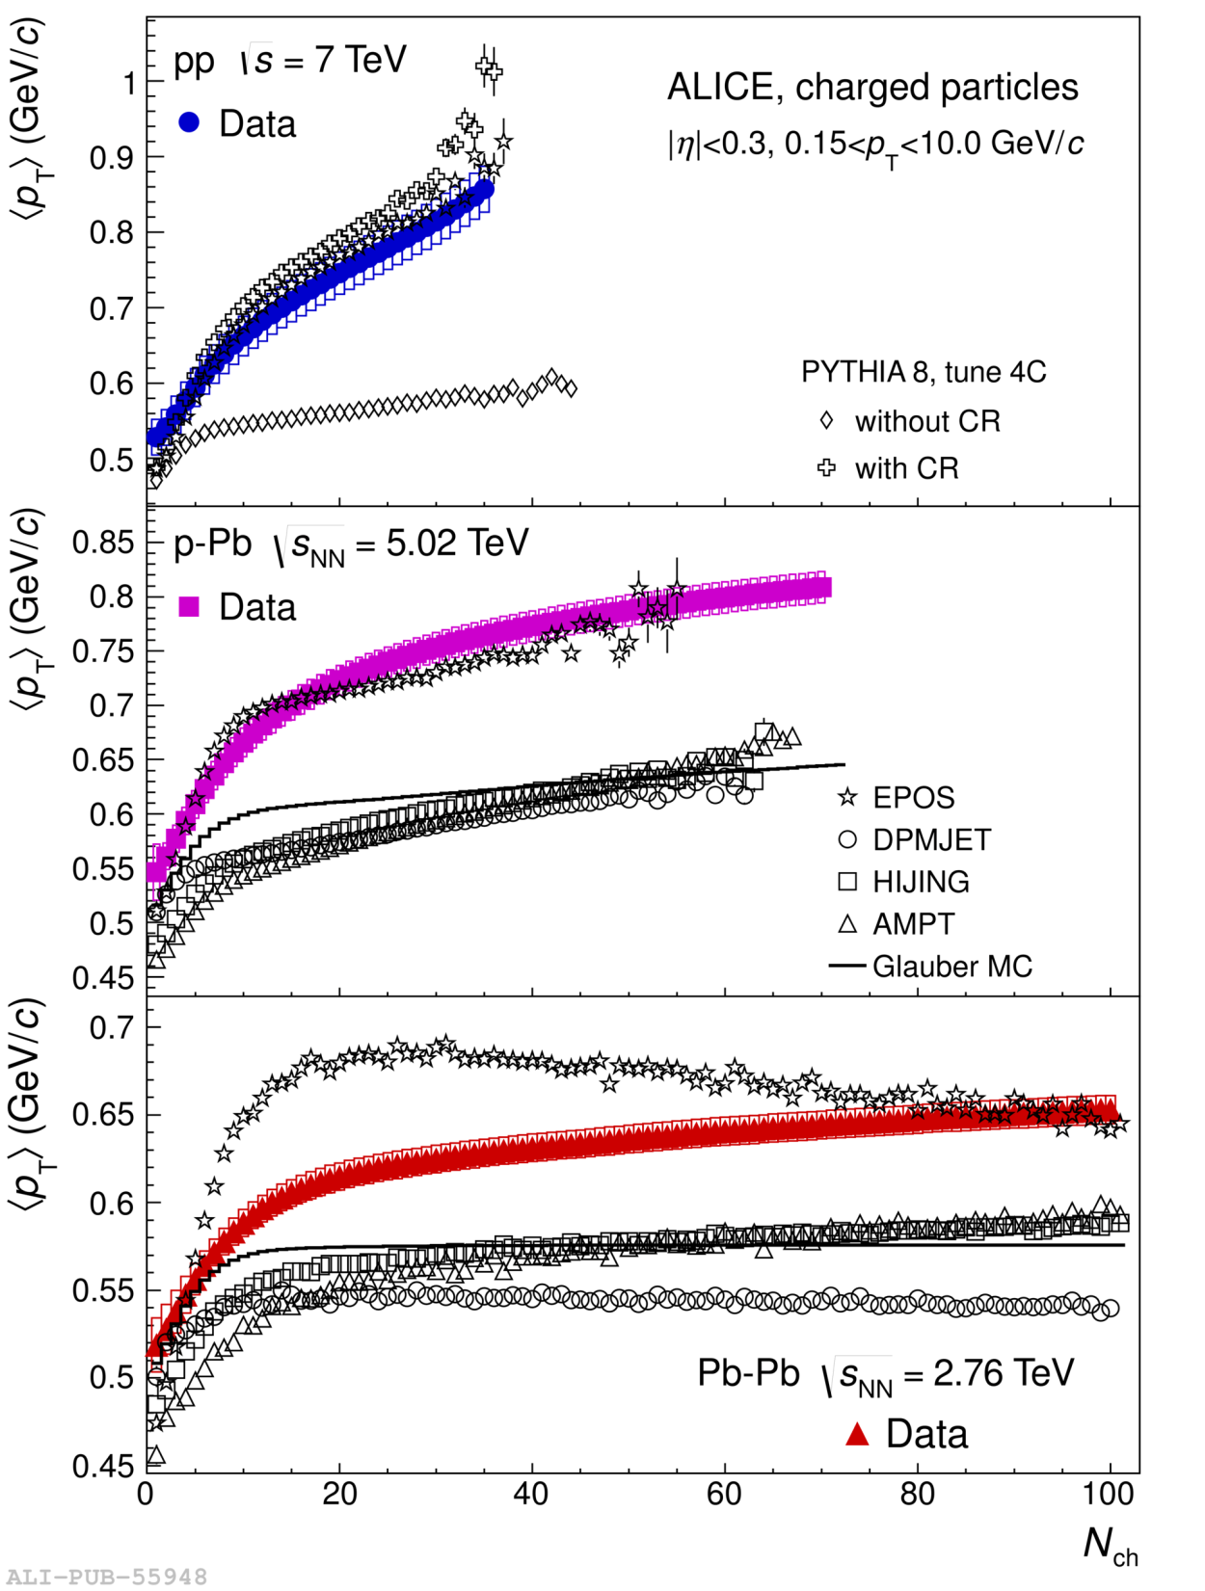
Color reconnection in pp models also minimizes particle production
Acta Phys.Polon. B40 (2009) 1981-1996

Slide 16
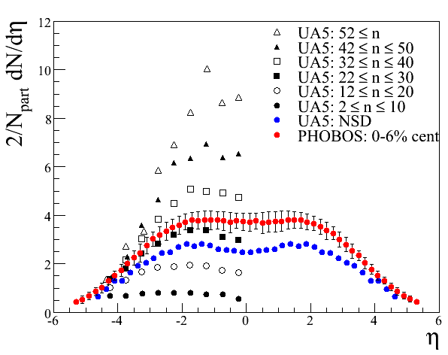
UA5 dN/dη for different multiplicity selections vs AA
We observe that a subset (~top 25%) of NSD pp collisions produce a similar charged particle pseudorapidity distribution as in A+A.

Slide 17
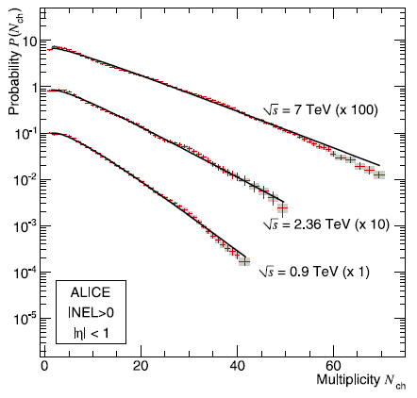
Multiplicity in pp
So pp is really a system where fluctuations plays a huge role!
√s=7 TeV MB (INEL>0) pp mult ~ 12

Slide 18
Is this why we should love central Pb-Pb collisions?
In central Pb-Pb collisions fluctuations are suppressed!
  We can neglect many fluctuations (not hard probes)
If pp collisions exhibits soft QGP like effects then Pb-Pb is the laboratory in which we want to study them
  This is a bit the inverse idea of how we argue for hard probes
If we want to measure the same things in pp collisions then we need to be able to “control” the fluctuations!

Slide 19
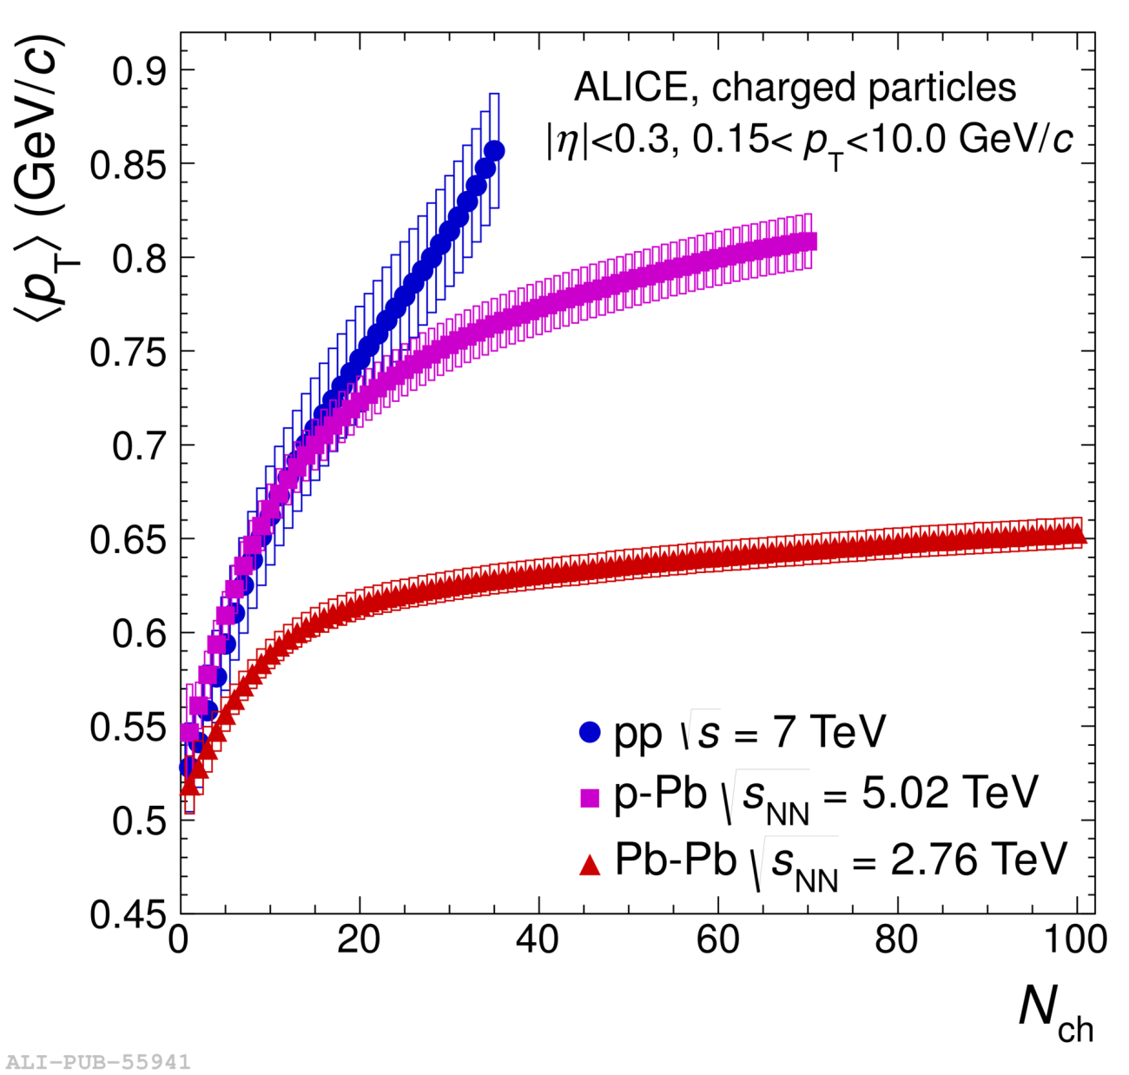
What are the challenges in comparing the systems?
We need to control
the hard scattering!

Slide 20
Where do we go from here experimentally?
One possibility is to try to understand what bias is needed to make pp comparable to Pb-Pb
Another possibility is to try to disentangle the physics we want to study
  This is what I will focus on first

Slide 21
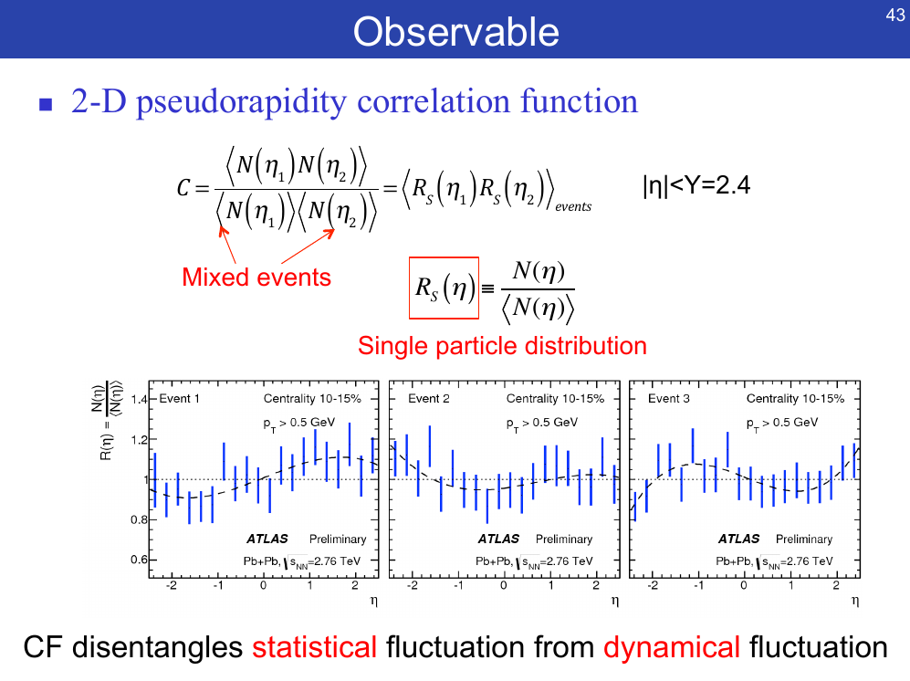
ATLAS studies of pseudorapidity correlations (1/3)
https://indico.cern.ch/
event/442430/
Is this just a superposition of similar independent sources?

Slide 22
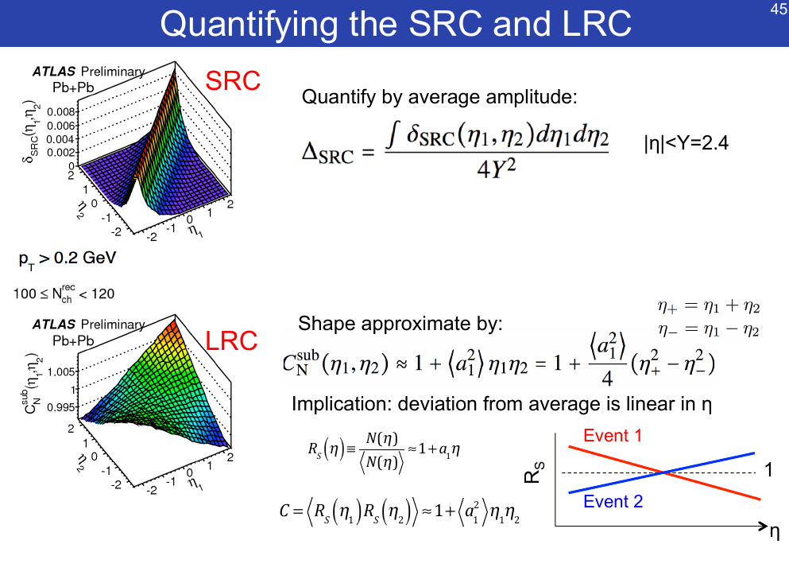
ATLAS studies of pseudorapidity correlations (2/3)
This is a way to handle the difference in the hard component (I return to that)

Slide 23
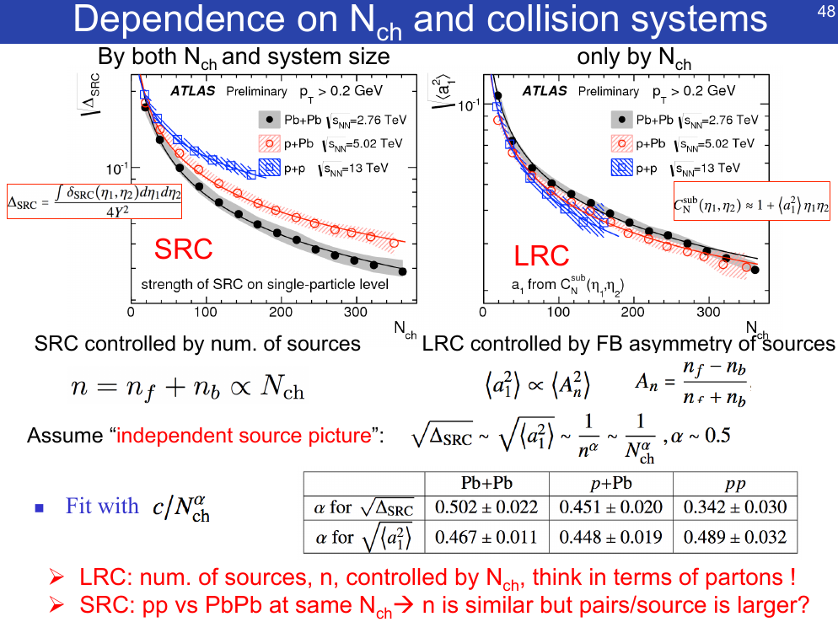
ATLAS studies of pseudorapidity correlations (3/3)
”SPAM”
”HAM”

Slide 24
What do we learn from this
The point of the ATLAS study
  If the fluctuations in the soft Underlying Event is the same for pp, p-Pb, Pb-Pb then where are the geometrical effects? (e.g. Color Glass Condensate)
A general point
  Factorize pp, p-Pb, Pb-Pb into a common soft Underlying Event and a hard short range component
    Separate out what we know differs from what we want to study
Are there other ways to do this?

Slide 25
What are the challenges in comparing the systems?
We need to control
the hard scattering!

Slide 26
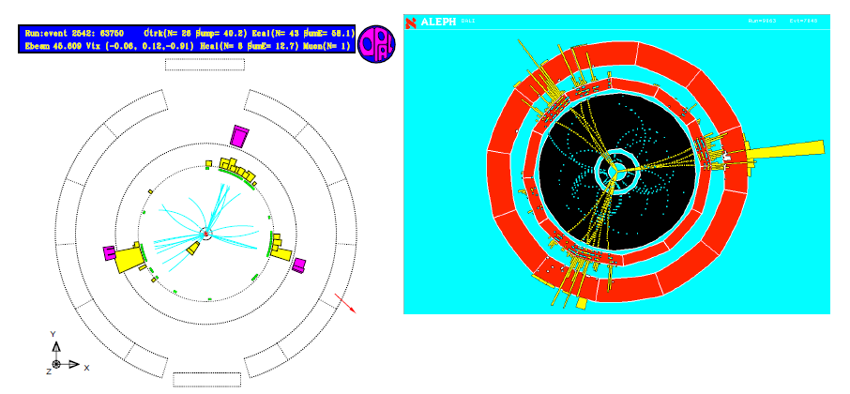
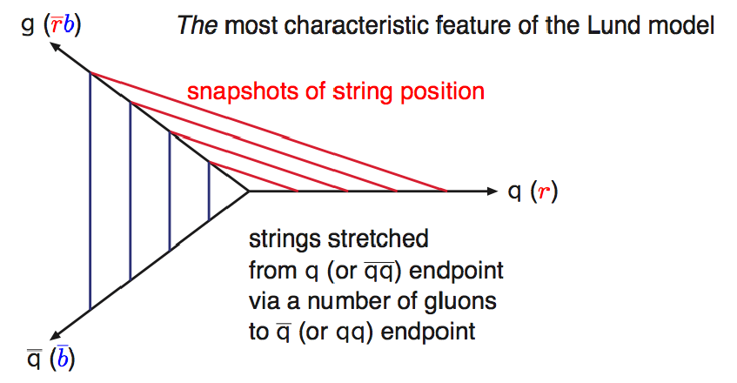
PYTHIA is built around the hard scattering (1/3)
e⁺e⁻→qq̅g
candidates
From Lund String Intro
by Torbjörn Sjöstrand

Slide 27
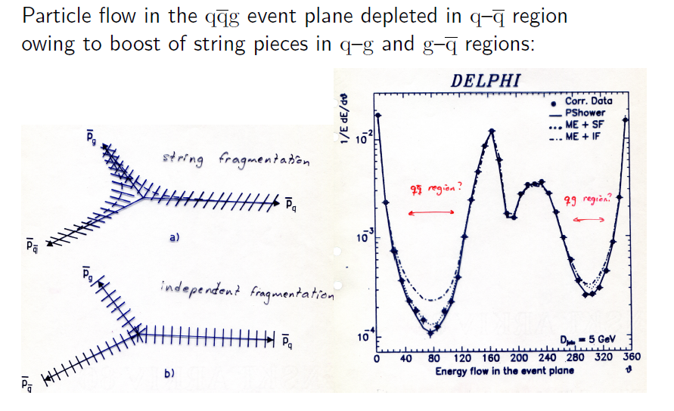
PYTHIA is built around the hard scattering (2/3)
From Lund String Intro
by Torbjörn Sjöstrand
Leading
2nd
3rd

Slide 28
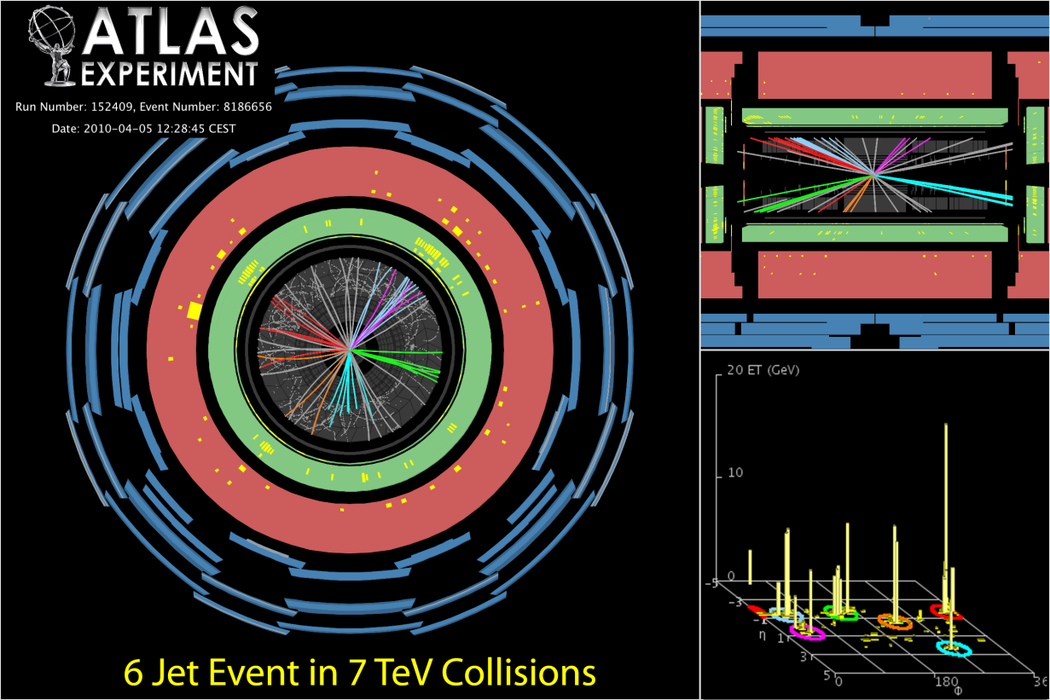
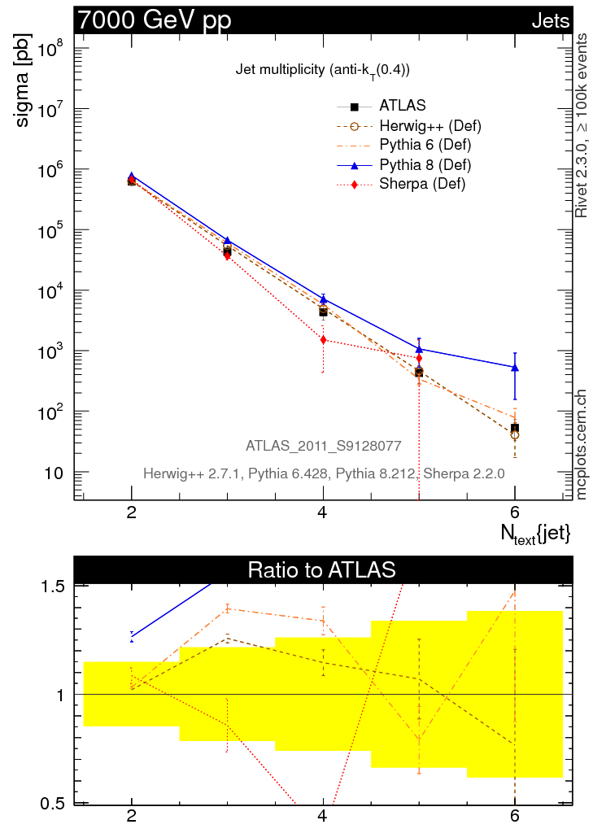
PYTHIA is built around the hard scattering (3/3)
http://mcplots.cern.ch/
For the hard scattering we cannot avoid QCD and so we immediately limit ourselves to a few large system models that can be used for small systems
Unless we can suppress the hard scattering!
https://twiki.cern.ch/twiki/bin/view/AtlasPublic/EventDisplayStandAlone#6_jets

Slide 29
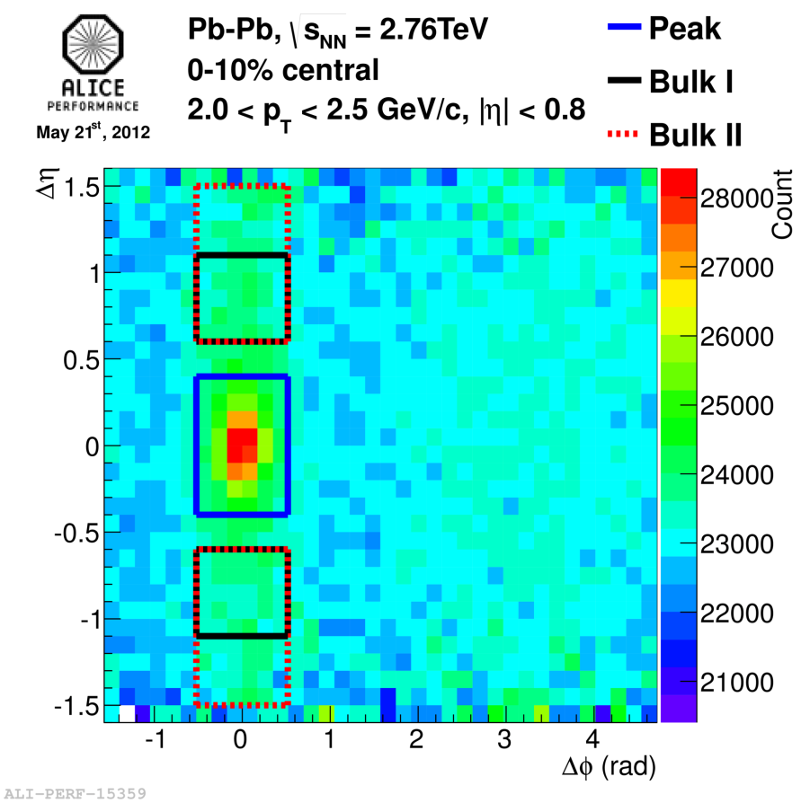
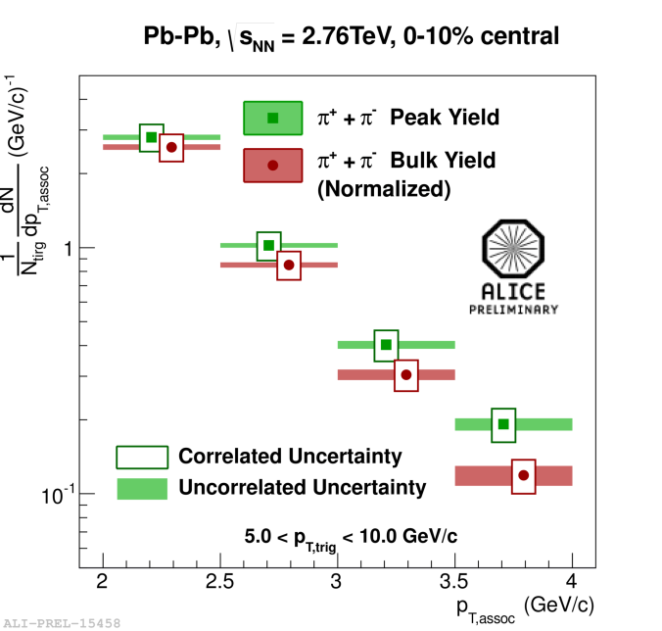
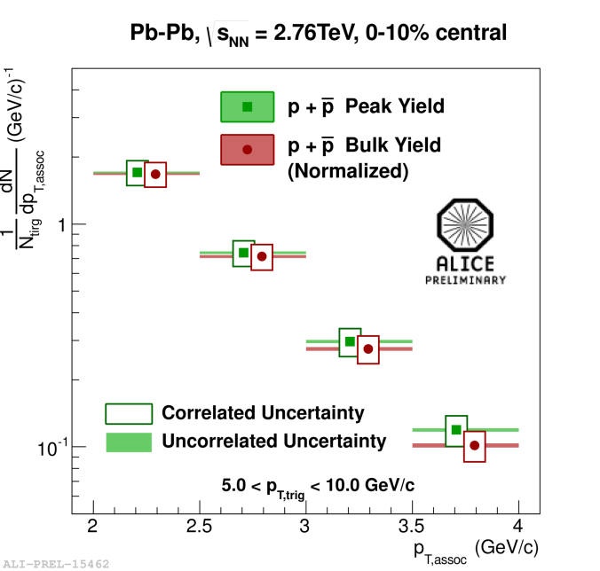
How to suppress the hard scattering

Slide 30
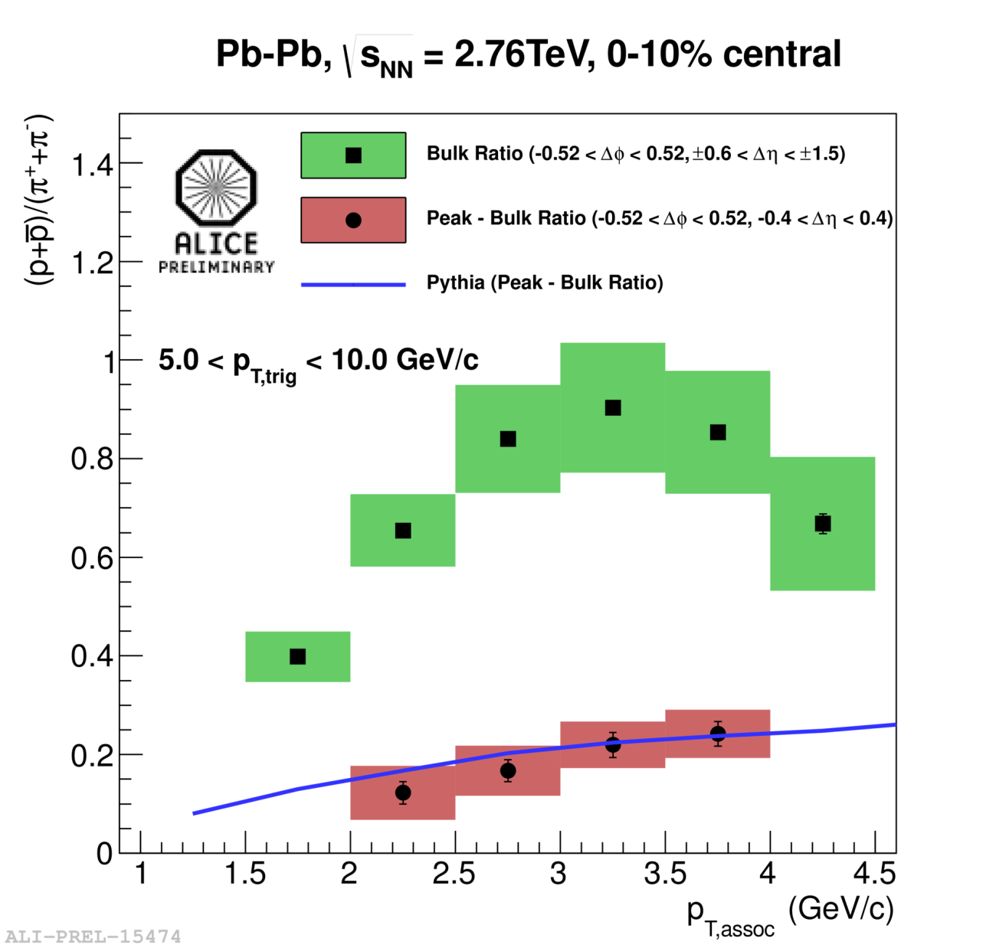
How to suppress the hard scattering

Slide 31
How to suppress the hard scattering
Underlying event
soft part
ee like hard part

Slide 32
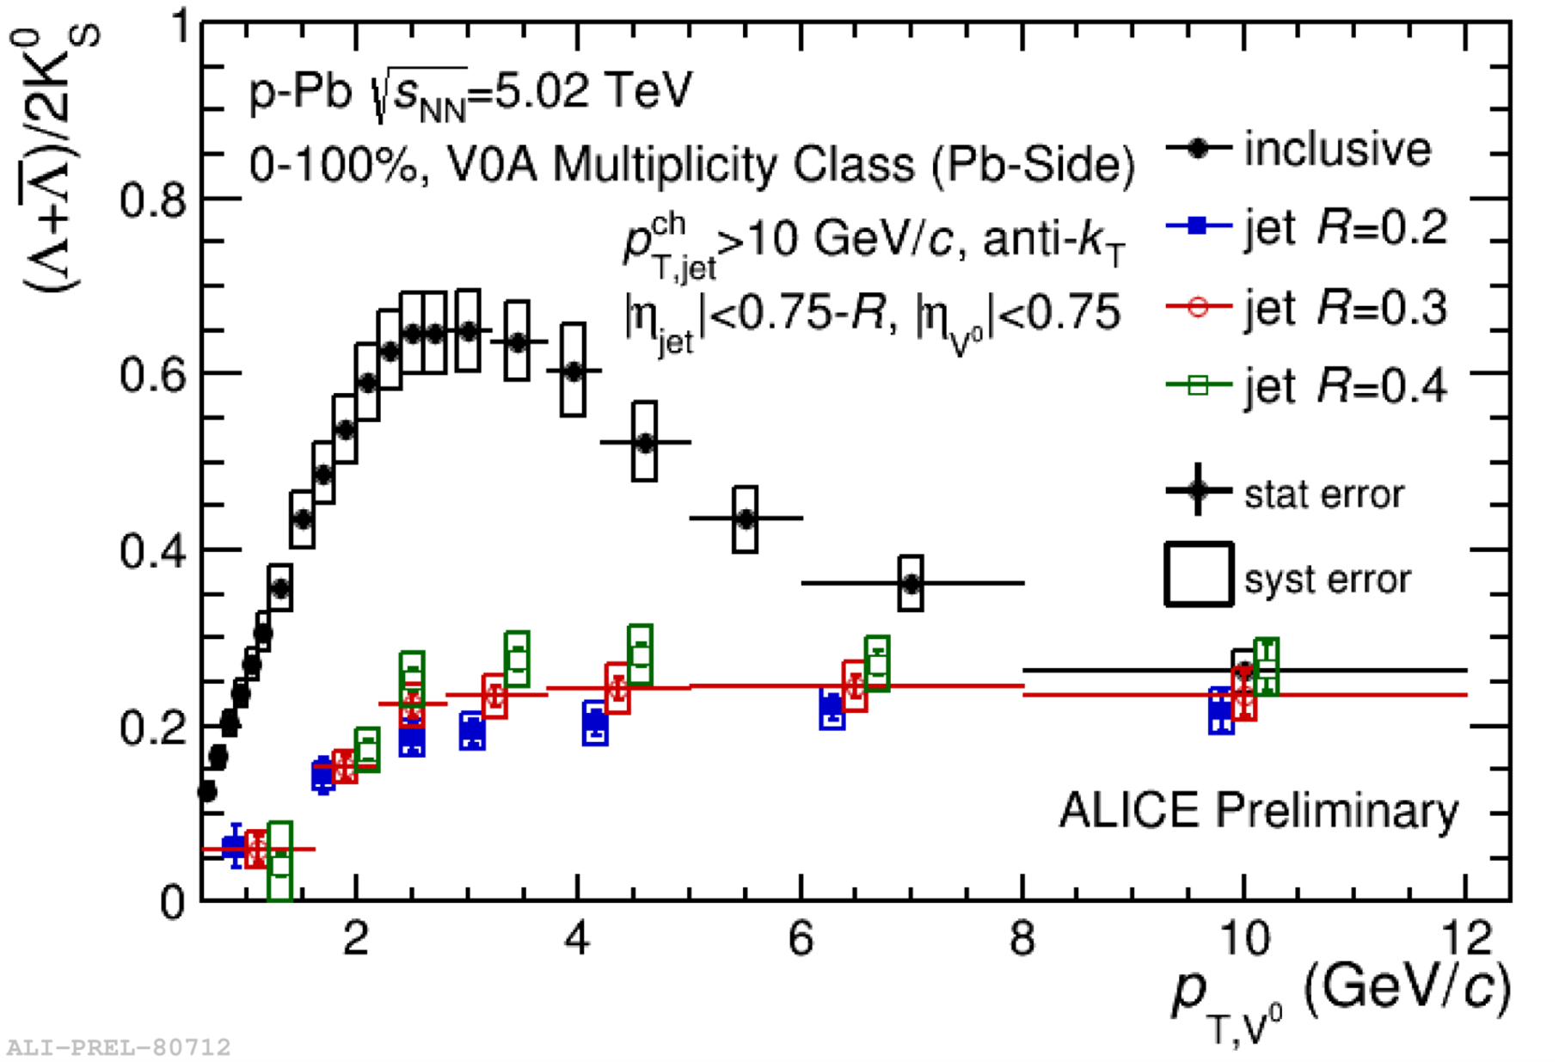
This also works in p-Pb
Note that here the Inclusive yield is shown and not the
Underlying Event

Slide 33
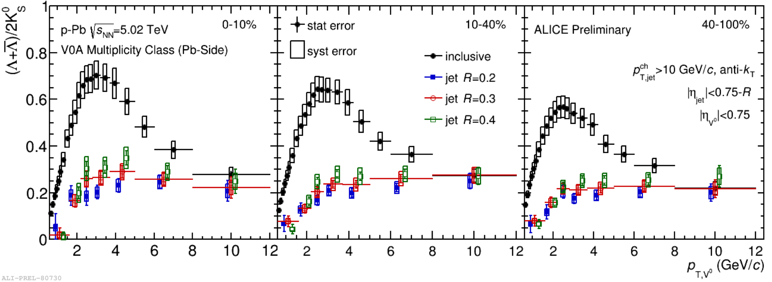
Evolution with mult
Where the focus so far has been on studying the hard scattering to look for modification in Pb-Pb collisions the
“Jet” = “Peak” – “Underlying Event”
study could be a tool to study the Underlying Event in pp
  Especially as a function of mult

Slide 34
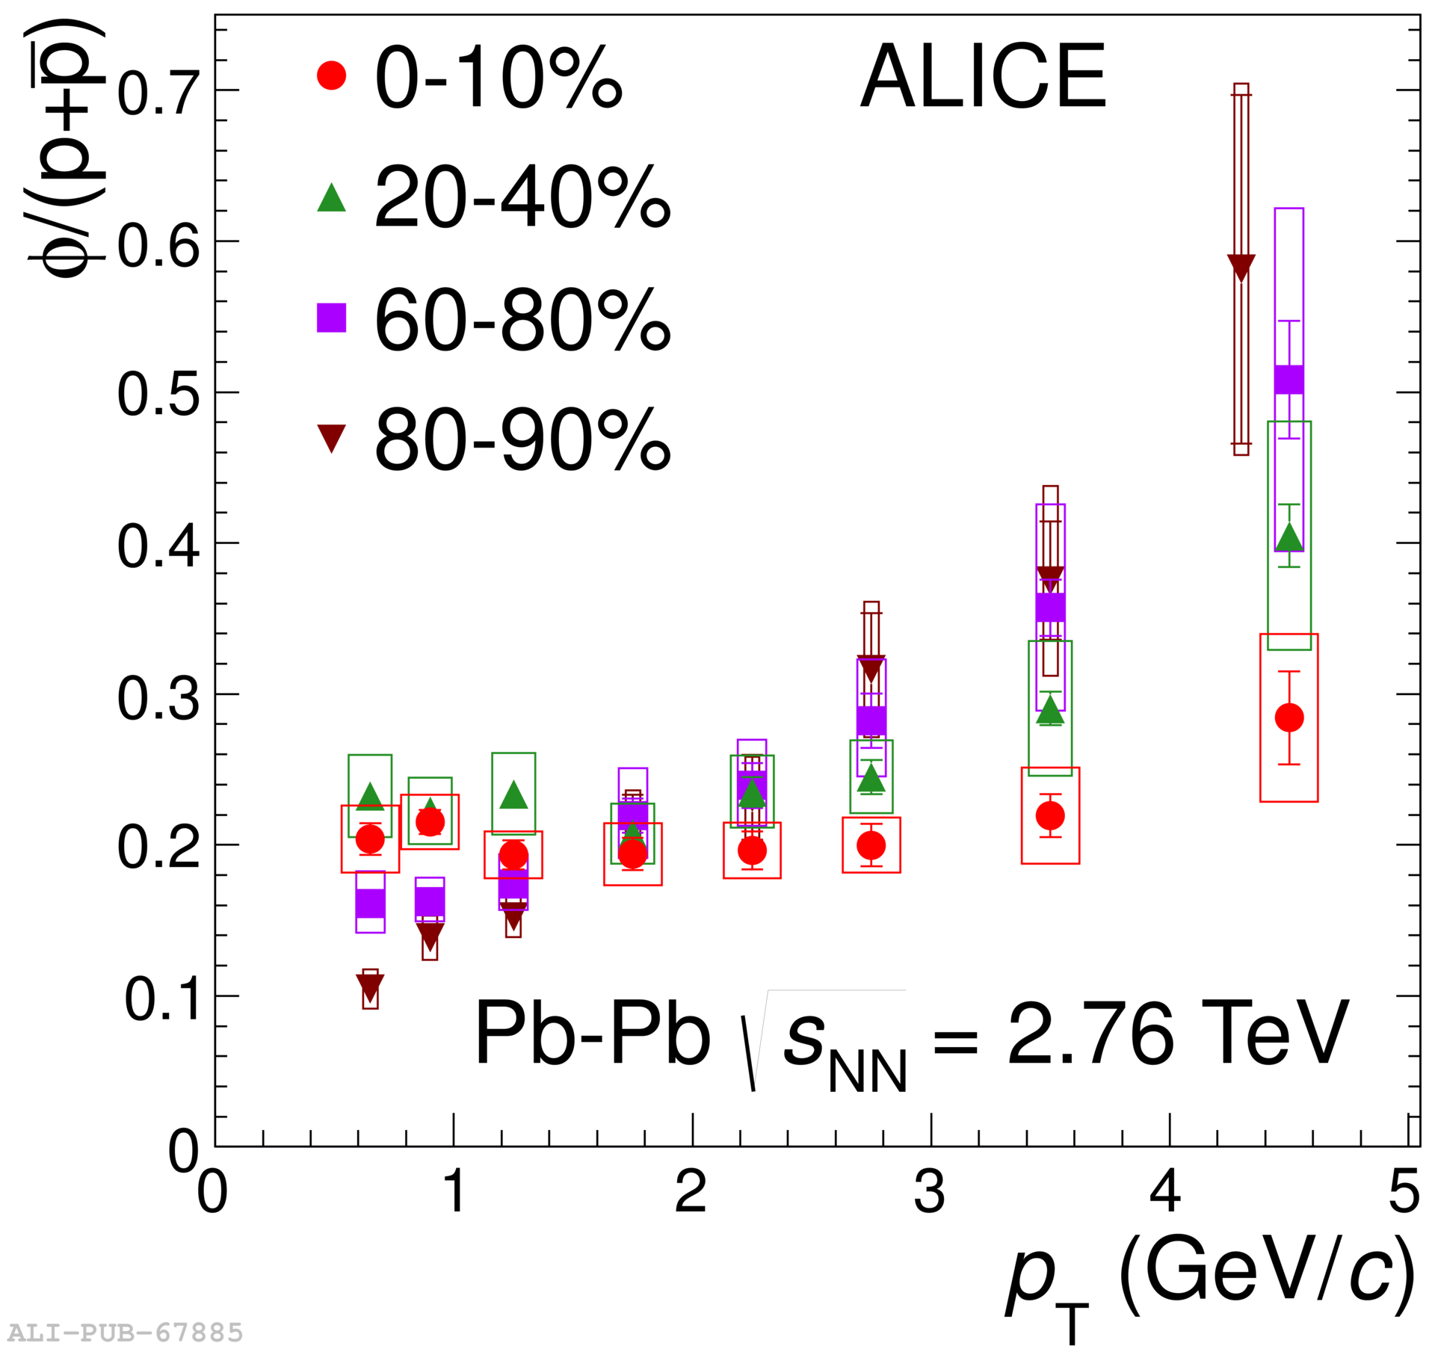
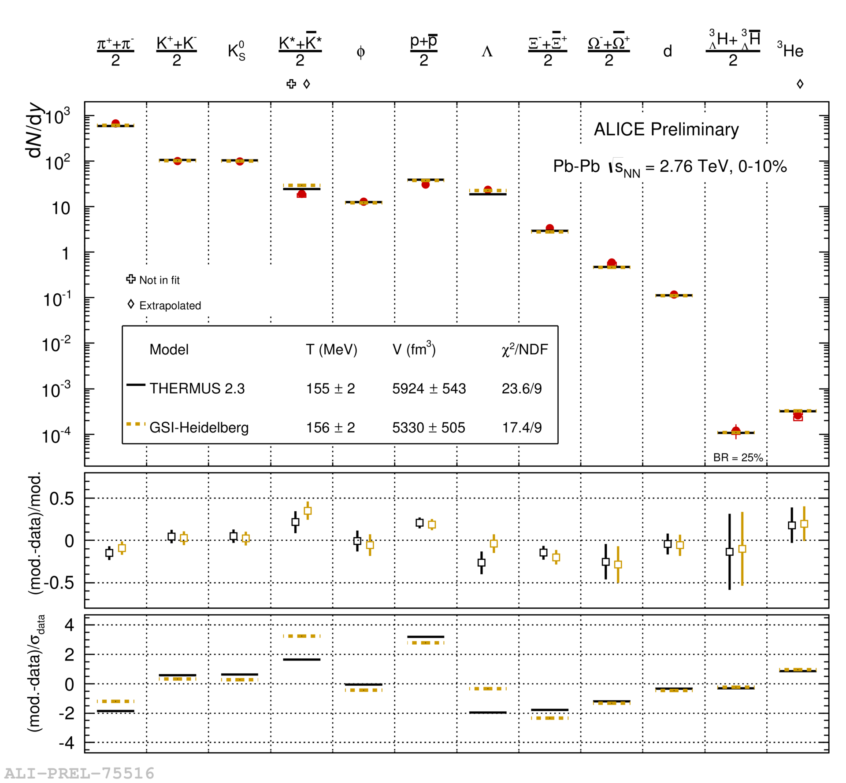
What particle to measure?

Slide 35
Phi is double suppressed in string models
φ
s
s̅
q
q̅
s̅
s
I need 2 string breakings to make a φ
2 ”QGP”-like signatures
  Yield and pT shape

Slide 36
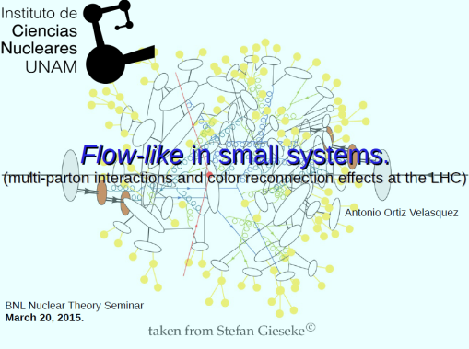
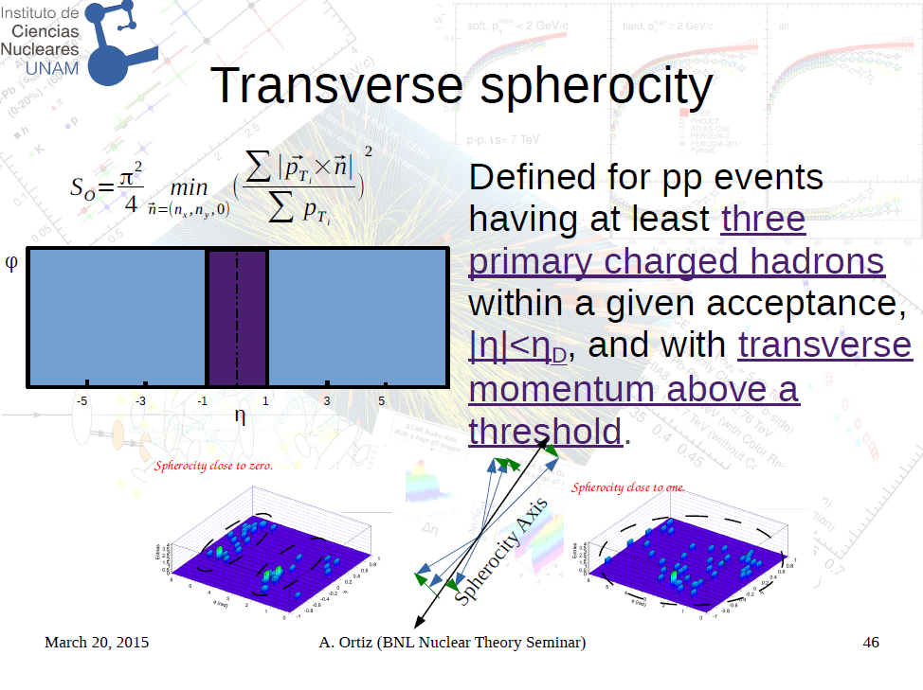
Event topology
“Disentangling the soft and hard components of the pp collisions using the sphero(i)city approach”, E. Cuautle Flores, R. T. Jimenez Bustamante, I. A. Maldonado Cervantes,
A. Ortiz Velasquez, G. Paic and E. Perez Lezama, arXiv:1404.2372

Slide 37
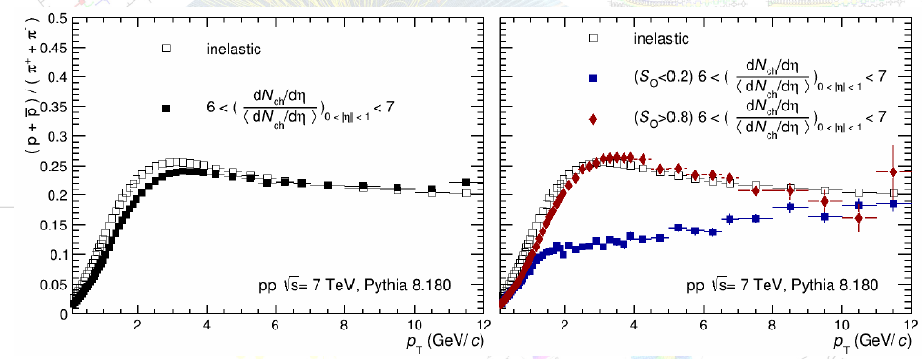
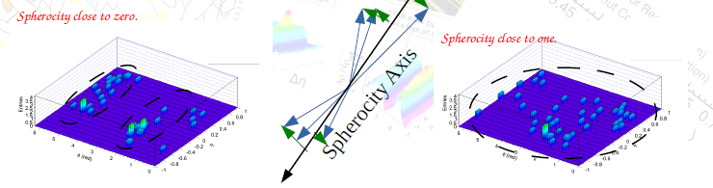
Particle ratios in PYTHIA (1/2)
”UE”
”jetty”

Slide 38
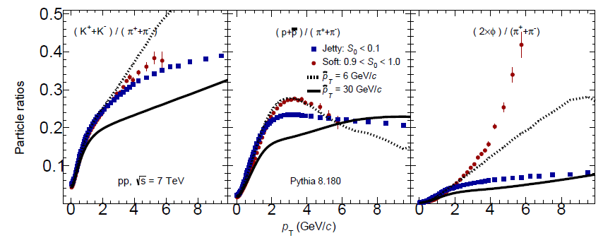
Particle ratios in PYTHIA (2/2)
arXiv:1404.2372
”UE”
”jetty”

Slide 39
Theoretical side
Can a small QCD system be macroscopic?
  Can we get a short mean free path in small systems?
  Are surface effects (due to confinement) small?
    In the transverse plane they must go as 1/r
Are QGP effects abundant in hadronic collisions?
  What are the conditions needed to have QGP effects?

Slide 40
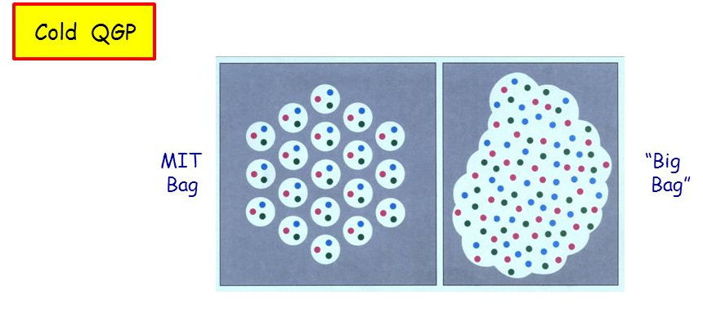
A simple picture of the nucleon and the QGP
In the BAG picture one has confinement from the vacuum BAG pressure while one has asymptotic freedom inside the BAG
  This seems to be a QGP gas model

Slide 41
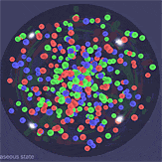
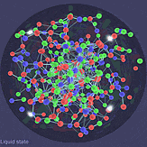
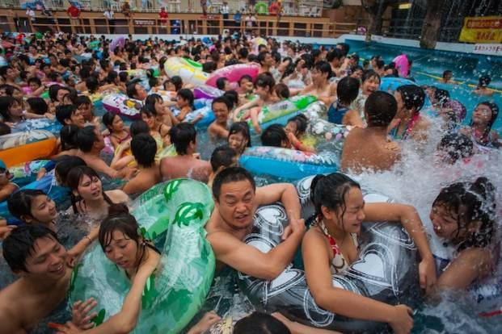
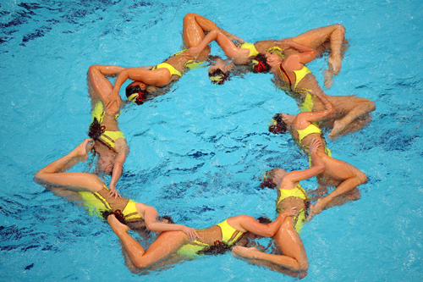
The QGP we found is not a gas but a perfect liquid

Slide 42
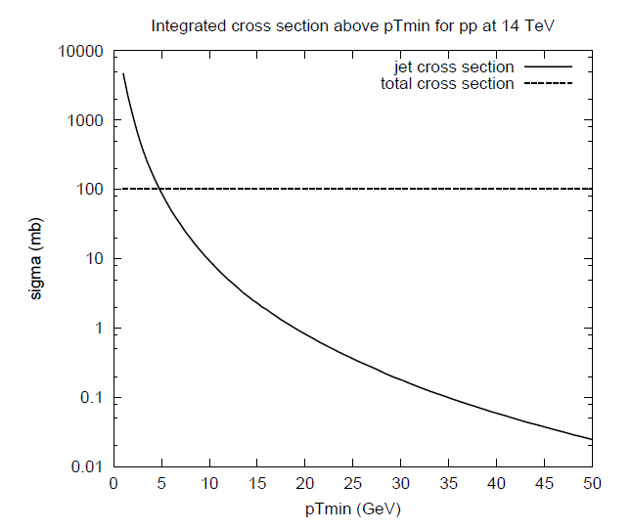
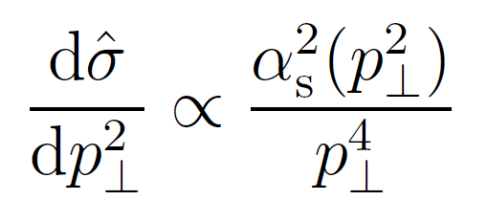
But already the proton has smaller scales
The partonic cross section
scales as:
In PYTHIA it is regularized via a p_{T,min} of order ~2 GeV/c
(This plays a big role for MPIs)
The interpretation of this scale is that the proton appears to be color neutral on scales larger than ~0.1 fm (whereas they expected Λ_{QCD} ~ 1 fm)

Slide 43
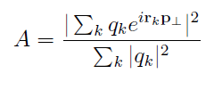
How to understand this scale
There are random (?) structures in the proton wave function that can be resolved by QED but not by QCD (and vice versa)
d(red)
u̅ (anti-red)
d(red)
d̅ (anti-blue)
Resolved by photon but not by gluon
Resolved by gluon but not by photon
Toy model study by Johann Dischler and Torbjörn Sjöstrand (Eur. Phys. J. direct C3 (2001) 2) where they evolve a proton (uud + 2g) to a new scale and then, randomly fixing the position of the partons, resolves it with a gluon
They study the ratio of the coherent to the incoherent cross section

Slide 44
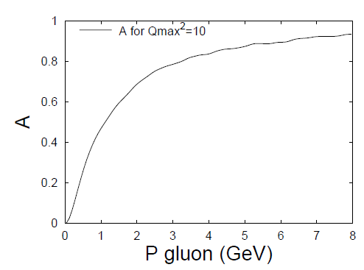
Results of toy model study
Coherent / incoherent partonic Xsection
In their model the screening is random (weakly coupled) and has some energy dependence due to the pdfs
One could ask if the screening is really random or it reflects strong correlations in the proton wave function

Slide 45
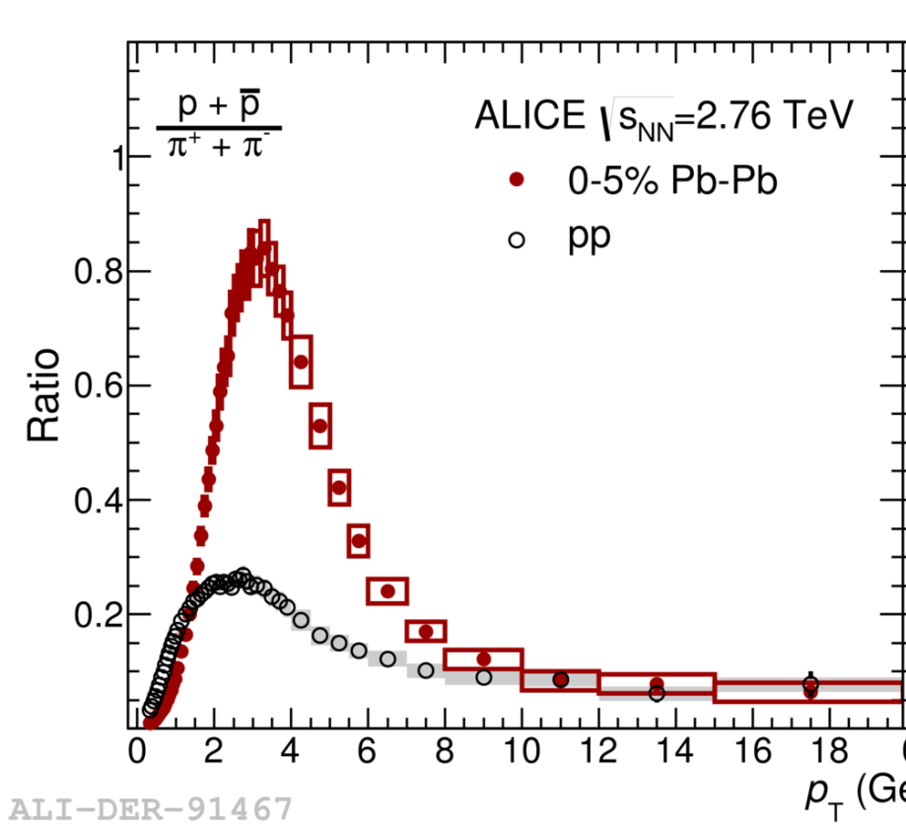

Does this also reflect the scales of the physics?
arXiv:1601.03658
Does initial state and final state effects reflect the same physics?
It is clearly in a range of p_{T}s that appears to be similar...

Slide 46
My idea is
If there are scales (degrees of freedom) that are much smaller than the proton size then the proton can be thought of as a macroscopic system (thermalization, flow)
  If not, then what?
Could these scales (degrees of freedom) also be at work in the final states?
  This seems to me to be a possible consequence of small systems exhibiting QGP like effects
In this case also QGP effects are abundant!

Slide 47

Are QGP effects abundant?
Old idea (bag model): there are QGP conditions inside a nucleon (I call it the overlap picture)
  If we can squeeze together matter so it will get the same density as a proton then the quarks will not know which nucleon they are part of (high density limit)
The critical energy density estimated this way (r=0.88fm) is ~0.6 GeV/fm³
  This is quite close to LQCD
  estimates e.g. 0.7GeV/fm³

Slide 48

How precise are LQCD calculations?
Rep. Prog. Phys. 74 (2011) 014001
The critical temperature is important as the energy density on the QGP side scales with T⁴

Slide 49
Pushing the envelope
There are calculations, PRL 111, 202302 (2013), suggesting that the strange quark freezes out at 1.11 times higher temperature than the u and d quark
This would mean an energy density that is 1.11⁴ = 1.52 times higher
If one interprets this in a way that the strange quark density in hadrons is similar higher, then the constituent strange quark mass is ~1.5 times the constituent u/d mass
  450 MeV instead of 300 MeV

Slide 50
My idea is
If the overlap picture is a good picture
Weak statement: A proton (and all non-pseudo goldstone bosons) seems to have the necessary energy density to form a QGP
  This IMO suggests that QGP effects could be abundant in nature (e.g. also in pp collisions)
Strong statement: the confining nature of the QGP phase transition seems to imprint Tc on the ground state (non-Goldstone) hadrons
  And this is in fact an “anti-Hagedorn” picture

Slide 51
Reiterating the first questions
Experimental side:
  How different are pp and AA collisions?
    In particular how different are the initial states
  How can we separate hard and soft physics in pp collisions?
    Several existing ideas. Important that they can be modeled using Rivet
Theoretical side
  Can a small system be macroscopic?
    Is the proton a weakly coupled system or a strongly coupled system?
    Do you have the same organization in the proton wave function as in the plasma
  Are QGP effects abundant in hadronic collisions?
    Are QGP conditions present in most hadronic collisions?
Thank you!

Slide 52
Backup slides

Slide 53

dN/dy comparison

Slide 54

Why did we think the QGP would be a gas?
Stefan-Boltzmann energy density (rel. gas of massless bosons and fermions)
$$ϵ_{SB}=\frac{π^{2}}{30}\left(2×8+\frac{7}{8}2×2×3×3\right)T^{4}$$
Gluon spin and color
(Anti+)quark spin, color and flavor
This suggests that the Quark Gluon Plasma should behave as a gas of quarks and gluons!

Slide 55

In fact SB gas gives a good description of the energy density on the QGP side!
PRL 103,
232001 (2009)
Good description also of pure Gauge (gluons only) systems
This will be our picture of the QGP side!
  (Physics coupling to perfect liquid / flow)

