Slide 1



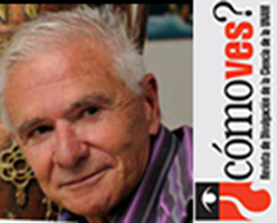

Slide 2
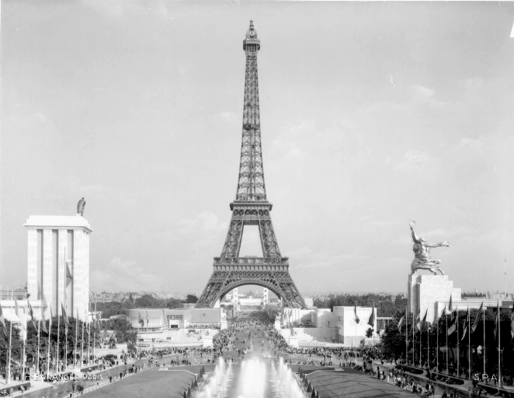
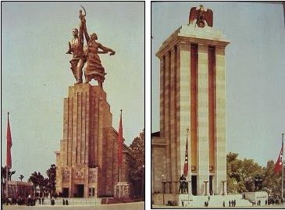
Guy was born in Paris in 1937
moved to Zagreb 1946
Nazi Germany and Soviet Union Pavilions won the golden medal of the World
Exhibition in Paris 1937

Slide 3
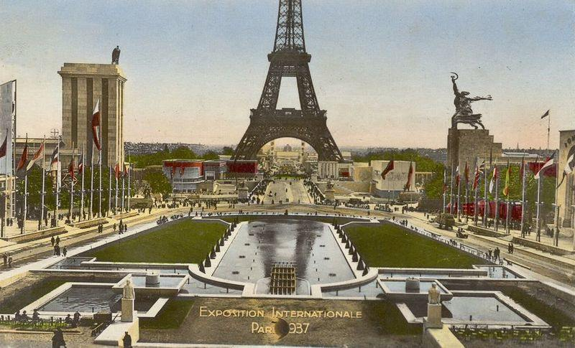
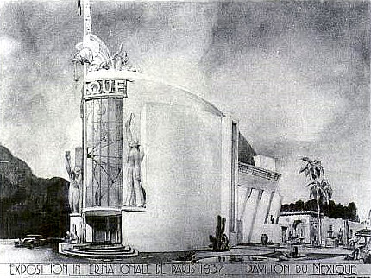
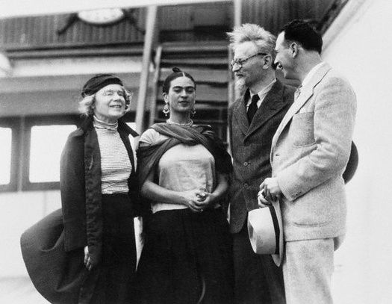
Frida Kahlo and Leon Trotsky
who arrived in Mexico 1937 …killed 1940
The mexican pavilion, Paris 1937

Slide 4
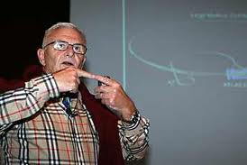
Completed his studies in 1964 with a PhD in Physics in Zagreb
First job in Ruder Boṡkoviƈ Insitutute Zagreb
1968-1970 UCLA Los Angeles
First encounter with México
Expert of the International Atomic Energy Agency and worked in
several african countries.
He made experiments in nuclear physics in Zagreb, Louvain Belgium
Juelich Germany and CERN ….
1968 received the Ruder Boṡkoviƈ Insitutute Prize
1973 received the Nicola Tesla Award
2003 arrived in México at the
National Autonomous University of Mexico

Slide 5
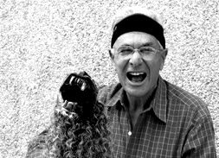
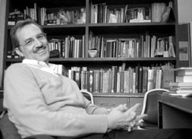
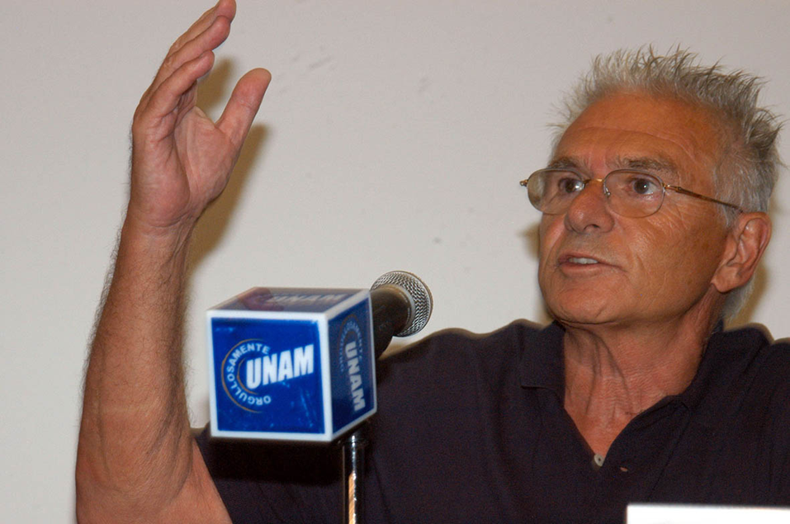
Guy started a Professor
position in Mexico on
April the 1st, 2003.
2003
Octavio Castaños
Director
Instituto de Ciencias Nucleares
UNAM

Slide 6
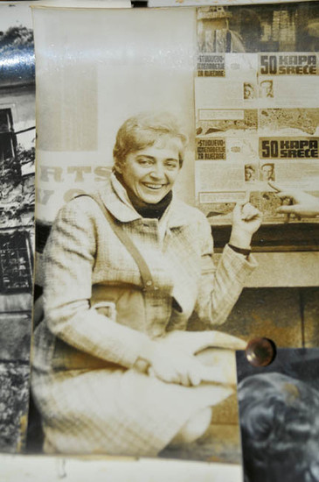
Arlette Ambrozic Paic

Slide 7
2004

Slide 8
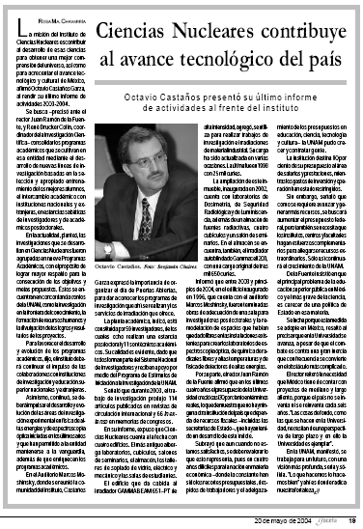

Slide 9
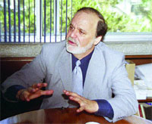
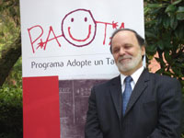
Alejando Frank Hoeflich
Director
Instituto de Ciencias Nucleares
UNAM
Gave shape to the stronger group in high energy physics in Mexico
Mario Iván, Eleazar Cuautle,
Sergio Vergara, Pedro Podesta,
Lukas Nellen
Enrique Patiño (electronics technician)
+
a well equiped instrumentation lab

Slide 10
He came with the proposal to participate in STAR – RHIC
"Proposal for a large time of flight system for STAR"
Date: Sat, 21 Sep 2002 13:25:03 +0200
From: Guy Paic <Guy.Paic@cern.ch>
To: Gerardo Herrera Corral <gherrera@fis.cinvestav.mx>
Subject: STAR
I just got a mail from Castanos. He did send the letter to STAR. So
everything is OK!, Regards, Guy
Guy Paic tel.+41227676618

Slide 11
From: Tim Hallman [mailto:hallman@bnl.gov]
Sent: Saturday, March 22, 2003 3:49 AM
To: ocasta@nuclecu.unam.mx
Cc: Guy.Paic@cern.ch; Gerardo.Herrera@fis.cinvestav.mx;
ayala@nuclecu.unam.mx; JNMarx@lbl.gov; vigdor@iucf.indiana.edu;
jhthomas@lbl.gov; hallman@bnl.gov
Subject: Application by UNAM-CINVESTAV to join STAR
Dear Professor Castaños (Octavio):
First I would like to say that we appreciate very much your
interest in STAR, and in the possibility of participation in
the STAR Collaboration by The Nuclear Science Institute and
the Physics Institute from UNAM and the Cinvestav.

Slide 12

The proposal for a Time of Flight did not go on …
but it represents an important aspect of
Guy coming to Mexico …
… he came with ideas.

Slide 13
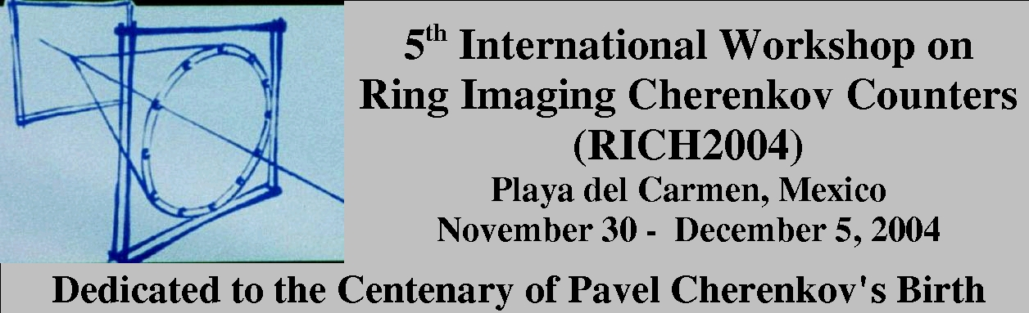
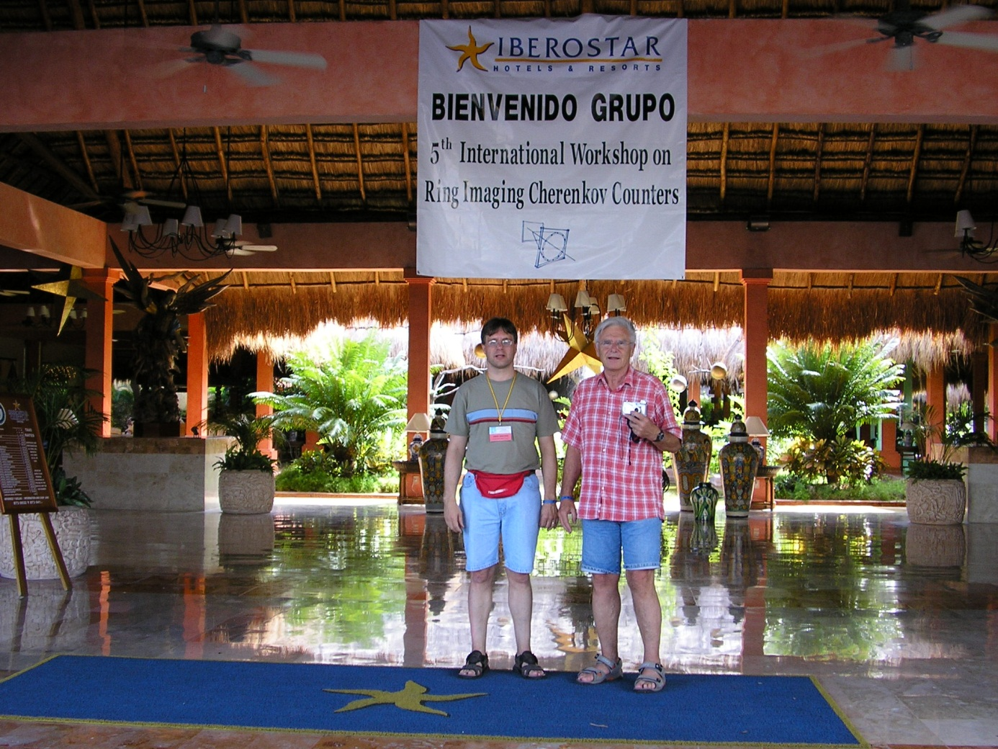
Organización en México de la Conferencia Cherenkov

Slide 14
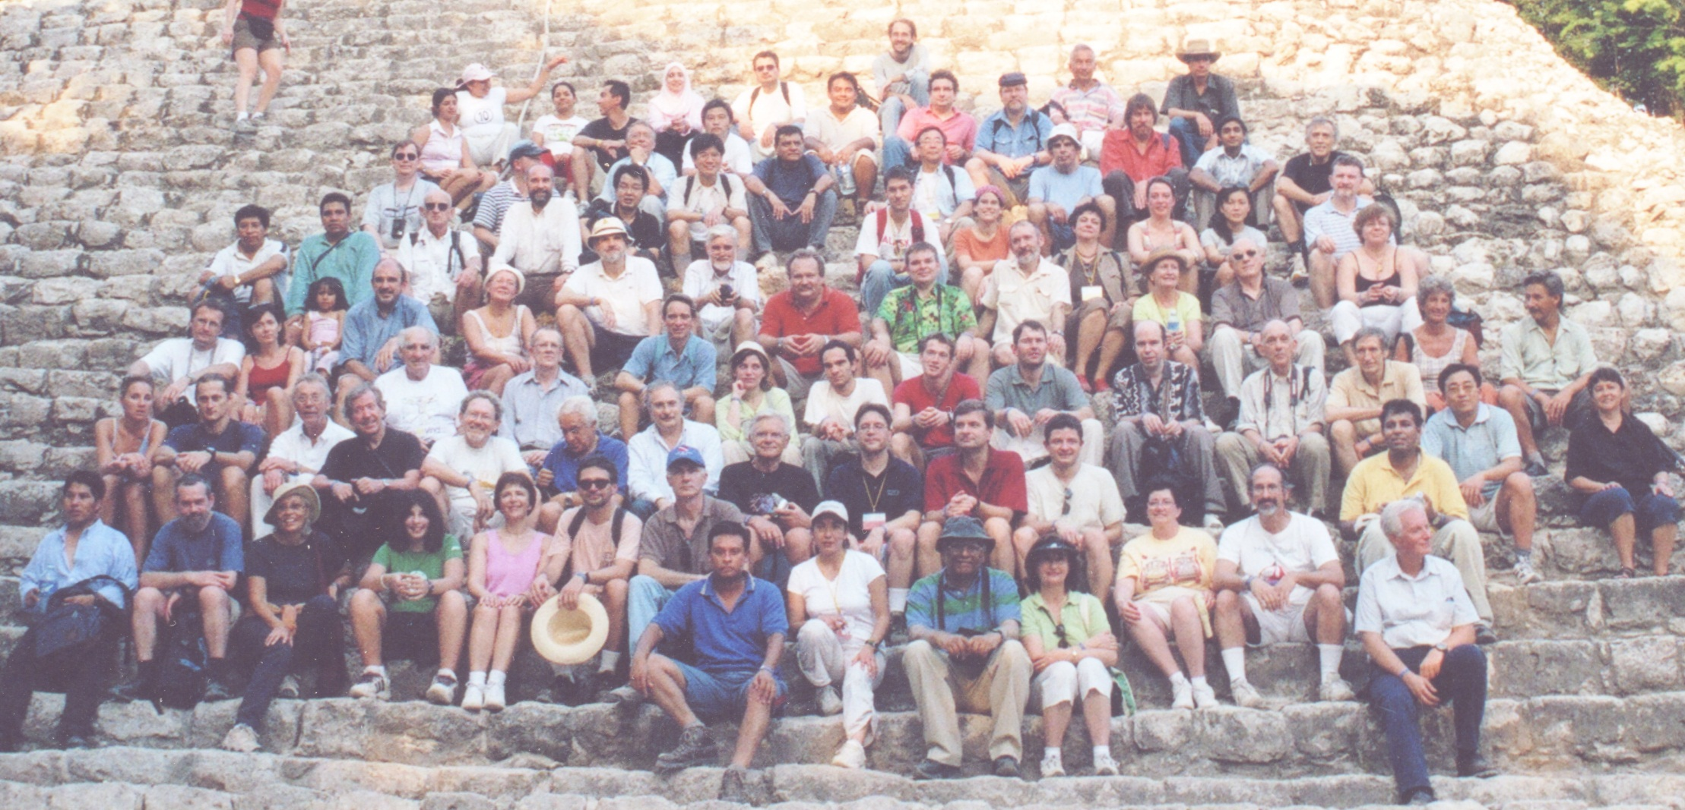

Slide 15
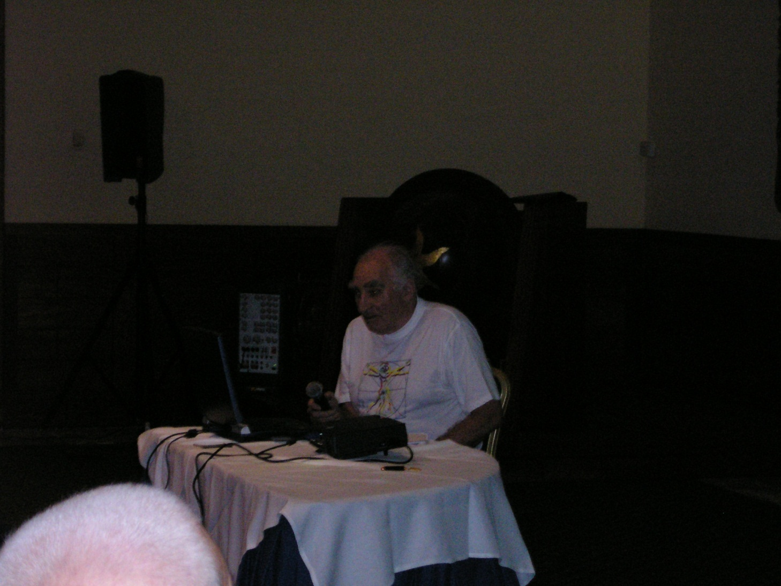
Elena Cherenkova daughter of Pavel Cherenkov
Boris Govorkov collaborator of Pavel Cherenkov

Slide 16
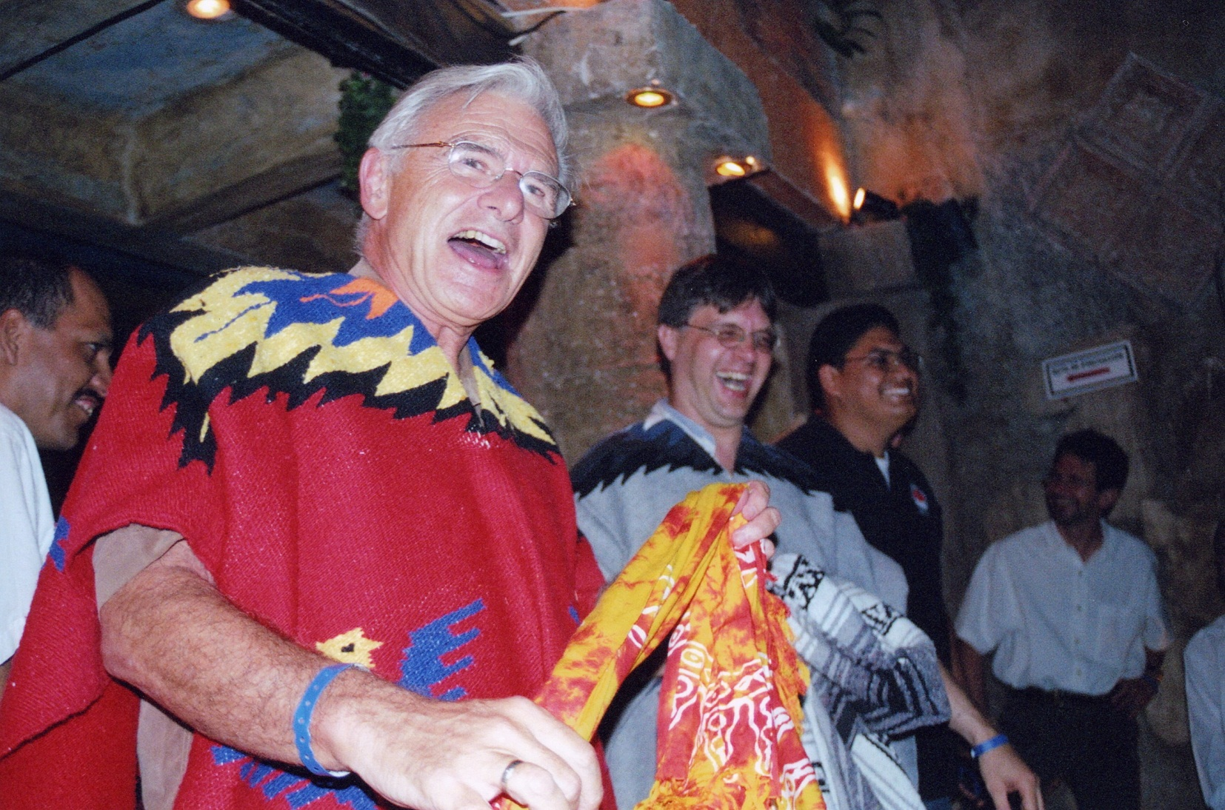
a successful conference !

Slide 17
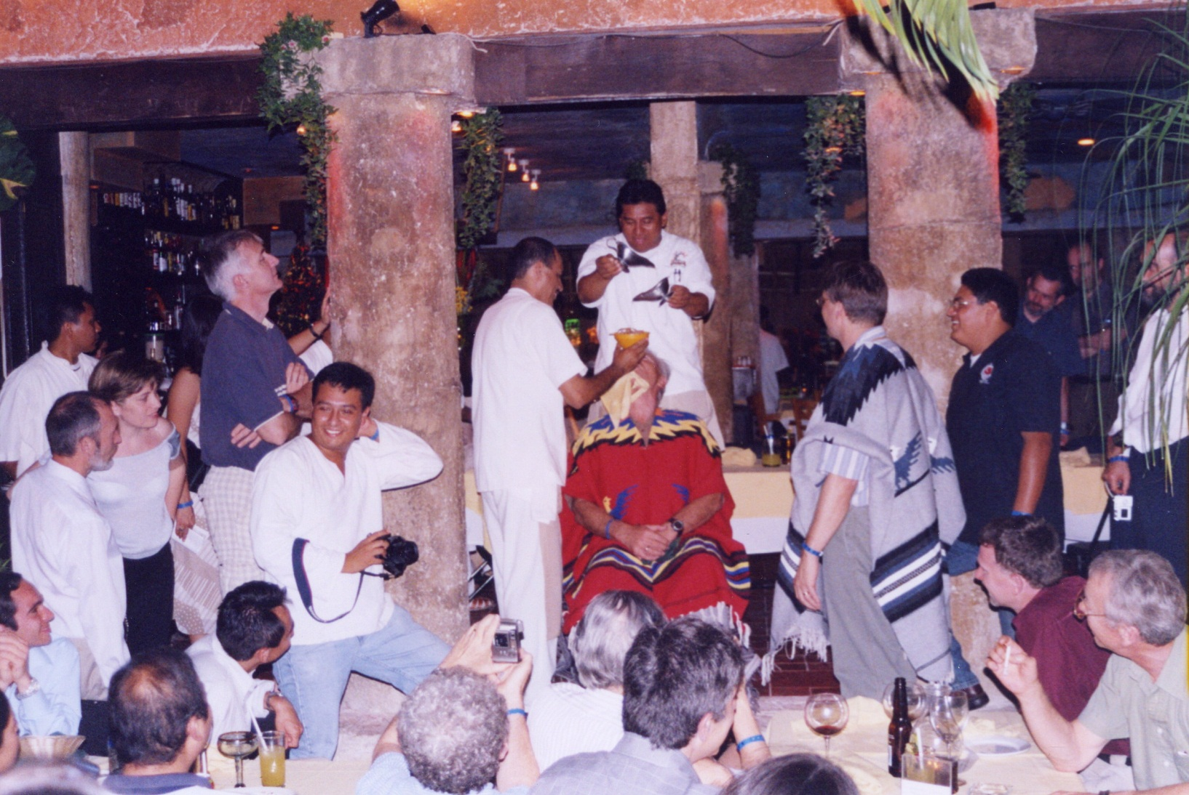
as you can see … !

Slide 18
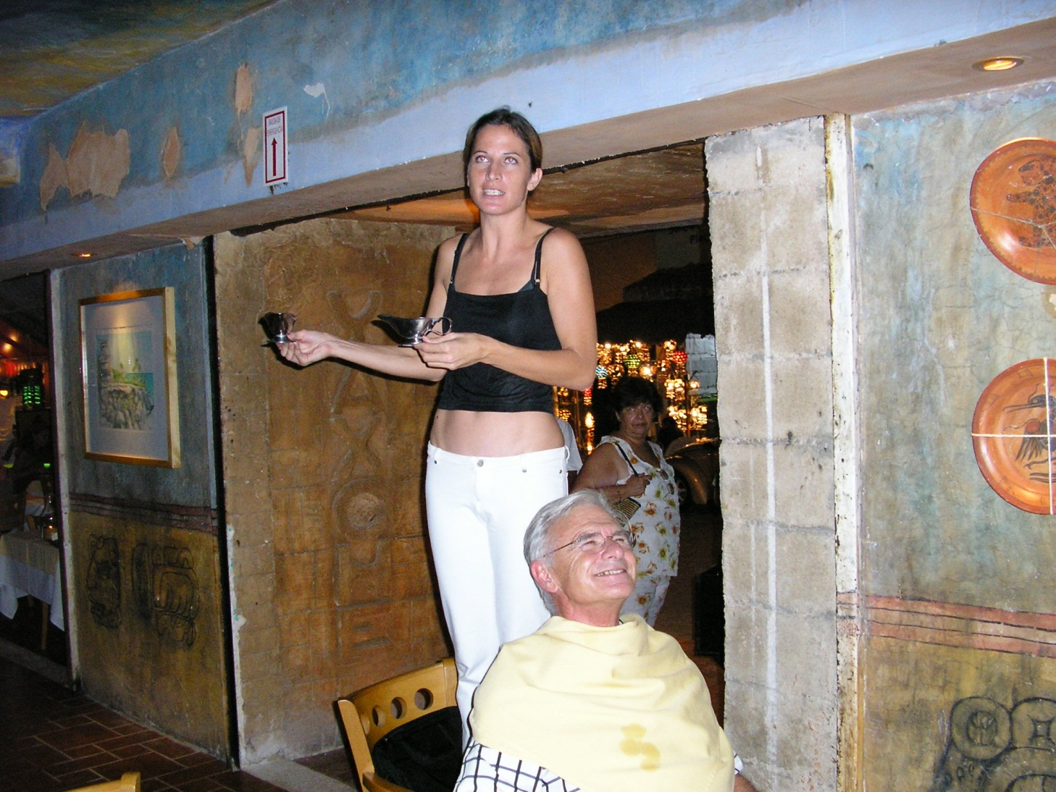
Guy dreamed …

Slide 19
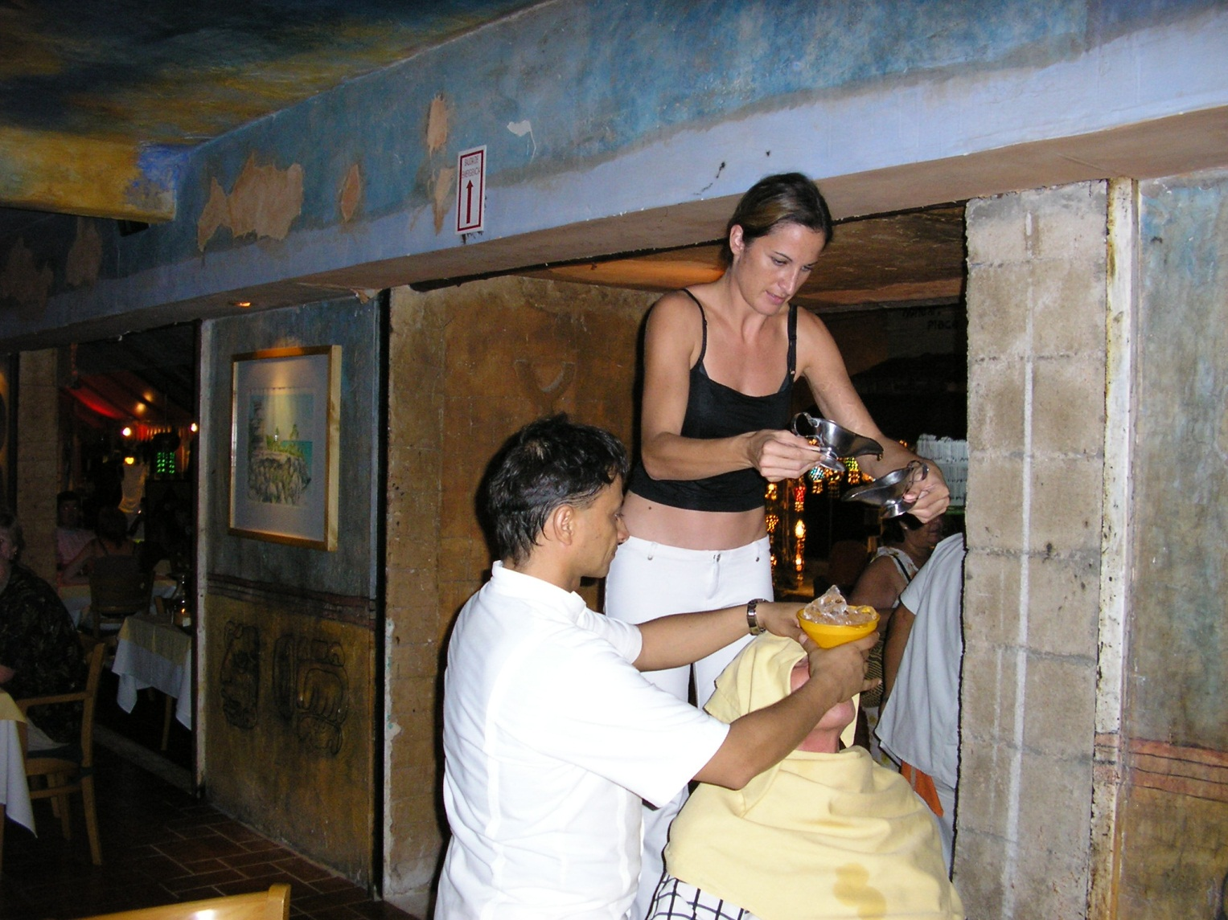
… and the dream came through !

Slide 20
Agency CONACYT approved funding in 2004
"Desarrollo de herramientas de simulación y detectores para el estudio de perdida de energía de partones en materia densa"

Slide 21
2005
Leading-particle suppression in high energy nucleus-nucleus collisions.
A. Dainese, C. Loizides,
G. Paic (Mexico U., ICN) . Jun 2004. 26pp.
Published in Eur.Phys.J.C38:461-474,2005.
208 citations in spires

Slide 22

2006

Slide 24
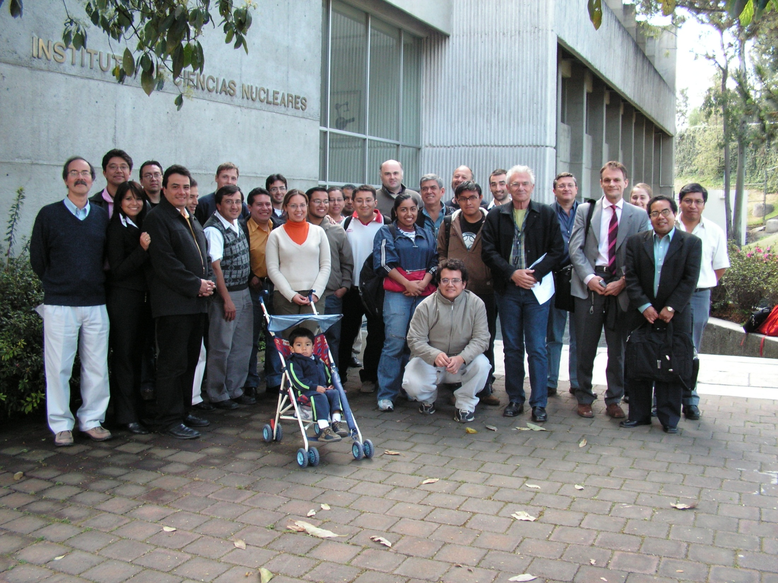
It seems like yesterday
but it was long ago

Slide 25
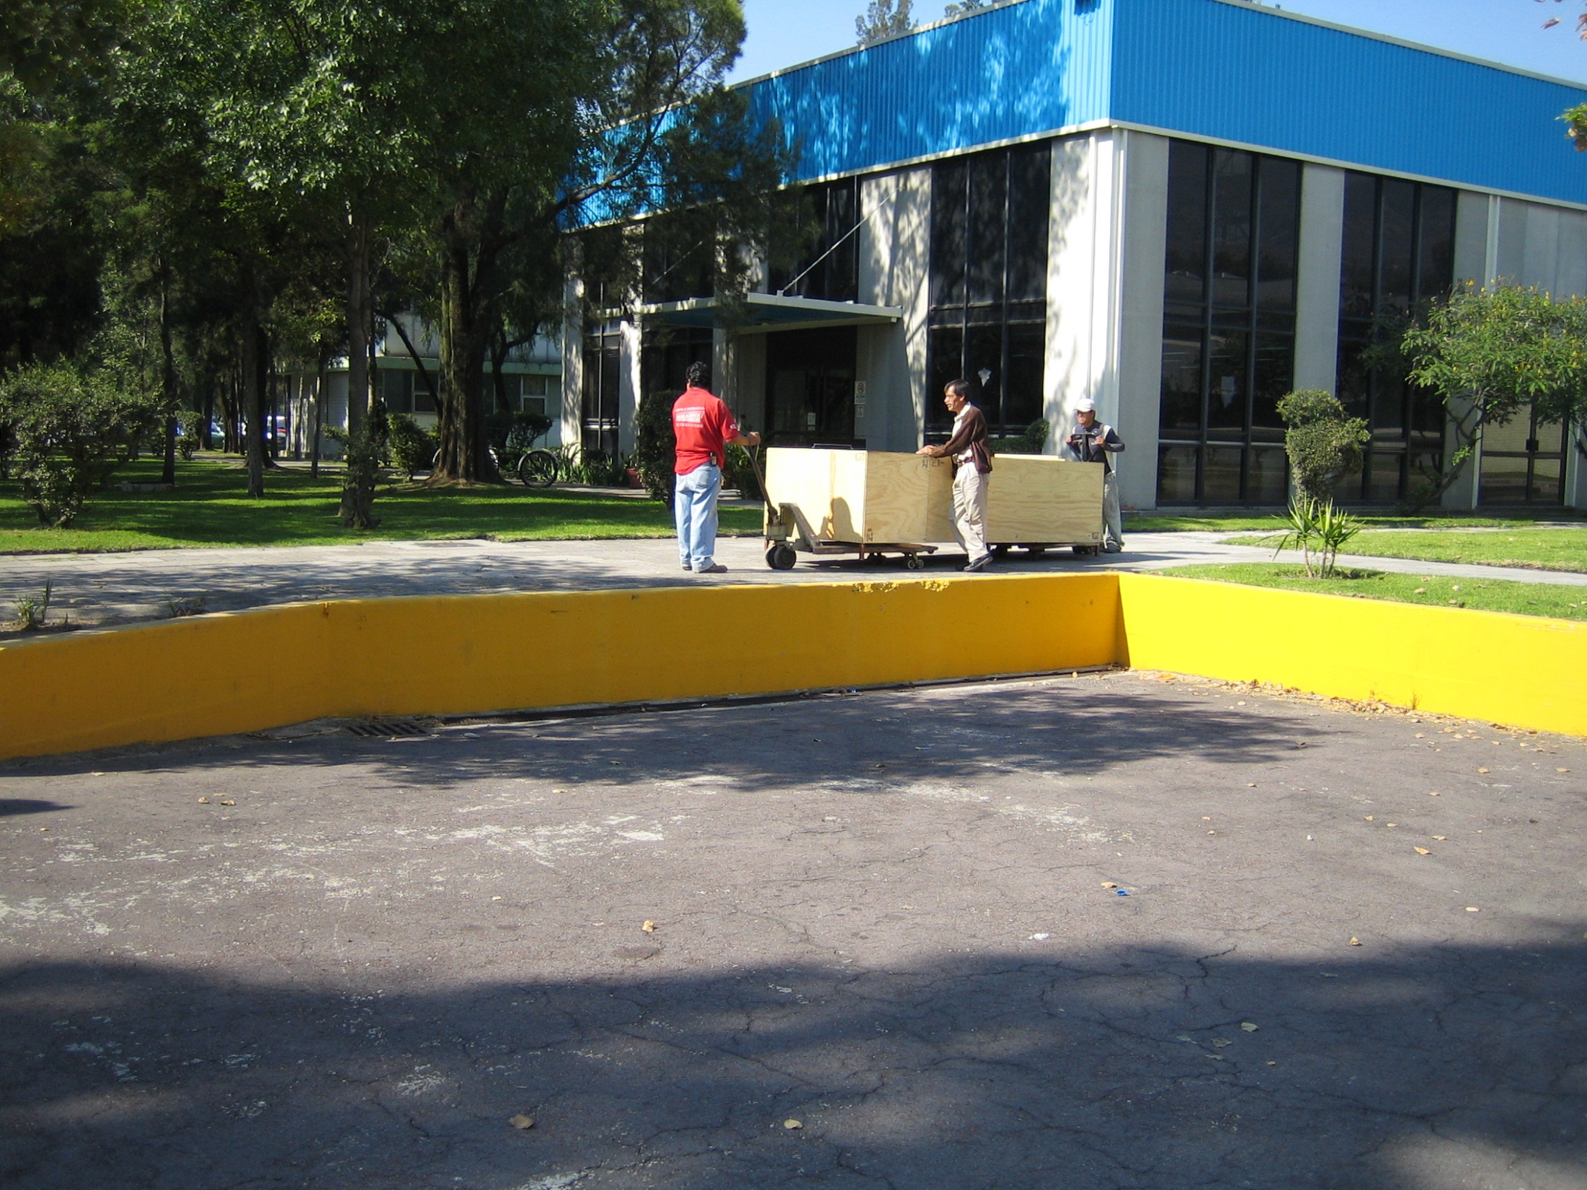
Shipping ACORDE Modules

Slide 26
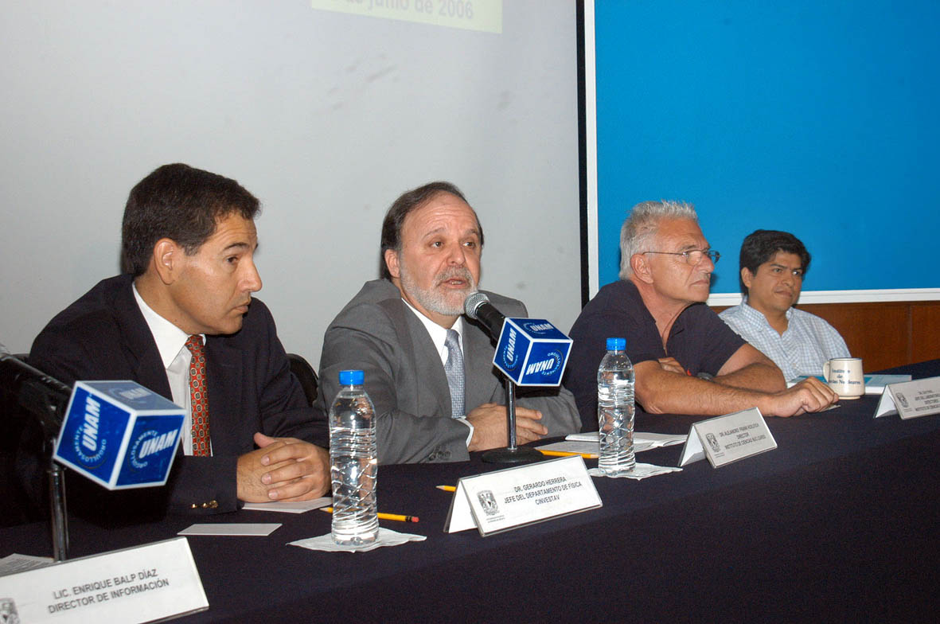
Shipping the electronics

Slide 27
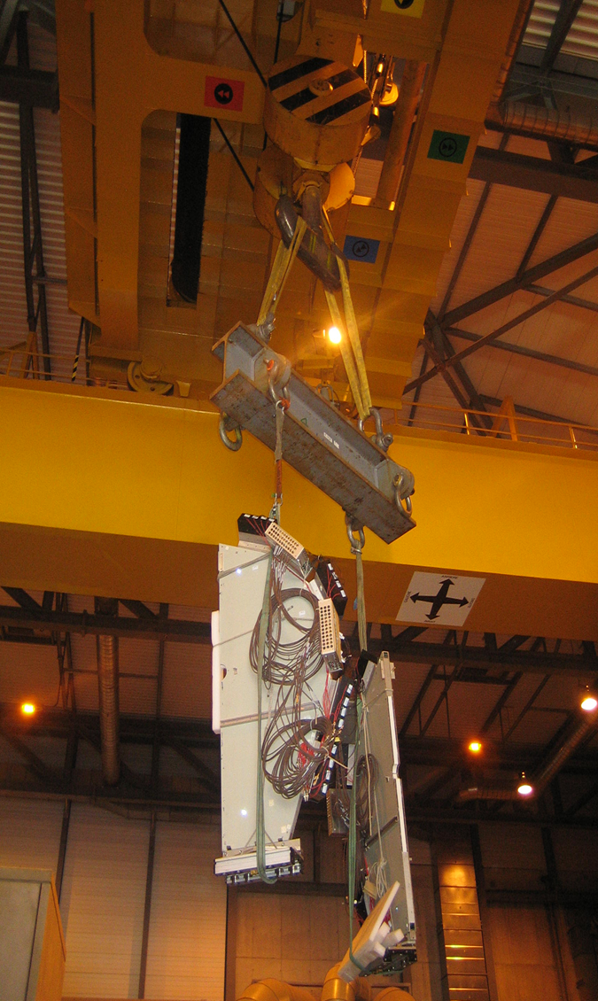
V0
Design
Radiation effects
PMT position
Arturo Menchaca - will talk about that

Slide 28
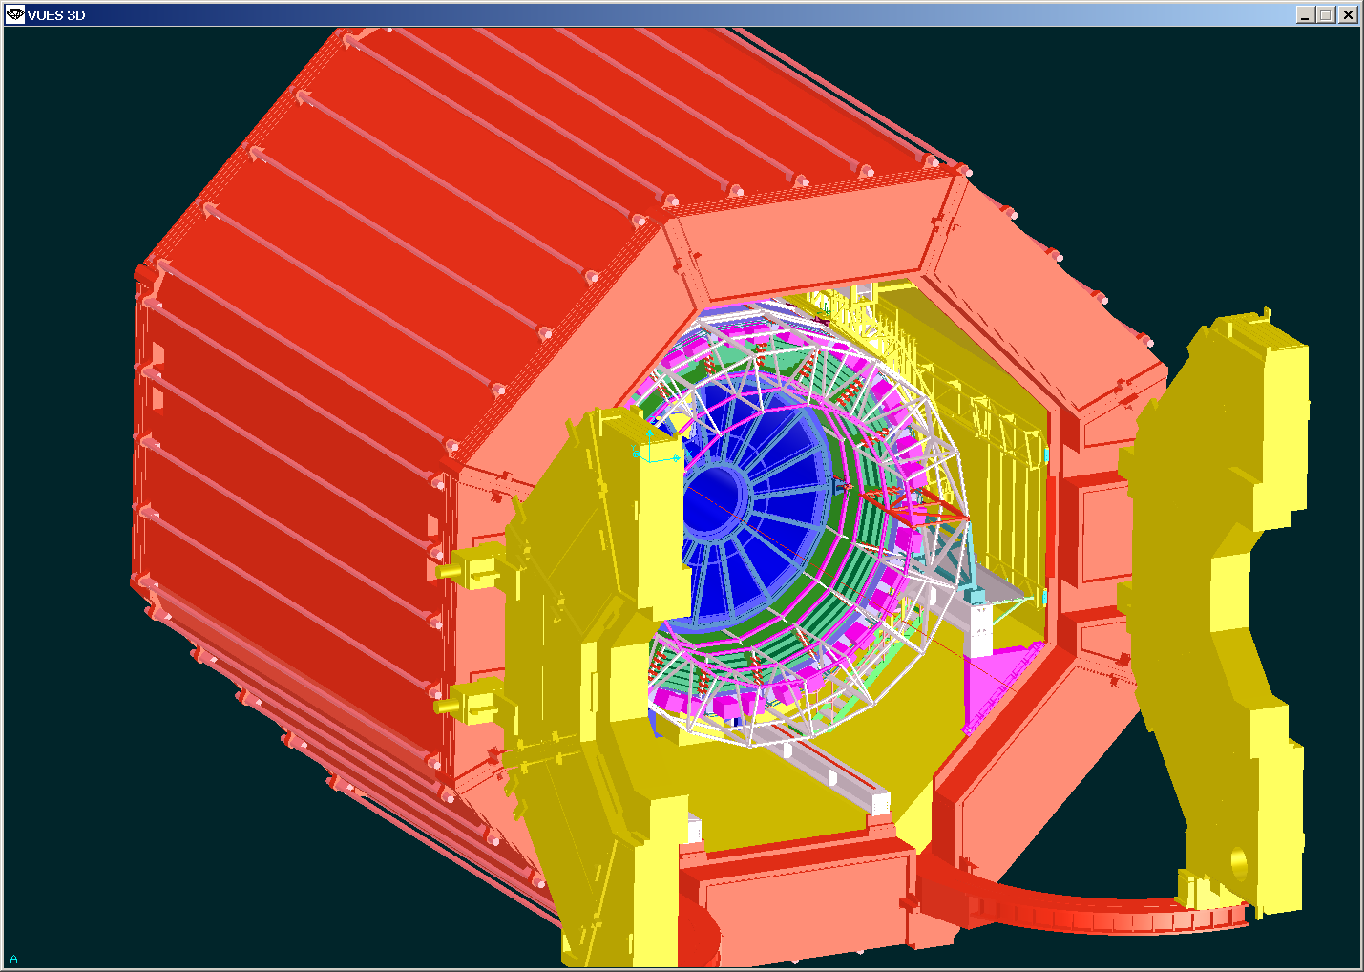
VHMPID for ALICE
upgrade

Slide 29
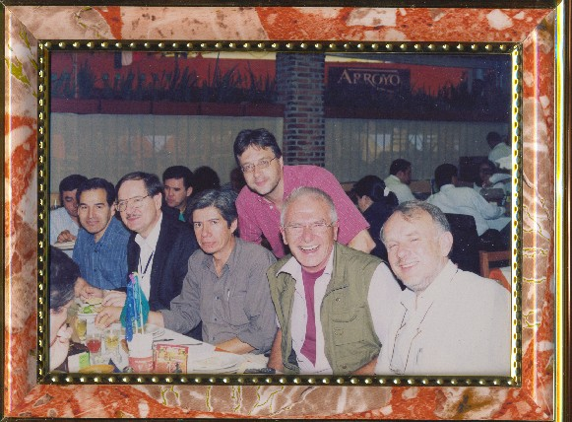
Mega proyectos a reason to “barbacoa”

Slide 30

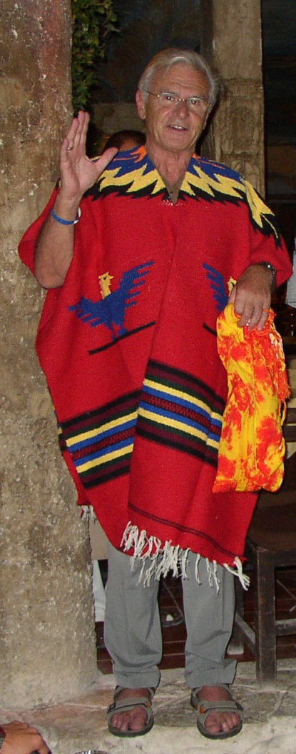
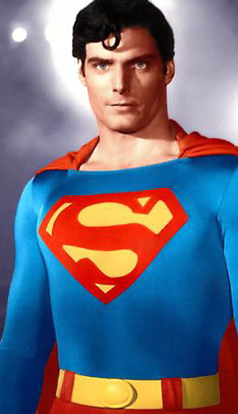
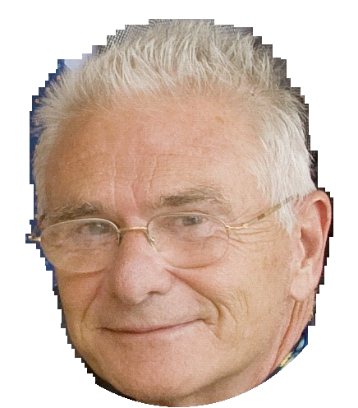
2006
Súper Coordinador of “Red de Física de Altas Energías”
CONACYT

Slide 31
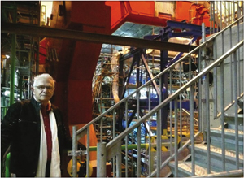

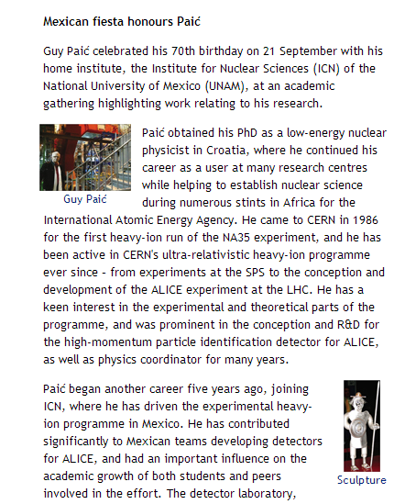

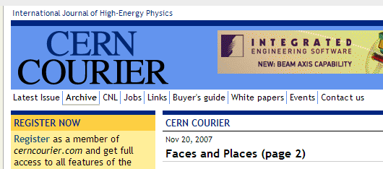
2007

Slide 32
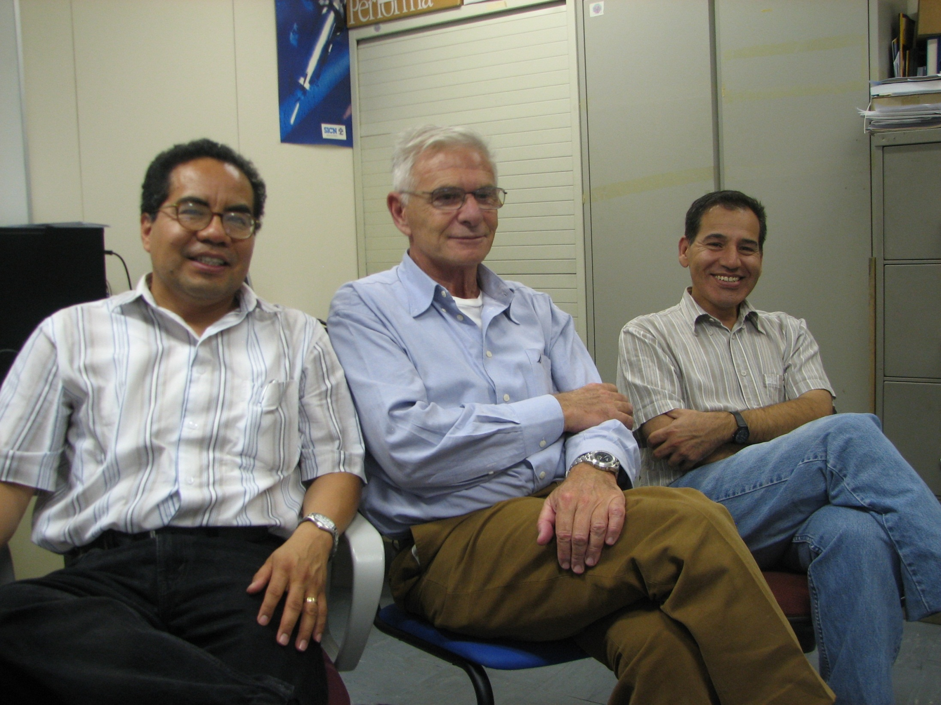
2008
We were young and strong, we were runnin
against the wind

Slide 33
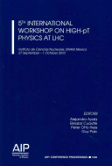
2010
5th Workshop on High PT Physics at LHC 2010
In this event the newest result of RHIC and LHC experiments as well as theoretical developments were presented.
The LHC results were mainly concentrated on p-p collisions and on the high transverse momentum transfer.
Experimental results were compared to existing theoretical models. Several discrepancies between experiment and theories were observed and possible explanations were discussed

Slide 34
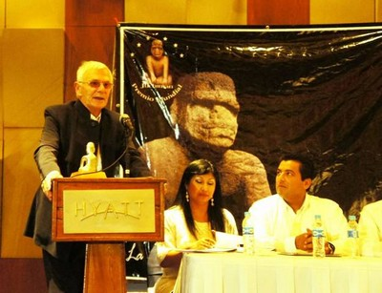
Guy Paic has received the “Juchimán de Plata” Award 2010
(Silver Juchiman Award)
for his Contribution to Science and Technology.
The award ceremony, on 11th November, 2010
was celebrated in Villahermosa City, Tabasco, México.
Juchimán is an Olmec stone idol
found near “La Venta” archeological
area in Huimanguillo, Tabasco,
México.
It represents the Tabasco State
Emblem.

Slide 35
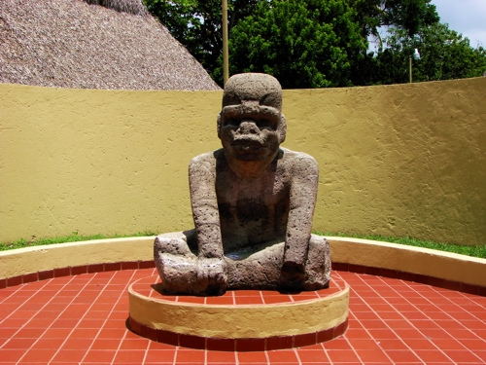
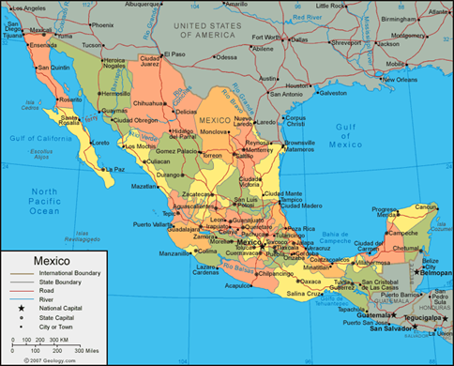
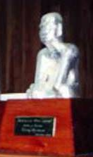
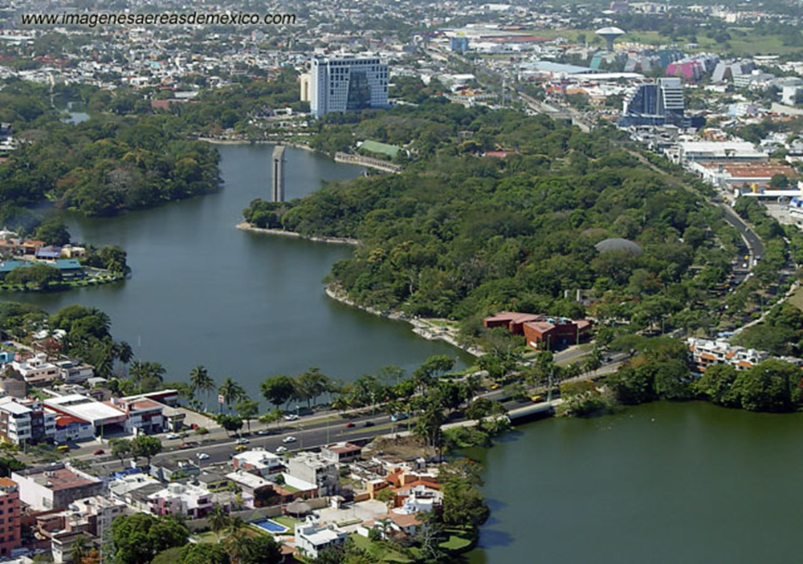
God of marshland

Slide 36
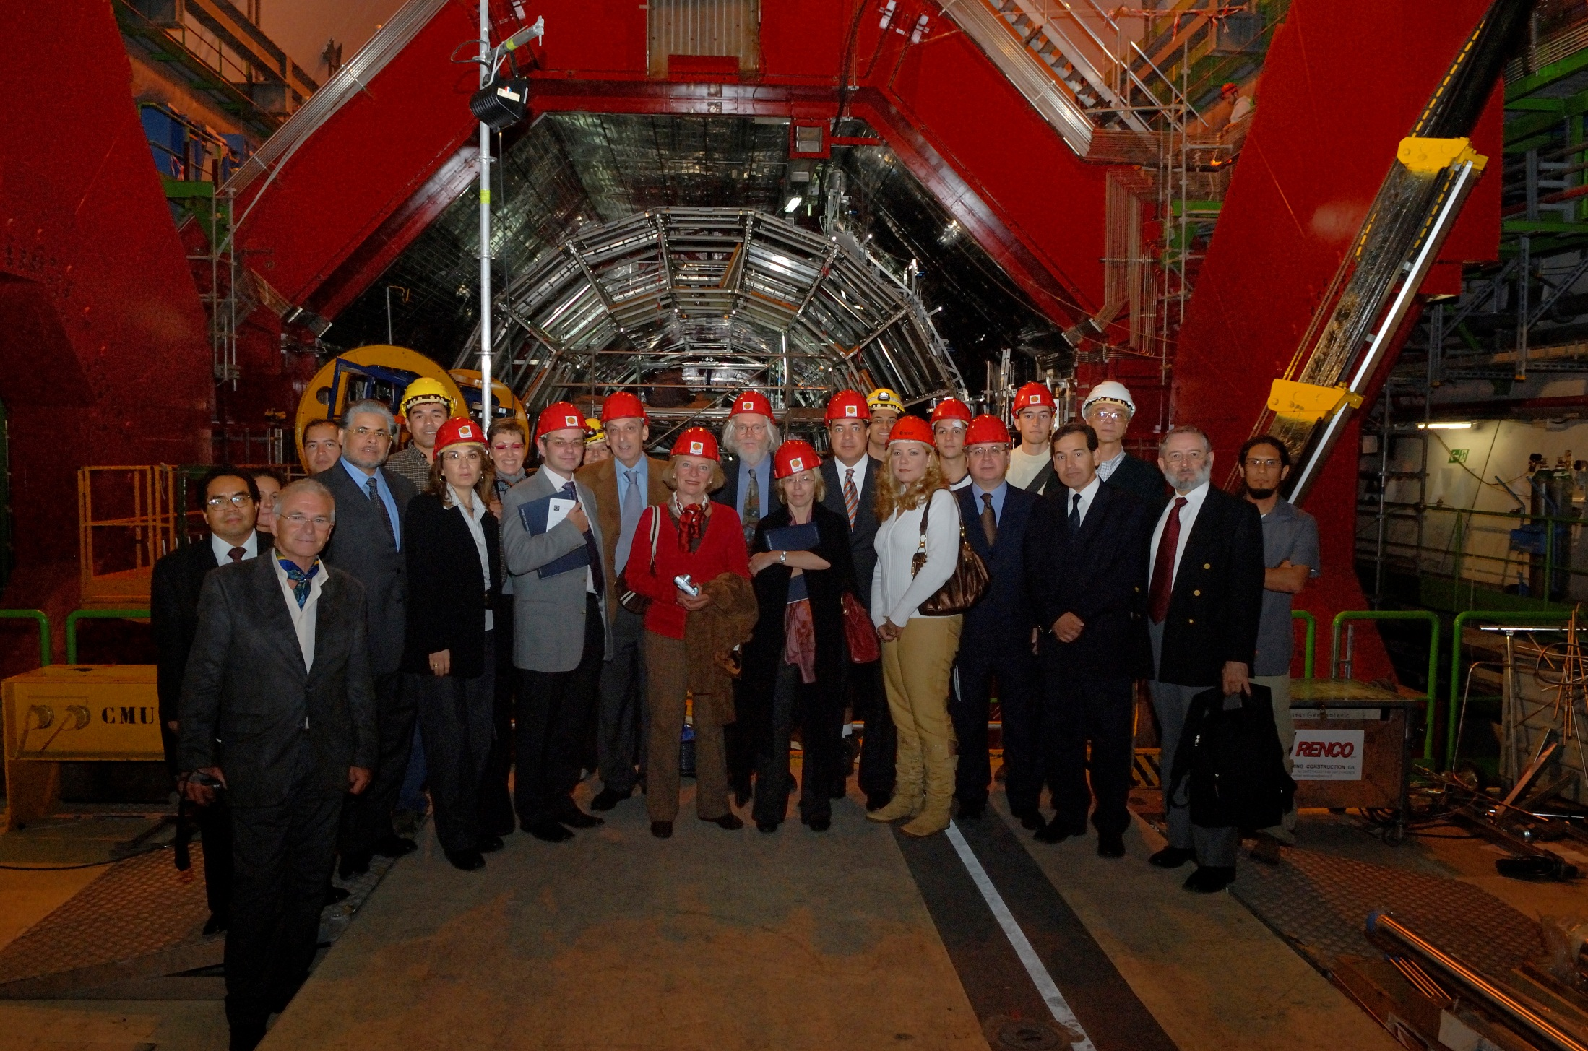

Slide 37
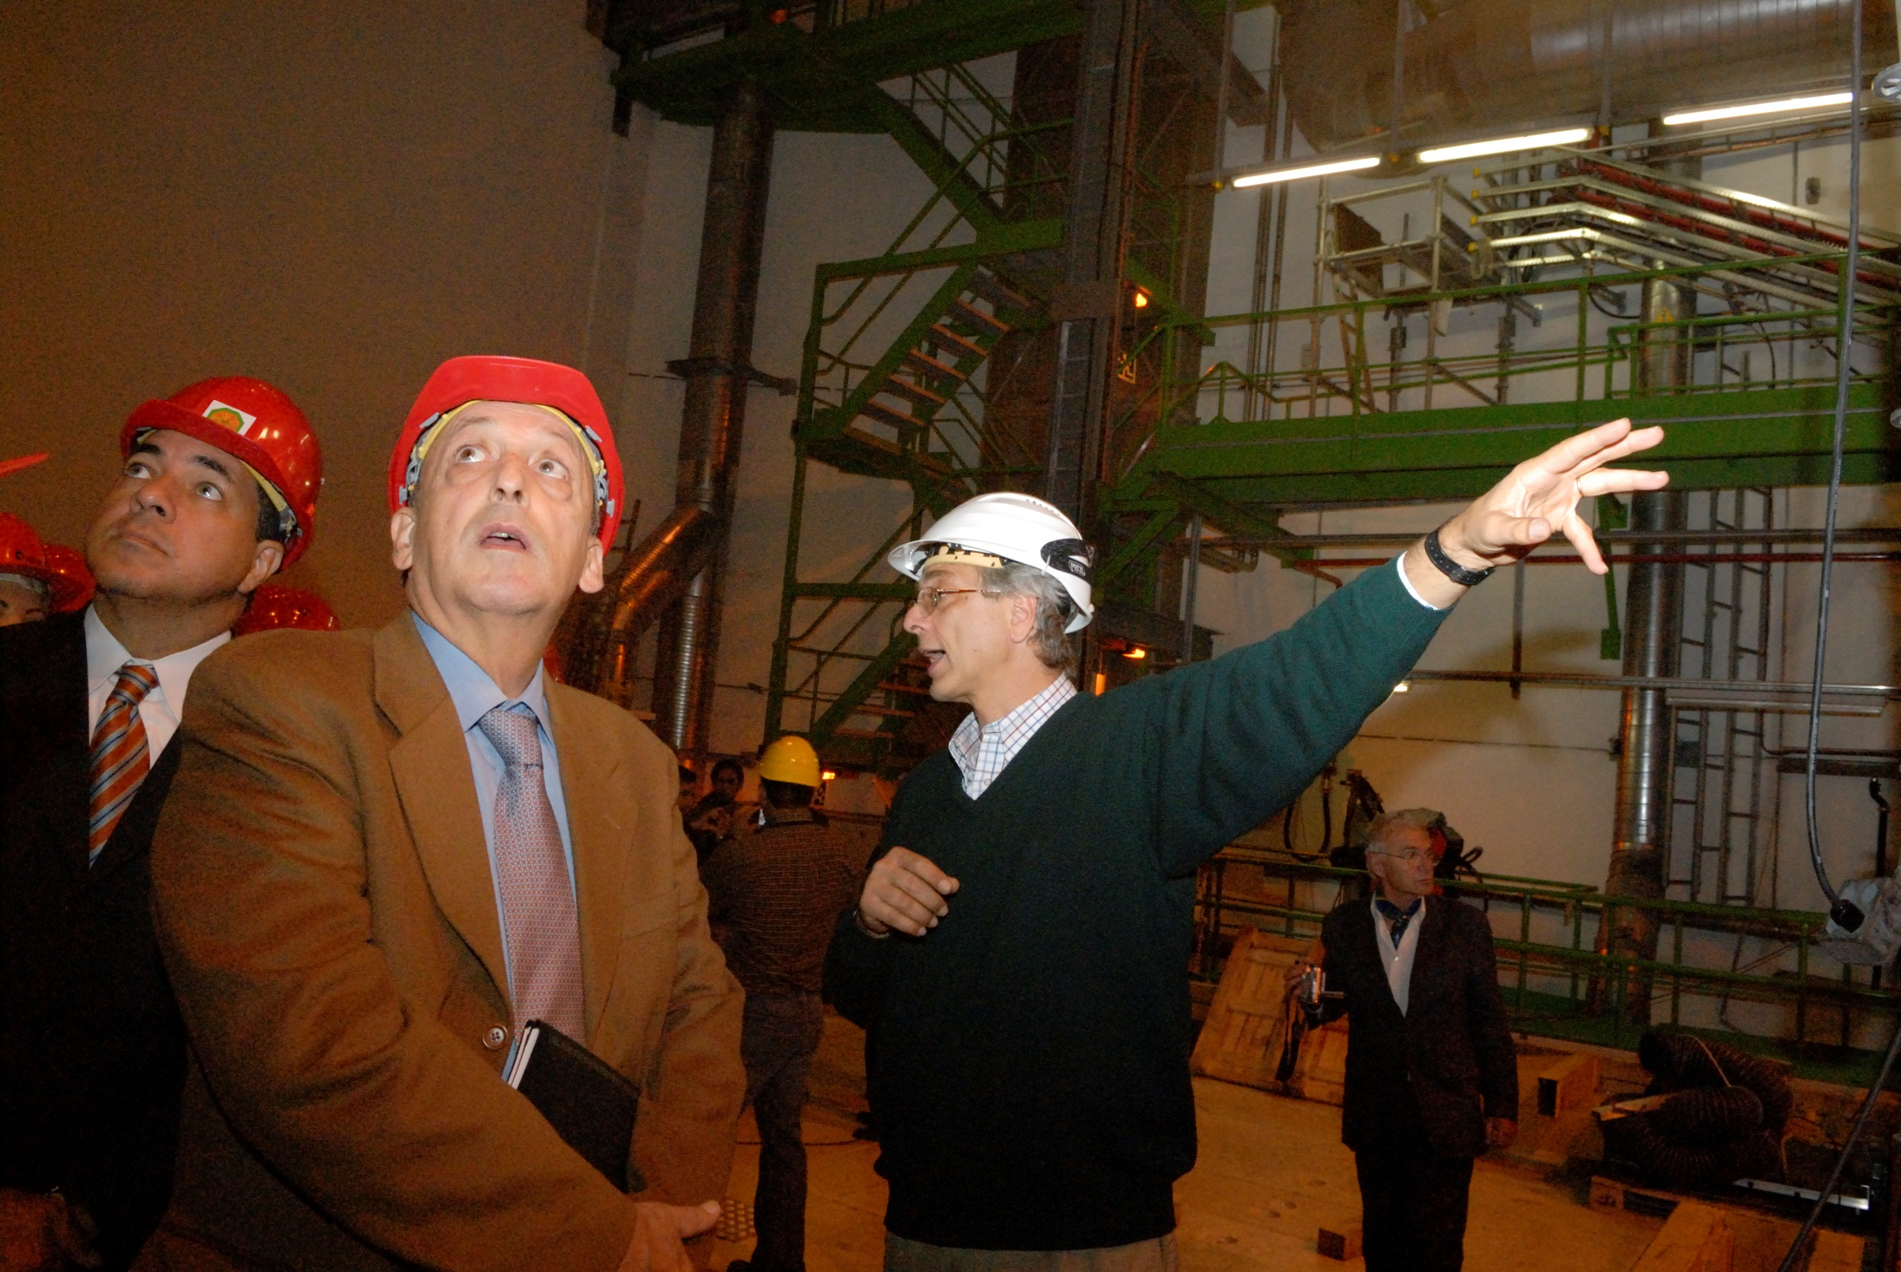

Slide 38
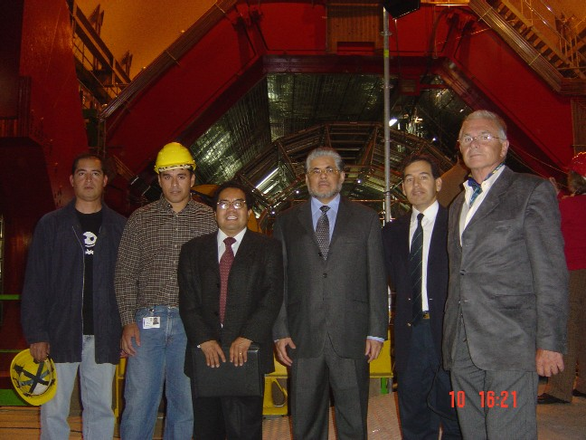

Slide 39
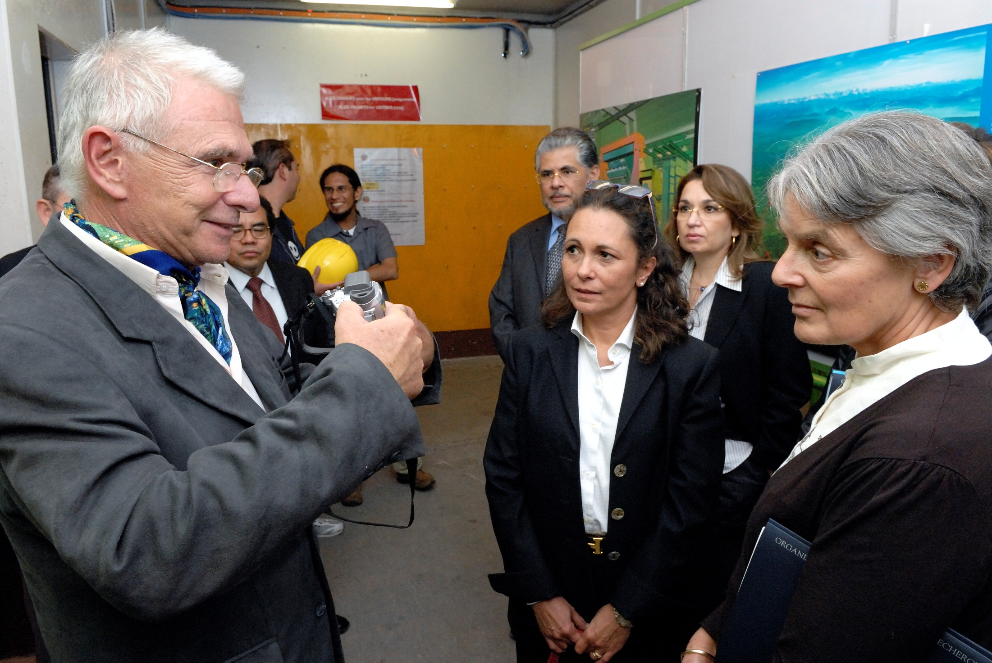

Slide 40
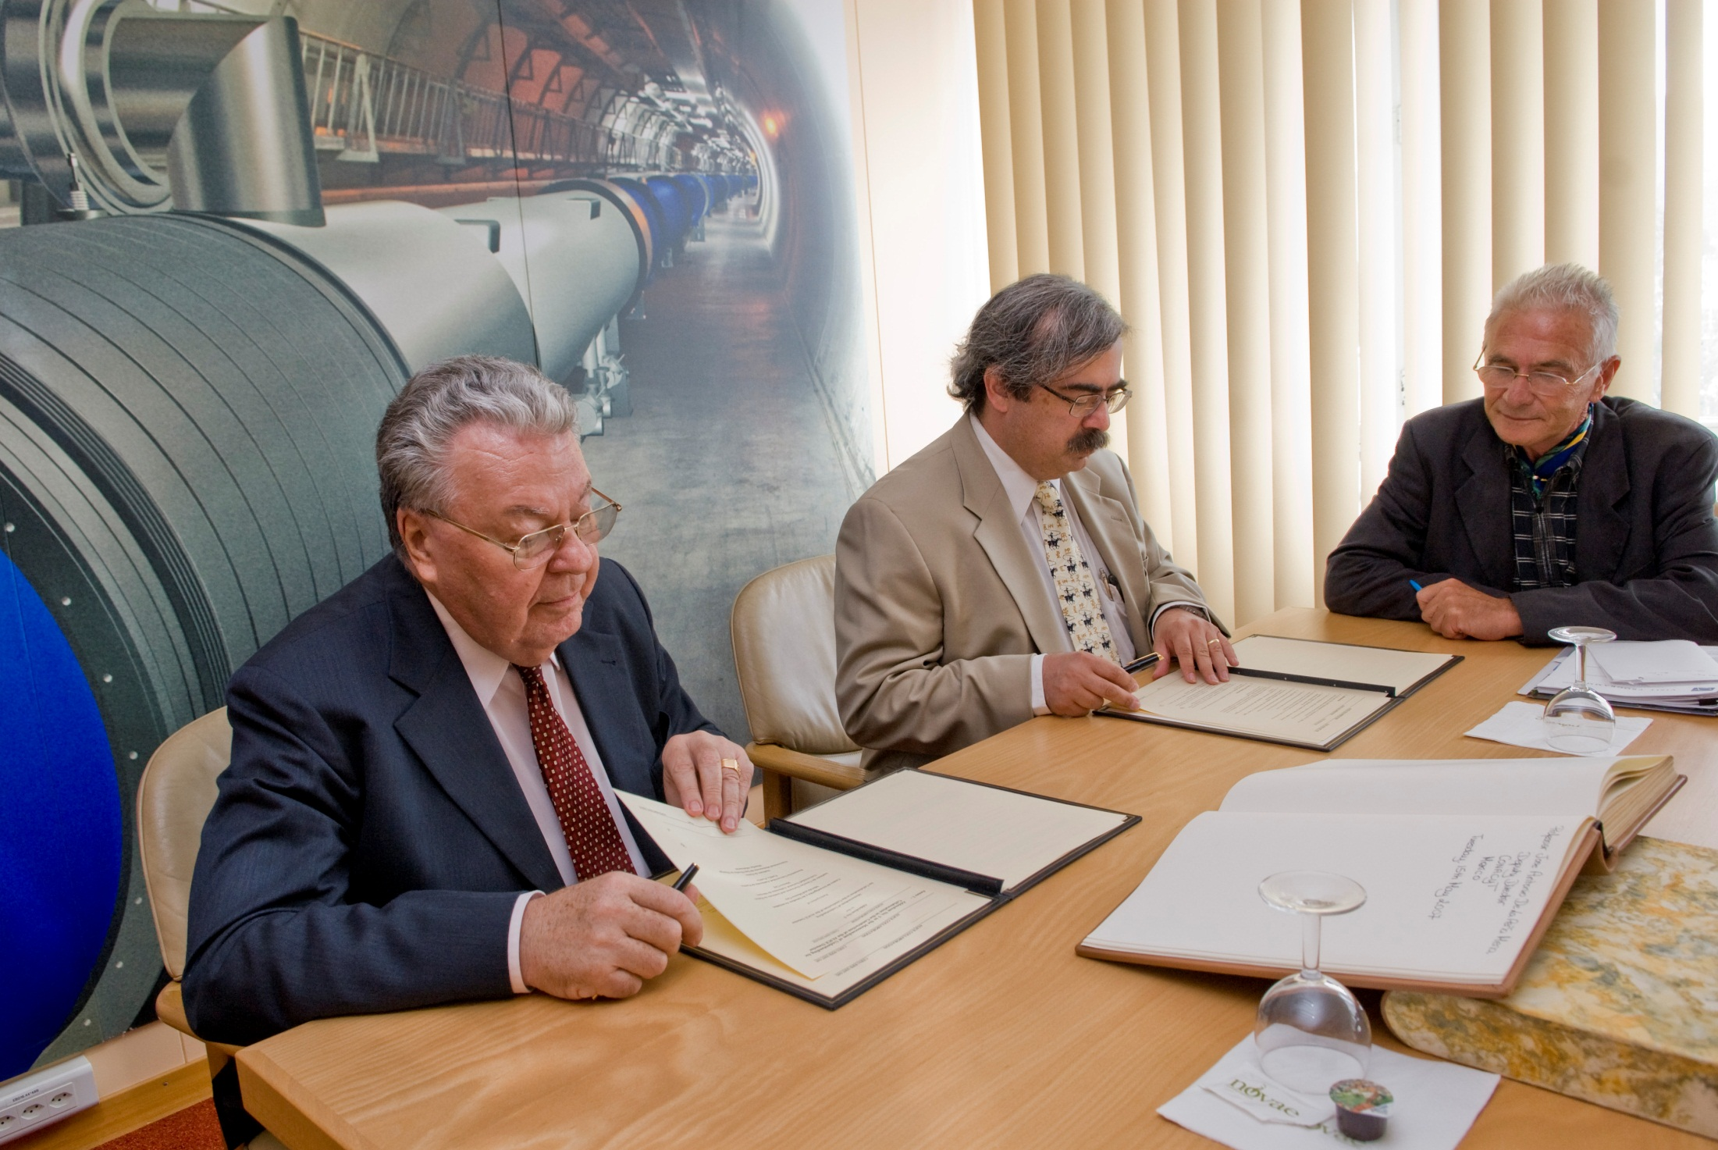
CERN DG Robert Aymar
Mexican People Guy Paic
CONACYT AD José Antonio de la Peña

Slide 41
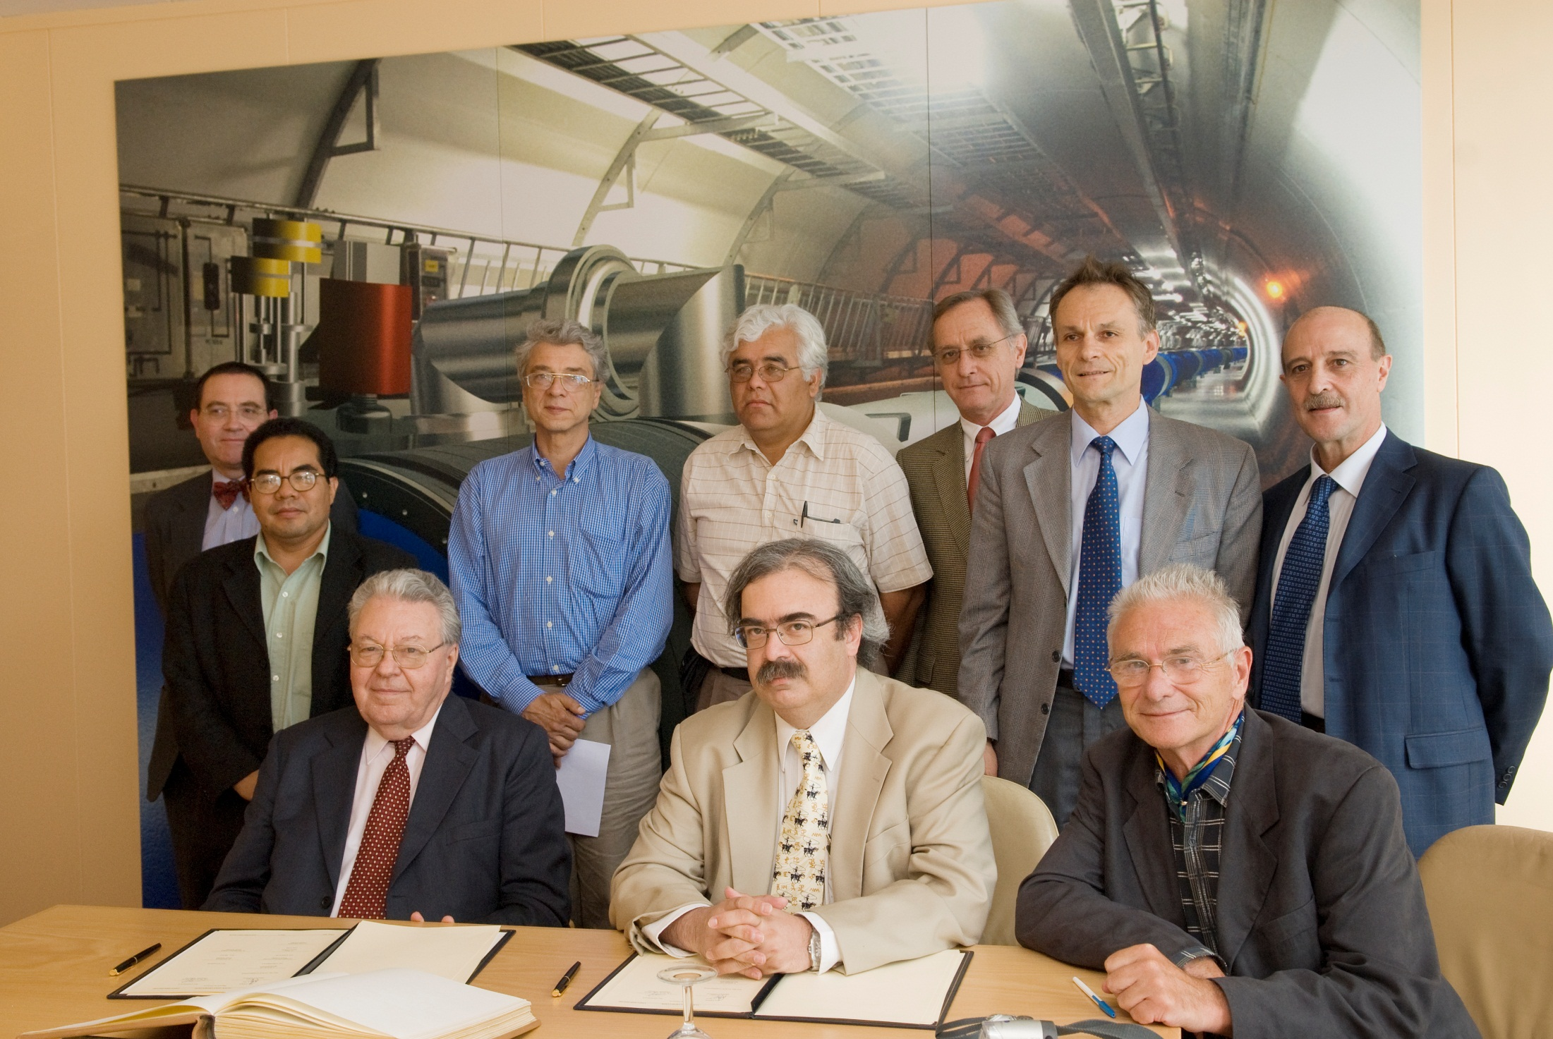

Slide 42
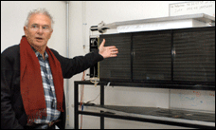
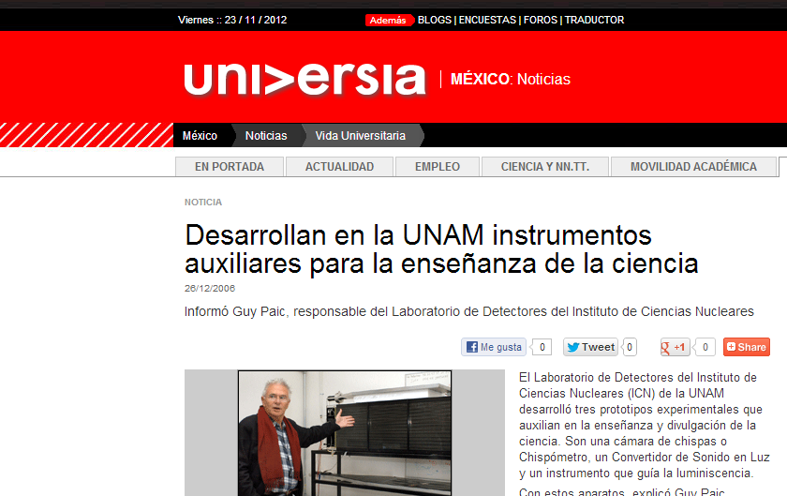
2012

Slide 43
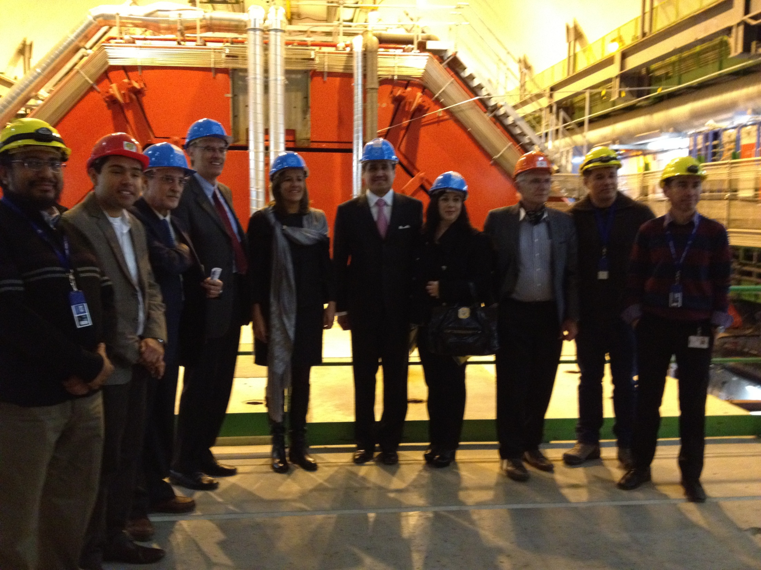

Slide 44


Slide 45


Slide 46


Slide 47


Slide 48


Slide 49


Slide 50

ALICE at the LHC

Slide 51
ALICE - Mexico
ACORDE
Activities of the Mexican Team
V0A
ADA1
VHMPID
ADD1
physics analysis activities

Slide 52
STUDENTS AND YOUNG POSDOCS INVOLVED IN DATA ANALYSIS IN ALICE
UAS
Isabel Domínguez PHD "jets" P. Podesta
Fernando Sánchez PHD "semileptonic b mesosn decays" P. Podesta
BUAP
Mario Rodríguez Cahuantzi PHD "Cosmic Ray" A. Fernández
Gibraham Napoles Cañedo MSc "UPC" D. Tapia - A.Fdz
Hector Bello Martínez MSc "Event shape studies" A. Ortiz - A. Fdz
Citlali Sosa Rodríguez Undergrad "Cosmis rays" M. Rodríguez- A. Fdz
Juan Grados Luyamdo Undergrad "Polarizarion studies“ E. Cuautle -A. Fdz
Salvador Sosa
Undergrad "Van der Meer Scan pp" D. Tapia - A Fdz
CINVESTAV
Rigoberto Cruz Albino PHD "Study pPb in the 2013 run" G. Herrera - D. Tapia
Veronica Canoa PHD "UPC" G. Herrera
ICN UNAM
Ivonne Maldonado PHD "Lambda polariation" E. Cuautle
Raul Tonathiu Bustamante MSc "p/pi vs sphericity" G. Paic.
Edgar Pérez Lezama MSc "phi/p" G Paic

Slide 53
IFUNAM
Eulogio Serradilla PHD "deuteron coalesence in pp“ A. Menchaca
Diego Gómez Coral Undergrad "coalescence" A. Menchaca
Laura González Trueba MSc "multiplicity" A. Sandoval
Sent to other institutions:
Pedro González Spain "Diffractive physics" A. Menchaca
Xitzel Sánchez Strasbourg "Hadron Correlations" E. Cuautle
Antonio Ortiz Lund "Event shape" Guy Paic
Lizardo Valencia Paris "J/Psi RAA in the dimuon channel“ R. Alfaro
Hermes León Frankfurt "jets" A. Sandoval
PEOPLE INVOLVED IN UPGRADE OF ALICE
Upgrade:
Ramón Gómez PHD "AD Diffractive Physics" CINVESTAV G Herrera
Mateo Ramírez MSc "V0 upgrade" CINVESTAV G Herrera -I. León

Slide 54
G. Tejeda PhD "TPC data compression" BUAP A. Fernández
G. Muñoz Undergrad "ACORDE efficiency" BUAP A. Fernández
D. Mayani MSc "GEM for TPC " ICN G. Paic
Estudiantes de Peru:
Rodrigo Huerta PHD "Diffraction"
Ernesto Calvo PHD "Diffraction"
Estudiante de U. Zacatecas
Nayeli Rodriguez "J/Psi pt en proton proton" D. Tapia

Slide 55
Thesis advisor:
Isabel Domínguez (PHD)
Leonid Serkin (MSc.) co-advisor E. Cuautle
Antonio Ortiz Velázquez (PHD)
Daniel Mayani (MSc)
Raúl Tonathiu (Bachellor)
Edgar Pérez (MSc)
Goran Simatovic (PHD)
- proyectos: BATATA
Engineering
…

Slide 56

this is where the cowboy rides away

Slide 57

the end

