Slide 1
HBT overview with emphasis on multiparticle correlations
T. Csörgő ^{1,2}
¹ Wigner RCP, Budapest, Hungary
² Eszterházy KU KRC, Gyöngyös, Hungary
Overview on fundamentals:
Hanbury Brown and Twiss
Positive definitene form – or not?
Two-particle symmetrization effect – or not?
Bose-Einstein condensation of charged particles – or not?
Gaussian shape – or not?
Sensitive to U_{A}(1) symmetry restoration
Summary, conclusions
Based on HBT Overview talks at HDNM 2017, Rehovot and ISMD 2017, Amsterdam
Supported by NKTIH and EFOP-3.6.1-16-2016-00001 (Hungary)

Slide 2
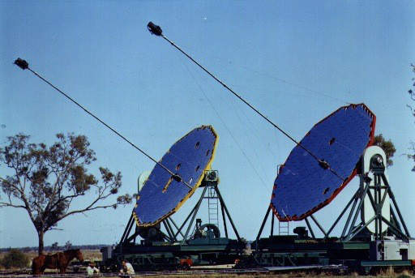
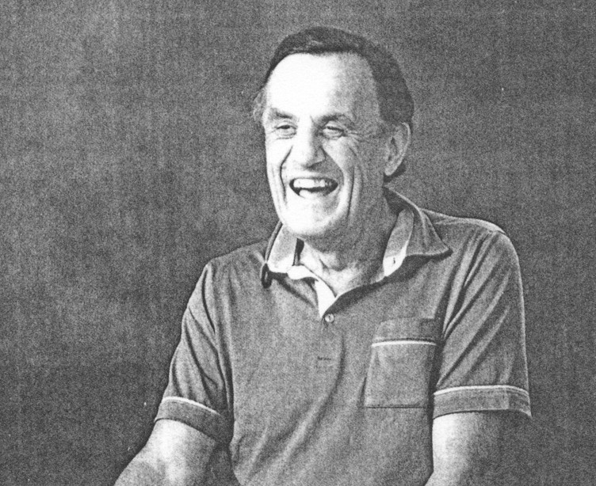
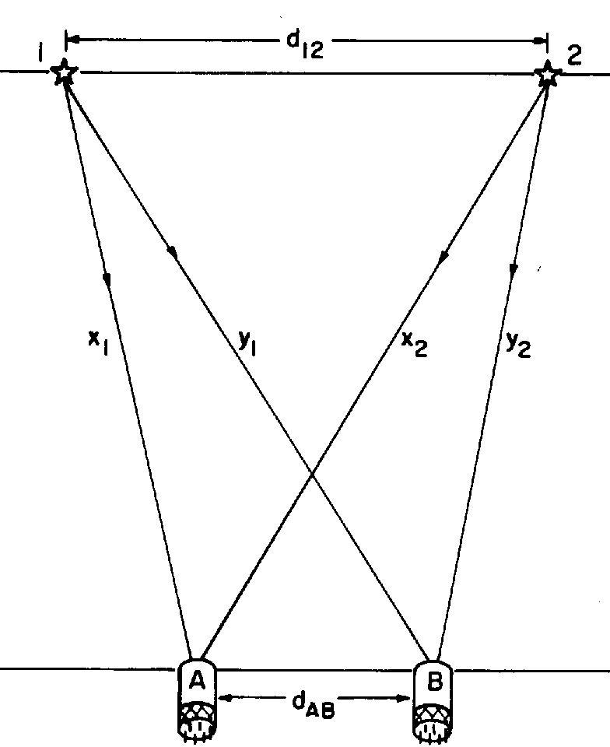
HBT: Robert Hanbury Brown – Richard Quincy Twiss
Two people: Robert Hanbury Brown and Richard Quincy Twiss
– Robert, Hanbury as well as Richard and Quincy: can be given names, but…
– Sir Robert Hanbury Brown had a compound family name,
– just like Sir Christopher Llywellyn Smith, whose compound family name is sometimes hyphenated
R. Hanbury Brown and R. Q. Twiss: Engineers, who worked in radio and optical astronomy
„Interference between two different photons can never occur.”
P. A. M. Dirac, The Principles of Quantum Mechanics, Oxford, 1930
„As an engineer my education in physics had stopped far short of the quantum theory.
Perhaps just as well … ignorance is sometimes a bliss in science.”
R. H. Brown: Boffin: A Personal Story … ISBN 0-7503-0130-9
2

Slide 3
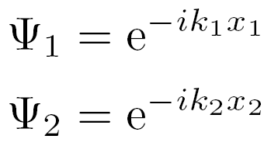
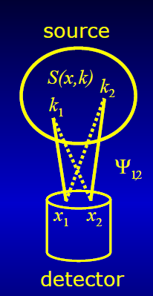




HBT: 1 + positive definite term
Two plane waves
Symmetrized, + for bosons, - for fermions
Expansion dynamics, final state interactions, multiparticle symmetrization effects: negligible
Two particle HBT correlations:
1 + positive definite term
1+ |Fourier–transform of the source|²,
Usually evaluated in Gaussian approximation
Dependence on mean momentum:
expansion dynamics ρ(x) → S(x,k)
Dubna school: use it as a tool
Kopylov and Podgoretskii: x <-> k
1+ |Fourier–transform of the source|²
3

Slide 4
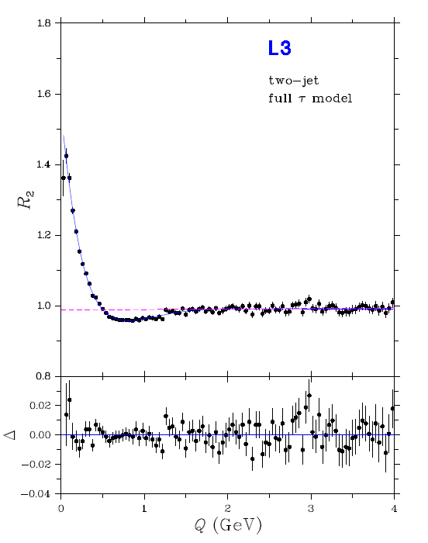
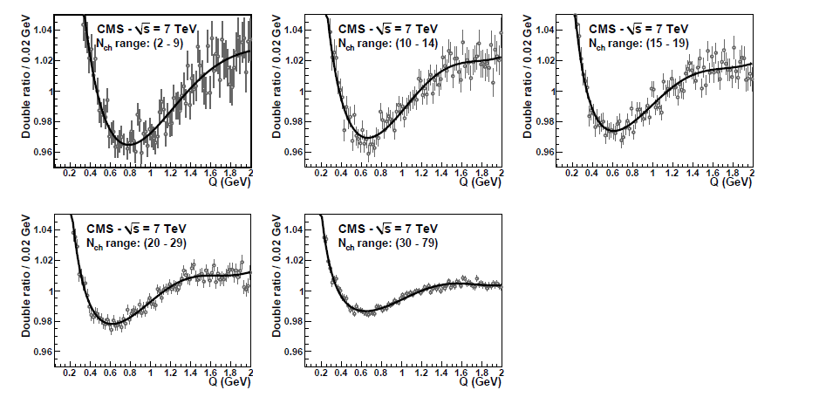
HBT: 1 + positive definite term
- or not ?
L3 e⁺e⁻ → two-jets
√s = 91.2 GeV
CMS p+p
√s = 7 TeV
Two experimental results:
L3 for Bose-Einstein in e⁺e⁻ at LEP
arXiv:1002.1303 [hep-ex]
CMS for Bose-Einstein in pp at LHC
arXiv:1101.3518 [hep-ex]
Expansion dynamics: role of jets?
→ strongly correlated phase-space,
τ-model: x ~ k → Δx Δk ~ Q_{inv}² ,
C(Q_{inv}) ≠ 1 + positive definite form
arXiv:0803.3528 [hep-ph]
See the WPCF2017 talk of Wes Metzger for details
4

Slide 5



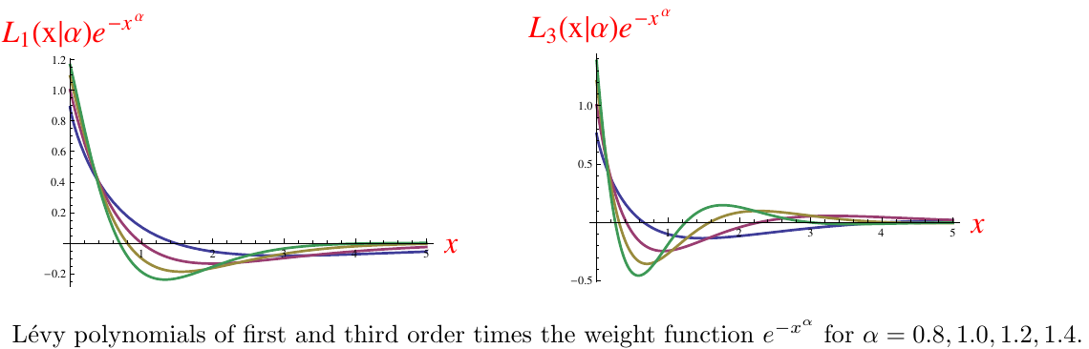
HBT: 1 + positive definite term?
Example: Levy expansions
Model-independent but:
Generalizes exponential (α =1) and Gaussian(α = 2)
ubiquoutous in nature
How far from a Levy?
Not necessarily positive definite!
          Notation: x = Q R
5
arXiv:1206.1680v1

Slide 6
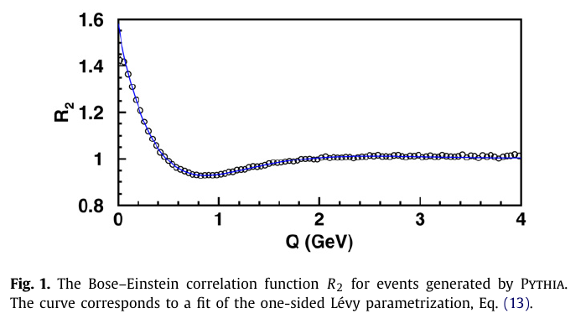
HBT: 1 + positive definite term?
L3 e⁺e⁻ → two-jets
√s = 91.2 GeV
Check dip and background with Levy/Laguerre/Edgeworth/Gauss
model independent expansions
See the talk of T. Novák at Low-x 2016
6

Slide 7

HBT: 1 + positive definite term?
Levy expansions for 1+ positive definite forms
Model-independent but:
Generalizes exponential (α =1) and Gaussian(α = 2)
In this case, for 1+ positive definite forms
ubiquoutous in nature
How far from a Levy?
Works also for cross-sections in elastic scattering
T. Novák, T. Cs., H. C. Eggers, M. de Kock:
arXiv:1604.05513 [physics.data-an]
7

Slide 8
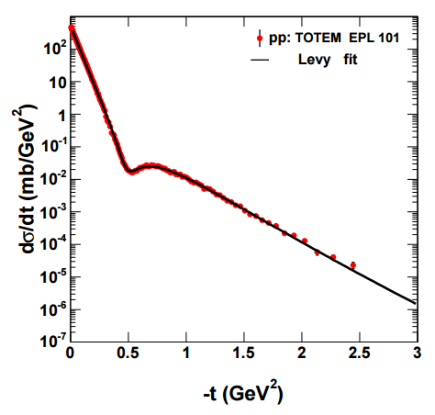
Example: Levy expansion for |f|²
T. Cs, W. Metzger, T. Novák, A. Ster, talk at Low-x 2016
8

Slide 9








HBT: Has to be a Gaussian, IF …
Model-independent but Gaussian IF we assume:
1 + positive definite forms
Plane wave approximation
Two-particle symmetrization (only)
IF f(q) is analytic at q = 0 and
IF means and variances are finite
Follows an approximate Gaussian(α = 2)
Model-independent but non-Gaussian IF we assume:
1 + positive definite form (same as above)
Plane wave approximation (same)
Two-particle symmetrization only (same)
IF f(q) is NOT analytic at q = 0 and
IF means and variances are NOT finite
IF Generalized Central Limit theorems are valid
Follows a Levy shape( 0 < α ≤ 2)
Earlier Gaussian recovered for α = 2
Cs. T, S. Hegyi, W. A. Zajc, nucl-th/0310042
9

Slide 10
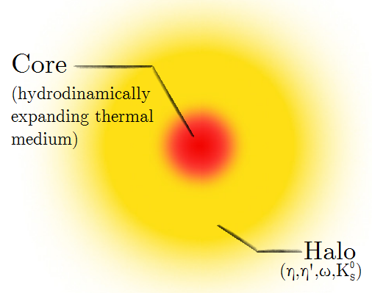
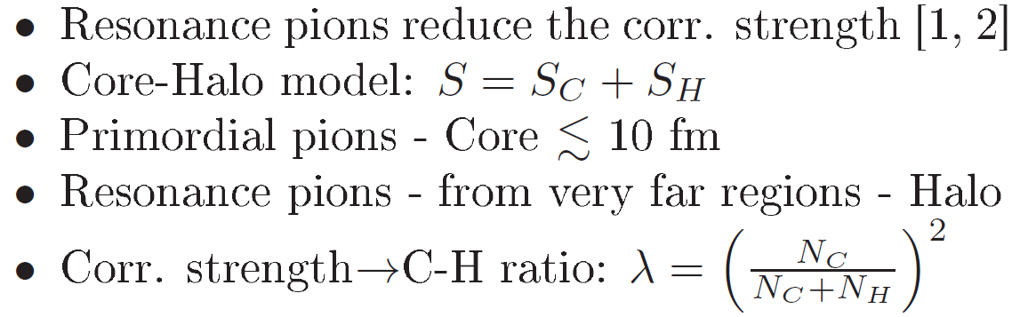
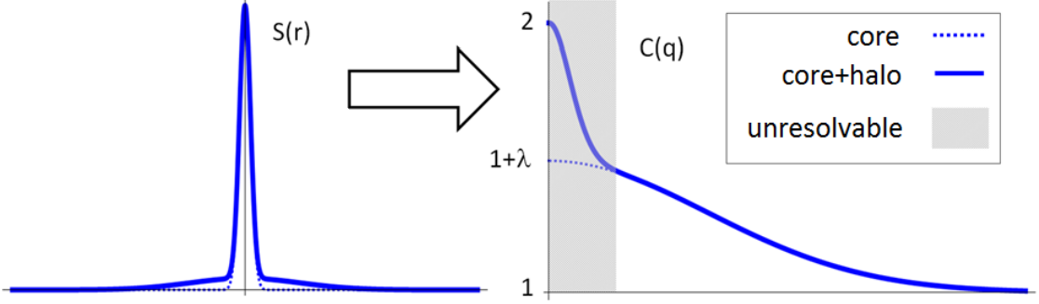
But: core/halo model, resonances
For details: D. Kincses, poster at QM17
Variance: halo dominated!
[1] J. Bolz et al: Phys.Rev. D47 (1993) 3860-3870
[2] T. Cs, B. Lörstad, J. Zimányi: hep-ph/9411307
10

Slide 11
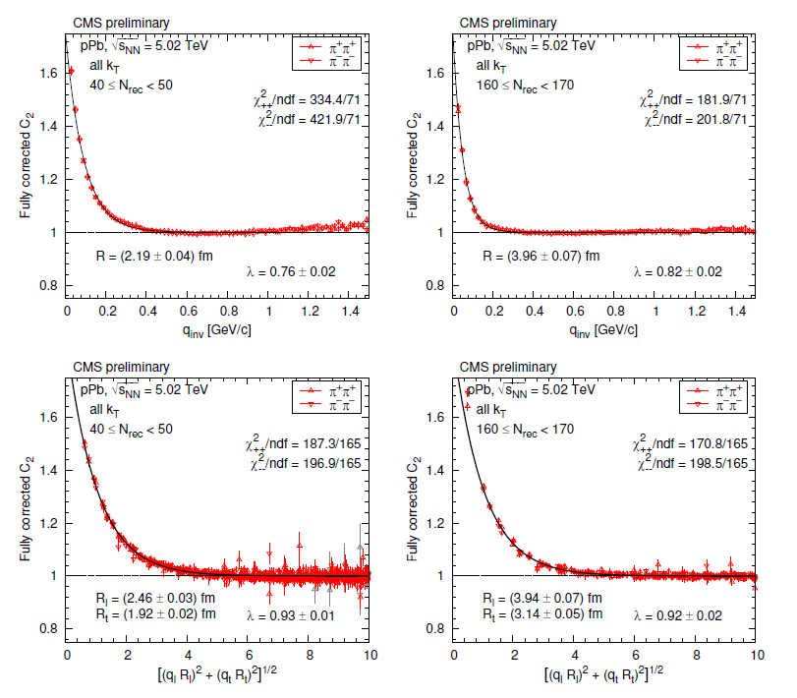
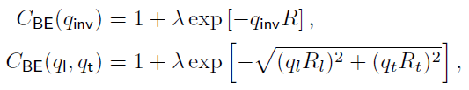
HBT: Is C(Q) a Gaussian?
CMS Preliminary
pPb@ √s = 5.02 TeV:
arXiv:1411.6609
1 + positive definite ?
CL of the fits?
NOT Gaussian !
BUT: Exponential !
IF α ≠ 2 → α = 1 ! (?)
As the dimensionality
increases from d= 1 to 3,
shape analysis degrades
arXiv:1411.6609
See WPCF2017 talk
of Sandra Padula for methods
11

Slide 12
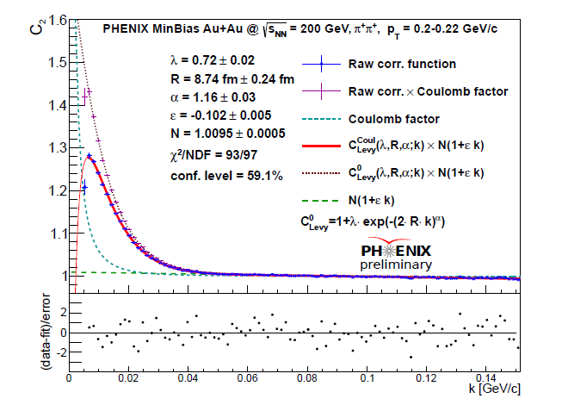
HBT: Is C(Q) indeed exponential?
PHENIX Preliminary min. bias Au+Au@ √s_{NN} = 200 GeV from arXiv:1610.05025
1 + positive definite
Levy expansion:
no 1st order correction
CL = 59.1 %
NOT Gaussian !
NOT Exponential !
1 < α < 2
α = 1.16 ±0.03
m_{t} dependent
What are the systematics
of the source parameters,
  λ = λ(m_{t}),
  R = R(m_{t}),
  α = α(m_{t}) ?
See the WPCF 2017 talk
of M. Csanád for details
12

Slide 13
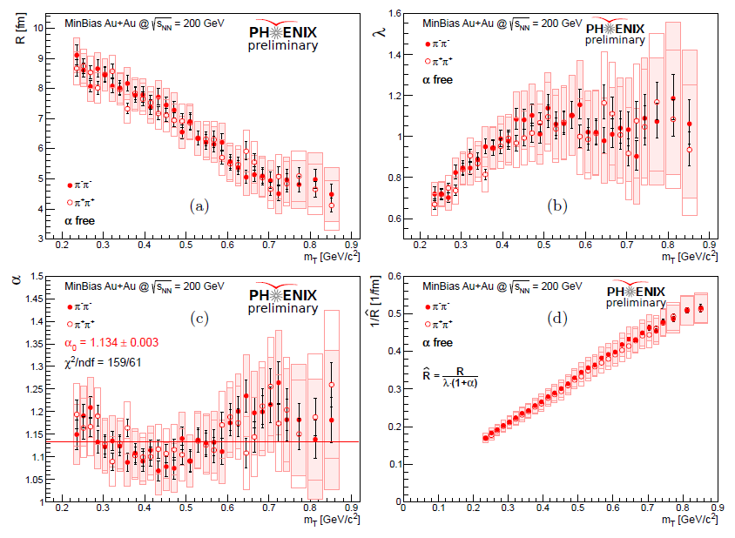
HBT: Is C(Q) an exponential?
arXiv:1610.05025c
1 < α < 2
13

Slide 14
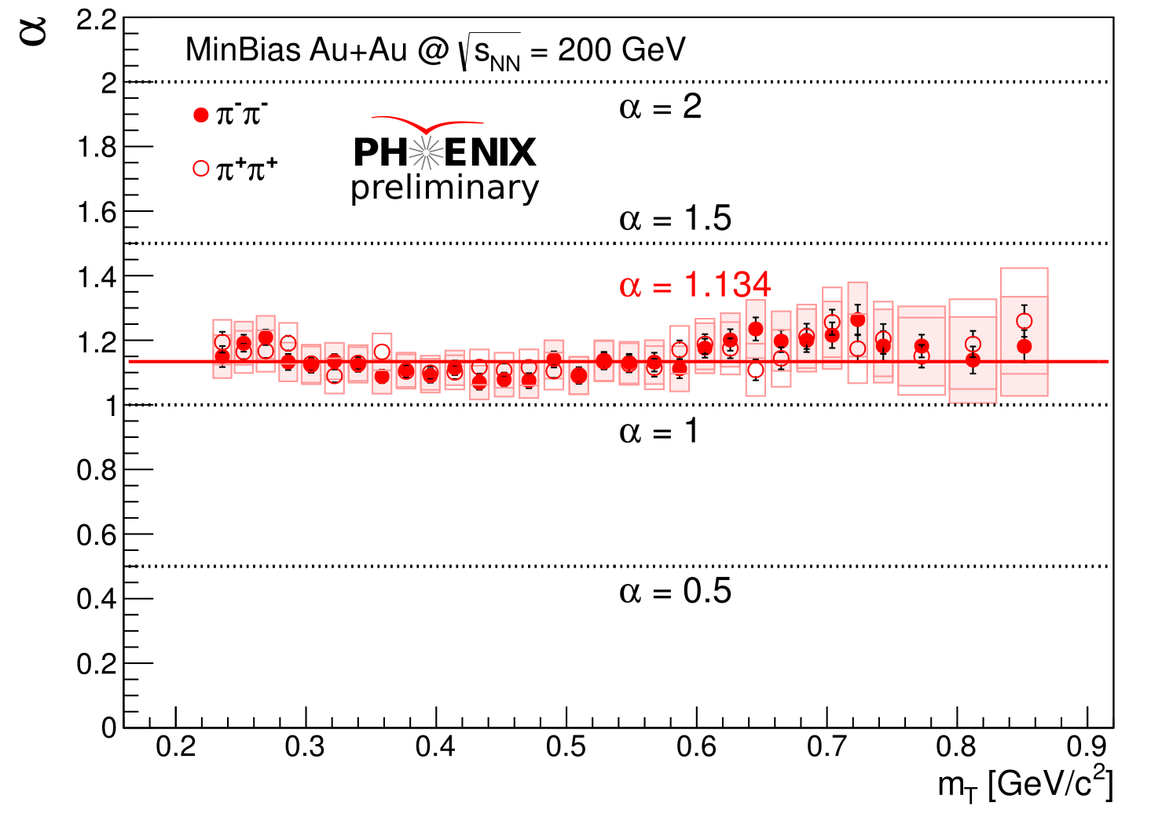
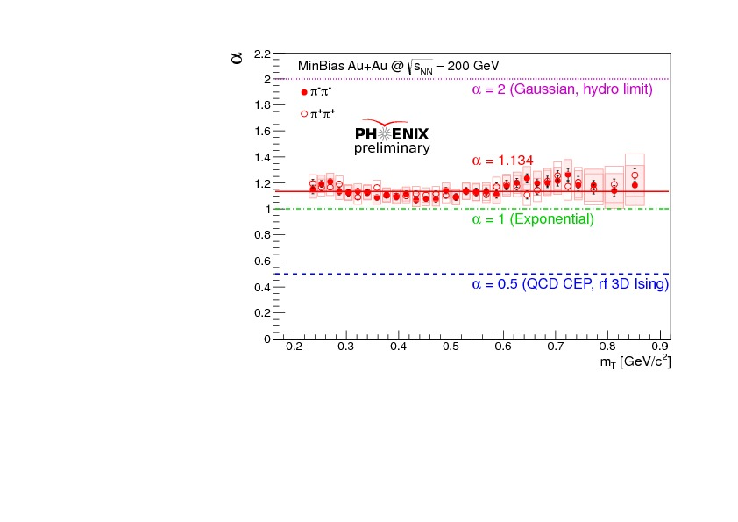
Interpretation of α
Prediction: at QCD CEP, α = η_{c} ≤ 0.5 (critical exponent of the correlation function)
T. Cs, S.Hegyi, T. Novák, W.A. Zajc, nucl-th/0512060 T. Cs, arXiv.org:0903.0669
Search for the QCD critical point with α (m_{T}, √s, %, …)
14

Slide 15
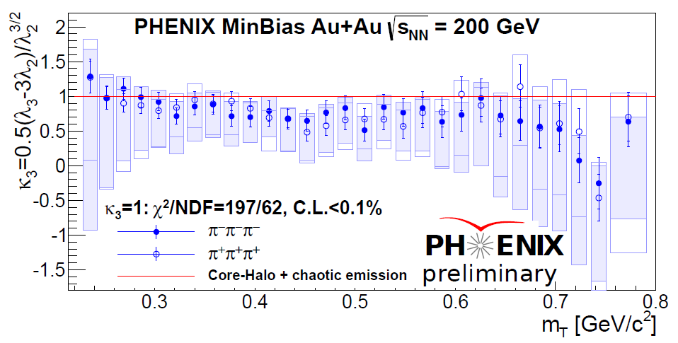
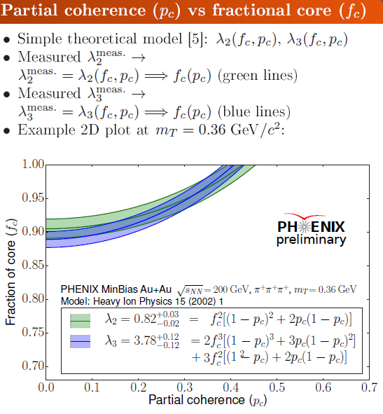
HBT: Two-particle symmetrization
- or not ?
See the WPCF 2017 talk of
Tamás Novák for details
PHENIX preliminary data from A.Bagoly, poster at QM17
Centrality dependence? Excitation function? Partial coherence measurement possible!
15

Slide 16
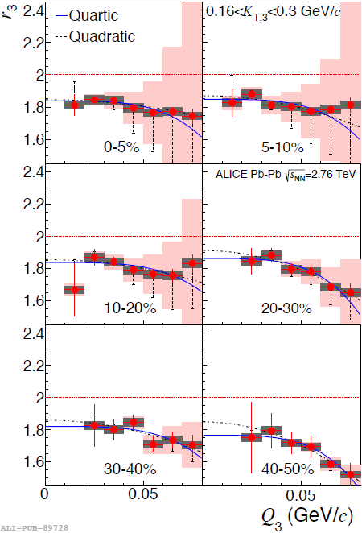

HBT: Two-particle symmetrization
- or not ?
ALICE Pb+Pb @ √s_{NN}= 2.76 TeV
Centrality dependence!
Partial coherence if
r₃(Q=0) ≠ 2
Result:
r₃(Q=0) < 2
p_{c}= 0.23± 0.08
First 3σ (+?) indication of
Bose-Einstein condensation
in a system of charged particles!
ALICE, Phys. Rev. C89 (2014) 024911
For details, see D. Gangadharan’s CERN talk
16

Slide 17
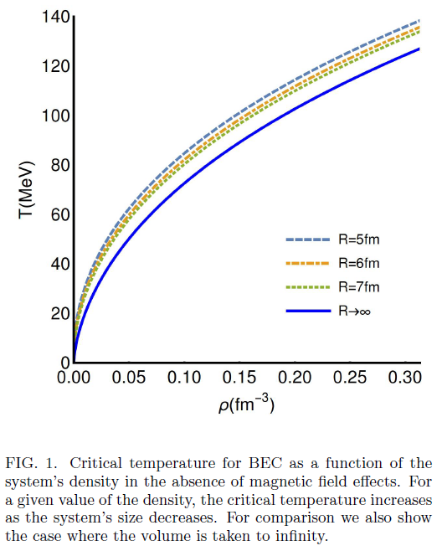
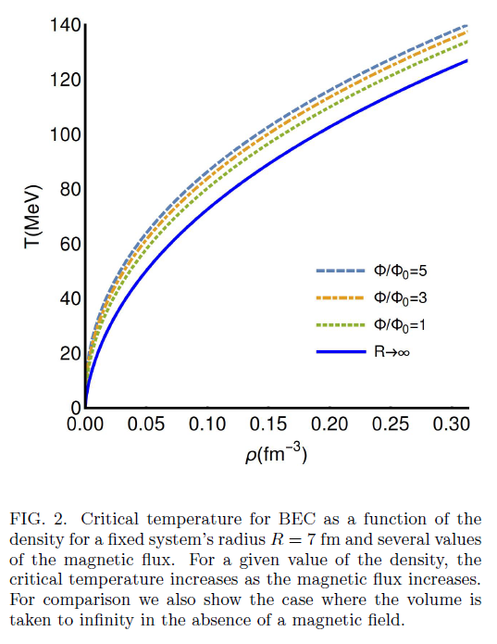
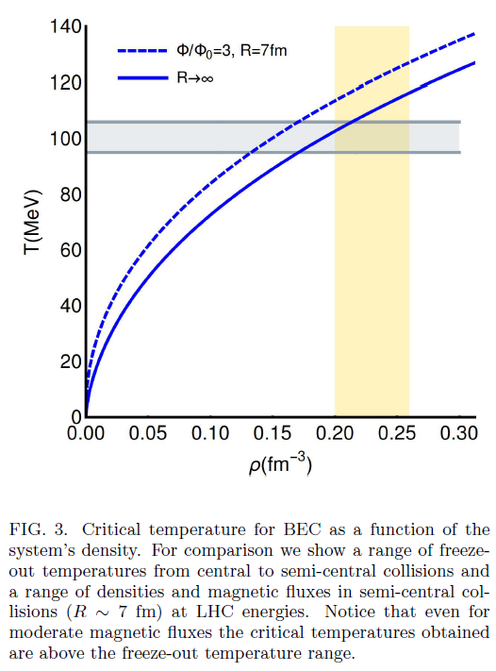
Magnetic catalysis of B-E condensation
of charged particles in finite V
A. Ayala, P. Mercado, C. Villavicencio, arXiv:1609.02595
Checks out the magnitude of the effect for transient magnetic fields in Pb+Pb at LHC
In peripheral heavy ion collisions at LHC, strong magnetic field and R ~ 7 fm
Critical temperature of Bose-Einstein condensation of charged pions above the freeze-out T.
17

Slide 18
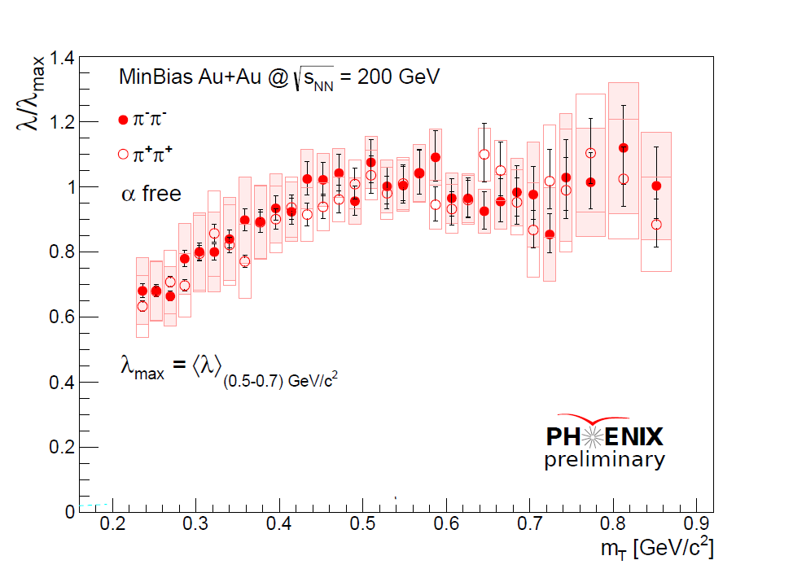
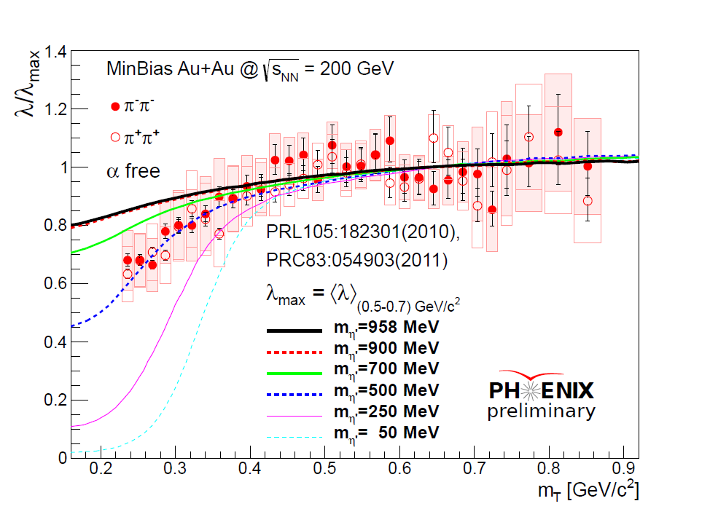
Interpretation of λ
See the talk of Máté Csanád
at WPCF 2017 for details
PHENIX preliminary data from arXiv:1610.05025
Method: S. Vance, T. Cs., D. Kharzeev: PRL 81 (1998) 2205-2208 , nucl-th/9802074
Predictions: Cs. T., R. Vértesi, J. Sziklai, arXiv:0912.5526 [nucl-ex] arXiv:0912.0258 [nucl-ex]
18

Slide 19

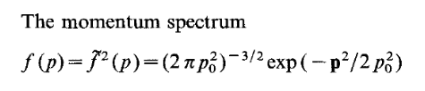

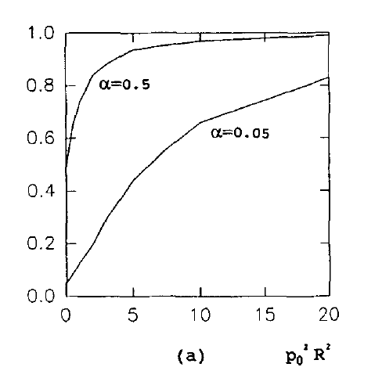


Cross-check, Sinyukov-Tolstykh model
Yu, M. Sinyukov, A. Yu. Tolstykh,
Z. Phys. C 61, 593 (1994)
Model based on partial coherence
Static Gaussian source, size R
Thermal momentum spectrum,
Slope p₀² = m T_{eff}
Gaussian HBT correlation function, with modified radius
R_{int} and intercept λ
Intercept parameter λ
Independent of momentum p
Decrease controlled by
source radii R and p₀ ² = m T_{eff}
p₀ R ~ average phase space volume

Slide 20
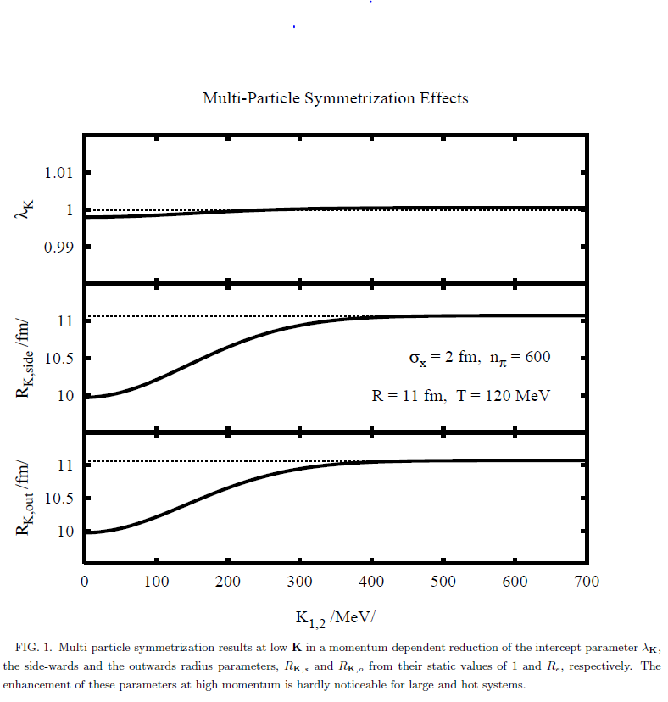

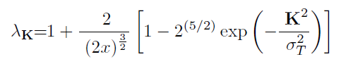


Cross-check, pion laser model
T. Cs, J. Zimányi, Phys.Rev.Lett. 80 (1998) 916-918,
Pion-laser model solved exactly. NP hard.
Bose-Einstein condensation of wave-packets.
Analytic result for fixed multiplicity n.
N-particle Bose-Einstein symmetrization.
Suppression parameter H controlled
by HBT radii R_{e} and σ_{T} ² = 2 σ ², width of the depression in λ(mt)
What about numerical values ?
R_{e}: limiting value of R(K) at large K
λ_{max} = 1+2/ (2x)^{3/2} > 1 slightly
H = 2^{5/2}/(1+ 2^{1/2}x^{3/2})
R_{e} ≥ 4 fm, σ²_{T} = 2 m_{π} T, T ≥ 170 MeV → x ≥ 16 → H ≤ 0.06, while H(preliminary) ~ 0.6
H, the size of the „hole” in λ(m_{T})/λ_{max} or is too small for PHENIX preliminary Au+Au

Slide 21
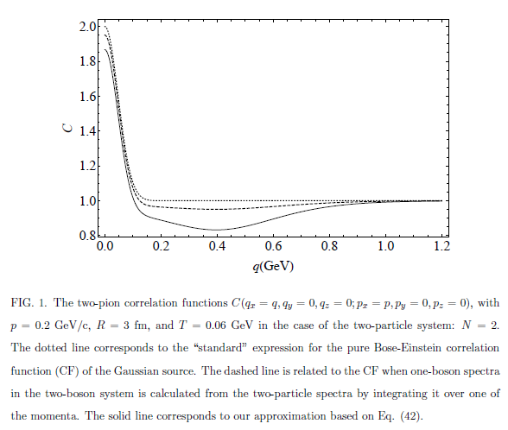




Cross-check, Akkelin-Sinyukov
S.V. Akkelin, Yu.M. Sinyukov, arXiv:1603.02951 [nucl-th]
Multi-particle Bose-Einstein symmetrization
Quantum canonical ensemble, fixed multiplicity
Analytic result for fixed multiplicity n. Suppression parameter H, in non-rel. appr.
controlled by
HBT radii R_{e} and σ_{T} ² = 2 σ ² = 2 m T, width of the depression in λ(mt)
What about numerical values ?
R_{e}: limiting value of R(K) at large K
λ_{max} = 1 (increase not obtailed)
H = 2^{7/2}/x^{3/2} here
R_{e} ≥ 4 fm, σ²_{T} = 2 m_{π} T, T ≥ 170 MeV → x ≥ 16 → H ≤ 0.18, while H(preliminary) ~ 0.6
H, the size of the „hole” in λ(m_{T})/λ_{max} or is too small for PHENIX preliminary Au+Au

Slide 22
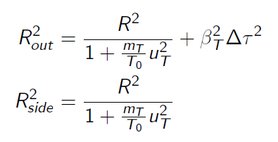
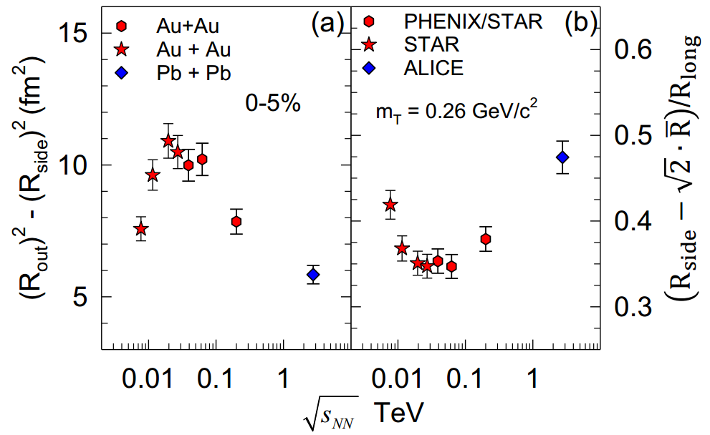
HBT: Signal of QCD Critical Point
- or not ?
Clear indication of non-monotonic behavior in combined ALICE, STAR and PHENIX data
Roy Lacey: √s_{NN} ~ 20-60 GeV → best value ~ 50 GeV. Needs further study!
22

Slide 23
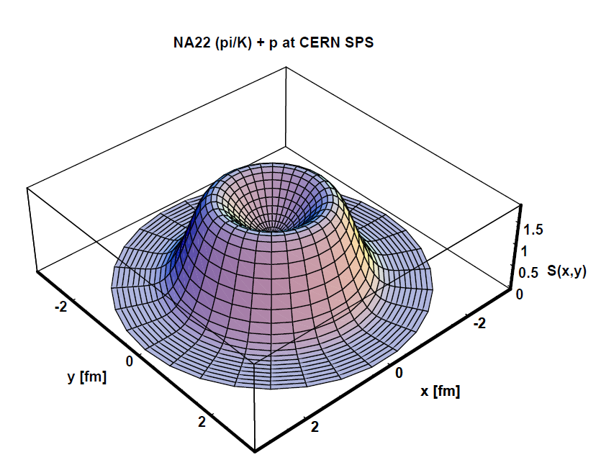
HBT: Signal of QCD Critical Point
- or not ?
hep-ph/0001233
R_{out} < R_{side}
Ring of fire
Roy Lacey: √s_{NN} ~ 20-60 GeV → best value ~ 50 GeV.
Roy Lacey’s 1st indication of QCD CEP needs further study!
Valid in a special m_{T} window: only if radial flow u_{T} ~ velocity of the pair β_{T}
Validity can be extended: also to R_{out} < R_{side}: use exact hydro solutions, allowing ring of fires !
23

Slide 24
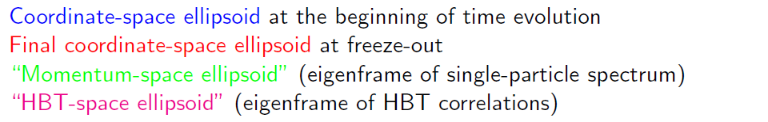



HBT: New solutions of fireball hydro
- triaxial, rotating and expanding
x
z
Three angles of rotation: in momentum space p, in HBT’s q-space, and in coordinate space r
θ_{p} ≠ θ_{q} ≠ θ_{r}
See Gábor Kasza’s talk
for more details
M.I. Nagy and T. Cs: arXiv:1606.09160
arXiv:1610.02197
24

Slide 25
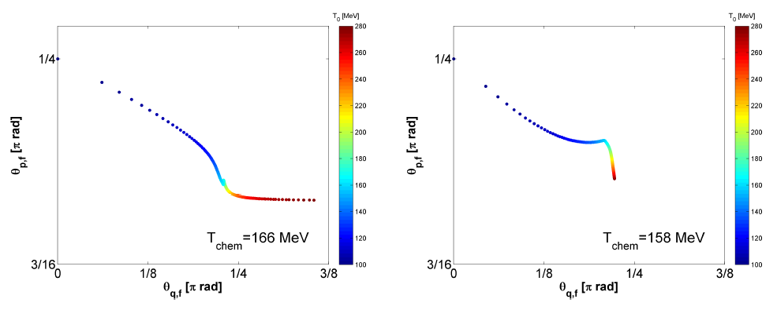
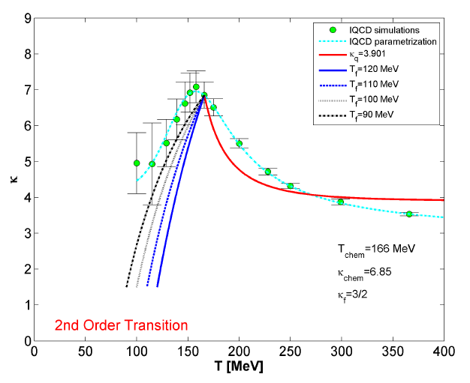
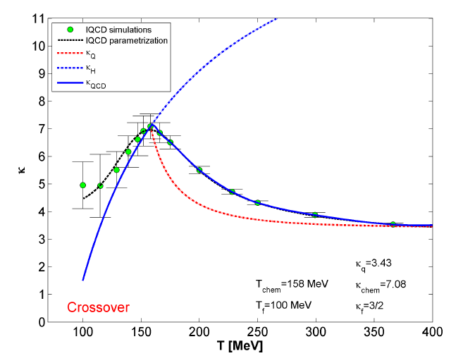
New, triaxial and rotating solutions
lattice QCD EoS for a 2nd order QCD transition
CEP
CO
CO:
cross-over
CEP:
2nd order PT
See G. Kasza’s talk
for more details
25

Slide 26
Summary and conclusions
Positive definitene form – or not?
Has to be checked:
L3 and CMS data show anticorrelated region
in e⁺e⁻ at LEP and in pp at LHC
Two-particle symmetrization effect – or not?
ALICE data indicates possible partial coherence
higher order symmetrization effects in system of charged particles
Seems to be consistent with theoretical expectations
Bose-Einstein condensation of charged particles never seen before!
MUST be cross-checked
Gaussian shape – or not?
Has to be checked:
PHENIX preliminary data indicates non-Gaussian structure
Levy index of stability α < 2 (Gaussian) significantly
New possibilities
model independent shape analysis
to measure η’ modification
to identify QCD CEP from angles of rotation
26

Slide 27
Backup slides
Questions?
27

Slide 28

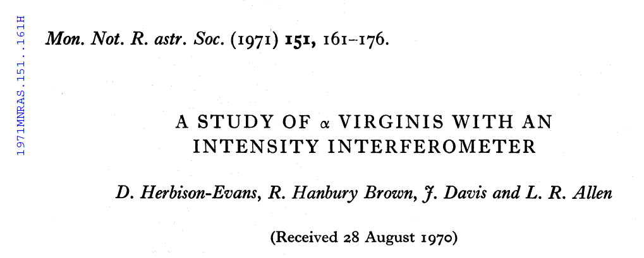
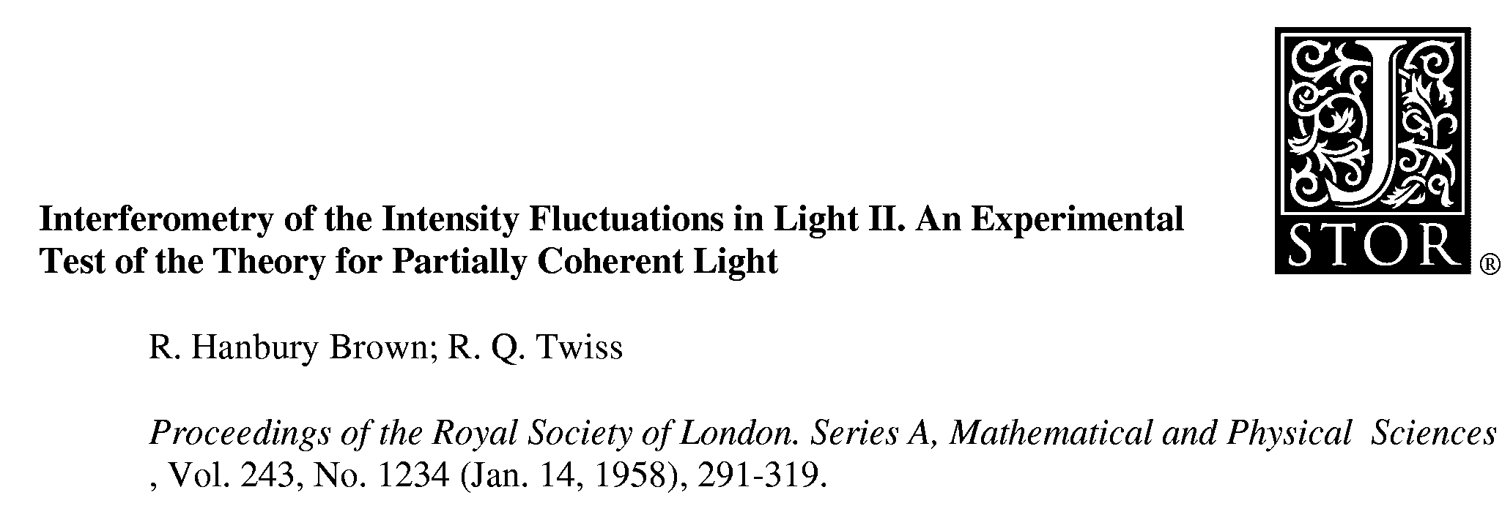
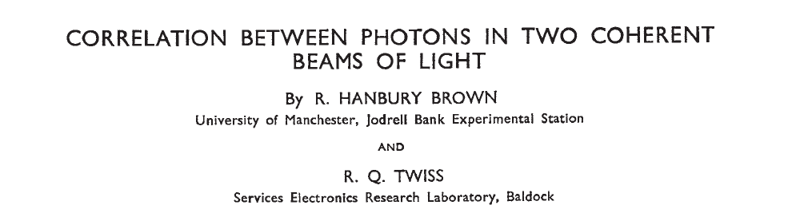
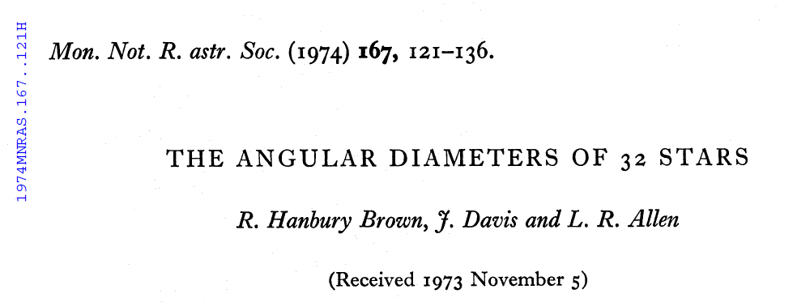

Hanbury Brown: a compound family name
28

Slide 29
Hanbury Brown: a family name
Grandfather: Sir Robert Hanbury Brown, K.C.M.G., a notable irrigation engineer (Wiki link)
Father: Basil Hanbury Brown
Twin sons:
Robert Hanbury Brown
Jordan Hanbury Brown
Daughter:
Marion Hanbury Brown
„It is not all that unusual that an English last name is a compound one, with or without a hyphen.”
Wes Metzger
Thank you Wes!
For private communications on the family of Sir Robert Hanbury Brown
29

Slide 30
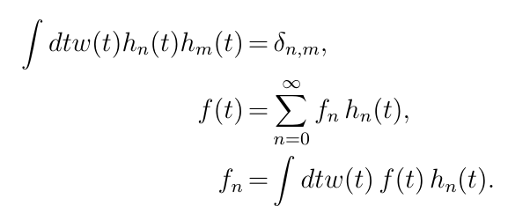

HBT: 1 + positive definite term:
- how to check ?
Model-independent method, to analyze Bose-Einstein correlations
IF experimental data satisfy
The measured data tend to a constant for large values of the observable Q.
There is a non-trivial structure at some definite value of Q, shift it to Q = 0.
Model-independent, but experimentally testable:
t = Q R
dimensionless scaling variable
approximate form of the correlations w(t)
Identify w(t) with a measure in an abstract Hilbert-space
T. Csörgő and S: Hegyi, hep-ph/9912220, T. Csörgő, hep-ph/001233
30

Slide 31
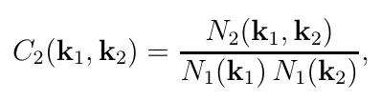




HBT: 1 + positive definite term:
How to check ?
Model-independent AND experimentally testable:
method for any approximate shape w(t)
the core-halo intercept parameter of the CF is
coefficients by numerical integration (fits to data)
condition for applicability: experimentally testabe
Nearly Gauss correlations, (- ∞, ∞) → Edgeworth
Nearly Gauss correlations, (0, ∞) → Gauss
Nearly exponential correlations, (0, ∞) → Laguarre
Nearly Levy correlations, (0, ∞) → Levy expansion
New!
New!
31

Slide 32
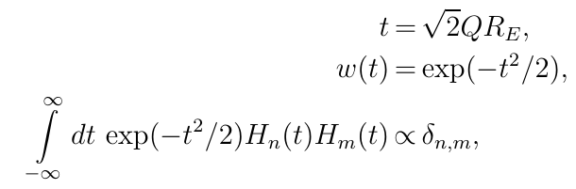
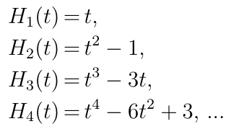
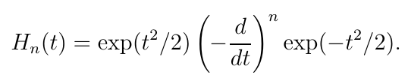
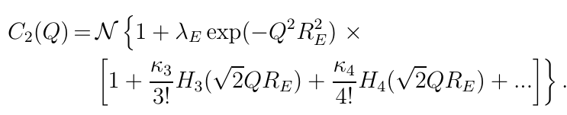
Edgeworth expansion method
Gaussian w(t), -∞ < t < ∞
3d generalization straightforward
Applied by NA22, L3, STAR, PHENIX, ALICE, CMS (LHCb)
32

Slide 33
Gauss expansion method
Gaussian w(t), 0 < t < ∞
Provides a new expansion around a Gaussian shape
that is defined for the non-negative values of t only.
Edgeworth expansion different, its around two-sided Gaussian, includes non-negative values of t also.
arXiv:1604.05513 [physics.data-an]
33

Slide 34
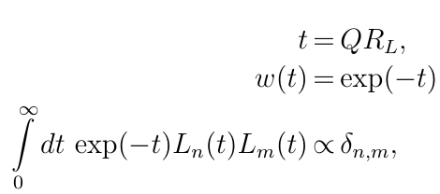




Laguerre expansion method
Model-independent but experimentally tested:
  w(t): Exponential
  0 < t < ∞
  Laguerre polynomials
First successful tests
  on NA22, UA1 data , convergence criteria satisfied
  Intercept: λ* ~ 1
34
34

Slide 35


HBT: Interpretation of R
Possibility: hydro scaling behaviour of R at low m_{T}
Hubble ratio of Big Bang and Little Bangs ~ 10⁴⁰ (needs centrality dependence, α = 2 …)
M. Csanád, T. Cs, B. Lörstad, A. Ster, nucl-th/0403074
35

Slide 36


HBT: New solutions of fireball hydro
- but academic ?
See the talk of G. Kasza
for details
36

Slide 37




HBT: Signals of 3d hydro flow
Indication of hydro scaling behaviour of R(side,out,long) at low m_{T}
R_{long} m_{t}-scaling: Yu. Sinyukov and A. Makhlin: Z.Phys. C39 (1988) 69
R_{side} , R_{out} , R_{long} m_{t}-scaling: T. Cs, B. Lörstad, hep-ph/9509213 (shells of fire vs fireballs)
S. Chapman, P. Scotto, U. W. Heinz, hep-ph/9408207
37

Slide 38



PHENIX preliminary data from
arXiv:nucl-ex/0509042
38

Slide 39

Cross-check: partial coherence
for pions only - or not ?
STAR p+p → K± K± + X √s = 200, 510 GeV
Fewer long lived resonances expected to decay to K (but φ)
Partial coherence not expected either: if λ₂ (Kaons) < 2 (f_{c,}, p_{c}) ≠ (1,0) ?
STAR preliminary result: λ₂(Kaons) < 2 in p+p . Halo from φ ? Cross-checks, implications ?
For details, see G. Nigmatkulov for STAR, Proc. SQM 15
For heavy ions: G. Nigmatkulov’s talk at HDNM 2017 and WPCF 2017
39

